Slide 1
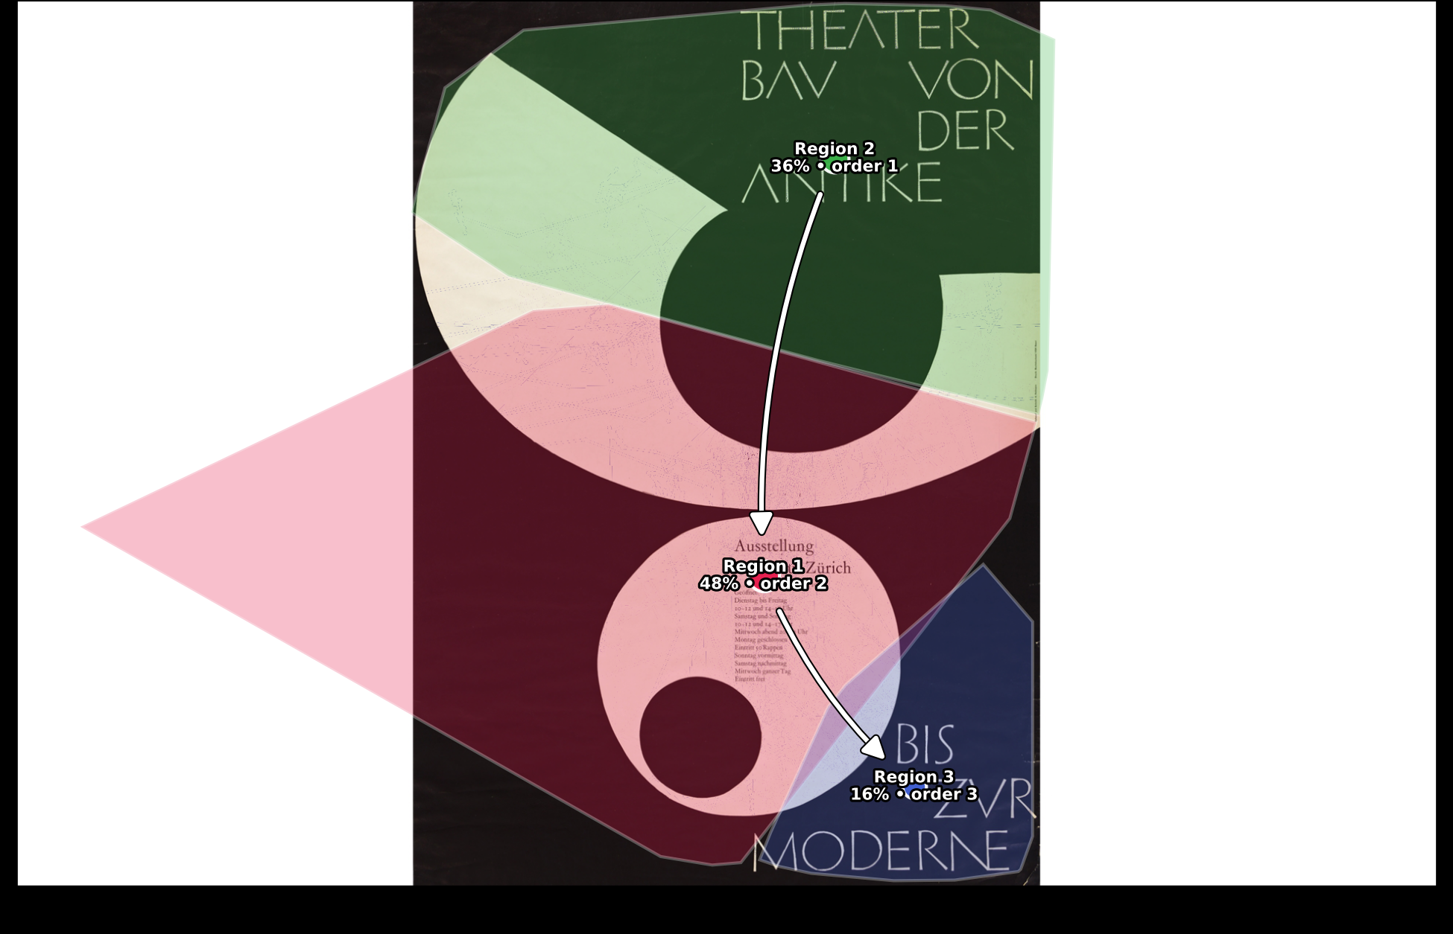
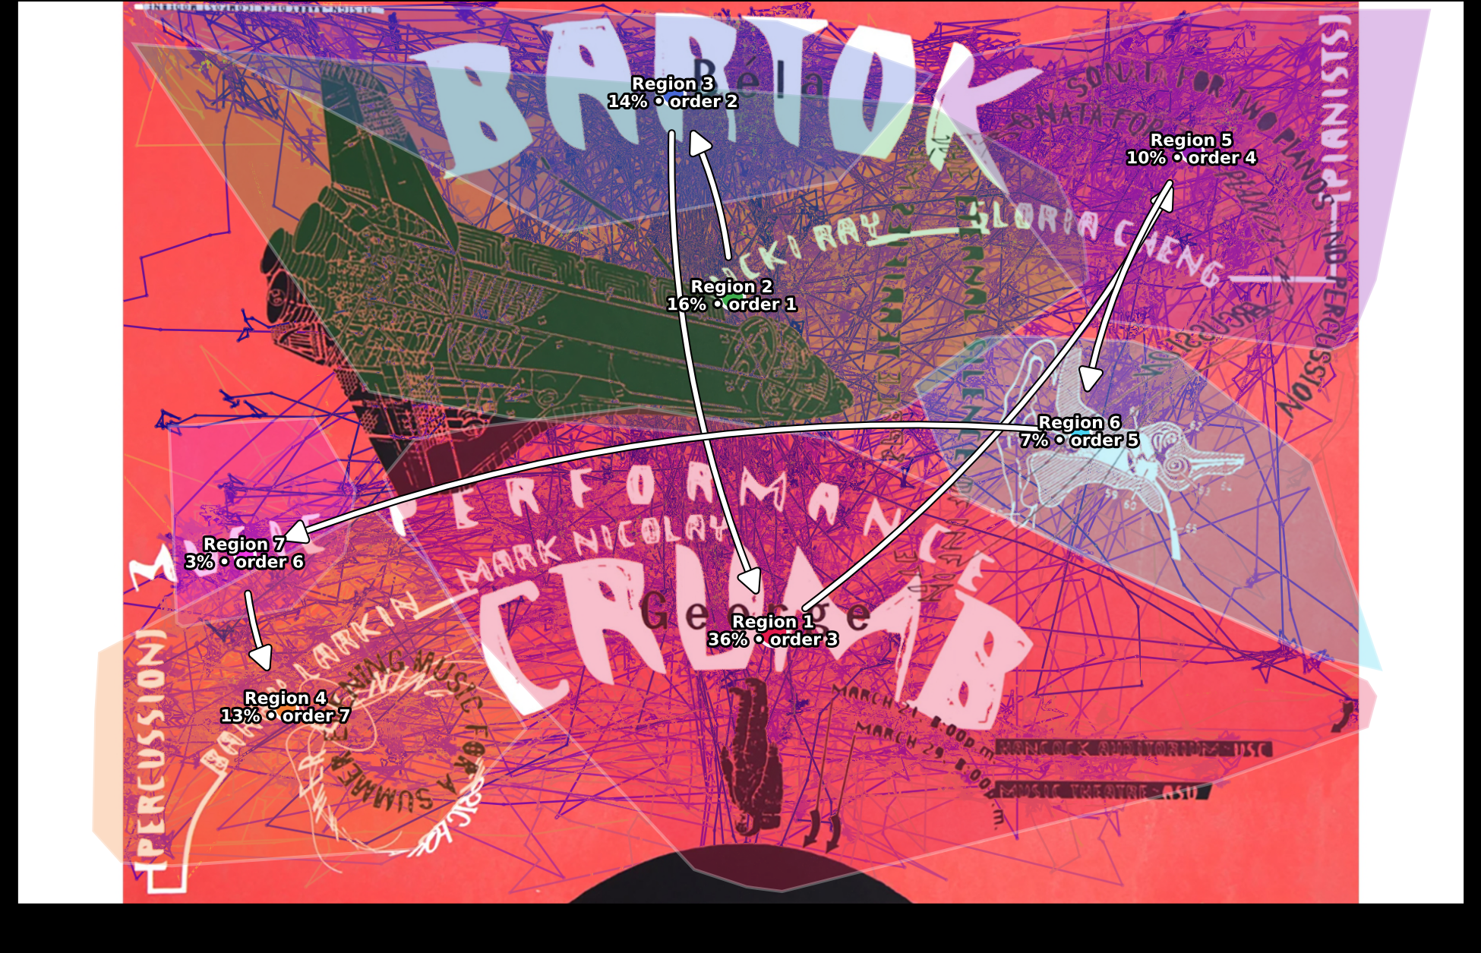
Where Do Eyes Go First?
A Data-Driven, Density-Based (DBSCAN) Analysis of Visual Attention on Graphic Design Posters
Vishnavi Abhishikta Bollapalli, Ze Kai Yang, Jingyu Liu, Xinran Hu
TReNDS Center, Georgia State University • [edit institution / lab line as needed]
Introduction
Results
Conclusion
Designers constantly guess where a viewer's eyes will go on a poster — layout, type, and imagery choices are usually made on intuition, not evidence.
This project asks that question with data: where does attention actually go, in what order, and for how long?
Instead of hand-drawing regions of interest, we let 48 participants' real gaze data define the regions using density-based clustering (DBSCAN).
Goal: evidence-based guidance for designers, and a test of whether unsupervised clustering can replace manual ROI annotation.
Armin Hofmann, 1955 — 3 Data-Driven Regions
Across two visually different posters, attention followed the same reliable pattern: the boldest title text wins the first glance almost immediately, and a nearby block of denser, informational text — not necessarily the visual centerpiece — earns the longest, most sustained looking. Density-based clustering (DBSCAN) recovered this structure directly from gaze data with no manually defined regions, adapting its region count to each poster's real complexity: 3 tidy regions for a restrained design, 7 finer ones for a busy, layered design.
64.6%
48.4%
235 ms
0.75
first fixation on top headline
of viewing time on middle text block
longest average fixation
silhouette score (region separation)
DBSCAN found the poster's 3 visible text blocks — headline, exhibition details, footer — matching K-means almost exactly. 64.6% of viewers' first fixation landed on the bold headline within 0.4s. Attention then shifted to the middle text block, which wasn't looked at first but captured the most total viewing time and the longest individual looks of any region. The footer was reached last, ~5.3s in, and held the least attention.
By the Numbers
Methods
48
3 → 7
.75 / .39
iMotions / Smart Eye Aurora eye-tracker; 48 participants; 16-second exposure per poster.
Per participant: continuous gaze X/Y, I-VT fixation events (location, start/end, duration), and slide-event timestamps marking each poster's exposure window.
Two posters analyzed here: Armin Hofmann (1955, typographic) and Barry Ceck (1988, busy/layered).
participants, 16s exposure per poster
regions found: Hofmann → Ceck
silhouette: Hofmann / Ceck
Future Directions
Scale the DBSCAN pipeline across the full poster set (12+ designs), not just two.
Automate region content-labeling (text / image / color) with OCR and object detection.
Study individual scanning strategies (text-first vs. image-first viewers) via per-participant clustering.
Link gaze metrics to the post-viewing survey data already collected (recall, preference).
Try HDBSCAN to handle regions of very different density in a single pass.
How It Works
1
Raw Samples
1920×1200 gaze coords, 48 participants
Barry Ceck, 1988 — 7 Data-Driven Regions
2
Fixation Events
I-VT filter → X, Y, start/end, duration
45.8%
35.7%
197 ms
7 vs 4
3
Pooled Data
All fixations pooled, 16-second window
first fixation split: “BARTOK” title
of viewing time on “CRUMB” / date block
longest avg. look (small illustration)
regions found (DBSCAN vs. K-means)
4
DBSCAN
Density clustering — no fixed region count
On this busier design, DBSCAN split attention into 7 regions instead of K-means' fixed 4 — separating a technical illustration and a hand-drawn creature graphic into their own hotspots. First attention split between the “BARTOK” title and the “CRUMB”/date block, which also drew the most total viewing time. The single longest average fixation occurred in the smallest region of all — the hand-drawn creature — suggesting few viewers notice it, but those who do pause unusually long.
Limitations
5
Region Stats
% time, visit order, heatmaps
Only 2 of the full poster set analyzed so far.
Region content-type (text / shape / color) still classified by visual judgment, not automatically.
Before → After: DBSCAN in Action
Acknowledgements
We thank the TReNDS Center and Georgia State University for supporting this research. [Add funding / grant info here.]
Raw Fixations
DBSCAN Regions
Illustrative example — DBSCAN groups nearby fixations by density (color) and flags sparse points as noise (gray), without a preset number of regions.
Contact
Why DBSCAN? eps and min_samples were grid-searched per poster and chosen by silhouette score — no region count was set by hand.
Vishnavi Abhishikta Bollapalli, Ze Kai Yang,
Jingyu Liu, Xinran Hu
vaishnavibollapalli@gmail.com
[edit / add co-author emails]
Chosen Parameters
Pattern across both posters
30 / 35
20 / 55
Same two-stage sequence on both posters: first glance to the boldest title text, then longest dwell on a denser block of nearby text.
Text dominates every high-attention region in both posters; abstract shapes and color fields are mostly skipped over.
Clustering method matters on complex layouts: DBSCAN matched K-means on the simple poster but found nearly double the regions on the busy one.
Hofmann — min_samples / eps
Ceck — min_samples / eps

