Slide 1


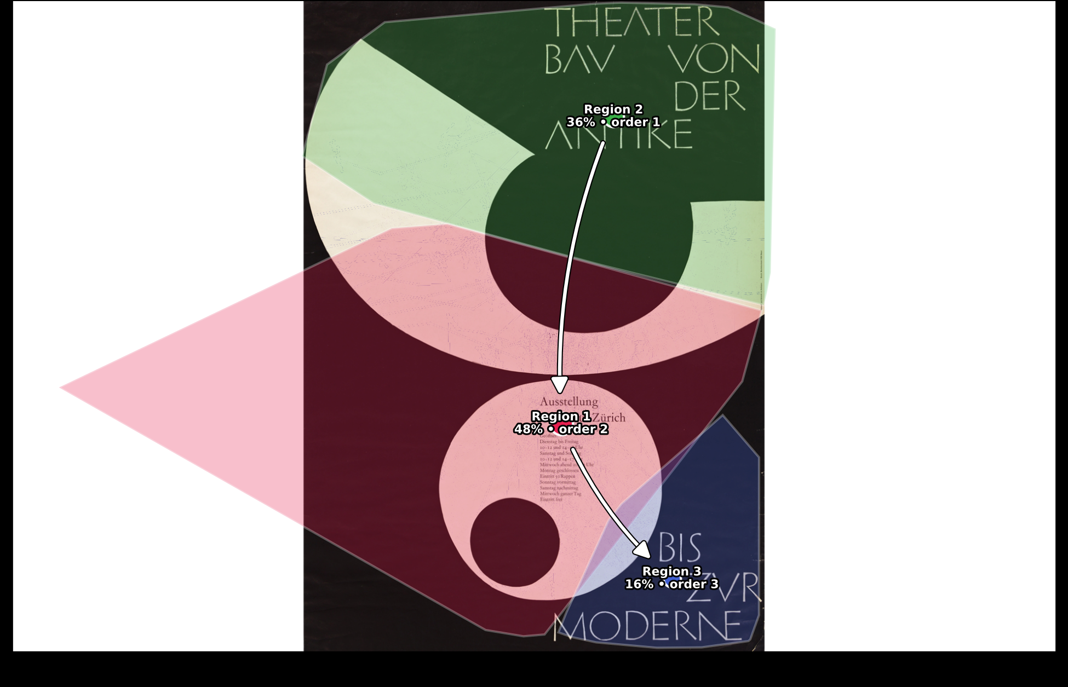
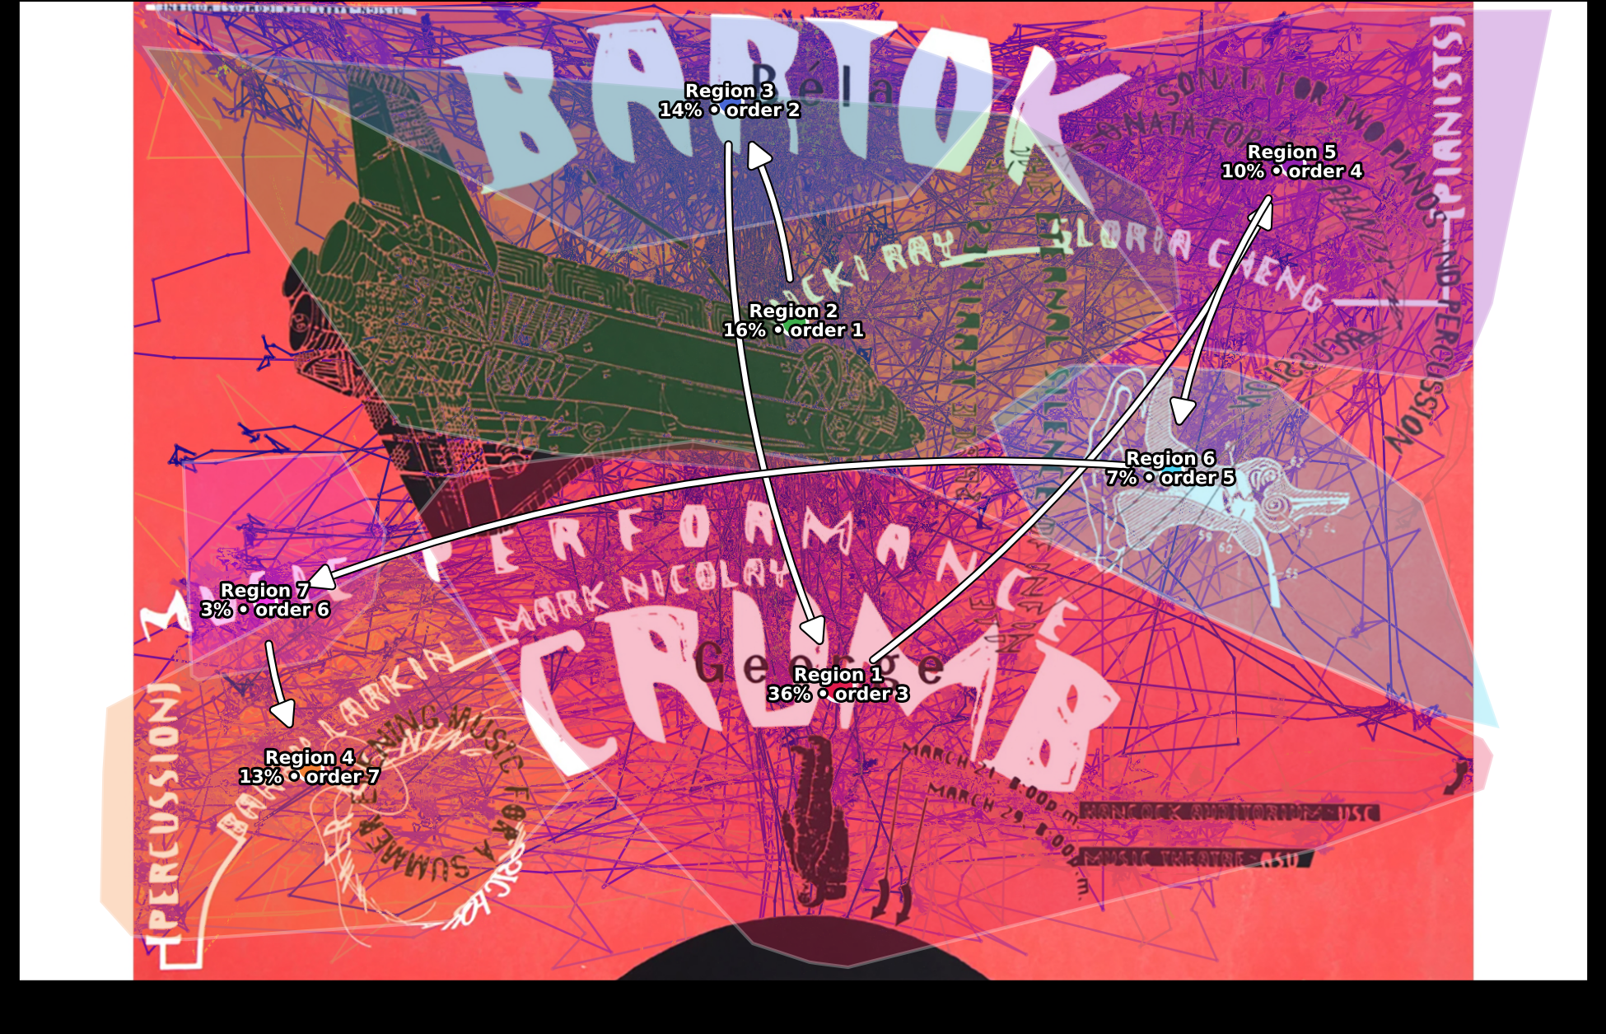
Methods
THE STIMULI
Armin Hofmann, 1955
Barry Ceck, 1988
EYE-TRACKING DATA
48 participants • 16-second exposure per poster
GAZE COORDINATES
FIXATION EVENTS
Continuous X, Y stream
I-VT filtered, X/Y + duration
COMBINED DATA PREPROCESSING
Exposure Window Matching
Slide events isolate each poster's 16s window
Fixation Pooling
All 48 participants pooled per poster
DBSCAN CLUSTERING
3 → 7
regions
No fixed region count — density-based
REGION MAPS
Hofmann — 3 regions
Ceck — 7 regions

