Slide 1
Eye-Tracking Region Clustering
DBSCAN vs. Agglomerative vs. Divisive Hierarchical Clustering
15 posters · 48 participants · fixation regions compared across three clustering methods

Slide 2
Methodology — Parameters Changed From Library Defaults
• Outlier filtering (applied before any clustering, identically for all 3 methods)
– Not a library default — custom pre-filter: a fixation is dropped if its distance to its 10th-nearest neighbour exceeds median + 3×MAD (robust z-score cutoff)
– Removes stray/isolated fixations (4–10% per poster) that would otherwise stretch a region's boundary or anchor their own spurious micro-cluster
• DBSCAN (sklearn.cluster.DBSCAN)
– Default eps=0.5, min_samples=5 are meaningless at 1936×1208 pixel scale — grid-searched eps ∈ {18…80}px × min_samples ∈ {8…30} instead
– k (region count) chosen from a narrowed 3–5 range (not the default unconstrained cluster count DBSCAN would otherwise find)
– Selection criterion is a combined silhouette + Davies-Bouldin "separation" score, not silhouette alone — and the noise-fraction gate (2–25%, capped at 40% on fallback) stops DBSCAN from "winning" via a tiny ultra-dense core with most points discarded
• Agglomerative (scipy.cluster.hierarchy.linkage)
– Linkage changed from scipy's default 'single' (chains nearest-neighbour pairs into long, stringy clusters) to 'ward' (minimizes within-cluster variance → compact, convex regions)
– Cut height (k) chosen 3–5 by the same combined separation score
• Divisive (bisecting k-means — hand-built; scikit-learn has no divisive clustering class)
– Each 2-way split's inner KMeans uses n_init=10 (explicit, not version-dependent 'auto') and random_state=42 (sklearn default is None / non-reproducible)
– Split-selection rule is deliberate: always bisect the cluster with the largest current SSE, so splits are spent where they most increase separation
– k chosen 3–5 by the same combined separation score

Slide 3
Results at a Glance
Poster | Winner | k | Silhouette | Davies-Bouldin | Noise %
ArminHofman-1955 | DBSCAN | 3 | 0.750 | 0.324 | 20.4
BarryCeck-1988 | Agglomerative | 4 | 0.461 | 0.739 | 0.0
DavidCarson | DBSCAN | 5 | 0.525 | 0.515 | 23.2
DavidCarson-1990 | Divisive | 3 | 0.571 | 0.609 | 0.0
EllaRosenblatt-2021 | Agglomerative | 5 | 0.574 | 0.584 | 0.0
IrisChung-2015 | Agglomerative | 4 | 0.431 | 0.730 | 0.0
JanTschichold-1927-DieFrauohneNamen | DBSCAN | 7 | 0.626 | 0.444 | 8.8
JanTschichold-1938-Der | Agglomerative | 5 | 0.642 | 0.475 | 0.0
JoostSchmidt-1923-Saatliches | DBSCAN | 5 | 0.515 | 0.459 | 5.7
PaulRand-1947 | Divisive | 3 | 0.545 | 0.648 | 0.0
PaulaScher-1995 | Divisive | 3 | 0.479 | 0.763 | 0.0
ScottBarry-2010 | DBSCAN | 5 | 0.524 | 0.584 | 2.4
SeanAlatorre | DBSCAN | 5 | 0.583 | 0.462 | 11.3
bookcover | Agglomerative | 5 | 0.473 | 0.749 | 0.0
nancy | DBSCAN | 4 | 0.696 | 0.387 | 24.2

Slide 4
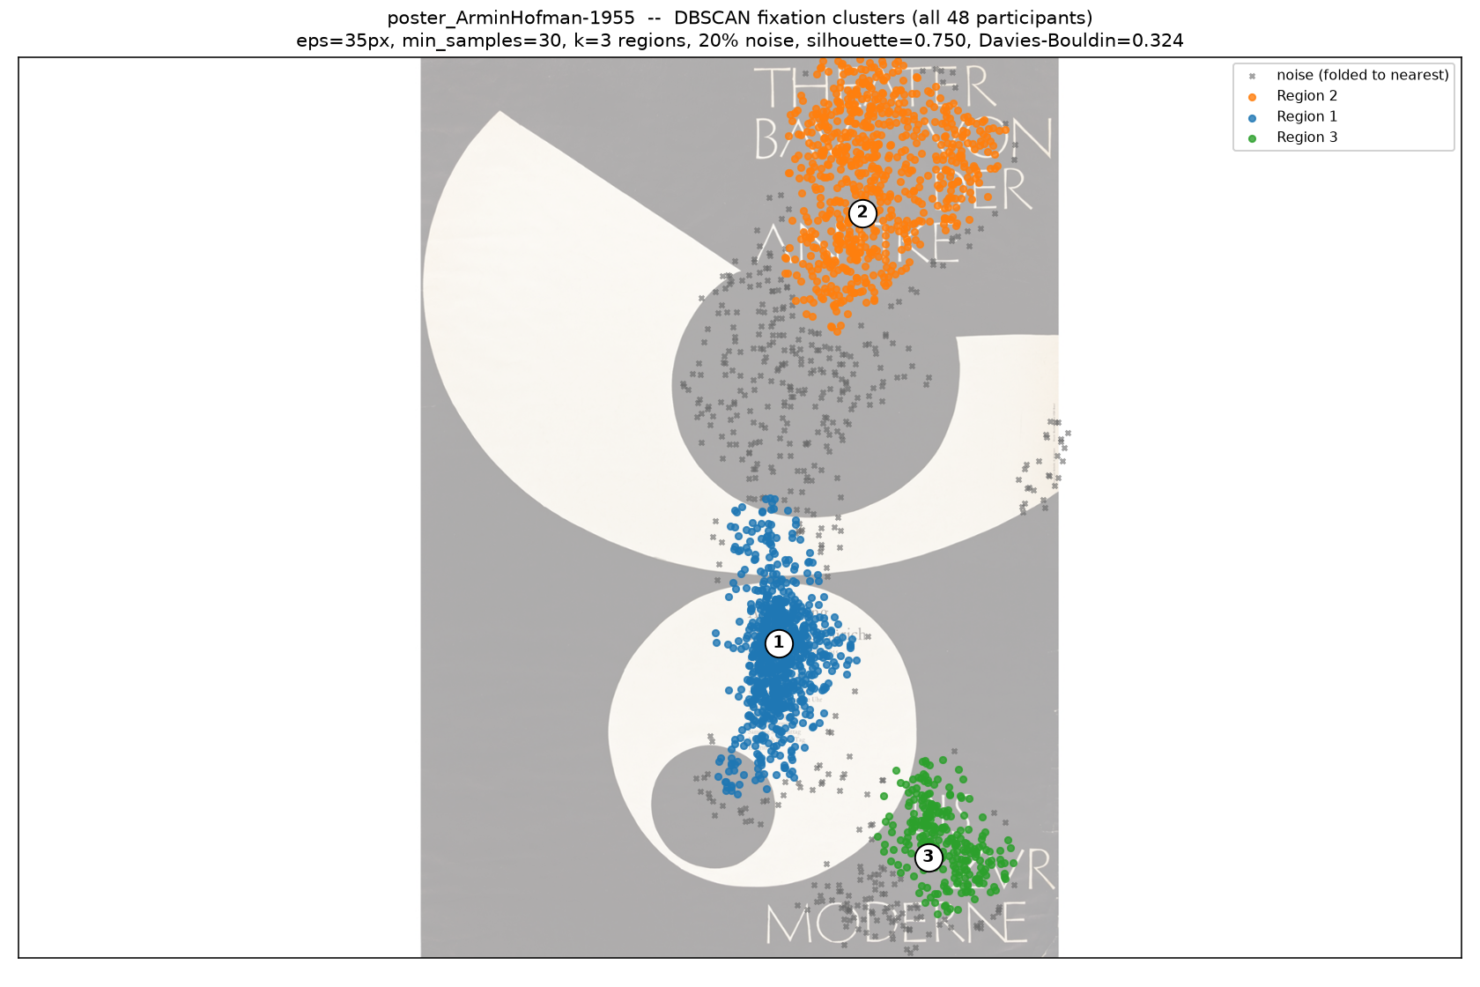
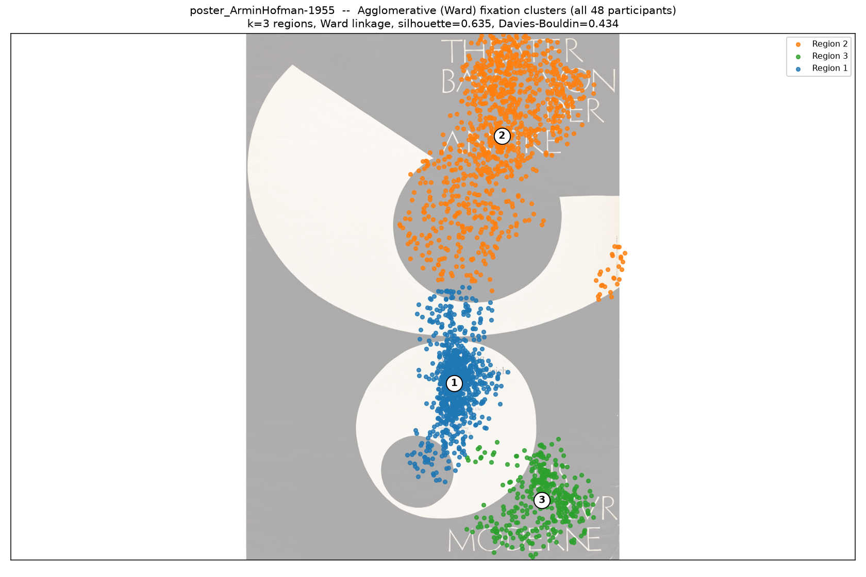
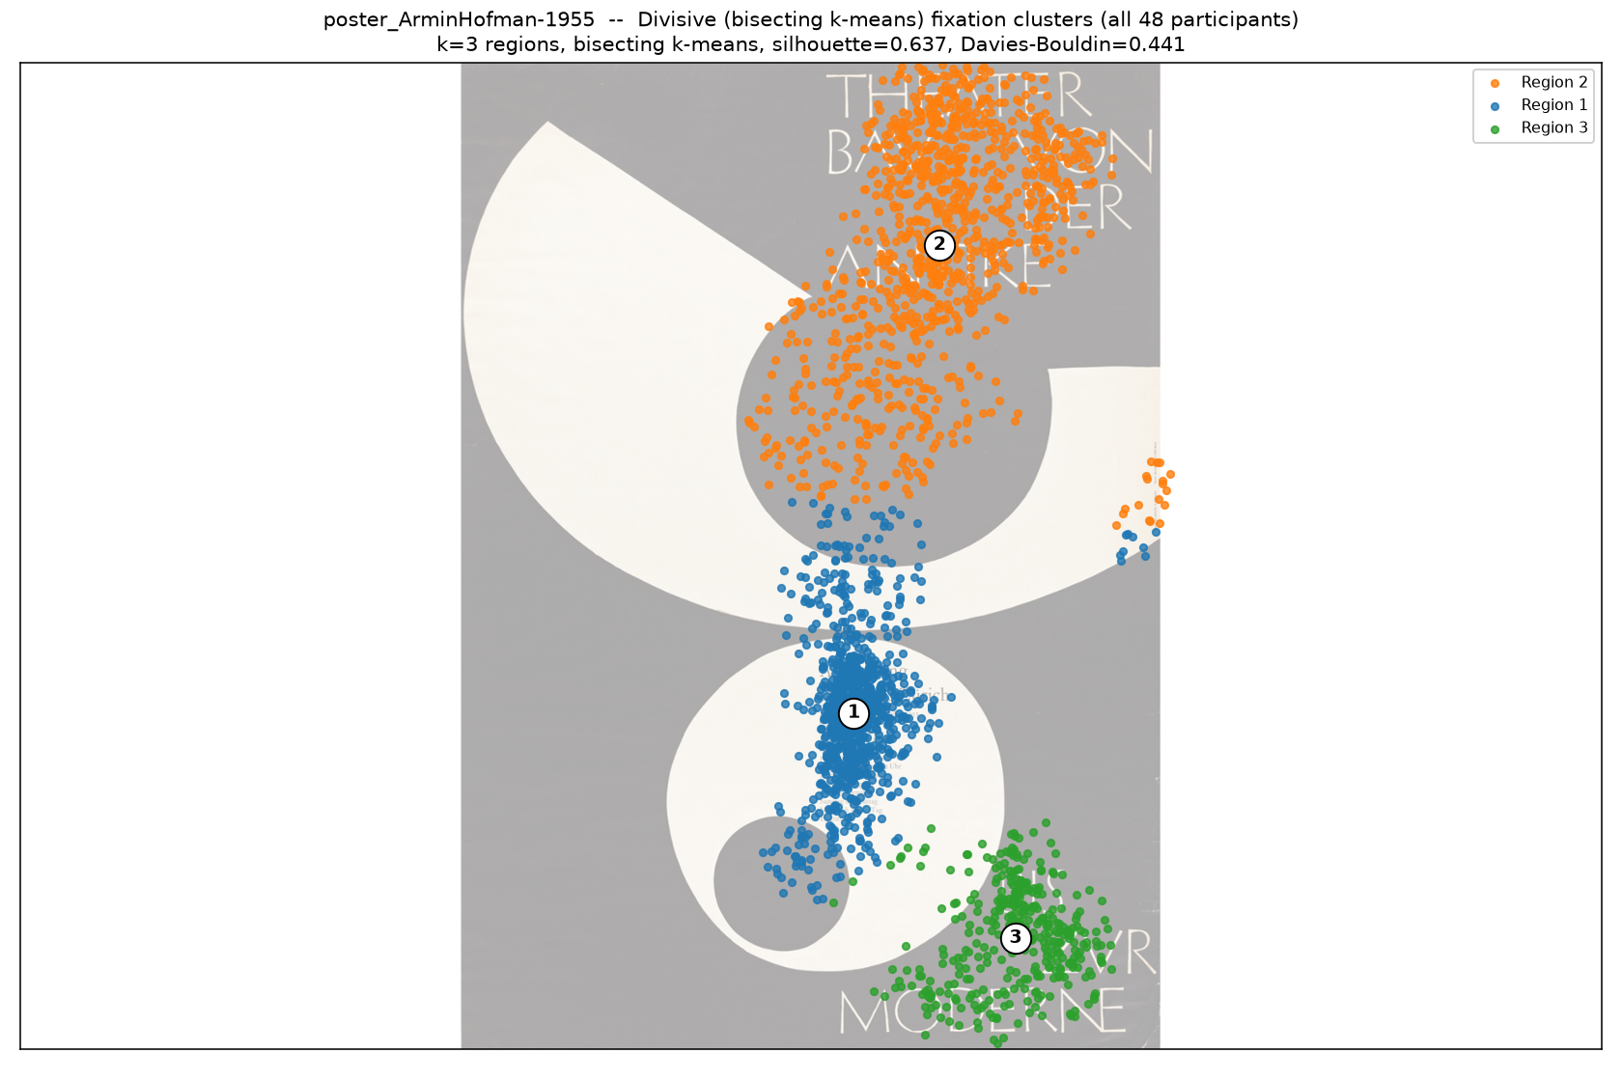
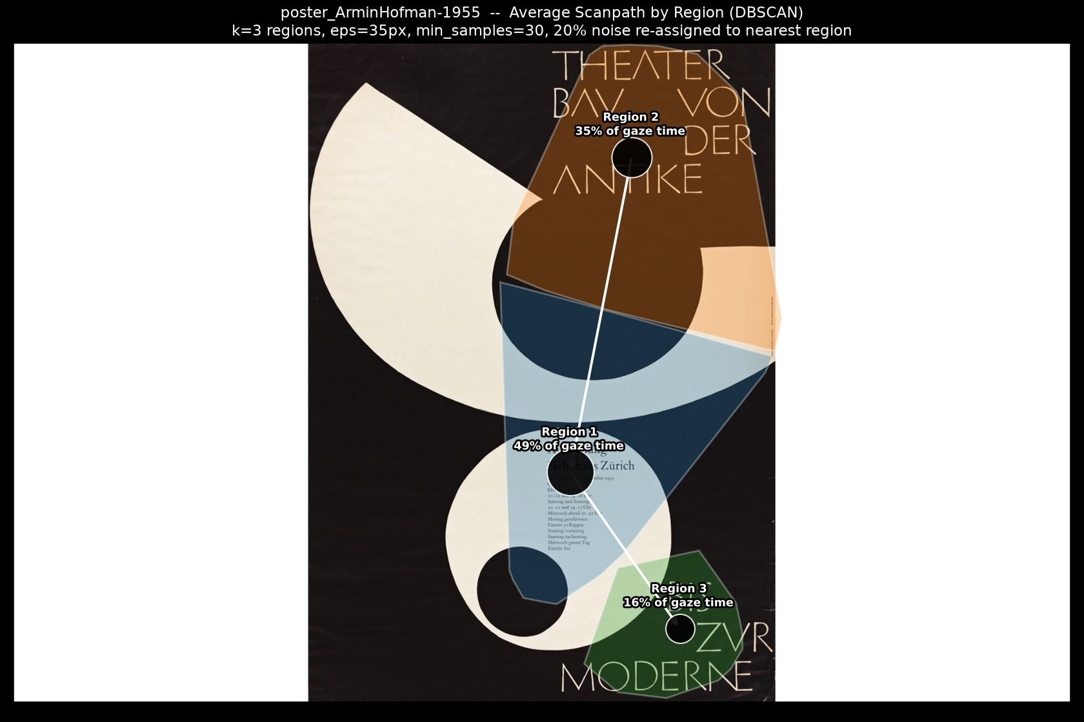
Armin Hofman- 1955
Best method: DBSCAN
DBSCAN wins: highest separation score (0.796 after a 20% noise discount), silhouette 0.750, Davies-Bouldin 0.324; Agglomerative scored 0.031 (silhouette 0.635, DB 0.434); Divisive scored 0.009 (silhouette 0.637, DB 0.441).
★ DBSCAN
Agglomerative
Divisive
Path (DBSCAN)
Animation (DBSCAN) — click to play

Slide 5
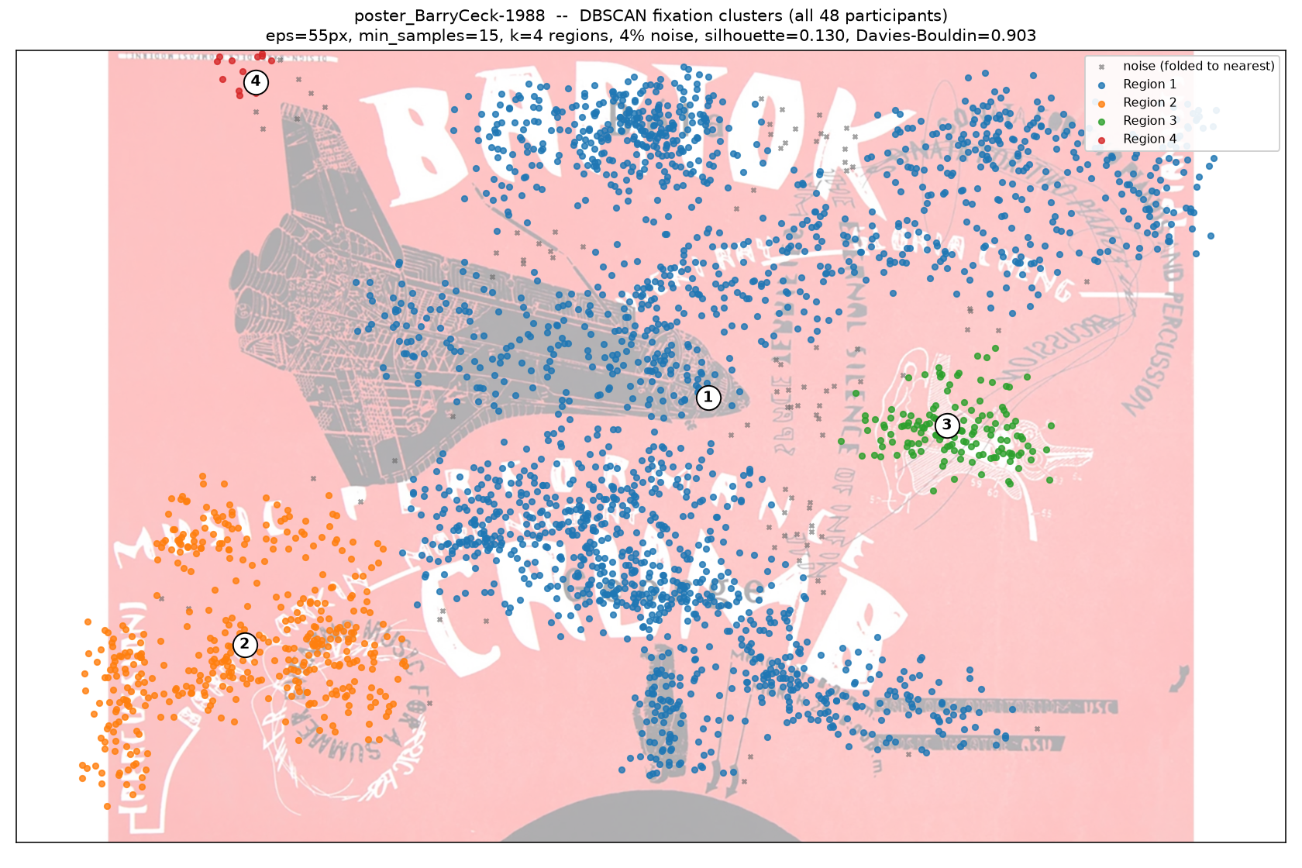
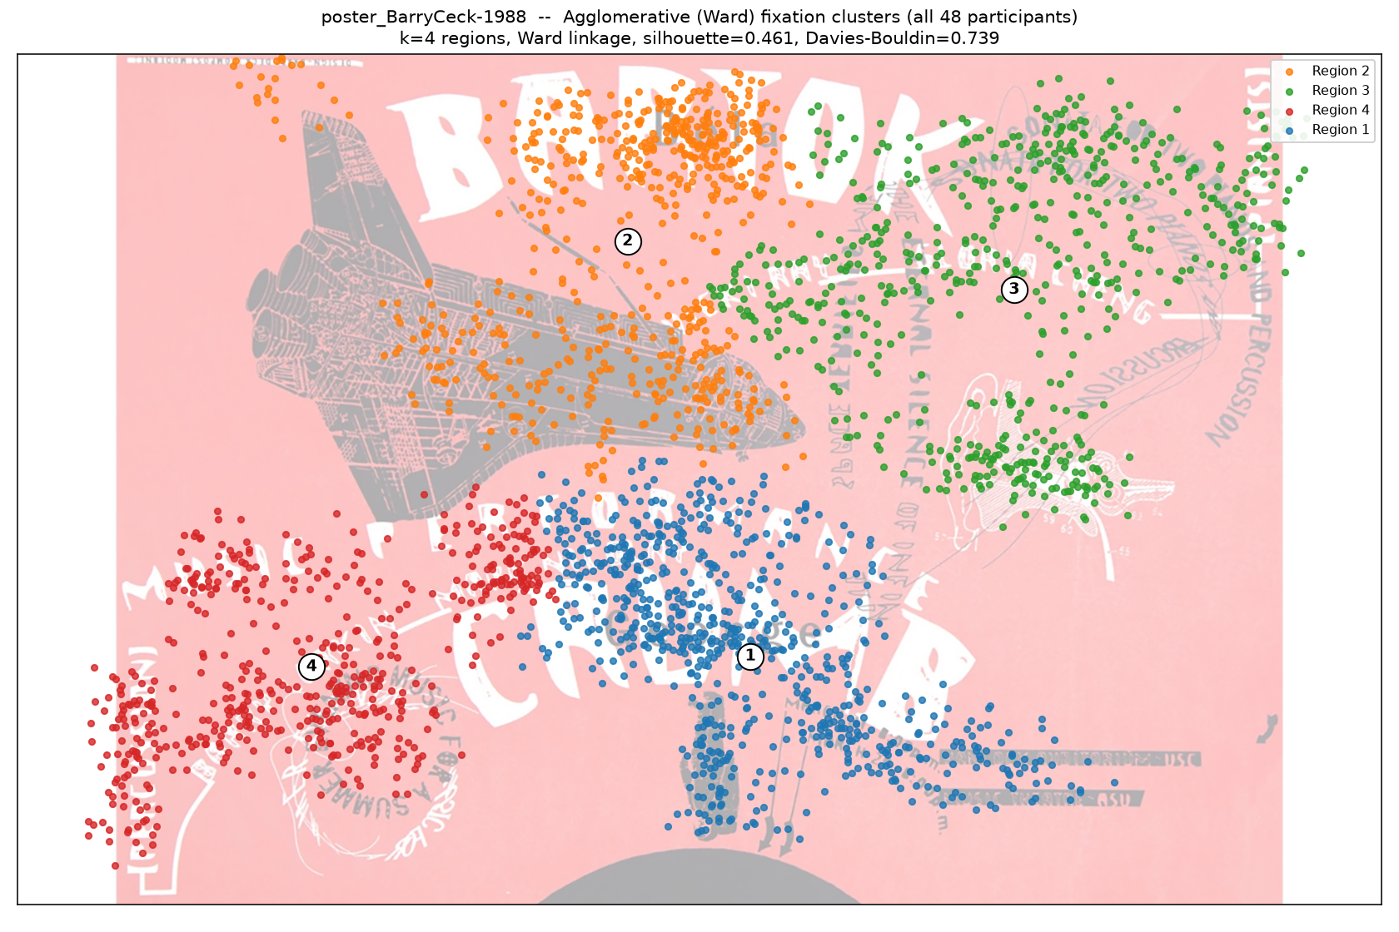
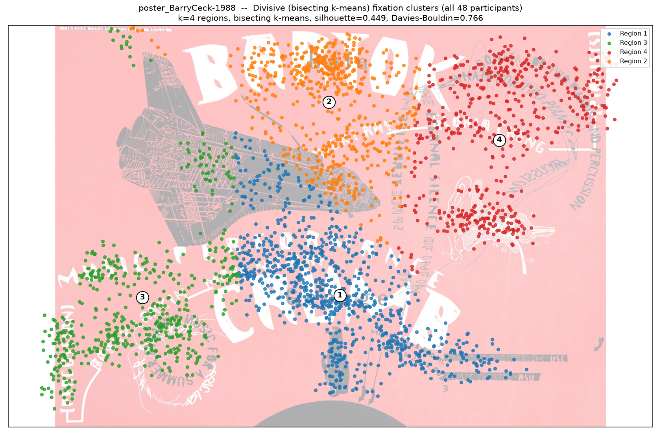
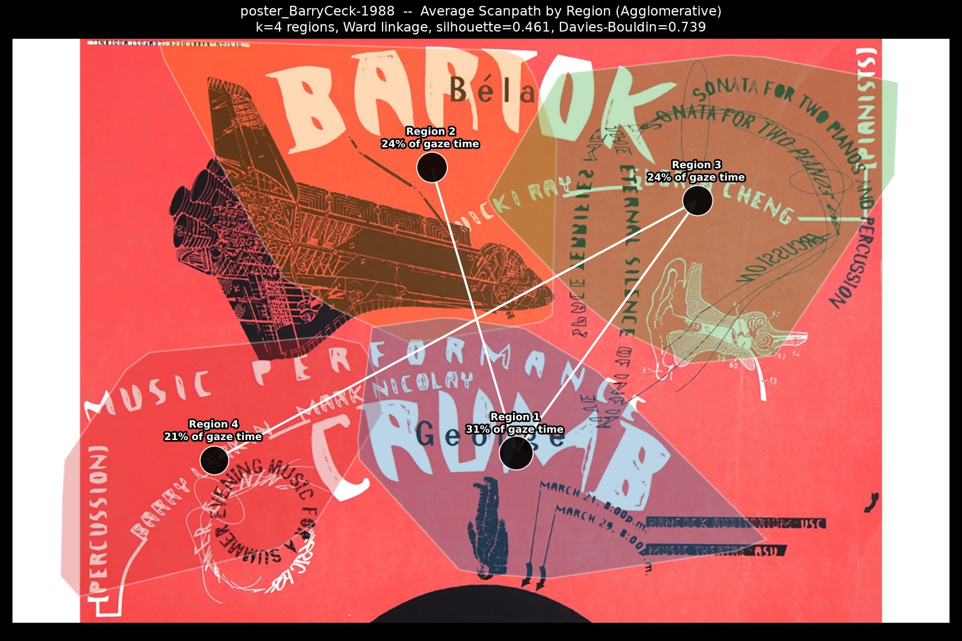
Barry Ceck - 1988
Best method: Agglomerative
Agglomerative wins: highest separation score (1.000), silhouette 0.461, Davies-Bouldin 0.739; DBSCAN scored 0.000 (silhouette 0.130, DB 0.903, 4% noise); Divisive scored 0.899 (silhouette 0.449, DB 0.766).
DBSCAN
★ Agglomerative
Divisive
Path (Agglomerative)
Animation (Agglomerative) — click to play

Slide 6
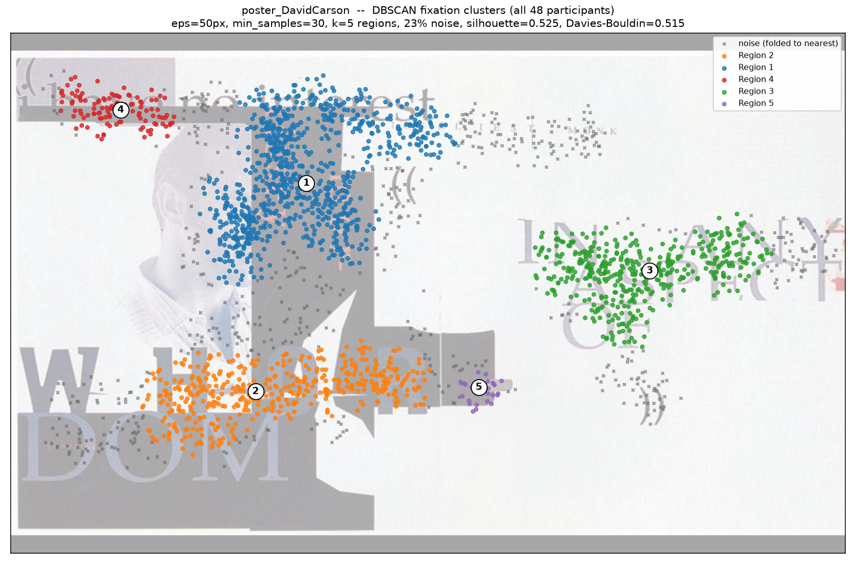
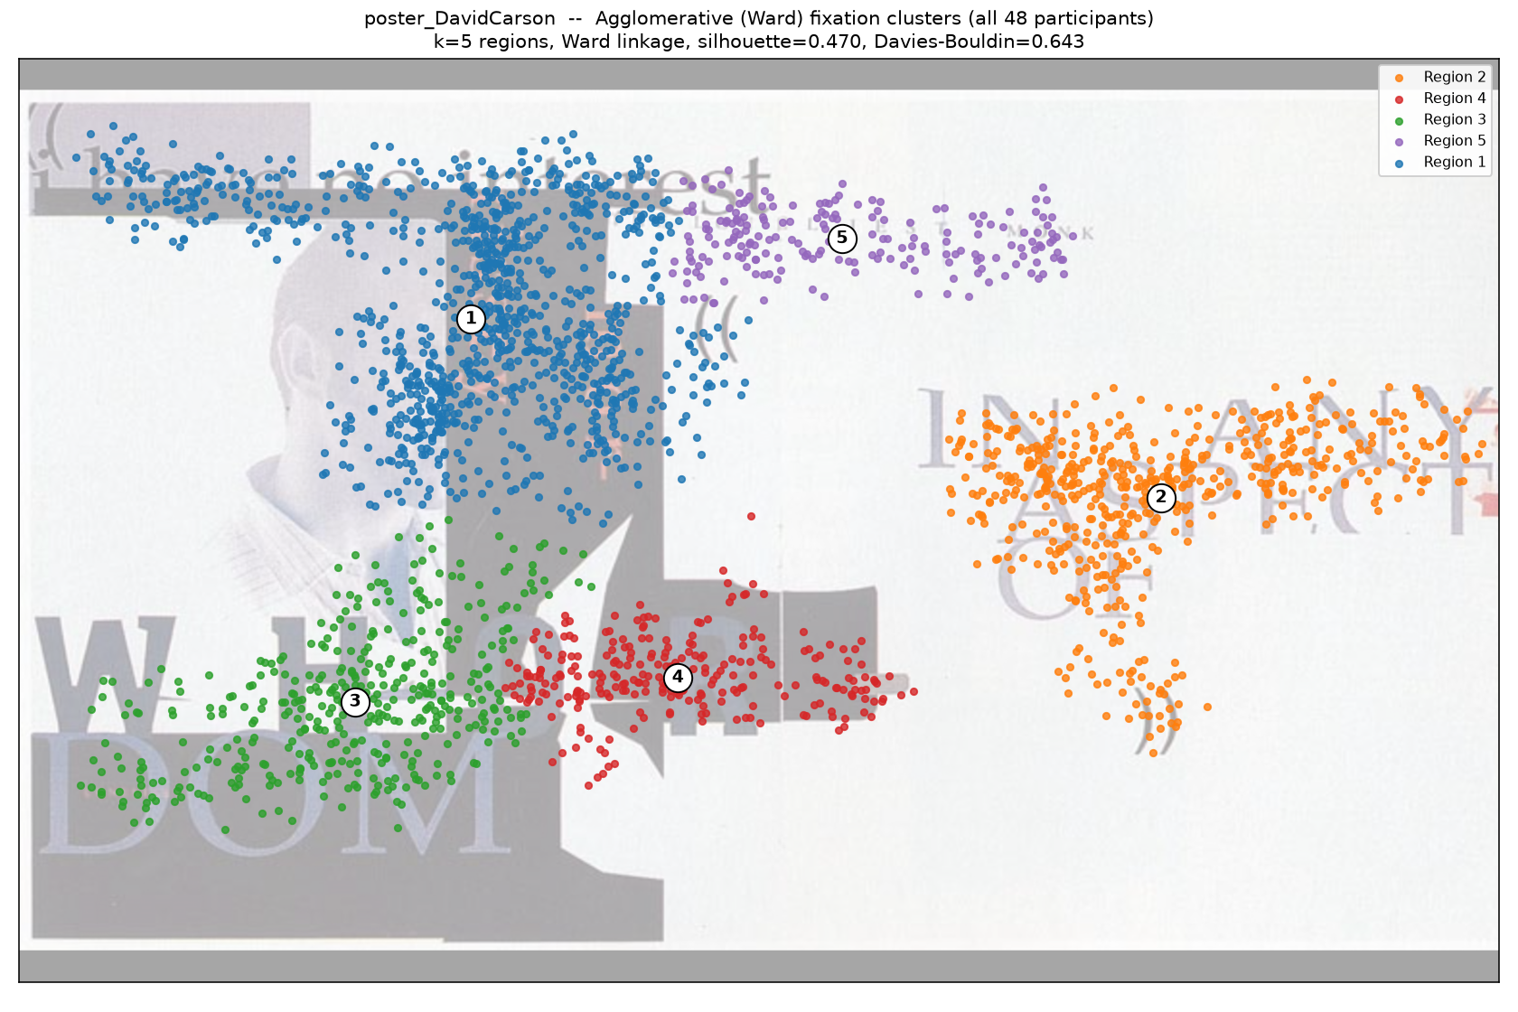
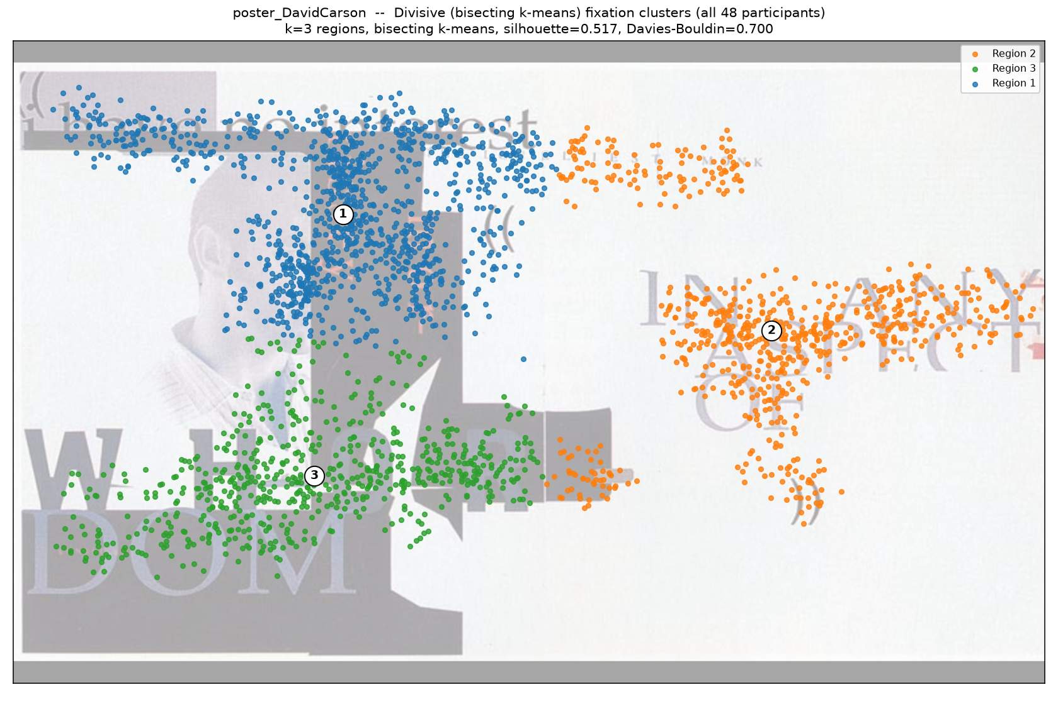
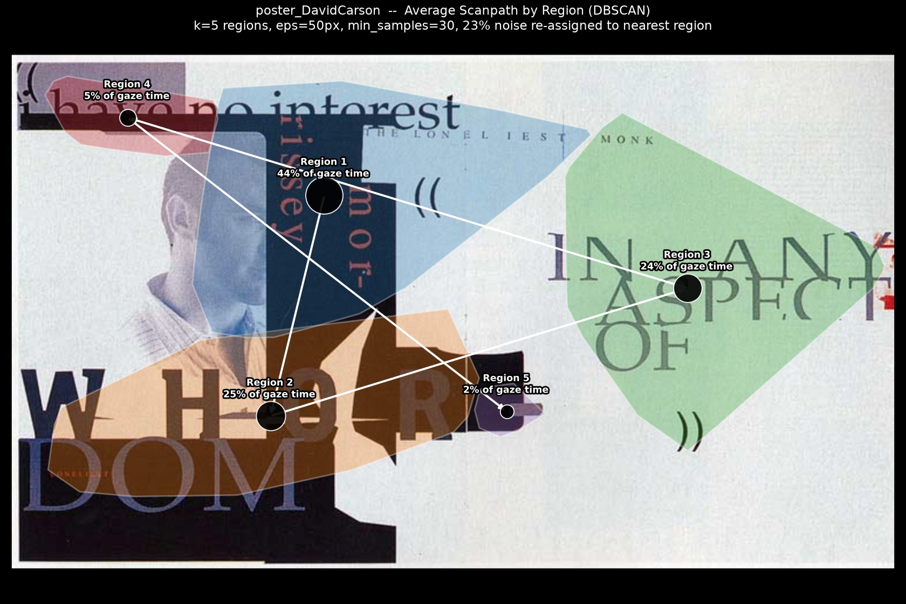
David Carson
Best method: DBSCAN
DBSCAN wins: highest separation score (0.768 after a 23% noise discount), silhouette 0.525, Davies-Bouldin 0.515; Agglomerative scored 0.156 (silhouette 0.470, DB 0.643); Divisive scored 0.429 (silhouette 0.517, DB 0.700).
★ DBSCAN
Agglomerative
Divisive
Path (DBSCAN)
Animation (DBSCAN) — click to play

Slide 7
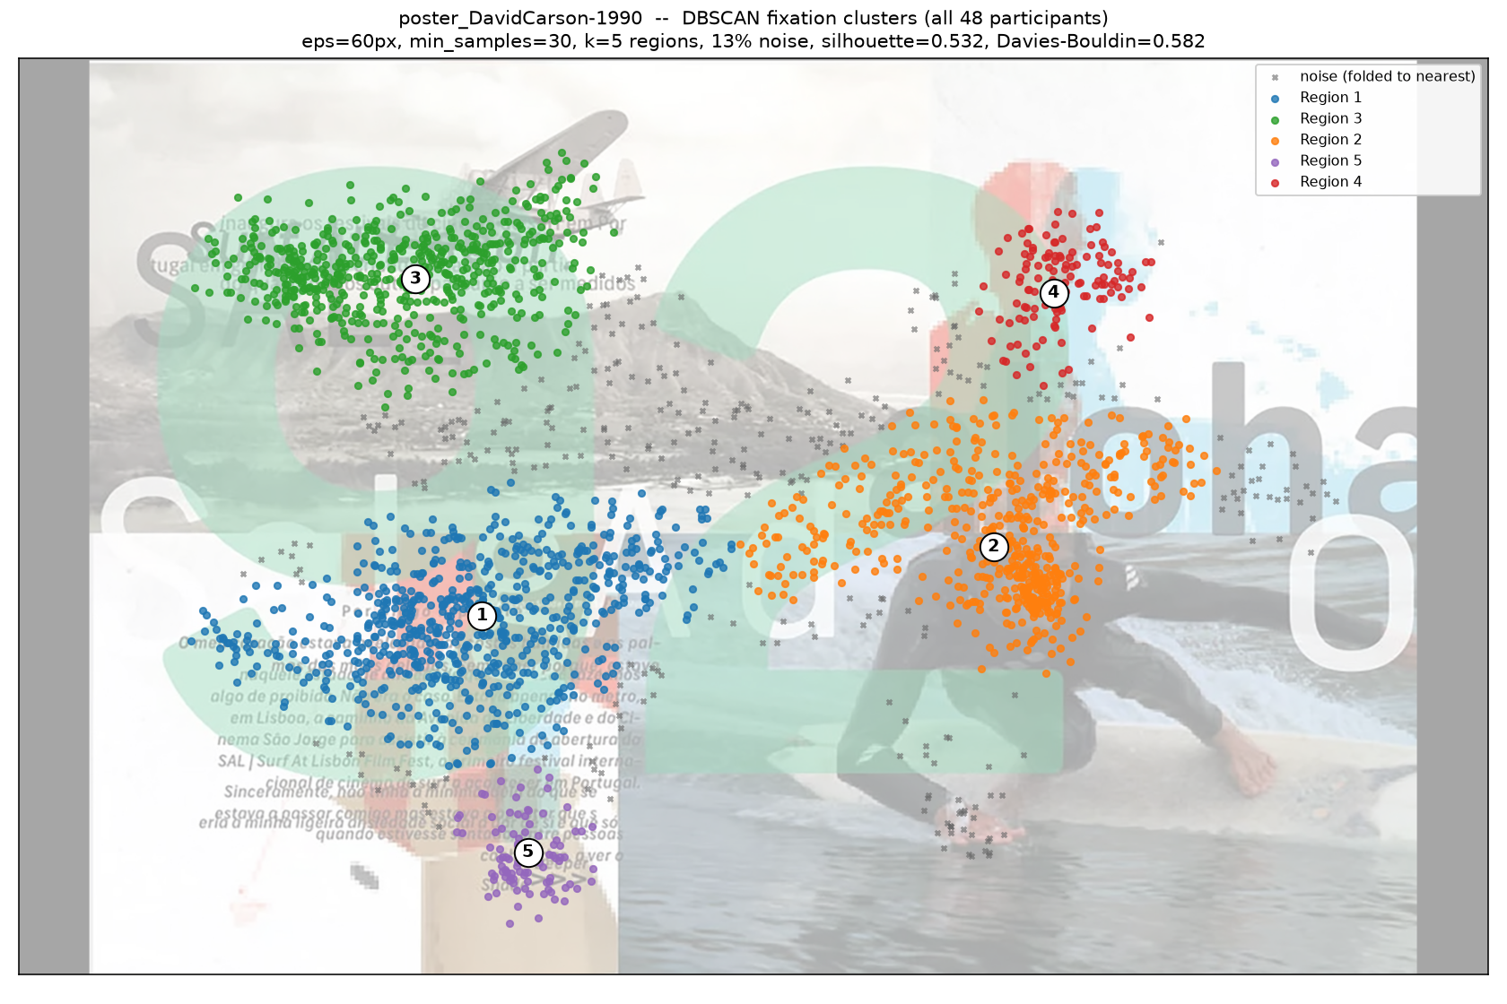
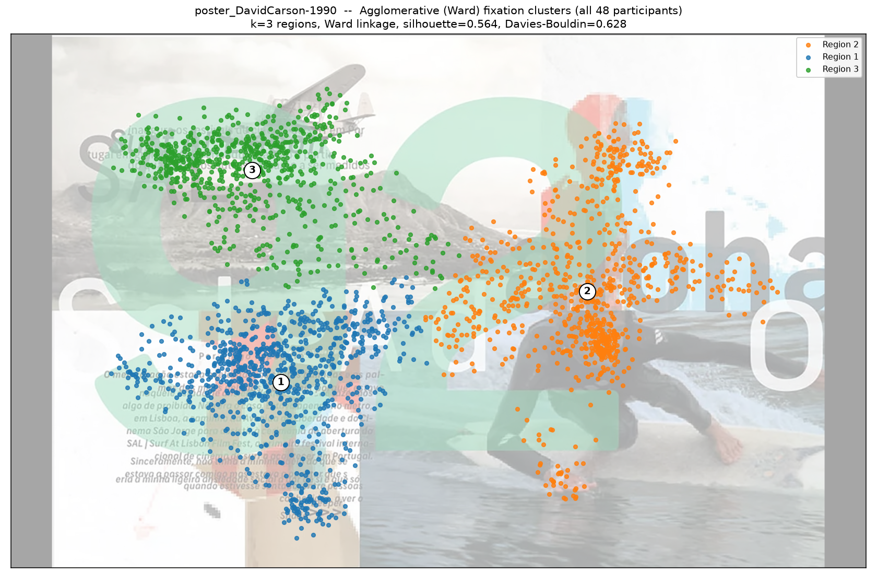
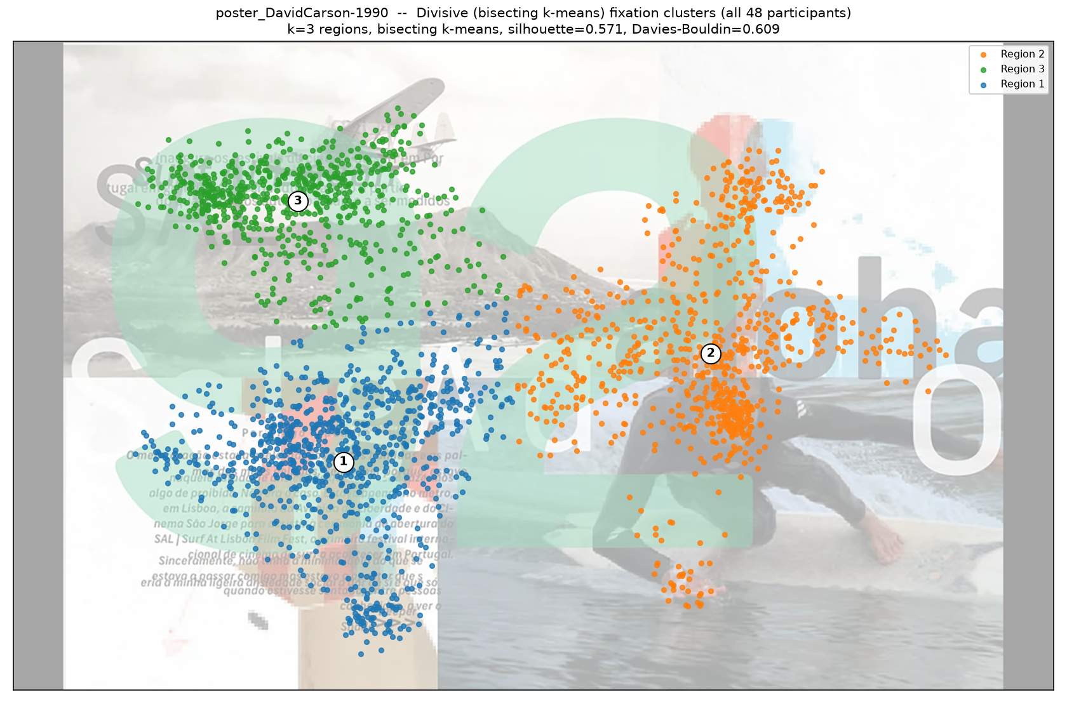
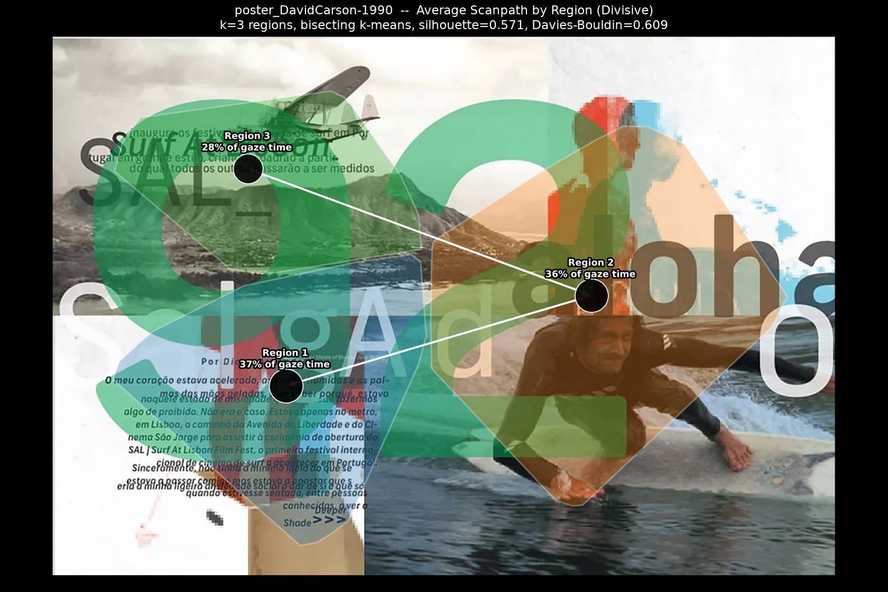
David Carson - 1990
Best method: Divisive
Divisive wins: highest separation score (0.709), silhouette 0.571, Davies-Bouldin 0.609; DBSCAN scored 0.433 (silhouette 0.532, DB 0.582, 13% noise); Agglomerative scored 0.410 (silhouette 0.564, DB 0.628).
DBSCAN
Agglomerative
★ Divisive
Path (Divisive)
Animation (Divisive) — click to play

Slide 8
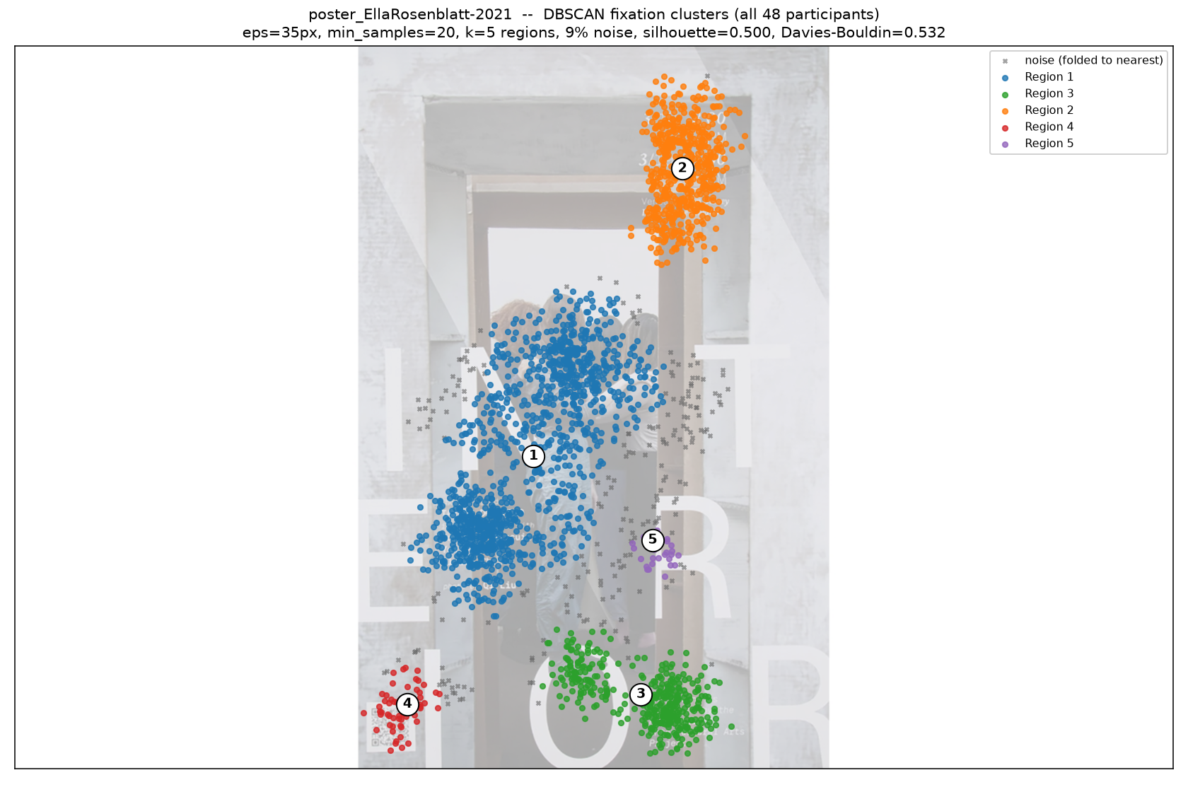
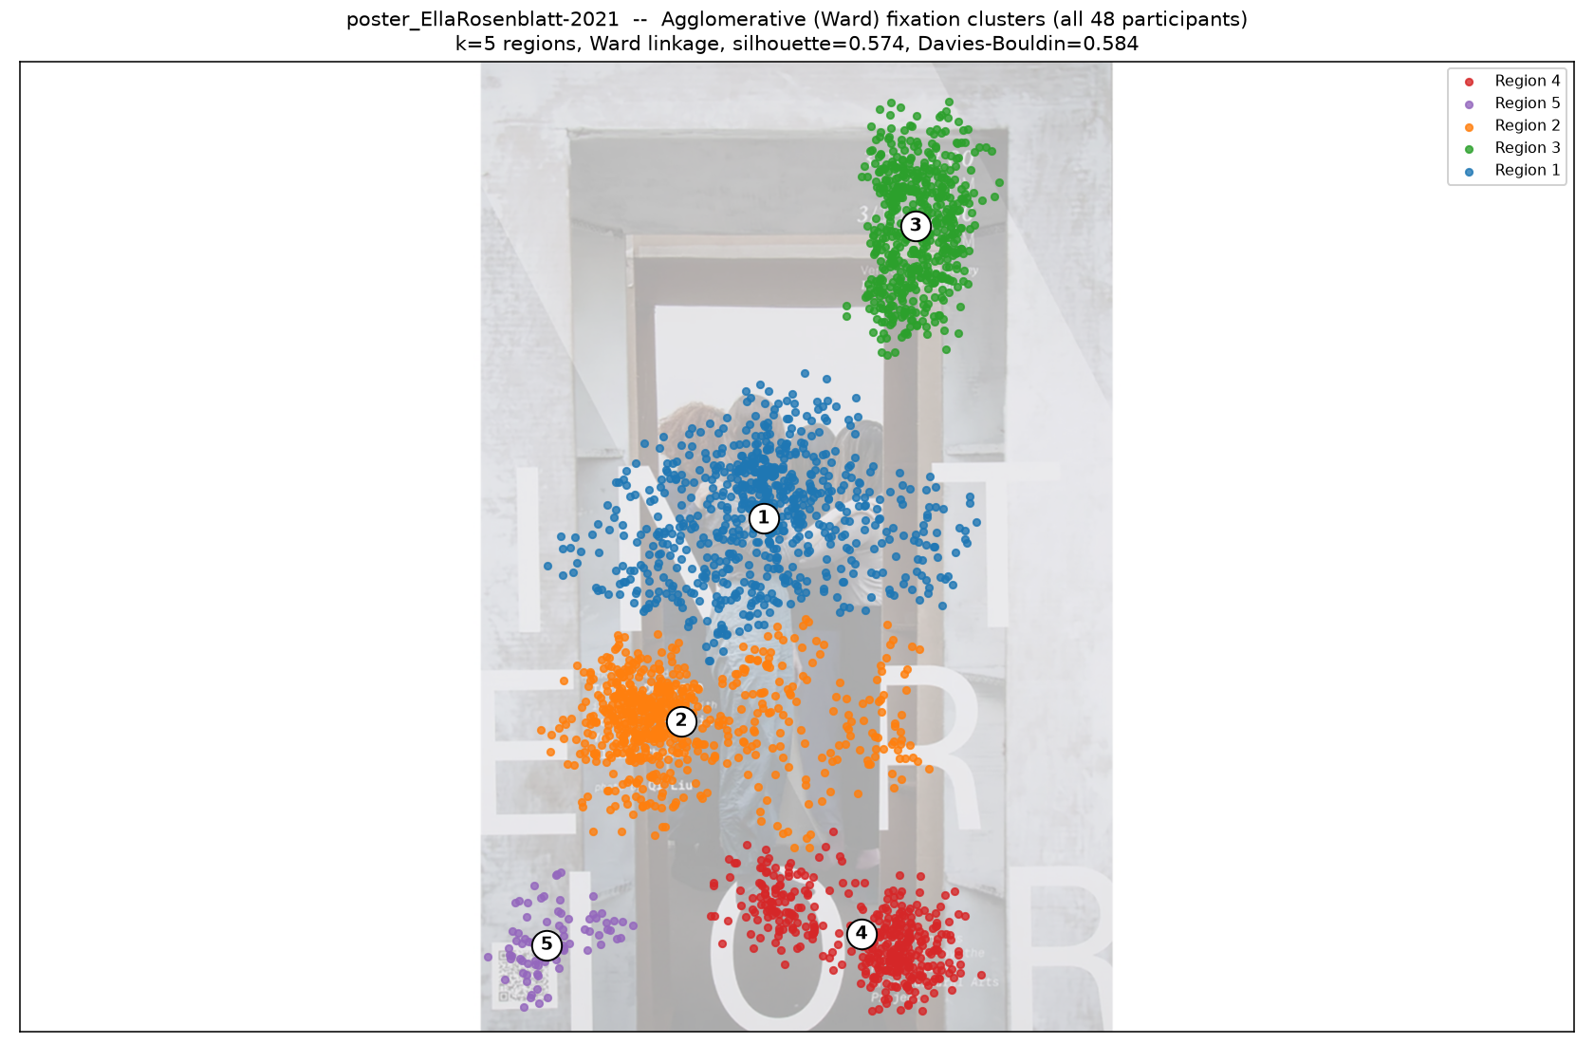
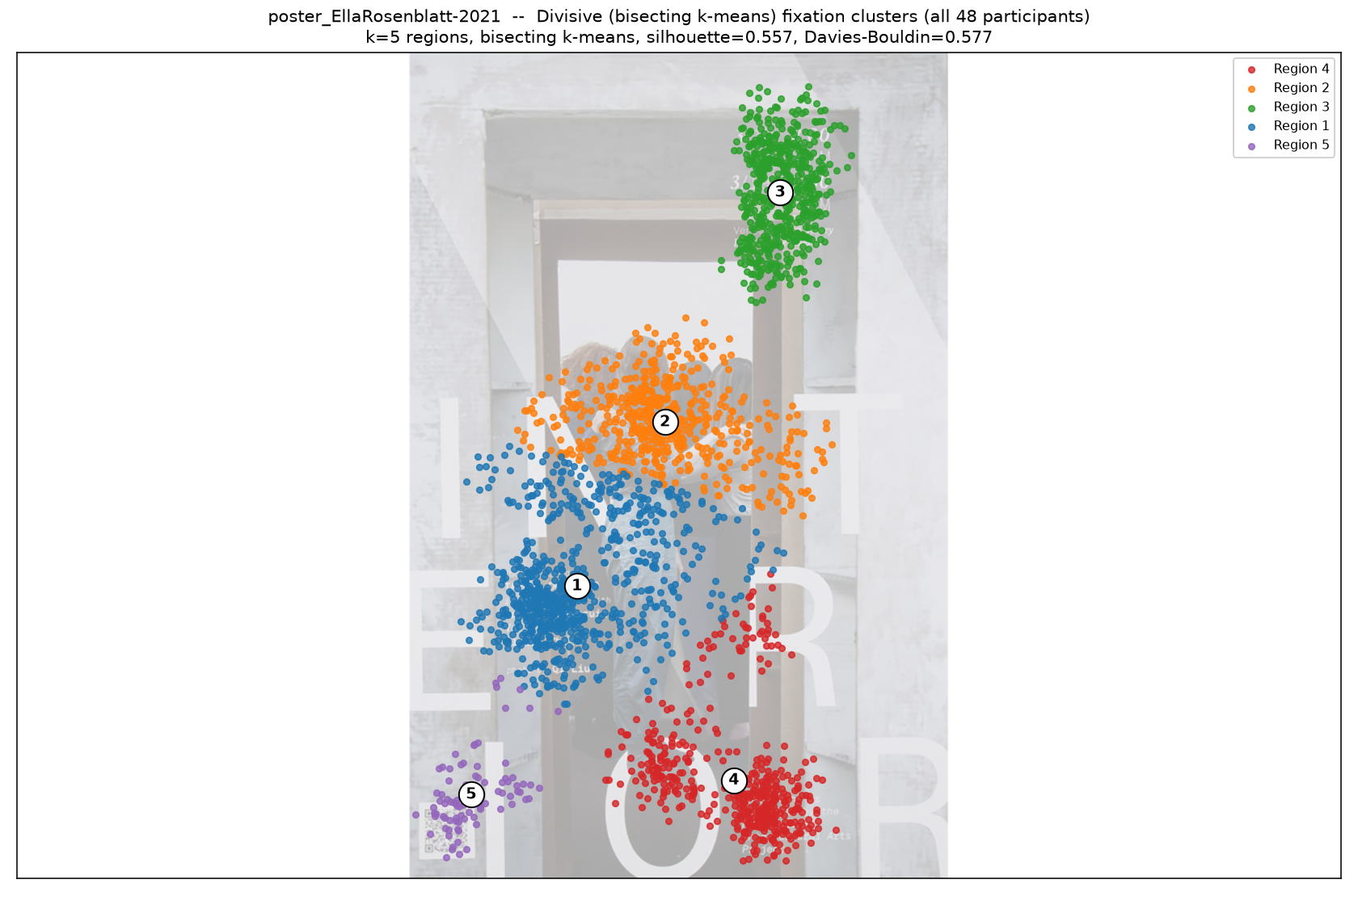
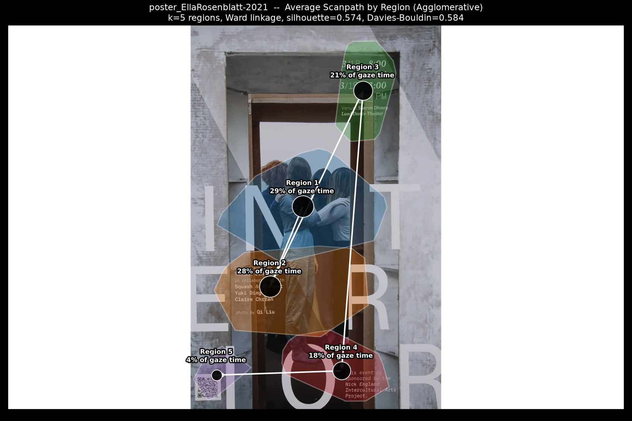
Ella Rosenblatt- 2021
Best method: Agglomerative
Agglomerative wins: highest separation score (0.500), silhouette 0.574, Davies-Bouldin 0.584; DBSCAN scored 0.455 (silhouette 0.500, DB 0.532, 9% noise); Divisive scored 0.444 (silhouette 0.557, DB 0.577).
DBSCAN
★ Agglomerative
Divisive
Path (Agglomerative)
Animation (Agglomerative) — click to play

Slide 9
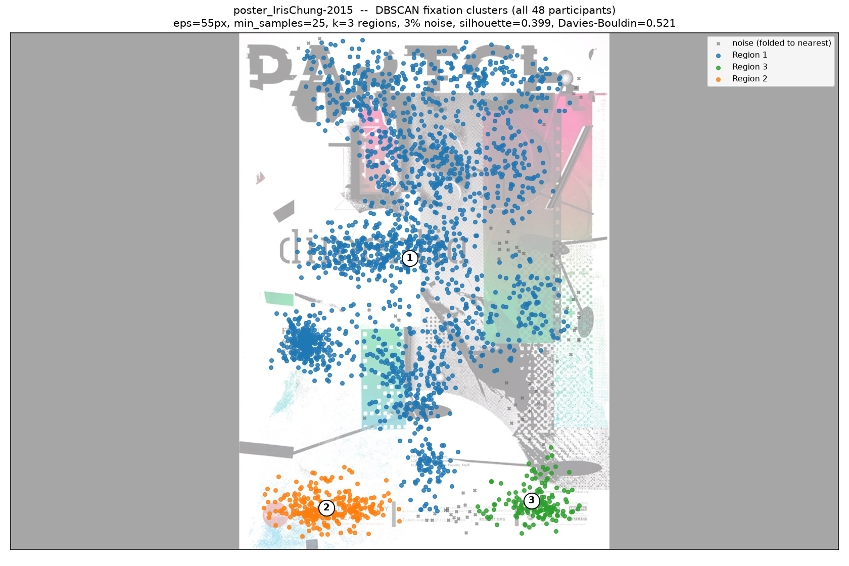
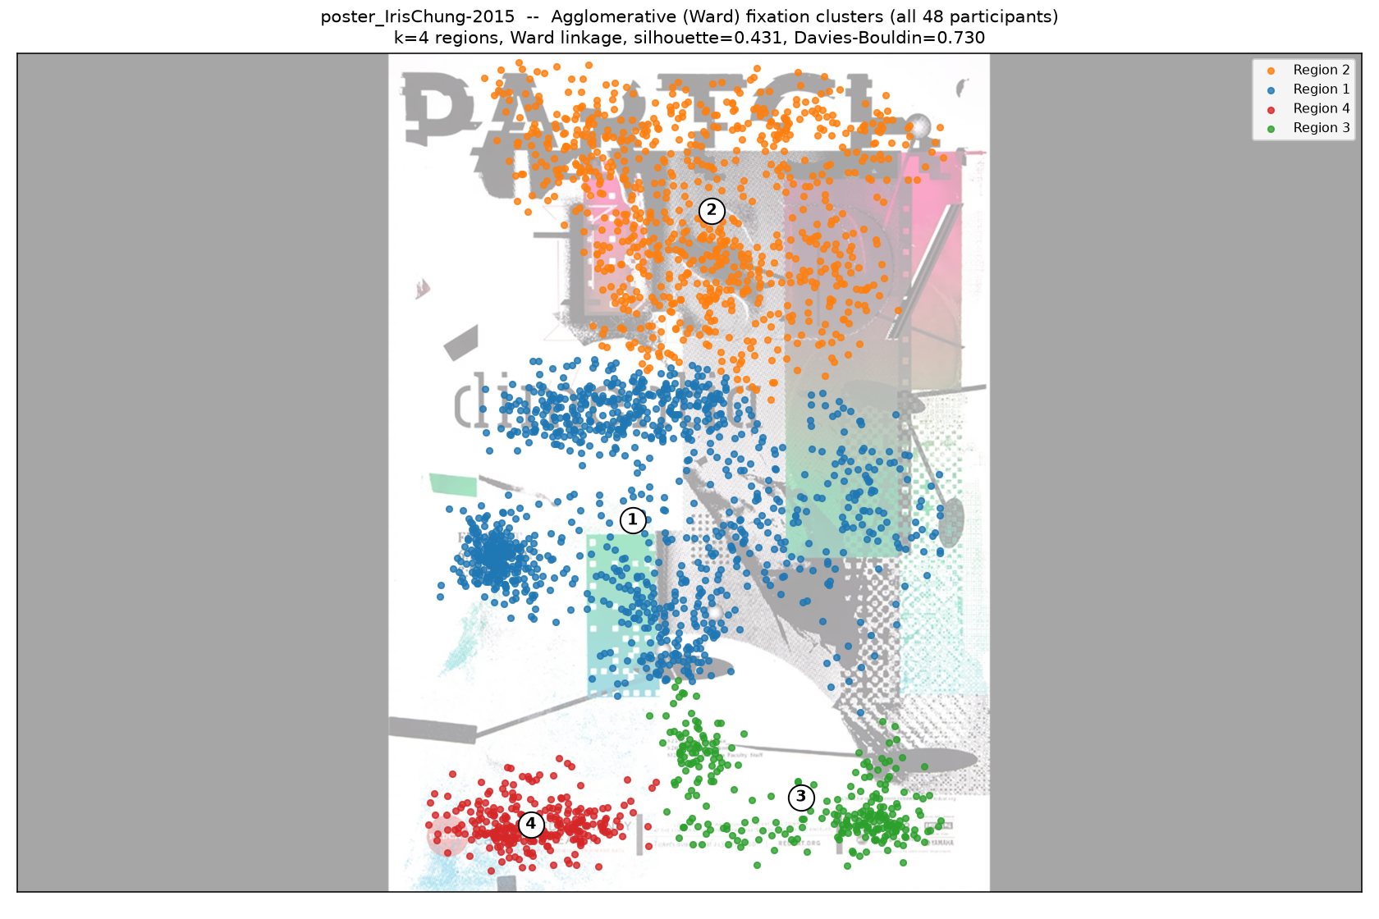
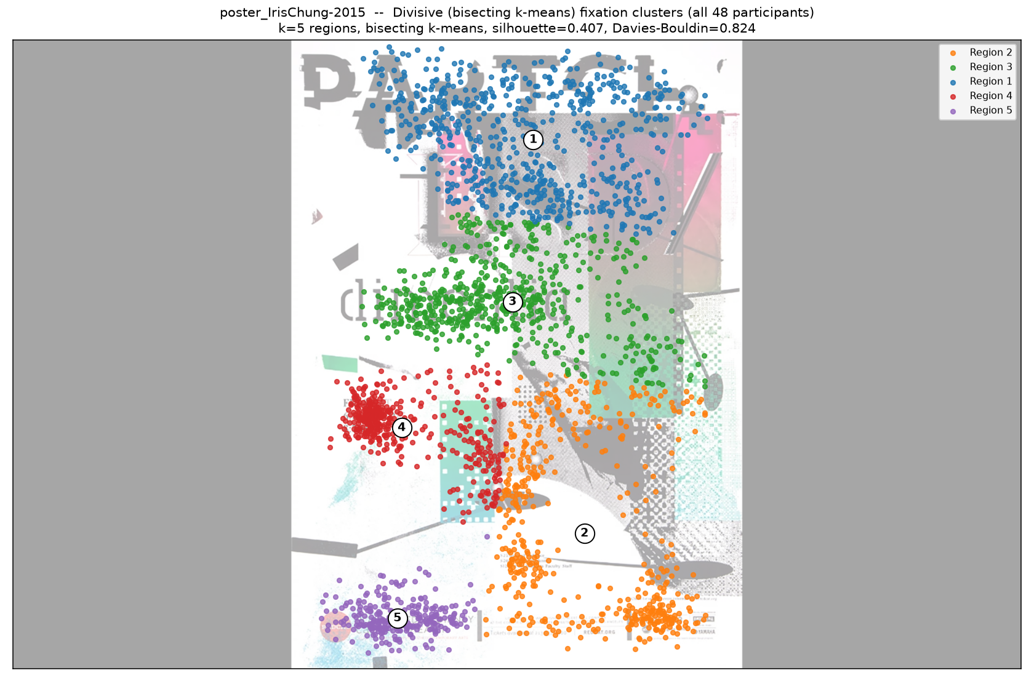
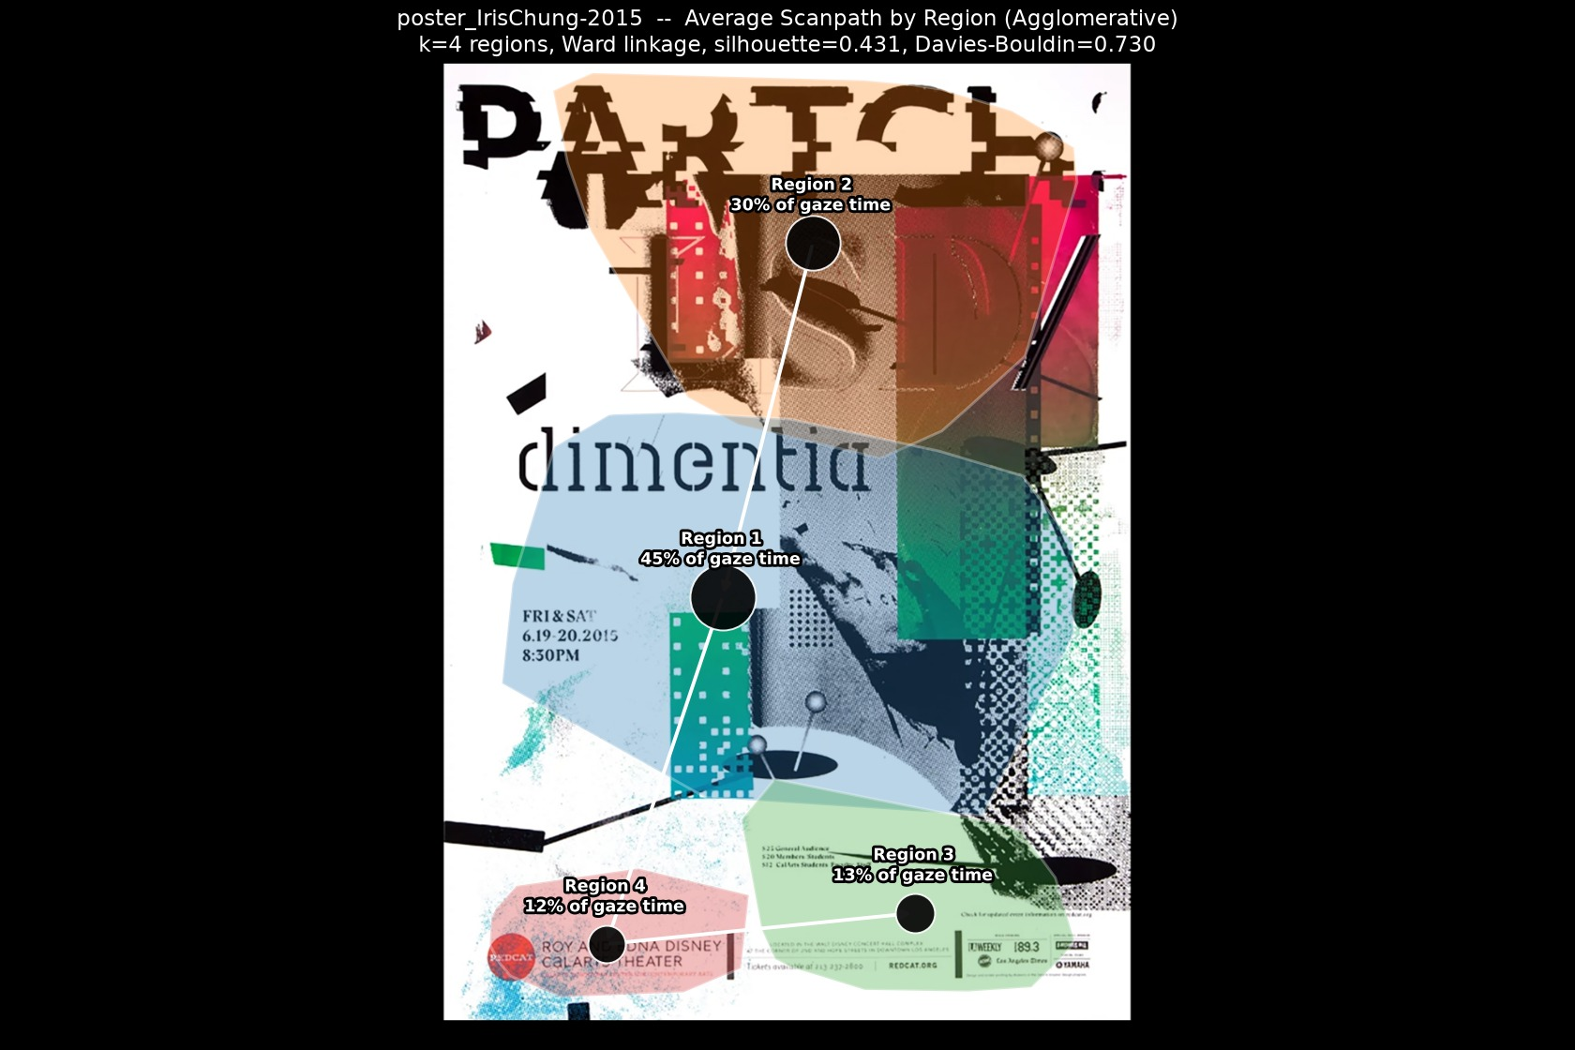
Iris Chung- 2015
Best method: Agglomerative
Agglomerative wins: highest separation score (0.655), silhouette 0.431, Davies-Bouldin 0.730; DBSCAN scored 0.485 (silhouette 0.399, DB 0.521, 3% noise); Divisive scored 0.121 (silhouette 0.407, DB 0.824).
DBSCAN
★ Agglomerative
Divisive
Path (Agglomerative)
Animation (Agglomerative) — click to play

Slide 10
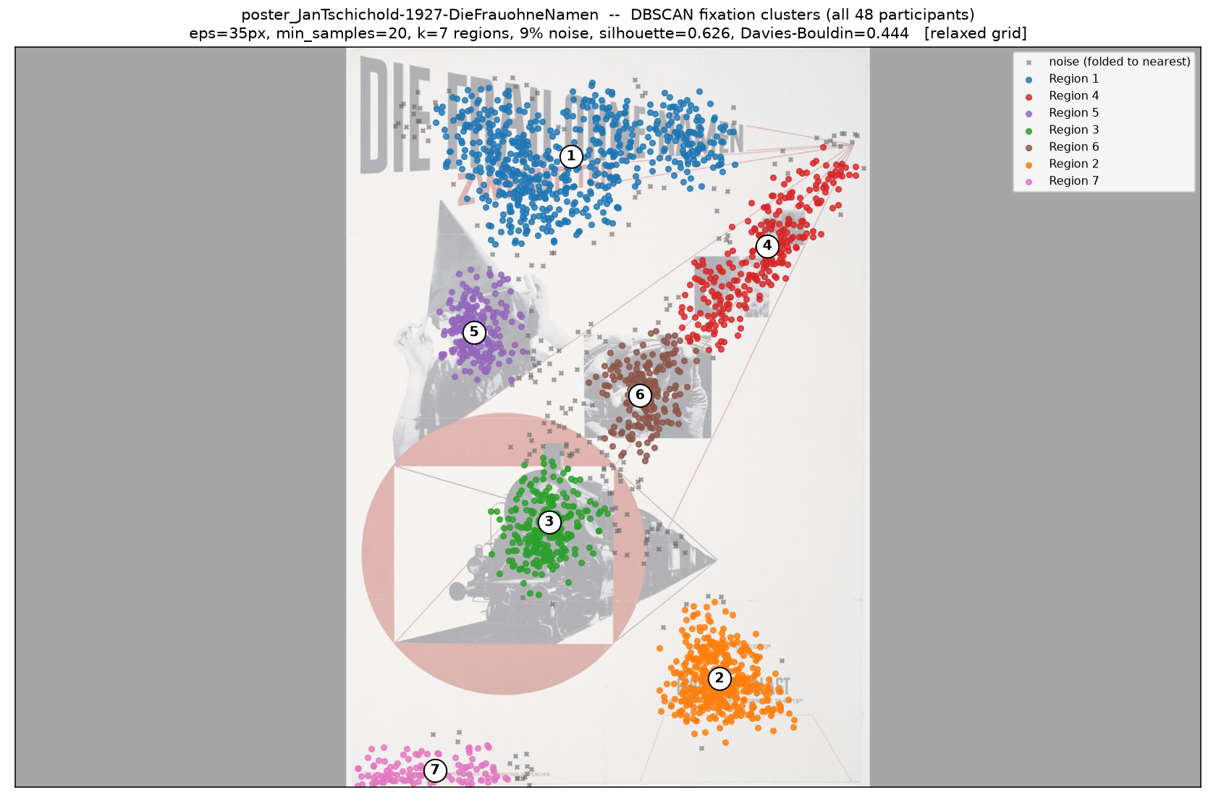
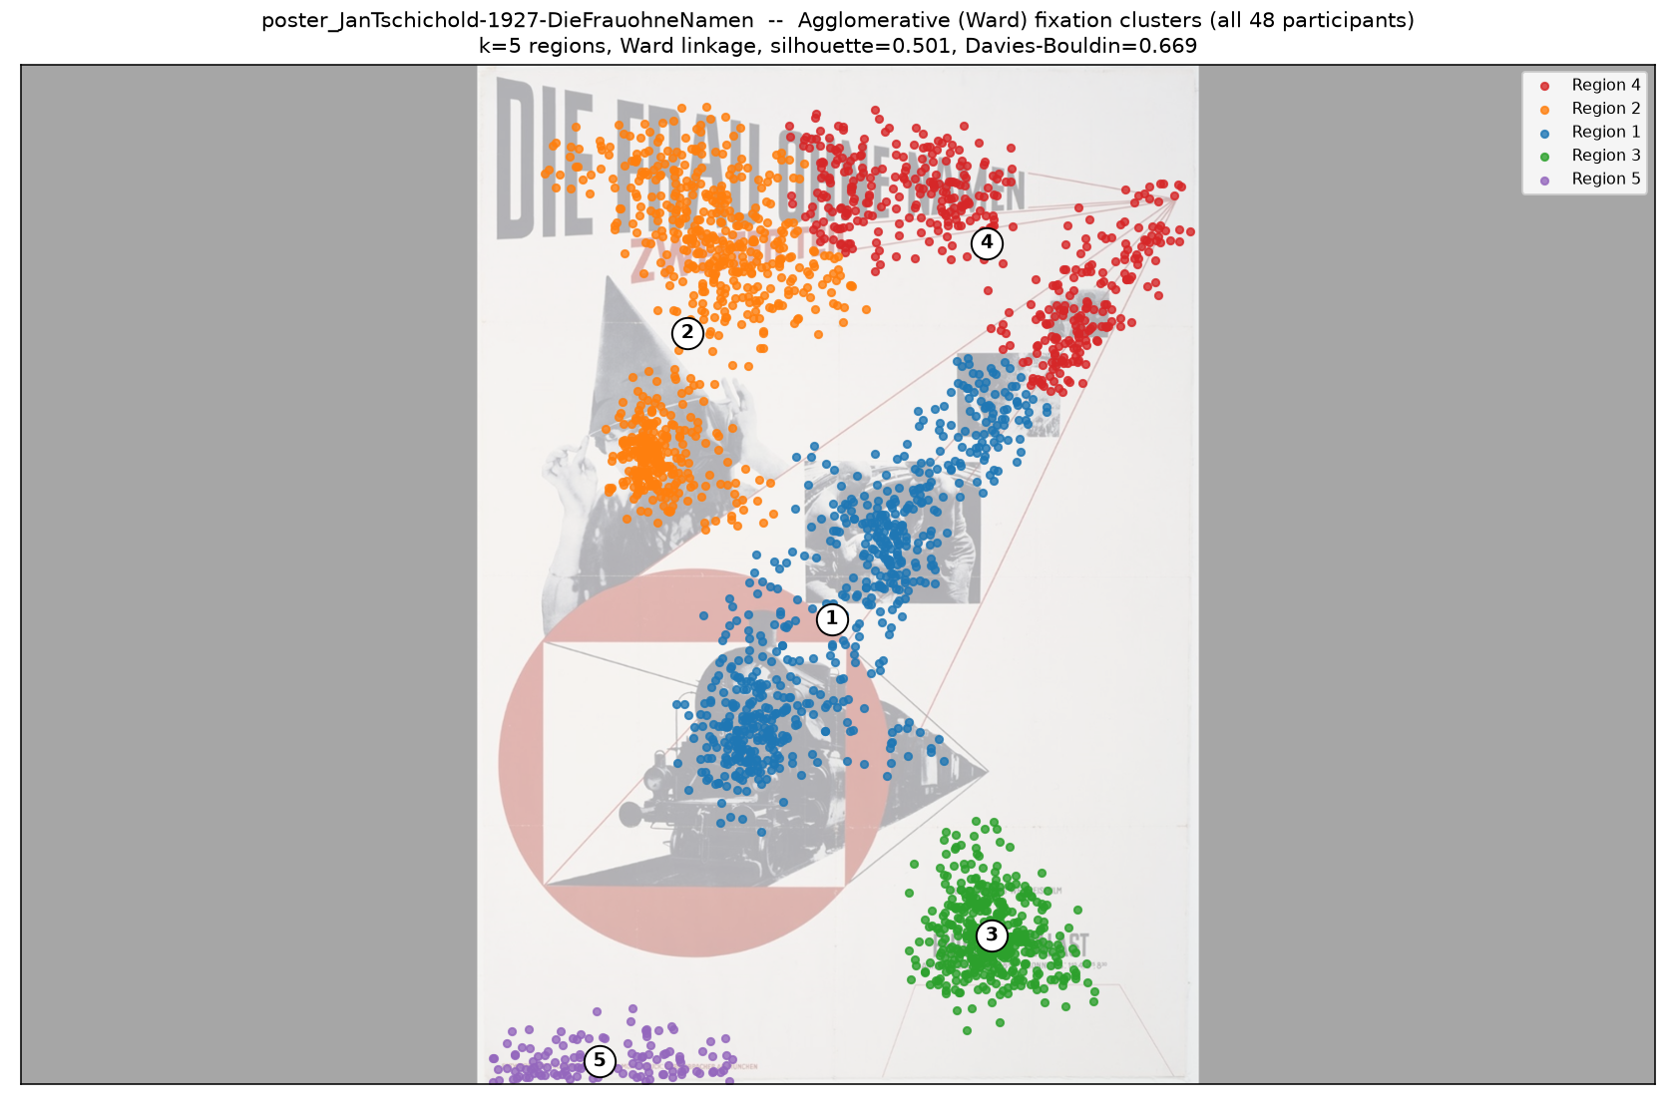
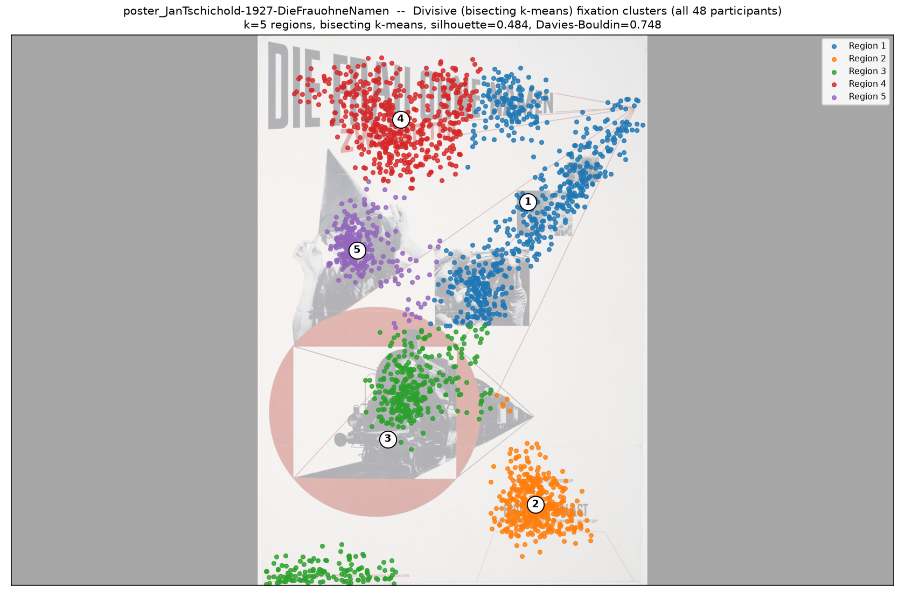
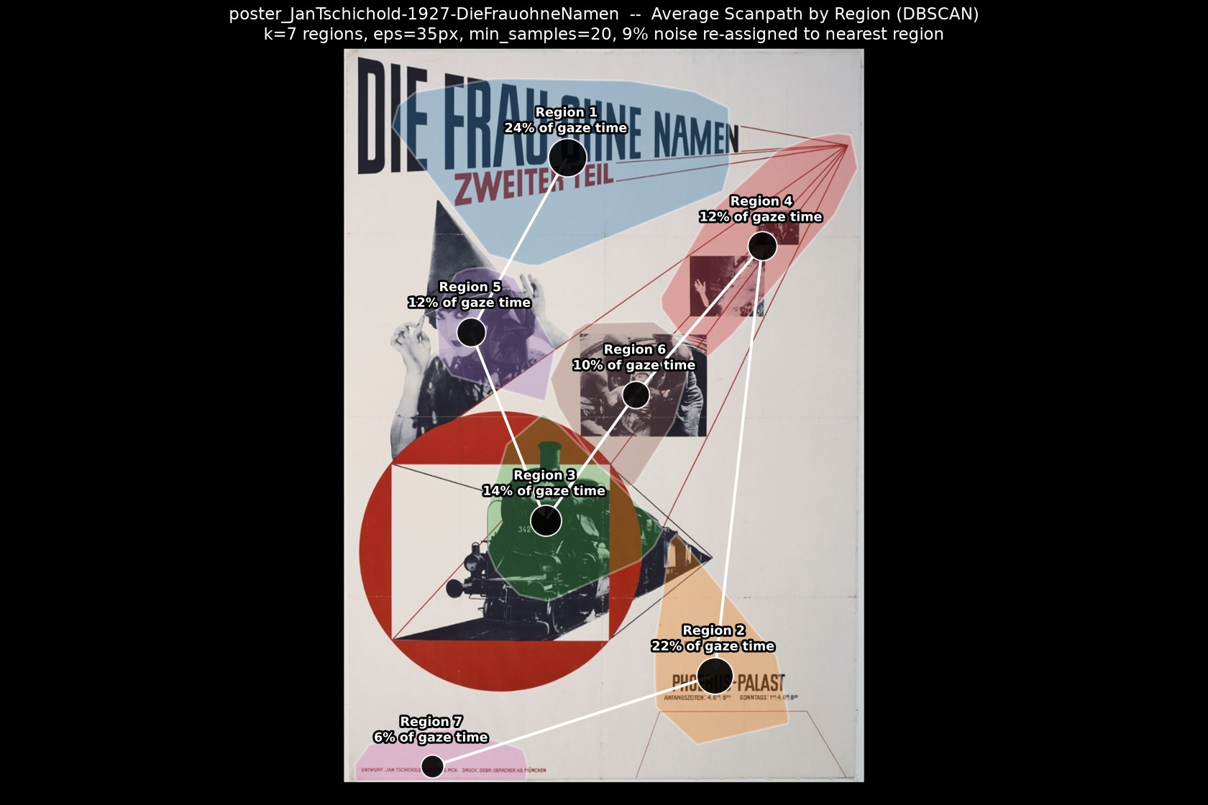
Jan Tschichold-1927-Die Frau ohne Namen
Best method: DBSCAN
DBSCAN wins: highest separation score (0.912 after a 9% noise discount), silhouette 0.626, Davies-Bouldin 0.444; Agglomerative scored 0.191 (silhouette 0.501, DB 0.669); Divisive scored 0.000 (silhouette 0.484, DB 0.748).
★ DBSCAN
Agglomerative
Divisive
Path (DBSCAN)
Animation (DBSCAN) — click to play

Slide 11
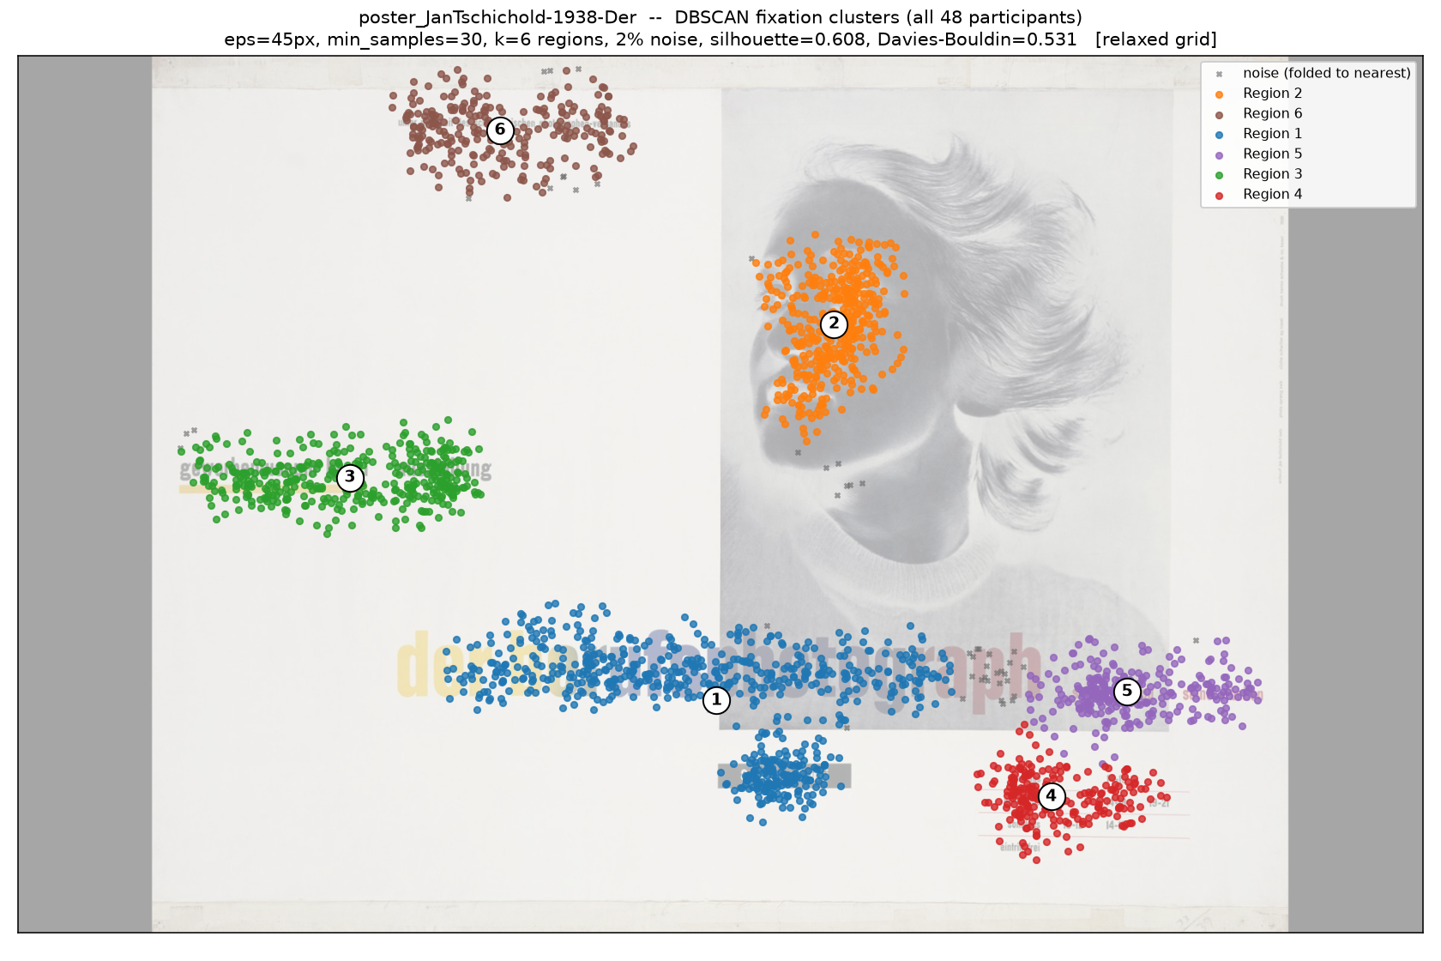
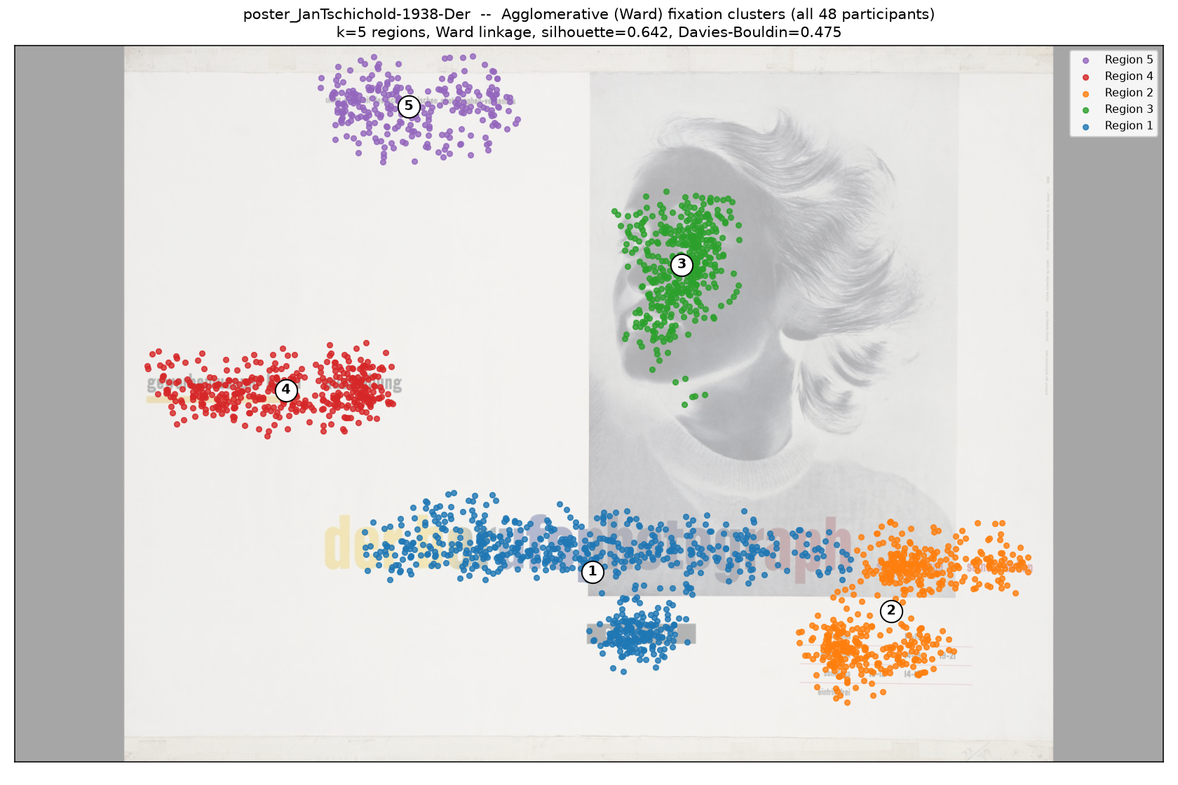
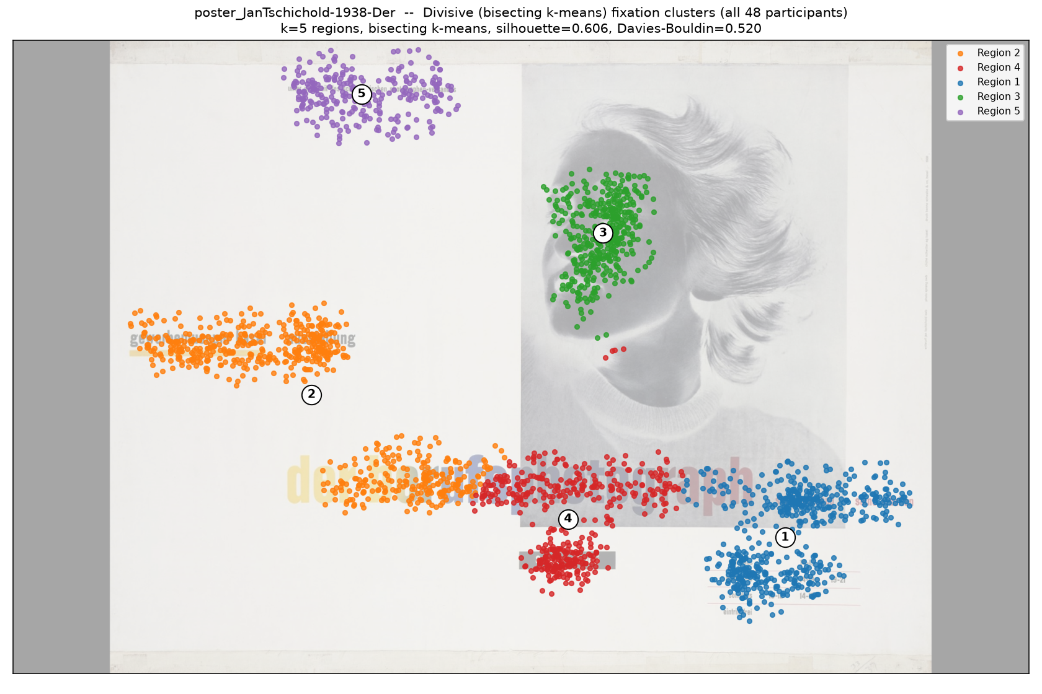
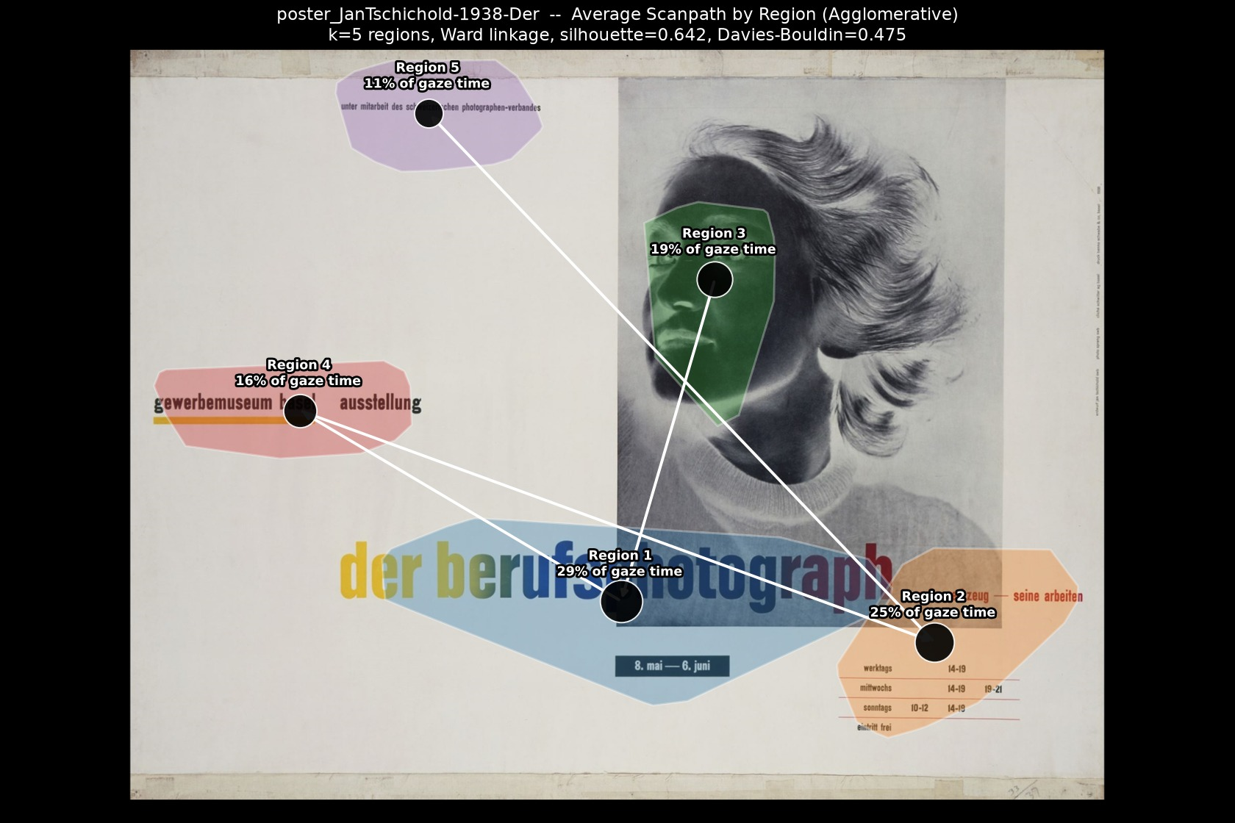
Jan Tschichold-1938-Der
Best method: Agglomerative
Agglomerative wins: highest separation score (1.000), silhouette 0.642, Davies-Bouldin 0.475; DBSCAN scored 0.018 (silhouette 0.608, DB 0.531, 2% noise); Divisive scored 0.096 (silhouette 0.606, DB 0.520).
DBSCAN
★ Agglomerative
Divisive
Path (Agglomerative)
Animation (Agglomerative) — click to play

Slide 12
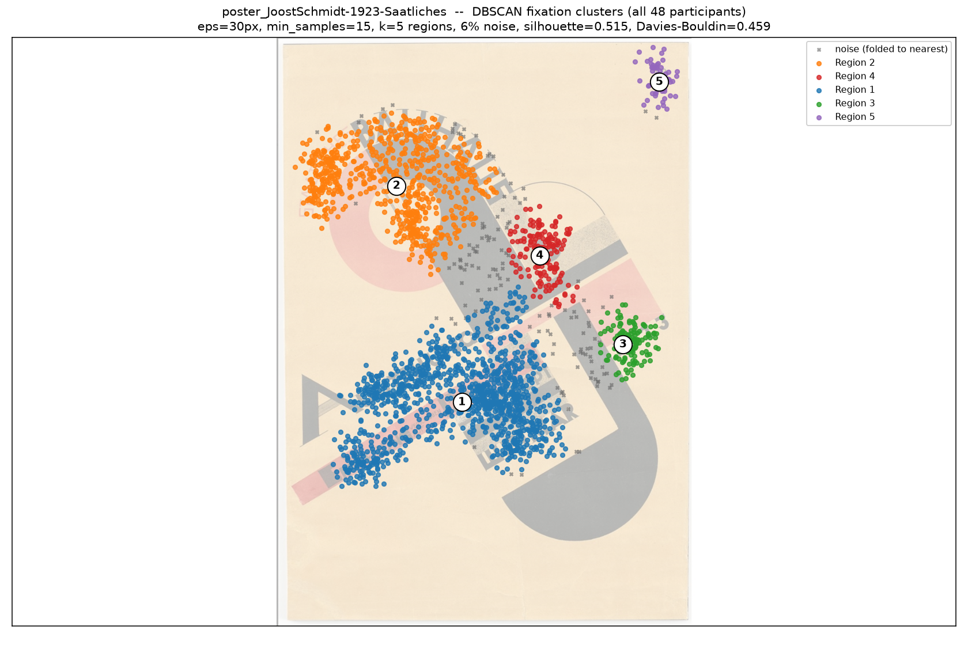
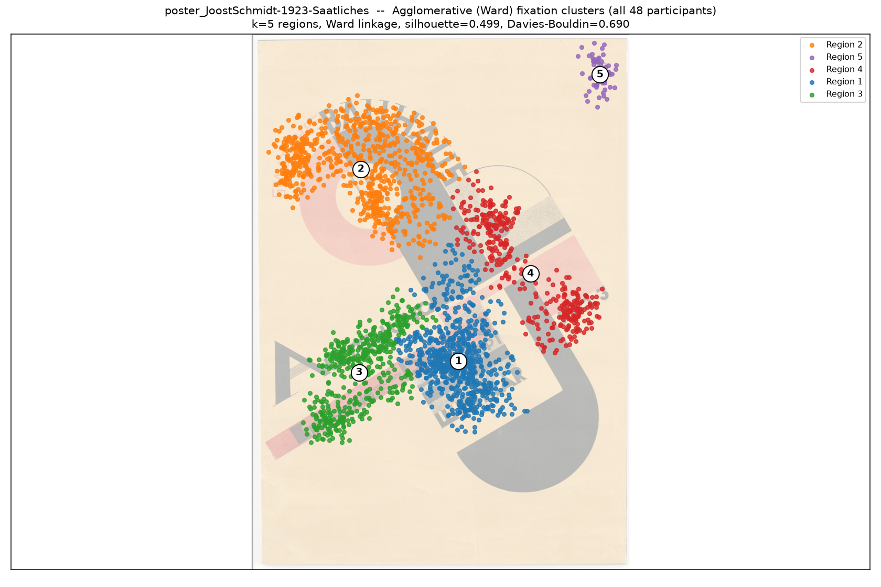
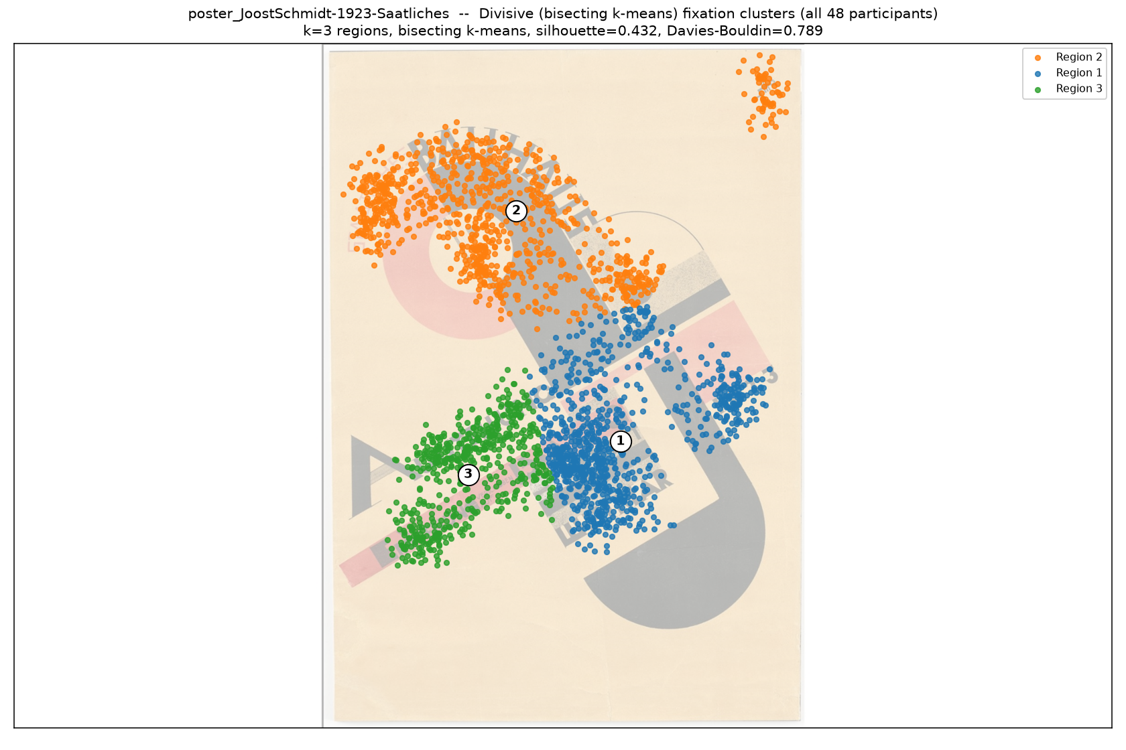
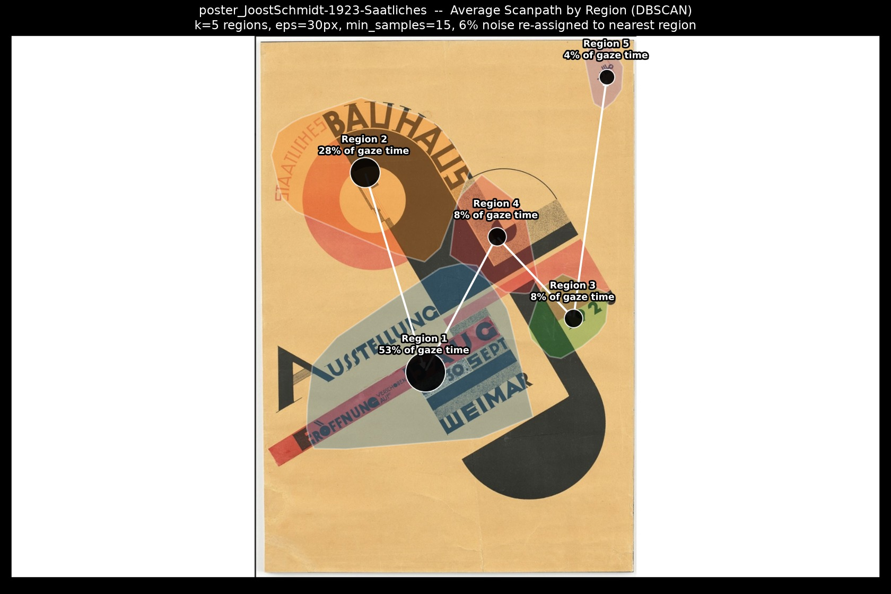
Joost Schmidt-1923-Saatliches
Best method: DBSCAN
DBSCAN wins: highest separation score (0.943 after a 6% noise discount), silhouette 0.515, Davies-Bouldin 0.459; Agglomerative scored 0.555 (silhouette 0.499, DB 0.690); Divisive scored 0.000 (silhouette 0.432, DB 0.789).
★ DBSCAN
Agglomerative
Divisive
Path (DBSCAN)
Animation (DBSCAN) — click to play

Slide 13
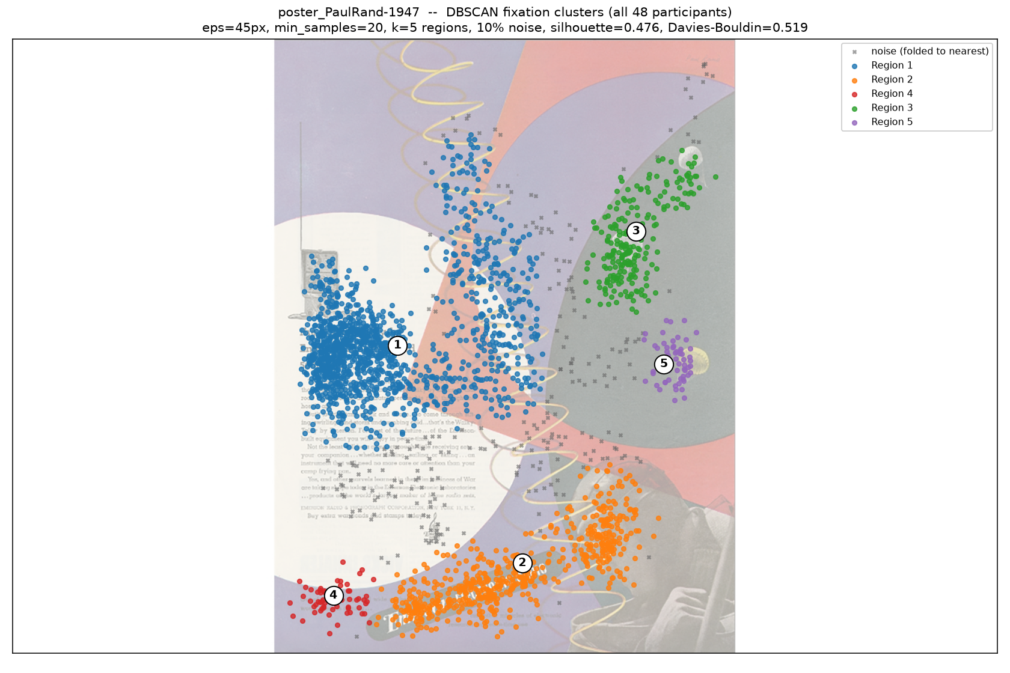
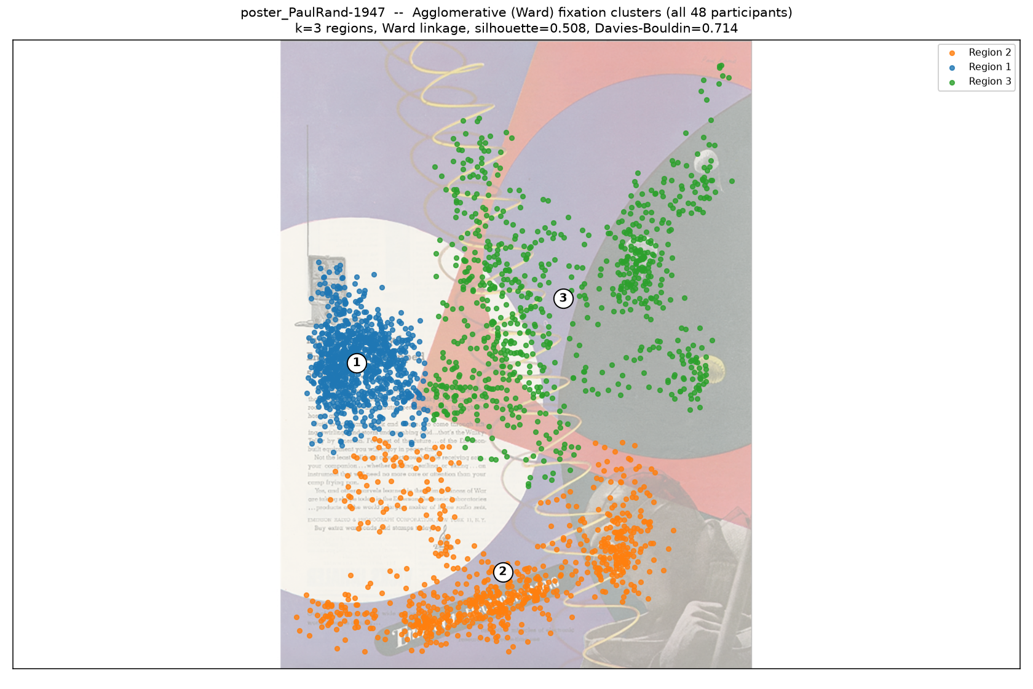
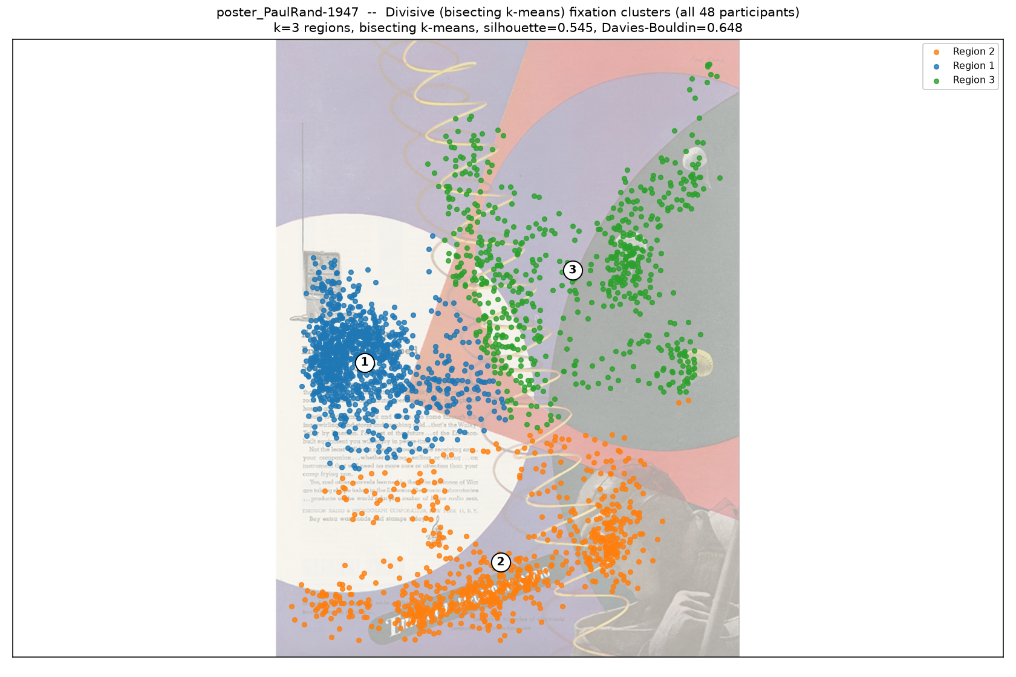
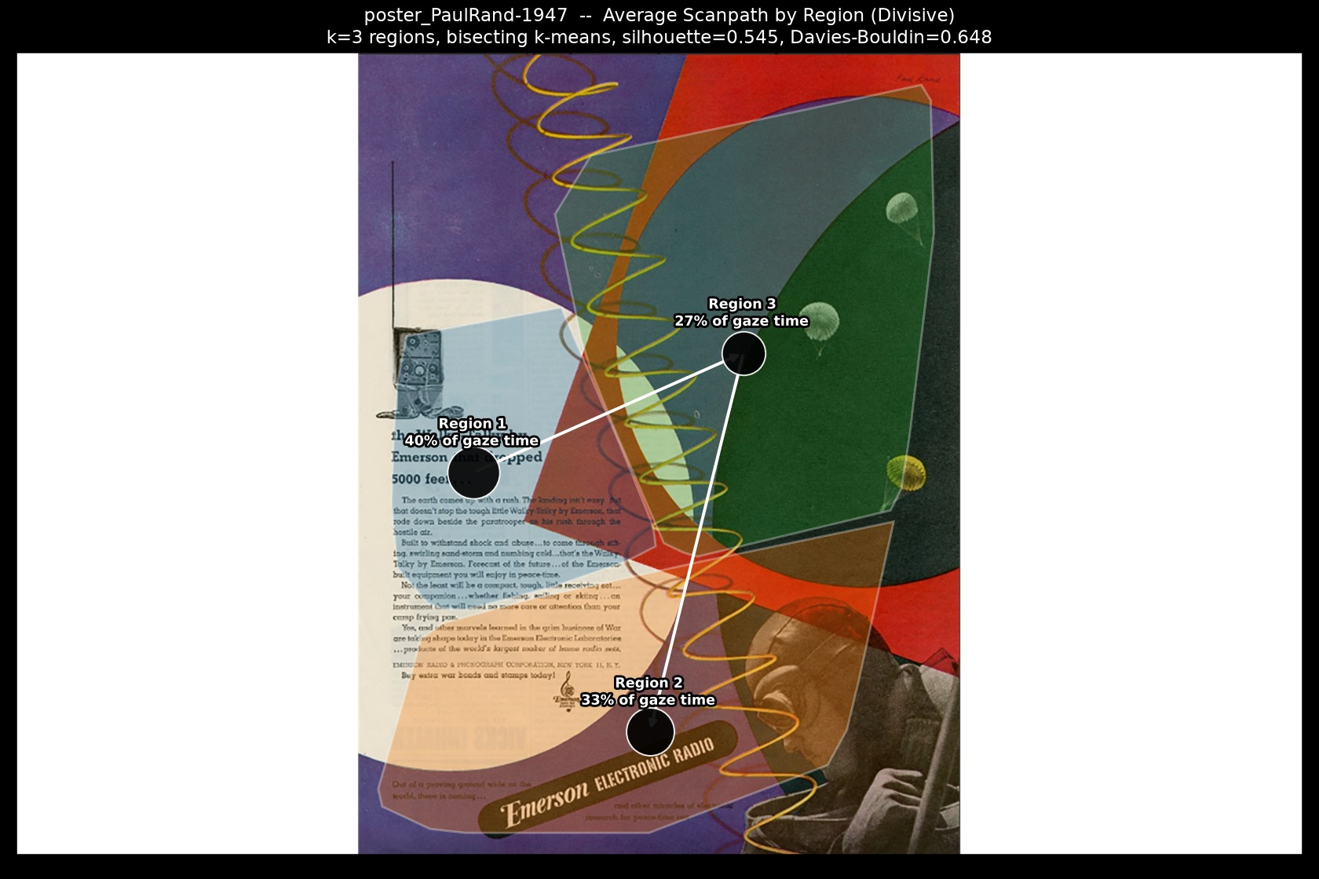
Paul Rand, 1947
Best method: Divisive
Divisive wins: highest separation score (0.670), silhouette 0.545, Davies-Bouldin 0.648; DBSCAN scored 0.451 (silhouette 0.476, DB 0.519, 10% noise); Agglomerative scored 0.230 (silhouette 0.508, DB 0.714).
DBSCAN
Agglomerative
★ Divisive
Path (Divisive)
Animation (Divisive) — click to play

Slide 14
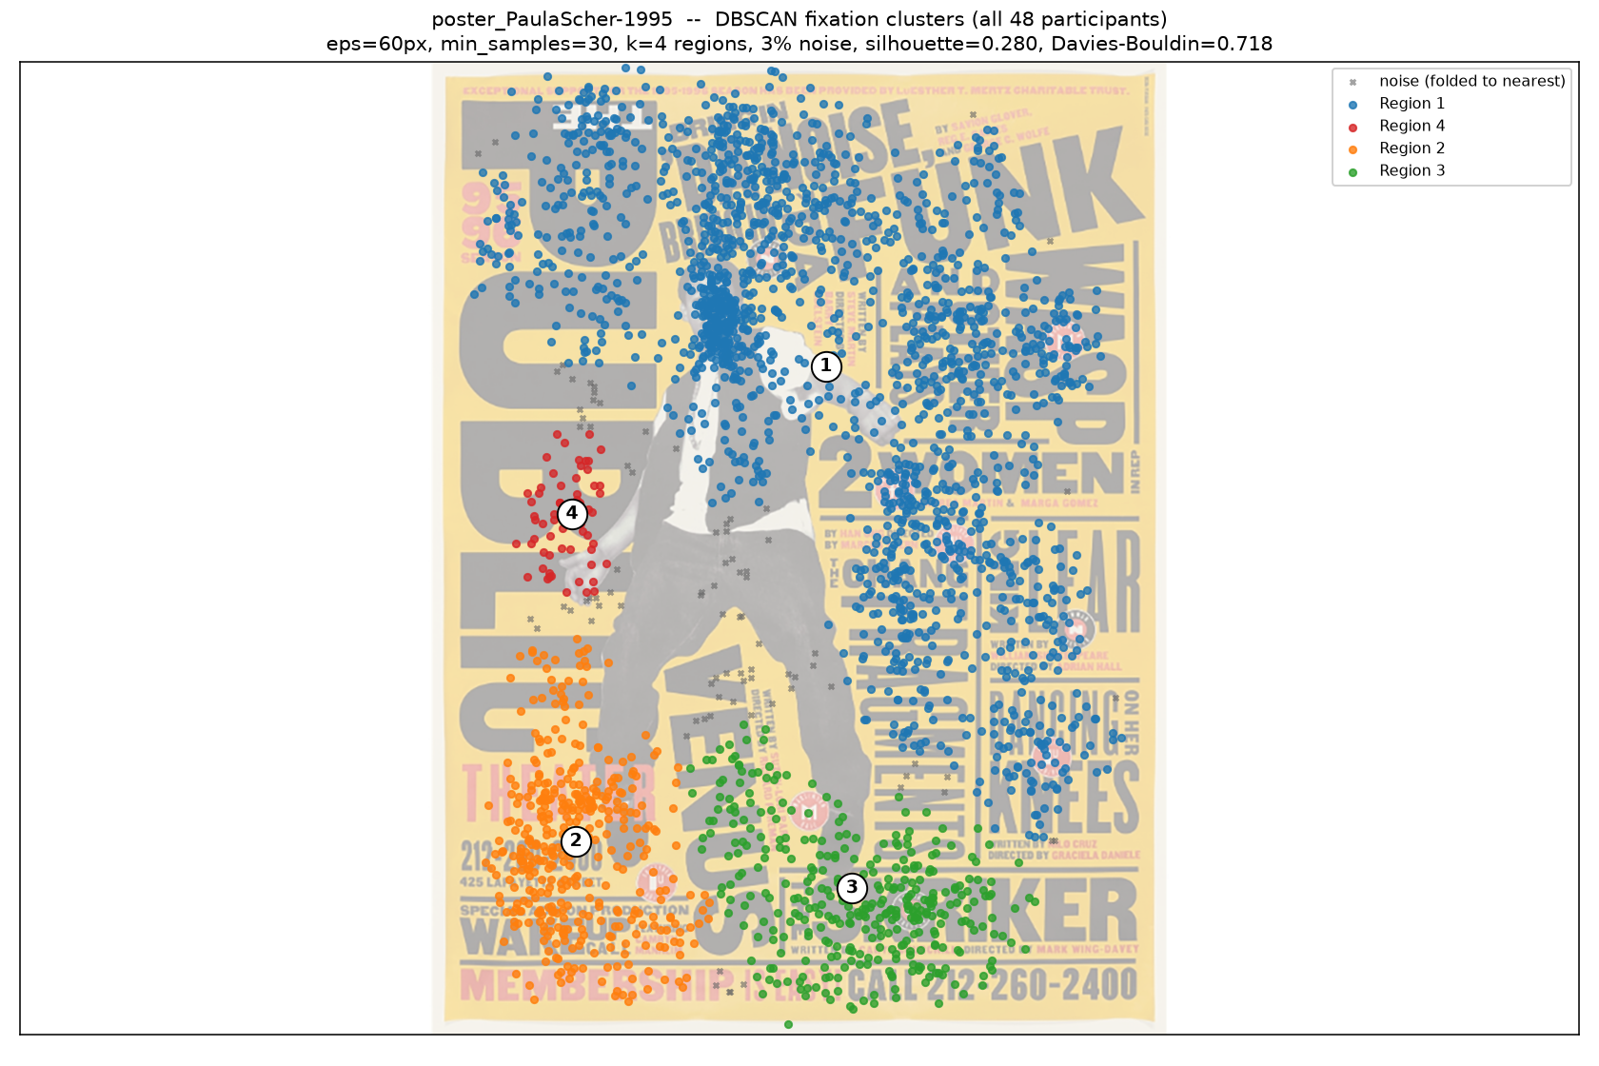
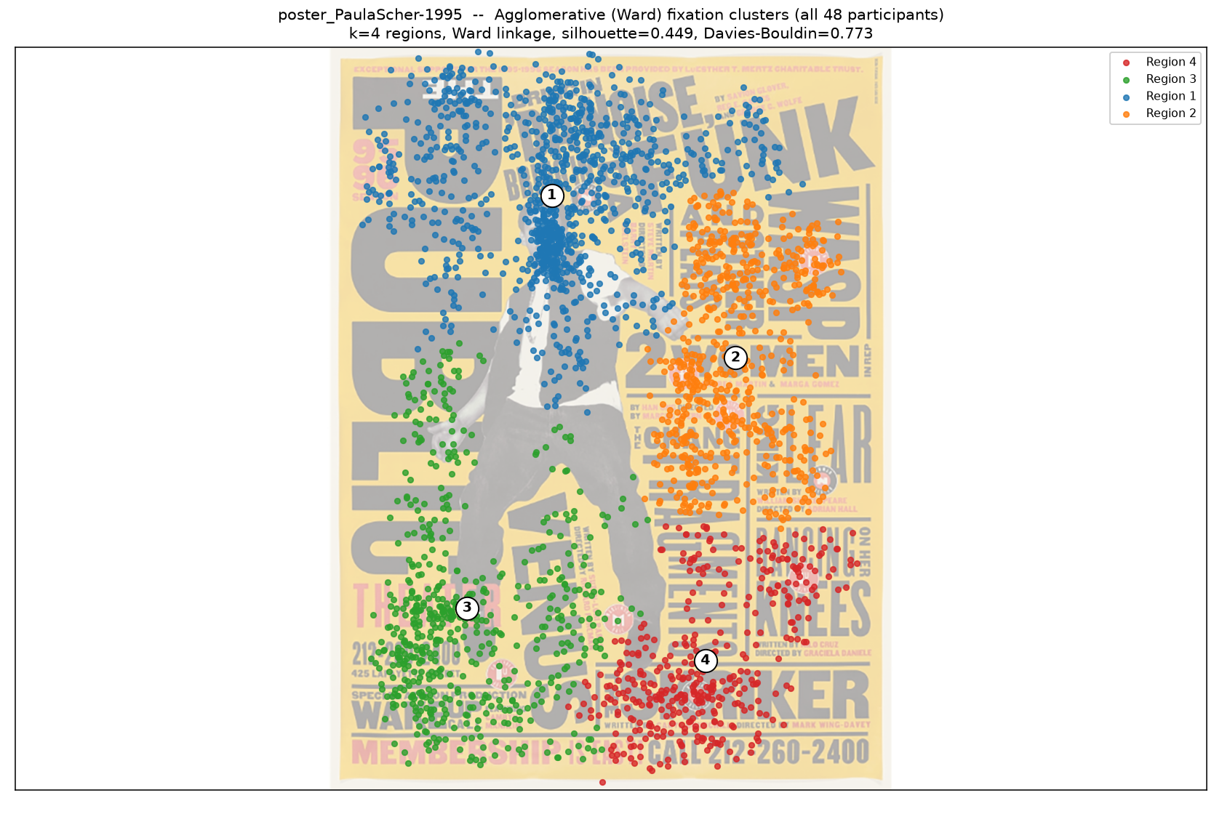
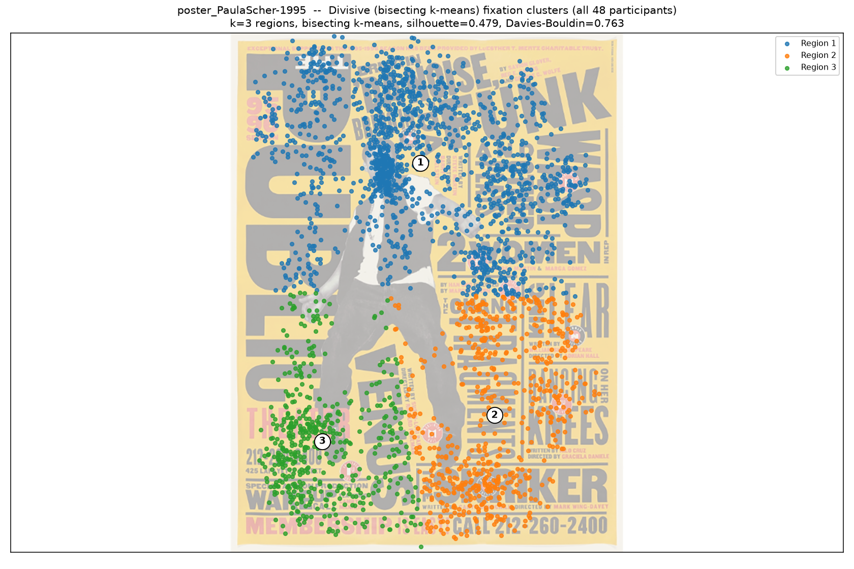
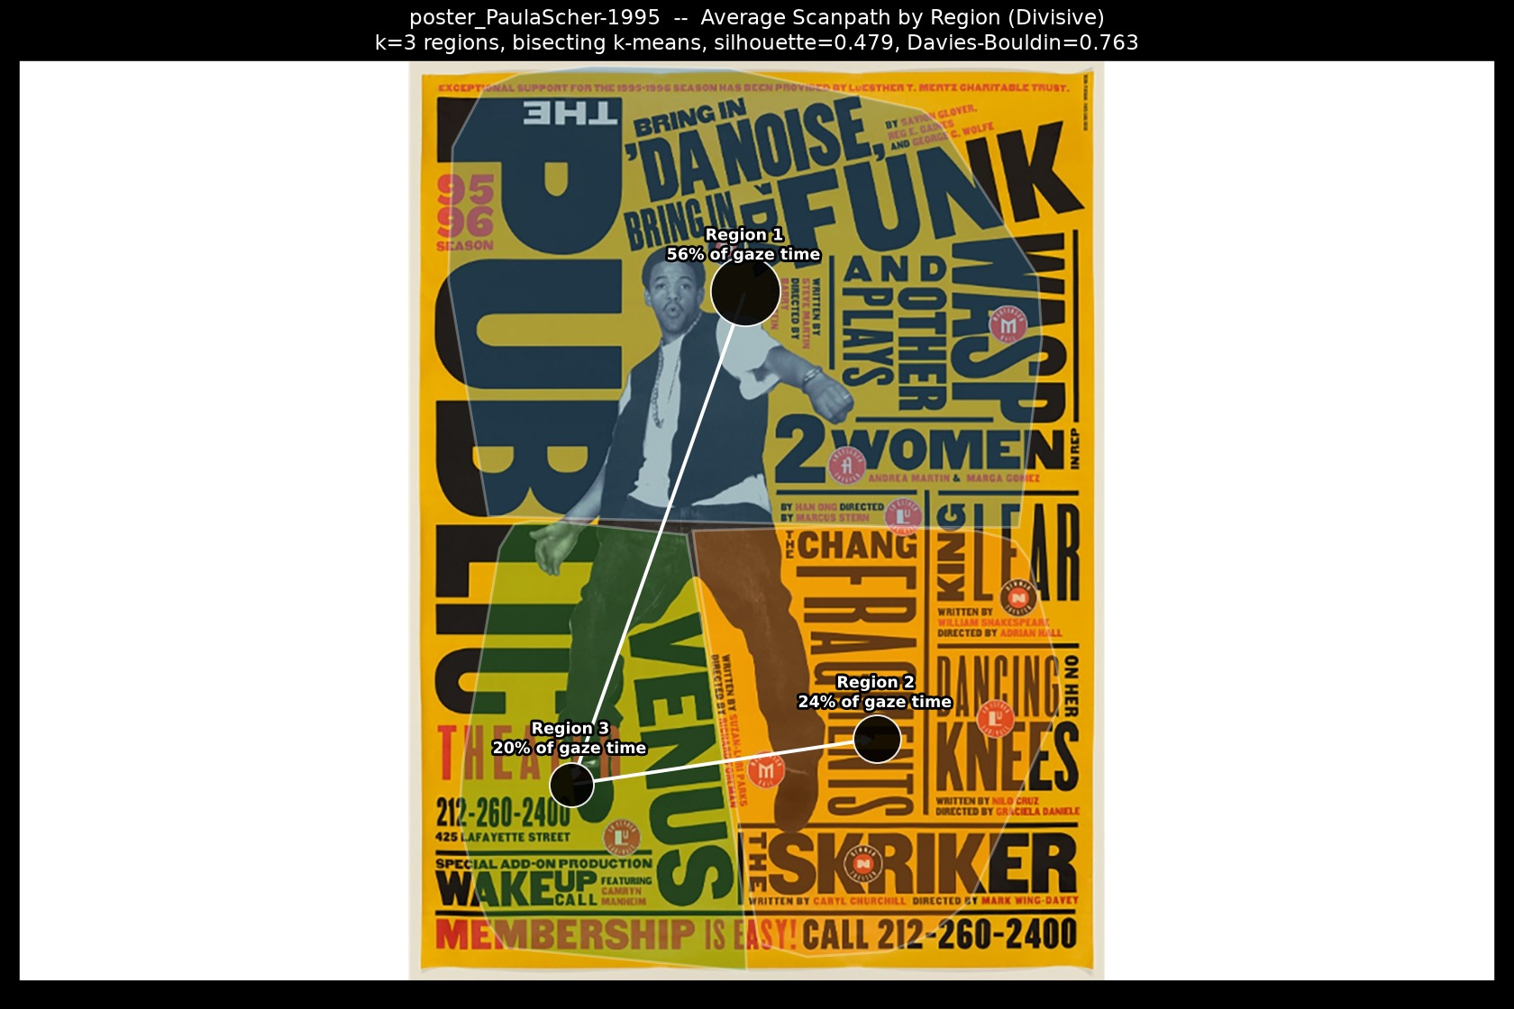
Paula Scher - 1995
Best method: Divisive
Divisive wins: highest separation score (0.588), silhouette 0.479, Davies-Bouldin 0.763; DBSCAN scored 0.484 (silhouette 0.280, DB 0.718, 3% noise); Agglomerative scored 0.423 (silhouette 0.449, DB 0.773).
DBSCAN
Agglomerative
★ Divisive
Path (Divisive)
Animation (Divisive) — click to play

Slide 15
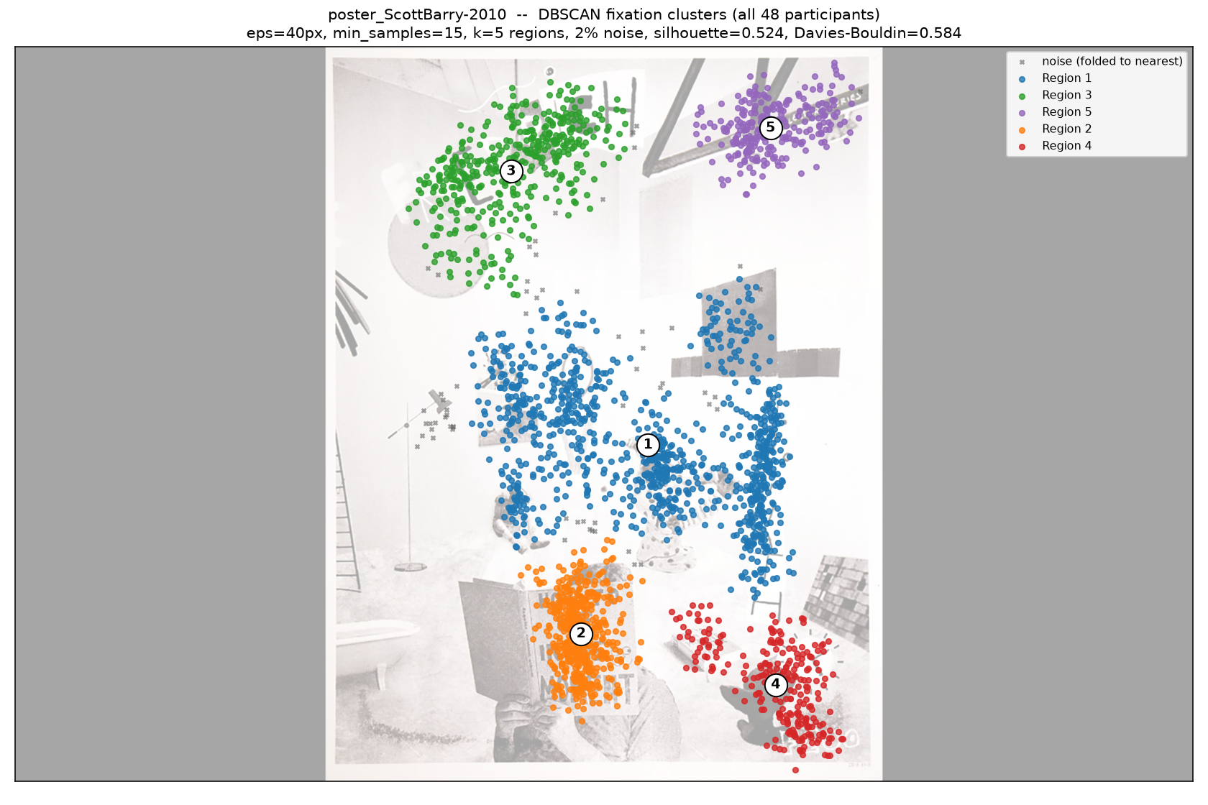
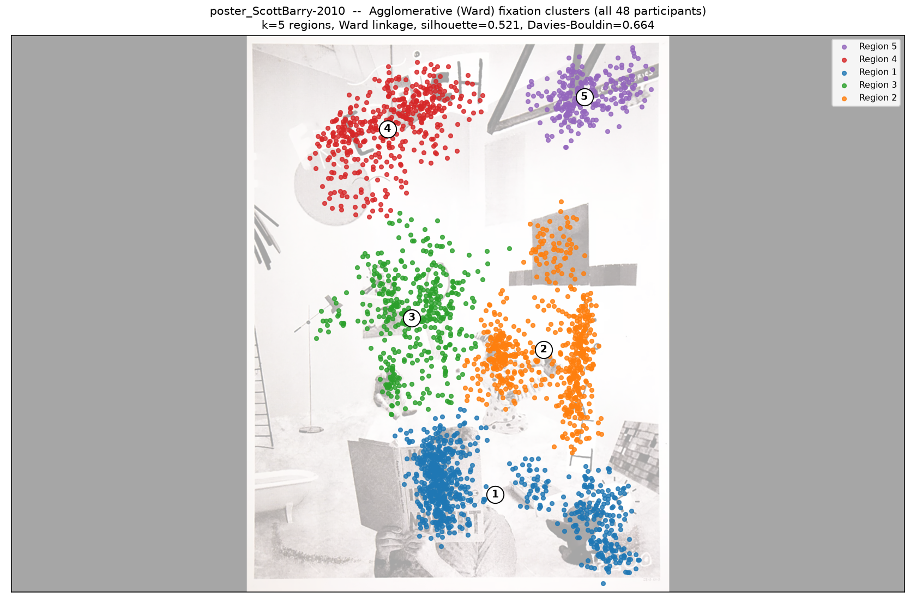
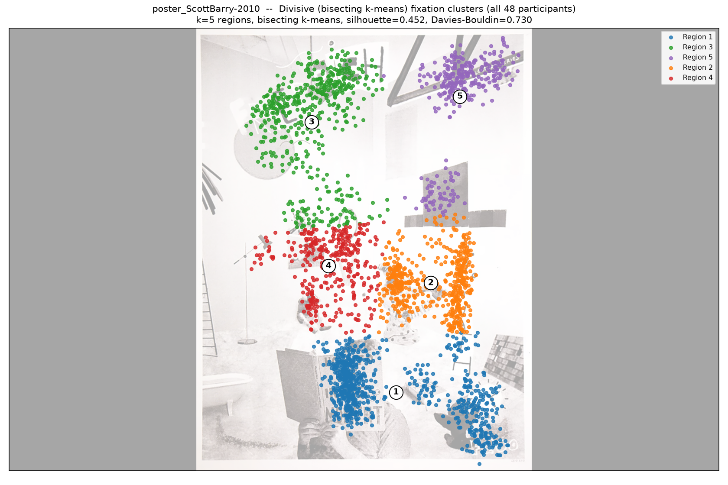
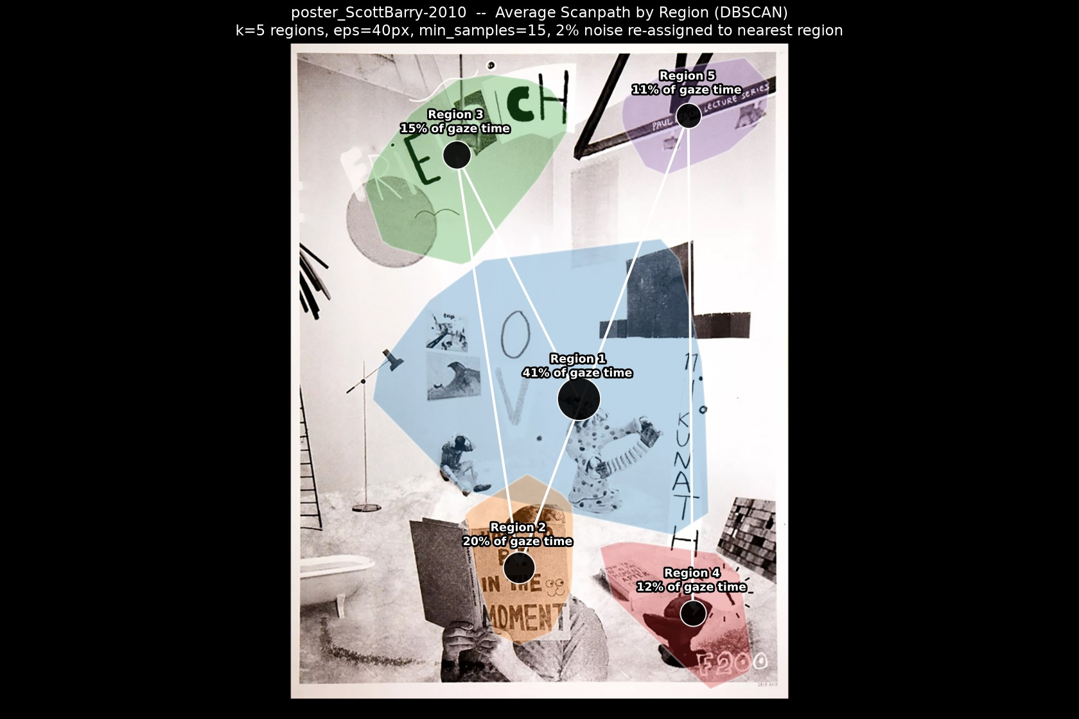
Scott Barry- 2010
Best method: DBSCAN
DBSCAN wins: highest separation score (0.976 after a 2% noise discount), silhouette 0.524, Davies-Bouldin 0.584; Agglomerative scored 0.703 (silhouette 0.521, DB 0.664); Divisive scored 0.000 (silhouette 0.452, DB 0.730).
★ DBSCAN
Agglomerative
Divisive
Path (DBSCAN)
Animation (DBSCAN) — click to play

Slide 16
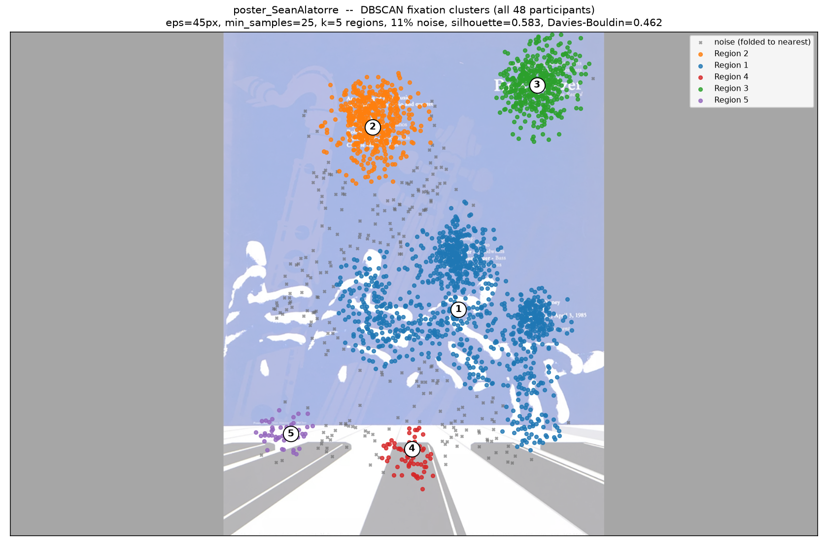
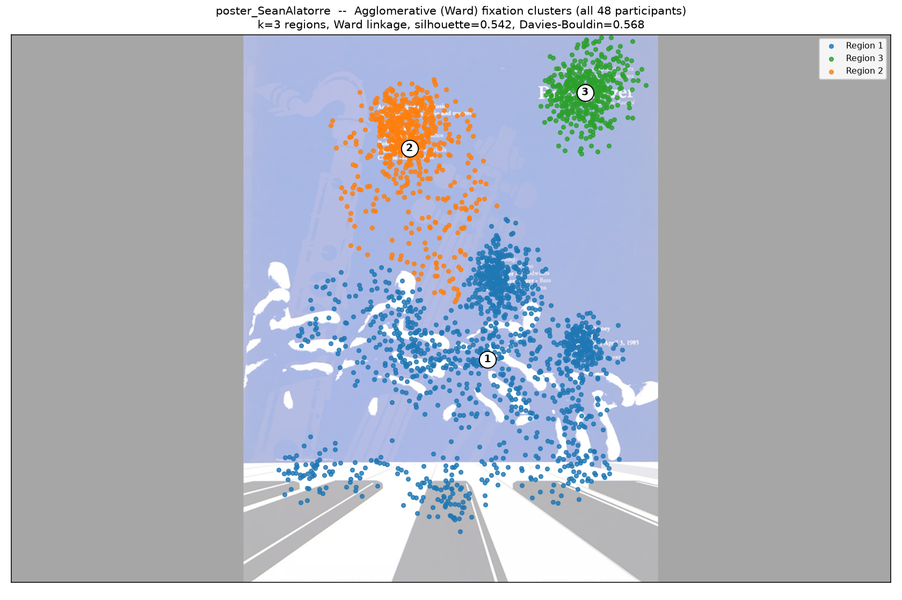


Sean Alatorre
Best method: DBSCAN
DBSCAN wins: highest separation score (0.887 after a 11% noise discount), silhouette 0.583, Davies-Bouldin 0.462; Agglomerative scored 0.343 (silhouette 0.542, DB 0.568); Divisive scored 0.000 (silhouette 0.533, DB 0.671).
★ DBSCAN
Agglomerative
Divisive
Path (DBSCAN)
Animation (DBSCAN) — click to play

Slide 17




bookcover
Best method: Agglomerative
Agglomerative wins: highest separation score (1.000), silhouette 0.473, Davies-Bouldin 0.749; DBSCAN scored 0.000 (silhouette 0.047, DB 1.302, 5% noise); Divisive scored 0.837 (silhouette 0.424, DB 0.865).
DBSCAN
★ Agglomerative
Divisive
Path (Agglomerative)
Animation (Agglomerative) — click to play

Slide 18




nancy poster
Best method: DBSCAN
DBSCAN wins: highest separation score (0.758 after a 24% noise discount), silhouette 0.696, Davies-Bouldin 0.387; Agglomerative scored 0.337 (silhouette 0.588, DB 0.557); Divisive scored 0.000 (silhouette 0.534, DB 0.644).
★ DBSCAN
Agglomerative
Divisive
Path (DBSCAN)
Animation (DBSCAN) — click to play

