Slide 1

DAYLIGHT
Habit Tracking Application
TEAM MEMBERS :
25MVCSMR0022-CHETTE VAISHNAVI
25MVCSMR0009-B.ANJALI
25MVCSMR0078-S.BHARGAVI
25MVCSMR0061-METTU THARANYA
DOMAIN Personal productivity · Wellness
MERN STACK · HABITS · PROGRESS
01 / 07

Slide 2
02 / THE CHALLENGE
2 / 7
Good intentions are easy. Consistency is hard.
People want healthier routines, but everyday progress is easy to lose track of.
1
2
3
When habits live in memory or scattered notes, it is difficult to see patterns, keep targets, or know whether a routine is working.
START
STICK WITH IT
SEE PROGRESS
Choose a realistic habit
Record it day by day
Review completion over time
WHY IT MATTERS
REAL-WORLD CHALLENGE
BUILD CHALLENGES
Small repeated actions shape long-term wellbeing.
A useful tracker must make daily logging quick and progress easy to understand.
Model habits, targets, dates, and completion reliably; protect each user’s records; keep the interface simple.
DAYLIGHT • HABIT TRACKING APPLICATION
02
Notes:
The project addresses the gap between setting a goal and maintaining a routine. The challenge is to make repeated logging simple while preserving structured, date-based records for each user.

Slide 3
03 / OUR INNOVATION
3 / 7
A calm, clear view of daily progress
One place to set a habit,
check in, and reflect.
01
Flexible routines
Create habits by category, target, unit, and frequency.
02
Fast daily check-in
Daylight combines an approachable daily dashboard with structured habit records and account-based history.
Mark today complete with a single action.
03
Useful feedback
See weekly completion, progress, and streak summaries.
04
Private accounts
Unique approach Progress feels supportive, not punitive.
JWT sign-in keeps habit records scoped to each user.
DAYLIGHT • HABIT TRACKING APPLICATION
03
Notes:
Daylight focuses on a low-friction daily loop: define a habit, log it, and see a compact view of progress. The visual tone is intentionally calm. The working project includes account authentication, habit CRUD endpoints, and date-based completion records.

Slide 4
04 / HOW IT WORKS
4 / 7
From a small promise to a visible result
01
02
03
04
INPUT
PROCESSING
ALGORITHM
OUTPUT
Habit name
Target · frequency
Category
React form
REST request
JWT identifies user
Validate fields
Match habit + date
Save completion count
Today’s status
Weekly progress
Insights view
USER JOURNEY
Create an account → add a habit → check in each day → review progress → adjust the routine
MongoDB stores user, habit, and completion records. The dashboard refreshes from the API after each saved action.
DAYLIGHT • HABIT TRACKING APPLICATION
04
Notes:
The client sends authenticated REST requests to Express. The backend validates each write, checks ownership, and stores a completion keyed by habit and date. The React view then refreshes its progress summary.

Slide 5
05 / TECHNOLOGY & ALGORITHM
5 / 7
A MERN foundation with date-based tracking
TECHNOLOGY STACK
COMPLETION LOGIC
M
MongoDB
Progress = habits meeting target ÷ active habits
Users · habits · daily completions
Express.js
A completion is stored for one habit and one calendar date. The unique (habit, date) index supports safe updates.
E
REST endpoints and request validation
R
React.js
COMPLEXITY
Responsive dashboard and user flows
Daily summary: O(H) · H = active habits
N
Node.js
Indexed completion lookup/update: O(log C) expected
API runtime, JWT, password hashing
History requests are capped at 500 records to keep the weekly view bounded.
DAYLIGHT • HABIT TRACKING APPLICATION
05
Notes:
The dashboard computes a completion percentage by counting habits whose saved daily count meets the target. H is the number of active habits. MongoDB uses a unique compound index on habit and date, so a daily completion can be upserted rather than duplicated. B-tree lookup/update is expected O(log C), where C is the indexed completion collection size. The current API limits returned history to 500 rows.

Slide 6
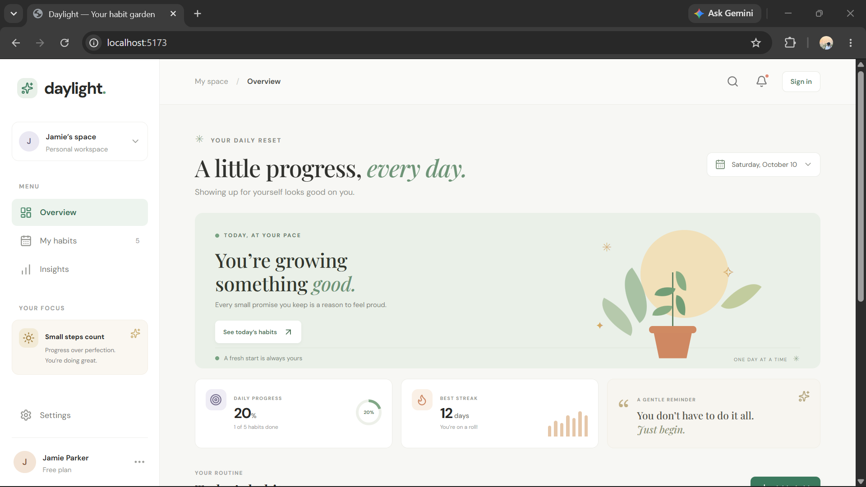
06 / DEMO & IMPACT
6 / 7
A quick check-in, a clearer picture
✳ daylight
WHAT THE DEMO SHOWS
My space / Overview
A little progress, every day.
01
See today at a glance
MENU
Completion status and targets are visible beside each habit.
▦
Overview
Showing up for yourself looks good on you.
▤
My habits
TODAY, AT YOUR PACE
▥
Insights
You’re growing something good.
02
Manage the routine
Create, edit, archive, and delete habits from the interface.
Every small promise is a reason to feel proud.
DAILY PROGRESS
BEST STREAK
03
Keep progress personal
20%
1 of 5 done
12
days
Sign-in and per-user records support private tracking.
TODAY’S HABITS
Water · Wellness
5 / 8
Read · Learning
Done
Practical benefit: less guesswork, more follow-through.
Move · Fitness
Not yet
Illustrative app preview · progress figures use sample data, not measured user results
DAYLIGHT • HABIT TRACKING APPLICATION
06

Slide 7
07 / FUTURE VISION
7 / 7
A stronger routine, one release at a time
BUILT TODAY
NEXT STEPS
MERN dashboard and REST API
01
More complete streak and trend analytics
Account registration and sign-in
02
Scheduled reminders and weekly summaries
Habit and completion CRUD
03
Cloud deployment, backups, and monitoring
Insights and account preferences
04
Shared challenges for groups or teams
Small habits become meaningful when progress is easy to see.
Q & A
DAYLIGHT · THANK YOU
DAYLIGHT • HABIT TRACKING APPLICATION
07

