Slide 1

01 / PROJECT INTRODUCTION
ONE ELEVATOR / MULTIPLE HALL CALLS
F15
CALL
Smart Elevator
Scheduler
F12
CALL
F8
CALL
An explainable simulator that compares nearest-call greedy scheduling with a priority queue.
F6
CALL
PROBLEM DOMAIN
F3
CALL
Smart buildings · DAA scheduling
F1
LIFT · F1
TEAM MEMBERS
Chette Vaishnavi – 25MVCSMR0022
Banagari Anjali -25MVCSMR0009
S.Bhargavi-25MVCSMR0078
M. Tharanya – 25MVCSMR0061
Calls arrive over time. The scheduler chooses the next pickup.
SMART ELEVATOR SCHEDULER / HACKATHON PROTOTYPE
01 / 07
Notes:
Introduce the single-elevator scheduling problem. Team member names are intentionally left as an editable placeholder because none were provided.

Slide 2
02 / THE CHALLENGE
The Challenge
One car.
Many requests.
One next-stop decision.
01
Why it matters
Long or uneven waits affect passenger experience and building flow.
02
Calls arrive over time
A request may appear while the elevator is already serving another floor.
A pickup changes the elevator’s position and the wait of every call still in the queue.
03
Trade-offs are real
Nearest-first can shorten the next trip; urgency-first can protect priority calls.
04
The hard part
Choose a clear rule, measure its effect, and explain the selected order.
SMART ELEVATOR SCHEDULER / HACKATHON PROTOTYPE
02 / 07
Notes:
Frame the objective as understandable scheduling, not a claim that one strategy always wins. The simulation models one elevator and pickup calls; it does not model passenger drop-offs.

Slide 3
03 / OUR INNOVATION
Our Innovation
Two scheduling rules. One transparent comparison.
NEAREST-CALL GREEDY
PRIORITY QUEUE
Choose the closest
available call
Serve the most urgent
ready request
Local rule: minimize the next pickup distance.
Tie-break: earlier release, then call ID.
Queue order: priority 5 → 1, oldest call,
nearest floor, then call ID.
WHAT THE USER SEES
Pickup order · arrival time · wait per call · average and maximum wait · travel time · reason for each choice
SMART ELEVATOR SCHEDULER / HACKATHON PROTOTYPE
03 / 07
Notes:
The priority queue is rebuilt from calls currently released at each decision. The distance tie-break changes as the elevator moves, so the queue is recalculated before each selection.

Slide 4
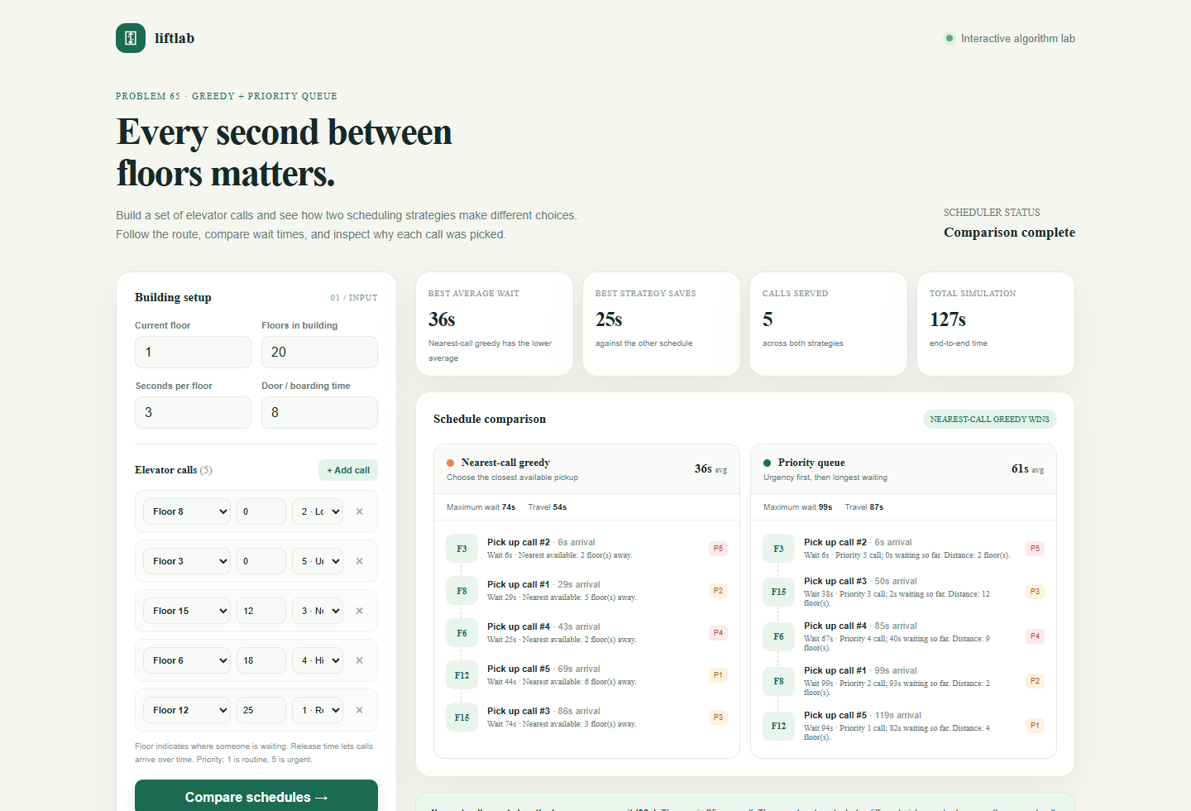
04 / HOW IT WORKS
How It Works
From editable calls to an explainable schedule
LIVE PROTOTYPE / DEFAULT 5-CALL SAMPLE
Input
Building settings +
floor, release time
and priority per call
01
Validate
Check ranges and
which calls are ready
02
Schedule
Run both rules on
the same call set
03
Explain
Show stop order,
waits and route cost
04
Input → compare both schedules → inspect each pickup and its wait
SMART ELEVATOR SCHEDULER / HACKATHON PROTOTYPE
04 / 07
Notes:
The screenshot is from the working prototype’s local Flask app using the included deterministic five-call sample. Both algorithms receive identical inputs. The app is a simulation and not a live building-control system.

Slide 5
05 / TECHNOLOGY & ALGORITHM
Technology & Algorithm
Python + Flask API · HTML / CSS / JavaScript interface
GREEDY
PRIORITY QUEUE / heapq
Nearest available call
Priority first, distance breaks ties
At each stop, scan released requests and pick the floor with the smallest distance.
Heap key: (−priority, release time, floor distance, call ID). Higher priority is selected first.
Time: O(n²) total · Space: O(n)
Time: O(n²) worst case · Space: O(n)
WHY REBUILD THE HEAP?
The set of ready calls and the elevator’s floor can change at every decision. The prototype rebuilds the heap so its distance tie-break stays current.
Complexity is for this prototype’s repeated selection process; a persistent indexed queue could change the trade-off.
SMART ELEVATOR SCHEDULER / HACKATHON PROTOTYPE
05 / 07
Notes:
The implementation scans remaining calls and constructs a heap at each stop. In the worst case, those repeated O(k) scans and heap builds sum to O(n²). The priority queue uses O(n) auxiliary space.

Slide 6
06 / DEMO & IMPACT
Demo & Impact
Sample run / 5 calls · start F1 · 3 sec per floor · 8 sec boarding
AVERAGE WAIT / SECONDS
PICKUP ORDER
Greedy
F3 → F8 → F6 → F12 → F15
Priority queue
F3 → F15 → F6 → F8 → F12
In this sample, nearest-call greedy averages 25.2 seconds less wait per call.
MAX WAIT
TRAVEL TIME
Greedy 74s · Priority 99s
Greedy 54s · Priority 87s
Illustrative model: one elevator, pickups only; drop-offs and real traffic are not modeled.
SMART ELEVATOR SCHEDULER / HACKATHON PROTOTYPE
06 / 07
Notes:
Results come from the prototype’s deterministic sample: calls at F8/P2/t0, F3/P5/t0, F15/P3/t12, F6/P4/t18, F12/P1/t25. Starting floor F1; 3 seconds per floor; 8 seconds boarding after each pickup. Greedy waits: 6, 29, 25, 44, 74 seconds (average 35.6; max 74). Priority waits: 6, 38, 67, 99, 94 seconds (average 60.8; max 99). Travel totals are 54 and 87 seconds. This is one sample, not a general guarantee.

Slide 7
User interface of prototype:

Slide 8
07 / FUTURE VISION
Future Vision
CURRENT ACHIEVEMENT
NEXT IMPROVEMENTS
A working, explainable comparison for one elevator and time-stamped hall calls.
01
Fairness
Age waiting calls so routine riders cannot be postponed indefinitely.
The interface exposes the visit order, waits, travel cost and choice rule.
02
Multiple cars
Assign requests across elevators and compare zone or nearest-car policies.
PRACTICAL BENEFITS
Compare average and worst waits before choosing a policy.
Use editable calls for quick what-if planning or teaching.
03
Real traffic
Add passenger destinations, peak demand and replayable building data.
See why urgency can trade shorter trips for longer routine waits.
FINAL TAKEAWAY
Make the scheduling rule visible. Measure who waits, and choose the trade-off that fits the building.
THANK YOU
Q&A
SMART ELEVATOR SCHEDULER / HACKATHON PROTOTYPE
07 / 07
Notes:
Practical benefits are prototype use cases: compare the measured wait trade-off for a chosen call set, explore scenarios, and explain the policy to learners or building planners. The simulator is not validated for dispatching real elevators. Future versions should model drop-offs, multiple cars, and fairness rules before claiming real-world performance.

