Slide 1

CMR COLLEGE OF ENGINEERING & TECHNOLOGY
Kandlakoya, Medchal, Hyderabad - 501401
Department of Computer Science and Engineering-(AI&ML)
Career Guidance System For Students Using Machine Learning
Batch No.:
D-CSM-2
Name of the student:
A. Yuva Venkat – 22H51A6603
P. Jayanth Kumar – 22H55A6645
G. Vaishnavi – 23H55A6609
Under esteemed guidance of
Mrs. K. Anusha
Batch: 2022-2026 Major Project –I(A466803)/(A473803)

Slide 2
Outline
Introduction
Problem statement
Research objectives
Proposed system
Methodology
Results and Discussions
Conclusion
References
Notes:
2

Slide 3
INTRODUCTION
Notes:
3

Slide 4
Introduction
Title: Career Guidance System for Students Using Machine Learning
Explanation: This project aims to develop an AI-based platform that assists students in selecting the most appropriate career path by analyzing their academic performance, skills, and interests. Machine Learning algorithms are used to predict and recommend careers suited to each individual, reducing confusion and helping students make informed choices.
Notes:
4

Slide 5
Problem Statement
Notes:
5

Slide 6
Problem Statement
Many students face difficulty in choosing the right career path after completing their education due to:
Lack of proper guidance or expert counselors.
Decisions influenced by parents or peers rather than aptitude.
Manual counseling being time-consuming and inconsistent.
Hence, there is a need for an intelligent and automated system that can accurately guide students toward the most suitable career based on data analysis and prediction.
Notes:
6

Slide 7
Research Objectives
Notes:
7

Slide 8
Research Objectives
The objectives of this project are:
To develop a machine learning-based model that predicts career options for students.
To analyze student data (marks, skills, interests) for better accuracy.
To design a web interface for easy user interaction.
To provide personalized and data-driven career guidance.
To improve accuracy, reduce human bias, and make counseling more accessible.

Slide 9
Proposed System
Notes:
9

Slide 10
Proposed System
Title: Career Guidance System For Students Using ML
Proposed Idea: The proposed idea is to develop an AI-Based Career Guidance System that helps students make informed career decisions using machine learning techniques. The system analyzes a student’s academic performance, aptitude, skills, interests, and personality traits to recommend the most suitable career paths.
Features: ✅ Combines academic, skill, and psychometric data ✅ Generates personalized career recommendations ✅ Learns and improves with feedback

Slide 11
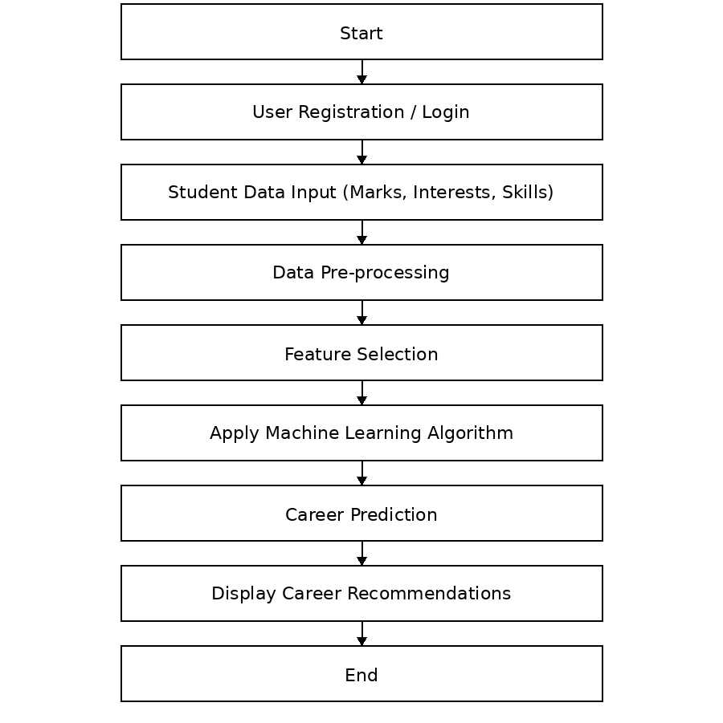
Methodology

Slide 12
Methodology
Step 1: User Registration & Login
Students create an account or log in to the system.
Basic details such as name, age, education level, interests, and academic background are collected.
Step 2: Data Collection
The system collects:
Academic scores
Interest and aptitude responses (questionnaire/test)
Skills and preferences
This data acts as input features for the machine learning model.
Step 3: Data Pre-processing
Raw user data is cleaned and formatted.
Operations include:
Handling missing values
Encoding categorical data
Normalization/scaling of numerical values

Slide 13
Methodology
Step 4: Feature Extraction
Important attributes (marks, interests, skills) are selected.
Irrelevant or redundant data is removed to improve accuracy.
Step 5: Machine Learning Model Execution
Preprocessed data is fed into the trained ML model.
Algorithms analyze patterns and similarities with past datasets.
The model predicts suitable career domains.
Step 6: Career Recommendation Generation
Based on model output, the system recommends:
Career paths
Required skills
Courses and learning resources

Slide 14
Methodology
Step 7: Result Display & Guidance
Results are displayed through a user-friendly interface.
Students receive personalized career guidance instantly.

Slide 15
Result & Discussion
Trained on a 1000-record dataset using an 80:20 split
Implemented Decision Tree, Random Forest, KNN, and Naïve Bayes
Decision Tree performed best and was selected
System generated personalized career recommendations
ML-based approach reduced bias and improved scalability

Slide 16
Conclusion
Notes:
16

Slide 17
Conclusion
The AI-Based Career Guidance System uses machine learning to analyze student data and provide personalized career recommendations. It reduces human bias, saves time, and offers scalable guidance through a web-based platform. The project demonstrates that AI can effectively support students in making informed career decisions.

Slide 18
References
Notes:
18

Slide 19
References
Career_guidance_system_for_students_using_machine_.pdf - Google Drive
https://files.eric.ed.gov/fulltext/EJ1318705.pdf
https://ijarsct.co.in/Paper17841.pdf
https://www.irjmets.com/uploadedfiles/paper/issue_3_march_2022/20476/final/fin_irjmets1649056741.pdf
https://ijarsct.co.in/Paper23904.pdf

Slide 20
Thank You!

