Slide 1
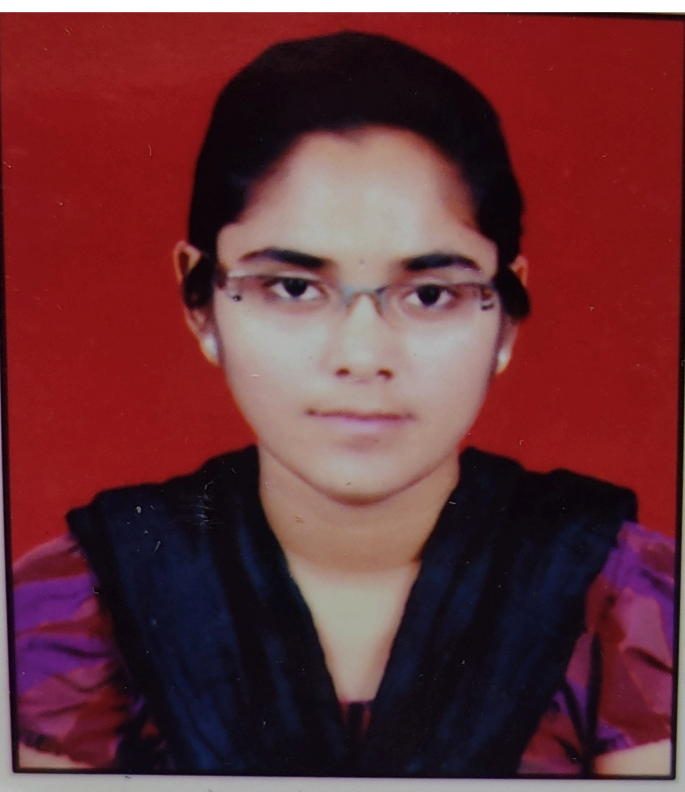
Godse Vaishnavi Dipak
B.Tech in electronics and telecommunication engineering: 2016-2019
Analyst/Software Engineer
Skills C#
Asp.net
Core Mvc
Web Api
SQL
Database
SQL database – MySQL
Web Technologies
HTML
Add-ons
GitHub
Postman
Additional Details
Leadership
Excellent Communication Skills
Team management
Quick Learner
Mumbai
VAISHNAVI-DIPAK.GODSE@CAPGEMINI.COM
8766515475
A4
A self-driven learner eager to work in a team of dedicated people and serve a key role in the enhancement and development of the project.
A team player with good communication skills always ready to work for the enrichment of knowledge.
Proficient in C# and OOPs concepts.
Hands on experience in creating Web Application with Asp.net and Mvc Core.
Hands on experience in developing web pages using HTML5,Asp.net, Object Oriented Programming.
Experience in creating documentation with swagger.
Employee Leave Management System
Completed end to end case study of Employee Leave Management System along with Swagger, Fiddler testing using Core Mvc, Web Api and SqlServer
Trained on Dot Net, SQL Server, Ado.net, Core Mvc, Core Web API, Entity Framework.

