Slide 1
Pizzaz
HOUSE
@Vaishnavikanase

Slide 2

PROJECT OVERVIEW
The Pizza Sales Analysis project leverages SQL to explore sales patterns, customer preferences, and business performance of a pizza house. Basic analysis includes calculating total orders, revenue, identifying the highest-priced pizza, the most common pizza size, and the top 5 most ordered pizza types. Intermediate analysis involves joining tables to find total quantities of each pizza category, distribution of orders by hour, category-wise pizza distribution, daily average orders, and top 3 pizza types of revenue. Advanced analysis calculates each pizza types’s revenue contribution, cumulative revenue over time, and top 3 pizza types by revenue within each category. These insights guide strategic decisions to optimize operations and boost profitability.

Slide 3

Analysis Questions
1.Retrive the total number of orders placed.
2. Calculate the total revenue generated from pizza sales.
3. Identify the highest-priced pizza.
4. Identify the most common pizza size ordered.
5. List the top 5 most ordered pizza types along with their quantities.
6. Join the necessary tables to find the total quantity of each pizza category ordered.
7. Determine the distribution of orders by hour of the day.
8. find the category-wise distribution of pizzas.
9. Group the orders by date and calculate the average number of pizzas ordered per day.
10. Determine the top 3 most ordered pizza types based on revenue.
11. Analyze the cumulative revenue generated over time.
12. Determine the top 3 most ordered pizza types based on revenue for each pizza category.

Slide 4
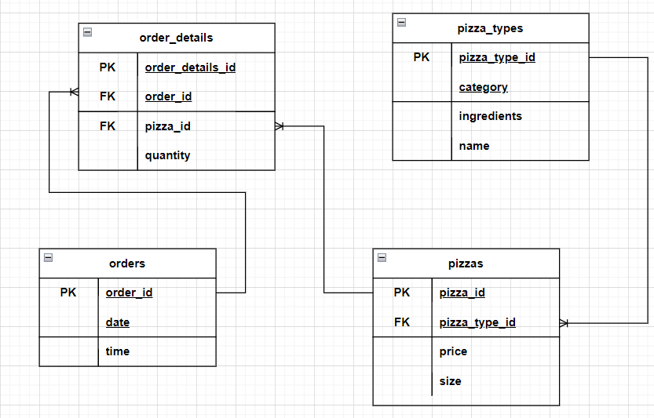
Schema
Entity Relationship Diagram

Slide 5
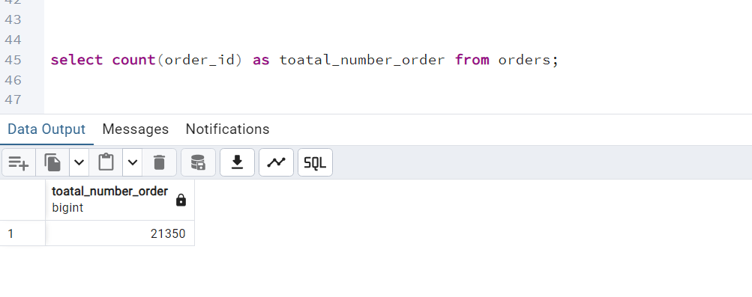
1.Retrive the total number of order placed

Slide 6
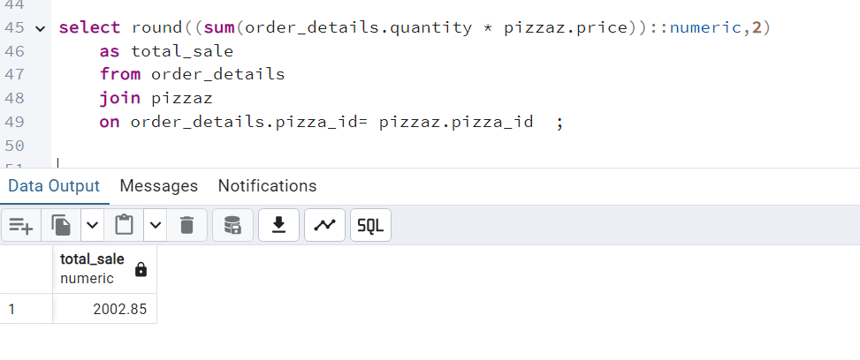
2.Calculate the total revenue generated by pizza sale.

Slide 7
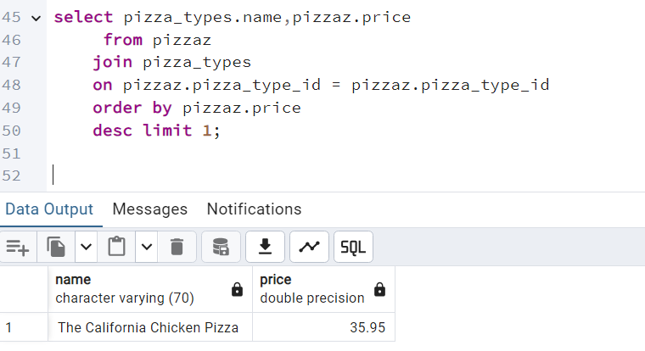
3. Identify the highest-priced pizza

Slide 8
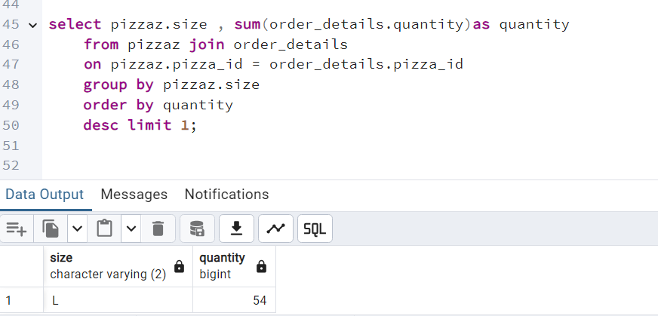
4.Identify the most common sized pizza ordered.

Slide 9
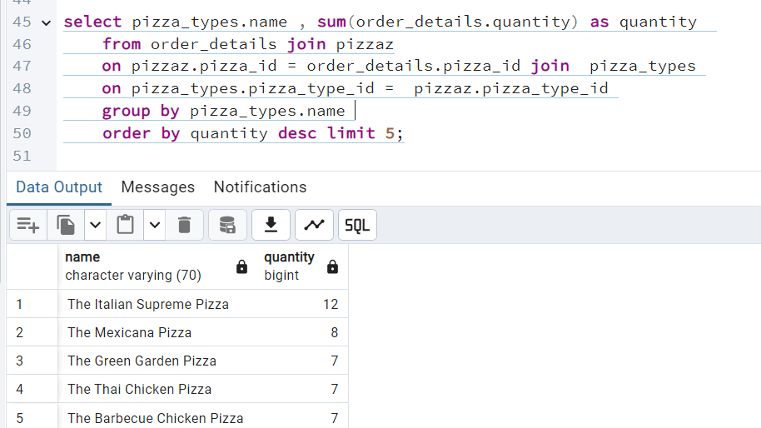
5.List the 5 most pizza ordered pizza types along with their quantities.

Slide 10
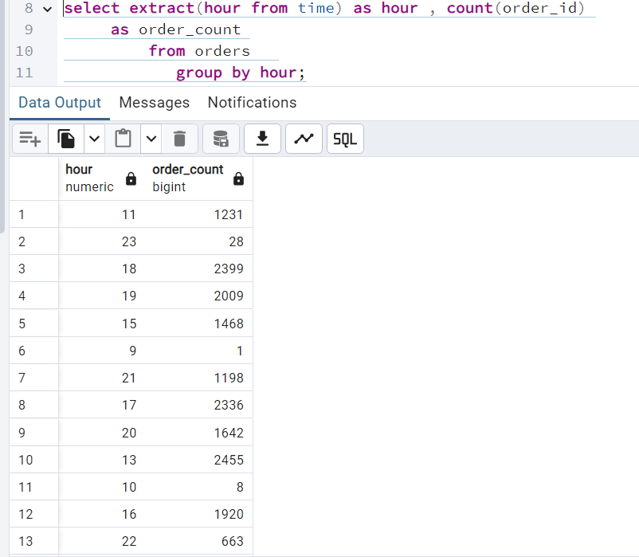
6.Determine the distribution of order by hour per day.

Slide 11
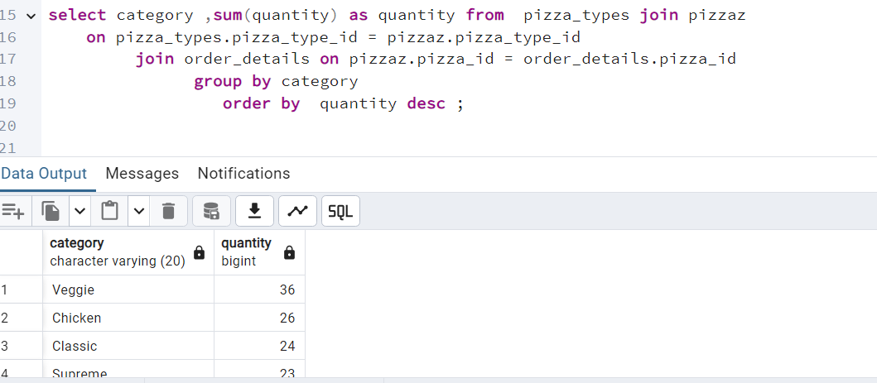
7.Find the total quantity of each pizza category ordered.

Slide 12
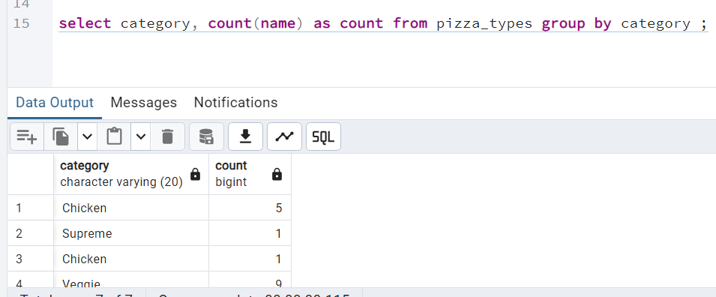
8 . find the category-wise distribution of pizzas.

Slide 13
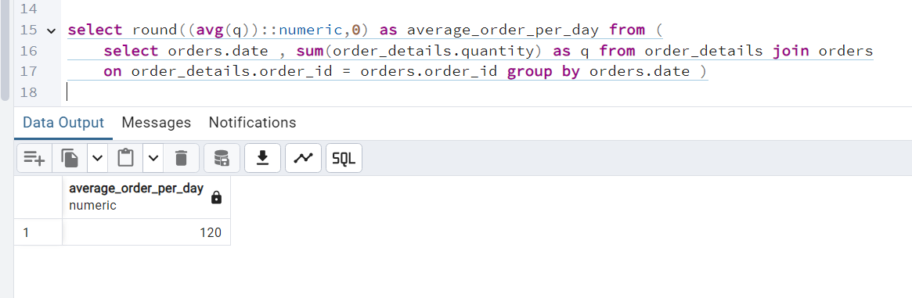
9.Group the orders by date and calculate the average number of pizzas ordered per day.

Slide 14
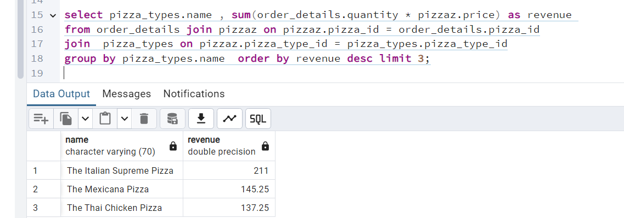
10. Determine the top 3 most ordered pizza types based on revenue.

Slide 15
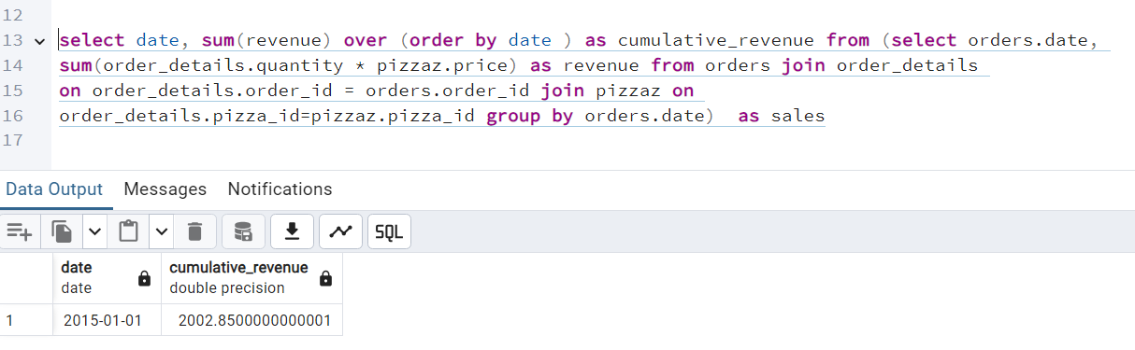
11. Analyze the cumulative revenue generated over time.

Slide 16
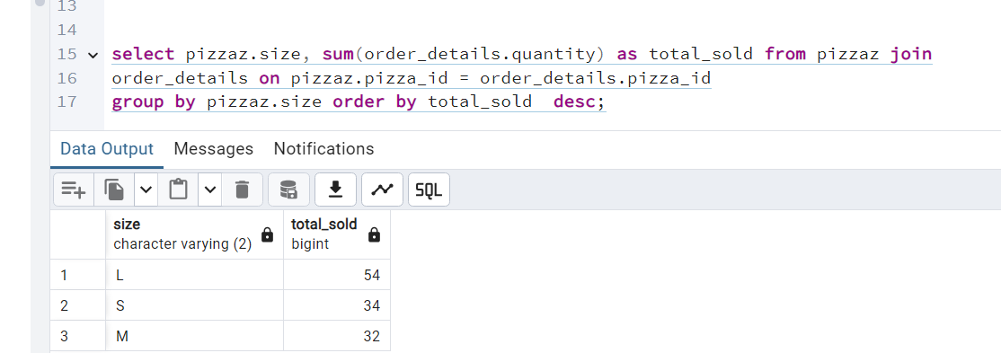
12. Determine the top 3 most ordered pizza types based on revenue for each pizza category.

Slide 17

Thank
YOU!

