Slide 1

Prostate Cancer Identification Survival Analysis
Vaishnavii Paramashivam

Slide 2
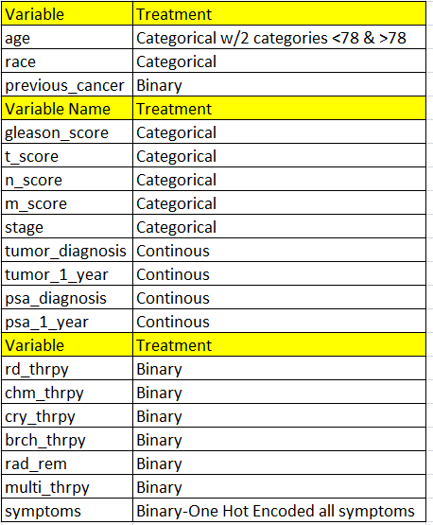
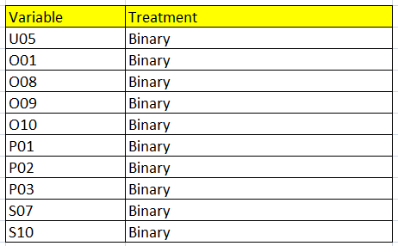
Introduction
Goal : To determine the 7-year survival rate of prostate cancer patients
The variables were transformed & Bi-Variate Analysis – Chi-Square test and t-tests were performed on categorical and continuous independent variables respectively and the statistically significant variables were chosen.

Slide 3
Conceptual Model
Post univariate & bi-variate analysis the below variables were identified as potential risk factors and were split into following four buckets
Patient History
Symptoms
Diagnosis
Treatment
-Race
-Age
-Previous Cancer
-U05
-O01
-O08
-O09
-O10
-P01
-P02
-P03
-S07
-S10
-Stage
-Initial Tumour Size
-Radio Therapy
-Surgical Removal
-Crypo Therapy
-Chemo Therapy
-Hormone Therapy
-Brachy Therapy

Slide 4
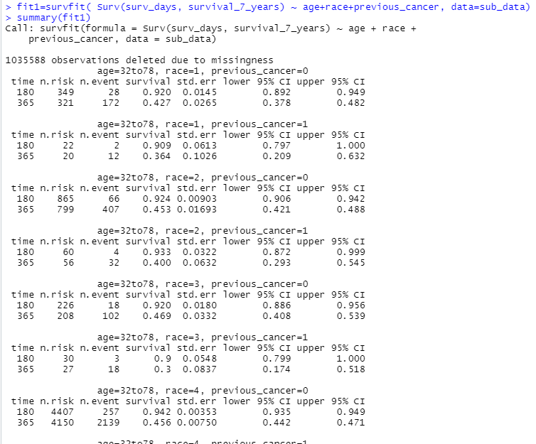
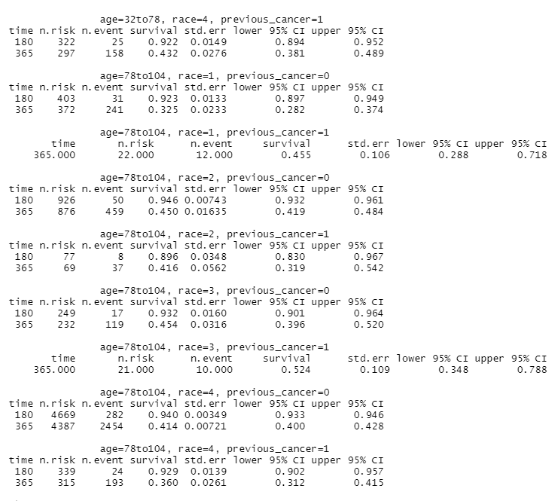

Survival Analysis – Patient History
The Survival Analysis was performed for the Patient History Bucket and it can be seen that
For the first year of diagnosis,8 people aged between 78 to 104,belonging to race 2 & having previous cancer history has the survival rate of 89.6% ,typically in the 95% confidence interval (0.830,0.967) and one year after diagnosis 37 people under the same category has the survival rate of 41.6%, typically in the 95% confidence interval (0.319,0.542)

Slide 5
Survival Analysis – Symptoms
The Survival Analysis was performed for the Symptoms Bucket and it can be seen that
For the first year of diagnosis,1 person having the symptoms U05 and S07 has a survival rate of 90% ,typically in the 95% confidence interval (0.754,1) whereas 1 year after diagnosis 8 people having the same symptoms has a survival rate of 18.2% in the confidence interval (0.0519,0.637)

Slide 6


Survival Analysis – Diagnosis
The Survival Analysis was performed for the Diagnosis Bucket and it can be seen that
For first year of diagnosis, a 12 people with stage 1 cancer and initial tumor size ranging between 31 to 71mm has the survival rate of 96.6%, typically in the 95% confidence interval (0.947, 985) and 1 year after diagnosis, 112 people with same stage and tumour size has a survival rate of 64.8% in the confidence interval (0.600, 0.700)
For first year of diagnosis, 15 people with stage iv cancer and initial tumor size ranging between 79 to 84mm has the survival rate of 88.9% ,typically in the 95% confidence interval (0.837, 0.944) and 1 year after diagnosis, 88 people with same stage and tumour size has a survival rate of 23.7% in the confidence interval (0.175, 0.321)

Slide 7
Survival Analysis – Treatment
The Survival Analysis was performed for the Treatment Bucket and it can be seen that
For first year of diagnosis, 3 people who was in stage IIB and has undergone chemotherapy, radiation therapy and brachy therapy has a survival rate of 96% ,typically in the 95% confidence interval (0.917, 1) whereas 1 year after diagnosis, 47 people who was in stage IIB and has undergone same therapies had a survival rate of 33.3% in the confidence interval (0.242, 0.459)
For first year of diagnosis, 2 people who was in stage IV and has undergone crypotherapy, chemotherapy, surgery and radiation therepy has a survival rate of 71.4% ,typically in the 95% confidence interval (0.4471, 1) whereas 1 year after diagnosis, 4 people who was in stage IV and same therapies had a survival rate of 14.3% in the confidence interval (0.0233, 0.877)

Slide 8
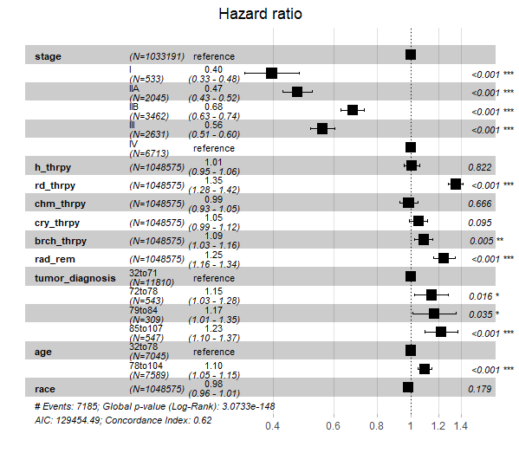
Cox Regression – Hazard Ratio
From the plot,
The hazard ratio for stage 1 cancer when compared to stage 4,decreases by a factor of 0.60
The hazard ratio for people aged between 78to 104 when compared to people between 32 to 78 increases by a factor of 0.10

