Slide 1

DATA GLACIER
G2M Case Study

Slide 2
G2M Case Study
XYZ is a private firm in US. Due to remarkable growth in the Cab Industry in last few years and multiple key players in the market, it is planning for an investment in Cab industry.
The analysis has been divided into 5 types:
Data overview
Data cleaning and Feature Engineering
Statistical Overview and Data Analysis
Inferential Data Analysis
Time Series Analysis

Slide 3
1. Data Overview
In this section, the shape of the Dataset’s i.e., features and entries, missing values(NA or null values), feature datatypes, merging datasets are analysed.
2. Data Cleaning and Feature Engineering
In this section, some features to appropriate datatypes and formats are transformed.

Slide 4
3. Statistical Overview and Data Analysis
Statistics is a branch of mathematics that is concerned with collecting, organizing, and interpreting data to represent specific characteristics.
Statistics is presumed as the science of learning from data, which acts as a measure of attributes of a given sample..
In this section, statinfos , distributions , outliers , boxplots , correlations , covariance and so on of some columns of entire MasterData are analyzed.

Slide 5
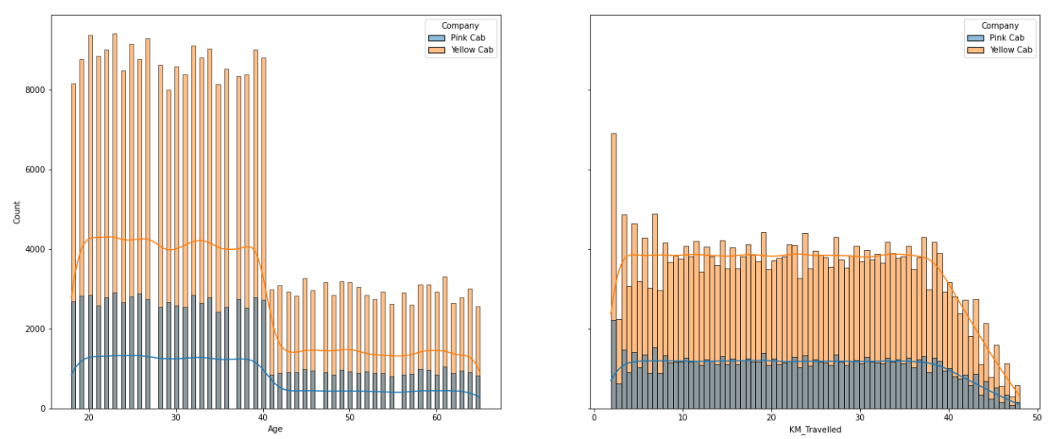
The KDE curves and distribution of plots of selected variables with respect to cab firms are shown:
From the graph, we can observe that “Yellow Cab” has travelled more number of kilometres and used adequately by different age groups when compared with the “Pink Cabs”.

Slide 6
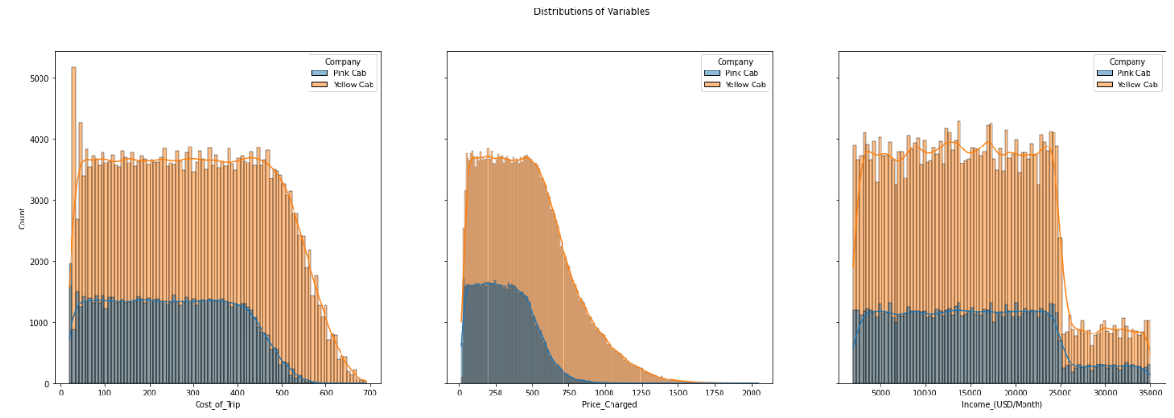
The KDE curves and distribution of plots of selected variables with respect to cab firms are shown:
The various aspects like Cost of Trip, Price Charged, Income(USD_Month) of both “Pink Cab” and “Yellow Cab” are shown here:

Slide 7
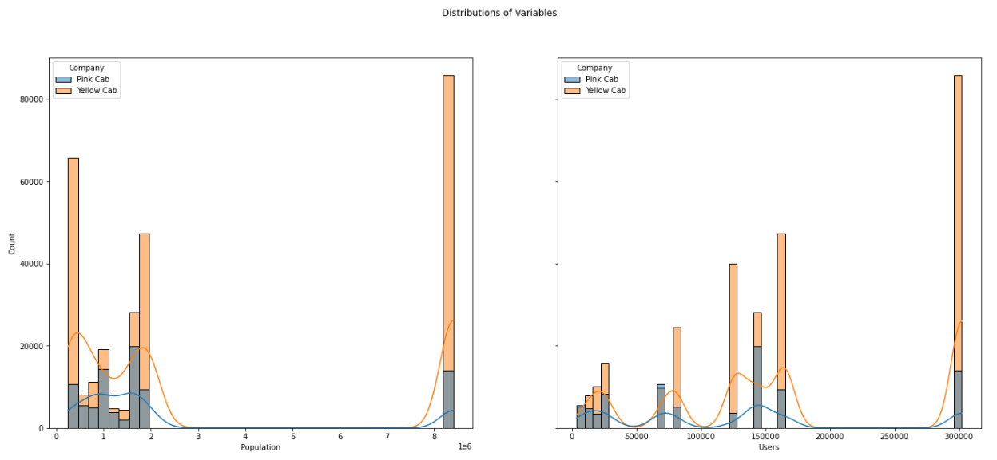
The KDE curves and distribution of plots of selected variables with respect to cab firms are shown:
The various parameters like Population and number of Users of both “Pink Cab” and “Yellow Cab” are shown here:

Slide 8
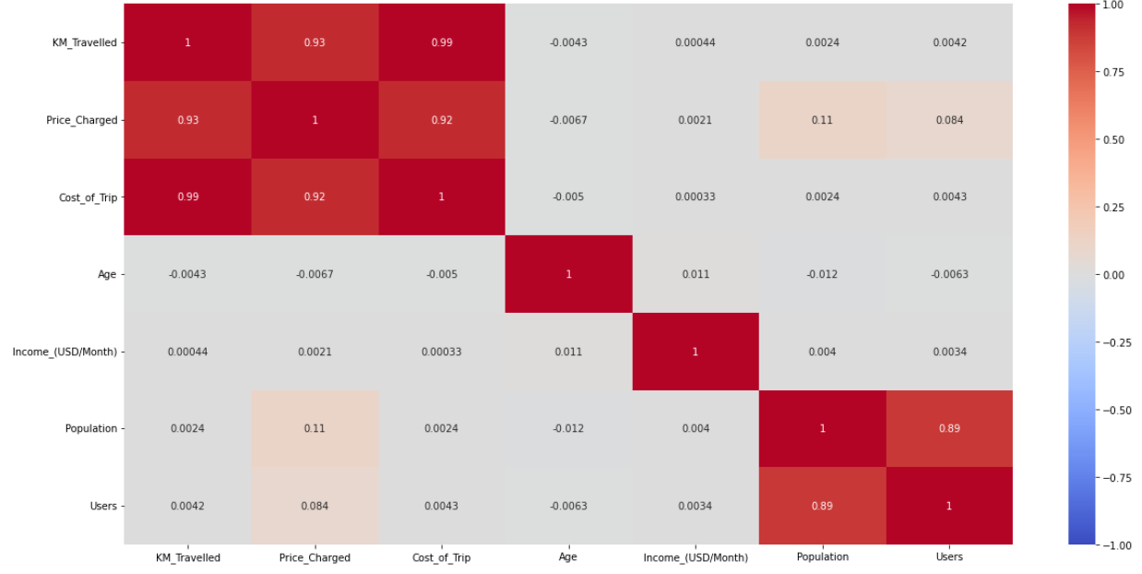
The correlation of MasterData features by heatmap for Pink Cab Firm is visualized here :
The correlation of Master Data features of various aspects like KM_Travelled, Price_Changed, Cost_of_Trip, Age, Income(USD/Month), Population, Users of “Pink Cab Firm” can be seen here.

Slide 9
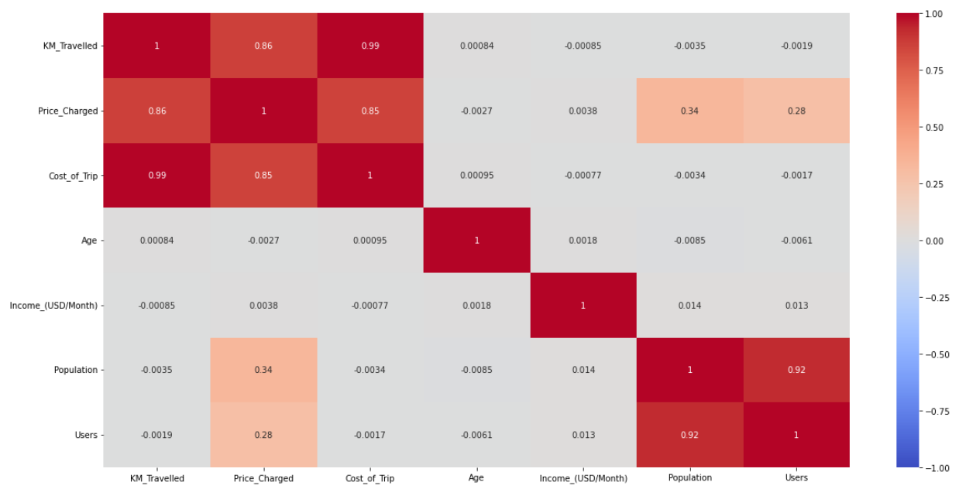
The correlation of MasterData features by heatmap for Yellow Cab Firm is visualized here :
The correlation of Master Data features of various aspects like KM_Travelled, Price_Changed, Cost_of_Trip, Age, Income(USD/Month), Population, Users of “Yellow Cab Firm” can be seen here.

Slide 10
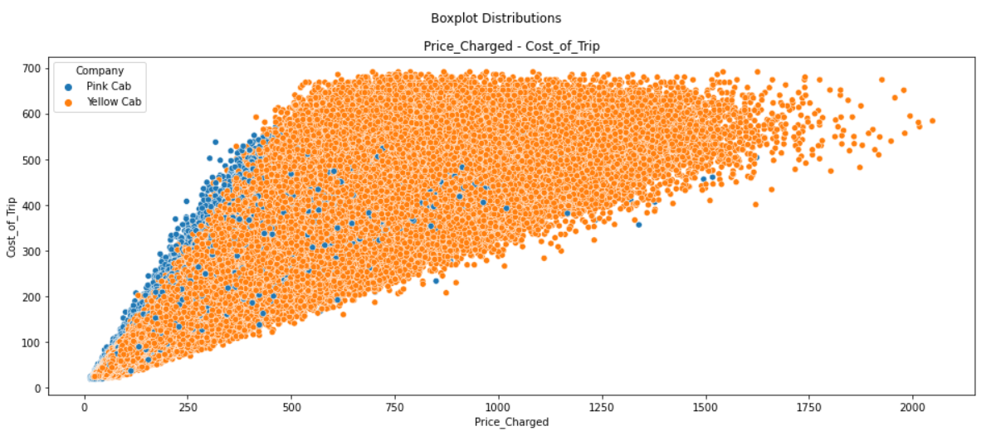
Visualization of scatter plots of MasterData features to see correlations between them if exists:
The relationship between Price Charged and Cost of Trip is shown using scatter plot

Slide 11
4. Inferential Data Analysis
Inferential statistics allow one to draw conclusions or inferences from data.
Usually this analysis, we can derive conclusions about a population on the basis of data describing a sample.
In this section , I analyzed MasterData and some meaningful pieces of MasterData which are extracted from it to make a sensible decision which Cab Firm is most valuable for investing in future times by taking insights and inferences from data analysis and visualizations with different aspects

Slide 12
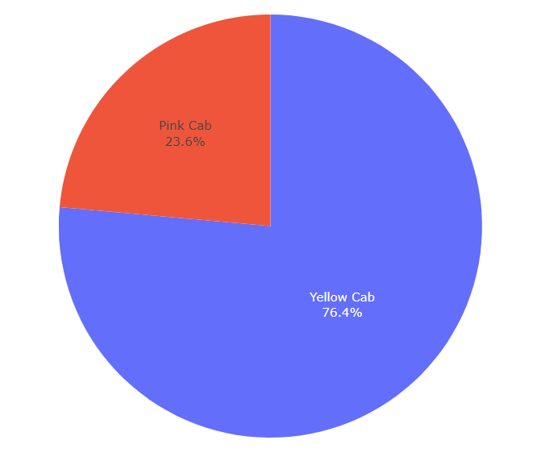
Pink and Yellow Cab total user's overview
As seen from this Pie Chart, The total number of users of Yellow Cab is approximately 3 times that of Pink Cab.

Slide 13
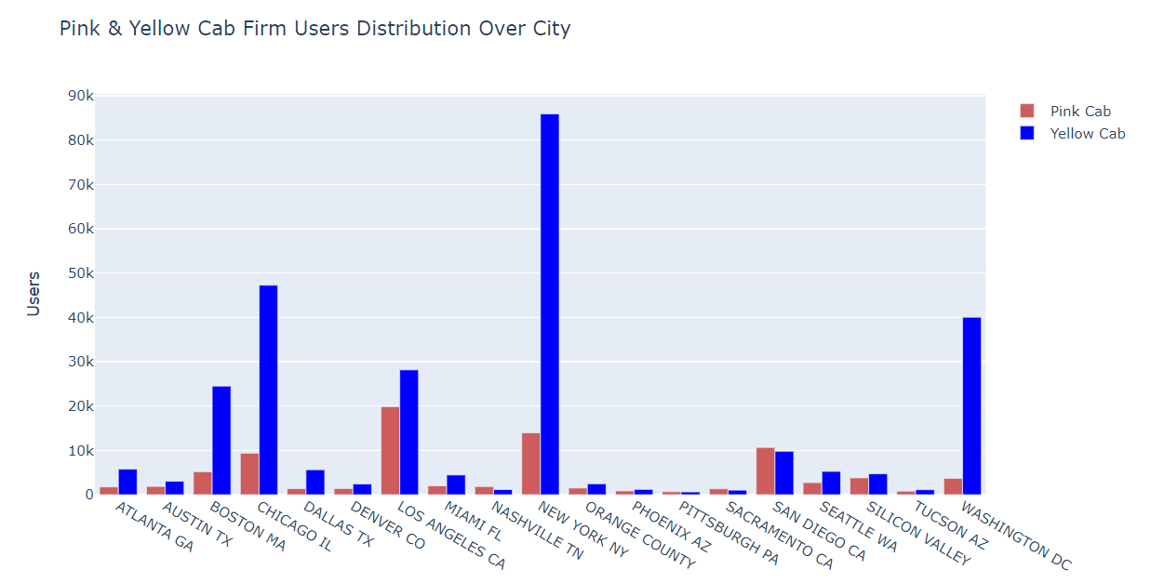
Pink and Yellow Cab Users Distribution over City
As seen from this Bar Chart;
For the Yellow Cab Company, the highest number of users on a city basis are in New York, Washington and Chicago, while for the Pink Cab Company, the most are in Los Angeles, New York and San Diego.

Slide 14
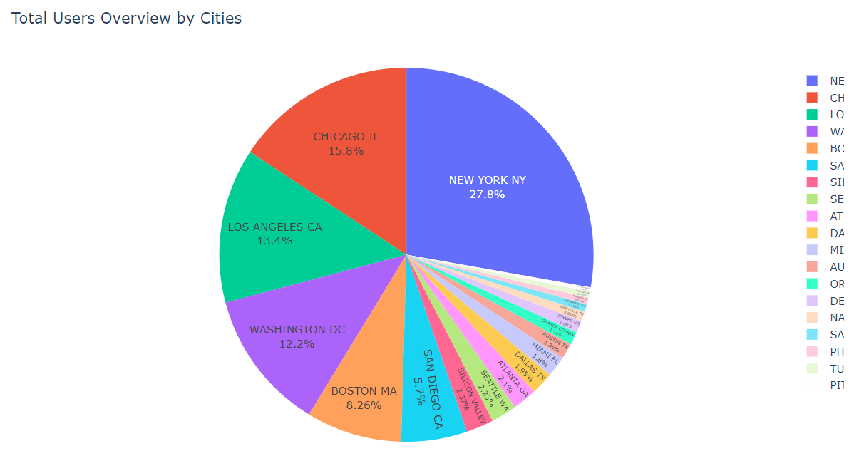
Total Users Overview by City
As seen from this Pie Chart;
Based on cities, the highest number of total users are in New York, Chicago, Los Angeles, Washington and Boston

Slide 15
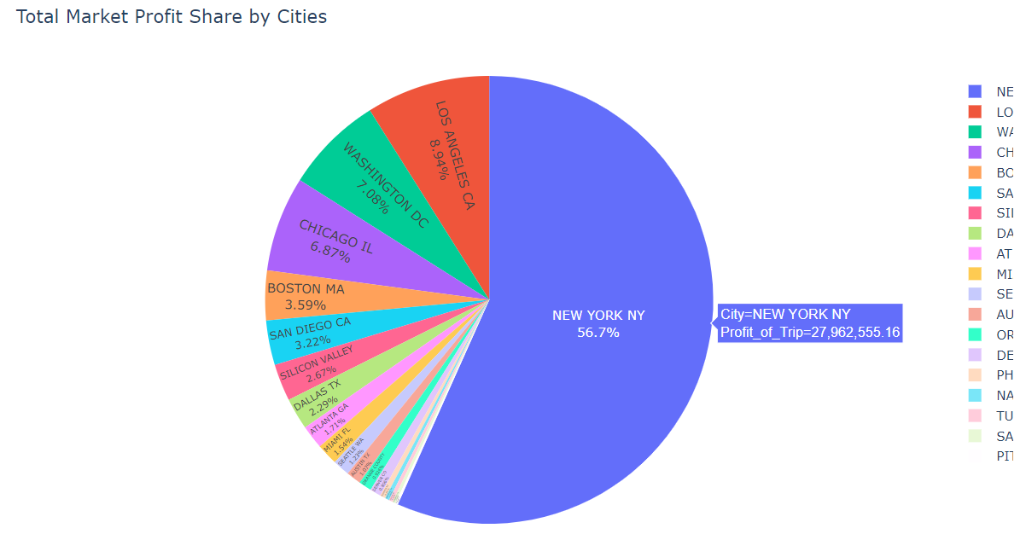
Total Market Profits Shared by Cities
As seen from this Pie Chart;
More than half of the total market profit share on the basis of cities belongs to New York.

Slide 16
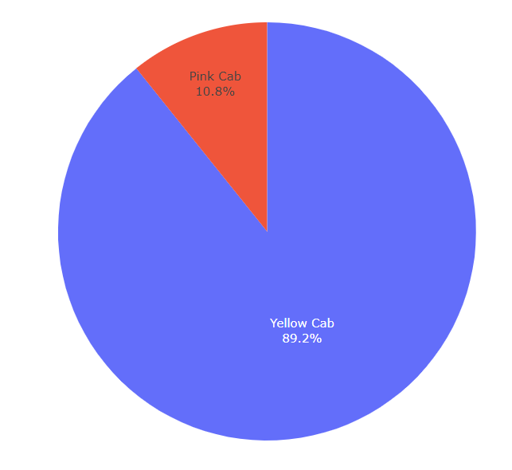
Total Market Profit Share by Cab Firms
As seen from this Pie Chart;
The total market profit share of Yellow Cab is approximately 9 times that of Pink Cab.

Slide 17
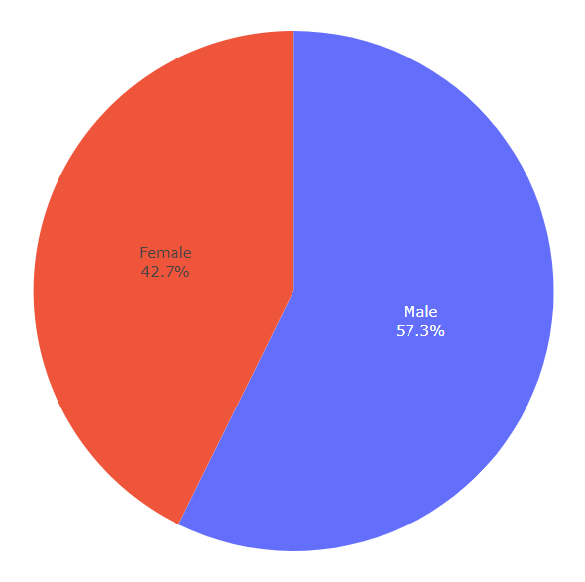
Total Users Overview by Gender
As seen from this Pie Chart;
In the distribution of users by gender, there is an approximate 3 to 2 ratio for men and women.

Slide 18
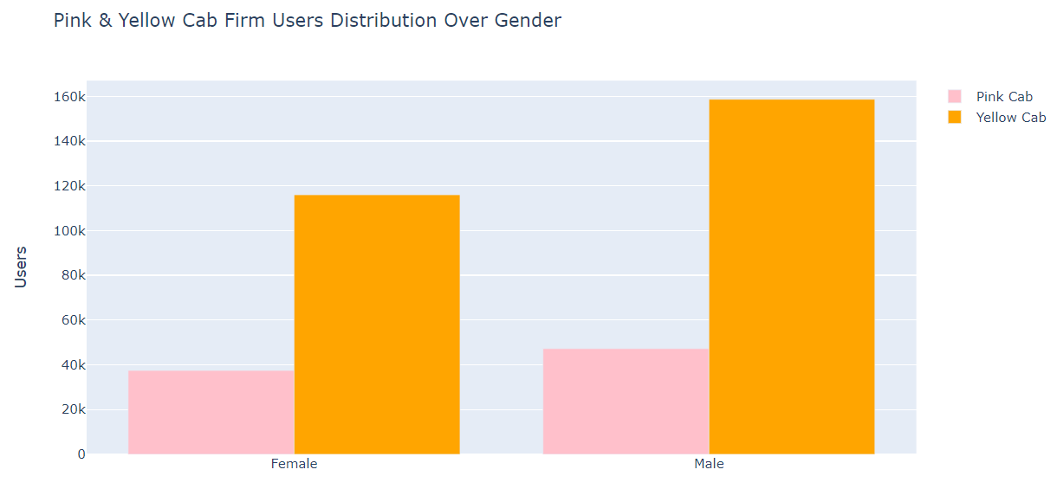
Pink and Yellow Cab Firm Distribution Basing on Gender:
As seen from this Bar Chart;
When the distribution of users by gender is analyzed on a company basis, while the male-female ratio is 57.6% - 42.4% in Yellow Cab Company, the male-female ratio is 55.9% - 44.1% in Pink Cab Company

Slide 19
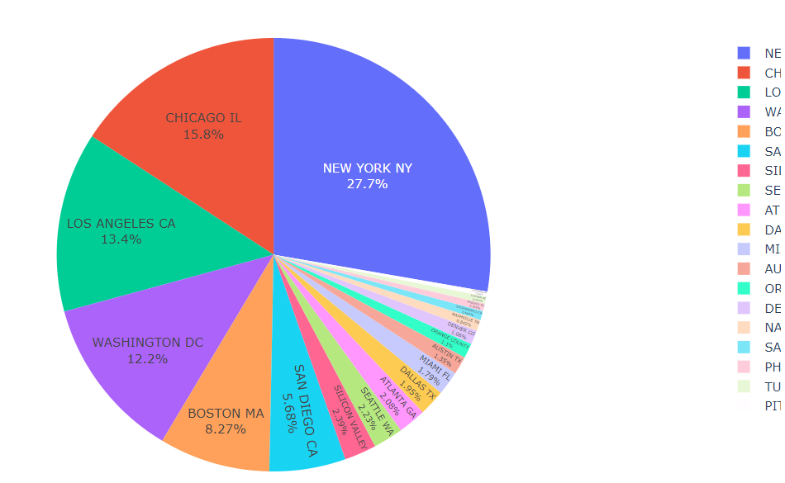
Total KM Travelled by Cities
As seen from this Pie Chart;
On the basis of cities, the most travelled in KM are New York, Chicago, Los Angeles, Washington and Boston.

Slide 20
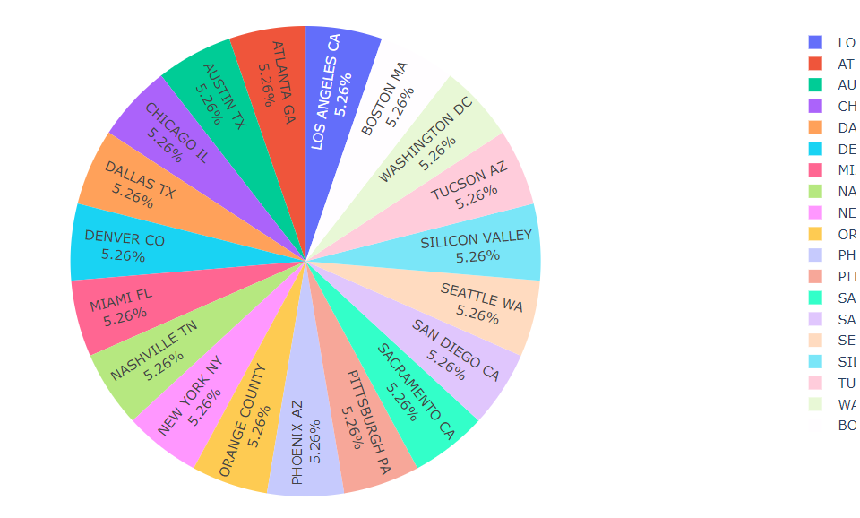
Average Profit per KM Travelled by Cities
As seen from this Pie Chart;
The average profit per travelled in KM by cities is approximately equal.

Slide 21
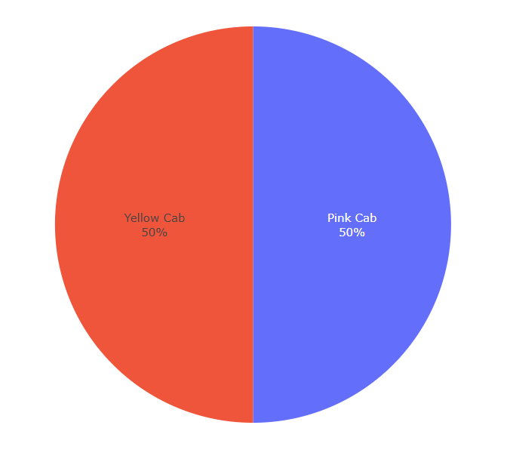
Average Profit per KM Travelled by Cab Firm
As seen from this Pie Chart;
The average profit per travelled in KM by companies is approximately equal.

Slide 22
5. Time Series Analysis
Time series analysis is a specific way of analyzing a sequence of data points collected over an interval of time.
In time series analysis, analysts record data points at consistent intervals over a set period of time rather than just recording the data points intermittently or randomly.

Slide 23
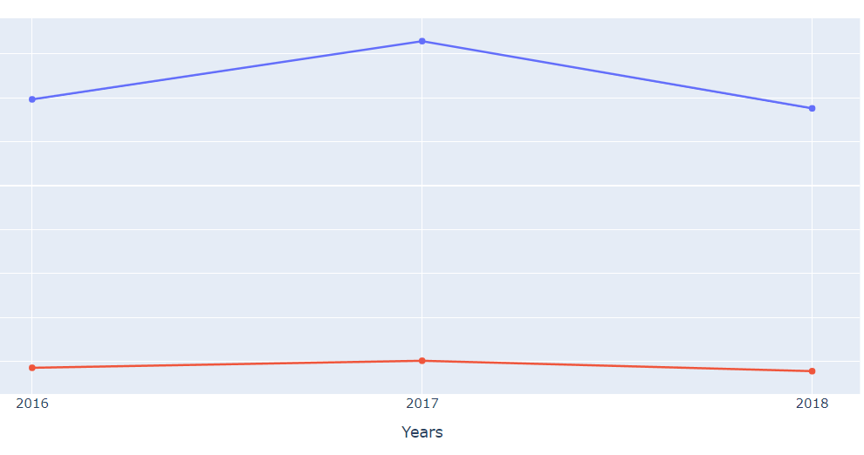
Total Profit Year by Cab Firm
From the pie chart:
In 2016 , The total market profit share of Yellow Cab is approximately 8.15 times that of Pink Cab. In 2017 , The total market profit share of Yellow Cab is approximately 8.16 times that of Pink Cab. In 2018 , The total market profit share of Yellow Cab is approximately 8.66 times that of Pink Cab.

Slide 24
Conclusion
When we consider for both Cab Firms in terms of total market profit share , total user share , yearly market profit share , total travelled in KM by Users, we will recommend Yellow Cab Firm for investment.

Slide 25
Thank you
Vaishnavi Imandi

