Slide 1

A project
Report On
ATM Interface
By
Batch 2021-6520

Slide 2
Under the Guidance of,
Chittaranjan Ghosh
Technical Trainer
EduBridge
(School of coding)

Slide 3
Name:- Vaishnavi Jagdish Jadhav
Batch:-2021-6520
Enrollment No:-EBEON1221507064

Slide 4
Introduction
A ATM Interface Java Program is used for is an electronic banking outlet that allows customers
to complete basic transactions without aid of a branch
Representative or teller. In this ATM interface java program are allowing consumer to perform quick self service transactions such as deposite,cash withdrawals and checking balance.
Security is the foundation of a good ATM system. This system will provide for secure authentication connection between user and bank servers. The whole process will be automated right PIN validation to transaction completion.

Slide 5
Module
ATM user
I have developed this Application in java and MySQL.
The aims of ATM’s by variuos banks have brought about freedom from the interminable queues
In front of withdrawal and deposite counters at bank.

Slide 6
Software Requirement
Front end: Java
Back end:MySQL workbench 8.0
Browser: Google Chrome
Oprating System:Window 10

Slide 7
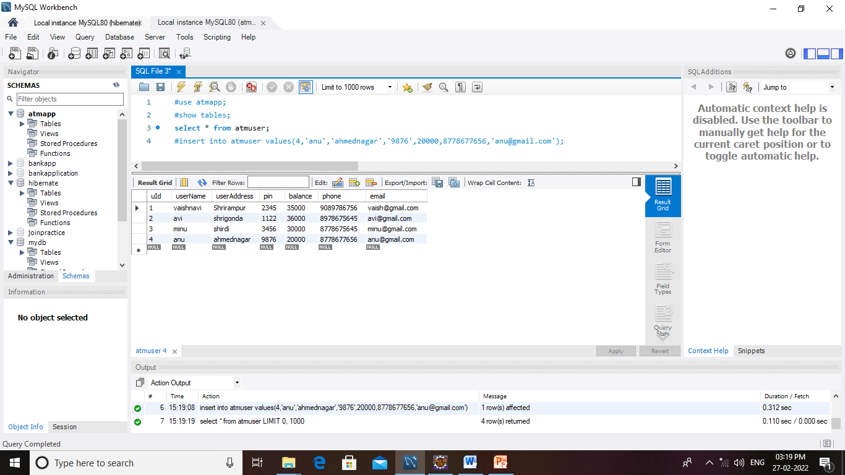
Data Dictionary Create Database Atmuser

Slide 8
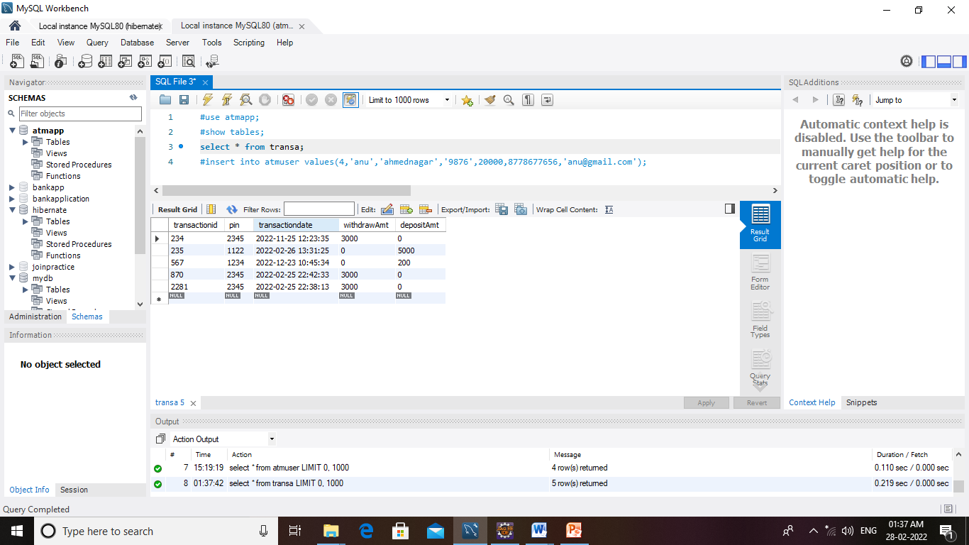
Transaction Database

Slide 9
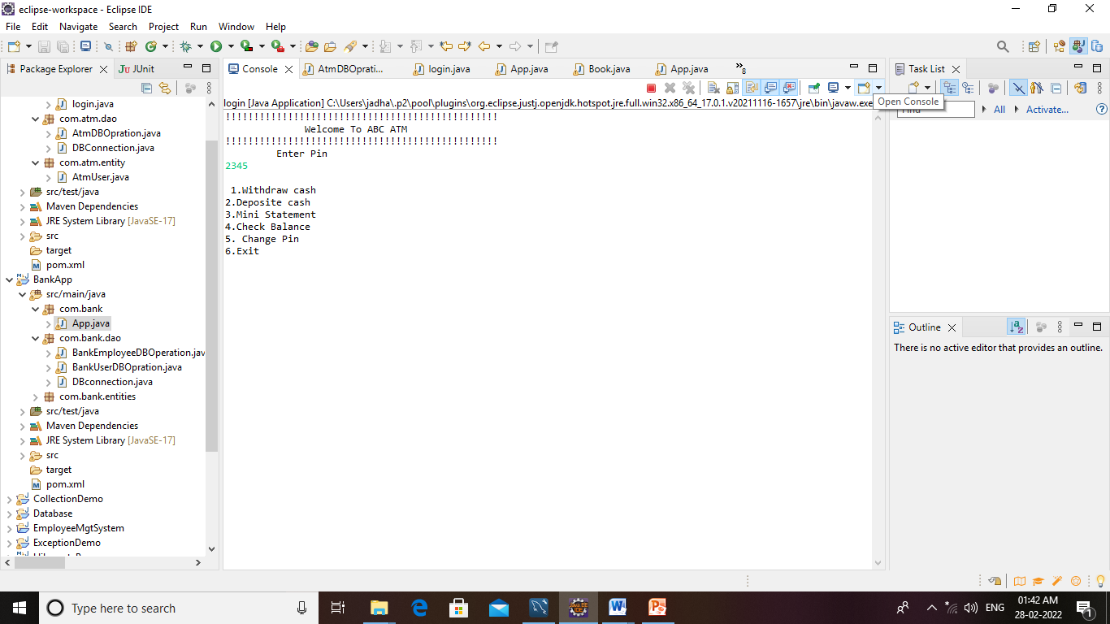
Screenshots
Home page

Slide 10
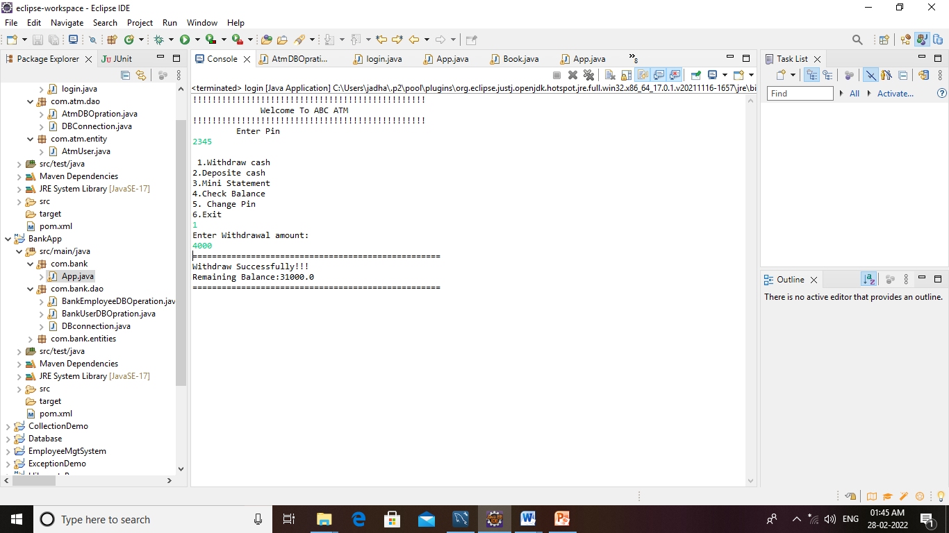
Withdraw Money

Slide 11
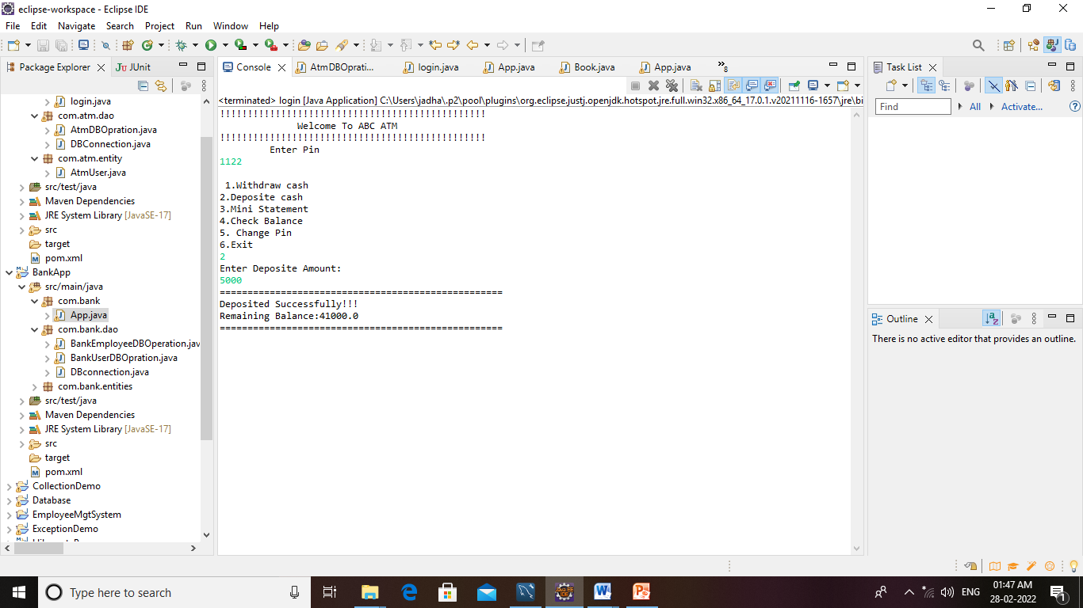
Deposite Money

Slide 12
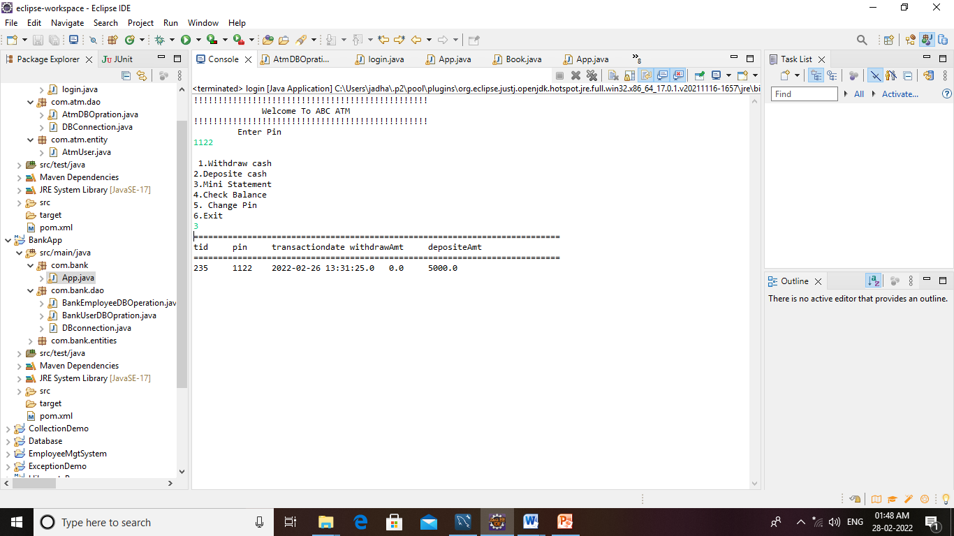
Mini Statement

Slide 13
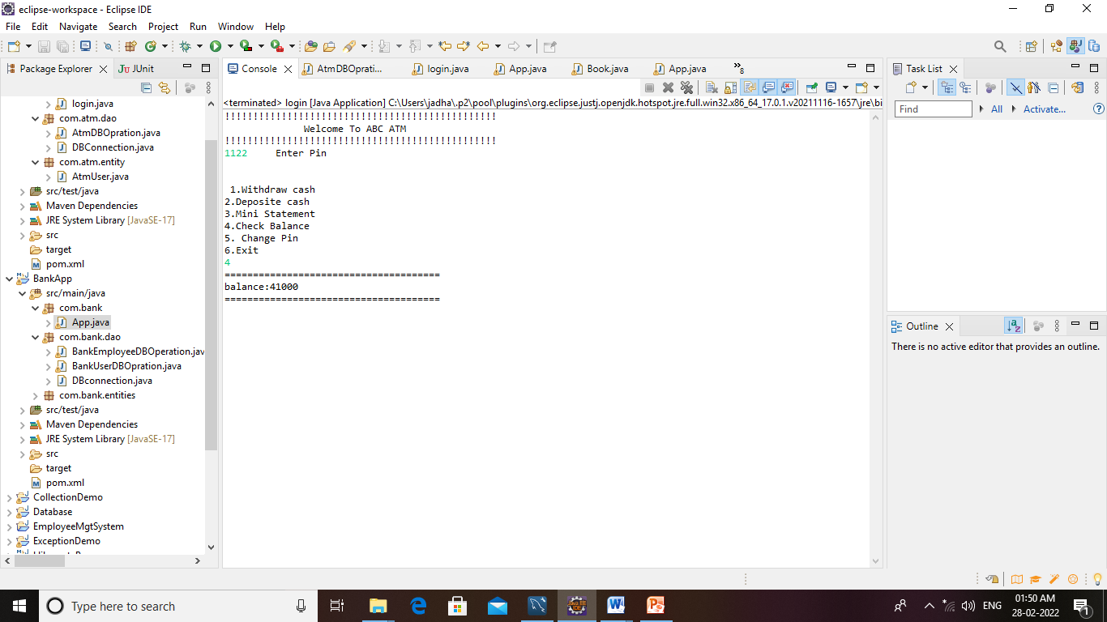
Check Balance

Slide 14
Thank You

