Slide 1

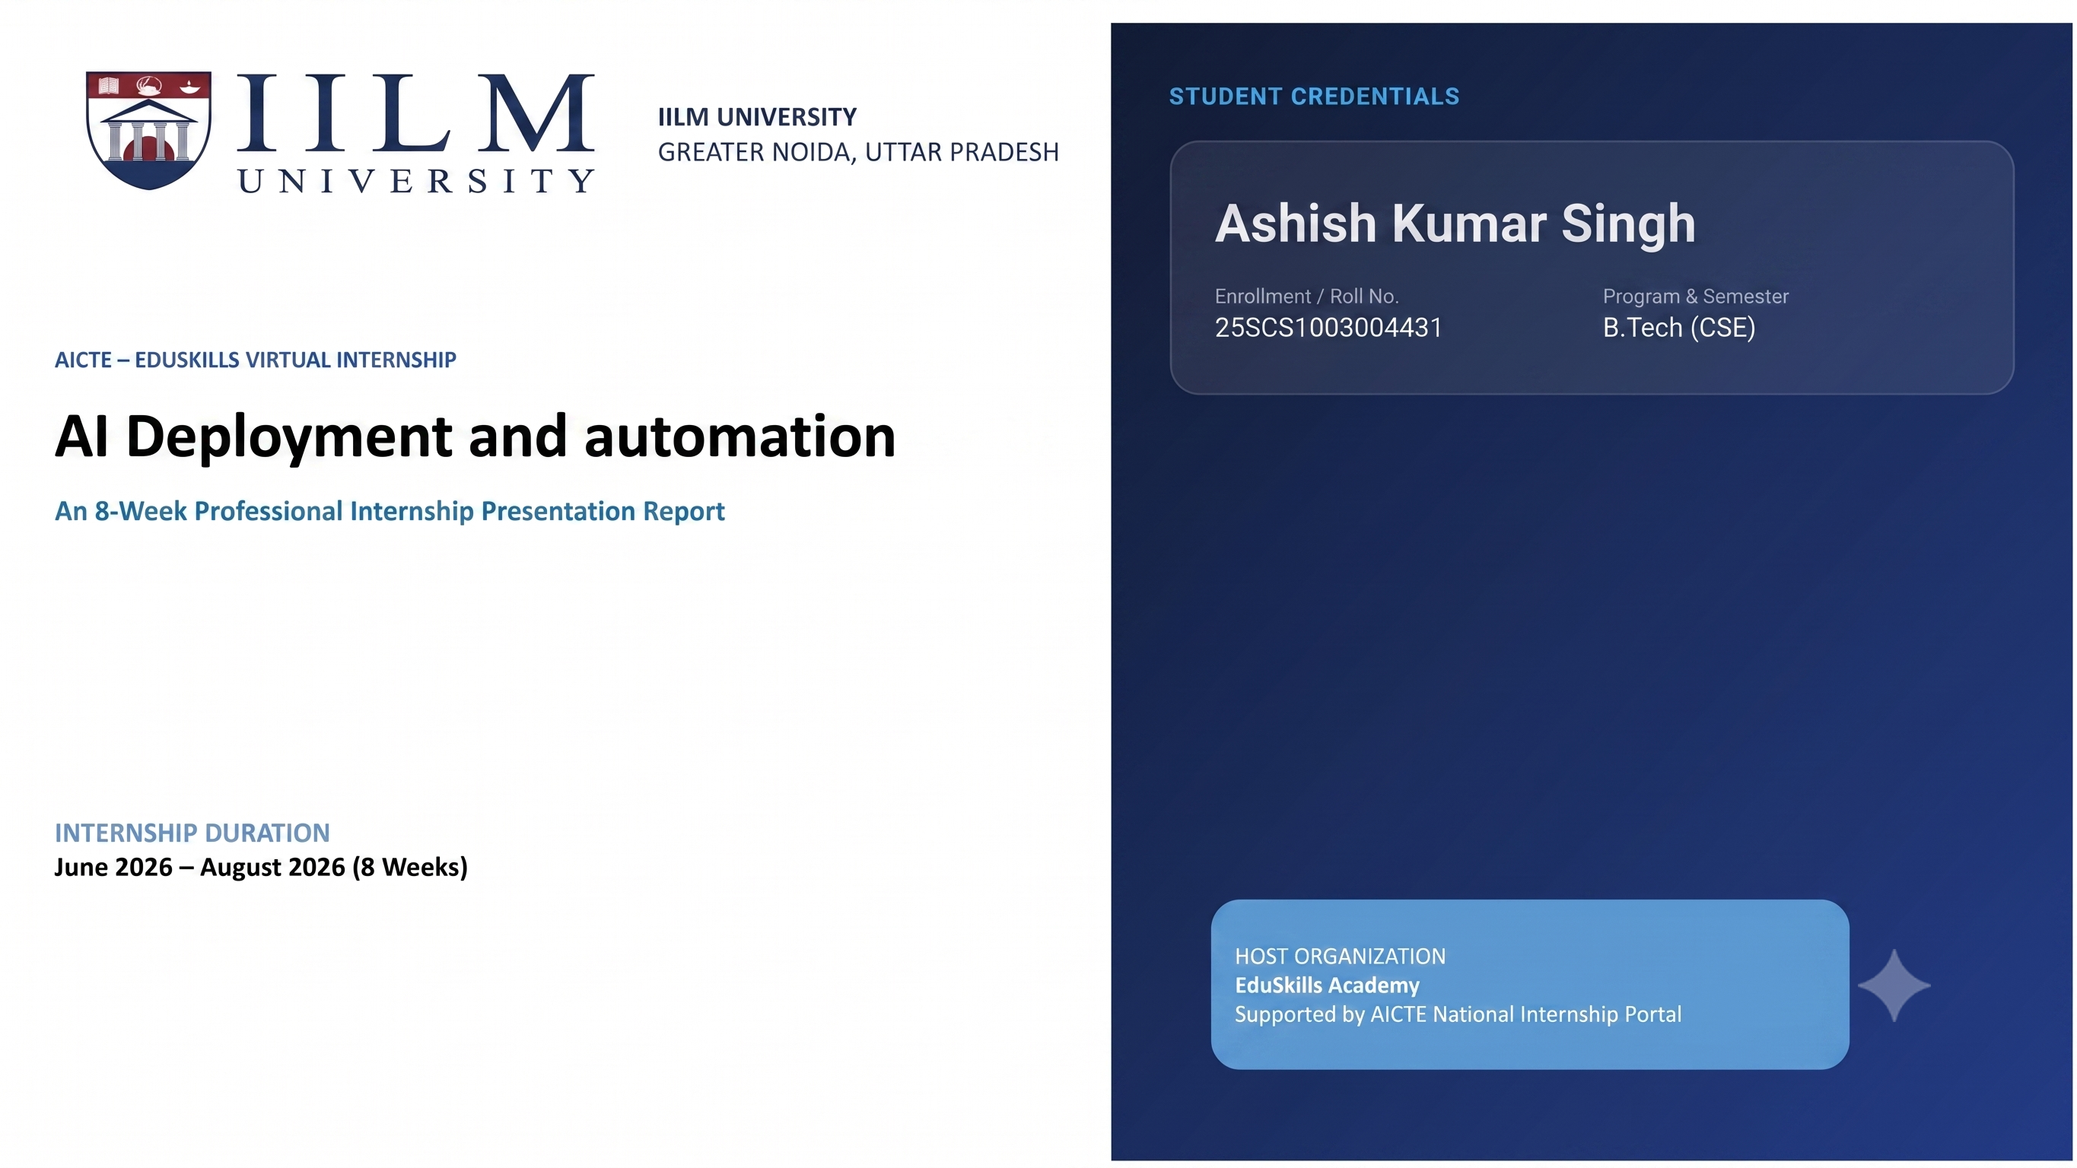
STUDENT CREDENTIALS
Vaishnavi
Enrollment / Roll No.
Internship Profile
25SCS1003002368
Artificial Intelligence Intern
CODEC TECHNOLOGIES INTERNSHIP
Artificial Intelligence Internship
An 8-Week Professional Internship Presentation Report
INTERNSHIP DURATION
30 July 2026 – 30 August 2026 (1 Month)
HOST ORGANIZATION
Codec Technologies Pvt. Ltd.
AICTE & ICAC Approved Internship Program

Slide 2

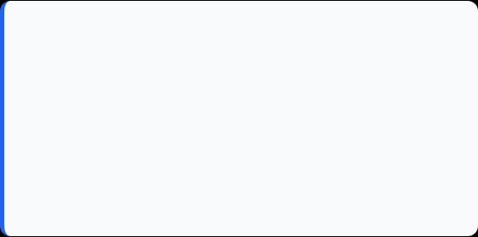
Candidate & Internship Overview
Candidate Details
Internship Profile
Student Name: VAISHNAVI
Program: AICTE & ICAC Approved Internship
Roll Number: 25SCS1003002368
Organization: Codec Technologies Pvt. Ltd.
Internship Role: Artificial Intelligence Intern
Domain: Artificial Intelligence
Internship Duration: 1 Month
Mode: Internship Program
Internship Dates: 30/07/2026 – 30/08/2026
Certificate: Internship Completion Certificate

Slide 3


Organization Profile: Codec Technologies Pvt. Ltd.
Codec Technologies Pvt. Ltd. provided the internship program in the field of Artificial Intelligence.
The internship was designed to give practical exposure to AI concepts and their applications.
The program helped connect academic learning with practical understanding of Artificial Intelligence.
Internship Domain: Artificial Intelligence

Slide 4

Internship Context & Learning Scope
The Learning Challenge
The Internship Scope
Artificial Intelligence includes concepts such as data processing, machine learning, intelligent decision-making, and automation.
The one-month internship focused on building practical understanding of Artificial Intelligence and developing industry-oriented technical skills.
The program provided an opportunity to learn, practice, and understand AI concepts through structured internship activities.
Students benefit from practical exposure because it helps them understand how AI concepts are applied beyond classroom theory.

Slide 5








Core Internship Learning Objectives
Artificial Intelligence Fundamentals
Machine Learning Concepts
Practical AI Skills
Industry-Oriented Learning
Connect academic concepts with practical applications and improve technical confidence.
Understand the basic concepts, applications, and importance of Artificial Intelligence.
Learn how machine learning supports intelligent systems and data-driven decision making.
Develop practical understanding of AI workflows, problem solving, and technical implementation.

Slide 6





Technologies & AI Internship Learning Areas
AI Fundamentals
Programming & Tools
Machine Learning
Professional Skills
Concepts: Artificial Intelligence, intelligent systems, automation
Programming: Python and basic programming concepts for AI
Concepts: Data, features, models, training and prediction
Documentation: Organizing work and presenting technical outcomes
Skills: Understanding AI/ML workflow and evaluation
Development: Analytical thinking, learning, and problem solving
Learning: Problem solving, data-driven thinking, AI applications
Practical Work: Implementation, experimentation, and testing

Slide 7
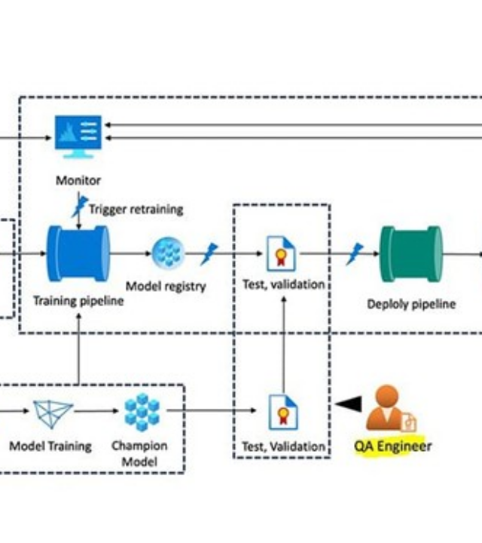
Artificial Intelligence Workflow
Input & Data: Collect and understand the information required for an AI task.
Preprocessing: Prepare and organize data so it can be used effectively.
Model / Logic: Apply AI or machine-learning concepts to identify patterns or make decisions.
Output: Generate a useful prediction, classification, or intelligent result.
Evaluation: Check results, identify errors, and improve the overall approach.

Slide 8




Internship Timeline — Month 1
Week 2
Week 4
Machine Learning Basics
Understanding data, learning methods, models, and AI workflows.
Review & Finalization
Consolidating learning, documenting work, and preparing the internship outcomes.
Week 1
Week 3
AI Fundamentals
Introduction to Artificial Intelligence, applications, and basic concepts.
Practical AI Learning
Applying concepts through examples, implementation, testing, and problem solving.

Slide 9
Key Learning Outcomes
Learning Outcome 2
Learning Outcome 4
Technical Skills
Improved programming, analytical thinking, and practical problem-solving skills.
Professional Development
Improved documentation, presentation, and industry-oriented learning habits.
Learning Outcome 1
Learning Outcome 3
AI Understanding
Built a stronger foundation in Artificial Intelligence concepts and applications.
Practical Exposure
Understood how AI concepts can be translated into practical solutions.

Slide 10
Skills & Internship Outcomes
AI Fundamentals: Developed a clearer understanding of Artificial Intelligence and its applications.
Problem Solving: Practiced analytical thinking and structured approaches to AI-related problems.
Technical Learning: Strengthened understanding of programming and AI/ML concepts.
Practical Exposure: Connected theoretical concepts with practical internship-based learning.
Professional Growth: Improved documentation, communication, presentation, and confidence.

Slide 11

Certification & Official Verification
Verification Metric | Official Record / Credential Details
Internship Title | Artificial Intelligence Intern
Issuing Organization | Codec Technologies Pvt. Ltd.
Program Approval | AICTE & ICAC Approved Internship Program
Duration | 1 Month
Internship Dates | 30/07/2026 – 30/08/2026
Certificate | Internship Completion Certificate

Slide 12
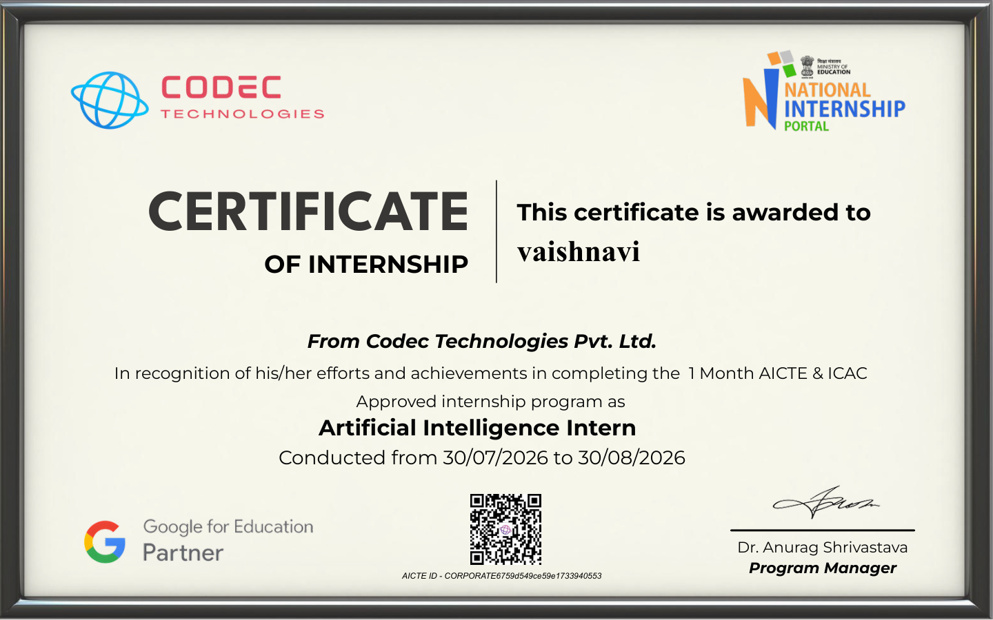
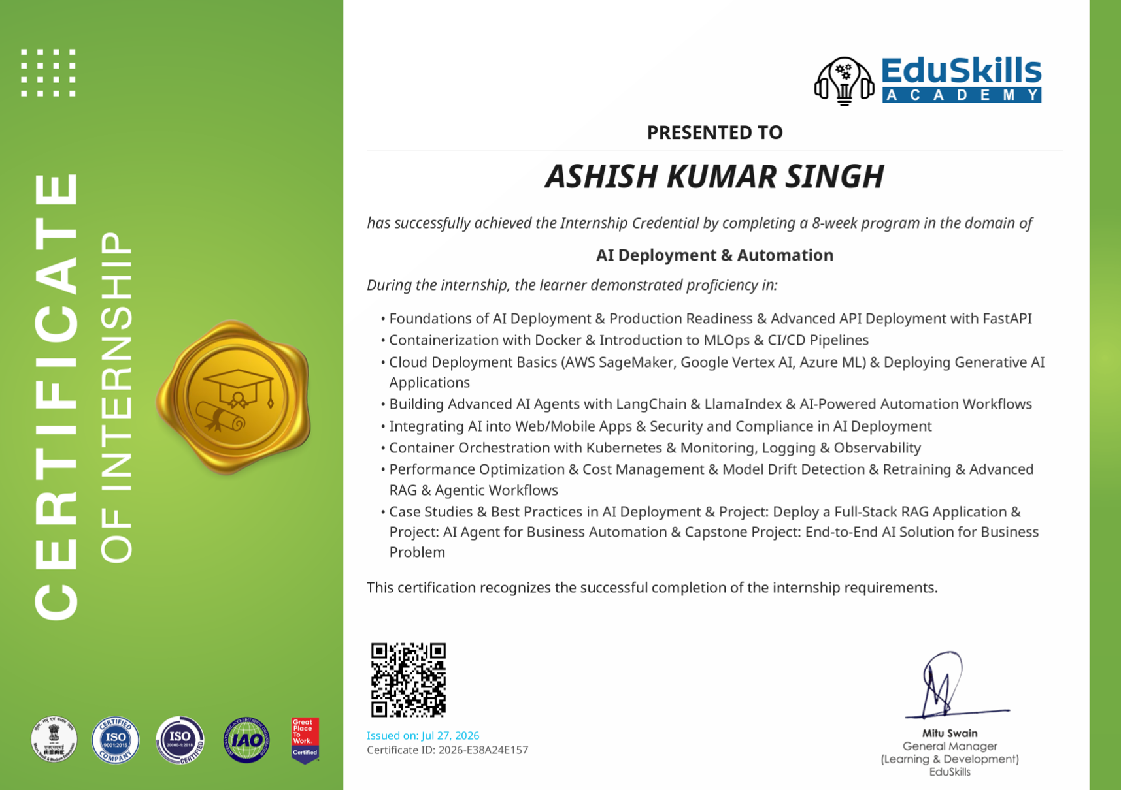


CERTIFICATION & OFFICIAL VERIFICATION

Slide 13
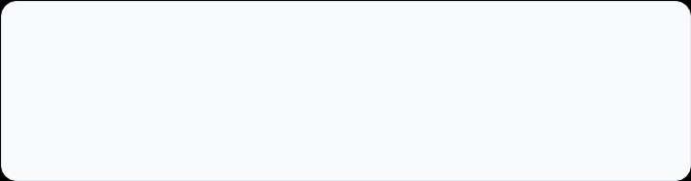
Thank You!
Vaishnavi
Artificial Intelligence Intern
Roll No: 25SCS1003002368
Codec Technologies Pvt. Ltd.

