Slide 1

DESIGN & SIMULATION OF A
SMART WATER TANK
Overflow Protection & Pump Control System
Using Combinational Logic
6-module project presentation
Course: Digital Design & Computer Architecture
TEAM MEMBERS
VAISHNAVI KOLLI – 2620040020 | SANJANA – 2620040041
SNIGDHA – 2620040042 | SAI KARTHIKEYA – 2620040024
SISTLA AISHWARYA LAKSHMI – 2620040059

Slide 2
System Inputs & Design Assumptions
COMBINATIONAL LOGIC
Symbol | Input meaning | Logic 1 means
L | Low-level sensor | Water is at/above the low sensor point
M | Medium-level sensor | Water is at/above the medium point
H | High-level sensor | High-level limit is reached
P | Pump output | 1 = ON, 0 = OFF
Assumption: sensors are ordered vertically (L below M below H). Real hardware needs sensor conditioning and electrical isolation.
05 / 20

Slide 3
Water-Level Sensing Concept
COMBINATIONAL LOGIC
• Three digital sensors convert a changing water level into binary signals.
• L — LOW: indicates the tank has reached the minimum sensor point.
• M — MEDIUM: provides an intermediate water-level indication.
• H — HIGH: signals the upper limit; the pump must be OFF.
• Sensor polarity and exact thresholds must be confirmed for the selected hardware.
06 / 20

Slide 4
What Is Combinational Logic?
COMBINATIONAL LOGIC
L, M, H
Inputs
BOOLEAN
LOGIC
P
Output
• The output depends only on the current inputs; no clock or stored state is required.
• When an input changes, the output updates after a small circuit delay.
• A practical pump system may add a latch, timer or interlock.
07 / 20

Slide 5
Truth Table — Pump Decision
COMBINATIONAL LOGIC
Chosen rule: pump ON only when the tank is below the low-level point.
L | M | H | P | Interpretation
0 | 0 | 0 | 1 | Below low sensor — fill
0 | 0 | 1 | 0 | Invalid sensor combination
0 | 1 | 0 | 0 | Invalid sensor combination
0 | 1 | 1 | 0 | Invalid sensor combination
1 | 0 | 0 | 0 | Low sensor reached
1 | 0 | 1 | 0 | Invalid sensor combination
1 | 1 | 0 | 0 | Medium level reached
1 | 1 | 1 | 0 | High limit reached
This demonstration turns the pump OFF as soon as L becomes 1, so it does not continue filling to the medium level.
08 / 20

Slide 6
Simulation Setup
SIMULATION & TESTING
• Suggested tools: Logisim Evolution or Digital logic simulator.
• 1. Place three input pins labelled L, M and H.
• 2. Add a 3-input NOR gate or an equivalent gate network.
• 3. Connect P to an output pin or LED indicator.
• Toggle all eight input combinations, compare each output with the truth table, then save the circuit and capture a screenshot.
15 / 20

Slide 7
CONCLUSION
• Digital sensors represent water level using binary inputs.
• The truth table defines the pump decision clearly.
• P = ¬(L + M + H), implemented by a NOR gate.
• Simulation checks every input combination before hardware implementation.
Design • Simulate • Verify • Improve

Slide 8
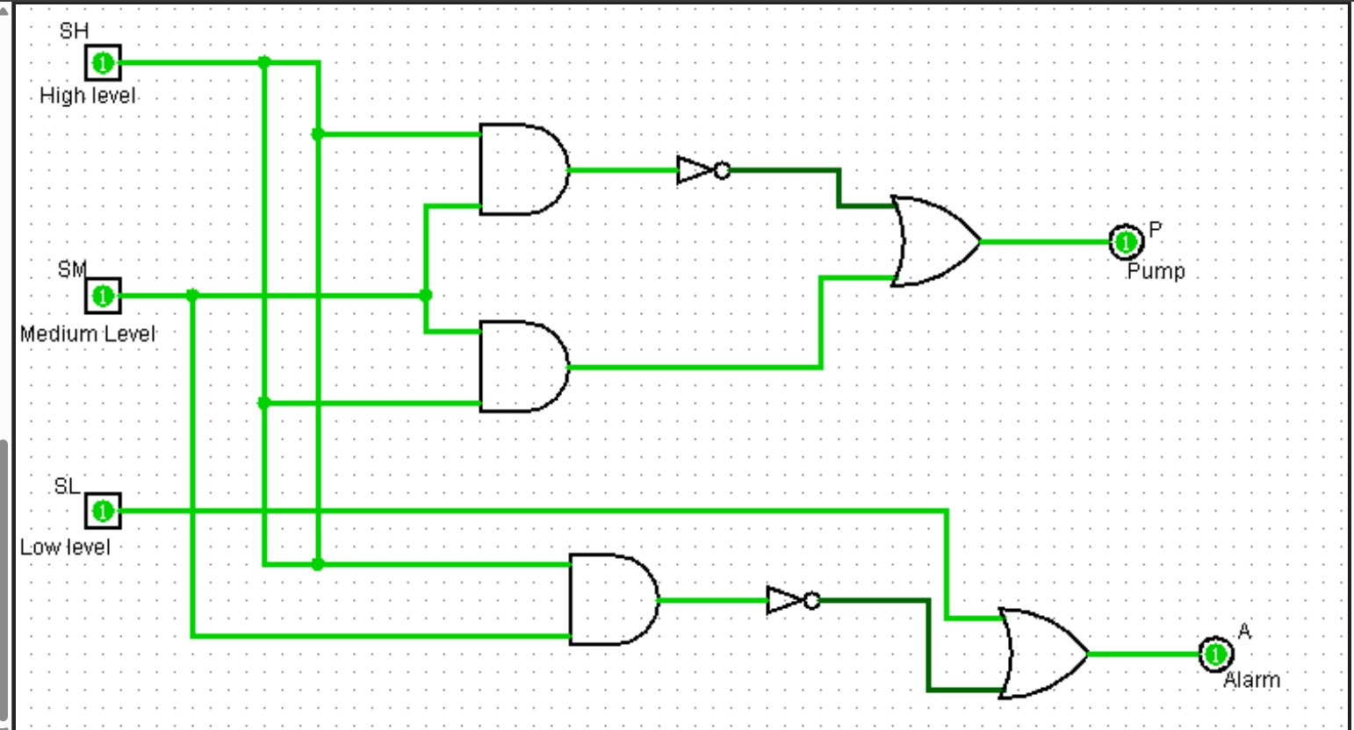

Slide 9


