Slide 1
Task 4: Data Storytelling & Statistical Validation
Fruit Classification Analysis
Prepared by: Konda Vaishnavi

Slide 2
Project Overview
Analyze dataset, KPI Analysis, Dashboard Development, Statistical Validation, Business Insights

Slide 3
Dataset Overview
Weight, Colour, Label, Fruit_Size, Label_Code

Slide 4
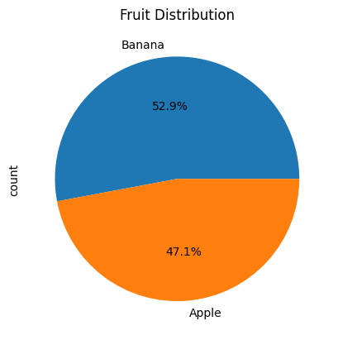
KPI Analysis
Total Fruits, Apple Count, Banana Count, Average Weight, Max Weight, Min Weight

Slide 5
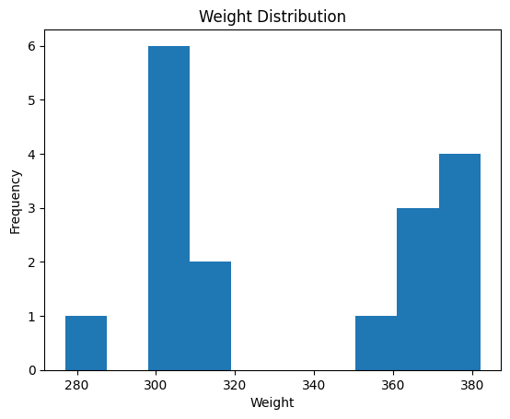
Visualizations
Add Pie Chart, Histogram, Bar Chart, Fruit Size Chart

Slide 6
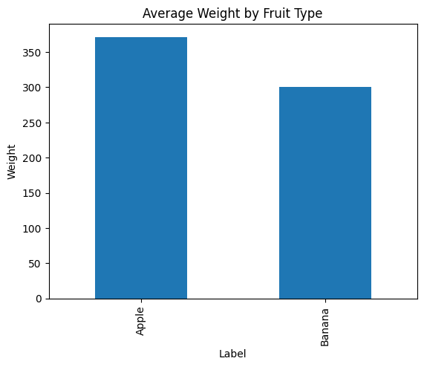
Data Storytelling
Problem Statement, Findings, Insights, Recommendations

Slide 7
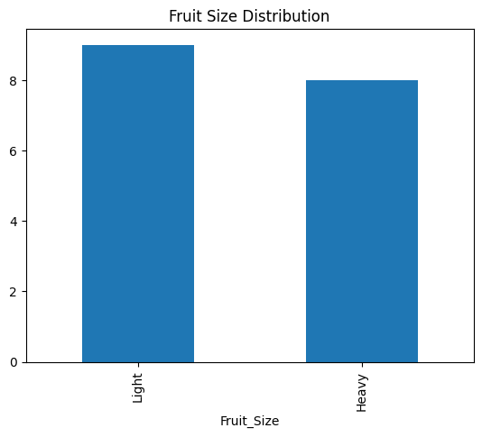
Hypothesis Testing
H0 and H1 with T-Test results

Slide 8
Conclusion
Summary and business recommendations

