Slide 1
JAVA JDK Architecture
Prepared By : Vaishnavi Kulthe

Slide 2
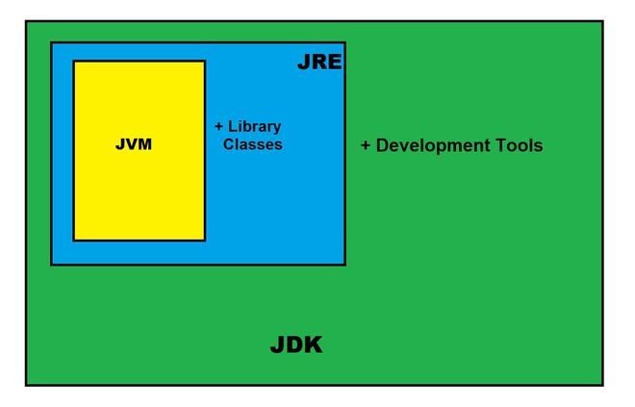
Components of Java Architecture
The Java architecture includes the three main components:
Java Virtual Machine (JVM)
Java Runtime Environment (JRE)
Java Development Kit (JDK)

Slide 3
Java Development Kit (JDK)
Java Development Kit (JDK) can be considered as the super-set of JRE. JDK includes all features that JRE has and over and above it contains development tools such like compiler, debugger etc.
(Java Development Kit) is a Kit that provides the environment to develop and execute(run) the Java program.
JDK is a kit(or package) that includes two things
Development Tools(to provide an environment to develop your java programs)
JRE (to execute your java program).

Slide 4
Java Runtime Environment(JRE)
Java Programs Can Run In A Runtime Environment Created By The Jre Software.
The Java Runtime Environment (Jre) Is A Disk-based System That Mixes Java Code With Necessary Libraries.
Finally, The Java Virtual Machine (Jvm) Begins To Run The Java Code. The Java Runtime Environment (Jre) Contains All Of The Libraries And Software Required To Run Java Programs.
Although Jre Is Included In The Jdk, It Is Also Available For Download Individually.

Slide 5
Java Virtual Machine(JVM)
JVM (Java Virtual Machine) is a very important part of both JDK and JRE because it is contained or inbuilt in both.
Whatever Java program you run using JRE or JDK goes into JVM and JVM is responsible for executing the java program line by line , hence it is also known as an interpreter.
JVM becomes an instance of JRE at the runtime of a Javaprogram. It is widely known as a runtime interpreter.
Java Virtual machine(JVM) is a part of the JRE(Java Runtime Environment).
Java applications are WORA (Write Once Run Anywhere).

Slide 6
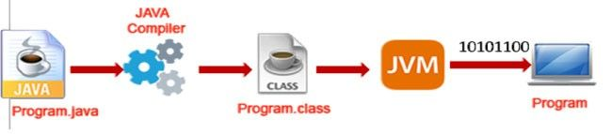
Steps involved to write and execute a java program
First, we should have a java source code which must be saved with program.java extension.
2.Then we use a JAVA Compiler to compile the source code to get java bytecode which must have a program.class extension. We can say that Java bytecode is a modified version of java source code.
3.Now we pass the java bytecode through an interpreter called JVM (JAVA Virtual Machine) which will read every single statement at a time from java bytecode and convert it to machine level code and then will execute the code. We get the output only after JVM converts and execute the code.

Slide 7
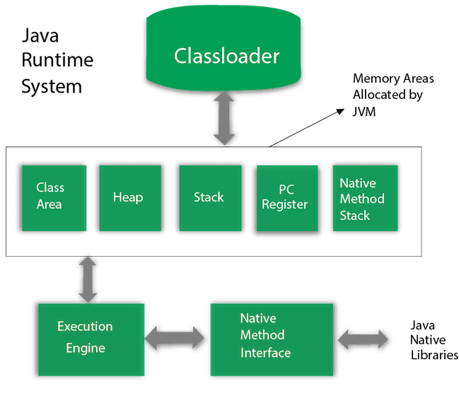
JVM Architecture

Slide 8
THANK YOU

