Slide 1
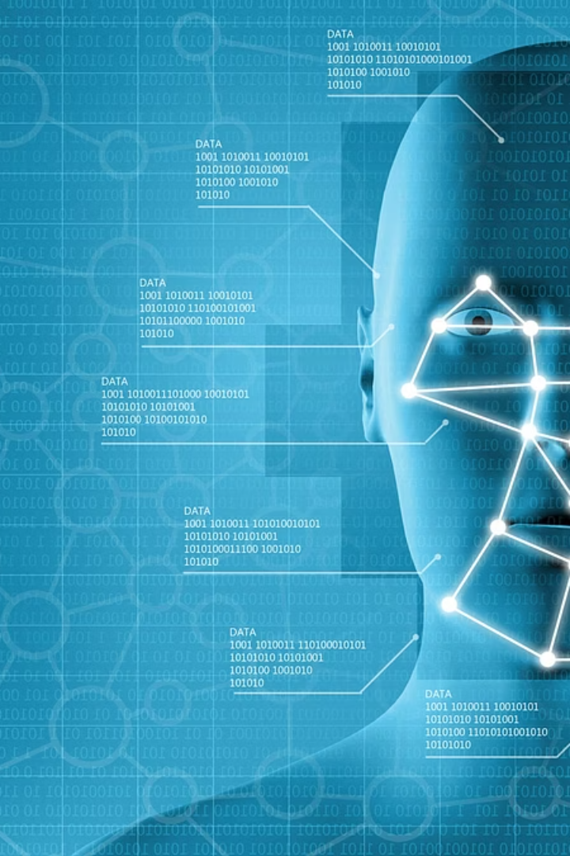

Real-time Attendance Tracker using Facial Features
Student: Vaishnavi Lokhanday (SEN: A869145023001)
Batch Year: 2023–2025
Guide: Dr. Chandrashekhar, HOI, AIIT

Slide 2
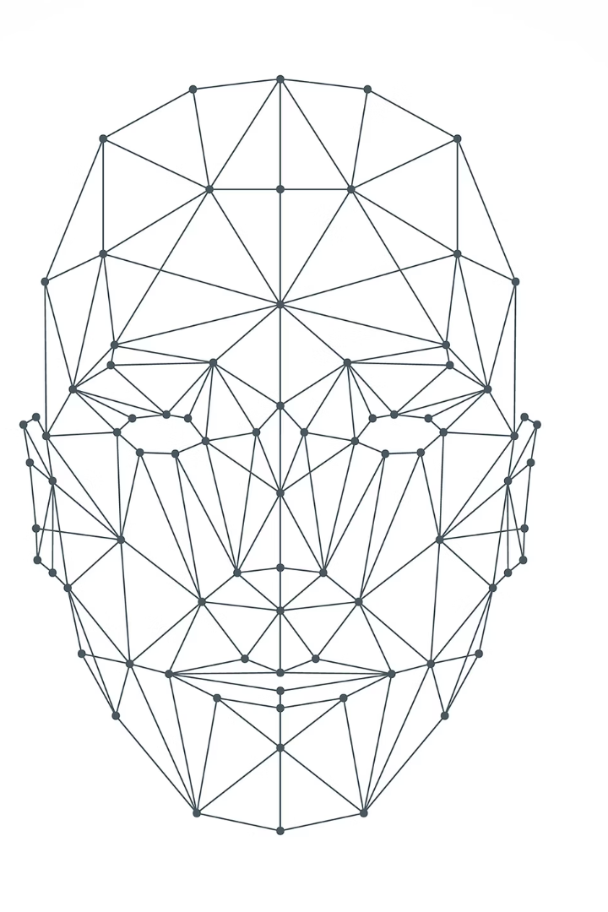
Introduction to Attendance Systems
Limitations of Traditional Systems
Biometric Systems Challenges
Manual roll calls and ID card scans are slow, prone to human error, and vulnerable to proxy attendance issues.
While biometric methods improve accuracy, physical contact raises hygiene concerns, especially post-pandemic.
Proposed Solution
A contactless, automated attendance system using face recognition, offering speed, security, and convenience.

Slide 3
Literature Review:
S.No. | Related Work | Observations or Methodology | Issues Identified | Overcome in our work
1. | Mekala, V., 2019 | The paper uses the Microsoft Cognitive Face API with PCA for face recognition, capturing images at fixed intervals using a mechanical setup. Attendance is marked if a match is found, but the system struggles with real-time performance and varying conditions. | Uses PCA with a static image capture setup, which struggles with real-time detection and varying lighting or angles. | This system uses deep learning for better accuracy and real-time video feed for continuous, reliable attendance marking.
2. | Raj, A. Arjun, 2020 | Collected and preprocessed facial images, trained a CNN model, detected faces, extracted features, and matched them for recognition using OpenCV and Python. | The paper employs a basic CNN model for face recognition, which may not generalize well across diverse real-world conditions due to limited data augmentation and lack of advanced training techniques. | This project utilizes a more robust deep learning architecture with extensive data augmentation and transfer learning, enhancing accuracy and adaptability in varied environments.
Notes:
PCA – Principle Component Analysis is used to reduce the complexity of the facial data. It's a statistical method, but it’s not as accurate or robust as modern deep learning approaches.
API – Application Programming Interface

Slide 4
Literature Review:
S.No. | Related Work | Observations or Methodology | Issues Identified | Overcome in our work
3. | Gode, Chetan S., 2022 | The system utilizes facial recognition to automate attendance marking, aiming to reduce errors and time consumption associated with traditional methods. However, the paper does not provide specific details on the algorithms or datasets employed. | The paper lacks detailed information on the specific face recognition algorithms and datasets used, making it challenging to assess the system's robustness and generalizability. | This project employs advanced deep learning models trained on diverse datasets, ensuring higher accuracy and adaptability across various real-world scenarios.
4. | Prajapati, Harshit, and Ashwani Kumar Mishra, 2025 | The paper studies the implementation and effectiveness of a face recognition attendance system, focusing on integration, performance, and user feedback, but lacks details on the algorithms and datasets used. | The study lacks detailed information on the specific face recognition algorithms and datasets used, making it challenging to assess the system's robustness and generalizability. | This project employs advanced deep learning models trained on diverse datasets, ensuring higher accuracy and adaptability across various real-world scenarios.

Slide 5
Literature Review:
S.No. | Related Work | Observations or Methodology | Issues Identified | Overcome in our work
5. | Shaheer, S., 2024 | The paper presents a face recognition-based attendance system developed using Python. However, it does not provide specific details on the algorithms or datasets employed. | The paper lacks detailed information on the specific face recognition algorithms and datasets used, making it challenging to assess the system's robustness and generalizability. | This project employs advanced deep learning models trained on diverse datasets, ensuring higher accuracy and adaptability across various real-world scenarios.

Slide 6

Problem Statement: Challenges to Address
Outdated Methods: Manual and semi-automated attendance systems are no longer effective or secure.
Proxy Issues: Existing systems cannot prevent fake or proxy attendance.
Hygiene Risks: Physical biometric devices pose health concerns, especially during pandemics.
Need for Innovation: A contactless, reliable, and user-friendly attendance solution is essential.

Slide 7
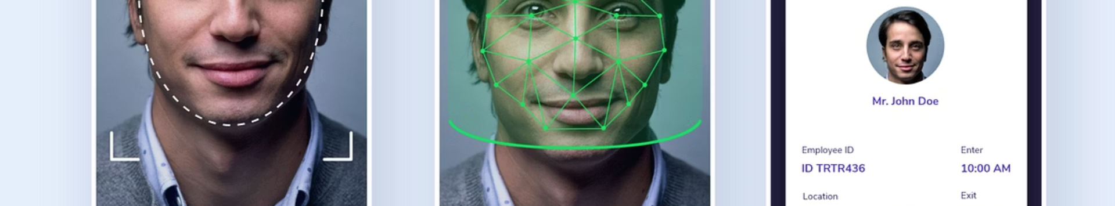
Project Objectives
Objective 1: Developing real-time attendance using OpenCV
Implement a live camera feed to detect and recognize faces for real-time attendance marking
Objective 2: Develop Attendance Tracker
Create a reliable system to log and store attendance data with timestamps in a structured format

Slide 8
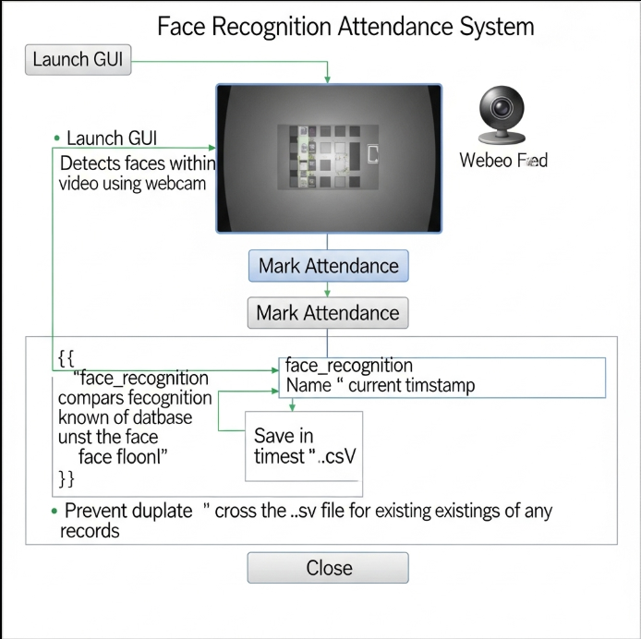




Methodology: System Architecture and Workflow
Image Dataset Creation
Collect and organize user face images into folders for initial training and encoding.
Face Encoding
Transform images into numerical vectors using face_recognition for efficient comparison.
Live Detection & Recognition
Use webcam feed to perform continuous face detection and match against encoded data.
GUI Integration & Logging
Deploy a Tkinter-based interface with a “Mark Attendance” button to control and log attendance events.

Slide 9
Implementation Technologies and Features
Programming Stack
Key Functional Features
Python for core logic
Real-time bounding box visualization with identification
Tkinter for lightweight GUI
OpenCV for video capture and processing
User-initiated attendance marking to prevent false logging
face_recognition for encoding and recognition
Pillow for image handling in GUI
CSV-based attendance logs with timestamps
NumPy for handling arrays and numerical operations
Dlib used by face_recognition for facial landmark detction

Slide 10
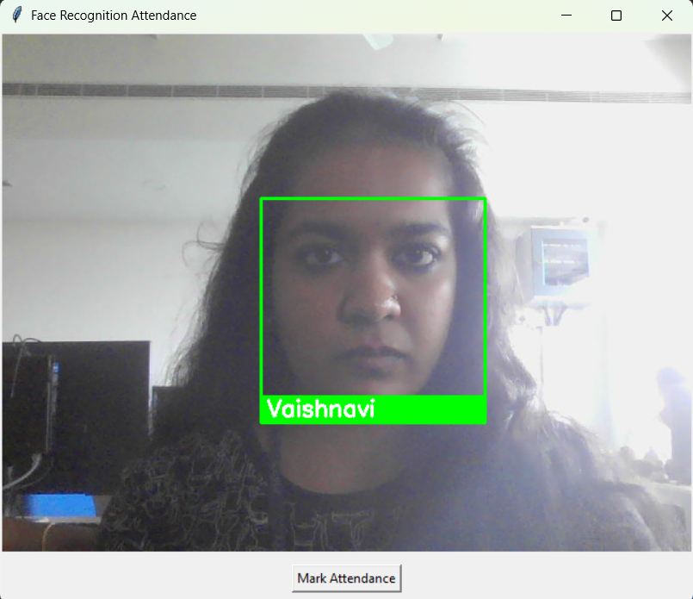
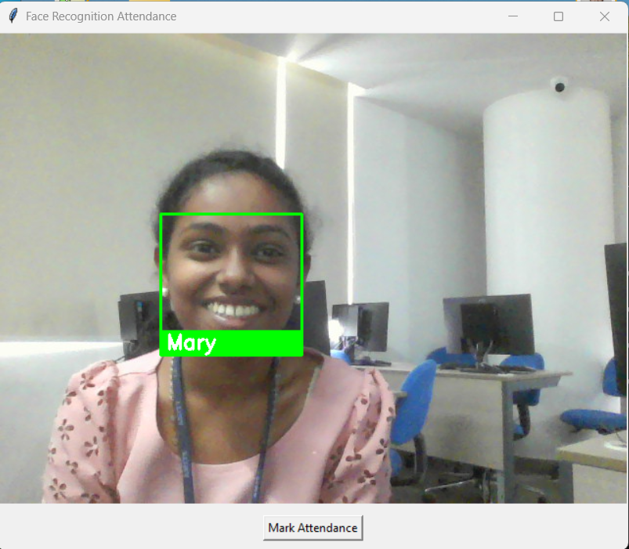
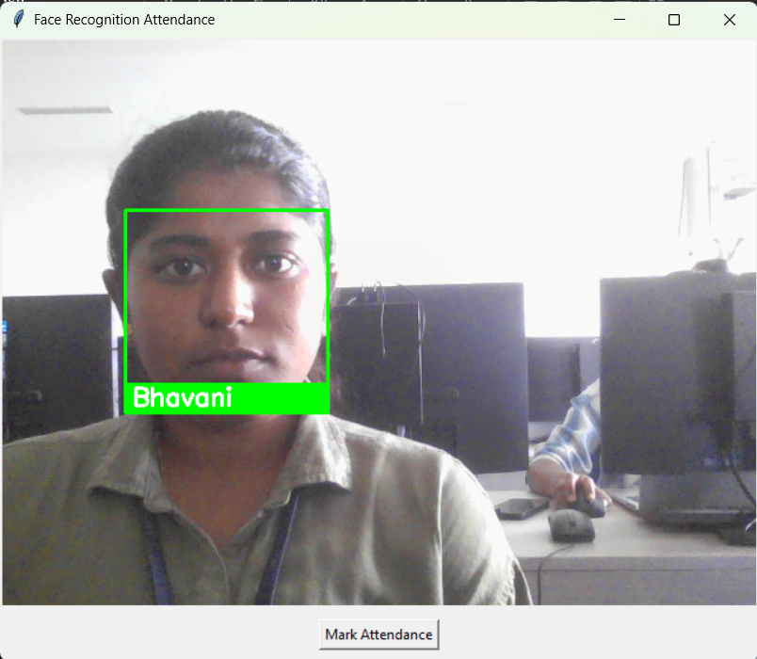
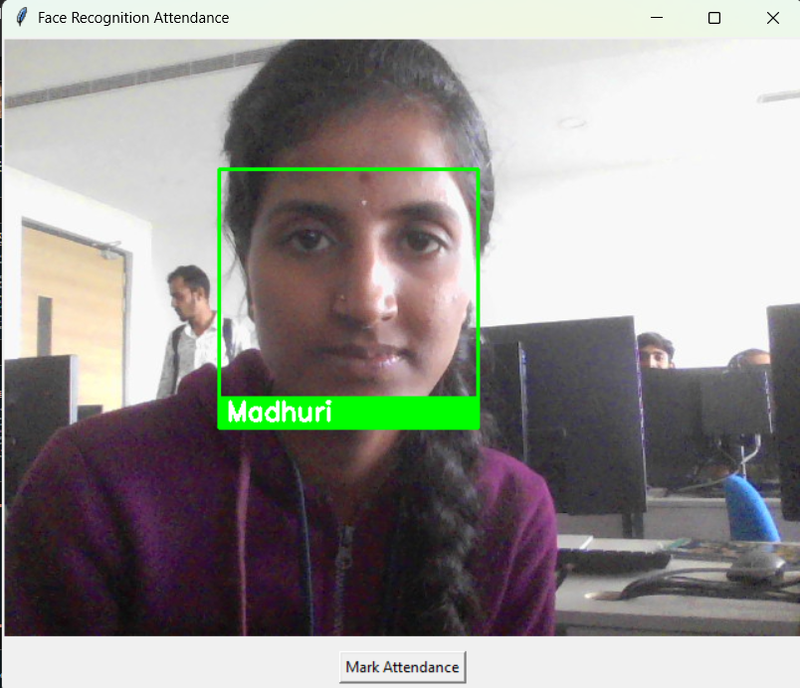
Results and Discussion
System Performance
Advantages
Accurately detects and labels multiple faces in real-time, streamlines attendance marking with minimal manual intervention.
Contactless operation enhances hygiene
Reduces human errors and proxies
Easy scalability to larger groups

Slide 11

Conclusion
The face recognition-based attendance system successfully achieves contactless, and accurate attendance tracking. It addresses critical hygiene and fraud concerns inherent in legacy methods while providing a user-friendly interface.

Slide 12
References
OpenCV Documentation – https://docs.opencv.org
face_recognition GitHub Repository – https://github.com/ageitgey/face_recognition
Tkinter Official Documentation – https://docs.python.org/3/library/tkinter.html
Dlib Face Recognition Library – http://dlib.net/
Referred Papers
Mekala, V., et al. "Face recognition based attendance system." International Journal of Innovative Technology and Exploring Engineering 8.12 (2019): 520-525.
Raj, A. Arjun, et al. "Face recognition based smart attendance system." 2020 International conference on intelligent engineering and management (ICIEM). IEEE, 2020.
Gode, Chetan S., et al. "Face recognition-based attendance system." Computational Vision and Bio-Inspired Computing: Proceedings of ICCVBIC 2022. Singapore: Springer Nature Singapore, 2023. 159-166.
Prajapati, Harshit, and Ashwani Kumar Mishra. "Attendance System using Face Clusters." MATRIX Academic International Online Journal Of Engineering And Technology 8.1 (2025): 1-11.
Shaheer, S., et al. "Face Recognition-Based Attendance System Using Python: A Novel Approach to Automated Attendance Management." INTERANTIONAL JOURNAL OF SCIENTIFIC RESEARCH IN ENGINEERING AND MANAGEMENT 8.008.(2024)

Slide 13
Thank You
I appreciate your time and interest in my project.
Feel free to ask questions or request further details.

