Slide 1

Regular Expressions for Real-World Text Processing
PATTERN
\d+
DSA0311 - Natural Language Processing
TEXT
Room 214, Floor 3
MATCHES
Presented by: M Vaishnavi - 192324162
Department: AIDS
214 3
Notes:
Good morning everyone. Today my topic is Regular Expressions for Real-World Text Processing, which is part of Natural Language Processing, or NLP. My topic code is TP-03. In the next few minutes, I will explain what regular expressions are, how they work, and where we use them. I will also show a small Python example. Let us start with the basic idea.

Slide 2



Introduction to Regular Expressions
Regex = Regular Expression
Regex is the short form of regular expressions.
INPUT TEXT
My email is student@gmail.com
A pattern for text
Used to search, match, validate, and extract text.
PATTERN USED
\w+@\w+\.\w+
Important in NLP
Finds useful data inside raw, messy text.
EXTRACTED RESULT
student@gmail.com
Notes:
First, what is a regular expression? Regex is the short form of regular expressions. A regular expression is a pattern that helps us search, match, validate, and extract text. You can think of it as a smart search tool that looks for the shape of the text, instead of one exact word. In NLP, computers work with a lot of raw text, such as emails, messages, and reports. Regex helps us pick out the useful information from that text quickly. Here is a simple example. The sentence says, My email is student at gmail dot com. A pattern can find the email address and extract it for us. Now let us see which symbols we use to build these patterns.

Slide 3
Basic Regex Symbols
Symbol | Meaning | Example
\d | Matches a digit | 5
\w | Matches a word character | A
+ | Matches one or more repetitions | 123 with \d+
@ | Matches the literal @ symbol | abc@
TEXT
Room 123 is open
PATTERN
\d+
MATCHED PART
123
Combining symbols creates a pattern for finding specific types of text.
Notes:
Patterns are built from small symbols. Backslash d matches one digit, like 5. Backslash w matches one word character, like the letter A. The plus sign means one or more repetitions, so the pattern backslash d plus matches 123 as a whole. The at symbol matches the literal at sign, as in abc at. When we combine these symbols, we create a pattern that finds a specific type of text. On the right, you can see the pattern backslash d plus finding the number 123 inside a sentence. Next, let us see where this is used in real life.

Slide 4



Real-World Applications
Email Extraction
Phone Number Detection
Find emails in documents
Detect phone numbers in text
Example:
student@gmail.com
Example:
9876543210
Date Extraction
Keyword Searching
Pick out dates from reports
Search keywords in big files
Example:
22/10/2026
Example:
NLP
Notes:
Regular expressions are used in many real-world tasks. First, email extraction: we can collect email addresses from long documents. Second, phone number detection: for example, finding a ten-digit number in a message. Third, date extraction: we can pull dates like 22 slash 10 slash 2026 out of reports. Fourth, keyword searching: we can find a word like NLP in hundreds of pages in a few seconds. All of these tasks would take a very long time to do by hand. Now let me show you a small Python program.

Slide 5
Extracting Numbers Using Python
import re
text = "I have 2 books and 15 pens."
result = re.findall(r'\d+', text)
print(result)
1
Import the re module
2
Store the input sentence
3
Use re.findall() to find all digit sequences
Output: ['2', '15']
4
Display the extracted numbers
\d+ matches one or more consecutive digits
Notes:
Here is a simple Python program that extracts numbers from a sentence. Step one, we import the re module, which is Python's built-in tool for regular expressions. Step two, we store the sentence: I have 2 books and 15 pens. Step three, we use re dot findall with the pattern backslash d plus. The pattern backslash d plus means one or more digits in a row, so 15 is found as one number, not as 1 and 5 separately. Step four, we print the result. The output is a list with 2 and 15. As you can see, just a few lines of code find the numbers automatically. Now let us look at the strengths and weaknesses of regex.

Slide 6









Advantages and Limitations
Advantages
Limitations
Fast text searching
Complex patterns can be difficult to write
Easy information extraction
Unusual text formats may not match the pattern
Reduces manual work
Regex alone cannot fully understand the meaning or context of language
Useful for text validation
Notes:
Regular expressions have clear advantages. They make text searching fast, they make it easy to extract information, they reduce manual work, and they are useful for validating text, such as checking an email or a phone number. However, they also have limitations. Complex patterns can be difficult to write and to read. Unusual text formats may not match the pattern. Also, regex cannot fully understand the meaning or context of language, so NLP uses other techniques as well for deeper understanding. So regex is powerful, but it works best as one tool among many. Let me finish with a short summary.

Slide 7


Conclusion
Regular expressions identify patterns in text.
They help extract useful information automatically.
They are useful in Python and NLP applications.
Thank You!
They make many text-processing tasks faster and easier.
Notes:
To conclude, regular expressions identify patterns in text. They help us extract useful information automatically. They are easy to use in Python and are very useful in NLP applications. Most importantly, they make many text-processing tasks faster and easier. Thank you for listening. I am happy to answer any questions.

Slide 8
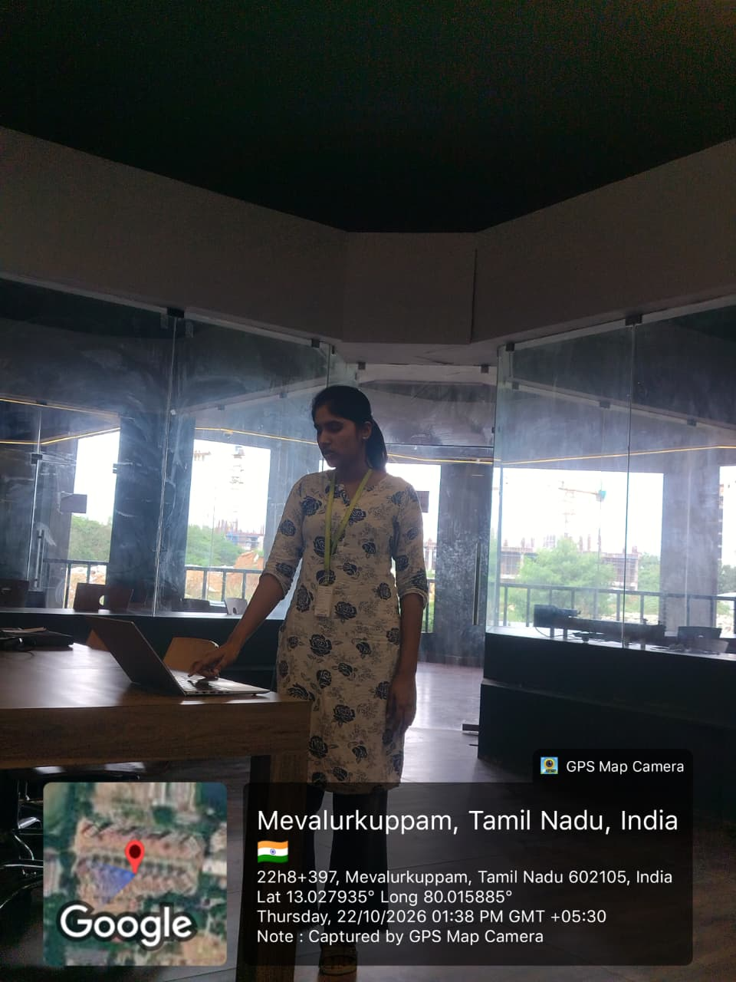
Geo Tag Technical Presentation

