Slide 1
MASTER OF SCIENCE APPLIED DATA SCIENCE PORTFOLIO MILESTONE
Vaishnavi Meka SUID: 893304899
Email: vameka@syr.edu
May 2025
Syracuse University

Slide 2
INTRODUCTION
The Syracuse University Applied Data Science program is designed to give students the skills necessary to become professionals who can analyze data to solve problems.
These skills include:
Data collection, transformation, and storage
Knowing how to visualize the data to both see trends and patterns, and report findings
Using supervised and unsupervised machine learning to gain an understanding of the data and make predictions
Reporting the findings and tailoring them to the knowledge of individuals with various technical backgrounds
Making recommendations from the analysis to the business/organization/management/shareholders

Slide 3
INTRODUCTION (CONT)
The following projects demonstrate the skills I have learned in various classes of my program:
IST 652 Scripting for Data Analysis
IST 707 Applied Machine Learning
IST 719 Information Visualization

Slide 4
IST 652 SCRIPTING FOR DATA ANALYSIS
Goal: Are there consistent patterns or behaviors among the two groups of riders between the years 2022 and 2023?
About the data: The data for the analysis is extracted from the Divvy website for the years 2022 & 2023, along with Chicago city weather data set from their website. I have collected data from over 2 million records and 40+ columns. My team and I conducted a thorough analysis of the dataset, addressed missing values, and applied appropriate transformations to relevant columns to ensure alignment with the project's objectives.
Methodology I followed in solving the problem:
First, I focused on understanding the business goals and narrowing down the key questions needed to solve the problem. I pulled bike rental data from Divvy’s platform and combined it with weather data from free online sources such as the Chicago city weather website. Using Python (mostly Pandas for organizing the data and Matplotlib/Seaborn for graphs), I cleaned up the datasets—fixing missing data, deleting duplicates, and reorganizing columns that didn’t make sense. I created new features, like grouping trips by time of day or linking weather conditions to rentals, to make the data easier to analyze. Finally, I ran stats and made charts to look for trends, like how trip duration impacted bike usage, and finalized these insights, which can help improve Divvy’s strategies.

Slide 5
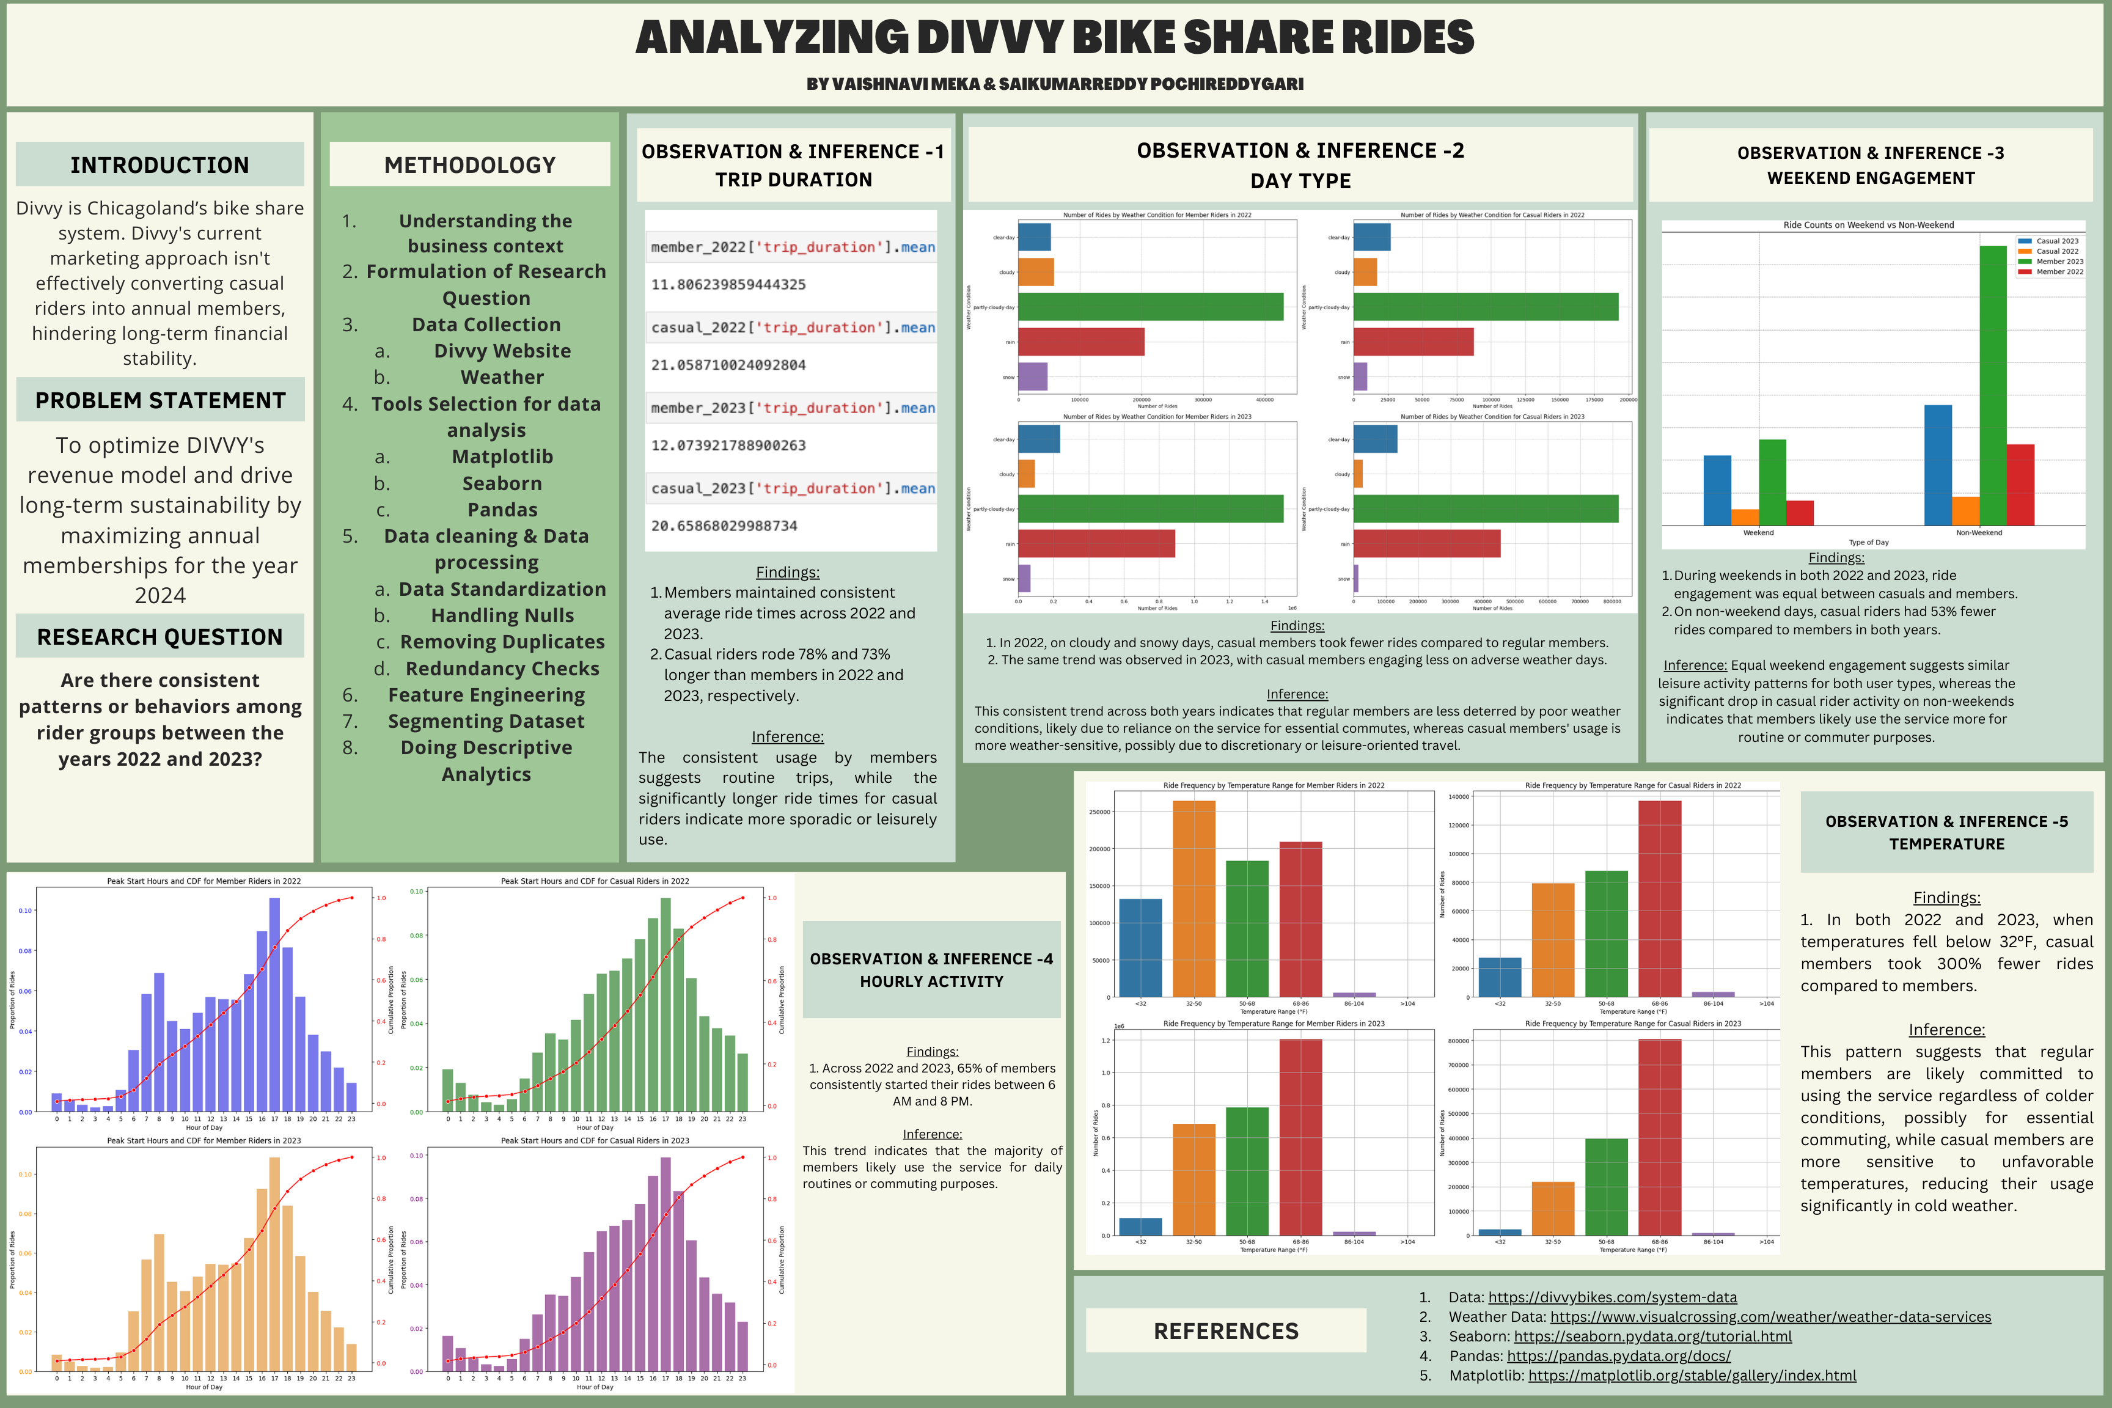

Slide 6
CONCLUSION
My analysis worked out way better than I expected! I found 11 key factors that clearly separate the two types of riders. Using these insights, I proposed sending targeted marketing emails to casual users to nudge them toward becoming paid members.
The key factors are:- total_trip_duration, weekend engagement, Temperature, Peak Hour, and Type of Day.
Skills learned from this project:
Loading, cleaning, and preparing bike rental data for analysis
Handling Big data processing, since the Data was too big
Creating useful factful visuals from the dataset that help to better meaningful insights
Making/finalizing recommendations from the findings of the data analysis

Slide 7
IST 707: APPLIED MACHINE LEARNING
Goal: This project aims to predict the daily usage counts of the Chicago Divvy bike-sharing program.

Slide 8
INTRODUCTION
Domain Problem:
The Divvy bike-sharing program in Chicago is a popular transportation option for both residents and visitors. Understanding the factors that drive bike usage can help the program's stakeholders make informed decisions about station placement, bike fleet management, and service optimization. This project will analyze historical data to develop a predictive model for bike usage.
Stakeholders:
Our main stakeholder is the Chicago Department of Transportation (CDOT). Our predicted bike usage information can not only guide the planning and allocation of shared bike resources, but also support futural decisions about where to expand or adjust services to integrate with other modes of transportation. To summarize, our project could help optimize the city’s bike-sharing infrastructure.

Slide 9
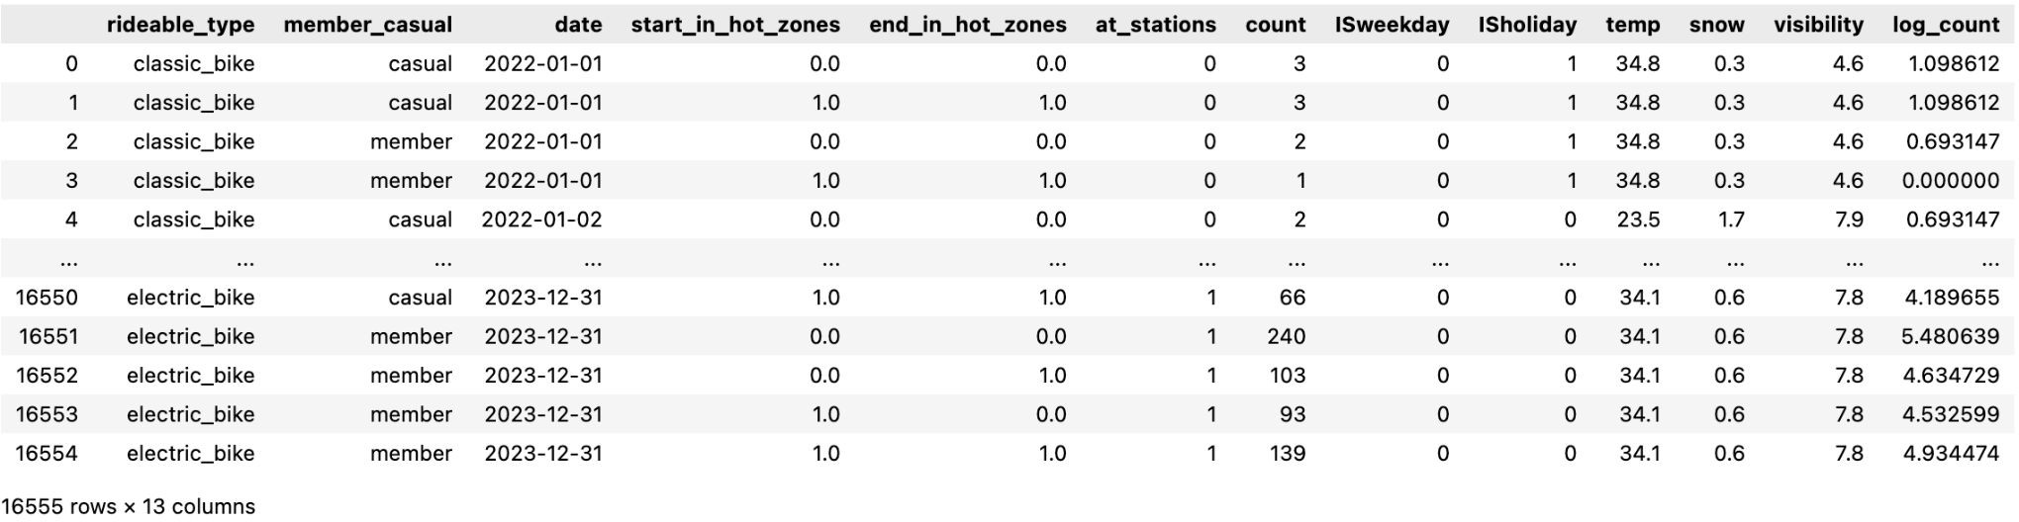
Data
Green: Depedent variable, aggregated daily counts of bike usage.
Blue: Weather data, including temperature, snow and visibility.
Orange: Date, holiday and weekday information Purple: Geographic Information
Yellow: Record details
Bike-sharing trip data: The Divvy bike-sharing program is ran by CDOT (Chicago Department of Transportation), this dataset is highly reliable. We used two-year bike trip data from 2022 to 2023 for this project.
Chicago neighbourhoods shapefile: This dataset comes from Chicago open data portal, it's well maintained by Chicago government and highly reliable .
Holiday information: According the calendar, we've compiled all the weekdays and holidays from 2022 to 2023.
Daily weather data: Weather data for 2022 to 2023 collected from the Visual Crossing website.

Slide 10
METHODS
Data Preprocessing:
Model Selection:
LinearRegression is the initial model we used.
Random Forest model to get the features importance.
KNN model
Decision Tree model
SVM model
XGboost model gives the best results
Neural Network model
Aggregation: Final model was aggregated
group by features within records then joined with data from other sources.
Geographic Information Extraction: Counting the total start and end points within each neighborhoods of Chicago city, the top five with highest number are labeled as hot zones.
Outlier removal: There are certain aggregated records with few or several times more records than others, these daily counts are identified as outliers

Slide 11
RESULTS
1
R-squared: 0.97
2
RMSE of Logged count: 0.3
The rooted mean squared error (RMSE) of the logged model was 0.3, indicating the average predicted bike usage counts varies from 0.74 - 1.34 times of the true value. Still needs improvement.
3
Key Findings
The final model
achieved an R-squared value of 0.97, indicating most of the variations can be explained by the features. It is quite high because we divided daily counts into many groups.
According to feature
importances in random forest model, bike type, member type, holidays were key categorical features. Temperature was found the key numerical feature.

Slide 12
SKILLS LEARNED FROM THIS PROJECT:
Data Analysis Skills: By analyzing bike-sharing data, I learned to work with large datasets and conduct data analysis.
Real World Problem-Solving: Developing models to predict Fleet management helped me gain real problem-solving skills.
Technical Proficiency: By Using machine learning models, various statistical skills, & more. I learned many technical skills.

Slide 13
IST 719 INFORMATION VISUALIZATION
Goal: ARE YOU STRATEGICALLY LOCATED FOR YOUR H1B VISA in 2025.. ?
Motivation: My motivation is that, as a potential H1B Visa applicant, I want to be best prepared and have a strategic plan to apply for my visa and benefit from it. To do that, I have analyzed the past 2 years (2023, 2024 data) and gathered insights
About the data: This dataset has 118,689 rows and 12 columns, This data was directly sourced from USCIS website. A data point talks about applicant’s geographic, industry presence and many more.

Slide 14
METHODOLOGY I FOLLOWED IN SOLVING THE PROBLEM:
For my H1B visa strategic analysis, I implemented a comprehensive data-driven approach using R. After sourcing 118,689 records with 12 columns directly from the USCIS Website, I employed rigorous preprocessing techniques for data integrity.
My analytical pipeline utilized:
dplyr for exploratory analysis and data transformation
ggplot2 for generating interpretable visualizations of geographical distributions
usmap for creating responsive choropleth maps of state-level hiring patterns
wordcloud2 for text mining top sponsoring companies
I prioritized geographic and industry-based analyses, focusing on identifying high-density hiring locations (CA, TX, NY) and dominant sectors (Professional/Scientific/Tech Services). This methodical approach revealed actionable insights for optimizing visa application strategy across both geographic and industry dimensions, providing a quantitative foundation for my full-time job application decisions.

Slide 15
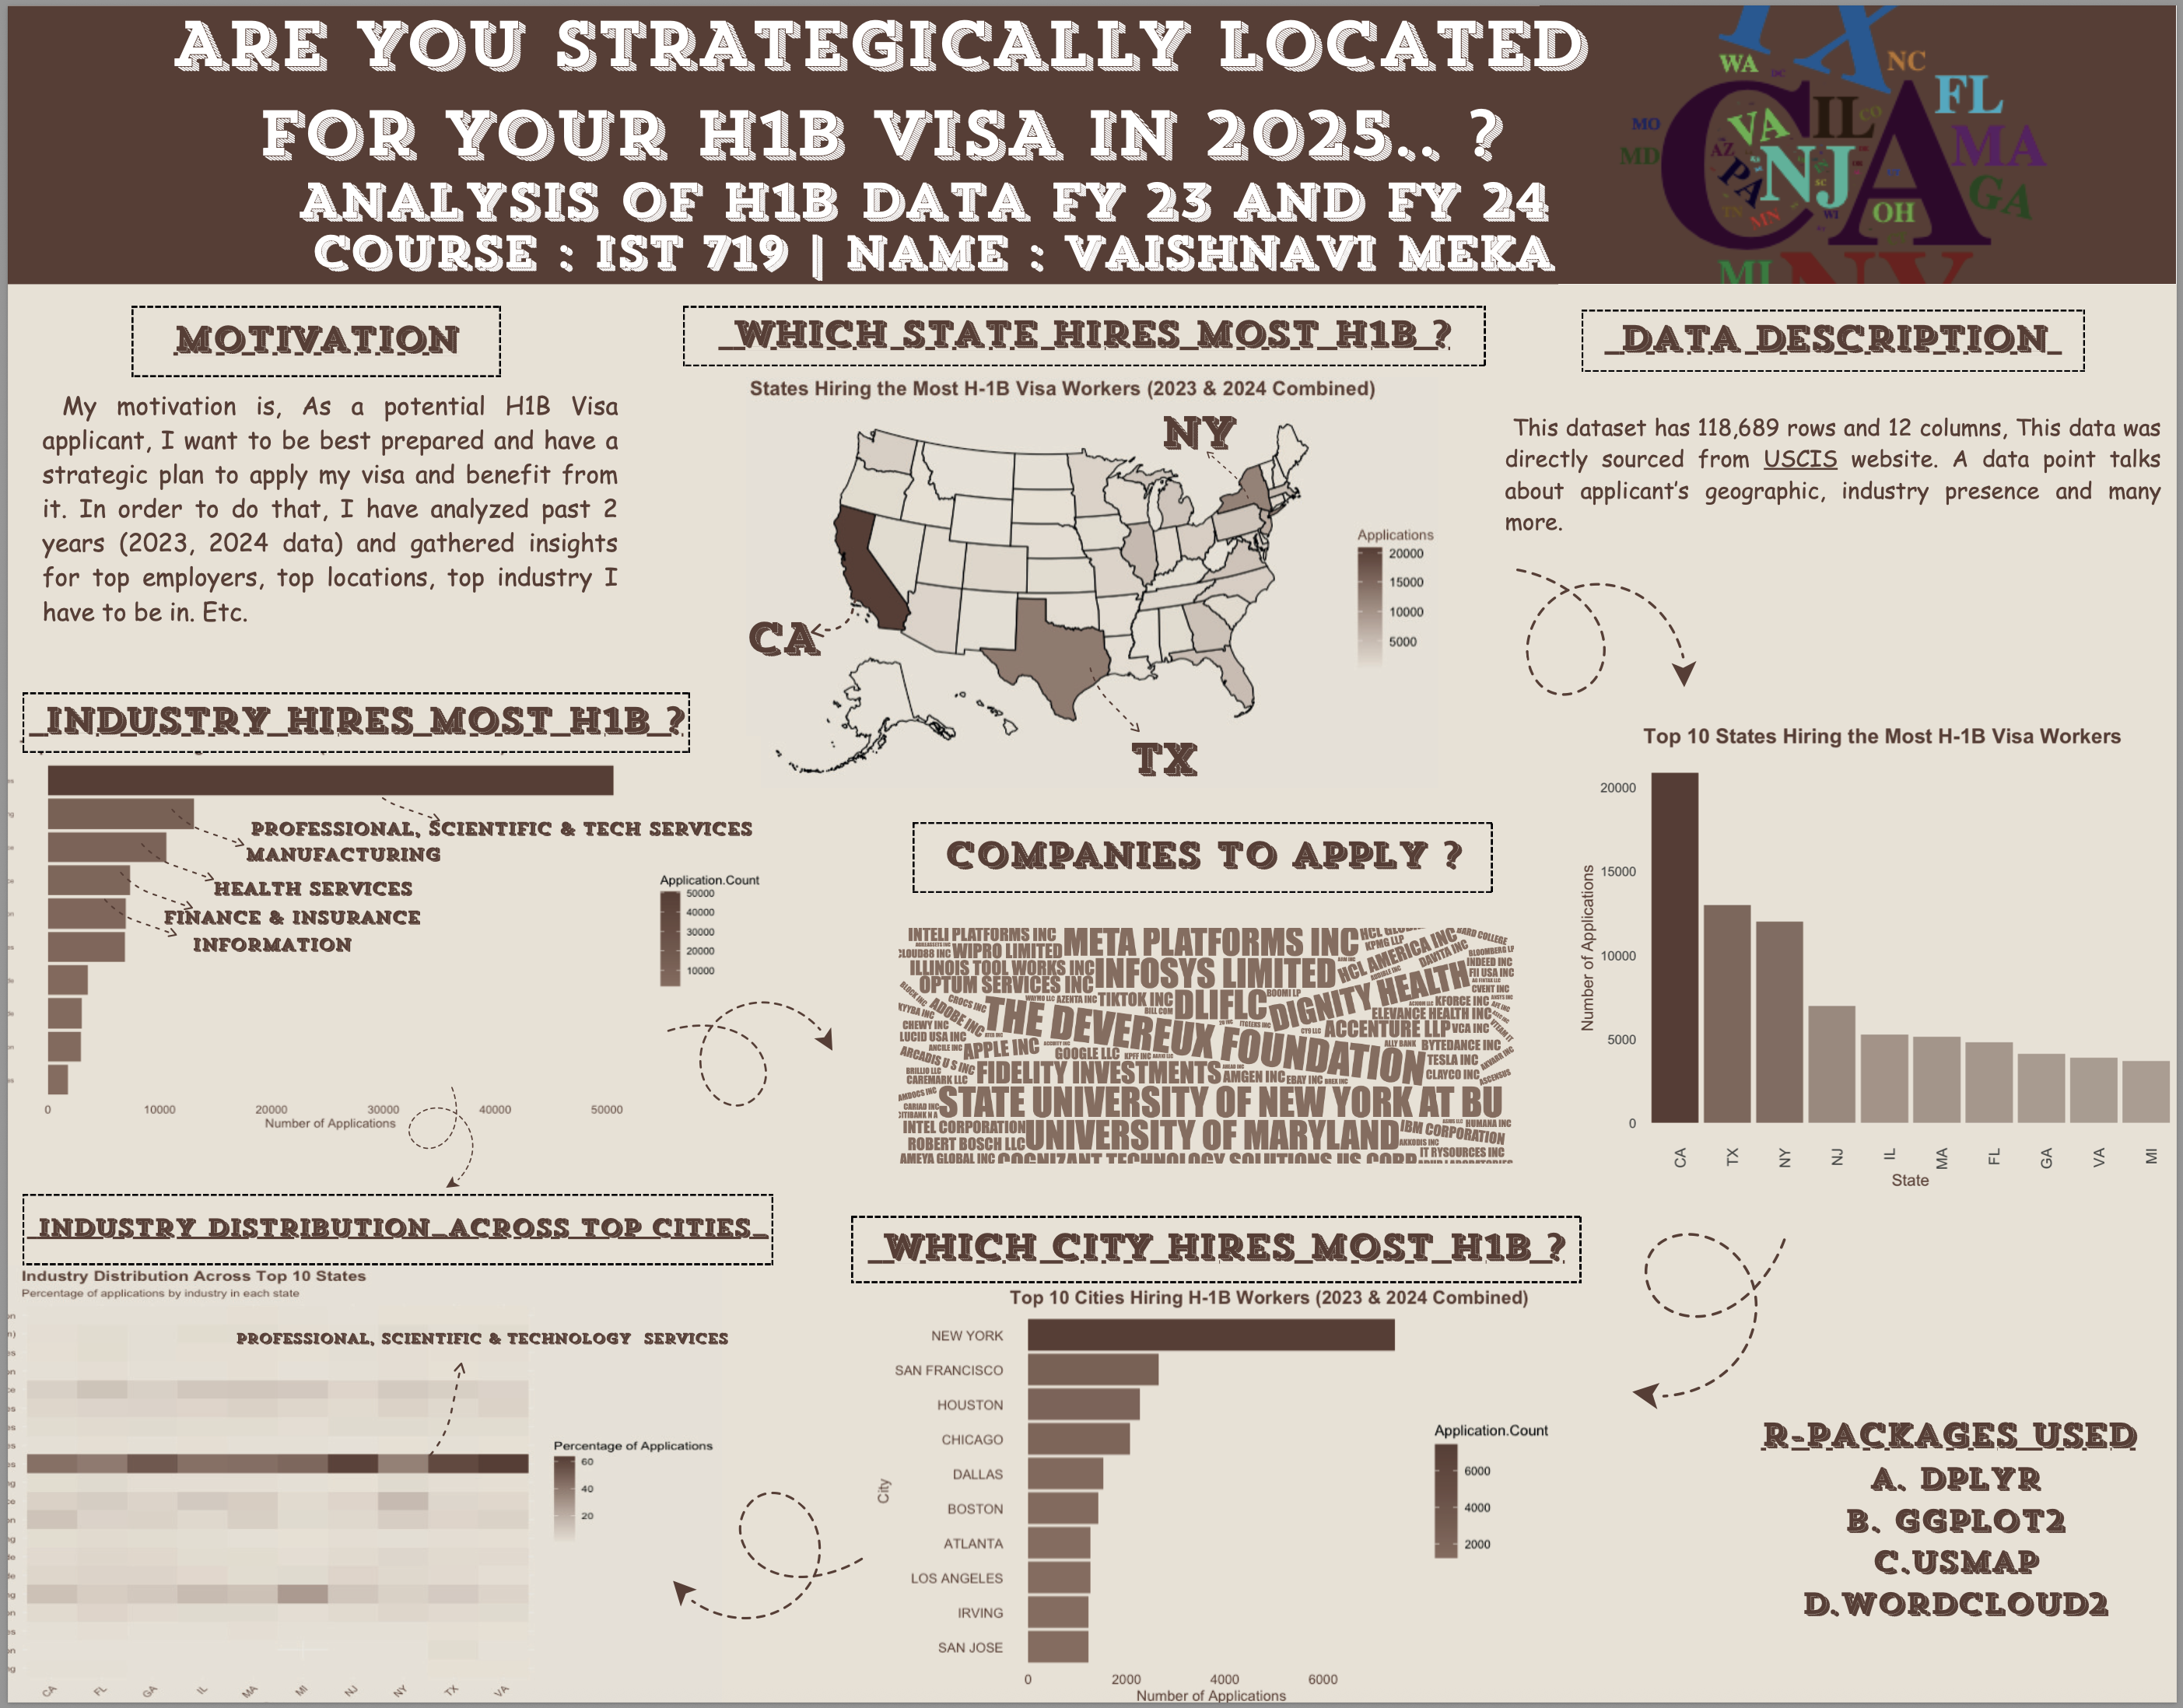

Slide 16
SKILLS I LEARNED FROM THIS PROJECT
1. Scripting in R: - By using a programmatic approach to do my tasks in the R language, I worked on generating graphs using R.
2. Preparing data & Plotting Data: - By preparing & analyzing H1B data using R, I developed ability to work with data & plot the data graphs using R.
3. Visual Graphs: - By working on this project I got to create visually appealing graphs using various tools and I choose to stick with three color pallet options to enhance my graphs visually.
4. Real-World Problem-Solving: - By utilizing skills learned in this project enabled me to solve real-world Students’ problem in terms of Job Visas.

Slide 17
REFLECTION ON THE PROGRAM
Throughout my Syracuse journey, I've evolved from a data novice to a confident analyst capable of extracting meaningful insights using visualizations, statistical modeling, and machine learning algorithms. I've mastered the art of transforming complex findings into actionable recommendations for diverse stakeholders. I'm deeply grateful to my brilliant professors who challenged me, supportive classmates who inspired me, and dedicated advisors who mentored me—each playing a crucial role in preparing me to succeed as a woman in this exciting field.

Slide 18
REFERENCES
Vaishnavi, Meka (2025) IST-652: MSADS Portfolio Scripting for Data Analysis https://github.com/vaishnavimeka27-data/IST-782-ADS-Portfolio/tree/main/IST%20652%20Scripting%20for%20Data%20Analysis
Vaishnavi, Meka (2025) IST-707: MSADS Portfolio Applied Machine Learning https://github.com/vaishnavimeka27-data/IST-782-ADS-Portfolio/tree/main/IST%20707%20Applied%20Machine%20Learning
Vaishnavi, Meka (2025) IST-719: MSADS Portfolio Information Visualization https://github.com/vaishnavimeka27-data/IST-782-ADS-Portfolio/tree/main/IST%20719%20%20Information%20Visualization

