Slide 1
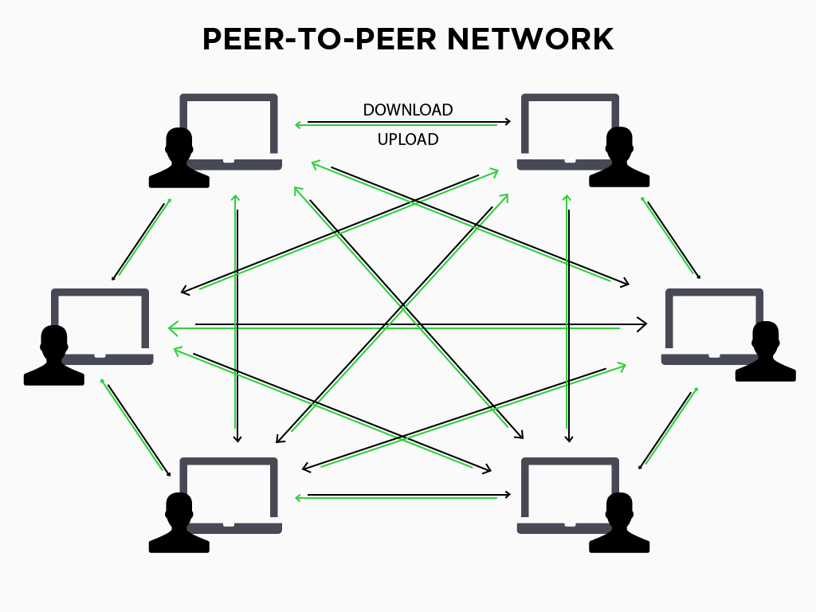

Project Title:
IP ADDRESS
FINDER AND GEOLOCATOR
IP Address finder and geolocater

Slide 2
OBJECTIVES:
To implement splay tree based data structure called Schord to improve the efficiency of locating resources in Peer To Peer Networks.
Implementation of fast searching operation using splay trees.
To find the IP Address of the devices in the peer to peer network from ID value.
To find the geolocation of sender’s and receiver’s device from IP addresses.

Slide 3
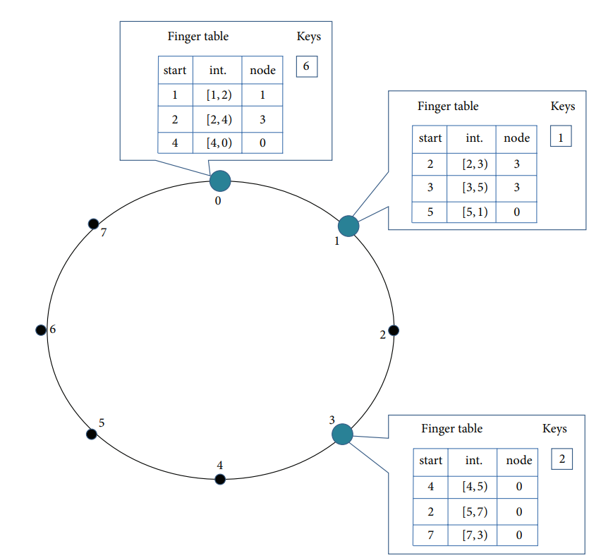
What is P2P?Schord?
Peer-to-peer (P2P) networks are a type of computer network where computers, also known as peers, directly connect and communicate with each other without the need for a central server.
Schord is a popular topology for structured peer-to-peer networks, where nodes are arranged in a ring.
A splay finger table is utilized to improve the efficiency of resource lookup in a P2P network. Each peer in the network maintains its own splay finger table, which keeps track of the locations of frequently accessed or important resources.
Total nodes=8
No. of fingers in finger table=3

Slide 4
BLOCK DIAGRAM:
Enter ID value of sender’s and receiver’s node
Get the IP addresses of node’s from lookup using Schord
Get the Geolocation of sender and receiver
Sends the data to appropriate
receiver
Get time required for searching receiver’s node.

Slide 5
Data Structures Used:
Splay finger table:
FOR GEOLOCATION:
Each Peer/node has a splay finger table.
Splay finger table includes:
(1)ST: the splay tree that provides insertion and lookup of the desired key;
(2) Count: a counter that records of the number of nodes in 𝑆𝑇;
(3):min ID value.
(4):max ID value.
For Geolocation, we have used a standard library in C which is “CURL”.
This library helps us to send https request to API .
This API retrives the geolocation of nodes from IP address ,which gets displayed to user.

Slide 6
Scope:
SChord is a highly scalable, available, and efficient resource location protocol. It takes advantage of splay tree where lookup caching can be used to accelerate later lookups. So the lookup performance increases based on the total number of lookups done on the node.
Theoretical analysis and simulation results both confirm the fact that the lookup performance in SChord has increased up to 62% in comparison with Chord.
Moreover with larger CACHE MAX the lookup performance can be further enhanced in SChord. Detailed studies in the design space of SChord also bring interesting and useful results in building a load balance P2Psystem in practice.

Slide 7
References Used:
Research Article based on Splay Tree based approach for efficient Resource Location in P2P Networks.
Stack Overflow website.
https://youtu.be/2v6KqRB7adg For Peer To Peer Networks.

Slide 8
Thank You!!!!
Group Members:
1.Vaishnavi Mulik-112110079
2.Shreya Yadav-112103157
3.Vaishnavi Thakur-112103147

