Slide 1
SHREE UTTAR GUJARAT BCA COLLEGE
A
Seminar Presentation on
TERRAFORM
Submited By:
Patel Vaishnavi Rajneshkumar
Exam no : 3715
Guided By:
Dr. Khushbu A.Patel

Slide 2
Sr No. | Title
1 | Introduction Of Terraform
2 | Installing and Setting Up Terraform
3 | Terraform Core Architecture & Components
4 | Configuration and Management with Terraform
5 | Terraform Workflow & Lifecycle
6 | Configuring Terraform for Cloud Providers
7 | Terraform for Infrastructure Automation (CI/CD)
8 | Terraform for Containers
9 | Terraform for Kubernetes
10 | Real-World Case Studies & Industry Applications
11 | Security & Compliance in Terraform
12 | Future of Terraform
13 | Conclusion
14 | References

Slide 3
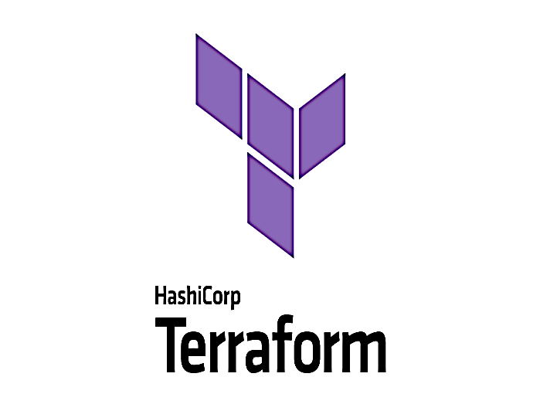

Introduction to Terraform
Terraform is open-source infrastructure as code (IaC) tool.
It’s developed by HashiCorp that allows you to define, provision, and manage infrastructure using a declarative configuration language called HashiCorp Configuration Language (HCL) or JSON.

Slide 4

What is Infrastructure as Code (IaC)?
Tools allow You to manage infrastructure with configuration files rather than through a graphical user interface.
IaC allows you to build, change, and manage your infrastructure in a safe, consistent, and repeatable way by defining resource configurations that you can version, reuse and share.

Slide 5
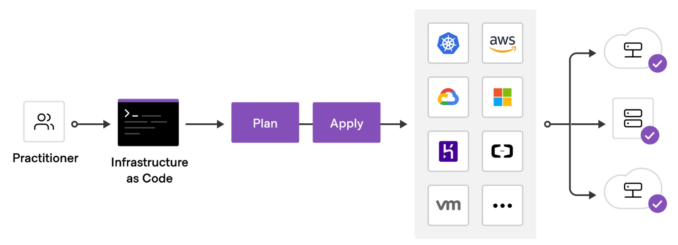
Terraform Workflow

Slide 6
Terraform Key Features
1
Infrastructure as Code (IaC)
2
Multi-Cloud Support
Define infrastructure using declarative configuration files.(HCL -HashiCorp Configuration Language)
Works with AWS, Azure, GCP, and many other providers.
State Management
4
Modularity & Reusability
3
Maintains a state file to track infrastructure changes.
Supports reusable modules for better organization.
5
Execution Plans
6
Resource Graph
5
Previews changes before applying them to infrastructure.
Builds and manages dependencies between resources efficiently.
Integration with CI/CD
Pipelines
Secret Management
7
8
Works with GitHub Actions, Jenkins, GitLab CI/CD, and other DevOps tools.
Integrates with Vault and environment variables for secrets.

Slide 7
Advantages of Terraform
Consistency: Eliminates manual errors with codified infrastructure.
Version Control: Integrates with Git for change tracking.
Automation: Faster deployments compared to manual processes.
Community & Ecosystem: Large community + registry of pre-built modules.
Immutable Infrastructure: Replaces resources instead of modifying them (reduces drift).

Slide 8
Disadvantages of Terraform
State file risks – can expose sensitive data if not secured properly.
Learning curve for HCL and complex logic.
Lack of native rollback on failure.
Recreation of resources for minor changes can cause downtime.
Managing large environments requires strong structuring and best practices.

Slide 9

Installing Terraform
Windows
Linux
Download the Terraform
binary. Add it to your
system's PATH.
Use a package manager
like apt or yum. Install the
Terraform package.
Mac
Use Homebrew to install Terraform.
Run brew install terraform.

Slide 10




First Configuration
Create a File
Write Configuration
Apply
Create a file named
main.tf.
Define a resource.
Example: AWS EC2 instance.
Run terraform apply to
provision infrastructure.

Slide 11
Terraform Architecture
Providers
Resources
State
Providers interact with cloud platforms. Examples include AWS, Azure, and Google Cloud.
A resource is a component of infrastructure. Virtual machines, databases, and networks are examples.
Terraform state(terraform.tfstate) tracks your infrastructure current status. Remote state is recommended for collaboration.
This state file can be stored locally or remotely , with remote storage options enabling collaboration by sharing the state across teams and environments.
provider "aws" { region = "us-west-2" }
resource "aws_instance" "example" { ... }

Slide 12






Terraform Language (HCL)
Declarative
Describe the desired end state. Terraform figures out how to achieve it.
Configuration Files
Written in HashiCorp Configuration Language (HCL). Easy to read and write.
Resources
Represent infrastructure components. Examples: servers, networks, databases.
Variables
Define dynamic values to make configurations reusable and flexible.
Modules
Reusable configuration blocks to simplify complex deployments.
Outputs
Retrieve and expose values from Terraform configurations for use elsewhere.

Slide 13
Terraform Configuration: HCL Syntax
Blocks
Variables
Data Sources
Modules
Define resources like instances. Example:
Parameterize for reuse. Define:
Fetch existing infrastructure info. Example:
Group related resources and variables for reusability. Use the Terraform Registry.
resource "aws_instance" "example" { ... }
variable "instance_type" { default = "t2.micro" }
data "aws_ami" "ubuntu" { ... }
. Use:
instance_type = var.instance_type

Slide 14




Terraform Lifecycle
plan
init
1
Creates an execution plan. Shows what will be created, changed, or destroyed.
Initializes the Terraform working directory. Downloads providers.
2
destroy
4
apply
Destroys all resources managed by Terraform.
3
Applies the changes to the infrastructure. Provisions resources.

Slide 15

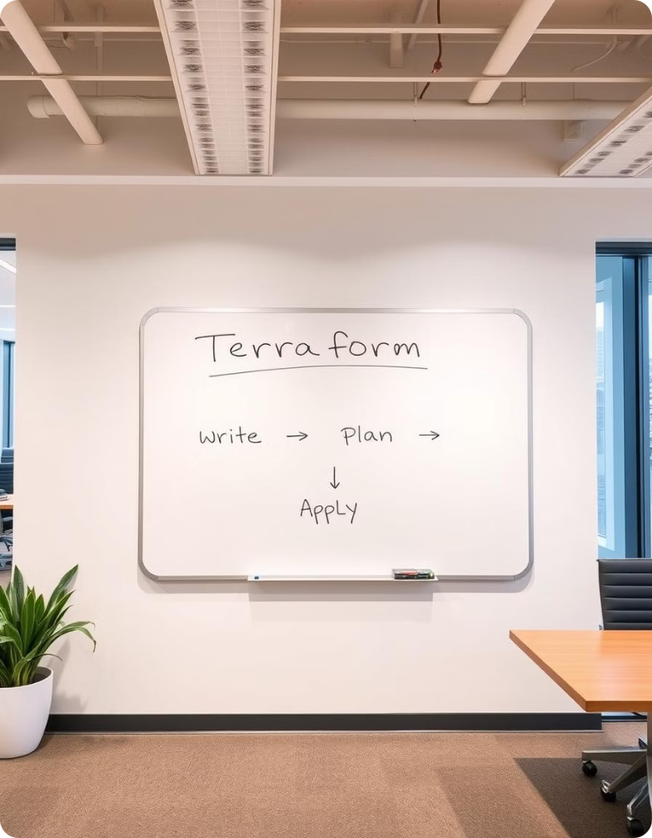



How to Use Terraform
Terraform streamlines your infrastructure management. Begin with writing, planning, and applying the configuration.
Write
Create Terraform files defining your infrastructure. Use a simple, declarative language.
Plan
Review the execution plan. Understand proposed changes before applying.
Apply
Provision the infrastructure resources. Deploy them into your cloud provider.

Slide 16




Configuration and Cloud Provider
Configuration
Cloud Providers
Modules
Terraform interacts with cloud platforms. AWS, Azure, GCP are examples.
Reusable configurations are encapsulated. They simplify complex deployments.
Terraform configurations define resources. This defines your infrastructure.

Slide 17
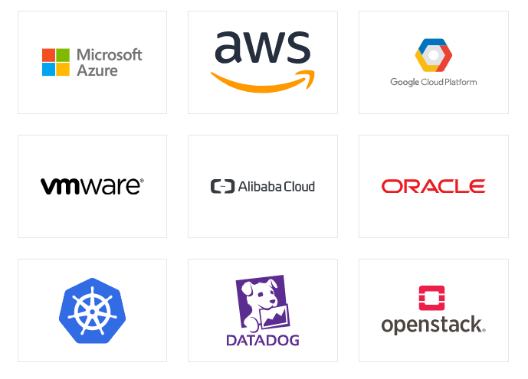
Terraform for Cloud Providers
AWS
Azure
Terraform supports a wide range of AWS services, including EC2, S3, and VPC.
Terraform can be used to deploy and manage Azure resources like virtual machines, storage, and networking.
OpenStack
GCP
Open-source cloud for private and public cloud infrastructure.
Terraform provides support for Google Cloud Platform services, such as Compute Engine, Cloud Storage, and Cloud SQL.
Kubernetes (K8s)
Oracle Cloud Infrastructure (OCI )
Container orchestration for automated deployment and scaling.
Enterprise-grade cloud for databases and applications.

Slide 18
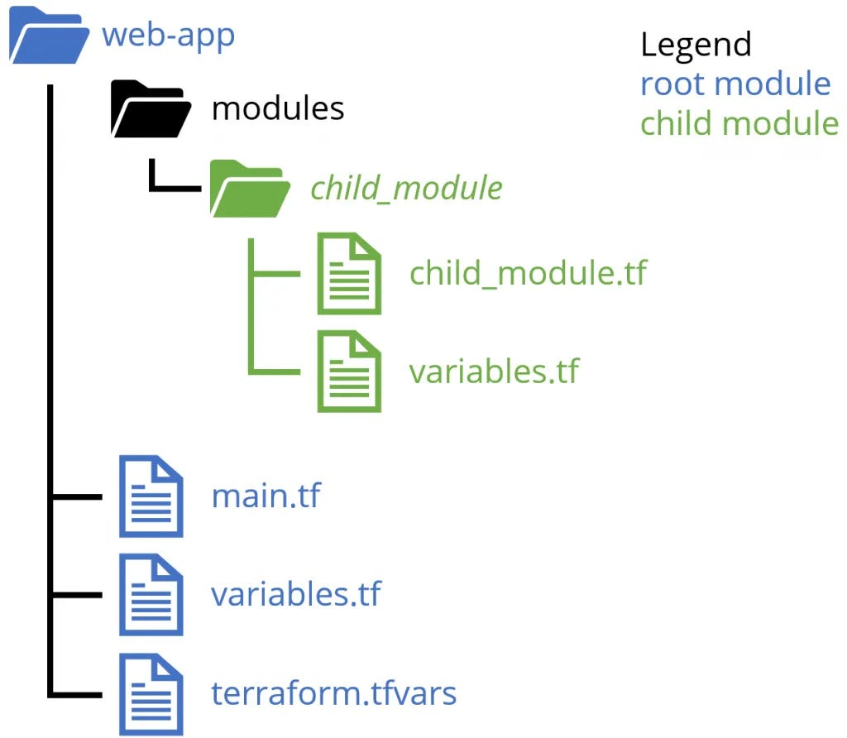





Terraform Modules
Reusable
Module Structure
Registry
Self-contained packages of configurations.
Public repository for module discovery.
`main.tf`, `variables.tf`, and `outputs.tf` files.
Nested Modules
Versioning
Self-contained packages of configurations.
Modules support versioning to ensure consistent deployments.

Slide 19
Terraform for Automation (CI/CD)
1
Version Control
2
CI System
3
Automated Deployment
Integrating Terraform with Continuous Integration and Continuous Deployment (CI/CD) enables automated, efficient, and consistent infrastructure provisioning and management. This approach ensures that infrastructure changes are tested, reviewed, and deployed seamlessly.
Use tools like Jenkins, GitLab CI, or CircleCI

Slide 20


Terraform and Containers
Terraform simplifies containerized application deployment and infrastructure management by integrating with various container orchestration platforms like Docker, Kubernetes, and AWS ECS. Using Terraform, teams can define containerized environments as Infrastructure as Code (IaC), ensuring consistency, automation, and scalability.
Docker
Kubernetes
Cloud Services
Deploy and manage containers using Terraform's Docker provider.
Orchestrate container deployments with the Kubernetes provider.
Integrate with cloud-native container services.

Slide 21
Terraform for Kubernetes
Cluster Provisioning
Use Terraform to create and configure your Kubernetes cluster on any cloud provider.
1
Resource Management
Deploy and manage Kubernetes resources like deployments, services, and ingress controllers.
2
Security & Compliance
Use Terraform to create and configure your Kubernetes cluster on any cloud provider.
3
Networking & Load Balancing
Automate the creation of networking components like service meshes, load balancers, and ingress controllers.
4
Monitoring & Logging
Integrate monitoring tools like Prometheus and logging solutions like Fluentd to track cluster health and performance
5

Slide 22
Real-World Case Study and Industry Application
Financial Services
Healthcare
E-commerce
Terraform automates infrastructure for trading platforms, ensuring high availability and low latency. It ensures compliance with regulations like PCI DSS and reduces deployment times from weeks to hours.
It manages HIPAA-compliant infrastructure in the cloud, safeguarding sensitive patient data. Terraform enables rapid scaling of healthcare applications to meet patient needs and ensures data privacy and security.
Terraform automates infrastructure for online retail platforms, optimizing performance and reliability. It handles seasonal traffic spikes efficiently, ensuring a seamless shopping experience for customers and supports rapid deployment of new features and updates.

Slide 23

Security and Compliance
Access Controls
Policy Enforcement
Secrets Management
Access Control ensures that only authorized users can apply Terraform changes.
Use IAM Roles & Policies (AWS, Azure, GCP) to limit Terraform access.
Policy enforcement ensures that Terraform deployments follow security, cost, and compliance standards.
It helps organizations prevent misconfigurations, unauthorized changes, and policy violations.
Terraform configurations should never store sensitive credentials directly.
Example:
variable "db_password" {
type = string
sensitive = true
}

Slide 24

Future of Terraform
1
Improved Integrations
Deeper integration with cloud providers and other tools.
2
Enhanced Automation
More sophisticated automation capabilities for complex workflows.
3
AI-Powered Insights
AI to analyze configurations and suggest improvements.
4
State management & performance
Improvements
Terraform will focus on better state management to reduce
latency in large infrastructures.
5
Low-Code & No-Code Terraform Solution
Terraform may introduce more user-friendly
low-code interfaces.

Slide 25




Best Practices & Conclusion
Code
Modularize, use variables and comments.
1
2
Version Control
Git, branches and pull requests.
Testing
Security
Automated validation.
4
3
Secure state, least privilege IAM.
Terraform improves infrastructure management. Follow best practices for reliability and security. It allows for more scalability.

Slide 26
References
https://developer.hashicorp.com/terraform/docs.
https://www.geeksforgeeks.org/
https://www.terraform.io/

Slide 27


