Slide 1
MANAGEMENT OF SOFTWARE PROJECT
Presentation on
Doctor Consultation System
Presented by:- MTech Computer Engineering
232190007 | Chetan Phogat
232191015 | Vaishnavi Patil
Under Guidance of
Prof. Om Gopalani

Slide 2
INTRODUCTION
A doctor consultation system in a hospital software is an online platform designed to enhance the process of scheduling and conducting medical consultations between patients and healthcare providers.
This system typically offers several key features:
Appointment Scheduling
Patient Management
Doctor Availability Management
Prescription Management
Billing and Payment Integration

Slide 3
PROJECT OBJECTIVES
Develop a user-friendly doctor consultation system accessible via web platforms.
Allow patients to schedule appointments with doctors based on their availability.
Enable secure and confidential communication between patients and doctors.
Implement a system for patients to securely upload medical history, test results, and other relevant documents.
Provide features for doctors to review patient records, prescribe medications, and recommend further tests or treatments.
Ensure compliance with healthcare regulations regarding patient data privacy and security.
Integrate payment processing for consultation fees and other medical services.

Slide 4
PROJECT SCOPE
Project Title: Doctor Consultation System Development
Scope:
The doctor consultation system project will include the development of a comprehensive platform for facilitating medical consultations between patients and healthcare professionals.
The scope encompasses web design, development, testing, and deployment. Key features include appointment scheduling, secure communication channels, medical record management, prescription services, and payment integration.
The system will adhere to relevant healthcare regulations and standards to ensure patient data privacy and security.
Exclusion: The Doctor consultation module will not include medical services, diagnosis, medical records, pathology, radiology, or treatment.

Slide 5
DELIVERABLES
Project Plan
Requirements Documentation
System Design
Codebase
Test Plan and Test Cases
User Interface (UI) Designs
User Manuals and Documentation
Training Materials
Deployment Packages
Release Notes
Maintenance and Support Plan
Project Closure Report

Slide 6
TEAM RESPONSIBILITIES
Team Member | Vaishnavi Patil | Chetan Singh Phogat | Shubham Tedginkeri
Task
Requirement | Communicate with client and gather requirement | Analyse requirements (NF And NFR) | Prioritize requirement
Planning | Use Cases, Risk management, Gantt chart | Tech stack, Risk Matrix, WBS | -
Design | DFD, HLD | Software architecture, DFD, HLD | ER diagram, LLD
Estimation | Effort estimation | Cost estimation | Layed Off
Testing | Unit test & Black box test cases | API test cases, Integration test cases | Layed Off

Slide 7
ASSUMPTIONS
Assumptions
Module | Assumptions Made | Reason
Technical | Programming Languages | Based on previous project done on the same tech stack
Testing | Probability of Occurrence | Prioritizes testing efforts on the most important parts of the system.
 | Impact
 | Multiple concurrent users | Multiple users can login and book appointment simultaneously
Cost Estimation | Percentage of projected profit | A 20% profit margin is a common benchmark in software development projects.

Slide 8
REQUIREMENTS
The user must be able to register and login through an online portal and book an appointment
Users must be able to book an appointment by visiting the hospital reception.
Slot booking according to available slots and doctor's availability.
Email and SMS updates for appointment confirmation and cancellation.
A unique ID is given to each patient after registration.
Patient visits the hospital, take patient medical history
Register the patient and book a slot.
Doctor consultation.
Payment at reception (cash, CC, DB, UPI)
Mapped with medical records and pharmacy.

Slide 9
FUNCTIONAL REQUIREMENTS
Interface Name | Data to be interfaced | Mandatory Fields | Frequency of update
Consultation | Patient Unique ID | Auto-generated | Once
 | Patient Name | * | Every consultation
 | Department | * | Every consultation
 | Doctor to be consulted | * | Every consultation
 | Date and time | * | Every consultation
 | Relation with patient | If applicable | Every consultation
Medical Records | Patient ID | Mapped with patient profie | Once
 | Major surgery/ Food allergy/ Diseases / Medication | * | Once
 | Department | * | Every consultation
 | Doctors | * | Every consultation/availability
 | Tests | If applicable | After every test
 | Diagnosis and reports | If applicable | After every test
Pharmacy | Patient ID | Mapped with patient profile | On first purchase
 | Doctors prescription | * | If prescribed
 | Inventory | * | After every purchase/ Restock
 | Payment Gateway | * | After every purchase
 | Bill | * | After every purchase
 | Purchase History | * | Every purchase up to 90 days
Payment Gateway | Patient ID | Mapped with patient profile | Once
 | Transaction ID | * | Every payment
 | Department | * | Every payment
 | Inpatient /Outpatient | * | Every payment
 | Payment Mode | * | After every payment(Success/failure)
 | Bill | * | After every purchase
 | Purchase History | * | Every purchase up to 90 days

Slide 10
NON - FUNCTIONAL REQUIREMENTS
Non-functional Attribute | Applicable | Remarks
Performance | Yes
Security | Yes | Two factor authentication
Compatibility | Yes | Webpage, So it can be easily accessible by client easily
Usability | Yes | Use friendly interface
Scalability | Yes | If no. of patient, hospital branch increases
Portability | Yes | Platform independent
Reliability | Yes
Availability | Yes | 99.99% available on cloud
Data Migration | Yes | Migration will be easy on cloud
Interoperability | Yes | Exchanging data with other module
Recoverability | Yes | AWS Backup service
Integrity | Yes | Role based authorization for data integrity
Documentation | Yes | SRS, DFD, ER etc.

Slide 11
TECH STACK
Technology | Name
Programming Language | Java
Frontend | HTML, CSS, Javascript
Backend Framework | Spring Boot
Front end | Bootstrap, Angular.JS
Security | Spring Security
Microserivces Communication | Feign-Client, REST Template
Config Server | Eureka Server, Github
Database | MySQL
API Gateway | Spring Netflix ZUL
Cloud | Spring Cloud
Service Registry | Eureka Server
Build Tool | Maven
Deployment | AWS(Cloud)
Dashboard | Hystrix
Documentation API | OpenAPI Swagger

Slide 12
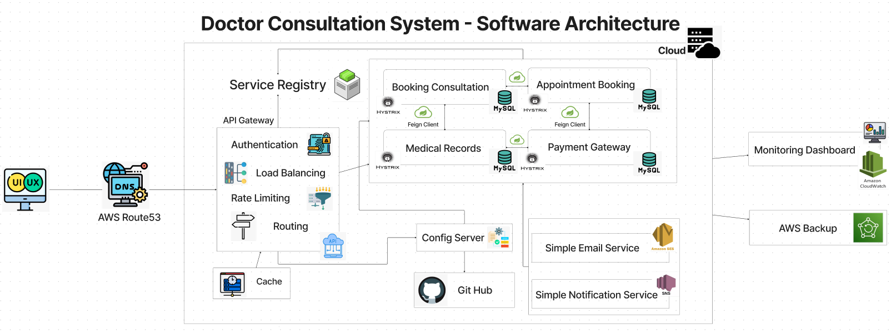

Slide 13
DATA FLOW DIAGRAM
Zero Level DFD | Context Diagram
First Level DFD | General Overview
Second Level DFD | Detailed View

Slide 14
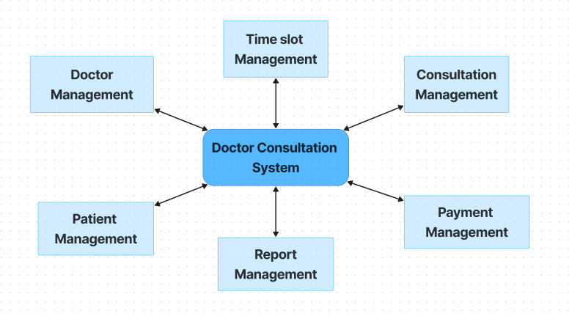
DOCTOR CONSULTATION SYSTEM - ZERO LEVEL DFD

Slide 15
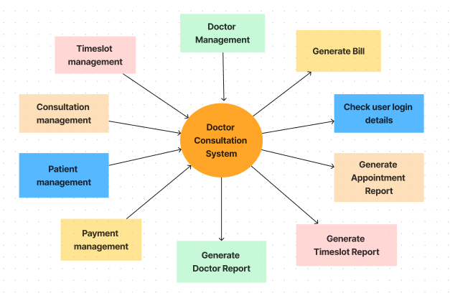
DOCTOR CONSULTATION SYSTEM – FIRST-LEVEL DFD

Slide 16
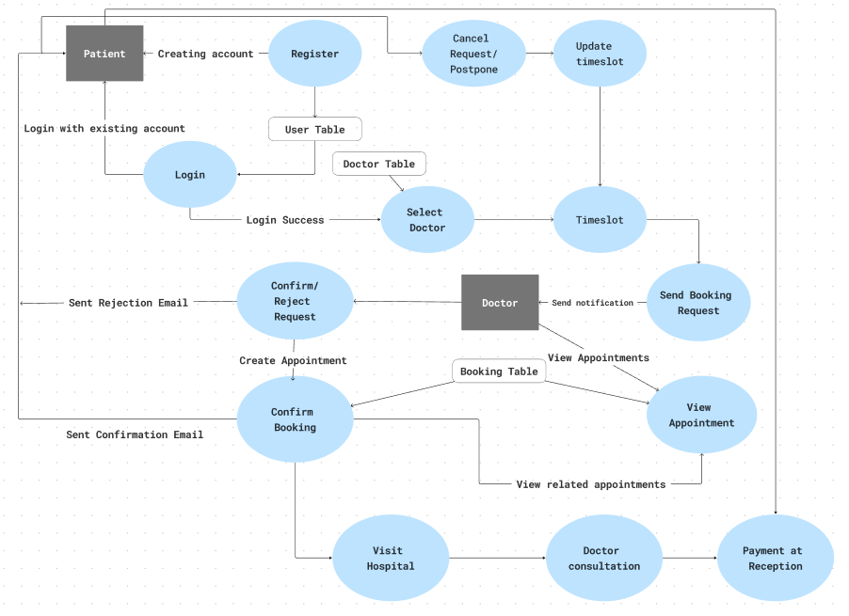
DOCTOR CONSULTATION SYSTEM - SECOND LEVEL DFD

Slide 17
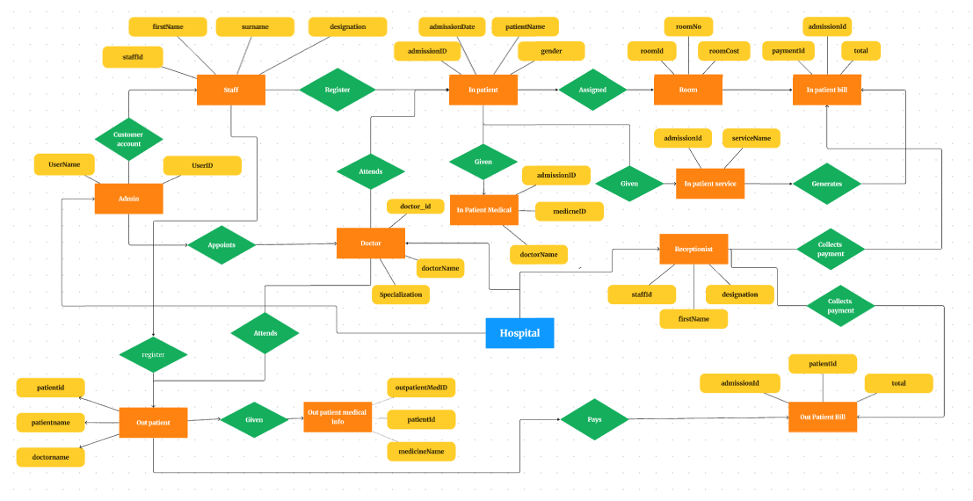
DOCTOR CONSULTATION SYSTEM - ER

Slide 18
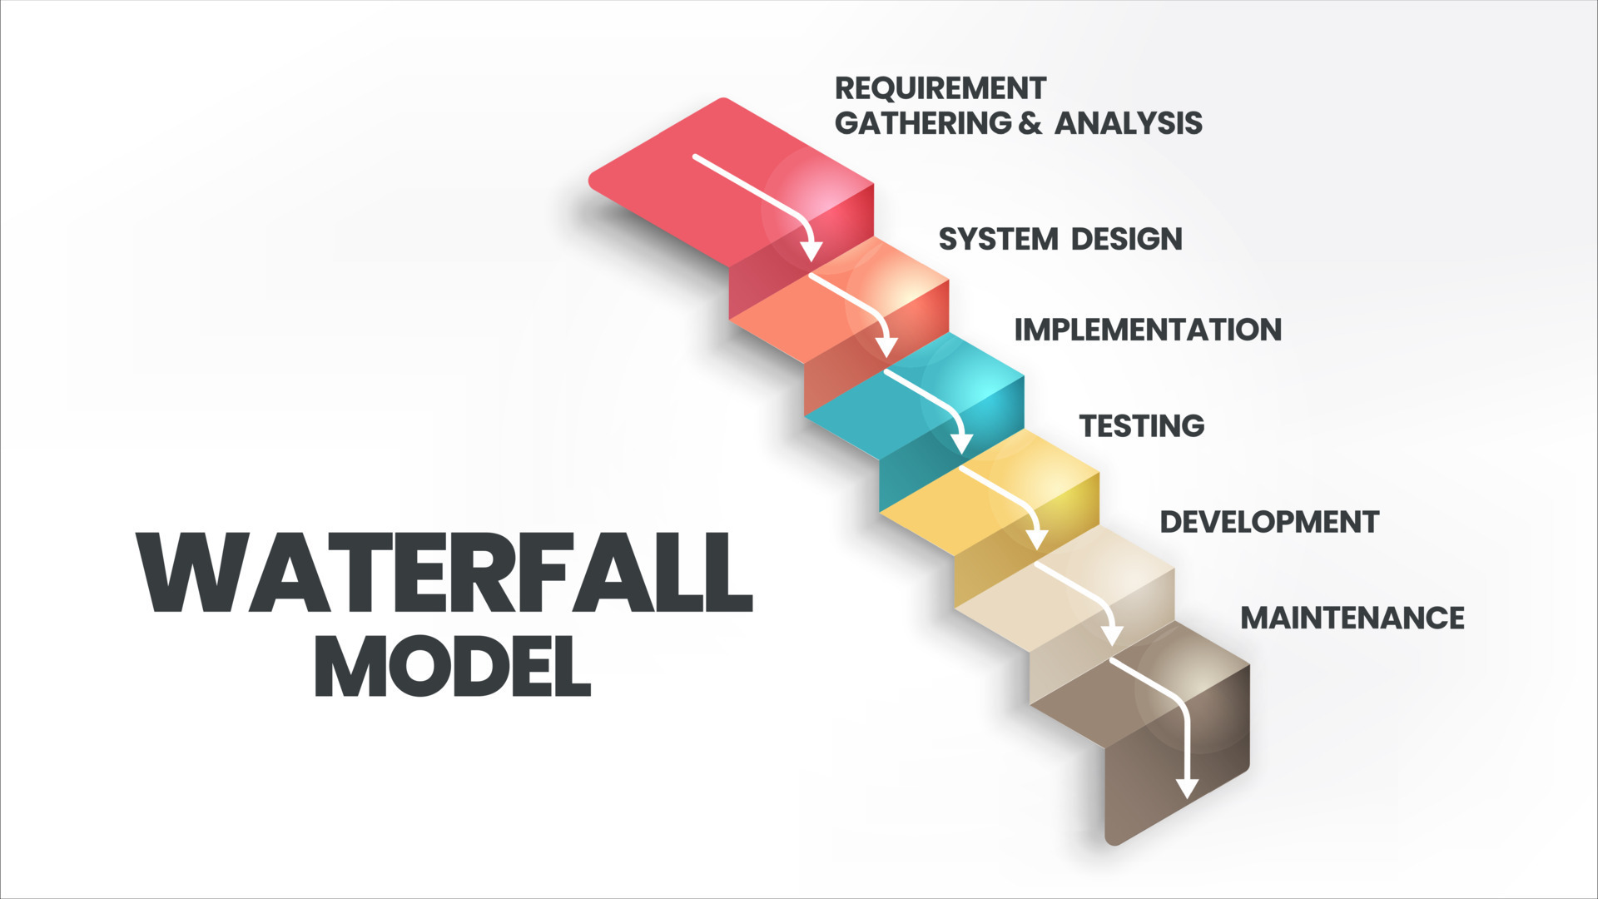

Slide 19
WHY WATERFALL?
Clarity of Requirements:
The waterfall model is best suited when the requirements are well-understood and unlikely to change significantly throughout the project. In the case of a doctor consultation system, the requirements might have been clear from the outset, such as patient registration, appointment scheduling, medical history recording, consultation recording, etc.
Documentation:
The waterfall model emphasizes documentation at each phase, This can be helpful in a hospital because we need to follow rules closely, for auditing purposes, It's like having a big instruction manual for building something step by step.

Slide 20
SIZE ESTIMATION – USE CASE POINT
Factors Calculation
TCF | Technical Complexity Factor | 0.94
EF | Environmental Factor | 0.815
UUCP | Unadjusted Use Case Points | 110
AW | Actor Weighting | 18
Calculation of Use Case Points
UCP | Use Case Points | 98.1
Calculation of Estimated Effort
 | Hours of Effort per Use Case Point | 28
Hours of Effort |  | 2,746

Slide 21
WORK BREAKDOWN STRUCTURE
Task No. | Task Description | Task Owner | Task Status | Days to complete | Description
1 | Requirement |  |  | 34.4
1.1 | Requirement Gathering | Project Manager, Business Analyst | Completed | 34.4 | Understanding project objective and scope
2 | Initiation Phase |  |  | 13.7
2.1 | Set up hardware | Developers | Completed | 4.7 | Setting up initial project work
2.1.1 | Install software |  | Completed | 2
2.1.2 | Format software |  | Completed | 4
2.1.3 | Test Environment Setup |  | Completed | 3
3 | Requirement Analysis |  |  | 41.2
3.1 | Requirements Study and Analysis | Project Manager, Business Analyst | Completed | 15 | Detailed understanding for better accuracy
3.1.1 | Prototype |  | Completed | 10
3.2.1 | Create |  | Completed | 10
3.2.2 | P2P Review |  | Completed | 3
3.2.3 | Rework |  | Completed | 3.2
4 | Functional Specifications |  |  | 30.96
4.1 | Requirements Study | Project Manager, UI/UX Designer, Business Analyst | Completed | 12 | Defining system functionality clearly
4.1.1 | Create |  | Completed | 9
4.1.2 | Peer to Peer Review |  | Completed | 3
4.1.3 | Peer Group Review |  | Completed | 4
4.1.4 | Rework |  | Completed | 2.96

Slide 22
5 | Design |  |  | 48.16
5.1 | HLD | UI/UX Designer/Developer | Completed | 15 | Structuring for robust implementation
5.1.1 | Create |  | Completed
5.1.2 | Peer Group Review |  | Completed
5.1.3 | Rework |  | Completed
5.1 | LLD |  | Completed | 20
5.1.1 | Module_01(Name) |  | Completed
5.2.1 | Create |  | Completed
5.2.2 | P2P Review |  | Completed
5.2.3 | Rework |  | Completed
5.3 | Database Design |  | Completed | 13.16
5.1.1 | Create |  | Completed
5.1.2 | P2P Review |  | Completed
5.1.3 | Rework |  | Completed
6 | Coding |  |  | 82.56
6.1 | Components | Full Stack Developer | Completed |  | Translating designs into functional code
6.2 | Web Pages |  | Completed | 27.56
6.2.1 | Create |  | Completed
6.2.3 | Self Review |  | Completed
6.2.4 | P2P Review |  | Completed
6.2.5 | Rework |  | Completed
6.3 | Classes |  | Completed | 30
6.3.1 | Create |  | Completed
6.3.2 | Self Review |  | Completed
6.3.3 | P2P Review |  | Completed
6.3.4 | Rework |  | Completed
6.4 | Interfaces |  | Completed | 25
6.4.1 | Create |  | Completed
6.4.2 | Self Review |  | Completed
6.4.3 | P2P Review |  | Completed
6.4.4 | Rework |  | Completed

Slide 23
7 | Testing |  |  | 34.4
7.1 | Study | Developer, Tester | Completed | 4.4 | Ensuring system meets requirements
7.1.1 | Design Document |  | Completed
7.12 | Requirement Document |  | Completed
7.2 | Unit test cases |  | Completed | 5
7.2.1 | Create |  | Completed
7.2.2 | Peer to Peer Review |  | Completed
7.2.3 | Peer Review |  | Completed
7.2.4 | Rework |  | Completed
7.3 | Integration Test Cases |  | Completed | 5
7.3.1 | Create |  | Completed
7.3.2 | Peer to Peer Review |  | Completed
7.3.3 | Peer Review |  | Completed
7.3.4 | Rework |  | Completed
7.4 | Unit Testing |  | Completed | 6
7.4.1 | Testing |  | Completed
7.4.2 | Defect fixing |  | Completed
7.5 | Integration Testing |  | Completed | 10
7.5.1 | Testing |  | Completed
7.5.2 | Defect fixing |  | Completed
7.6 | Review |  | Completed | 4
8 | Deployment |  |  | 20.64
8.1 | Environment Setup | Full Stack Developer | Completed | 20.64 | Implementing the solution
8.1.1 | Build |  | Completed
8.1.2 | Documentation |  | Completed
8.2 | Post Depolyment task |  | Completed
8.2.1 | Backup and recovery |  | Completed
9 | Acceptance Support |  |  | 17.2
9.1 | Acceptance Testing | Tester, Project Manager | Completed | 5 | Stakeholder agreement and approval
9.2 | Defect Fixing |  | Completed | 7.2
9.3 | Regression Testing |  | Completed | 5
10 | User Documentation |  |  | 13.7
10.1 | Create | Project Manager, Developer | Completed | 8 | Providing in-depth documentation for users
10.2 | Review |  | Completed | 2
10.3 | Rework |  | Completed | 3.7
11 | Training |  |  | 6.9
11.1 | Project Related | Developer | Completed | 6.9 | Equipping users with necessary skills

Slide 24
GANTT CHART
Sr. No | Task Name | Start Date | End Date | Duration | Duration(without holiday) | PD/Task | PH/Task
1 | Requirement | 15-Jan | 08/Feb | 25 | 17 | 34 | 274.6
2 | Initiation Phase | 09/Feb | 19/Feb | 11 | 7 | 14 | 109.84
3 | Requirement Analysis | 20/Feb | 19/Mar | 29 | 21 | 41 | 329.52
4 | Functional Specifications | 20/Mar | 04/Apr | 16 | 10 | 31 | 247.14
5 | Design | 05/Apr | 30/Apr | 26 | 16 | 48 | 384.44
6 | Coding | 02/May | 01/Jul | 62 | 42 | 83 | 659.04
7 | Testing | 02/Jul | 10/Jul | 23 | 17 | 21 | 164.76
8 | Depolyment | 11/Jul | 02/Aug | 9 | 7 | 34 | 274.6
9 | Acceptance Support | 05/Aug | 16/Aug | 14 | 9 | 17 | 137.3
10 | User Documentation | 20/Aug | 27/Aug | 11 | 5 | 14 | 109.84
11 | Training | 28/Aug | 30/Aug | 3 | 3 | 7 | 54.92
In-Total |  |  |  | 229 | 154 | 344 | 2746

Slide 25
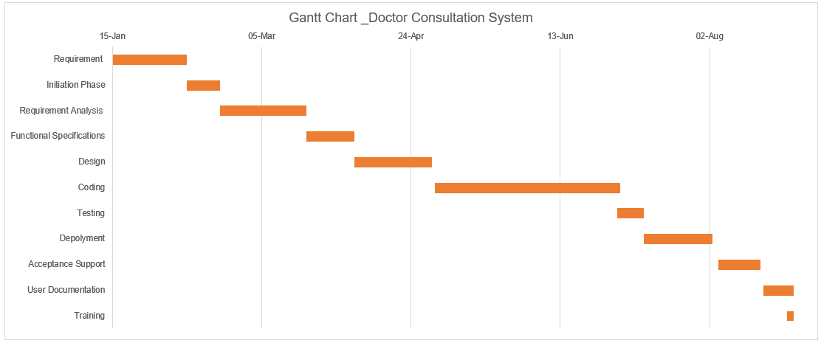
GANTT CHART

Slide 26
RESOURCE REQUIREMENTS
SALARIES
Role | Quantity | Cost Per Month Per person | Total Cost(8 Months)
Project Manager | 1 | 1,00,000 | 8,00,000
Business Analyst | 1 | 75,000 | 6,00,000
UI/UX Designer | 1 | 60,000 | 4,80,000
Full Stack Developer | 2 | 85,000 | 13,60,000
Testers | 1 | 75,000 | 6,00,000
Security Guard | 1 | 20,000 | 1,60,000
Office Cleaner | 1 | 15,000 | 1,20,000
TOTAL | 8 | 4,30,000 | 41,20,000

Slide 27
COST ESTIMATION – FIXED COST
Fixed Cost
Description |  | Monthly Cost (Rs) | Total Cost (Rs) (8 Months)
Software Licenses | Spring Boot (Free and open-source) | 0 | 0
 | Spring Security (Free and open-source) | 0 | 0
 | Feign-Client (Free and open-source) | 0 | 0
 | REST Template (Free and open-source) | 0 | 0
 | GitHub (for Config Server) | 0 | 0
 | MySQL (Free and open-source) | 0 | 0
 | Spring Cloud (Free and open-source) | 0 | 0
 | Eureka Server (Free and open-source) | 0 | 0
 | Maven (Free and open-source) | 0 | 0
Office Space | Office rent and utilities | 40,000 | 3,20,000
Total Cost |  | 40,000 | 3,20,000

Slide 28
COST ESTIMATION – CAPITAL COST
CAPITAL COST
Type | Description | Total Cost (Rs)
Development Laptops | 0 | 0
Hardware Servers | Development laptops for team members | 0
 | Wi Fi router | 1,099
 | Coffee machine | 10,000
 | Office furniture (desks, chairs, etc.) | 60,000
Other Capital Expenditures | -- | 10,000
Total Cost |  | Rs. 81,099

Slide 29
COST ESTIMATION – SALARIES
SALARIES
Role | Quantity | Cost Per Month Per person | Total Cost(8 Months)
Project Manager | 1 | 1,00,000 | 8,00,000
Business Analyst | 1 | 75,000 | 6,00,000
UI/UX Designer | 1 | 60,000 | 4,80,000
Full Stack Developer | 2 | 85,000 | 13,60,000
Testers | 1 | 75,000 | 6,00,000
Security Guard | 1 | 20,000 | 1,60,000
Office Cleaner | 1 | 15,000 | 1,20,000
TOTAL | 8 | 4,30,000 | 41,20,000

Slide 30
COST ESTIMATION – VARIABLE COSTS
VARIABLE COSTS
Description |  | Cost (Rs) | Total Cost (Rs)
Cloud Costs (AWS) | SNS (Simple Notification Service) | Rs. 41(Per 1 Million Notifications) | Rs. 164 (4 Months)
 | SES (Simple Email Service) | Rs. 166 (Per 1 Lakh Notifications) | Rs. 664 (4 Months)
 | Route 53 | Rs. 223 (1 billion queries per month) | Rs. 892(4 Months)
 | ElastiCache | Rs. 10 (Per GB-Hours) | Varies
 | AWS Backup | Varies | Varies
 | Monitoring Dashboard (Cloud Watch) | Rs. 4,670 (Per Month) | Rs. 18,680 (4 Months)
 | EC2 Instances (8 CPU) | Rs. 43,200 (Per Month) | Rs. 1,72,800 (4 Months)
Bills | Office Electricity Bill | Varies | Varies
 | Internet bills (300 Mbps) | Rs.1,499 | Rs. 11,992
Training | Training sessions for team members (Depends on no. of people needed to be trained) | Varies | Varies
Miscellaneous | Office supplies (stationery, printer cartridges, etc.) | Varies | Varies
 | Travel expenses (if any) | Varies | Varies
 | Legal and consulting fees | Varies | Varies
 | Contingency fund for unexpected expenses | Varies | Varies
Development Tools (Subscription Based) | IDEs (Integrated Development Environments) | 0 | 0
 | Design tools (Figma) | 0 | 0
 | Version control software (Git) | 0 | 0
 | Project management tools (Jira) | Rs. 640 | Rs. 5,120
 | Collaboration tools (Slack, Microsoft Teams) | Rs. 245.25 | Rs. 1,962
 | Testing tools (JUnit, Postman) | 0 | 0
Total Cost |  | Rs. 50,694.25 | Rs 2,12,274

Slide 31
COST ESTIMATION – RECURRING COST
RECURRING COSTS
Description | Monthly Cost (Rs) | Total Cost (Rs) (8 Months)
Daily Supplies (Milk, Tea/Coffee, etc) | 4,400 | 35,200
Cleaning Supplies | 600 | 4,800
Insurance | Varies | Varies
Total Cost | 5,000 | 40,000

Slide 32
COST ESTIMATION – TOTAL COST
TOTAL COST
Category | Amount
Project cost | Rs. 57,28,047.6
Category | Amount
Fixed Cost | Rs. 3,20,000
Capital Cost | Rs. 81,099
Salaries | Rs. 41,20,000
Variable Cost | Rs. 2,12,274
Recurring Cost | Rs. 40,000
Total Expenses | Rs. 47,73,373
Projected Profit | Rs. 9,54,674.6

Slide 33
TEST STRATEGY
Test Strategy
Objective | Techniques | Tools | Test Environment
Unit Testing | Testing individual components or units of the doctor consultation system. | JUnit or similar frameworks | Test environment similar to production, with mock data if necessary.
Black Box Testing | Testing the functionality of the doctor consultation system without looking into its internal code. | Test case management tools (Excel) | Environment simulating real user interactions and scenarios, possibly including different browsers and devices.
API Testing | Testing the application programming interfaces (APIs) used within the doctor consultation system. | Postman, Swagger | Environment with access to APIs, possibly using sandbox or staging environments.
Integration Testing | Testing the integration of the doctor consultation system with other modules or systems within the hospital management system. | Selenium, Apache JMeter, Load Runner | Integrated test environment resembling production setup, including databases, servers, and network configurations.

Slide 34
RISK MANAGEMENT
RISK MANAGEMENT
RISK ID | Risk Description | Probability of Occurrence | Risk Impact
RISK_001 | Data Security Breach | Medium | High
RISK_002 | System Outage | Low | Medium
RISK_003 | Unauthorized Access | Medium | High
RISK_004 | Consultation Booking Errors | Medium | Medium
RISK_005 | Integration Issues | Low | Medium
RISK_006 | Hardware Failure | Low | Medium
RISK_007 | Power Outage | Low | Medium
RISK_008 | Natural Disaster | Low | High
RISK_009 | Staff Training Issues | Medium | Low
RISK_010 | Cyberattack | Low | High
RISK_011 | Patient Privacy Breach | High | Medium

Slide 35
RISK ASSESSMENT MATRIX
RISK MATRIX
5x5 |  | IMPACT
 |  | 1 | 2 | 3 | 4 | 5
PROBABILTY (LIKELIHOOD) | 1 |  | RISK_005 |  |  | RISK_008
 | 2 | RISK_002 | RISK_006 |  |  | RISK_010
 | 3 |  | RISK_007 | RISK_004
 | 4 |  | RISK_009 RISK_011
 | 5 |  |  | RISK_001 RISK_003

Slide 36
CHANGE REQUEST AND STATUS
Change Request ID | Description | Reason | Approach | Task Status
1 | Back log entry | To digitalized old data of older patient | Manual data entry 1.Unique ID will be allocated in sequence. 2.Unique ID (Prefix OP_123456) 3.Old user ID will be mapped to new ID of the patient | Completed
2 | Fetching data from other hospitals | To Know more about patient medical history | Data Sharing Agreements | Completed
3 | Alternate if doctor cancels the consultation | What if doctor cancel or postpoend the consultation | Changed in DFD and Use case | Completed
4 | System Fault tolerance | To minimize downtime and improve User Experience | 1. Using Auto Scaling Group(ASG) - Horizontal Scaling 2. Load balancer integration (Springboot framework) 3. Microservices architecture (Load will be distributed to different modules and module only be called when requested) | Completed

Slide 37
REFERENCE
Projected Profit % :- https://www.capterra.com/resources/what-is-good-profit-margin-for-small-business/
DNS Pricing:- https://aws.amazon.com/route53/pricing/
SNS & SES Pricing :- https://aws.amazon.com/sns/pricing/
EC2 Pricing:- https://aws.amazon.com/elasticache/pricing/

Slide 38
THANK YOU

