Slide 1
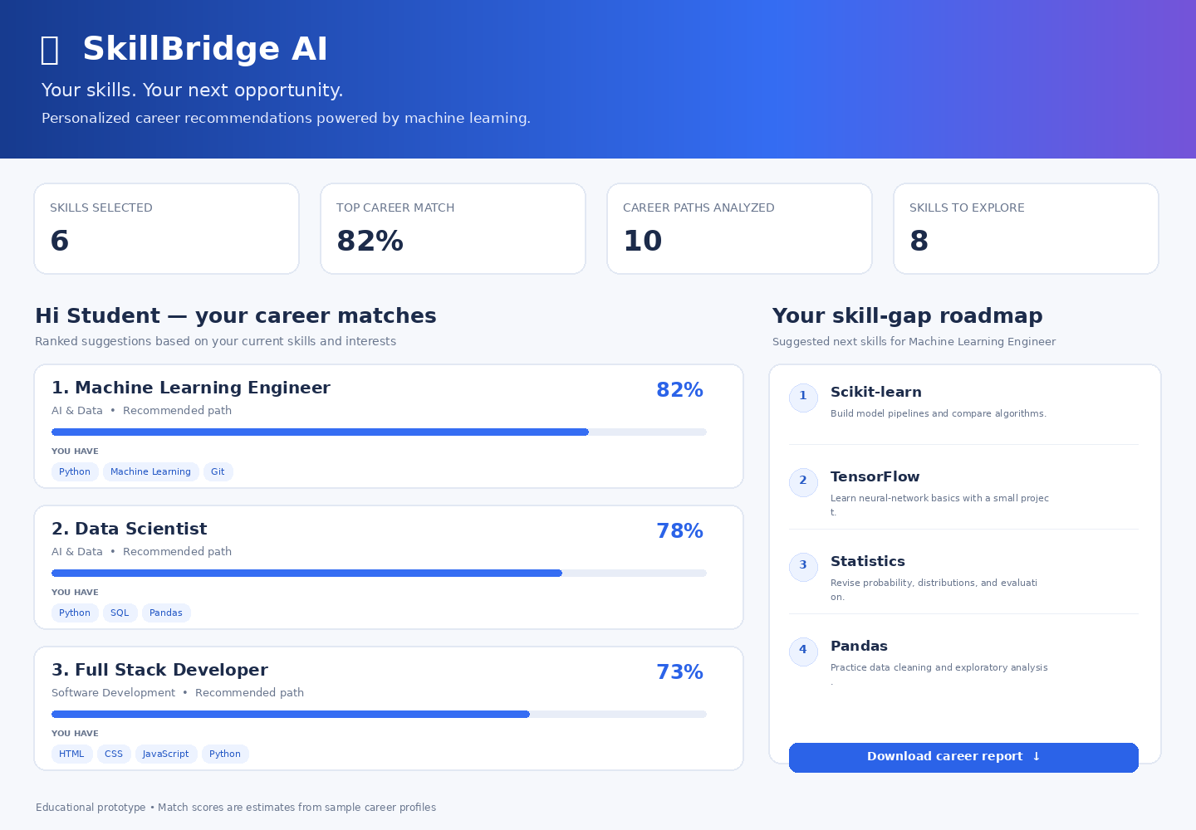
SKILLBRIDGE AI
Smart Career & Skill Recommendation System
AI/ML Internship Project • IBM BOB Masterclass 1 candidate
Prepared by: [Your Name]
Institute: [Your Institute]

Slide 2
Problem Statement
Why this project matters
•
Students may struggle to connect current skills with suitable career paths.
•
Career information is scattered, and skill priorities are not always clear.
•
A lightweight tool can compare a skill profile with sample role requirements and explain the gaps.

Slide 3
Project Objectives
•
Build a clean, interactive web dashboard for student career exploration.
•
Use TF-IDF and cosine similarity to compare skills with career profiles.
•
Show matched skills, missing skills, and practical learning suggestions.
•
Allow users to export ranked recommendations as a CSV file.

Slide 4
Proposed Solution
•
User selects current skills, education, and areas of interest.
•
The model vectorizes career profiles and the selected skill text.
•
Cosine similarity and skill coverage contribute to a transparent ranking.
•
The dashboard presents recommendations and a short learning roadmap.

Slide 5
Technology Stack
•
Language: Python
•
UI: Streamlit
•
Data handling: pandas
•
Machine learning: scikit-learn TF-IDF vectorizer and cosine similarity
•
Output: interactive dashboard and downloadable CSV

Slide 6
Methodology
From student profile to career suggestions
01
02
03
04
05
INPUT
TF-IDF
SIMILARITY
RANK
ROADMAP
Selected skills and interests
Convert role text to vectors
Compare vectors with cosine similarity
Combine similarity + skill coverage
Show gaps and learning actions

Slide 7
Main Features
•
Career-match cards with relative scores and progress bars.
•
Skill overlap and missing-skill lists for each suggested role.
•
Personalized starter roadmap for the highest-ranked role.
•
Career report export to CSV; no paid API key required.

Slide 8
User Interface Preview
Design preview of the SkillBridge AI dashboard

Slide 9
Evaluation Plan
•
Test an AI/data-focused profile (Python, SQL, statistics).
•
Test a web-focused profile (HTML, CSS, JavaScript).
•
Test a design-focused profile (Figma, user research).
•
Verify ranking, skill gaps, roadmap, and CSV download.
•
No accuracy claims are made until a labeled benchmark is created.

Slide 10
Limitations & Responsible Use
•
The built-in career catalog is small and illustrative, not live labor-market data.
•
Skills are self-reported and are not independently verified.
•
A match score is not a hiring probability or a guarantee of employment.
•
Users should verify role requirements and discuss plans with mentors.

Slide 11
Future Scope
•
Expand the role catalog with current, validated skill requirements.
•
Add optional resume parsing with clear user consent.
•
Measure ranking relevance with expert-labeled examples.
•
Add multilingual support, accessibility improvements, and project suggestions.

Slide 12
Conclusion
•
SkillBridge AI demonstrates a complete, explainable AI/ML workflow.
•
It connects self-reported skills to ranked sample career paths.
•
It turns missing skills into actionable learning suggestions.
•
The prototype is a starting point for a stronger, validated career guidance tool.

Slide 13
References & Demo
• Scikit-learn: https://scikit-learn.org/stable/modules/feature_extraction.html
• Scikit-learn metrics: https://scikit-learn.org/stable/modules/metrics.html
• Streamlit: https://docs.streamlit.io/
• Pandas: https://pandas.pydata.org/docs/
• Live demo: run `streamlit run app.py`
Before submission, replace the placeholders with your details and verify the required IBM BOB form instructions.

