Slide 1
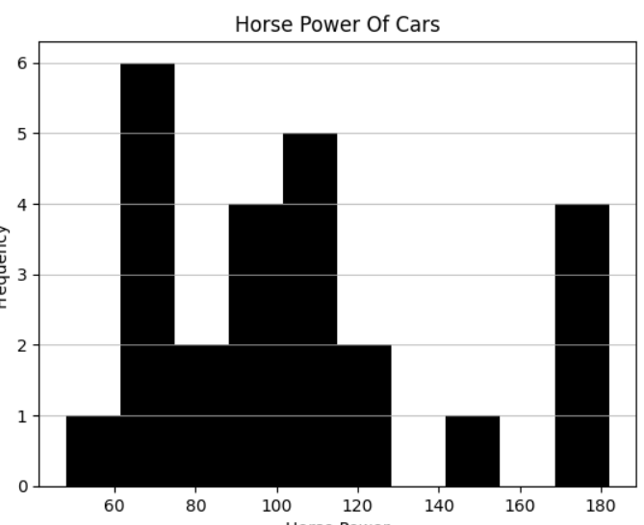
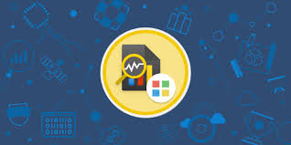
Presentation on My Internship Journey: A comprehensive report? Presented By Vaishnavi Rahamatkar [AM21014]

Slide 2
Contents:
Introduction
Roles and responsibilities
Project
Achievements
Conclusion

Slide 3
1.Introduction:
Duration
2 Weeks
Date:
10-07-2023
T0
23-07-2023
Internship Name
Data Analysis Using Python
Company Name
Codemate IT Sevices Nagpur
In this internship, we used Python
Language for data analysis.
This organization with the aim of
providing Industry standard training
courses, Internship programs which
will contribute to placements of learners.

Slide 4
Tools and Platforms:
Visual Studio
It is an IDE that you can use to write, edit, debug, and build code, and then deploy your app.
01
Google Colaboratory
It is a web IDE for Python that was released by Google in 2017.
02
03
Jupyter notebook
The Jupyter Notebook is a web-based interactive computing platform.
04
Kaggle Platform
It is an online community of data scientists and machine learning engineers. It has N numbers of datasets.

Slide 5
What is data analysis? Data Analysis is a process of analyzing, cleaning and transforming data for various uses. It also refers to converting raw data into meaningful graphical and non-graphical visualizations. It is used in a variety of fields including business, science, healthcare, social sciences, etc.

Slide 6
The topics we learn in this Internship:
02
Collection datatypes: In this, we mainly deal with Lists and dictionaries.
Basics of python: In this we learn about the basic concepts of python.
01
Numpy Library: This library allows us to perform mathematical operations on arrays and matrices.
Seaborn Library: It is a widely popular data visualization library that is commonly used for data science and machine learning tasks.
03
06
04
05
Pandas Library: It is a Python library
used for working with data sets. It
has functions for analyzing, cleaning,
exploring, and manipulating data.
Matplotlib Library: It is a comprehensive library for creating static, animated, and interactive visualizations in Python.

Slide 7
2.Roles and Responsibilities:
Step 04
Step 03
Step 02
Step 01
Upload all the task after finishing it.
Perform tasks either in VS or Jyupter Notebook.
Assign the task based on what we learn.
Learn new things.

Slide 8
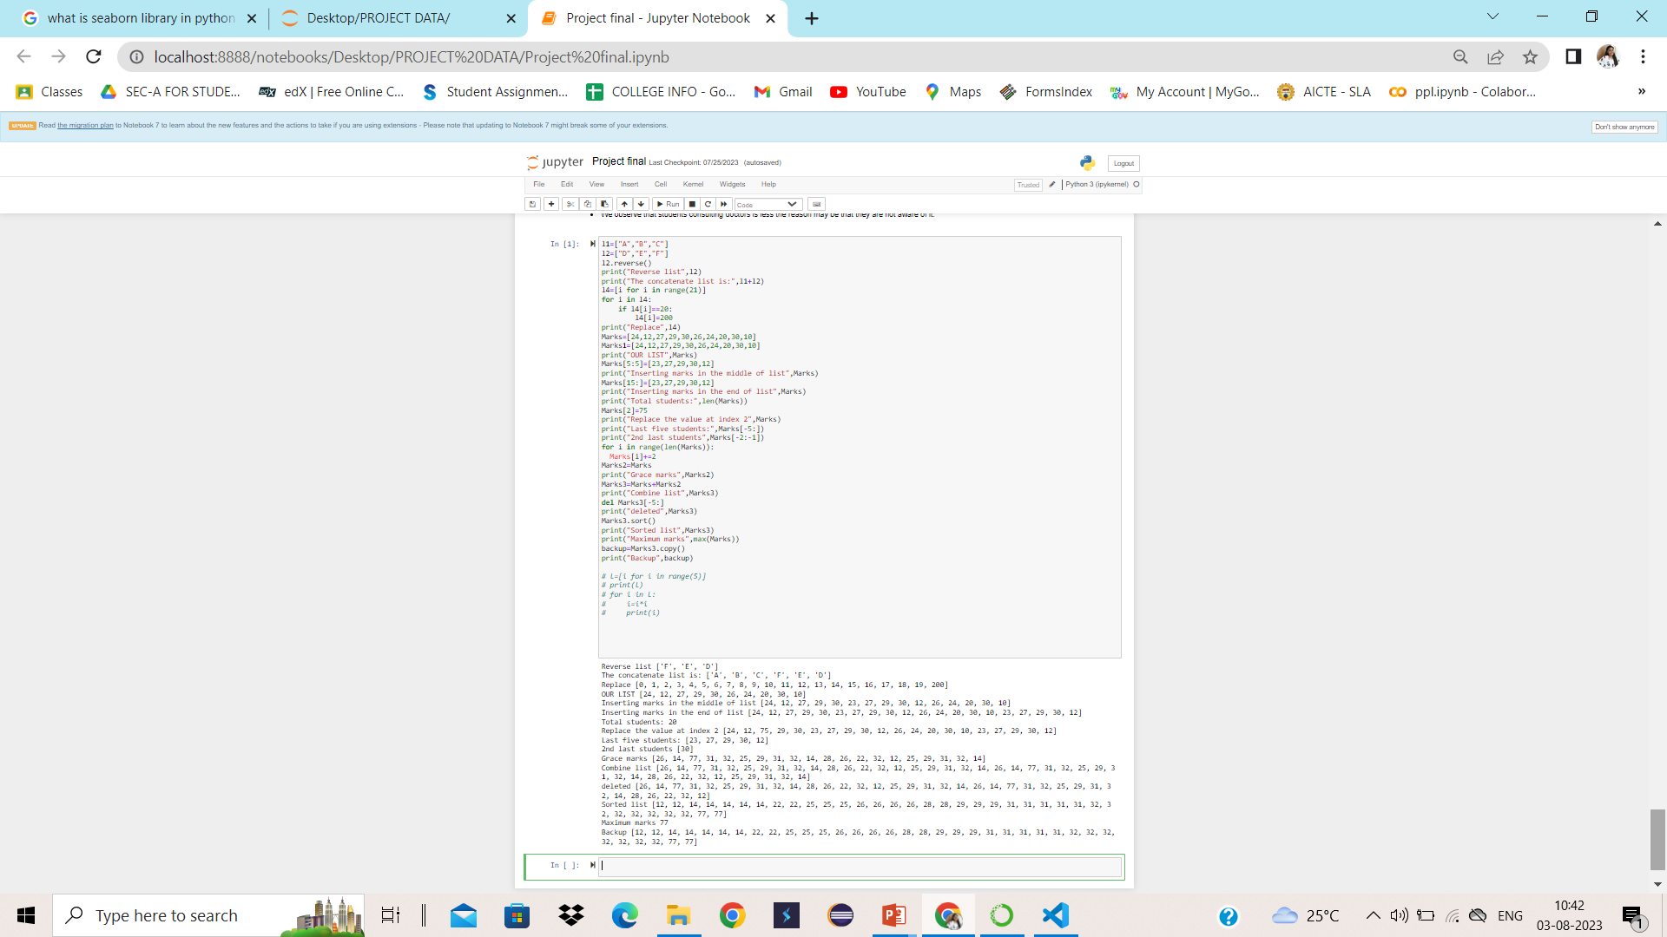
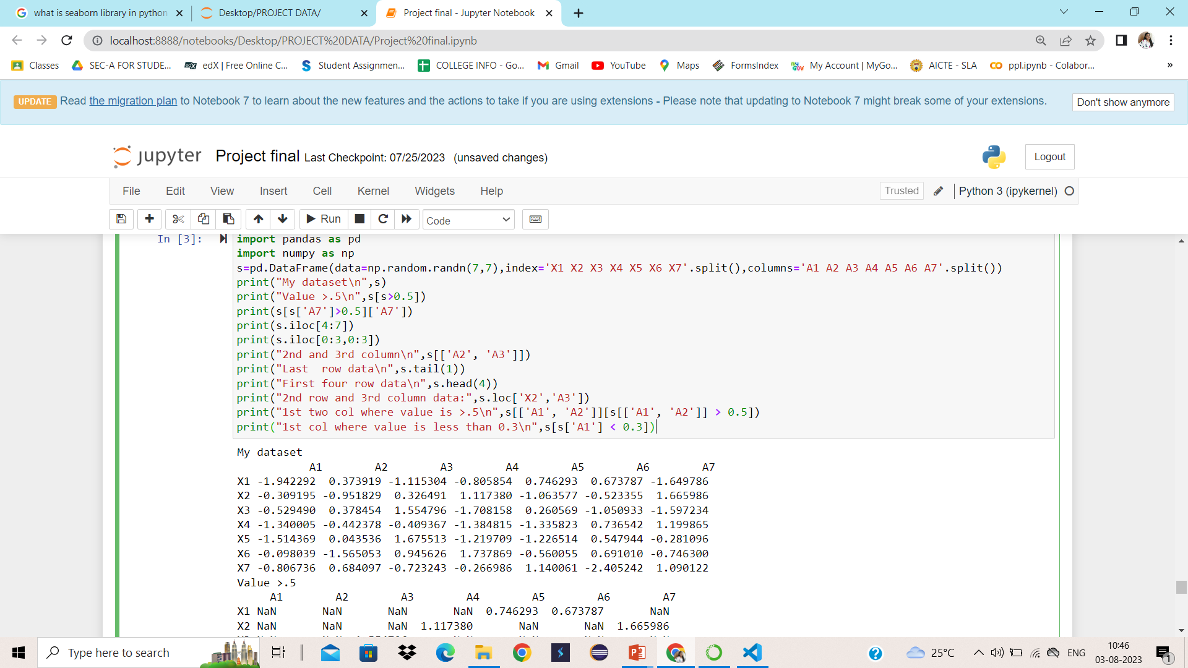
The glimpses of tasks we perform:

Slide 9
3.Project:
Project Overview
01 |  | Name | Exploratory data analysis on ‘zomato sales datasets’
02 |  | CSV | zomato_dataset.csv
03 |  | IDE | Juypter Notebook

Slide 10
4.NEW THING TO IN THIS INTERNSHIP PROGRAM :-
PANDAS PROFILING:-
The pandas_profiling library in Python include a method named as ProfileReport()
which generate a basic report on the input DataFrame.
The report consist of the following:
DataFrame overview,
Each attribute on which DataFrame is defined,
Correlations between attributes (Pearson Correlation and Spearman Correlation), and
A sample of DataFrame.

Slide 11
EDA on ‘zomato sales ’ Exploratory data analysis: EDA is applied to investigate the data and summarize the key insights. It will give you a basic understanding of your data, its distribution, null values and much more. About the project: In this project, I uploaded a CSV file from Kaggle.com. I imported the CSV file. I performed basic and advanced EDA. I deal with Univariate, bivariate and multivariate data. I performed graphical and nongraphical data analysis using Python. I summarize my project by observations I have seen in charts like pie charts, bar charts, box plots, histograms, etc.

Slide 12
Internship
Project
Github
zomato_dataset_eda.html
EDA on zomato - Jupyter Notebook
https://github.com/vaishnaviraham/EDA

Slide 13
4.Daily Task link:-
https://drive.google.com/drive/folders/150Ew9H8g8QueVb2jjY7bNIo0unHXwDEp?usp=sharing

Slide 14
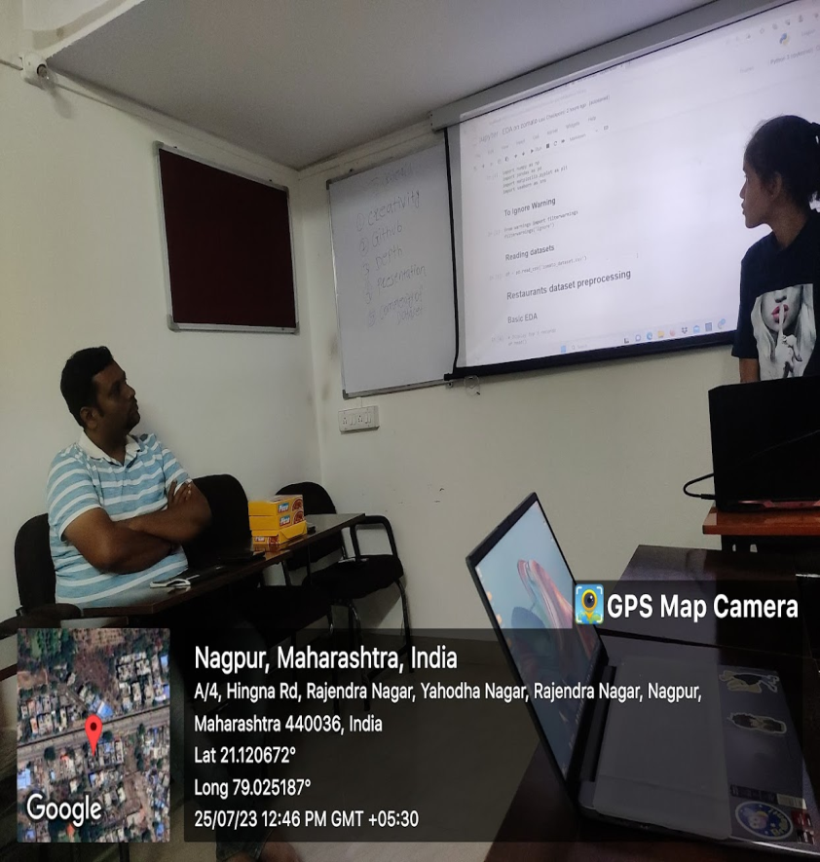
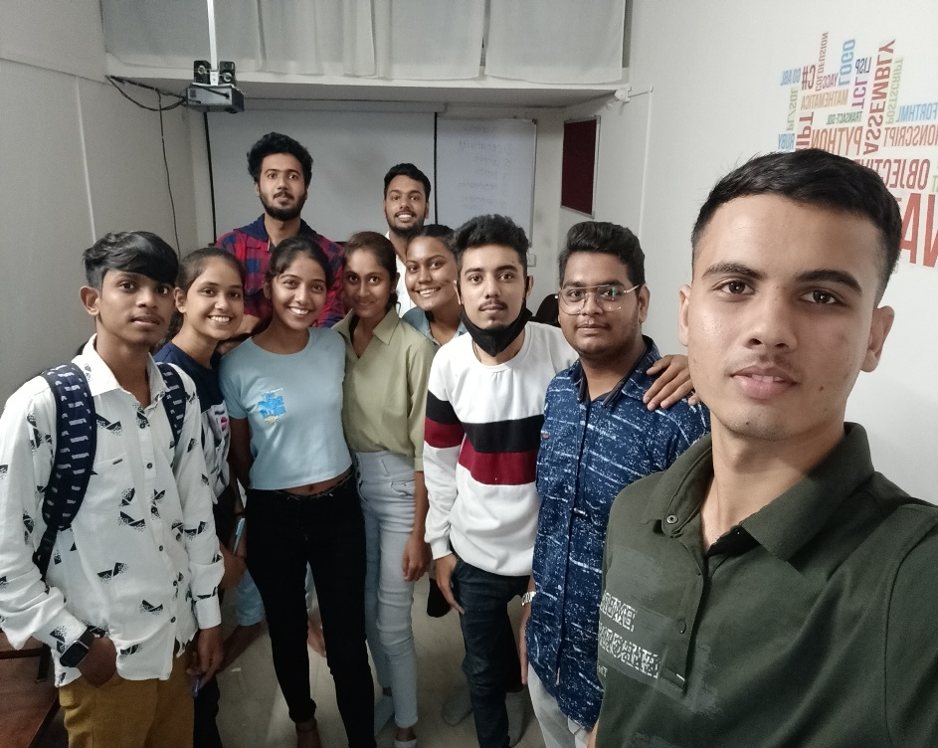
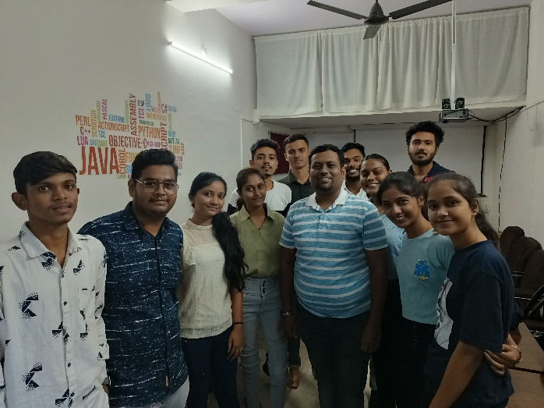
The glimpses of Internship:

Slide 15
5.Conclusion:
I learn about data analysis using Python, I worked with various libraries like Numpy, pandas, matplotlib and Seaborn for graphical and nongraphical representation of data. I performed EDA on ‘Student mental health’. This EDA is my project on that I performed basic, advanced EDA and deals with Univariate, Bivariate and Multivariate data. Developed different charts like bar charts, heatmap, boxplots,etc.

Slide 16
Thank you !!

