Slide 1

Ideate and implement a system to enhance the quality of education in Emerging Technology.
Presented by:-
Vaishnavi Rahamatkar (AM21014) Tanushree Sarode (AM21032)
Aboli Wankhede (AM21004)
Sakshi Mantri (AM21038)

Slide 2

Content
Problem Statement
Introduction
Objective
Methodology
Expectations
Challenges
Outcome
Research Paper

Slide 3
Introduction
Our goal is to enhance the quality of education in emerging technology by implementing a comprehensive system that includes a user-friendly online compiler for both students and faculty.
This system will have distinct roles for admin and users, creating a seamless platform.
Introducing an advanced online compiler for students and facult to elevate education in emerging technology.
Admins have control over system management, while users benefit from a online compilation experience. This initiative aims to efficient learning.

Slide 4
Objectives Of The Project
Develop and implement an online education system.
Develop an online compiler for students and faculty to enhance practical coding skills in emerging technologies.
Create a user-friendly website with distinct roles for admin and users.
Enable seamless interaction between students and faculty through the online compiler platform.
Facilitate real-time code compilation, execution, and debugging for a variety of programming languages.
Provide a collaborative learning environment by allowing users to share code snippets and solutions.

Slide 5
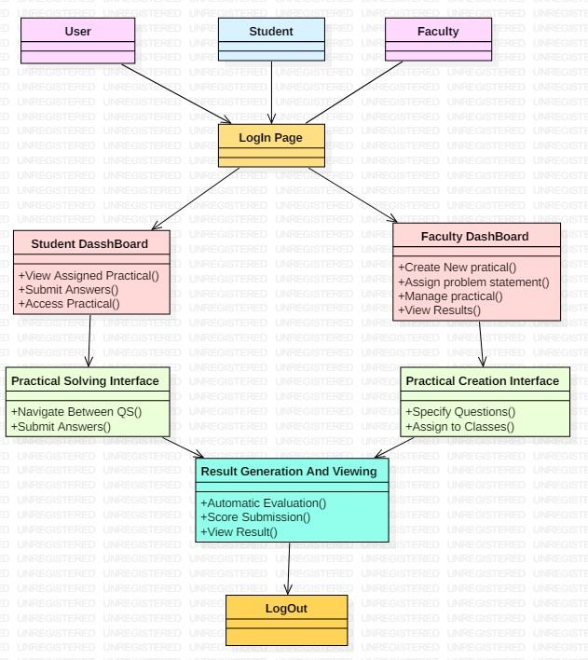
Methodology

Slide 6
Login Page:
Faculty and students log in using their respective credentials.
Separate login interfaces for faculty and students.
Faculty Dashboard:
Faculty can create new tests, manage existing tests, and view test results.
Interface for assigning tests to specific students or groups of students.
Test Creation:
Faculty can create tests by specifying questions, options, and correct answers.
Ability to set time limits, assign test to specific classes or groups, and customize test parameters.
Student Dashboard:
Students can view assigned tests and access them for solving.
Clear interface displaying test instructions and questions.

Slide 7
Test Solving:
Students can attempt tests within the specified time limit.
Interface should allow for easy navigation between questions and submission of answers.
Automatic Result Generation:
System automatically evaluates student responses against correct answers.
Generates test scores and provides immediate feedback to students upon completion.
Score Submission:
After completing the test, students can submit their answers for evaluation.
Scores are automatically recorded and submitted to the faculty.
Result Viewing:
Faculty can view test results for each student, including scores and detailed breakdown of answers.
Ability to export results for record-keeping or further analysis.

Slide 8

Expectations
Students expect an online compiler to provide a user-friendly interface.
Support for multiple programming languages.
Efficient code execution, helpful error messages and integration with version control systems.
Faculty expect features for code review, plagiarism detection, and classroom management, fostering a collaborative and productive learning environment for programming courses.

Slide 9
Outcome
For Students:
Practice and Skill Enhancement: Access to diverse coding challenges improves coding skills and problem-solving capabilities.
Instant Feedback: Real-time feedback on code submissions aids learning and iterative improvement.
Competition Motivation: Coding contests and challenges foster competition, motivating students to excel.
Structured Learning: Curated learning paths and tutorials facilitate systematic knowledge building in specific programming domains.

Slide 10
For Faculty:
Customized Assignments: Faculty can create tailored coding assignments and assessments.
Automated Grading: Grading tools automate evaluation, providing instant feedback and saving faculty time.
Performance Tracking: Analytics dashboards track student performance, enabling targeted instruction.
Community Interaction: Online forums foster faculty-student engagement for questions and support beyond class hours.

Slide 11

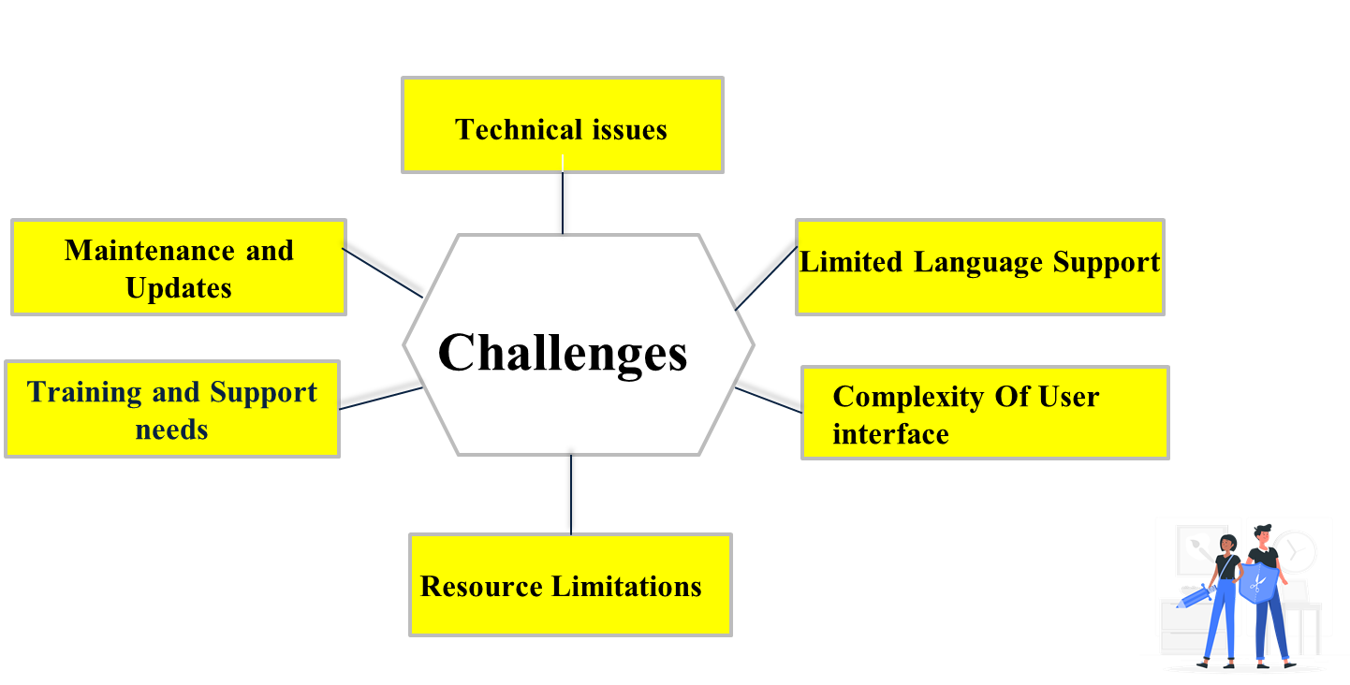
Challenges

Slide 12
Technical issues:
Code execution security, language support, performance optimization, error handling, concurrency, scalability, user interface design, data management,deployment, user management.
Limited language support:
Supporting numerous programming languages poses challenges, requiring prioritization based on user demand and technical feasibility to ensure optimal functionality.
Complexity of user interface:
A user-friendly interface is crucial for seamless interaction, prompting the need for intuitive design and clear navigation to mitigate user confusion and frustration.
Resource Limitations:
Resource limitations impact online compiler development. Optimize code execution, manage servers efficiently, and consider cloud solutions for scalability.
Maintenance and updates:
Regular maintenance and updates are crucial for ensuring system stability, security, and performance, requiring proactive monitoring, timely patching, and continuous improvement efforts.
The evolution of video processing continues with the emergence of cutting-edge technologies such as 4K resolution, HDR imaging, and real-time processing. These advancements are shaping the future of video content creation and consumption.

Slide 13

Research Paper Related With Project
1) https://www.academia.edu/32529973/Review_Paper_on_Online_Java_Compiler
2) https://www.researchgate.net/publication/323832187_Java_Code_Engine_for_Online_Code_Compilation
3) https://prolangs.cs.vt.edu/rutgers/reading/papers/chen_oopsla.pdf
4) https://www.irjet.net/archives/V4/i3/IRJET-V4I3122.pdf

Slide 14
Thank You
You

