Slide 1

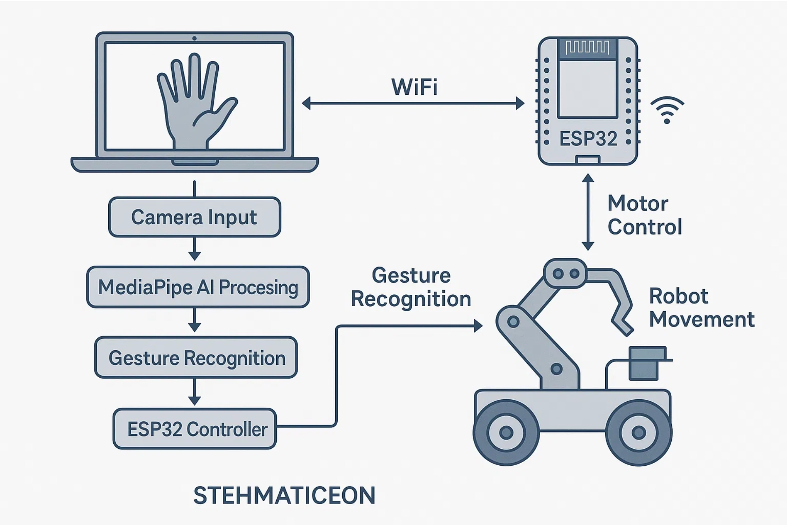
Smart Hand Gesture Controlled Robot
Using AI and ESP32 for Next-Gen Human-Robot Interaction
Name : BOJJA YUVA VAISHNAVI
Reg.no. 323129512005
September 11, 2025

Slide 2

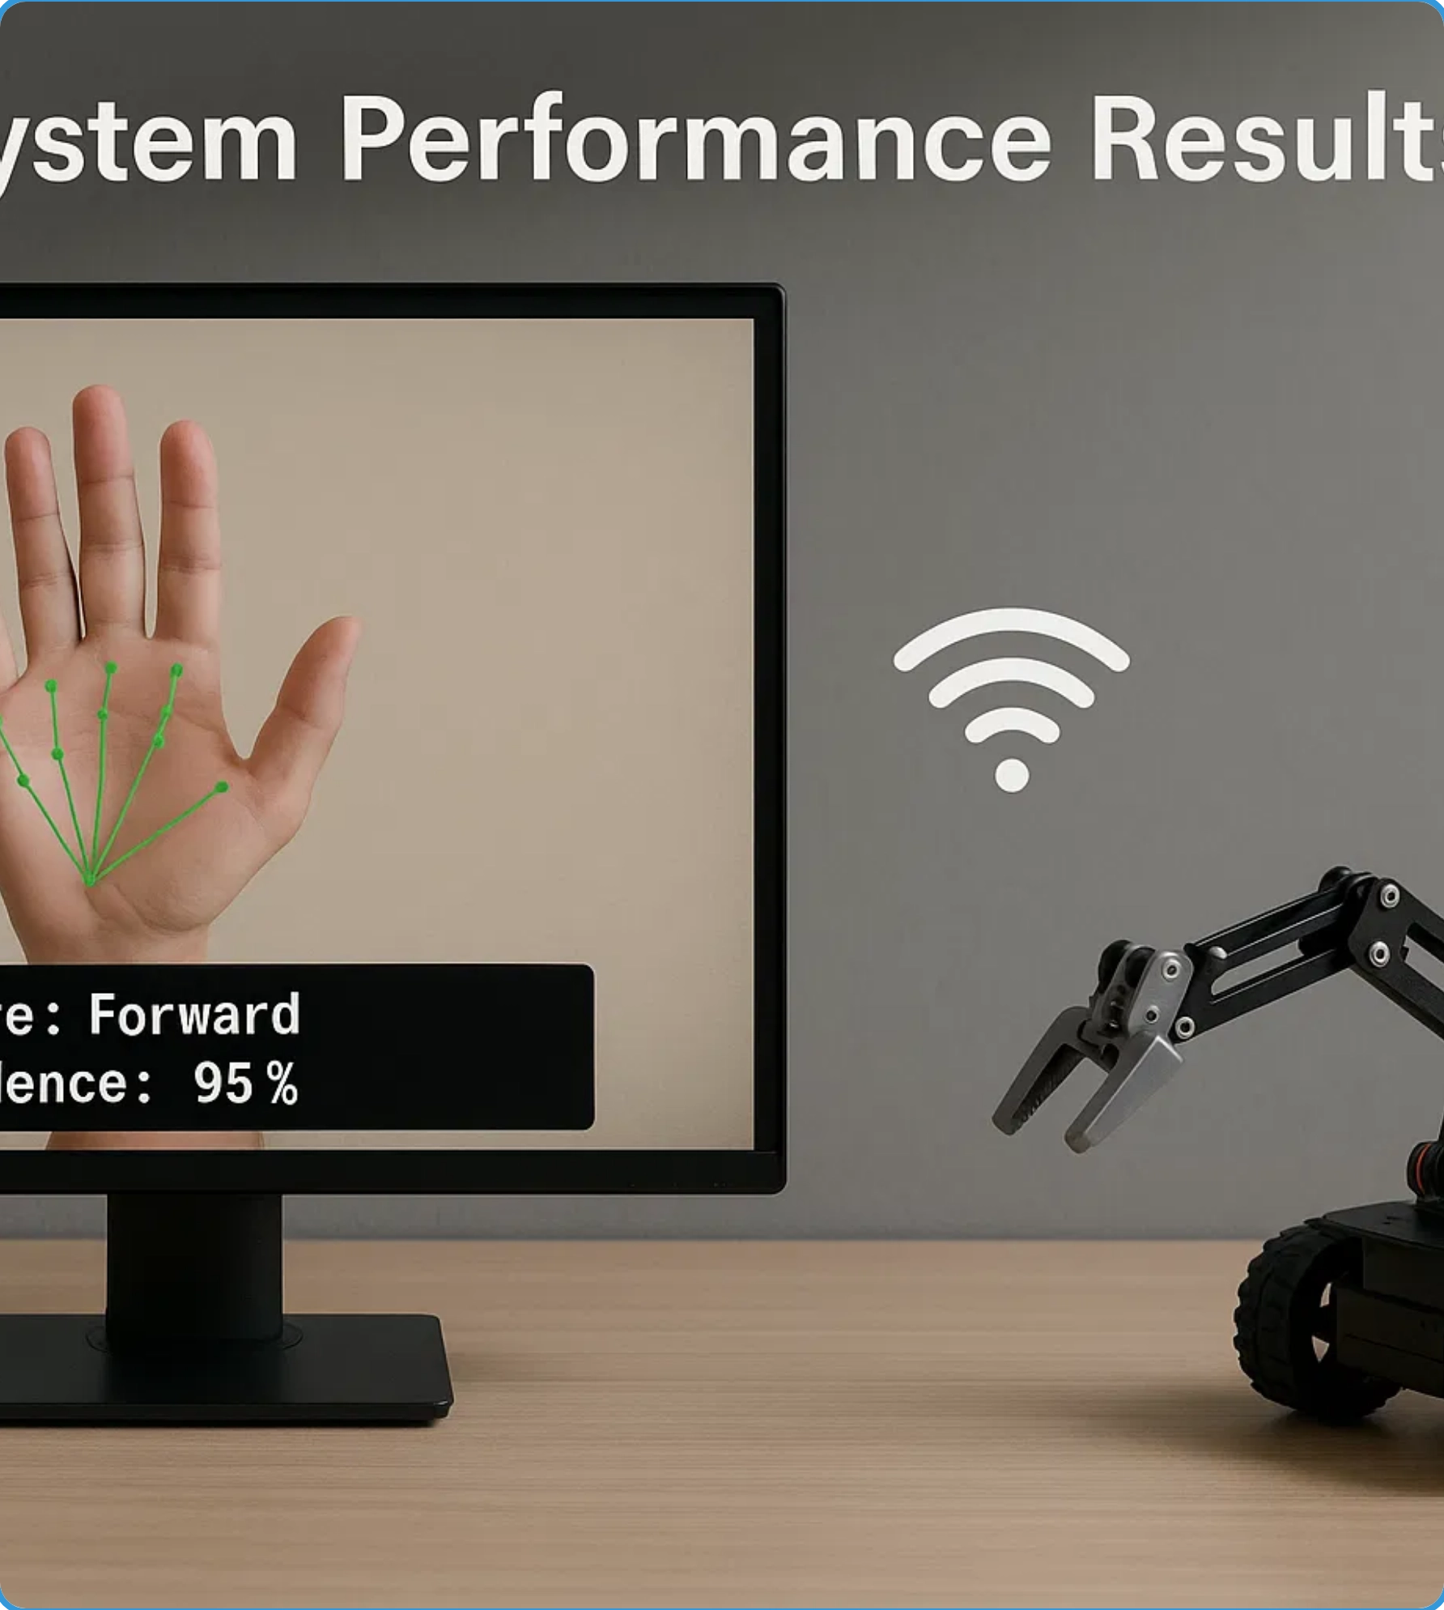


Problem Statement
Limitations of Conventional Robot Control Systems
Unintuitive for non-technical users, requiring specialized training
Restricted operator mobility due to physical hardware dependencies
Impractical in sterile environments like hospitals and cleanrooms
Accessibility challenges for individuals with physical impairments
Need for Advanced Solution
Touchless, natural interaction for intuitive control
Real-time response with minimal latency
Accessible to users with varying technical abilities
Adaptable to diverse environments and applications

Slide 3

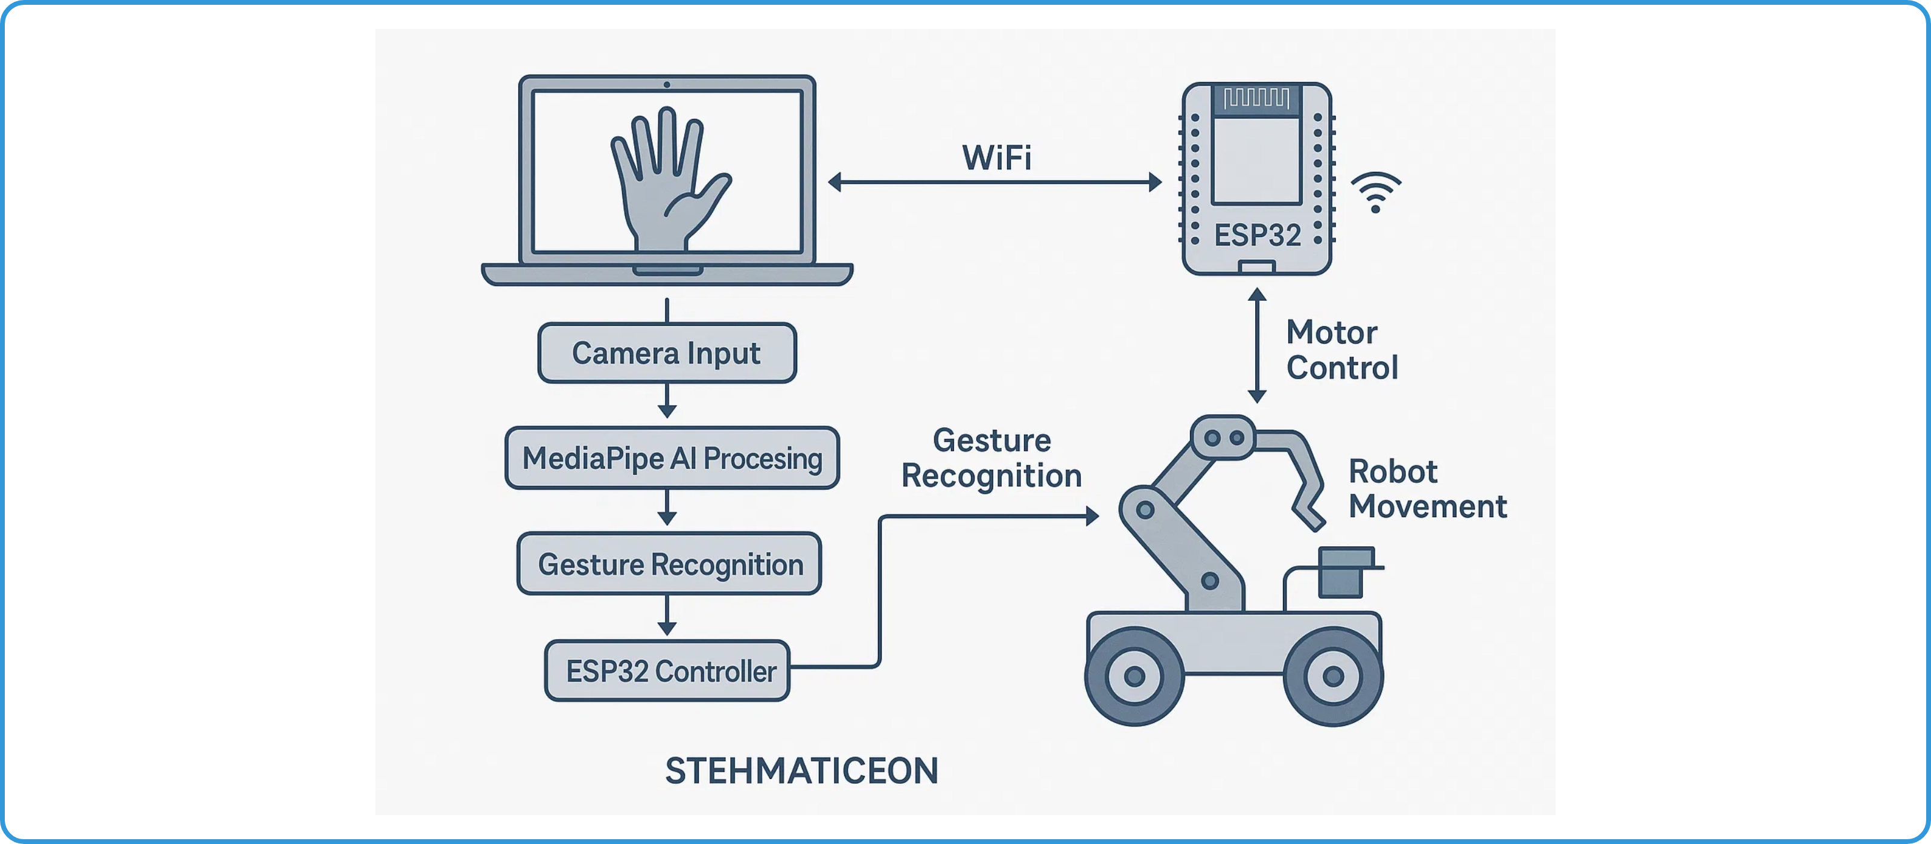



System Architecture
Gesture Recognition System
Communication Module
Robotic Platform
Python application using MediaPipe for real-time hand tracking and gesture classification. Processes video feed to identify 21 hand landmarks and interpret gestures.
WiFi-based communication system using TCP/IP sockets to transmit JSON command packets from the host computer to the ESP32 microcontroller with minimal latency.
ESP32-controlled wheeled robot with servo-operated gripper. Receives wireless commands and translates them into motor movements for navigation and manipulation.

Slide 4

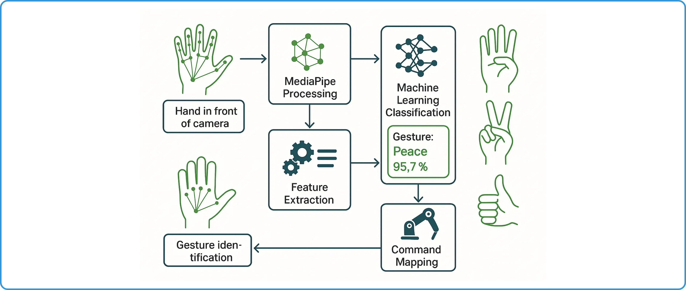




Gesture Recognition Technology
MediaPipe Hand Tracking
Feature Extraction
Gesture Classification
Real-time detection of 21 3D hand
Processing landmark data to extract
Dual approach for reliable gesture
landmarks with high precision.
meaningful features.
recognition.
Palm and finger joint positions
Finger angles and positions
Rule-based algorithm
3D spatial coordinates
Hand openness metrics
Machine learning model

Slide 5


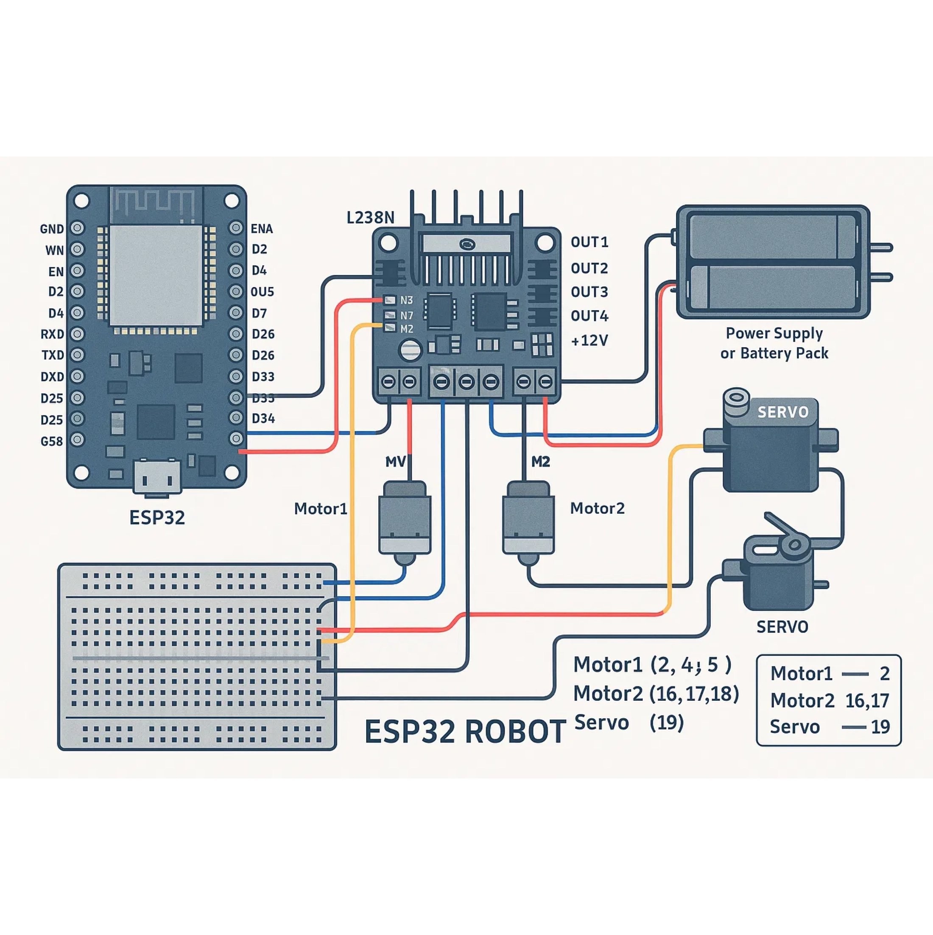




Hardware Implementation
ESP32 Development Board
Dual-core microcontroller with integrated WiFi and
Bluetooth
GPIO pins used: 2, 4, 5, 16, 17, 18, 19
L298N Motor Driver
Dual H-bridge motor driver for controlling two DC motors
Controls direction and speed of both motors
DC Motors & Chassis
Two DC motors for wheel movement mounted on a 2WD
chassis
Motor1: pins 2,4,5 | Motor2: pins 16,17,18
Servo Motor for Gripper
SG90 servo motor for gripper control with 180° rotation
Connected to pin 19
Power Supply
Battery pack providing 7.4V for motors and 5V for ESP32

Slide 6


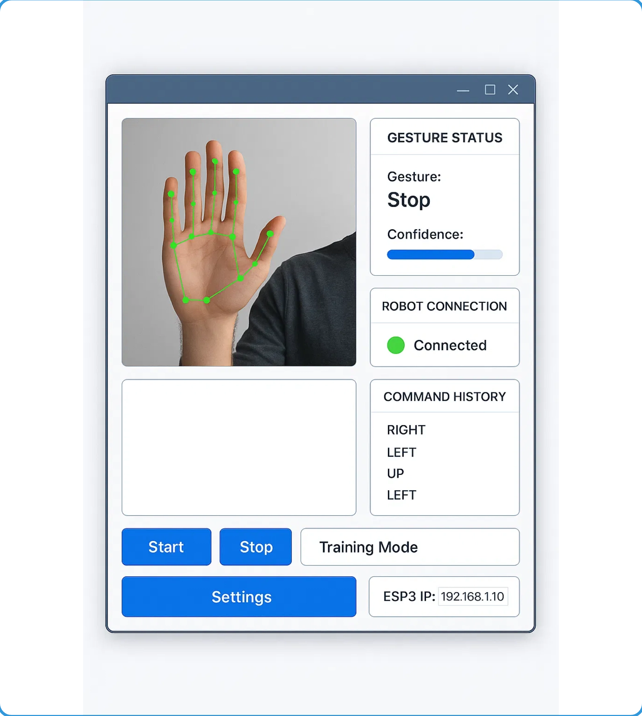






Software Implementation
Python Gesture Recognition
Core application for hand tracking and gesture classification
# Process frame for gesture recognition
def process_frame(frame):
# Convert BGR to RGB
rgb_frame = cv2.cvtColor(frame, cv2.COLOR_BGR2RGB)
# Process with MediaPipe
results = hands.process(rgb_frame)
Python
OpenCV
MediaPipe
ESP32 Robot Control
Arduino code for receiving commands and controlling motors
// Process received command
bool processCommand(String jsonCommand) {
DynamicJsonDocument doc(1024);
deserializeJson(doc, jsonCommand);
String command = doc["command"];
}
Arduino
ESP32 WiFi
TCP/IP

Slide 7

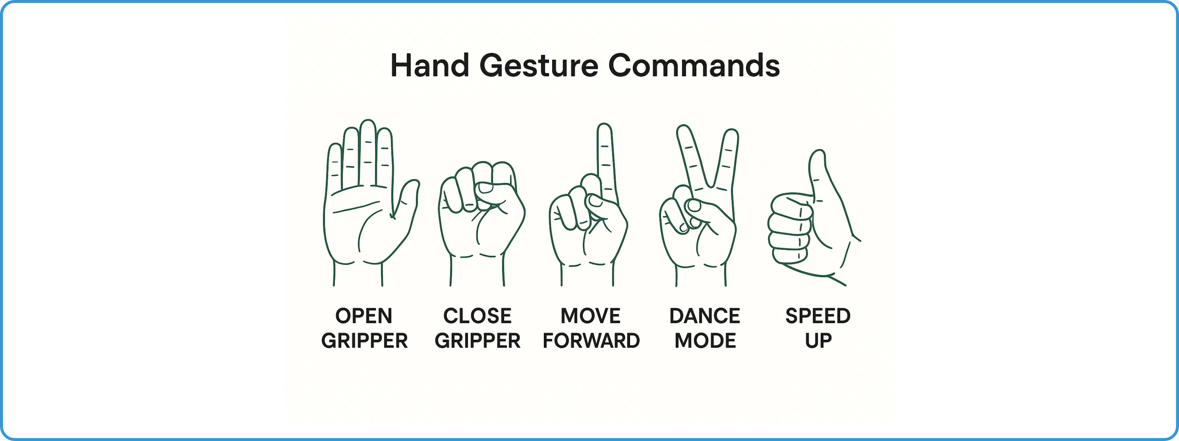
Gesture Command System
Gesture
Command
Robot Action
Open Hand
OPEN
Opens the gripper (servo rotates to 90°)
Closed Fist
CLOSE
Closes the gripper (servo rotates to 0°)
Index Finger
FORWARD
Robot moves forward (both motors rotate forward)
Peace Sign
DANCE
Robot performs pre-programmed dance sequence
Thumbs Up
SPEED_UP
Increases motor speed by 25 units

Slide 8


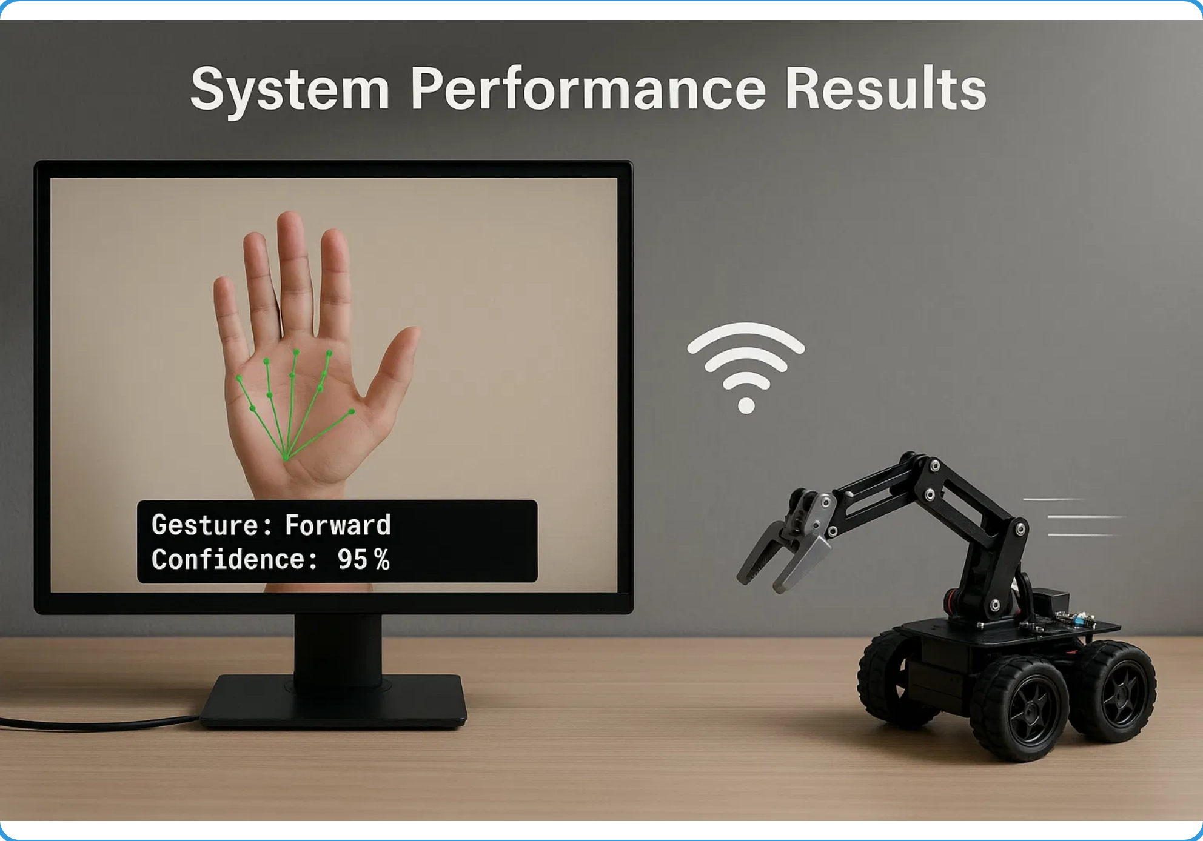

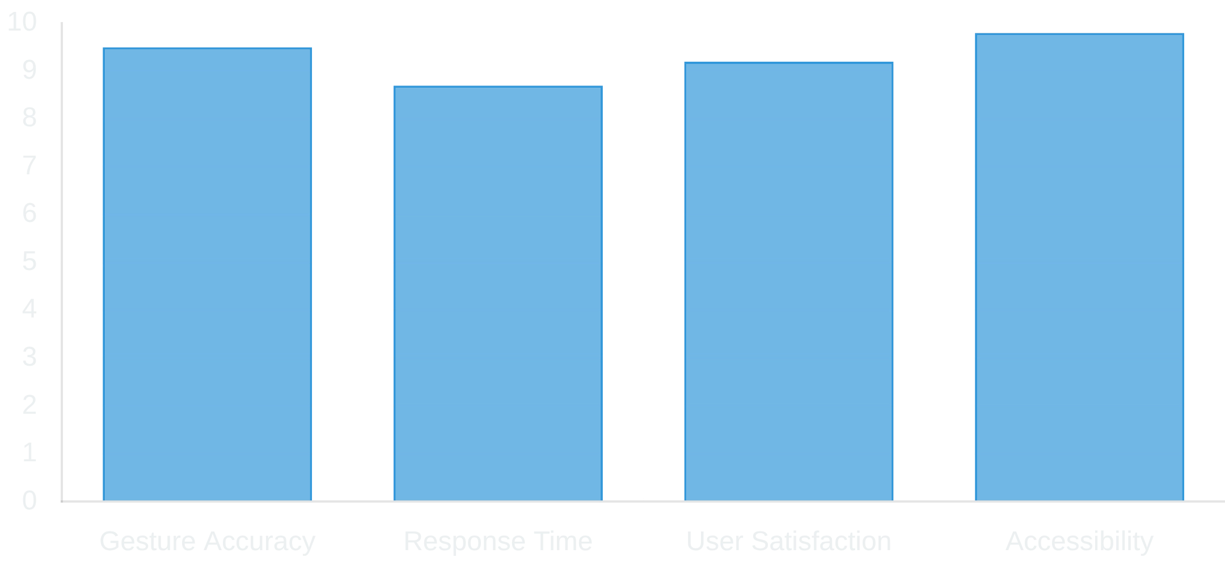
Results and Performance
System Performance Metrics
Gesture Recognition Accuracy
95.2%
End-to-End Latency
~180ms
Effective Control Range
Up to 20 meters
Key Achievements

Slide 9










Conclusion and Future Work
Key Achievements
Potential Applications
Successfully implemented a touchless, intuitive robot control system using hand gestures
Healthcare
Achieved high accuracy (95%+) in real-time gesture recognition
Touchless control of medical robots in sterile environments, assistive robots for patients with mobility limitations
Established reliable wireless communication between host computer and ESP32
Manufacturing
Created a system that enhances accessibility and usability for diverse users
Hands-free control of industrial robots, enhanced safety in hazardous environments
Future Work
Assistive Technology
Expand gesture vocabulary for more complex robot control
Accessible control systems for people with physical impairments, smart home automation
Implement machine learning for personalized gesture recognition
Reduce latency through optimized algorithms and communication
Education
Integrate with other sensing modalities (voice, vision) for multimodal control
Interactive learning tools, STEM education platforms, robotics training

