Slide 1
Project On HR ANALYTICS
BY-
Vaishnavi Sainath
K.Kirthana Samy
D.Aravind Kumar

Slide 2
AIM: To model probability of attrition of employees of a company. Results obtained will be used by the management to understand what changes they should make to their workplace, in order to get most of their employees to stay.
Problem Statement:
A large company named XYZ, employs, at any given point of time, around 4000 employees. However, every year, around 15% of its employees leave the company and need to be replaced with the talent pool available in the job market. The management believes that this level of attrition(employees leaving, either on their own or because they got fired) is bad for the company, because of the following reasons -
The former employees’ projects get delayed, which makes it difficult to meet timelines, resulting in a reputation loss among consumers and partners
A sizeable department has to be maintained, for the purposes of recruiting new talent
More often than not, the new employees have to be trained for the job and/or given time to acclimatise themselves to the company

Slide 3
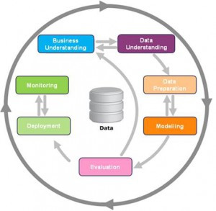
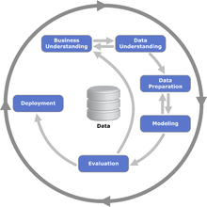
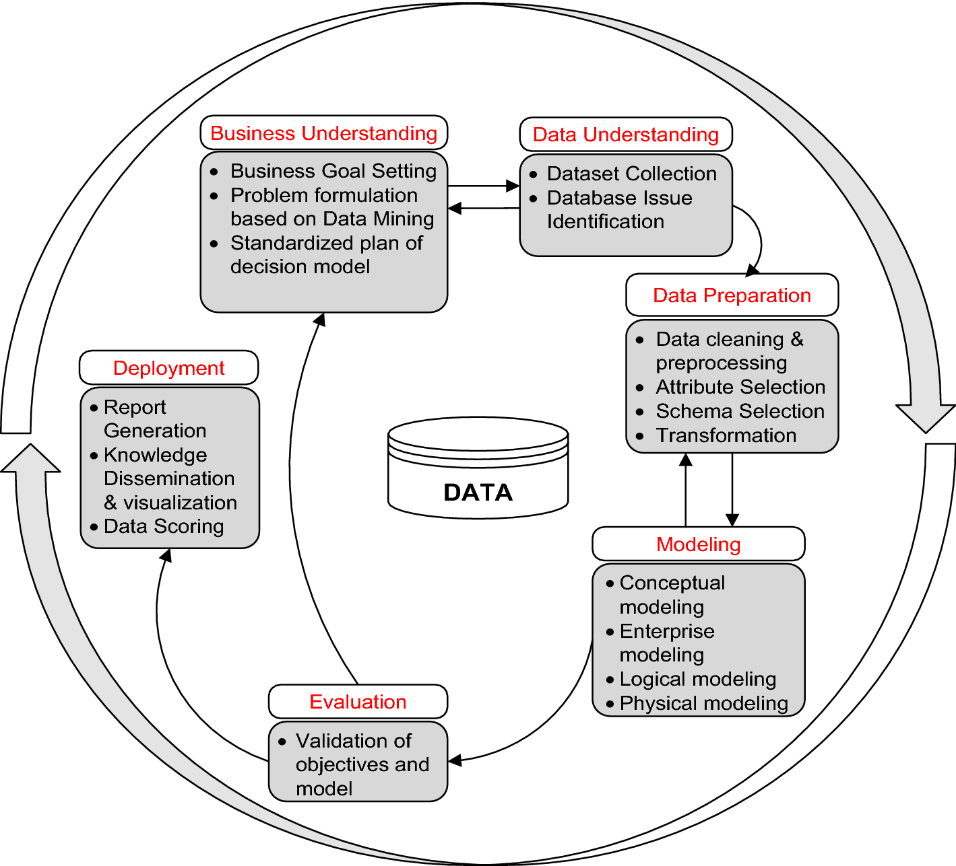
Project Methodology: Cross Industry Standard Process For Data Mining(CRISP-DM) is used to represent project methodology.

Slide 4
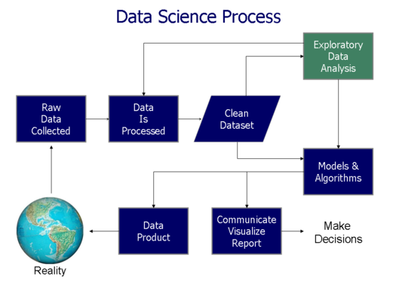
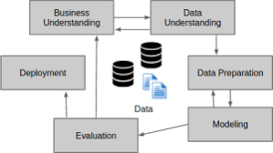

Slide 5
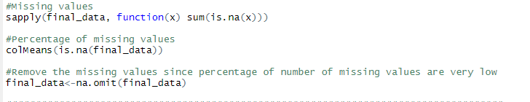
DATA PREPARATION DATA SETS: Employee Survey Data Manager Survey Data In Time Out Time General Data
Data is then processed and cleaned ,sets are merged if any primary key is found
Missing values are detected and omitted

Slide 6
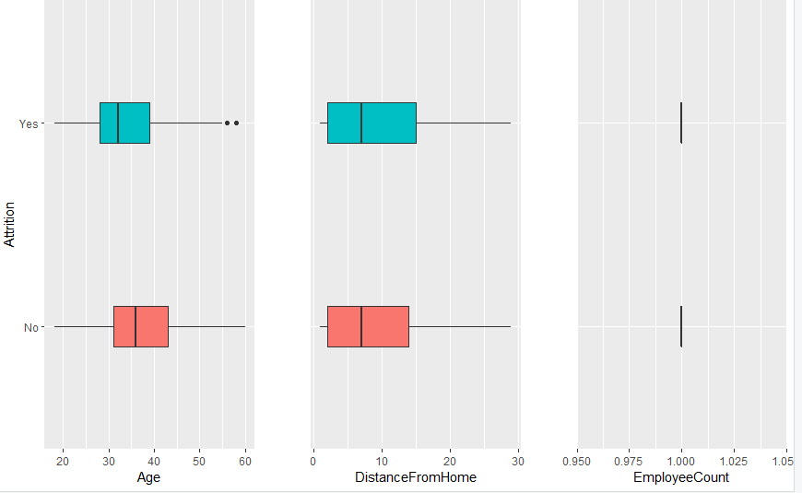
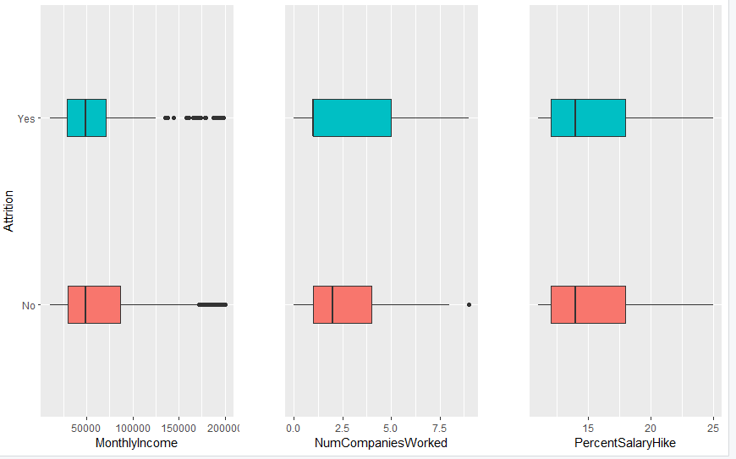
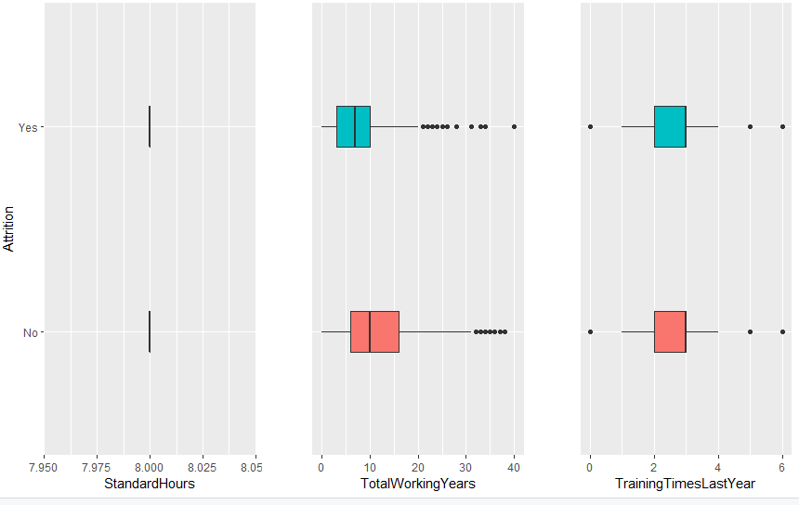
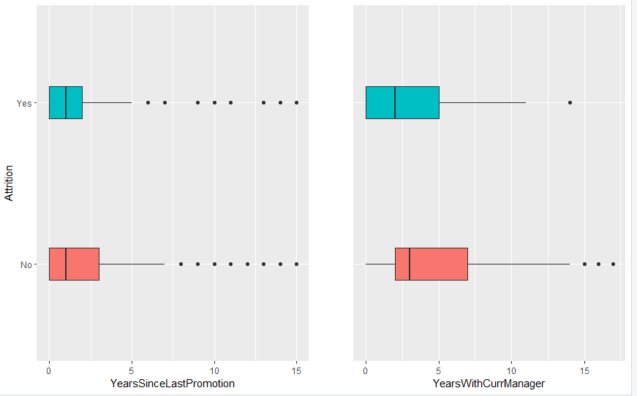
EXPLORATORY DATA ANALYSIS Plotting of attrition against various attributes is performed

Slide 7
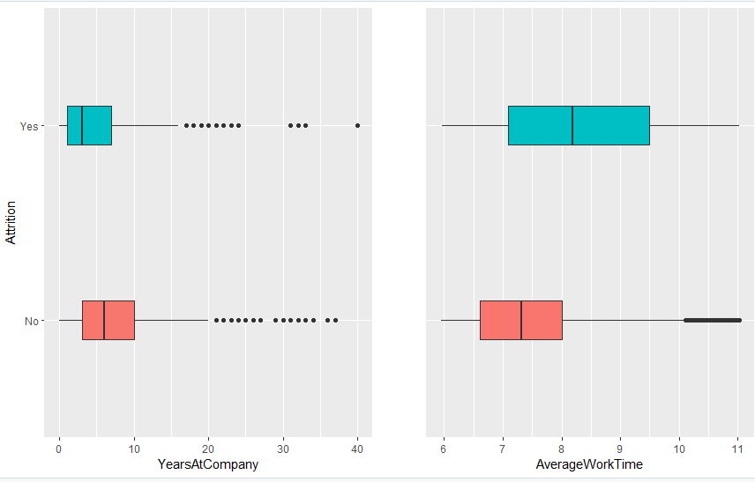
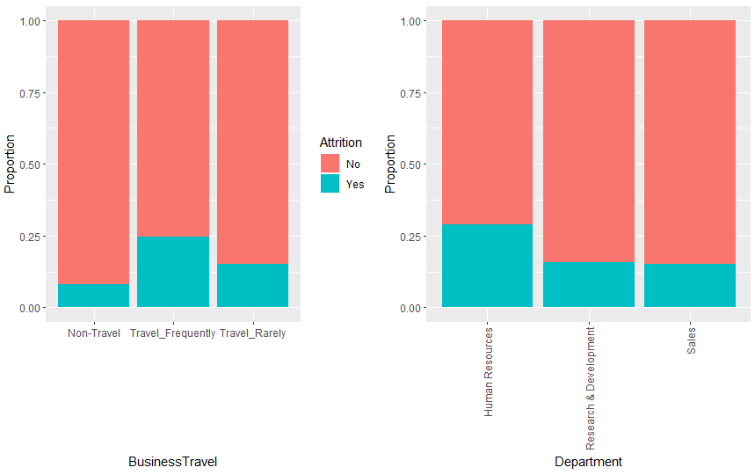
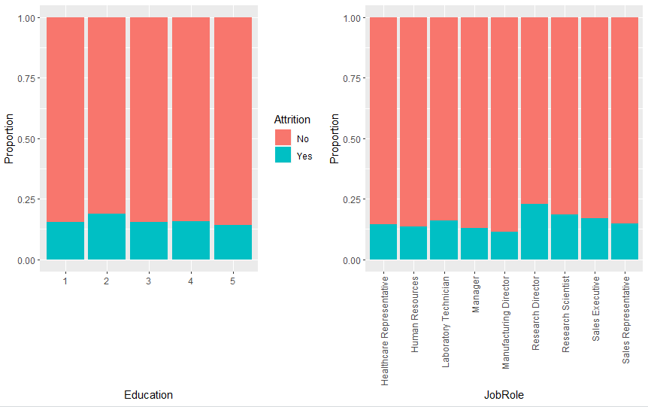
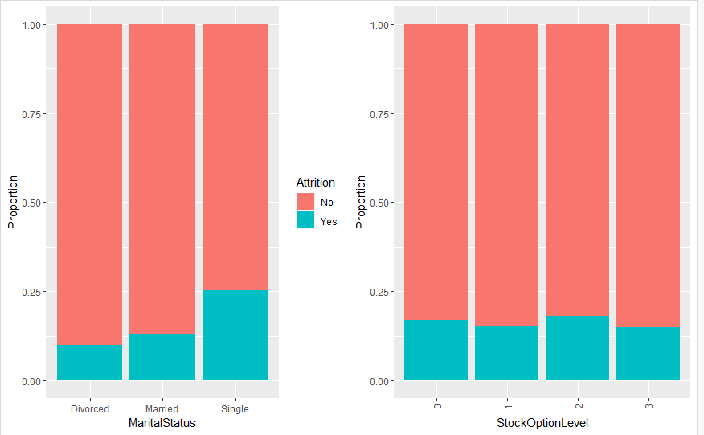

Slide 8
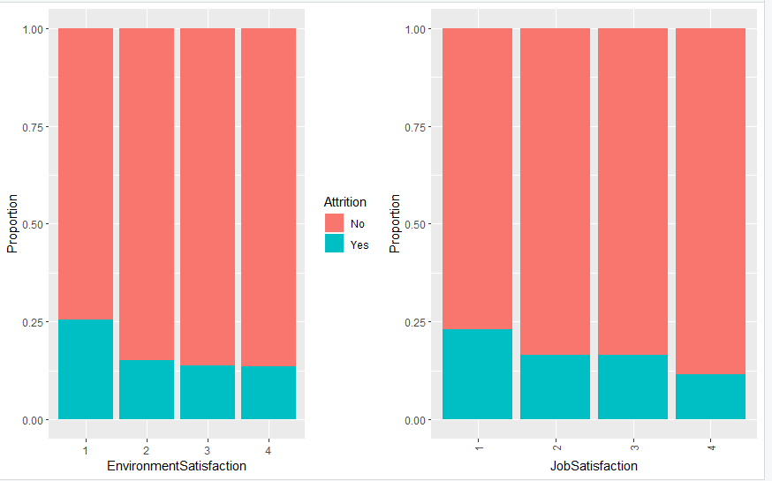
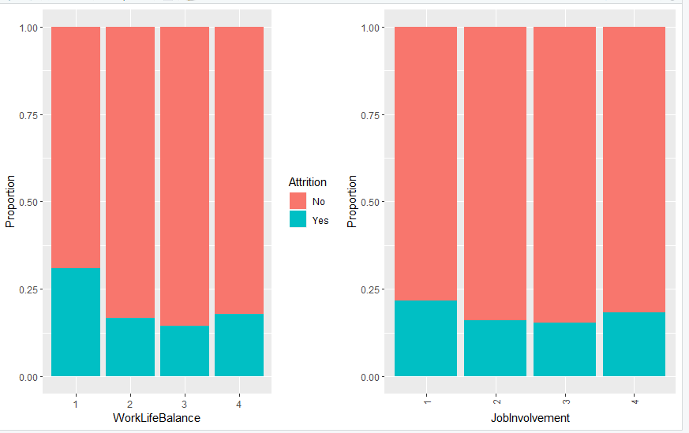
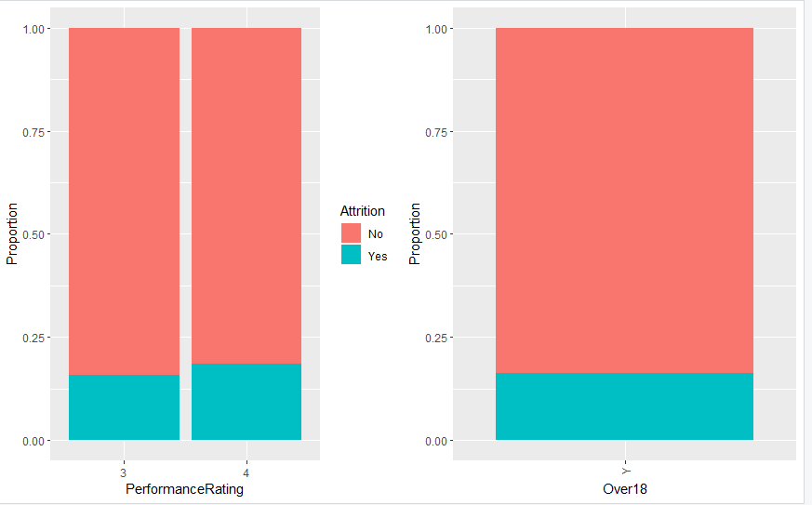

Slide 9
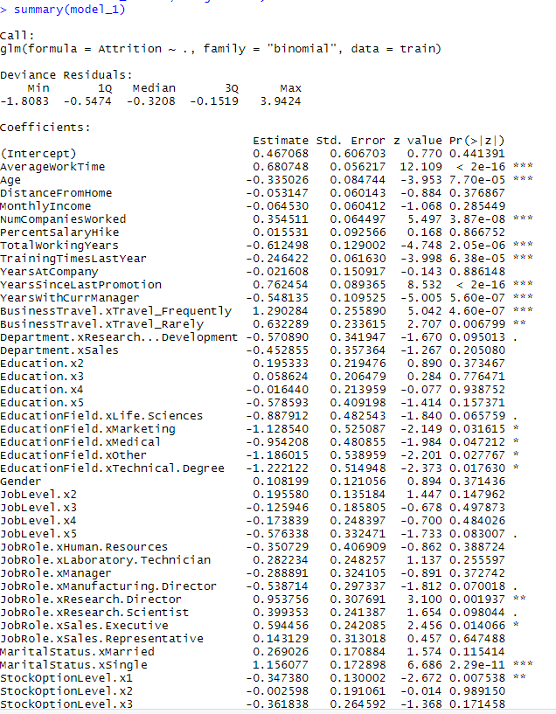
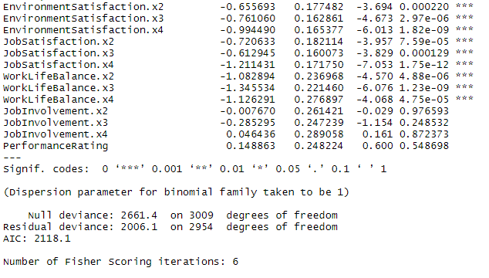
EVALUATION OF MODEL Final Model is created and then tested using test data Model-1:

Slide 10
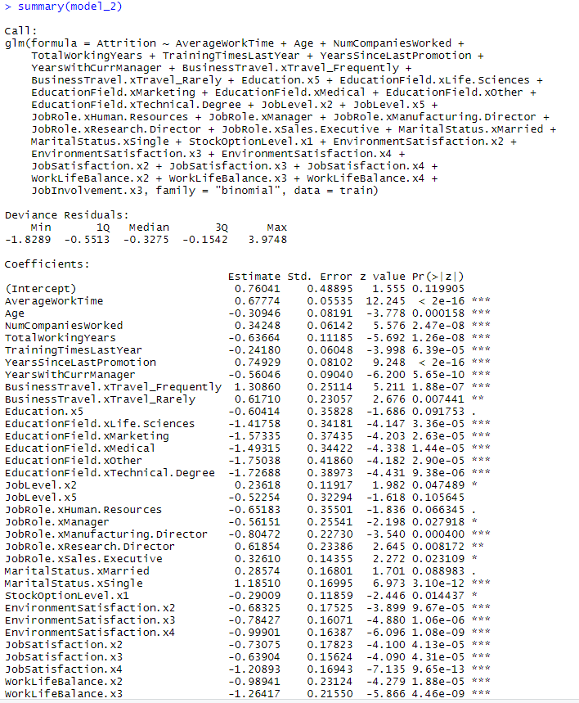
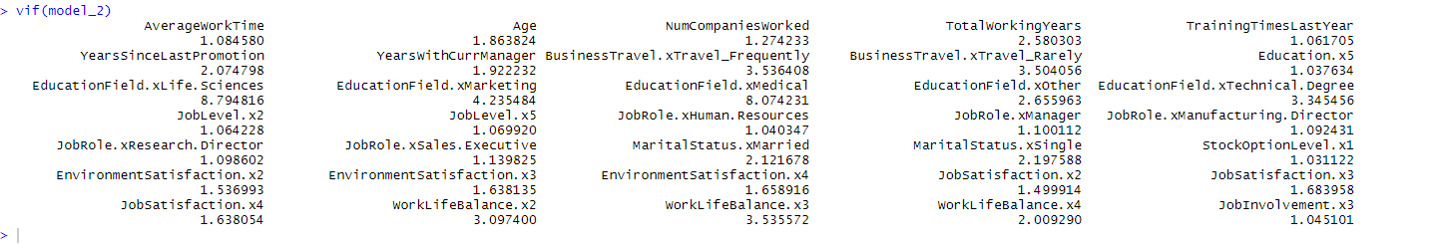
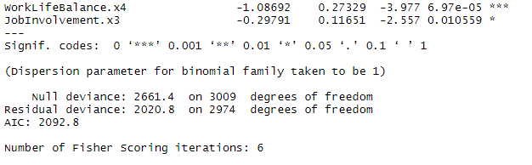
Model-2:

Slide 11
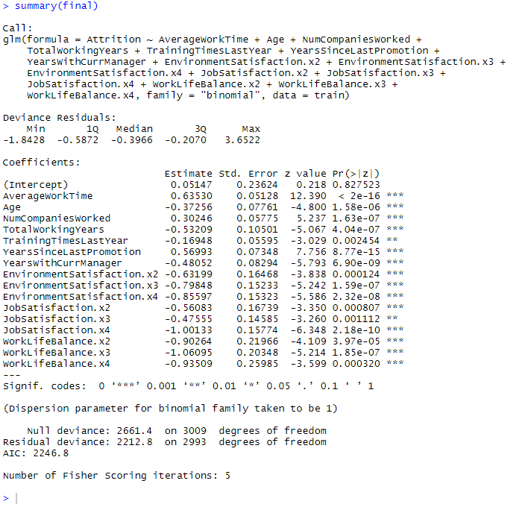
Similarly nearly 21 models are created using training data Final Model:

Slide 12
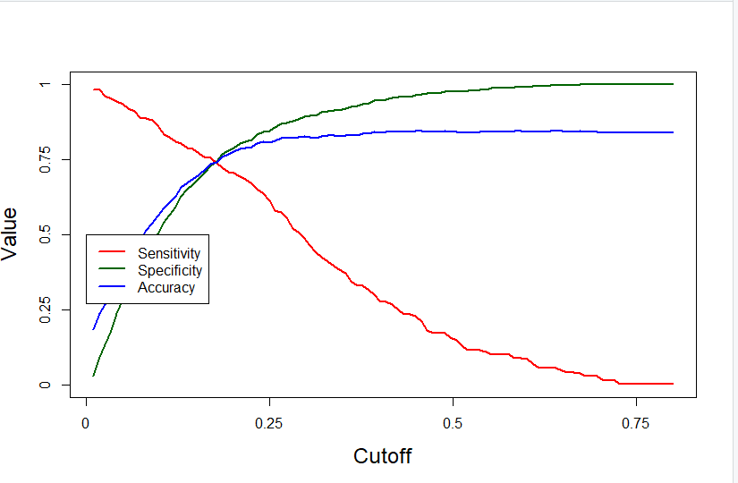
Probability Cutoff Graph:

Slide 13
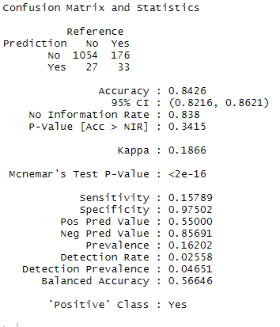
Confusion Matrix And Statistics:

Slide 14
Conclusion:
Therefore after testing the final model with the test data ,the values thus obtained are
Accuracy:84.26%
Sensitivity:15.789%
Specificity:97.502%
Model thus obtained is 84% accurate and thus provides attrition rate of the employees to that extent.This helps the management to know what changes should be made and which attribute is important and need to be dealt more carefully.

Slide 15
THANK YOU

