Slide 1
Sales Dashboard Summary
Data Analyst Internship - Task 3
Vaishnavi Chandrakant sakpal

Slide 2
Dataset Overview
• Data Source: Superstore Sales Dataset (Synthetic)
• Records: 1000 Rows
• Key Fields: Date, Category, Region, Sales, Profit, etc.
• Goal: Analyze performance trends and gain insights

Slide 3
Key KPIs in Dashboard
• Total Sales & Total Profit
• Profit Margin (%)
• Orders & Quantity Sold
• Average Order Value (AOV)

Slide 4
Visuals Used
• Tree Map: Sub-Category Sales
• Line Chart: Monthly Sales vs Profit
• Pie Chart: Segment-wise Sales
• Bar Chart: Regional Profit
• Table: City-wise Product Sales

Slide 5
Business Insights
• Accessories & Tables lead in category sales
• Sales peaked in mid-year months (Jun–Aug)
• South & West regions are top in profit
• Phoenix & Los Angeles contribute strong sales
• Discount doesn't guarantee profit boost

Slide 6
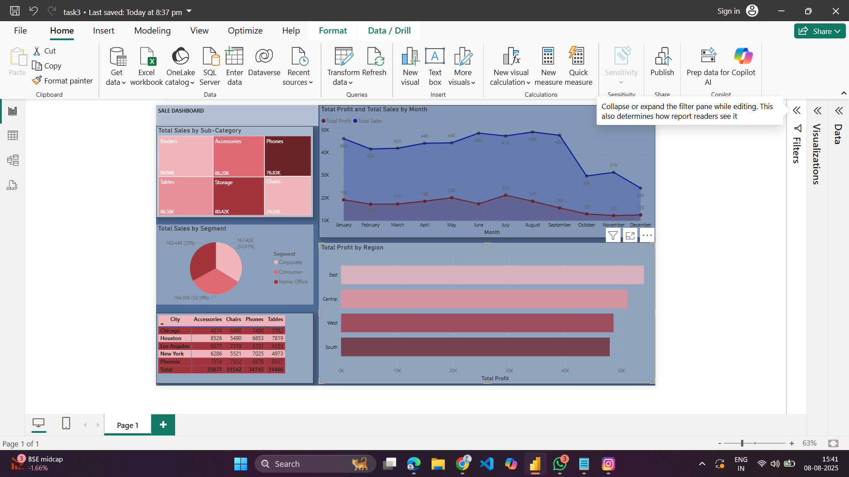
Final Dashboard Screenshot

