Slide 1
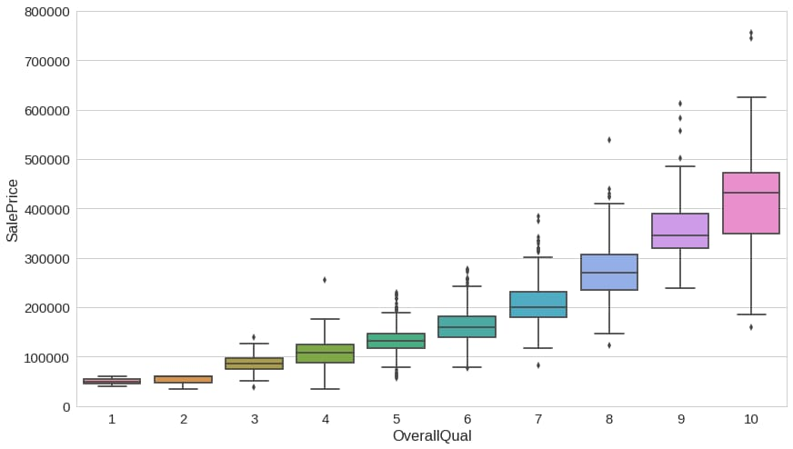
Forecasting house prices accurately using smart regression techniques in data science
*INTRODUCTION
*OBJECTIVES
*DATASET OVERVIEW
*DATA PREPROCESSING
*REGRESSION TECHNIQUES USED
*MODEL EVALUTION METRICS
*RESULT COMPARISON
*INSIGHTS AND ANALYSIS
*CONCLUSION

Slide 2
INTRODUCTION
Accurately forecasting house prices is a critical task in real estate, urban planning, and financial investment. With the increasing availability of housing data and advancements in data science, traditional valuation methods are being supplemented—and often outperformed—by intelligent regression techniques. These methods leverage large datasets, uncover hidden patterns, and model complex relationships between features such as location, property size, economic indicators, and market trends . This project explores how smart regression algorithms—including linear regression, decision trees, and ensemble methods like Random Forest and XGBoost —can be harnessed to predict housing prices with higher precision. By preprocessing data effectively and applying feature engineering, we demonstrate how modern data science approaches can deliver not just accurate forecasts, but also actionable insights for stakeholders across the housing market.

Slide 3
OBJECTIVES
Accurately Predict Housing PricesDevelop a predictive model that estimates house prices with high accuracy using historical and current housing data
2.Feature Engineering and SelectionIdentify and engineer relevant features (e.g., location, square footage, number of rooms, age of property) to improve model performance while reducing dimensionality and noise.
3. Apply Advanced Regression TechniquesImplement and compare smart regression techniques such as: Linear RegressionRidge/Lasso RegressionDecision Tree RegressionRandom Forest RegressionGradient Boosting (XGBoost, LightGBM)Neural Networks for Regression

Slide 4
DATASET OVERVIEW
[TARGET VARIABLE]
SALE PRICE:The final price at which the house was sold.
[FEATURES]
STRUCTURAL ATTRIBUTES: Overall Qual,Year built,TotalBsmtsf,GrLivArea,
Garage cars, etc.
LOCATION DETAILS: Neighborhood,Lot Frotage,LotArea.
INTERIOR/EXTERIOR QUAILTY: Kitchen Qual,Exter Qual,Bsmt Qual.
RENOVATION INFO: Year RemodAdd,GarageYrBlt.
CATEGORICAL VARIABLES: MSZoning,HouseStyle,SaleCondition.

Slide 5
RESULT COMPARISON
Accurate house price forecasting can be achieved by employing smart regression techniques in data science, with models like Gradient Boosting, XGBoost, and LightGBM generally outperforming simpler models like Linear Regression. These models excel at capturing complex, non-linear relationships in the data, making them particularly effective for house price prediction. However, it's crucial to consider the model's complexity and computational requirements, as more complex models like Stacked Generalization may offer higher accuracy but at the cost of increased complexity and time.
[Model Comparison]
Gradient Boosting and XGBoost : Generally outperform other models in terms of accuracy, especially when capturing complex, non-linear relationships. Stacked Generalization: Can achieve the highest accuracy but has a complicated architecture and worst time complexity. Hybrid Regression: Can perform better due to generalization.

Slide 6
DATA PREPROCESSING
[This is crucial to ensure quality input for your models]
Handle Missing Values: Use imputation (mean, median, mode, or predictive methods).
Outlier Detection: Use boxplots or z-scores to detect/remove anomalies.
Categorical Encoding:
Label Encoding for ordinal features (e.g., quality ratings).One-Hot Encoding for nominal features (e.g., neighborhood).
Feature Scaling: Use StandardScaler or MinMaxScaler for numeric features, especially for distance-based models.
Log Transform: Apply log transformation to skewed data (e.g., price).

Slide 7
REGRESSION TECHNIQUES USED
Linear Regression
Use Case: Baseline model for numeric predictions.
Assumptions: Linear relationship, no multicollinearity.
Pros: Simple and interpretable.
Cons: Poor performance on complex, non-linear data.
ElasticNet Regression
Use Case: Combine Lasso + Ridge benefits.
Pros: Balances between coefficient shrinkage and variable selection.
Decision Tree Regression
Use Case: Captures non-linear relationships.
Pros: Easy to interpret, no need for feature scaling.
Cons: Can overfit easily.

Slide 8
MODEL EVALUATION MATRICS
Mean Absolute Error (MAE)
Measures the average absolute difference between predicted and actual values.
Root Mean Squared Error (RMSE)
Calculates the square root of the average of squared differences, giving more weight to larger errors.
R-squared (Coefficient of Determination)
Indicates the proportion of variance in the dependent variable (price) that is explained by the independent variables (features).
K-fold Cross-Validation
A technique to assess model performance by splitting the data into multiple folds and training and testing on different combinations.

Slide 9
INSIGHTS AND ANALYSIS
Insights and Analysis:
Identifying Key Factors : Analyze the model's coefficients to understand which features have the most significant impact on house prices.Understanding Relationships:Explore the relationships between different features and house prices to gain a deeper understanding of the market. Predicting Future Trends:Use the trained model to predict house prices in the future and identify potential market trends.
Example : Imagine a dataset with features like square footage, number of bedrooms, location (e.g., zip code), age of the house, and number of bathrooms. Using linear regression, one might find that square footage and location have a strong positive correlation with house prices, while the age of the house may have a negative correlation. More sophisticated techniques like SVR or XGBoost can capture potentially non-linear relationships and provide more accurate predictions. By combining these techniques and insights, data scientists can build accurate models for house price prediction, providing valuable information for investors, developers, and homebuyers.

Slide 10
CONCLUSION
By leveraging smart regression techniques and carefully selecting relevant features, data scientists can create powerful tools for accurately forecasting house prices. This can provide valuable insights for real estate professionals, investors, and homeowners alike, enabling informed decision-making in the dynamic real estate market.

