Slide 1
Galaxy Smart
Troubleshooting Engine
Understand. Match. Validate. Resolve.
A hackathon-ready AI support experience for
Galaxy phone owners
Team: Byte4ce
Notes:
Galaxy Smart Troubleshooting Engine turns an uncertain support moment into a direct path to the right screen. It understands the complaint, grounds the answer, validates every action, and keeps a human fallback when certainty runs out.

Slide 2
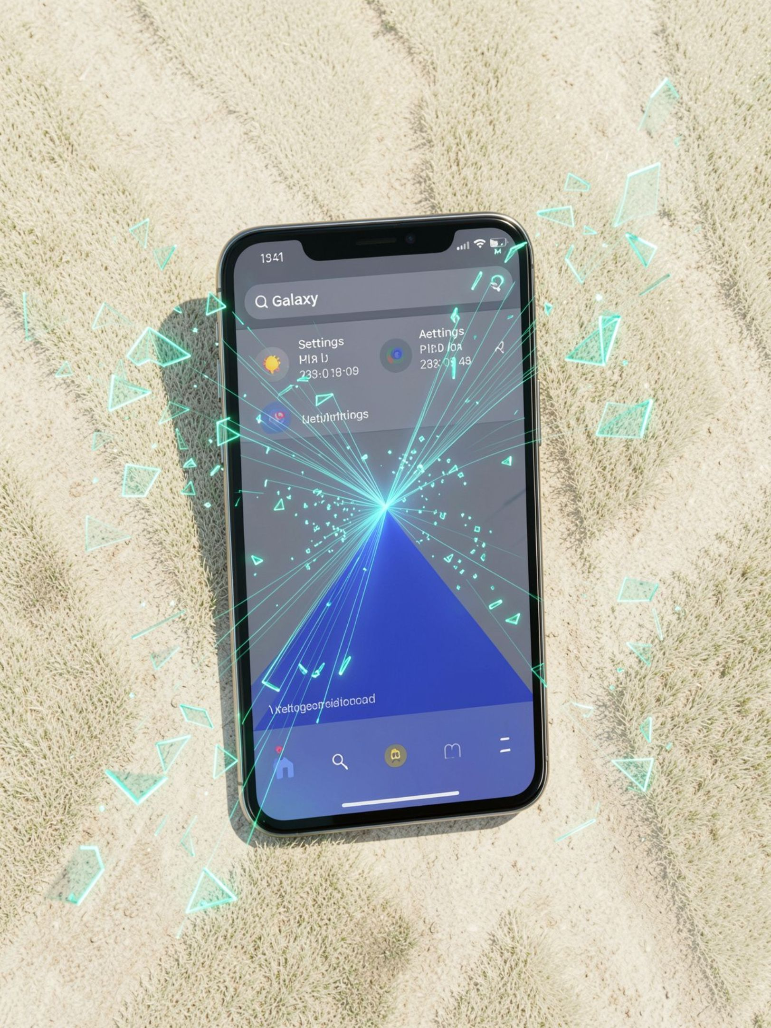
THE PROBLEM
Phone support starts with messy human language
“My phone keeps doing that thing where it stops connecting after I leave home.”
Owners describe symptoms in their own words, language, and level of detail.
Traditional support: generic, link-heavy, and built around product menus.
Risk: unvalidated AI can invent settings paths, expose web links, or suggest risky steps too early.
Notes:
The support problem begins before the settings menu. People explain symptoms with incomplete context, mixed languages, screenshots, and everyday phrasing. A useful engine must translate that mess into a safe next action without pretending to know more than it does.

Slide 3
THE SOLUTION
Our solution: a validated path from complaint to fix
Every answer moves through the same controlled journey.
01
02
03
04
05
Understand
Match
Ground
Validate
Resolve
Accept text, voice, screenshots, and multilingual complaints.
Restate the issue, identify its domain, and ask when input is too vague.
Build a troubleshooting plan from One UI reference knowledge.
Map safe actions to approved settings screens.
Deliver one-tap links—or escalate instead of guessing.
Notes:
The product promise is not simply an AI answer. It is a validated path: understand the person, ground the reasoning, match actions to an approved catalog, and resolve with a direct settings link or a clear escalation.

Slide 4

Architecture keeps the AI inside guardrails
Customer experience
Express API
React + TypeScript · text · voice · screenshot · language · device context
Understanding · cache · extraction · retrieval · validation · feedback loop
Server-side AI
Control plane
Gemini grounded by One UI reference text
Closed catalog of 36 entries · settings · cache · developer console
Validated response
Risk-labeled steps · approved deeplinks · confidence · escalation
Notes:
The architecture separates the customer experience from the reasoning engine and the control plane. Gemini is server-side only. One UI reference text provides grounding, while the closed catalog controls every allowed settings deeplink.

Slide 5


THE PIPELINE
Every request follows the same five-stage path
01
02
03
04
05
Input → Understand
AI → Extract
Cache
Validation
Final solution
Use grounded Gemini reasoning, or a rule-based fallback.
Reuse a validated answer for a semantically similar complaint.
Match actions with BM25 against approved catalog entries.
Deliver risk-labeled steps, deeplinks, confidence, and escalation when needed.
Detect language, domain, intent, and injection attempts.
Fast path · semantically similar complaint → validated cache answer
Cold path · new complaint → AI or rules → retrieval → validation
One validated output
Notes:
Every request has a predictable route. The fast path reuses a validated answer when the complaint is semantically similar. The cold path understands, extracts, retrieves, and validates before anything reaches the customer.

Slide 6
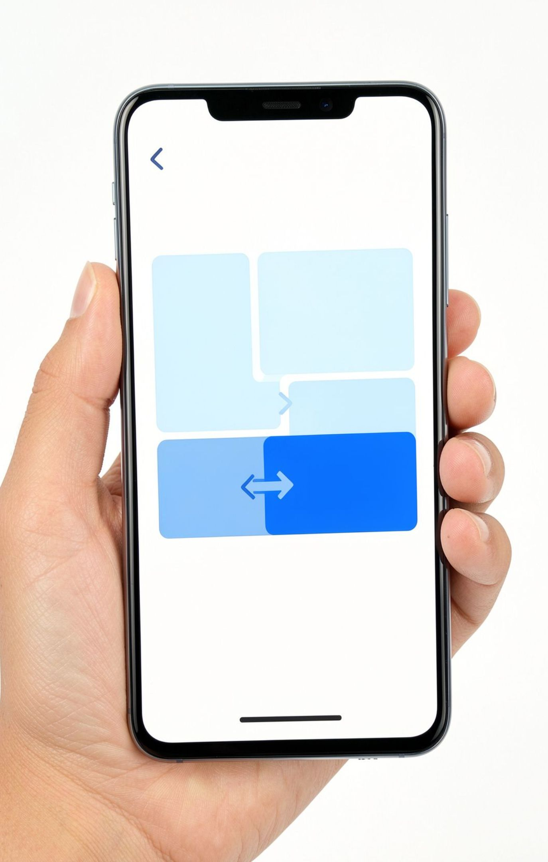





Designed around how people actually ask for help
Multilingual
Voice input
English, Hindi, Kannada, Tamil, and Hinglish understanding.
Browser speech recognition for hands-free complaints.
Screenshot diagnosis
Semantic cache
Reworded complaints can return a fast-path answer.
Show an error dialog or symptom instead of naming it.
One-tap settings + safety
Open the exact screen, order risk safely, and confirm critical actions.
Notes:
The experience meets people where they are. They can speak, switch languages, show a screenshot, or describe the symptom in their own phrasing. The engine keeps the interaction direct, while safety controls the order and level of every action.

Slide 7
THE STACK
The stack is practical, inspectable, and extensible
Frontend
Retrieval
React 19, TypeScript, Vite, Tailwind CSS.
BM25 hybrid matching across a fixed settings catalog.
Server
Operations
Express with a mobile-first customer view and developer console.
REST endpoints for troubleshooting, feedback, analytics, cache, catalog, and evaluation.
AI
Google Gemini API through the official SDK, configured server-side.
Notes:
The stack is intentionally familiar. A mobile-first React experience sits on Express services, with Gemini behind the server boundary. BM25 provides inspectable retrieval across a fixed catalog, and REST endpoints expose the parts engineers and judges need to evaluate.

Slide 8





Guard
Ground
Prompt injection: override attempts are refused before a model call.
Validation: URLs scrubbed; deeplinks must exist in catalog; titles, descriptions, and order repaired.
THE SAFETY MODEL
Safety and reliability are enforced in code
Validate
Escalate
Offline fallback: rule-based understanding and extraction keep plans flowing when Gemini is unavailable.
Confidence scoring: below 0.65 triggers a human escalation note; confident plans can enter the cache.
Guard the input. Ground the answer. Validate the action. Escalate uncertainty.
Risk controls
Physical hazards stop normal steps. Restart, safe mode, and reset stay last with confirmation.
Notes:
Safety is not a disclaimer added after generation. It is enforced before the model call, during retrieval and validation, and after confidence scoring. Risky actions stay last, critical actions require confirmation, and uncertainty becomes a human escalation note.

Slide 9

THE PATH FORWARD
From hackathon prototype to support platform
TODAY
ADVANTAGE
NEXT
Prototype
Fast path
Platform
A clear customer experience plus an inspectable console for judges and engineers.
Closed-catalog grounding prevents invented settings paths and web redirects.
Semantic fast path improves repeat-query speed and reduces model dependency.
Validated answers can enter the cache.
Replace lexical similarity with multilingual embeddings and persist cache and analytics.
Verify deeplinks on physical Galaxy devices, localize generated steps, and connect escalation to ticketing.
Notes:
The prototype already demonstrates the core experience and the inspectability judges need. The next step is not a new idea; it is platform hardening: multilingual embeddings, persisted operations data, physical-device deeplink verification, localized steps, and ticketing integration.

Slide 10

THE TAKEAWAY
Make support feel like a direct path to the right screen
Galaxy Smart Troubleshooting Engine turns vague complaints into grounded, validated, safe-to-follow actions.
Understand the person, not just the product menu.
Use AI where it helps, and rules where safety demands certainty.
Give every fix a clear path, a confidence signal, and a human fallback.
Thank you — questions welcome.
Notes:
Close on the experience, not the implementation. The engine understands the person, uses AI where it helps and rules where certainty matters, then gives every fix a clear path, a confidence signal, and a human fallback.

