Slide 1


Oxford college of computer Applications
A presentation of Mini Project on
“ANDROID APP”
“OXFORD COLLEGE APP”
Submitted to the partial fulfillment for the
award of the degree
Bachlore of computer Application
Presented by: Guided By:
Vaishnavi sinnur(20U10442) Prof Manjunath G.M
Srushti Goudar(20U10442)

Slide 2

overview
The application we are developing is about “Oxford College”. It is an android application used to find out the Information about websites, notes, Syllabus, Question papers, and also notification from college.

Slide 3
Content
Overview
Installation
Running
Languages used
Challenges
Project updates
Tools used
Future Work Plan
Conclusion

Slide 4
Installation
Android Studio(IDE)
JDK(java development kit)
SDK(software development kit)
.
Running
Gradle build
Emulator
Languages used
Java
XML
Google Firebase

Slide 5
Challenge
Software fragmentation
Device Fragmentation
User interface design rules
Security issues

Slide 6
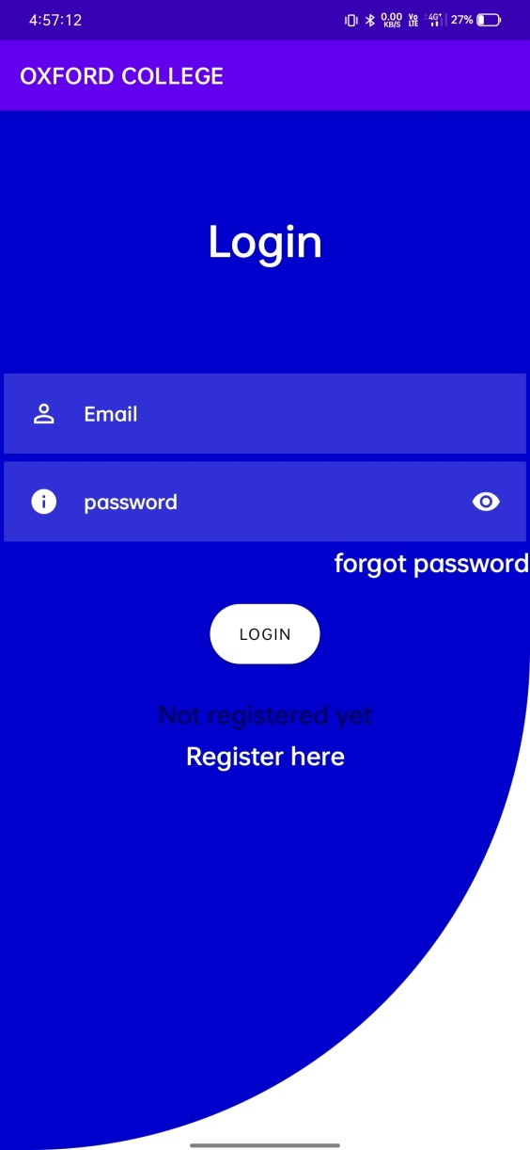
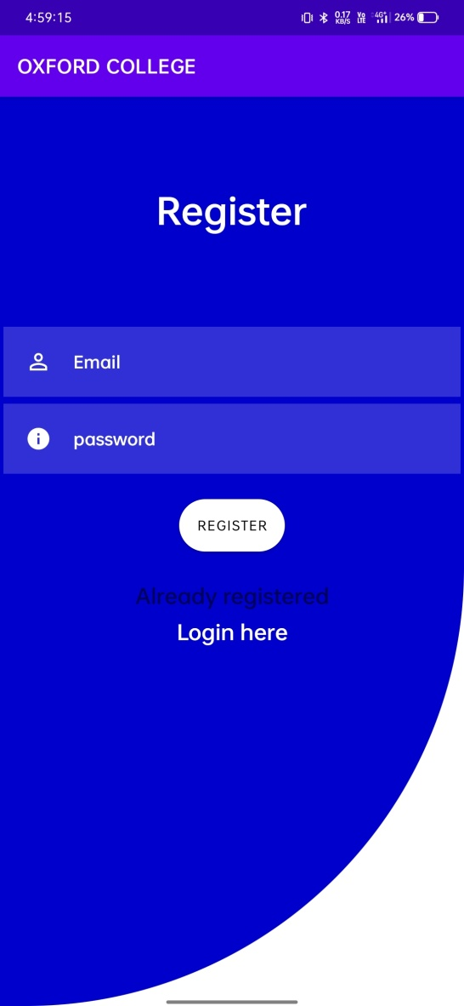
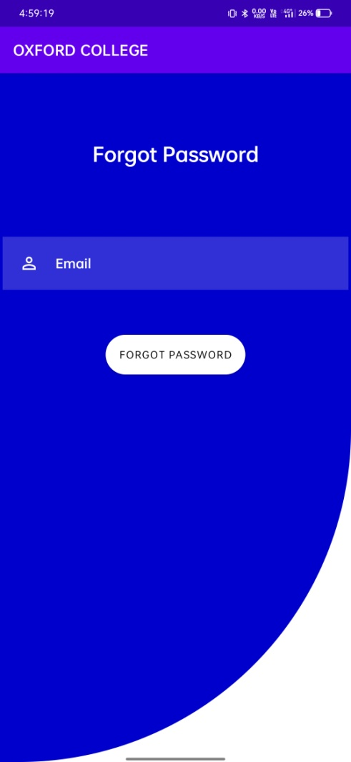
Project Updates

Slide 7
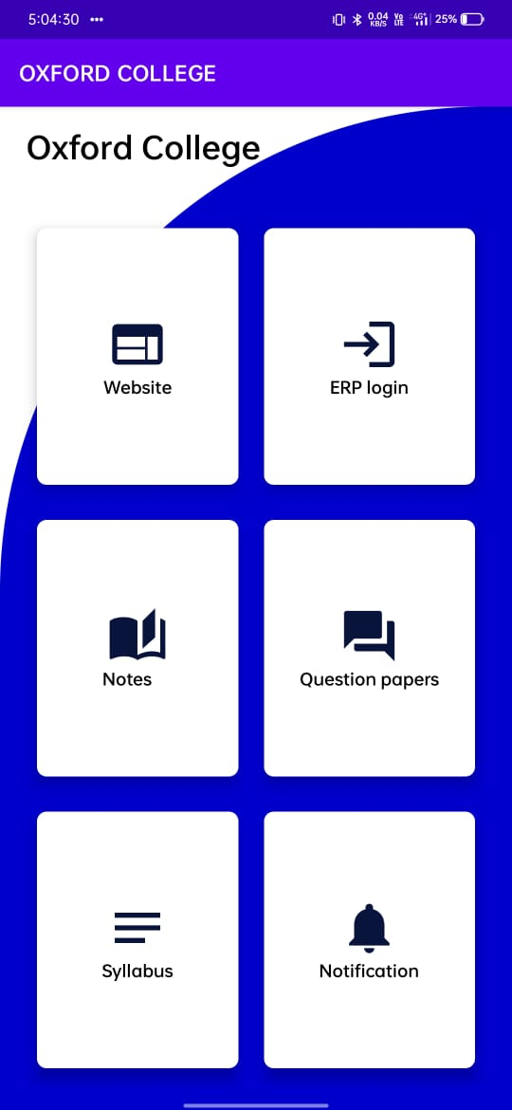
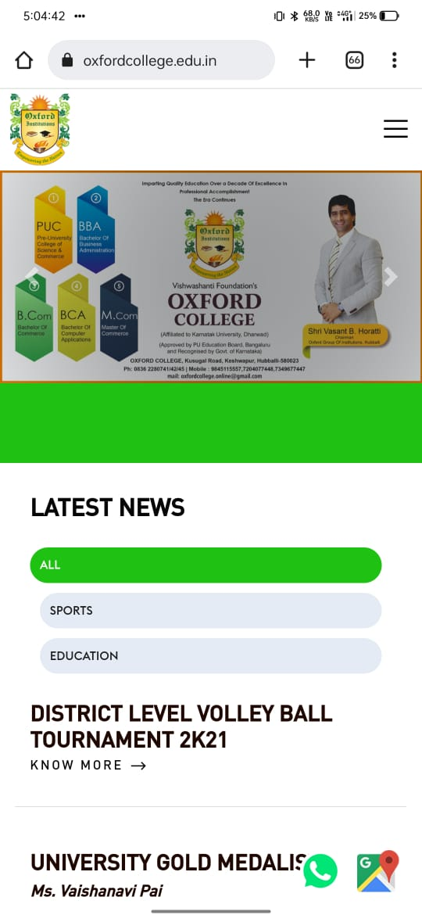
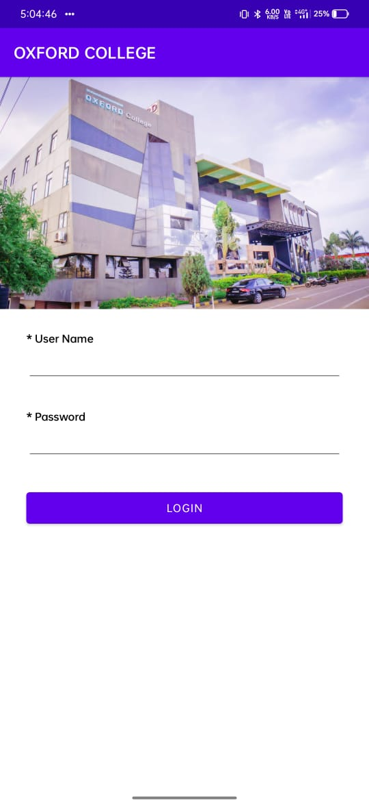

Slide 8
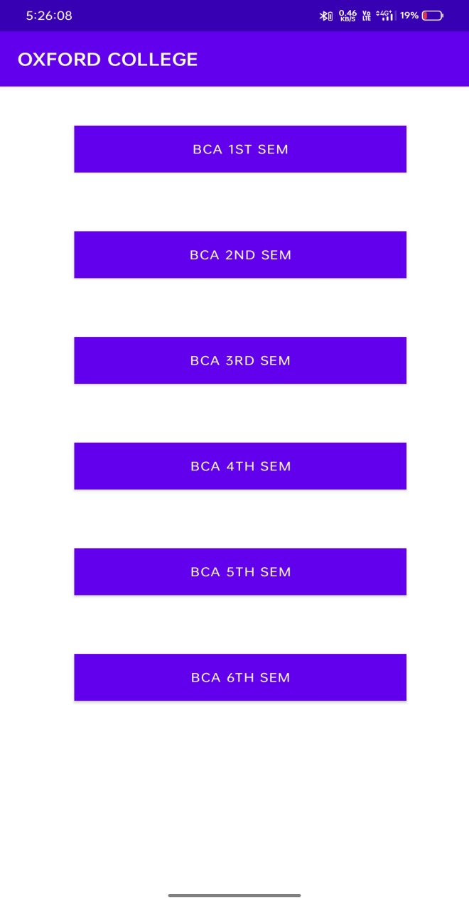
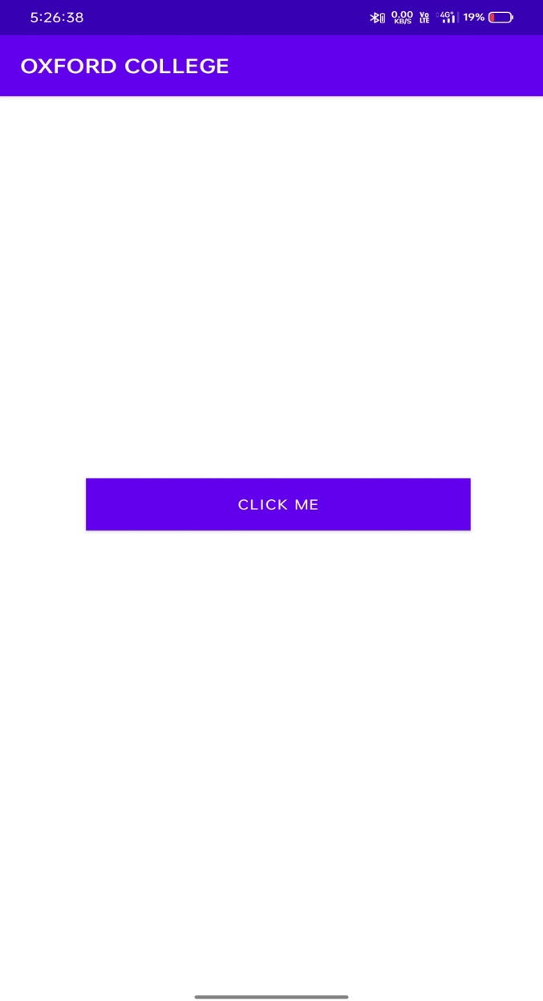

Slide 9
Tools used for Android Development
Android studio
AVD(Android Virtual Device)
Firebase
Android SDK
ABD(Android Debug Bridge)

Slide 10
Future work plan
In future we are willing to fulfill the database.
when new idea comes into brain, we are going to implement
it and provide the update to the user.

Slide 11
conclusion
Android studio is the best IDE in the market for android development.
It increases the productivity with its great set of tools and plugins.
It is easy to use and quick to learn with effective debugging features
It has got a lot of features like Emulator, plugins, Android SDK,
code shortcuts(hints)

Slide 12


