Slide 1


Enhancing Operational Efficiency in a Multispecialty Hospital
A data-driven analysis of patient wait times and workflow bottlenecks, with a digital-first roadmap to improve hospital operations.

Slide 2






Executive summary
Key headline
Notable findings: staffing explains little of the gap hospital-wide (r=0.13). Cardiology's digital registration pilot may confound tech effect vs departmental process differences. Radiology shows a stronger staff–wait correlation (r=0.50), suggesting targeted staffing helps there.
Across 3 departments and 30 patient visits, the average wait time is 43.0 minutes. Department-level averages range from 28 to 56 minutes — evidence that process design, not patient volume, drives most delay.
43.0 min
Overall average wait time (n=30)
56 vs 28 min
Widest departmental gap: Orthopedics vs Cardiology
Up to 38%
Estimated wait reduction from digital registration (pilot data)
3 departments
Cardiology, Orthopedics, Radiology analyzed

Slide 3



Business problem
Rising wait times
Low operational visibility
Manual administration
Inefficient scheduling and workflow bottlenecks increase patient waiting time across departments, degrading throughput and patient experience.
Staff availability, queue lengths, and diagnostic capacity are not tracked in real time — delaying tactical decisions and reallocation.
Paper-based registration and fragmented hand-offs create repeated data entry, queueing, and avoidable processing time.
These issues combine to produce unpredictable waits, uneven resource utilization, and diminished patient satisfaction — all addressable through process redesign and selective digital enablement.

Slide 4

Business objectives
Five measurable objectives align to operational outcomes and KPIs. Targets are intentionally specific to enable post-implementation evaluation.
Reduce patient wait time
Improve staff scheduling efficiency
Cut manual paperwork
Baseline: 43.0 min avg → Target: 30–35 min avg (20–30% reduction)
Baseline: ~70% manual registration → Target: digital-first registration across departments
Baseline: static rosters → Target: demand-aligned shifts by department and day
Improve cross-department flow
Enhance patient experience
Baseline: not measured → Target: track via standardized post-visit satisfaction score
Baseline: sequential handoffs → Target: real-time notifications and dynamic routing

Slide 5


Scope management
In-Scope
Analyze workflows from registration to discharge
Collect and analyze wait time, staffing, registration data
Map AS-IS vs TO-BE processes and identify bottlenecks
Recommend digital scheduling & registration solutions
Evaluate improvements using KPIs (wait time, flow efficiency)
Out-of-Scope
Clinical treatment protocols or medical practice changes
Major hiring or organizational redesign
Physical construction or capital equipment procurement
System upgrades unrelated to registration/scheduling/workflow
Scope boundaries maintain focus on operational processes and digital interventions that can be piloted and measured quickly.

Slide 6










Stakeholder analysis
Hospital administration
Doctors
Administrative staff
Decision-makers: require ROI, KPI tracking, phased rollout plan.
Prioritize patient flow and minimal disruption to clinical time.
Need streamlined registration and lower manual workload.
IT department
Patients
Responsible for system integration, security, and deployment feasibility.
End users: reduced waiting, clearer instructions, improved satisfaction.

Slide 7

Methodology
01
Data collection
30 patient visit records across Cardiology, Orthopedics & Radiology: wait time, staff availability, registration type, day of week.
02
Process mapping
AS-IS workflows documented in Lucidchart to identify manual hand-offs and queue points.
03
Quantitative analysis
Pivot tables, distributions, and correlation tests in Excel to isolate drivers of wait time.
Note: sample size (n=30) is representative for an academic exercise. Recommendations include a validation phase with larger operational data prior to full rollout.
04
Solution design
TO-BE processes and targeted digital recommendations built around identified bottlenecks.

Slide 8
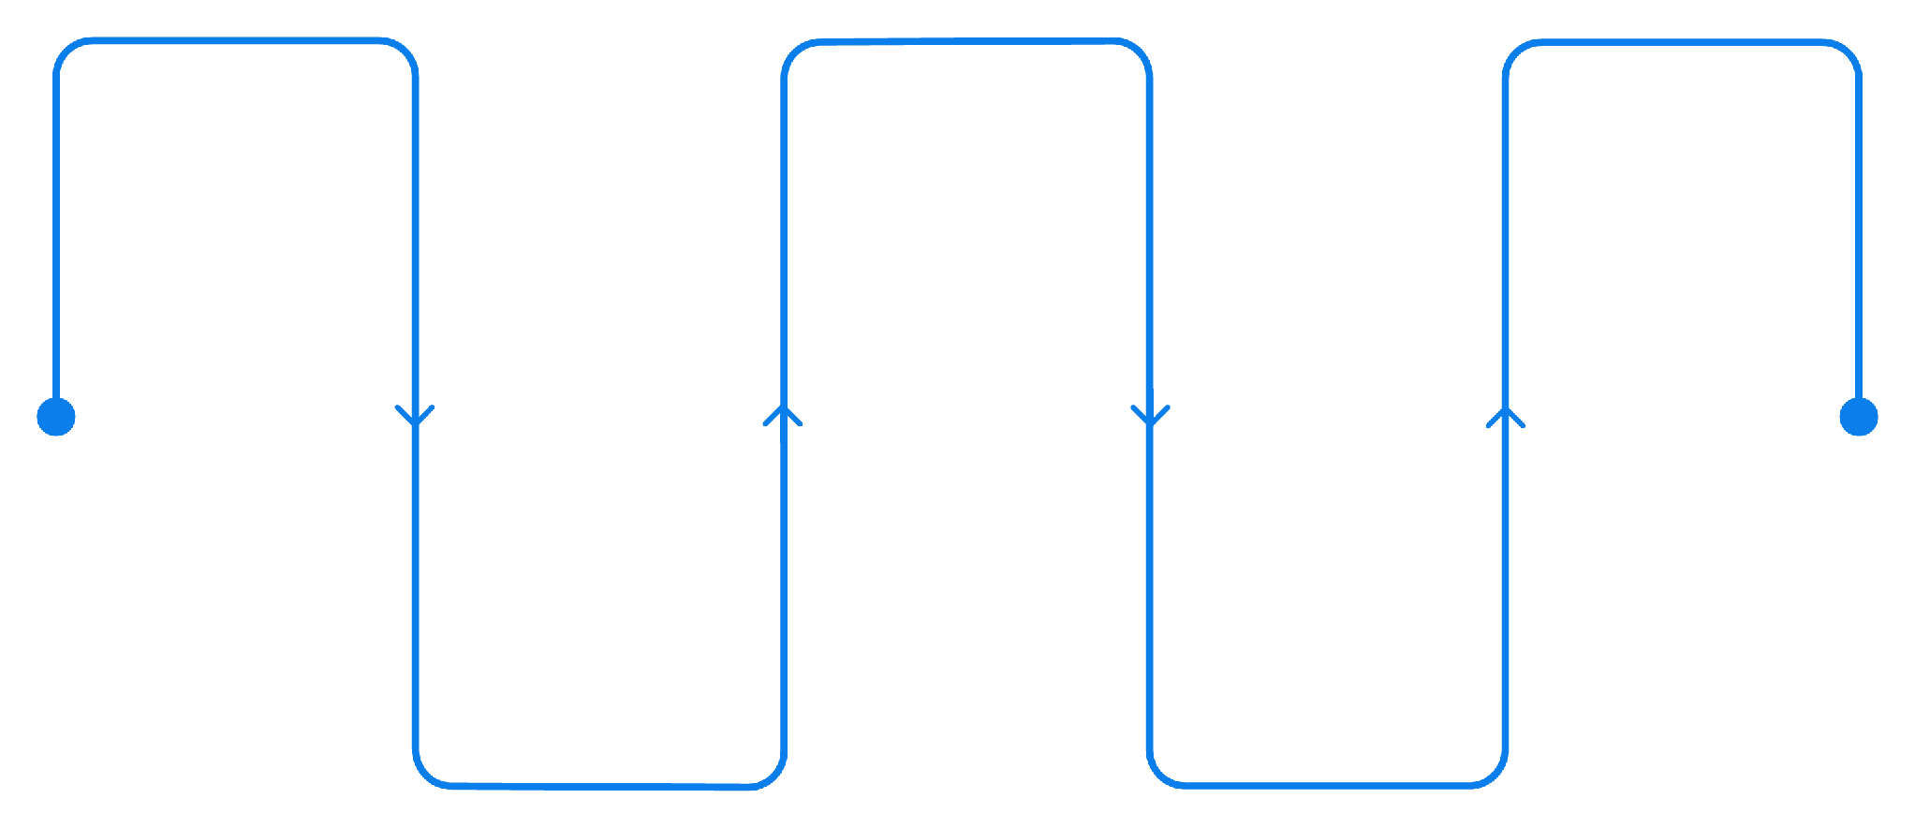
Process analysis — AS-IS
Arrival
Consultation
Waiting Queue
Patient checks in at reception
Doctor evaluates symptoms
Queueing delays; second bottleneck
Registration
Diagnostics
manual entry; key bottleneck
Tests and imaging performed
The current flow is linear and manual: arrival → registration → consultation → diagnostics → waiting → billing/discharge. Registration and queue management are disconnected from real-time departmental load and are responsible for most delay.

Slide 9

Data analysis — wait time variation
Wait time varies twofold across departments:
Orthopedics: 56 min average — slowest.
Cardiology: 28 min average — fastest despite similar staffing.
Radiology: 45 min average with highest variability (std dev ≈11.5 min) — least predictable.
Interpretation: departmental processes and coordination explain differences more than headcount or volume.

Slide 10
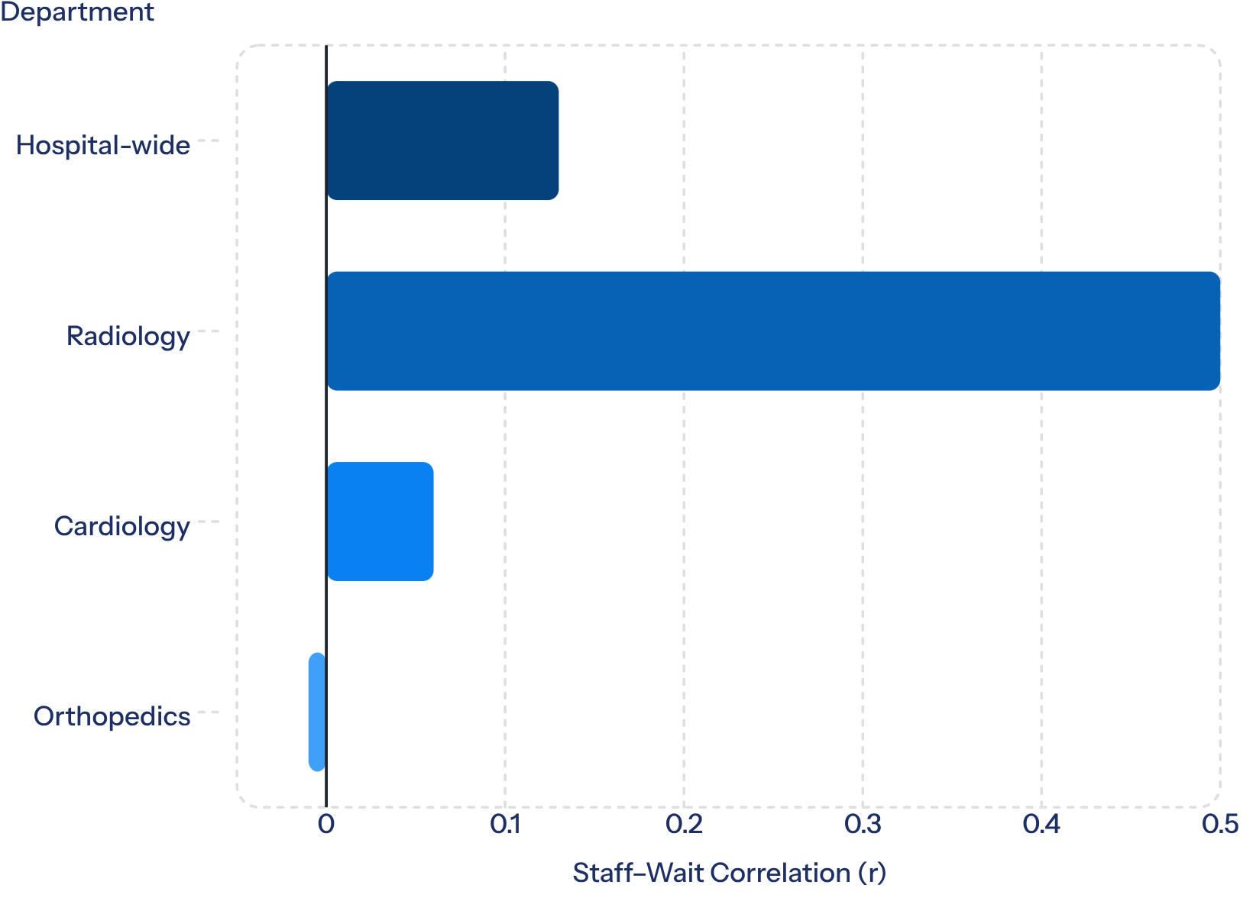

Data analysis — staffing correlation
Summary:
Hospital-wide correlation between staff availability and wait time is negligible (r=0.13).
Radiology is an exception (r=0.50): targeted staffing increases appear effective.
Cardiology and Orthopedics show near-zero or negative correlations, indicating process factors dominate.
Implication: Operational interventions must combine targeted staffing (where it helps) with process redesign and digital workflow controls.

