Slide 1
AirBnb Booking Analysis
By – Vaishnavi Patil

Slide 2
Content :
What is Airbnb?
Problem Statement
Data Summary
Preparing Dataset
Exploring Dataset
Conclusion

Slide 3

What is Airbnb?
Airbnb began in 2008 when two designers who had space to share hosted three travelers looking for a place to stay. Now, millions of Hosts and guests have created free Airbnb accounts to enjoy each other's unique view of the world.

Slide 4
Problem Statement
Since 2008, guests and hosts have used Airbnb to expand travelling possibilities.
Today, Airbnb has become a one-of-a-kind service that is used and recognized by the whole world and generates a lot of data.
Data that can be analyzed and used for security, business decisions, understanding of customers' and providers' (hosts) behavior and performance on the platform, guiding marketing initiatives, implementation of innovative additional services and much more.

Slide 5
Data Summary
Shape: Columns = 16, Rows = 48895
Id int64
Name object
host_id int64
host_name object
neighbourhood group object
neighbourhood object
latitude float64
longitude float64
room_type object
price int64
11) minimum_nights int64
12) number_of_reviews int64
13) last_review object
14) reviews_per_month float64
15) calculated_host_listings_ int64
16) availability_365 int64

Slide 6
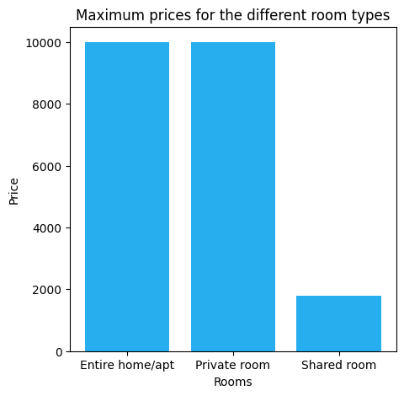
Maximum prices for the different room types
When i compared the different categorical rooms like Entire home/apt, Private room, Shared rooms,
Based on theses room categories i compared with maximum prices.
I can easily analyses here which rooms highest prices and which rooms are lower price of 2000.
Regarding the positive business impact, the insights gained from the analysis can help Airbnb hosts to set their prices according to the market trend and maximize their revenue.

Slide 7
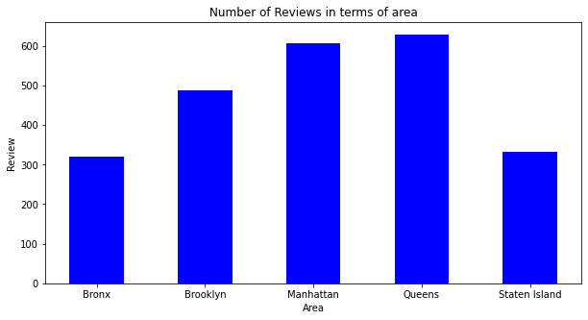
What can we learn from Data?
The most reviewed neighborhood group is Manhattan, followed by Brooklyn and Queens. Staten Island and The Bronx have the lowest number of reviews.
The Queens and Manhattan neighborhood group is the highest reviewed group is 600+
The Bronx have the lowest number of reviews
Are the 300 and 300+

Slide 8
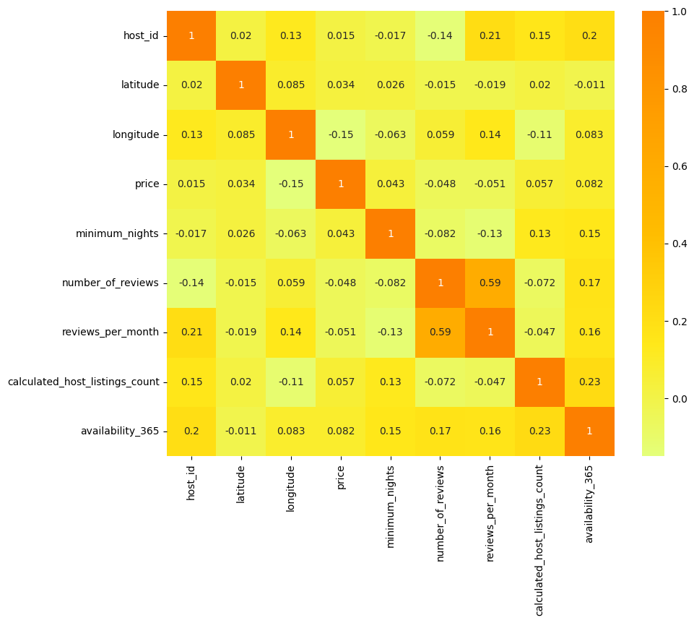
Correlation between price and minimum nights
Based on the heatmap chart, it appears that there is a weak negative correlation between price and minimum nights. The correlation coefficient value of -0.042
indicates that there is a slight tendency for listings with longer minimum night requirements to have slightly lower prices
The heatmap shows that there are other factors that have a stronger correlation with price, such as the number of bedrooms, accommodates, and bathrooms.

Slide 9
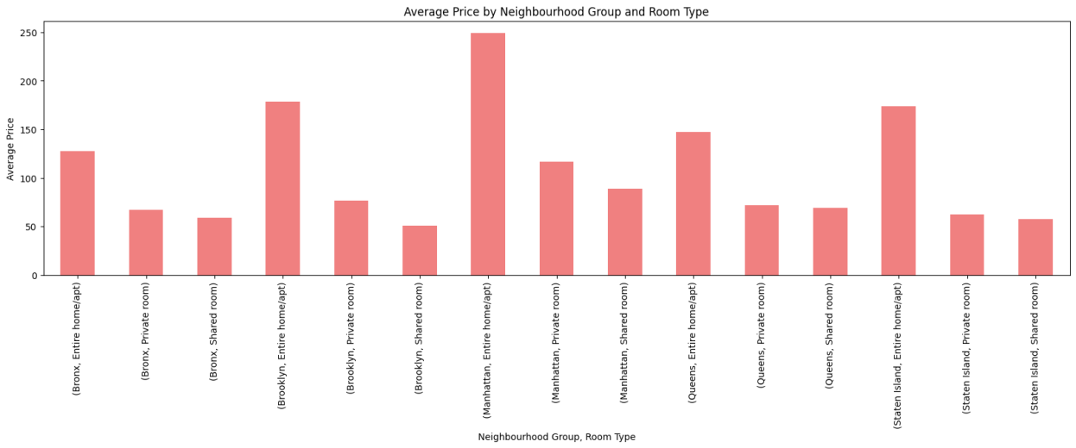
Average price of each room type in each neighborhood group
Manhattan has the highest average prices for all room types compared to other neighborhood groups around 249
Staten Island has the lowest average prices for all room types compared to other neighborhood groups around 50

Slide 10
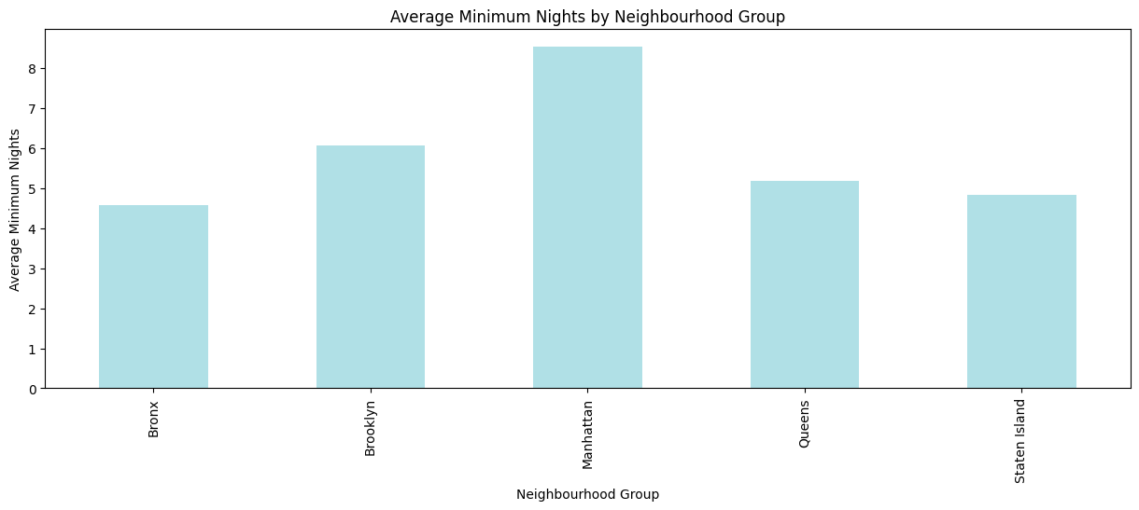
Average number of minimum nights required for each neighborhood group
The lowest average minimum nights are required in Staten Island, followed by Bronx and Queens
Manhattan and Brooklyn have the highest average minimum nights.

Slide 11
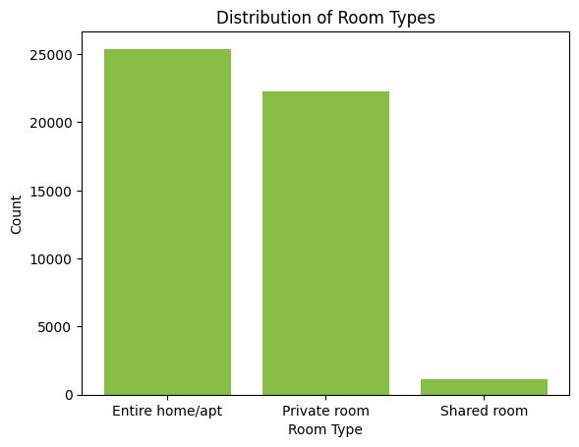
Distribution of room types
we can see that the majority of listings are for entire homes/apartments, followed by private rooms, and then shared rooms.
Here we can see that 2500 are the Entire home/apt, +2000 private room types and +100 are the shared rooms

Slide 12
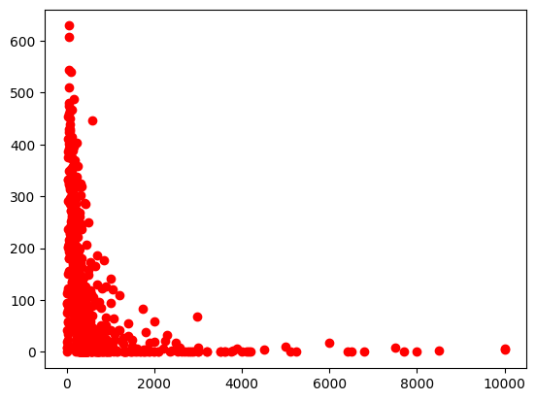
Price for review per month
Majority of the listings have a price below 1000
The maximum number of reviews received is highest for listings with prices between 0-200
Listings with prices between 200-600 tend to have more reviews compared to listings with prices above 600

Slide 13
Conclusion
Based on the visualization chart, we can conclude that the maximum prices for different room types in different neighborhoods of the Airbnb dataset vary significantly. The chart shows that the entire home/apartment type of rooms generally have the highest maximum prices, followed by private rooms and shared rooms.
We found that the Queens and Manhattan neighborhood group is the highest reviewed group .
The Manhattan is the highest average price over all the room types.
The Manhattan and Brooklyn have the highest average minimum nights.
The maximum number of reviews received is highest for listings with prices between 0-200
Overall we found that Manhattan is the highest traffic generated.

