Slide 1

BATCH NO.7
DEPARTMENT OF ELECTRONICS AND COMMUNICATION ENGINEERING
SMART BIN TECHNOLOGY
K. Nithin Goud
, ECE-B
Under guidance of
Dr. CAREY JOHN
IEDC Cell In-charge Faculty of ECE
K. Jaya Krishna , ECE-B
G. Vaishnavi Teja , ECE-B

Slide 2
SUBJECTS COVERED IN THE PROJECT
ANALOG ELECTRONICS (AEC)
DIGITAL ELECTRONICS
MICROCONTROLLERS & EMBEDDED SYSTEMS
CONTROL SYSTEMS
IoT (INTERNET OF THINGS)
ENVIRONMENTAL ENGINEERING
C/C++ PROGRAMMING

Slide 3
SUGGESTIONS GIVEN BY PRC
IoT Integration
Sustainability
AI Features
Community Engagement
Scalability
Data Analytics
Design Improvements
Partnerships
Feedback
Hygiene

Slide 4
ABSTRACT : SMART DUSTBIN USING ARDUINO
Objective: Design a smart dustbin for efficient waste management using automation and sensors.
Technology Used: Arduino, ultrasonic sensors, and servo motors for lid operation.
Functionality: Lid opens automatically when a person or object is detected.
Impact: Reduces manual contact, promoting hygiene and a cleaner environment.
Applications: Ideal for households, offices, public spaces, and hospitals.

Slide 5
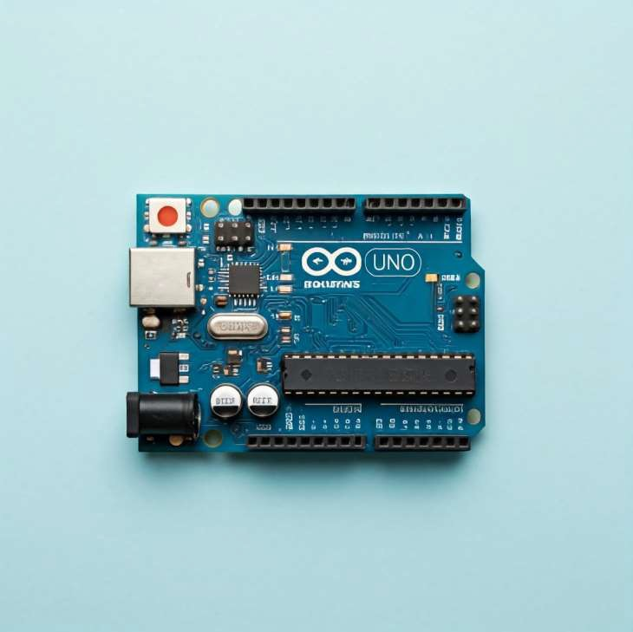
MOTIVATION OF PROJECT
We were inspired to create the "Smart Dustbin using Arduino" to address waste management issues and promote cleanliness. By leveraging technology, we aimed to develop a simple, efficient solution that encourages proper waste disposal and supports a sustainable environment.

Slide 6
OPTIMIZING WASTE MANAGEMENT: THE SMART BIN TECHNOLOGY

Slide 7
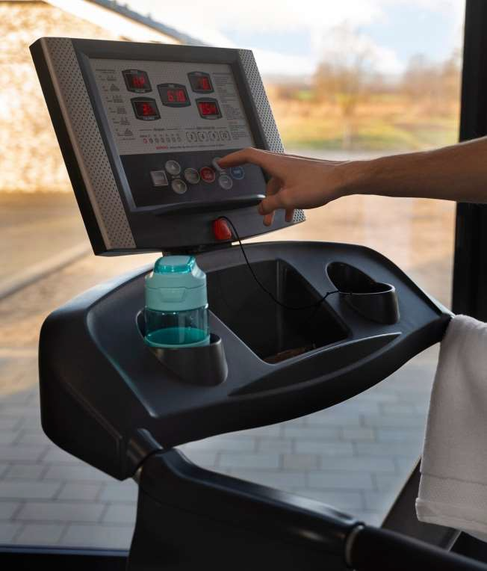
INTRODUCTION TO SMART BIN TECHNOLOGY
In today's world, waste management is critical. Smart bin technology offers innovative solutions that enhance efﬁciency and sustainability. This presentation explores the impact of these technologies on waste reduction and resource recovery.

Slide 8
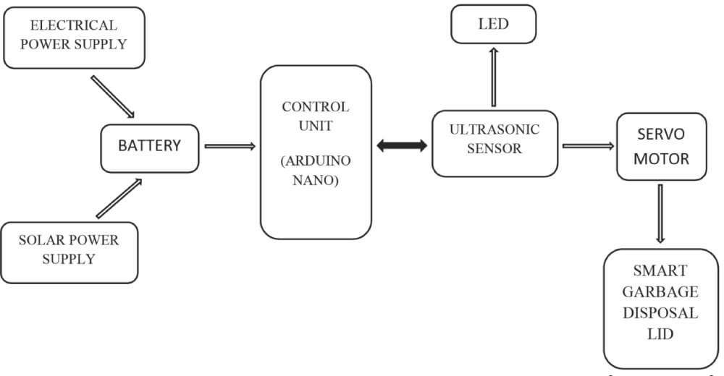
BLOCK DIAGRAM:
USB POWER SUPPLY
OR
9V BATTERY
UNO)

Slide 9
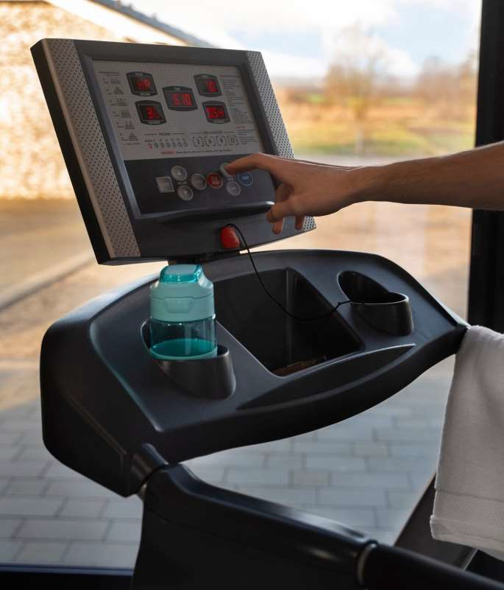
WHAT ARE SMART BINS?
Smart bins are equipped with sensors that monitor waste levels and optimize collection routes. By utilizing IoT technology, they provide real- time data, ensuring efﬁcient waste management and reducing operational costs.

Slide 10

BENEFITS OF SMART BIN TECHNOLOGY
Implementing smart bin technology reduced collection costs.
improved recycling rates, and enhanced public engagement.
These advantages contribute to a more sustainable urban environment.

Slide 11

ENVIRONMENTAL IMPACT
Waste Management Efficiency: Promotes better waste segregation and recycling.
Reduced Pollution: Decreases litter and pollution in public spaces.
Resource Conservation: Saves natural resources and energy through improved recycling.
Decreased Carbon Footprint: Reduces greenhouse gas emissions from landfills.

Slide 12
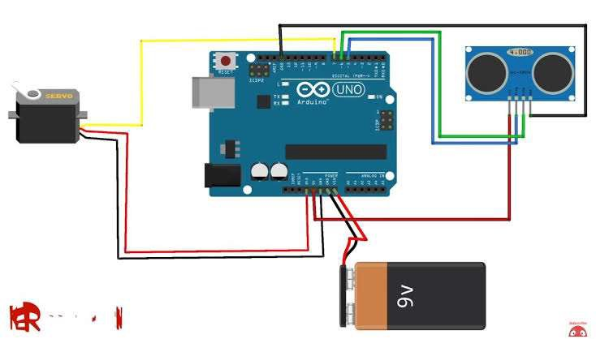
CIRCUIT CONNECTIONS:

Slide 13

CHALLENGES IN ADOPTION
Despite the beneﬁts, challenges exist in the adoption of smart bin technology, including high initial costs and the need for public education. Addressing these hurdles is essential for widespread implementation.

Slide 14
TIME REQUIRED TO COMPLETE THE PROJECT
Planning & Research: 1–2 weeks.
Procurement of Materials: 2 days.
Hardware Assembly: 2–3 days.
Software Development: 1 week.
Integration & Testing: 4 days.
Deployment & Documentation: 2-3 days.
Total Time: 3-4 weeks (depending on complexity and resources).

Slide 15
CONCLUSION: THE PATH FORWARD
Smart bin technology represents a signifficant advancement in waste management. By embracing these innovations, cities can achieve greater effficiency, promote sustainability, and enhance the quality of life for residents.

Slide 16
References:
1. Electronics
"Make: Electronics" by Charles Platt
"Practical Electronics for Inventors" by Paul Scherz
2. Programming & Microcontrollers
"Arduino Cookbook" by Michael Margolis
"Programming Arduino" by Simon Monk
3. IoT & Networking
"Internet of Things: A Hands-On Approach" by Arshdeep Bahga "Building the Internet of Things" by Maciej Kranz

Slide 17
Thanks!
Do you have any questions?

