Slide 2

The Power of the Pause Button : The Superpower of Feature Flags and the Future of Software Delivery
Vaishnavi Venkata Subramanian

Slide 3
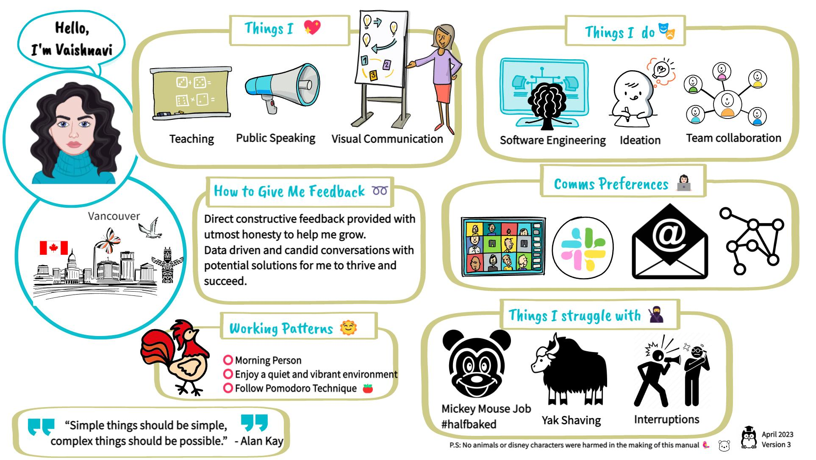

Slide 4
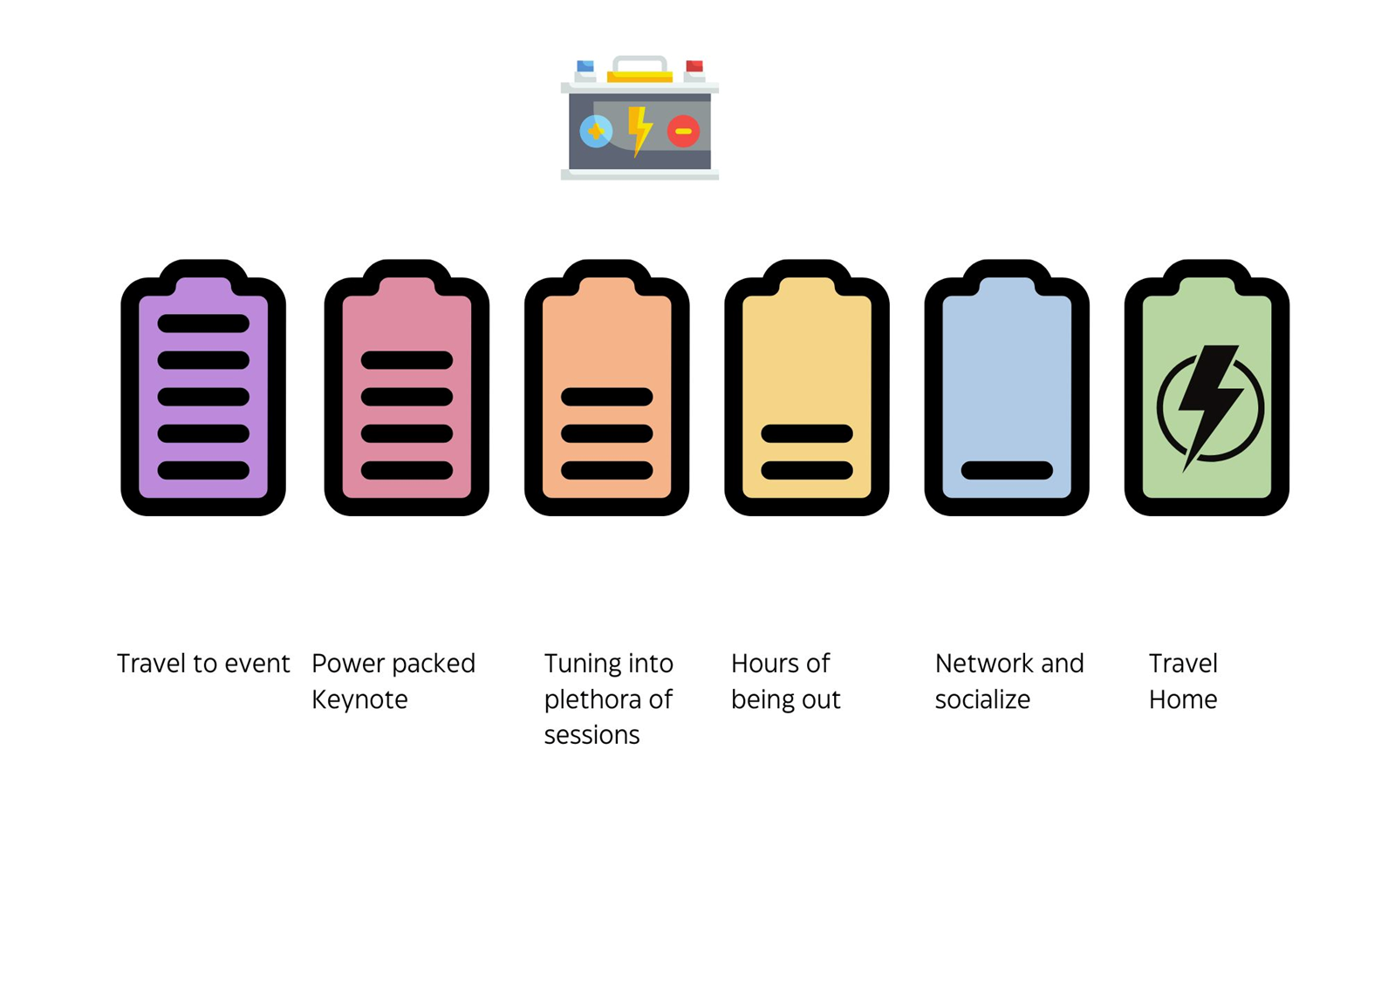

Slide 5

Photo by Schiba on Unsplash

Slide 6

Martin Fowler
Chief Scientist,
Thoughtworks
Image : thoughtworks

Slide 7

Edith Harbaugh
CEO, Executive Chair
LaunchDarkly
Image : launchdarkly.com

Slide 8
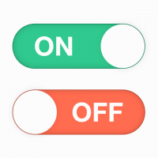
What Are Feature Flags?
Software engineering technique that allows teams to enable or disable specific features in their applications dynamically, without having to redeploy the code.
Image : cloudbees

Slide 9
Feature Flags/Toggles
Conditional switches in code to turn features ON or OFF at runtime.
Like a “pause button” for any feature - no redeploy needed.
Decouples the act of deploying code from the act of releasing features to users
Teams can use feature flags to control exactly when and how users experience changes

Slide 10
Kill Switch for unexpected events
Image tenor
Notes:
The Ren And Stimpy Show Red Button GIF

Slide 11
Why Use Feature Flags?
Safe and gradual rollouts
Provide a "kill switch" to instantly turn off problematic features without rolling back the entire deployment
Increase development velocity
Fast rollback

Slide 12
Dark Launch: Deploy the new version of the application anytime. Since the new features are disabled, this doesn't immediately impact users.
Enable features next day: Teams can turn on the feature flags based on business needs and conduct a gradual rollout.
A/B Testing, Canary Release and Experimentation
Improve collaboration - Decouple deployment from release
Why Use Feature Flags?
Notes:
control circuit multiple switch on off

Slide 13
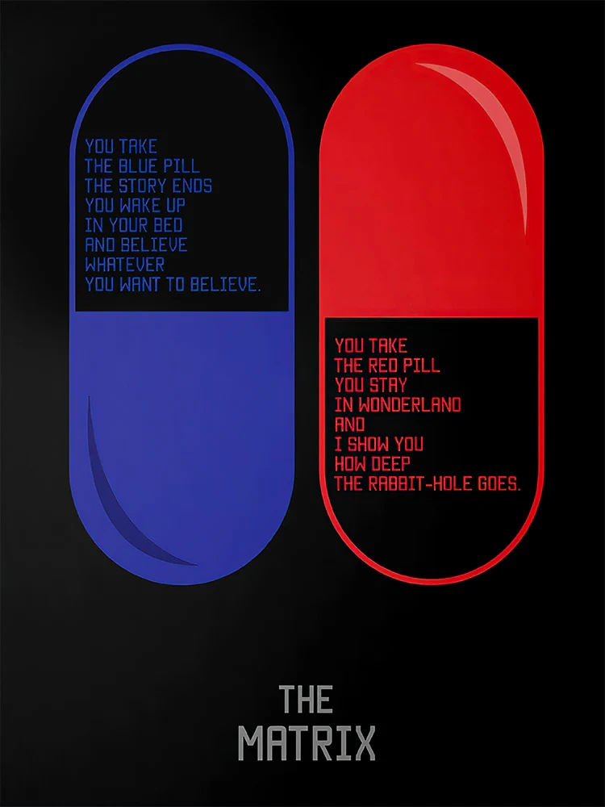
Experimentation through A/B Testing
Image : scifi.net
Notes:
Most of us have seen the movie The Matrix. What pill would you choose, if you had Morpheus asking you? Red pill for the truth of reality? Or would you pick the blue pill and continue to believe an illusion? What if you wanted to try both and then choose? Unfortunately, that wasn't possible in the movie, but in software, with feature flags, it's possible. the main character Neo (played by Keanu Reeves) is offered the choice between a red pill and a blue pill by rebel leader Morpheus

Slide 14
Types of Feature Toggles
Release flags
Experimentation flags
Operational flags
Permission flags

Slide 15
Release toggle
Allows developers to merge non-ready code to production, turning it on once it’s ready, without the exposure to users.
Who is responsible for toggling it: Developers.
When should you delete it: A week or two after the release of the feature

Slide 16
Experimentation toggle
Allows you to perform A/B testing. You divide the users into groups, each getting a different experience. While the toggle is active, you collect enough data to make the final decisions about which features to promote, refine, or retire.
Who is responsible for toggling it: It varies, but mostly PMs.
When should you delete it: a few days/weeks - once you get enough data to make a final decision.
Notes:
allow teams to present different versions of a feature to different user segments, collecting data on which variant performs better. This data-driven approach helps organizations make informed decisions about which features to promote, refine, or retire.

Slide 17
Operational toggles
May introduce when rolling out a new feature which has unclear performance implications so that system operators can disable or degrade that feature quickly in production if needed. Also called kill switches or circuit breakers
Who is responsible for toggling it: Ops team - probably through a dedicated tool.
When should you delete it: 1-2 weeks, once you gain confidence in the new feature. In rare cases, you might keep some “Kill Switches”, to stop non-critical functionality when the system is under unusually high load.
Notes:
they provide toggles for infrastructure or runtime controls. For example, an ops flag might be used to enable or disable a third-party integration, adjust system parameters, or control access to backend services. These flags are invaluable for responding to operational incidents

Slide 18
Permission toggles
Allows one to change the features and experiences specific users have on the application. It may be through having “premium” features for paying customers, geography or “alpha” / “beta” features, for internal users / beta customers.
This type is dangerous because it needs to be long-lived. Treating it the same way as the other toggles, as something that will be deleted soon, is a critical and common mistake.
Who is responsible for toggling it: Set role-based access control (RBAC) to specify who can delete flags in a given environment.
When should you delete it: Collective decision. Enable monitoring and observability. Thorough review and documentation

Slide 19
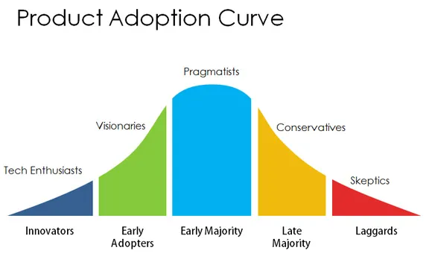
Image : prodpad.com

Slide 20
The double edged sword!

Slide 21

Knight Capital Group

Slide 22
Power Peg and SMARS (Smart Market Access Routing System)
August 1st, 2012, preparing for NYSE’s Retail Liquidity Program
Notes:
Power Peg was a test program that bought high and sold low; it was specifically designed to move stock prices higher and lower in order to verify behavior of its other proprietary trading algorithms in a controlled environment.

Slide 23
Power Peg and SMARS (Smart Market Access Routing System)
Power Peg - Trading algorithm that bought high and sold low; it was specifically designed to move stock prices higher and lower in order to verify behavior of its other proprietary trading algorithms in a controlled environment. Last used in 2003
It was not to be used in the live, production environment.
The errant code created a "ping-ponging" pattern of buying at the ask price (higher) and selling at the bid price (lower)—the exact opposite of profitable trading. Some stocks experienced dramatic price movements
Notes:
Power Peg was a test program that bought high and sold low; it was specifically designed to move stock prices higher and lower in order to verify behavior of its other proprietary trading algorithms in a controlled environment.

Slide 24
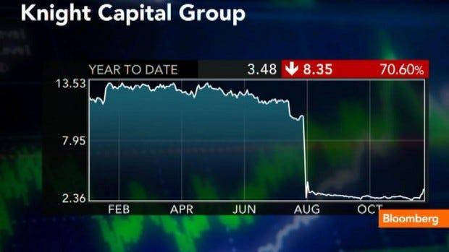
How to lose half a billion dollars with incorrect feature flags and a deployment failure
Image : statsig.com
Notes:
365 million dollar assets
Lost 450 million dollars

Slide 25
“Murphy's Law applies double in production environments”
Credit : soundofdevelopment

Slide 26
Dead Code is Dead Weight : Unused code shouldn't just lie dormant in your production systems but must be removed entirely.

Slide 27
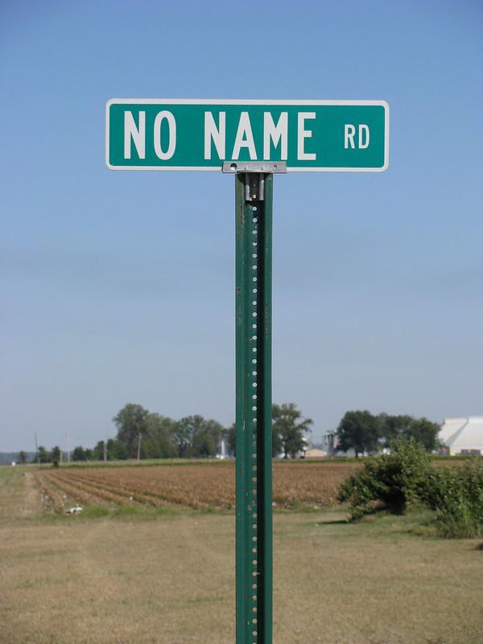
Mistakes to Avoid when Adopting
Feature Flags
Leaving stale flags in code causing a debt
Never reuse a toggle
Poor flag naming conventions
Lack of documentation
Performance bottlenecks
Security and Access Control
Image : flickr

Slide 28
Good names
Are descriptive. For example, is-v2-billing-dashboard-enabled is much clearer than is-dashboard-enabled. It includes useful version and product context.
Use name "types". This helps organize them and makes their purpose clear. Types might include experiments, releases, and permissions. For example, instead of new-billing, they would be new-billing-experiment or new-billing-release.
Reflect their return type. For example, is-premium-user for a boolean, enabled-integrations for an array, or selected-theme for a single string.
Use positive language for boolean flags. For example, is-premium-user instead of is-not-premium-user. This helps avoid confusing double negatives when checking the flag value (e.g. if !is_not_premium_user).
Source : posthog.com

Slide 29
The Meta Game Problem
Manual cleanup doesn’t work - devs are busy
Flags become permanent, codebase gets messy
Bugs and confusion increase over time

Slide 30
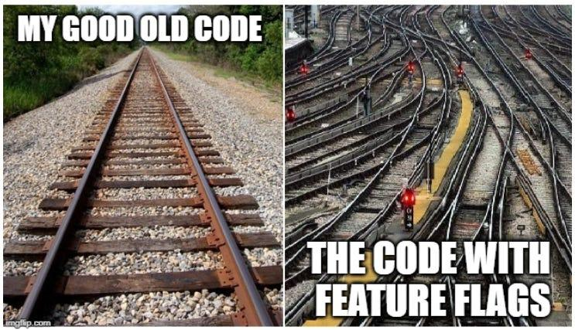
What’s wrong with the feature flags addiction
Feature Flags have a tendency to multiply rapidly, particularly when first introduced.
They are useful and cheap to create and so often a lot are created.
Image manager.dev

Slide 31
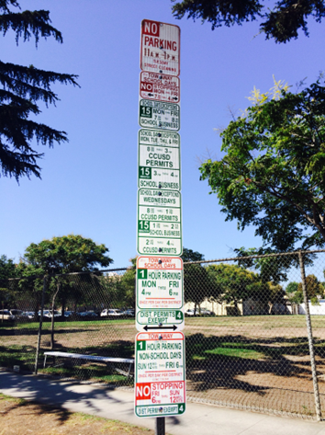
Conflicting Flags

Slide 32
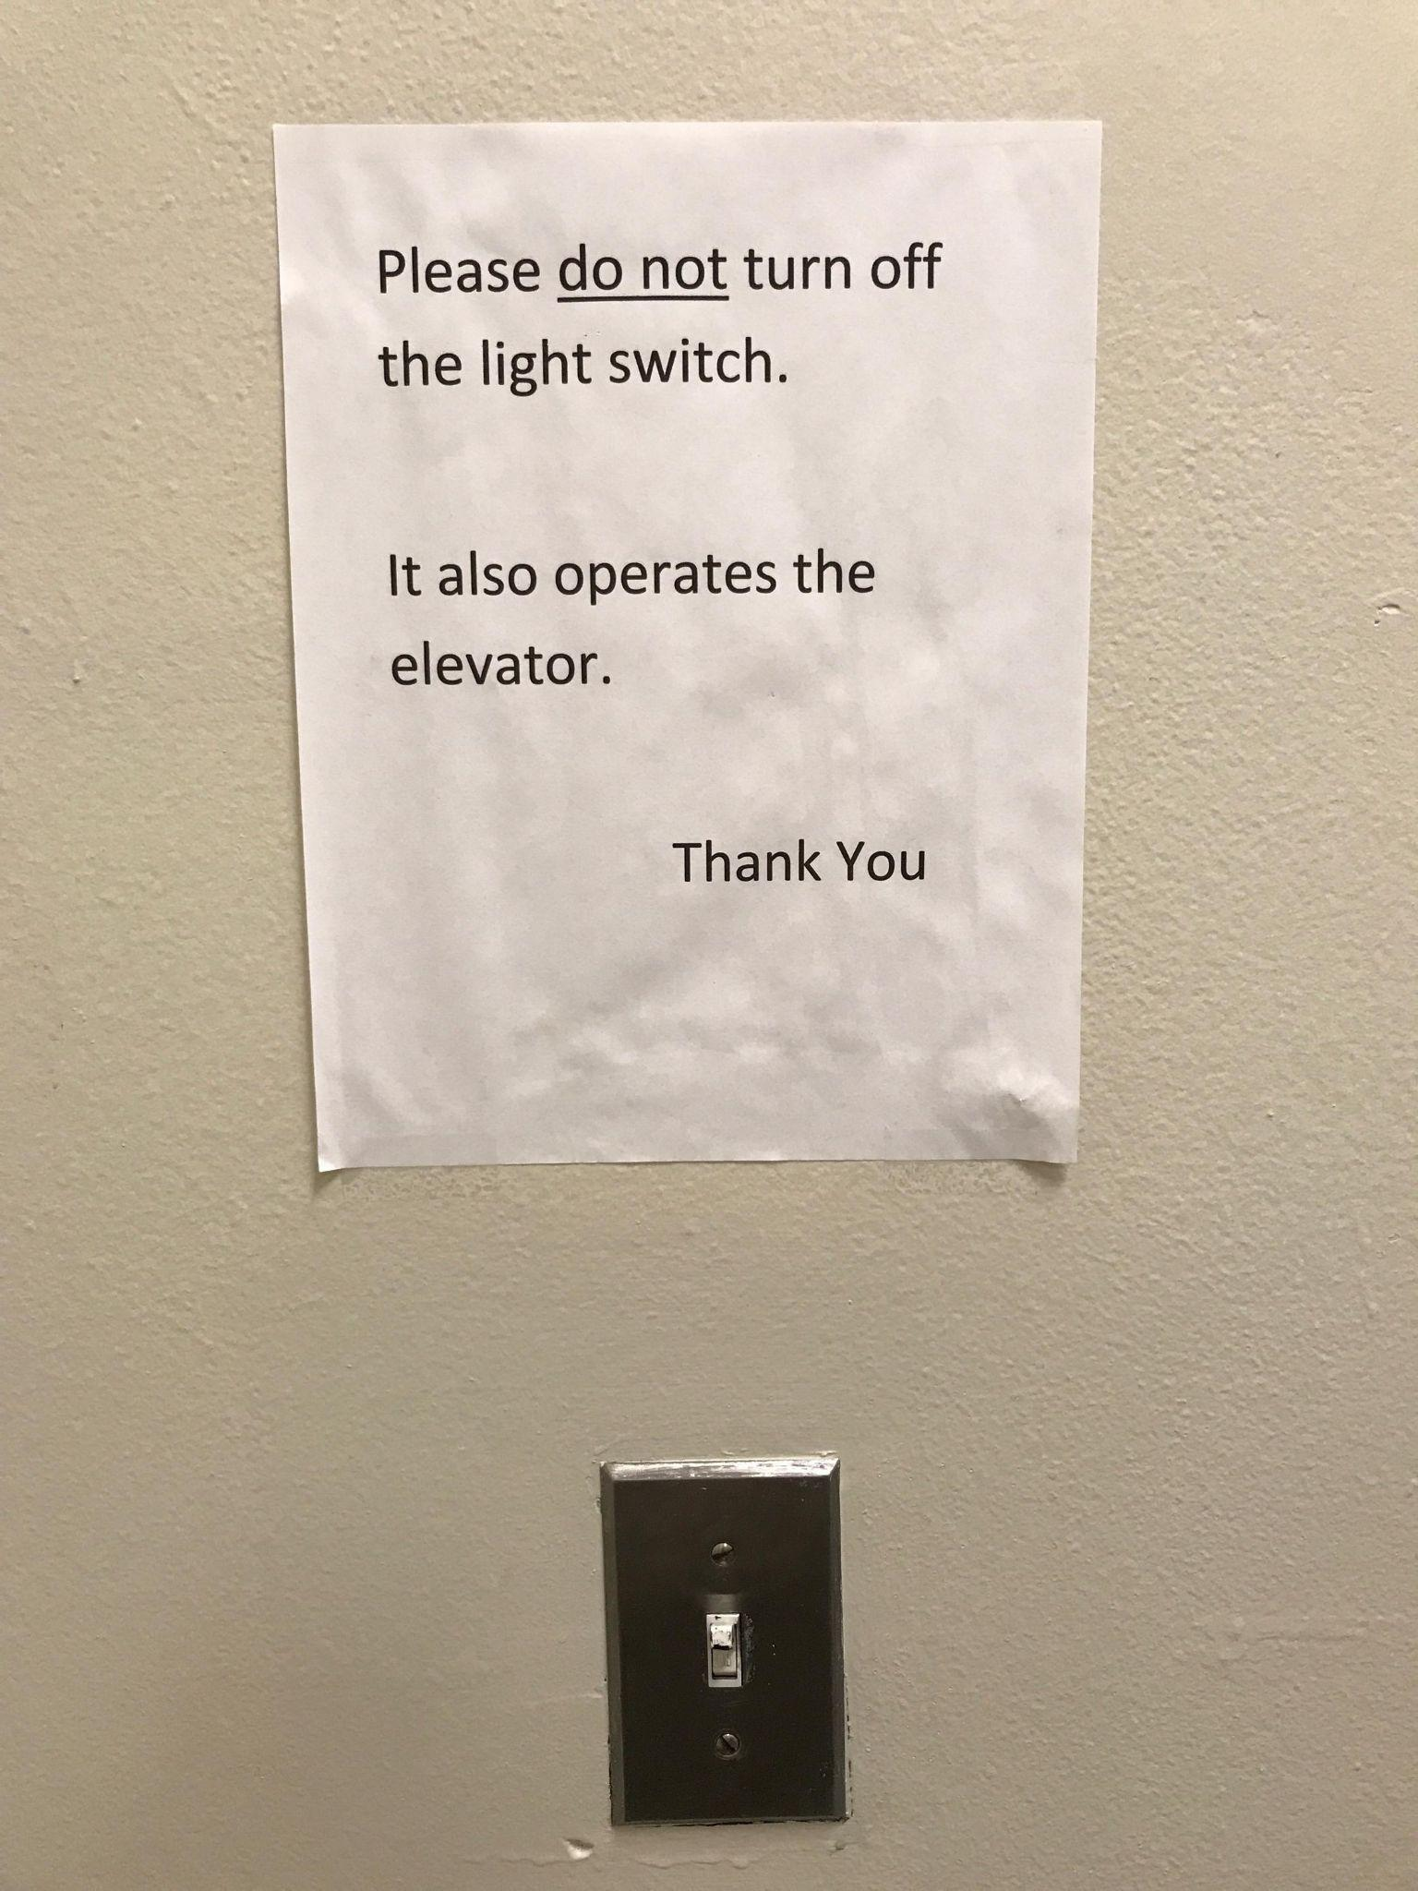
Overused Flags
Image : reddit

Slide 33
Best Practices for Scaling Feature Flag Management
Centralized Flag Management Tools
Flag carefully. Define Flag Lifecycles
Integrate with CI/CD Pipelines
Observability and Monitoring
Team Education
Trunk Based Delivery

Slide 34
Flag Lifecycle
Have a designated owner responsible for reviewing and monitoring flag’s status
Remove it when it is no longer needed
Regular audits of the codebase
Automated tools to track flag usage
Clear documentation can all help ensure that stale flags are identified and eliminated promptly
No expiry? Build fails.
Automated detection and alerts. When a flag hits the criteria, alert someone (like the owner) that it might be time to remove it. Keep reminding them until they do.

Slide 35
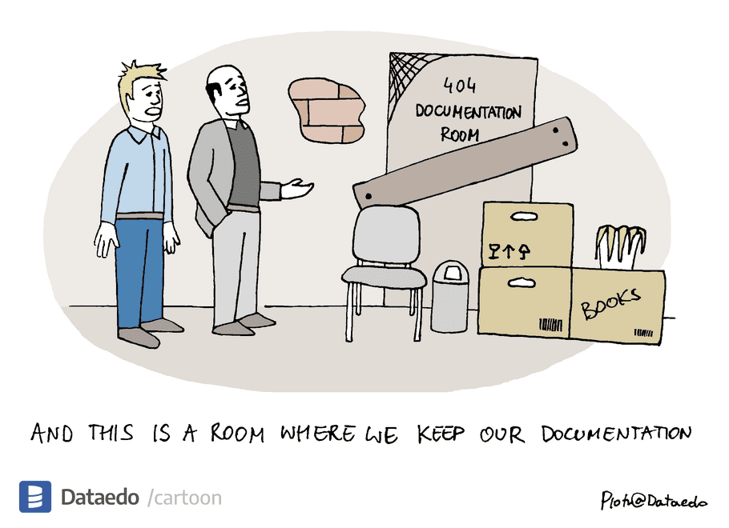

Slide 36
Documentation
Flag’s purpose
Owner
Creation date
Always provide default behavior for each flag if the configuration system fails or the flag value is undefined.
Planned removal date

Slide 37
Observability and Monitoring
Make Alerts Matter

Slide 38
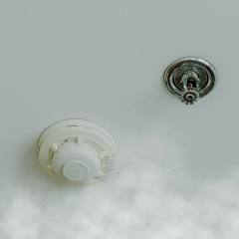
You cannot resolve a broken feature without knowing it's broken
Akin to having a sprinkler system without a smoke detector
Notes:
Monitoring tracks specific, predefined metrics to detect known issues, while observability uses a broader analysis of system data (like logs, metrics, and traces) to understand system behavior and diagnose both known and unknown problems. Monitoring is about collecting and displaying data, whereas observability is about investigating that data to understand why something is happening
Analogy
Monitoring A dashboard that shows you if your car's fuel is low or if the engine temperature is high.
Observability The ability to use a diagnostic tool to figure out why the engine is making a strange noise, even if it's a new problem.

Slide 39
The “Pause Button” Metaphor
•Instantly enable or disable features
•Reduce risk during launches
•Respond to issues in real-time

Slide 40
Feature Flag Decoupling
•Release code with features OFF, enable later
•No redeploy needed, everything works

Slide 41
Superpowers Unlocked
Safe Deployments: Ship code with features OFF, enable later
Instant Rollbacks: Turn off features if issues arise. No redeployment
Progressive Delivery: Canary, beta, or region-based rollouts

Slide 42
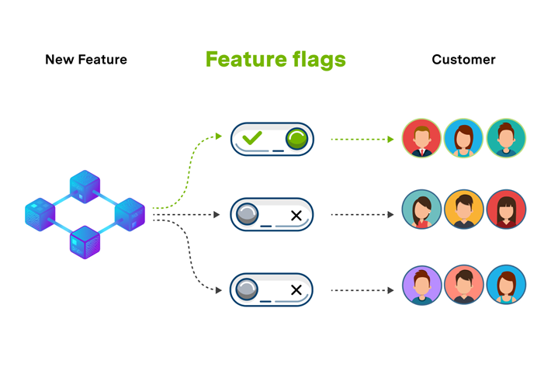
Real-World Example
Feature Flags Customer Lifecycle
Image : https://medium.com/@ridvanozcan48

Slide 43
Verbose Logging for Troubleshooting
Activate various levels to reproduce
https://medium.com/shipbook/android-log-levels-c0313055fdb9

Slide 44
Real-World Example
•New UI shipped to production, but only 5% of users see it
•If bugs appear, instantly revert for all users—no redeploy

Slide 45
Google Cloud Suffers Major Disruption
In June 2025 Google Cloud, Google Workspace and Google Security Operations products experienced increased 503 errors in external API requests, impacting customers.
According to the incident report by Google, on May 29, 2025, a new feature was added to Service Control for additional quota policy checks. This code change and binary release went through their region by region rollout, but the code path that failed was never exercised during this rollout due to needing a policy change that would trigger the code. As a safety precaution, this code change came with a red-button to turn off that particular policy serving path.
The issue with this change was that it did not have appropriate error handling nor was it feature flag protected.

Slide 46
Pitfalls
Too many flags (“flag debt”)
Flags never cleaned up
Hard-to-test flags (e.g., hidden in databases)
Configuration drift between environments - Development and Production flags are different
New developers start, current flag configuration is unknown until runtime

Slide 47
The Solution: Mandatory Expiry
•Every flag must have:
–An expiry date (hard-coded)
–A permanent value after expiry (ON/OFF/variant)
•No expiry? Build fails.

Slide 48
Enforced by Code
•After expiry, flag always returns the permanent value
•No manual intervention needed
•No more flag debt

Slide 49
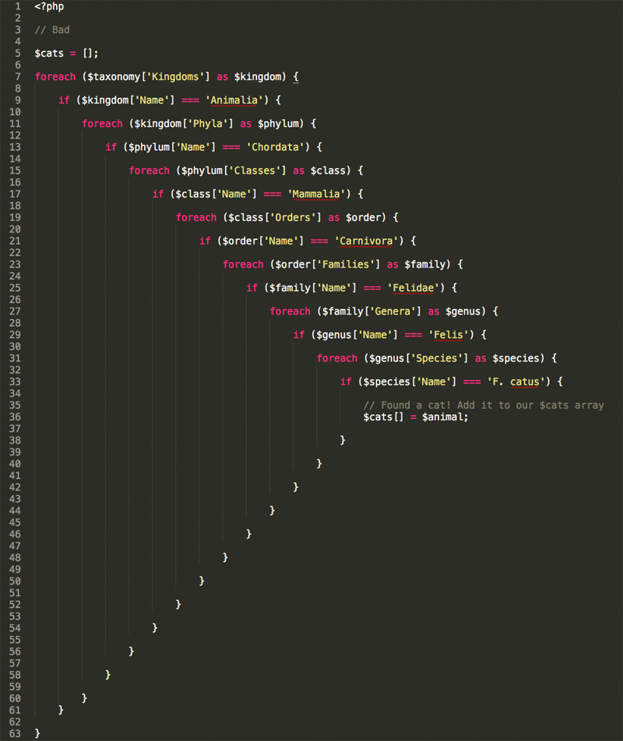
Bad Practise - Triangle of Doom

Slide 50
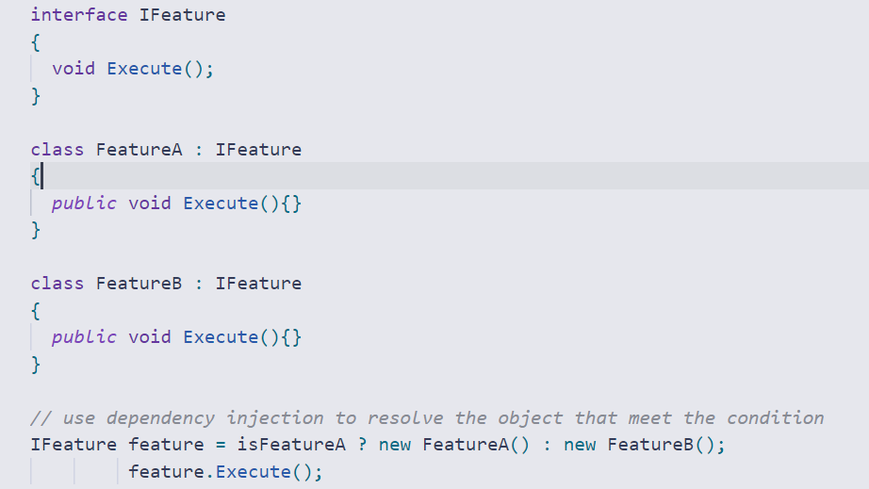
Good Practise - Dependency Injection

Slide 51
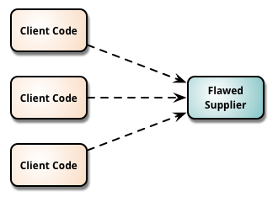
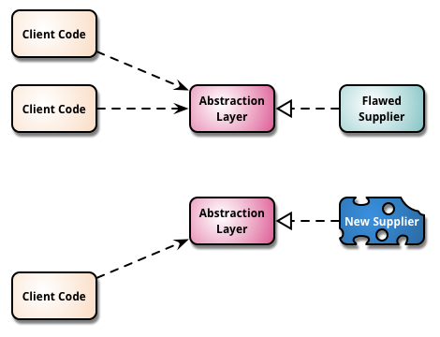
Branch By Abstraction

Slide 52
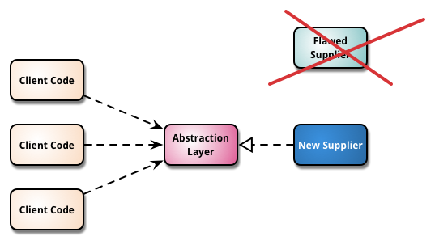
Branch By Abstraction
Image : martinfowler.com

Slide 53
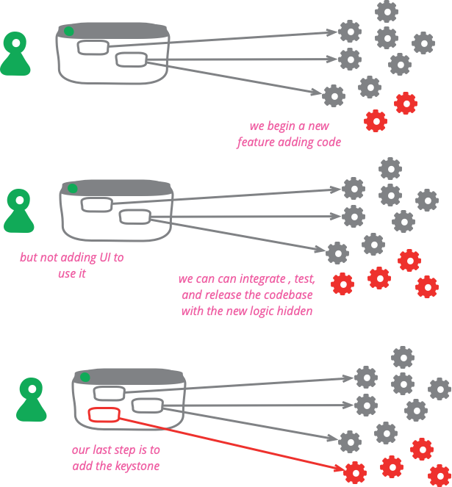
Keystone Interface
Image : martinfowler

Slide 54
Key Takeaways
Feature flags is a software superpower
“Pause button” for risk-free delivery
Mandatory expiry & permanent value = no flag debt
Enforced by code, not memory.
Don’t be afraid to sunset features
Branch by Abstraction

Slide 55
The Future of Software Delivery
•Feature flags as first-class citizens
•Automated, disciplined flag lifecycle
•Safer, faster, and smarter releases

Slide 56
Software Practices
Solving the Woes - Stale Flags & Technical Debt
Performance
Ownership & Documentation
Security
Collaboration
Experimentation
Avoid Triangle of Doom - multiple if-else

Slide 58
“If you love something, set it free.” The same is true of feature flags

Slide 59
Thank you!

Slide 60

Connect with me!

