Slide 1
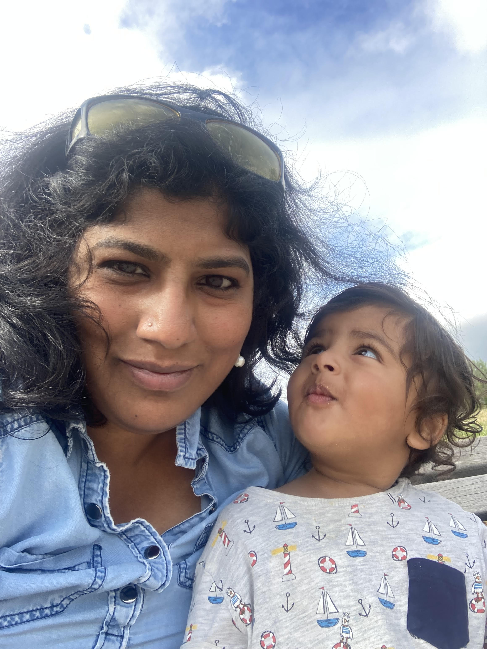
Designing for Neurodiversity, Empathy, Human Centric Design and Inclusion in Software Applications
Vaishnavi Venkata Subramanian

Slide 2
Kachow!

Slide 3
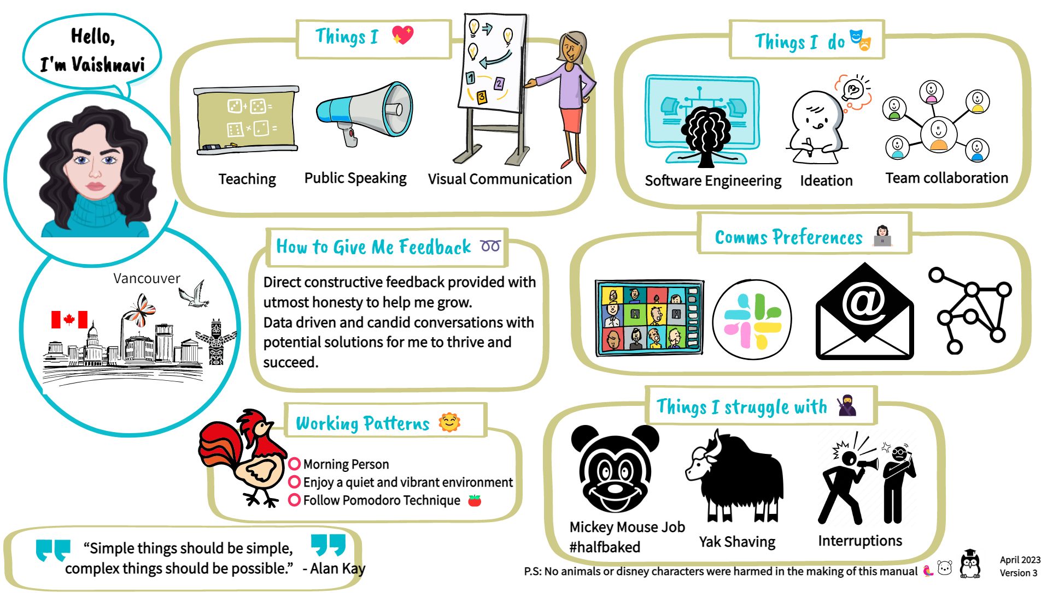

Slide 4
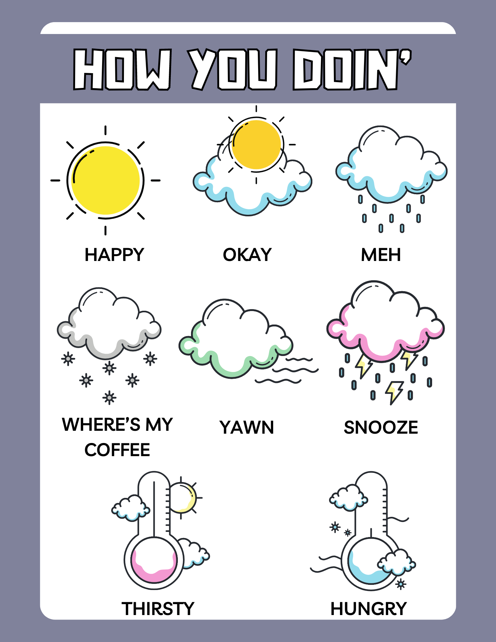

Slide 5
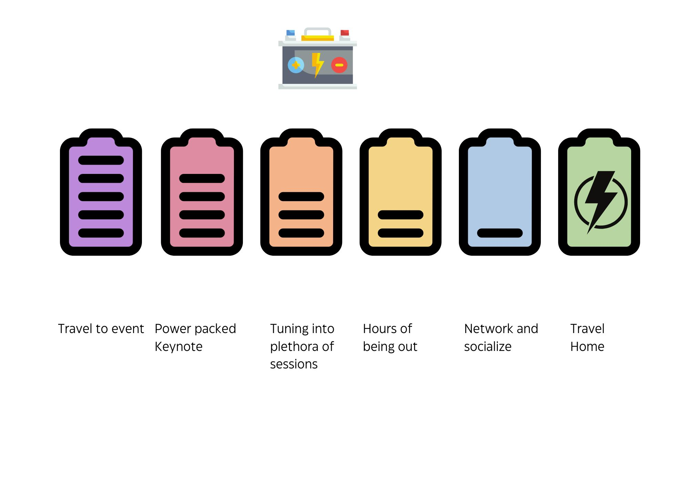
Social Battery

Slide 6
Glossophobia

Slide 7
Before November 30, 2022 and After

Slide 8


Slide 9
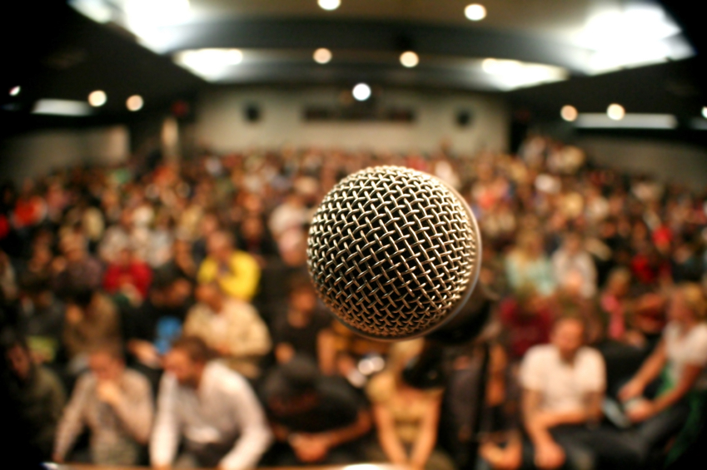

Slide 10
This presentation is for everyone!

Slide 11
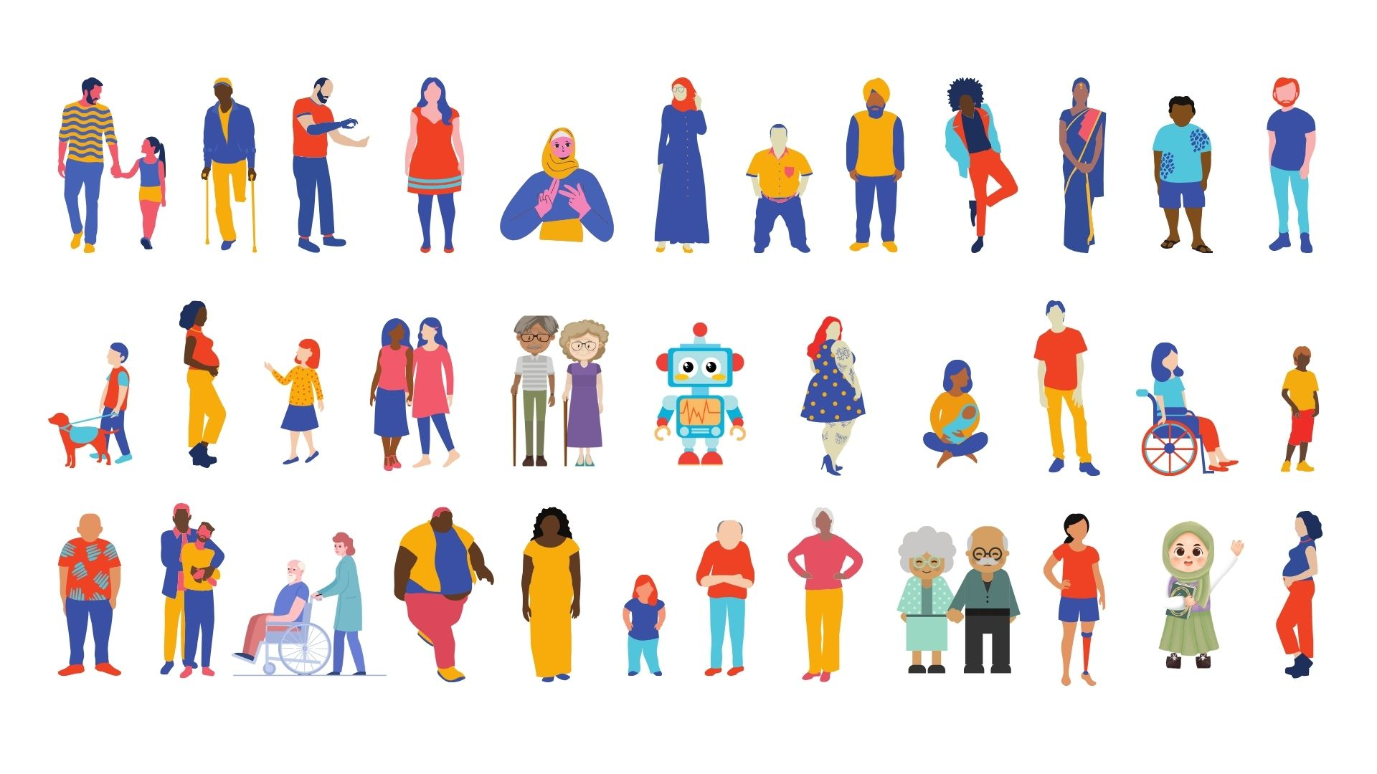

Slide 12
What is Neurodiversity? Accessibility vs ND Guidelines for Design Concluding Remarks
Agenda

Slide 13
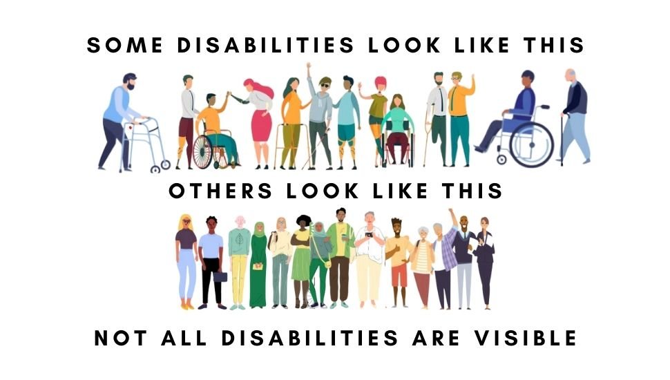
Source : https://greatcareers.org/neurodiversity-in-the-workplace-and-international-day-of-persons-with-disabilities/

Slide 14
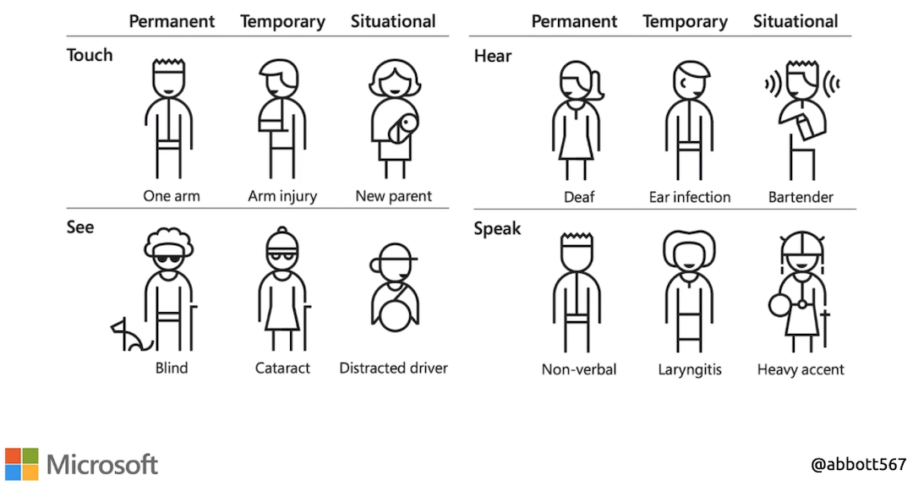

Slide 15
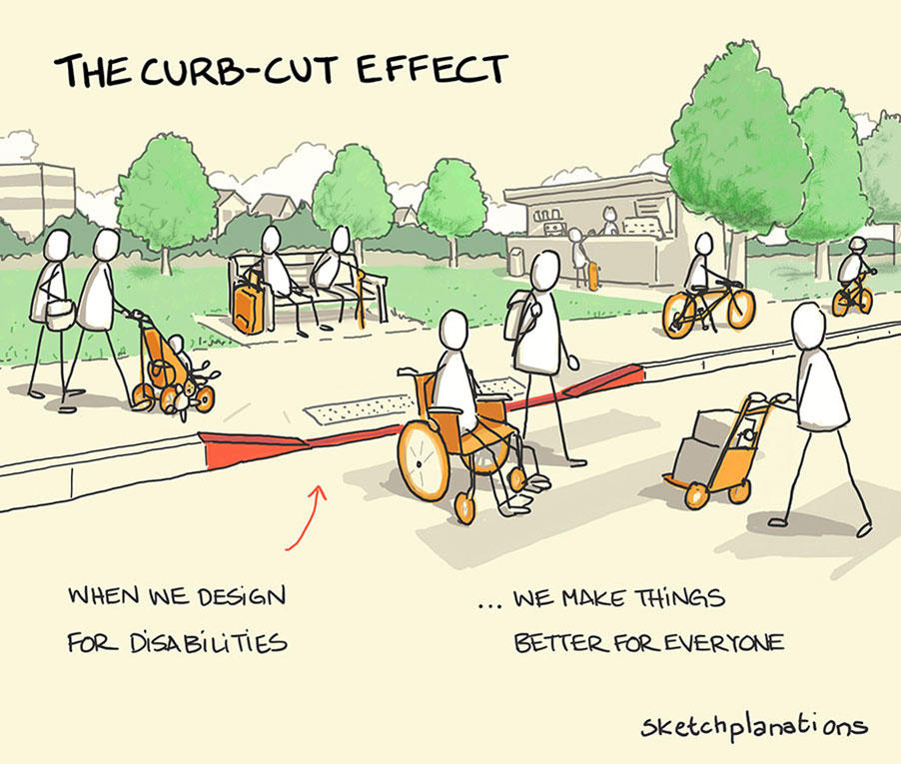
Notes:
Named after the curb cut that enables wheelchair users on and off

Slide 16
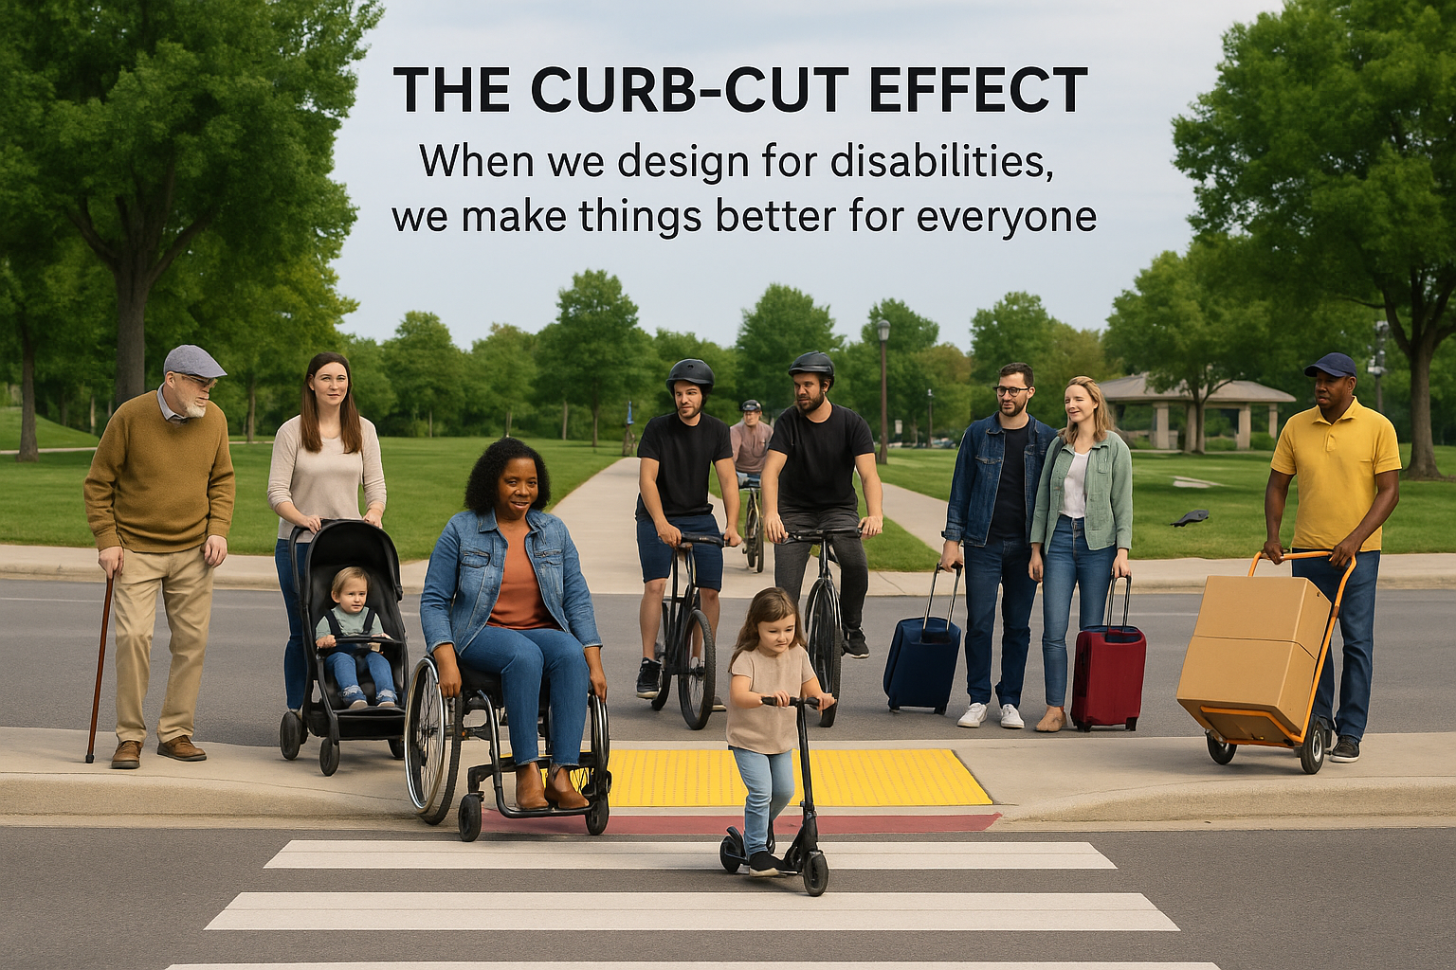

Slide 17
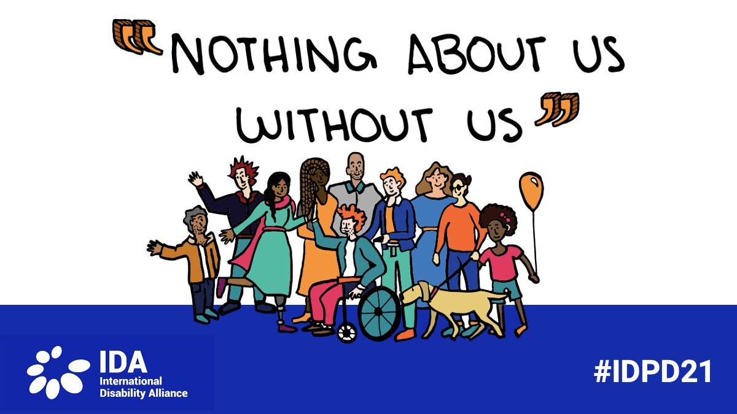

Slide 18
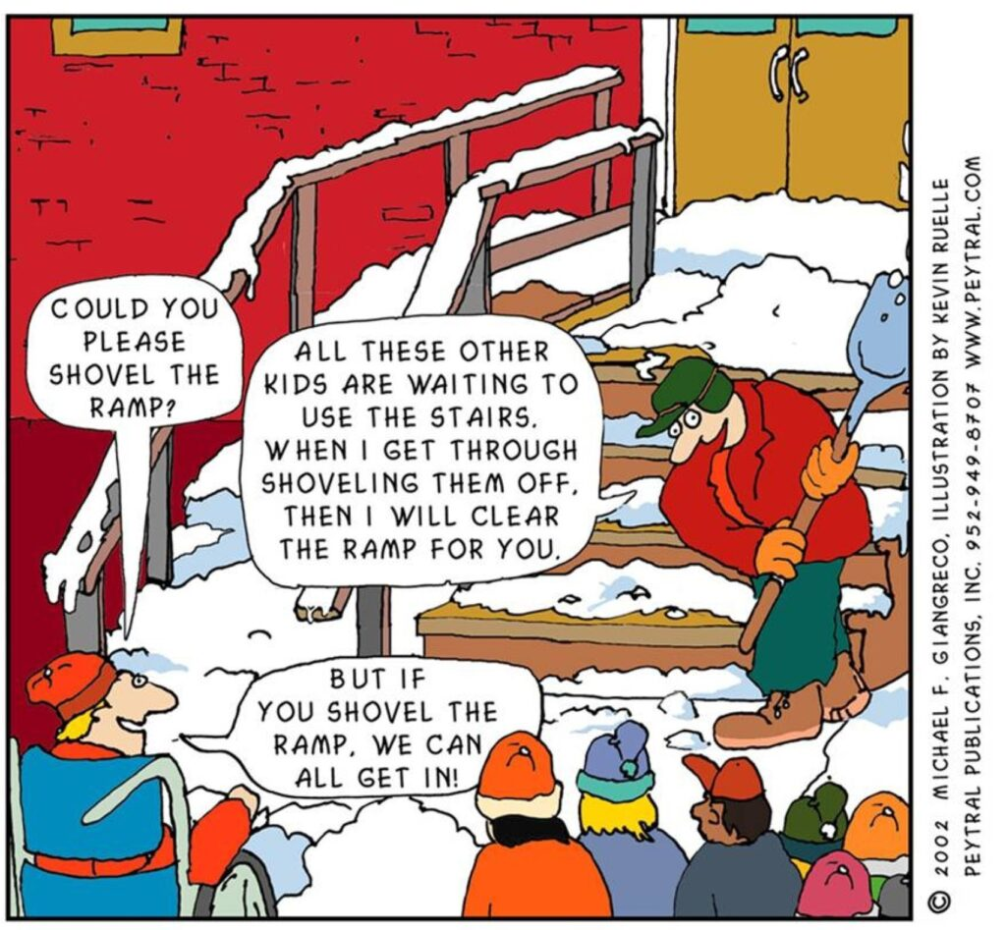

Slide 19
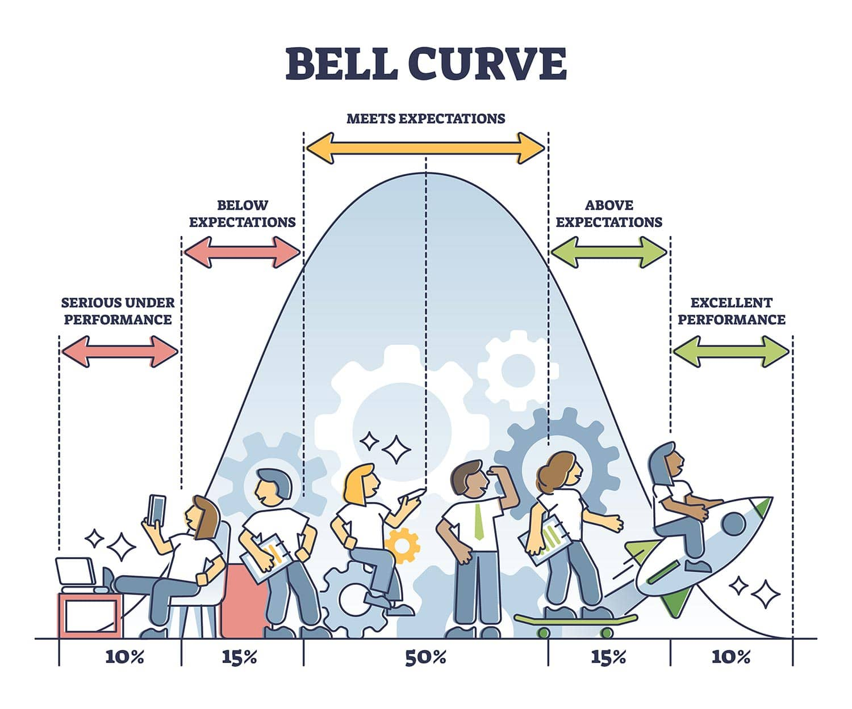
Source : https://www.simplypsychology.org/normal-distribution.html

Slide 20
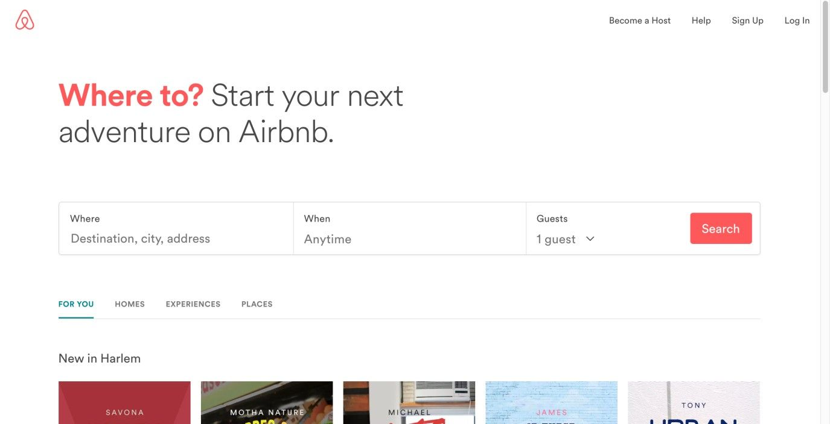
Implement a Forgiving Format to Accommodate Users’ Mistakes
“We don’t make mistakes, just happy little accidents.” —Bob Ross, American painter, painting instructor, and TV show host
Notes:
do not want to punish them for their irregularities and force them to correct things before providing them with the expected or desired responses. They’re users who are visiting your site by choice, not your students or employees.

Slide 21
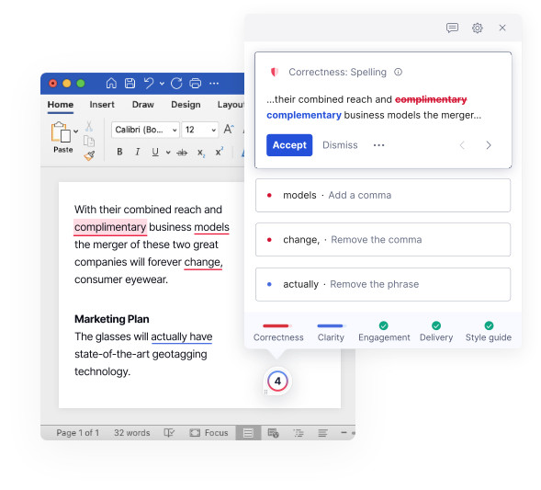
Be kind and forgiving Grammarly - Disneyland of Spelling

Slide 22
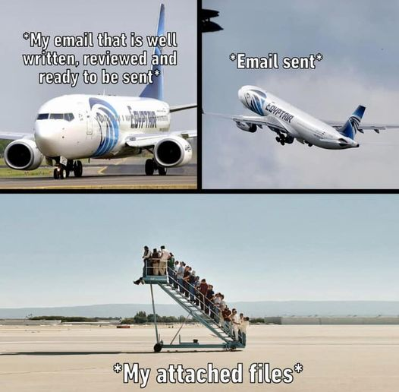
Forgot attachment?
Attachments first, message second, subject third, and recipients last.
This is my way.
Notes:
Attachments first, message second, subject third, and recipients last. This is the way.

Slide 23
Create Abundance; Not redundance

Slide 24
Universal Design Foods (UDF) Nursery to Nursing Homes

Slide 25
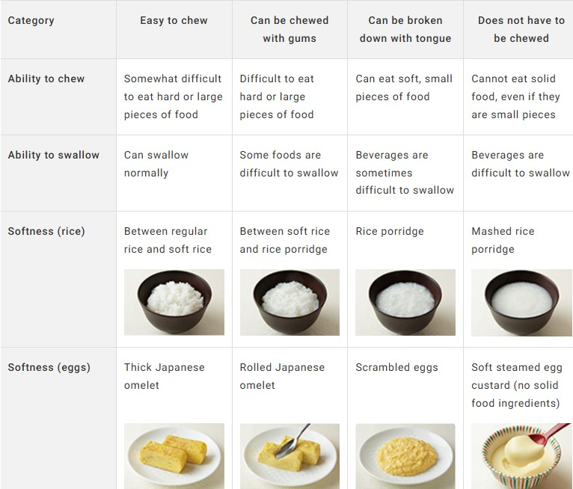
Image : https://www.kewpie.com/en/sustainability/dietary-lifestyle/universal/

Slide 26
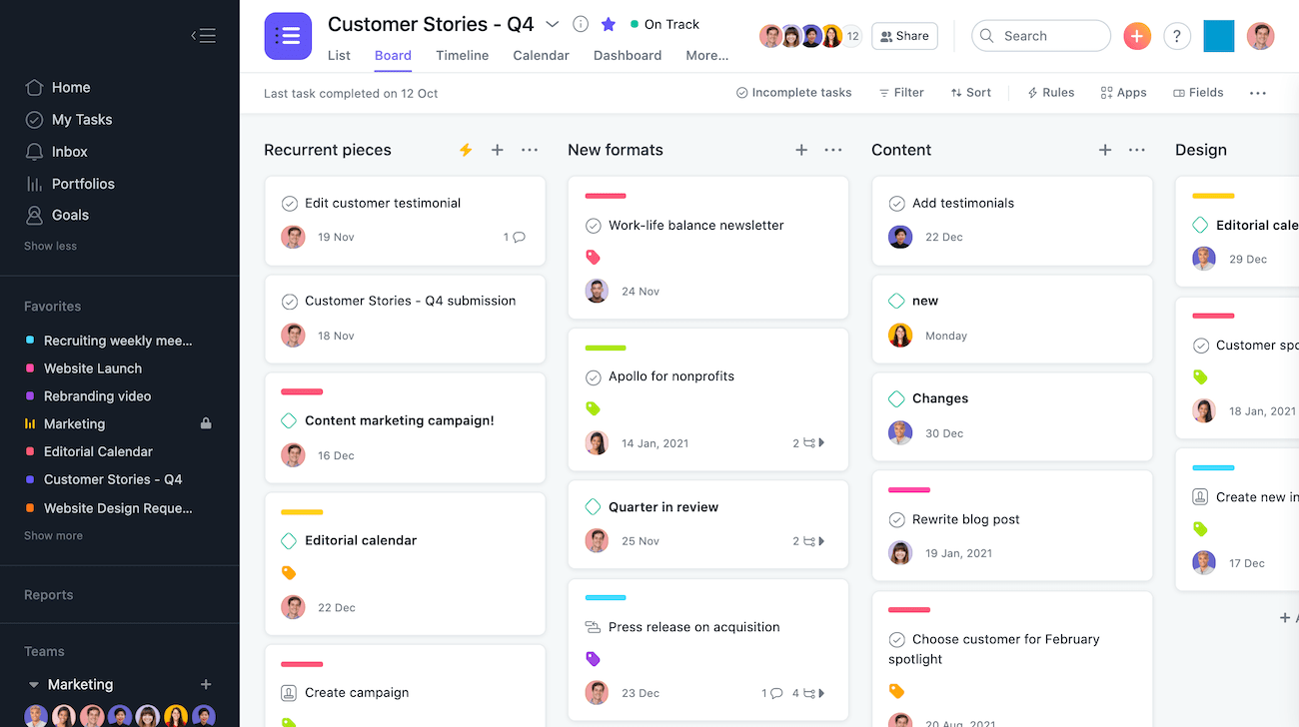
Notes:
For any Asana project, you can switch between several different views to see tasks however you want: Lists - For chronological to-dos. Boards - Kanban style view to move work through stages. Timeline - Gantt-style view for deadline-bound work with dependencies.

Slide 27
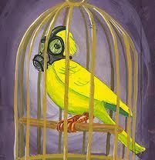
Canary in the coalmine

Slide 28
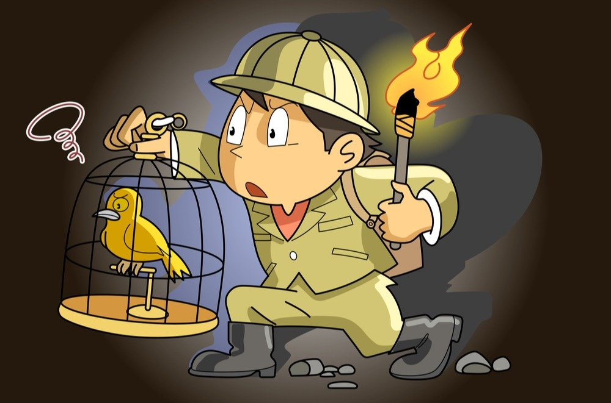
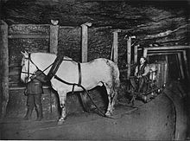
Often the first to sense danger akin to canaries in the coal mine Preventing miscommunication and not overwhelming the users
Notes:
Coal miners used to take canaries into coal mines with them. Canaries are more sensitive to dangerous gases than humans are. If the canary died, the miners knew there were dangerous gases present and would leave the mine.
Pit ponies, the other animal that went underground with human miners to haul coal, were also phased out by automation. T

Slide 29
Often the first to sense danger akin to canaries in the coal mine Preventing miscommunication and not overwhelming the users

Slide 30
Guidelines

Slide 31
Guidelines
Interpretable messages :
Avoid use of characters that look alike
E.g. 1lI, B8, QO0CD, and break up long strings in phone numbers e.g. (000) 000–0000
Stick to active voice :
Passive voice sentences are longer and harder to comprehend.
Users with ADHD will get bored, dyslexics will have even more trouble reading, and so will readers on the spectrum.
Avoid metaphors :
Trouble understanding metaphors, such as idioms and other abstract figures of speech.
E.g. Instead of calling it a day, it’s more inclusive to say that something is done.

Slide 32
Guidelines
Use emojis wisely :
Different languages have different interpretations. Custom and culture vary
Format your writing :
Divide large chunks of text into smaller paragraphs.
It is challenging for people struggling with limited attention spans.
Use descriptive buttons :
No vague microcopy, such as Click here. Think of screen readers
Describe the purpose of the button.
Example: Upload images, Register, Download the e-book.
This simple change makes navigation smoother and reduces anxiety.

Slide 33
Guidelines
Be careful with animations :
Too much stimulation can induce anxiety in people on the autism spectrum, which may even lead to physical pain, withdrawal, or meltdown.
Use of animated elements :
Should be limited to instances when it serves a purpose.
Also remember not to make them too invasive.
Mind the abbreviations :
AI in context Artificial Intelligence vs Artificial Insemination

Slide 34
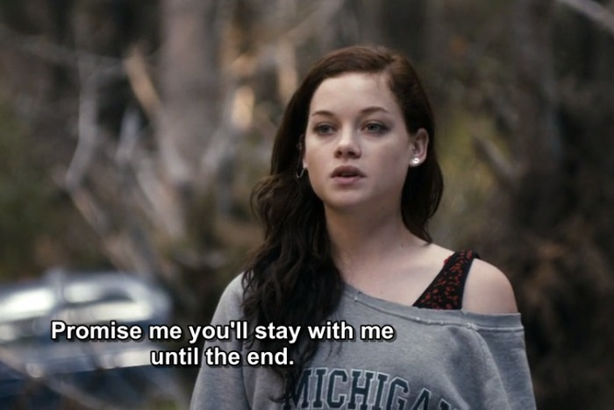
Avoid autoplay Unexpected movement is surprising and scary, not to mention the sound! Psstt I startle a lot! Add subtitles and captions
Guidelines

Slide 35
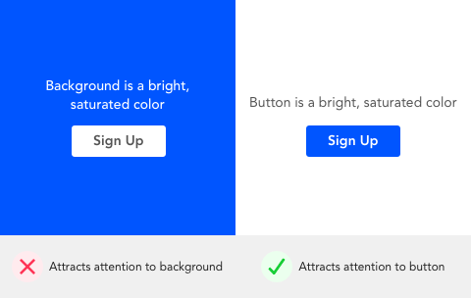
Aim to visually please, rather than disturb. Abstain from auto play in websites and music that suddenly appears out of nowhere. Skip highly vibrant colors. Perform user testing and focus groups with ND users.

Slide 36
Context is the king err queen
Think and Feel GILTY! GILT : A word salad! Globalization (G11N) Internationalization (I18N) Localization (L10N) Translation (T9N)
Source : https://www.adverbum.com/en/blog/globalization-internationalization-localization-translation
Notes:
Sour

Slide 37
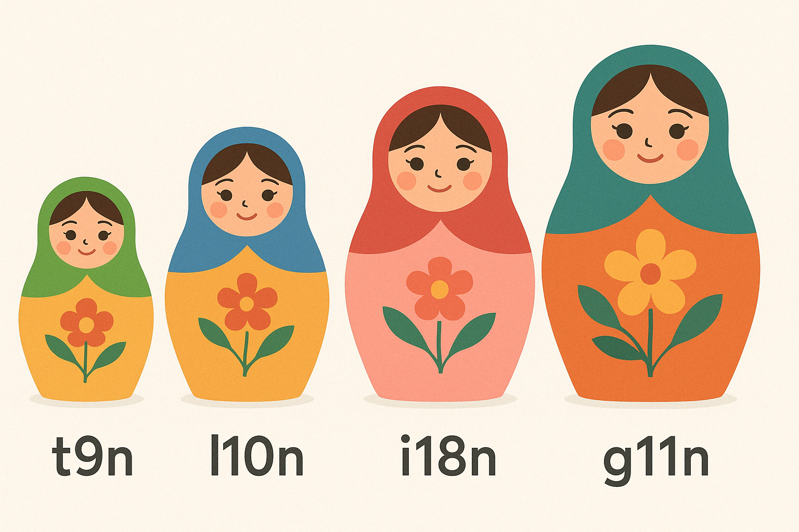

Slide 38
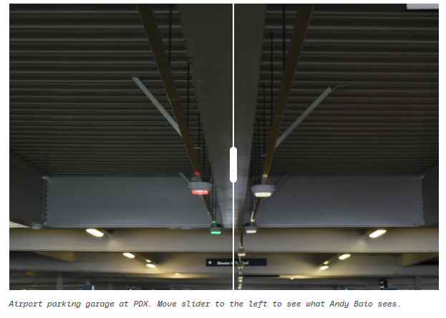
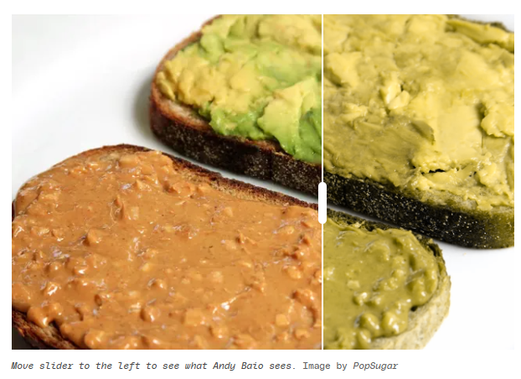
Protanopia - Colour Blindness
Test in Grayscale. Mute the colors
Source : https://www.theverge.com/23650428/colorblindness-design-ui-accessibility-wordle
Notes:
Sour

Slide 40
Takeaways
Aim to visually please, rather than disturb.
Abstain from auto play and music that suddenly appears out of nowhere.
Skip highly vibrant colors.

Slide 41
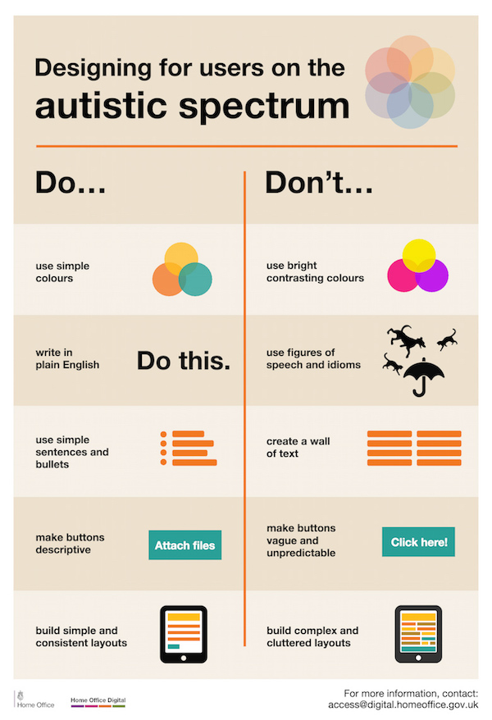

Slide 42
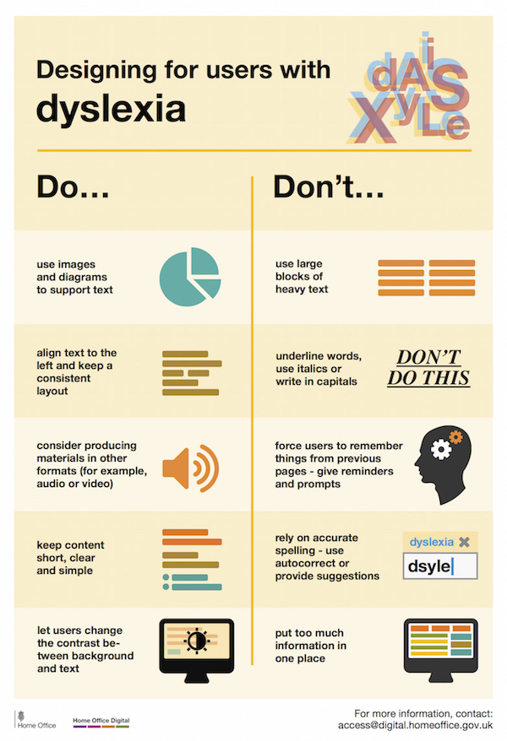

Slide 43
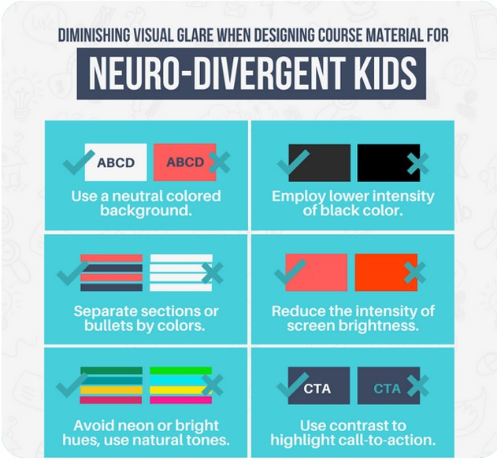
Credit : DesignMantic

Slide 44
Great Minds Think Unalike And Learn Differently Representation Matters!
Aim for higher SNR
more useful information (the signal) >>>>>> unwanted data (the noise)

Slide 45
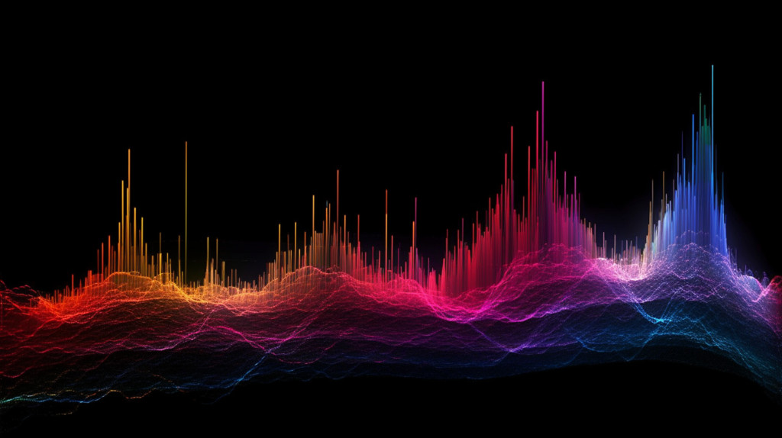
S/R (dB)
SNR

Slide 46
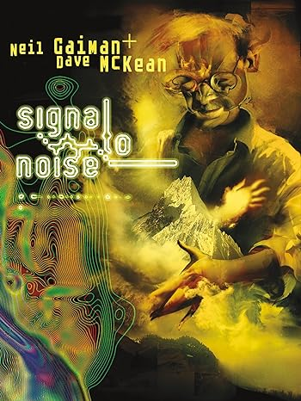
Great Minds Think Unalike And Learn Differently Representation Matters!
Aim for higher SNR
More useful information (the signal) >>>>>>
unwanted data (the noise)

Slide 47
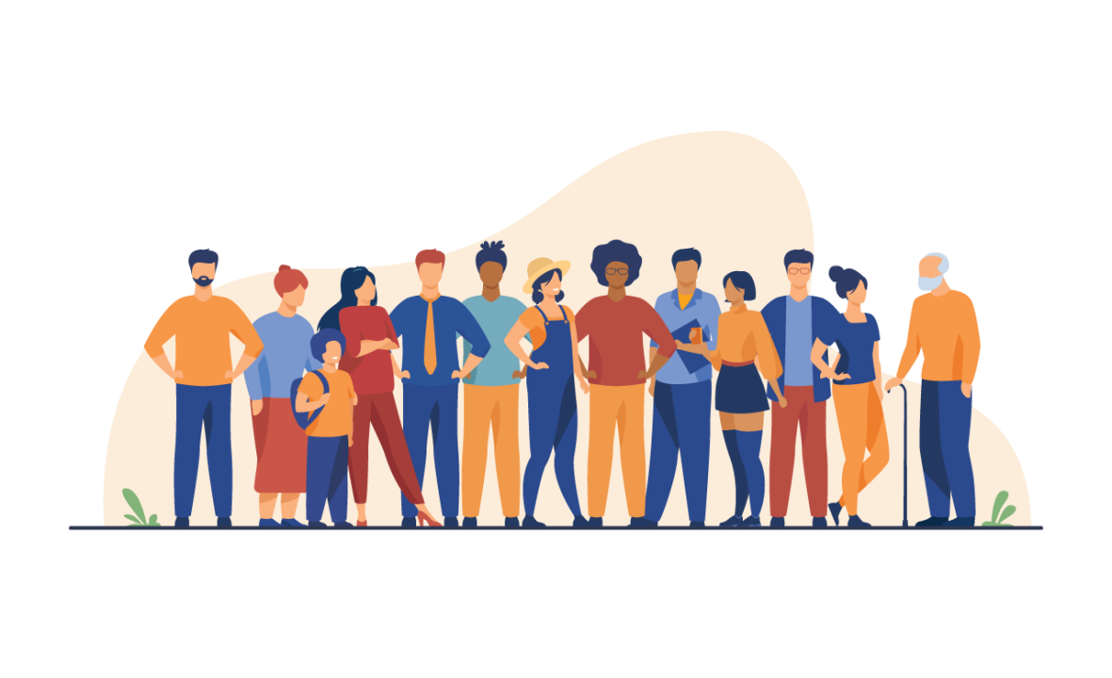
A design with inclusivity and neurodiversity in mind is not just ‘nice to have’ – it’s imperative
A design with inclusivity and neurodiversity in mind is not just ‘nice to have’ – it’s imperative

Slide 48
Accessibility is more than a ramp
Designing for 'disability first’ often uncovers solutions that help everyone.

Slide 49
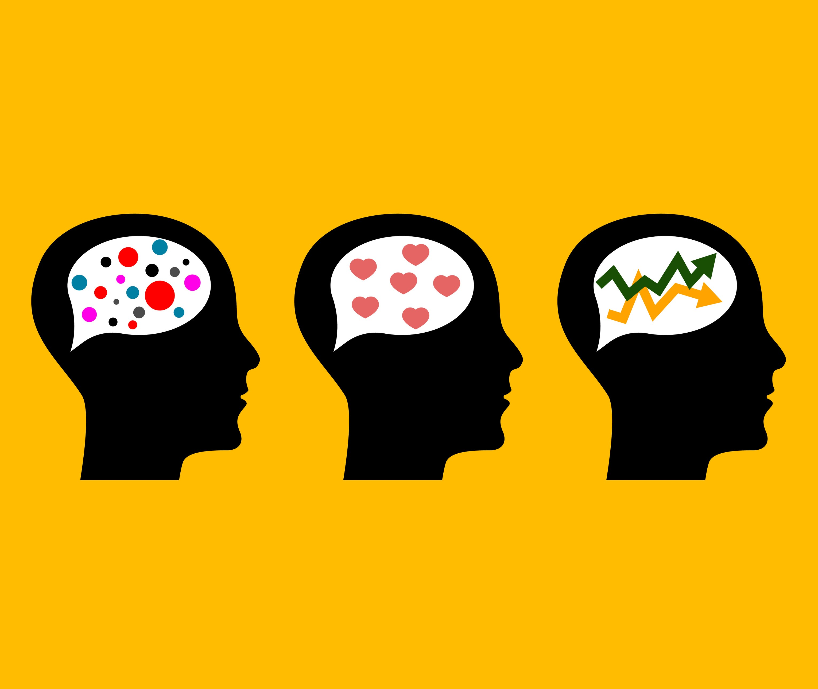
Great Minds Think Unalike And Learn Differently Representation Matters!
Great Minds Think Unalike And Learn Differently Representation Matters!

Slide 50
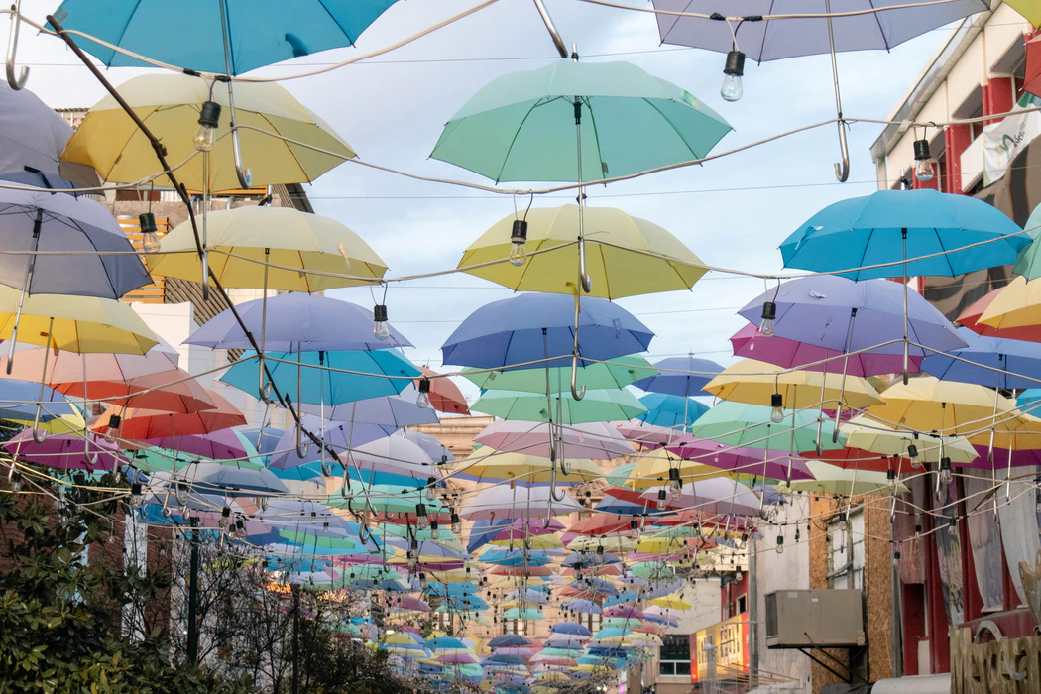

Slide 51

Thank you

Slide 52
