Slide 1
CITI-BRIDGE PROGRAM
CLEARING FEED GENERATION
Group Number : 4
Mentor : Aman Gaur
Group Members
Harshita Singh
Malvika Menon
Samradnyi Sarade
Shraddha Jadhav
Bhavana Bade

Slide 2
OUTLINE
Project Objective
Clearing Feed Cycle
Technologies Used
Benefits
Future Scope
Conclusion
Experience

Slide 3
PROJECT OBJECTIVE
Objective
Generate the feed file towards clearing system in a specific format based on the input transactions to the system.

Slide 4
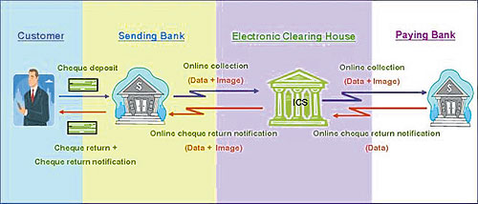
CLEARING FEED GENERATION

Slide 5
TECHNOLOGIES USED
Back-end
Java
Front - end
JAVASCRIPT
HTML
CSS
Bootstrap

Slide 6
Software Development Life Cycle WATERFALL MODEL

Slide 7
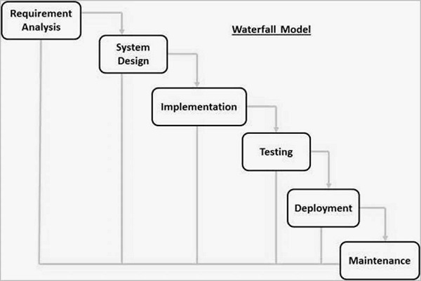

Slide 8

USE-CASE DIAGRAM
Browse File
ValidFile
<<includes>>
<<extends>>
Upload File
Initiate transaction processing
Feed File
Download
<<includes>>
<<extends>>
USER
Invalid

Slide 9
DEMONSTRATION

Slide 10
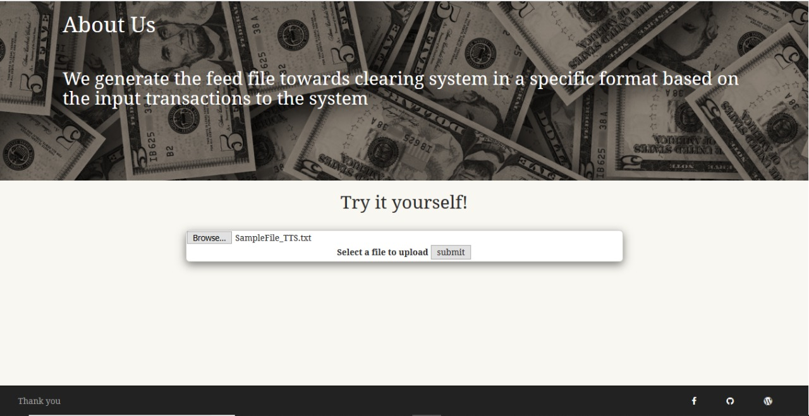

Slide 11
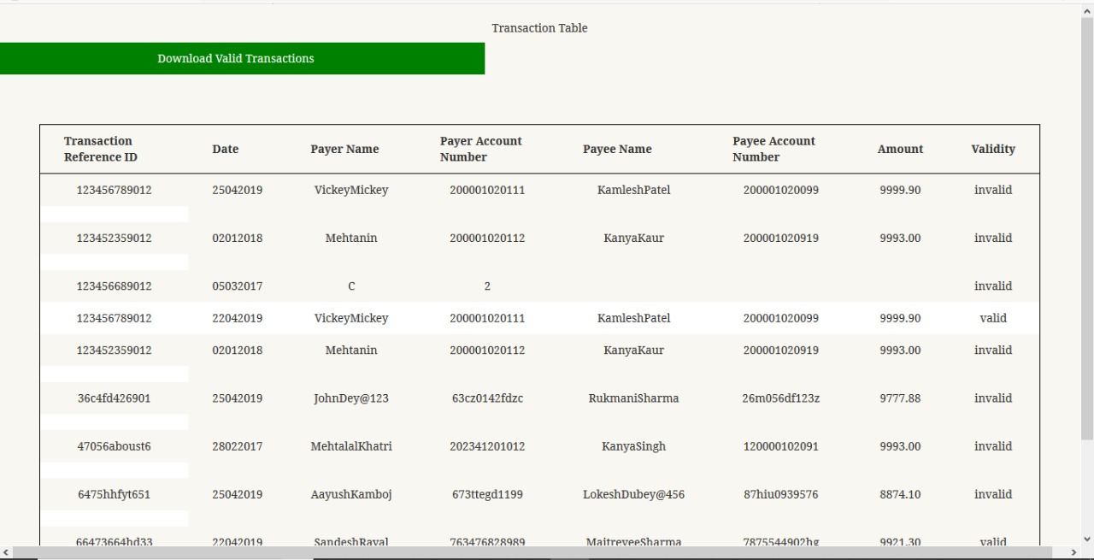

Slide 12
BENEFITS
The cheques in transit are most susceptible to frauds and customers of banks are the worst sufferers in the present system of physical movment of cheques from one place to another.
With the movement of cheques from one place to another having been stopped, there is no fear of loss of cheques in transmit and chances of cheques being lost due to mishandling etc are totally avoided.

Slide 13
FUTURE SCOPE
Online digital currency/transaction validation
If any transaction fails for multiple times then that ID can be added to the blacklist for the next 24 hours.

Slide 14
CONCLUSION
If your submitted data for the transactions is as per the norms of both the involved clients, only then will your transaction be considered successful.
Clearing feed acts as a mediator in validating transactions.
After clearing feed , the valid_feed.txt file is generated which will be given as input to the sanctioning process.

Slide 15
Thank You!
To CitiBridge Program

