Slide 1
SOCIAL MEDIA
PERFORMANCE ANALYTICS
Data Cleaning • EDA • Engagement Insights
Python | Pandas | NumPy | Matplotlib | Seaborn

Slide 2
Project Overview
Understanding what drives reach, engagement and virality
• Analyze 10,000 social media posts across four platforms.
• Explore content type, topic, sentiment, posting time and audience response.
• Clean and validate the dataset before analysis.
• Use univariate, bivariate and multivariate analysis to identify patterns.
• Translate findings into practical content-strategy recommendations.
Records
10,000
posts
Platforms
4
LinkedIn, Instagram, Medium, YouTube
Variables
15
original columns
Social Media Performance Analytics • 2

Slide 3
Dataset & Data Quality
Initial inspection and validation
Rows
Columns
Missing values
Duplicates
10,000
15
0
0
complete records
before feature engineering
across all columns
full rows / post IDs
• post_datetime was converted from object to datetime64[ns].
• Numeric performance fields were checked for negative values; none were found.
• sentiment_score stayed within the valid range of -1 to +1.
• is_viral contains only binary values: 0 and 1.
Result: the dataset was structurally clean and ready for EDA.
Social Media Performance Analytics • 3

Slide 4
Data Preparation & Feature Engineering
• Converted post_datetime to a proper datetime format.
• Created post_year, post_month and post_month_name.
• Created post_day, day_of_week and post_hour for time-based analysis.
• Created day_type to separate Weekday vs Weekend posts.
• Converted sentiment_score into Negative, Neutral and Positive categories.
• Created hashtag_count by counting hashtags in each post.
Average hashtags
5.12
per post
Hashtag range
3–7
hashtags per post
Sentiment range
-1 to +1
validated
Social Media Performance Analytics • 4

Slide 5
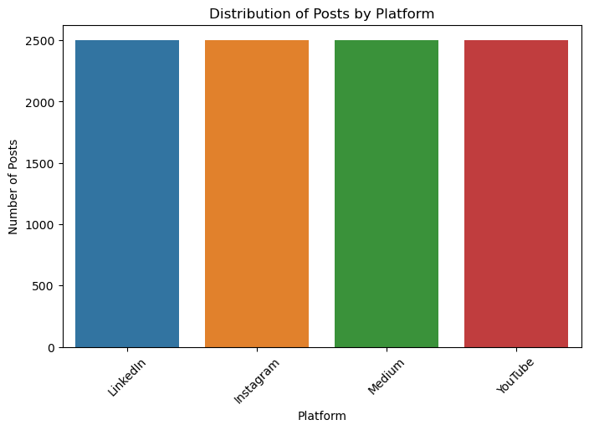
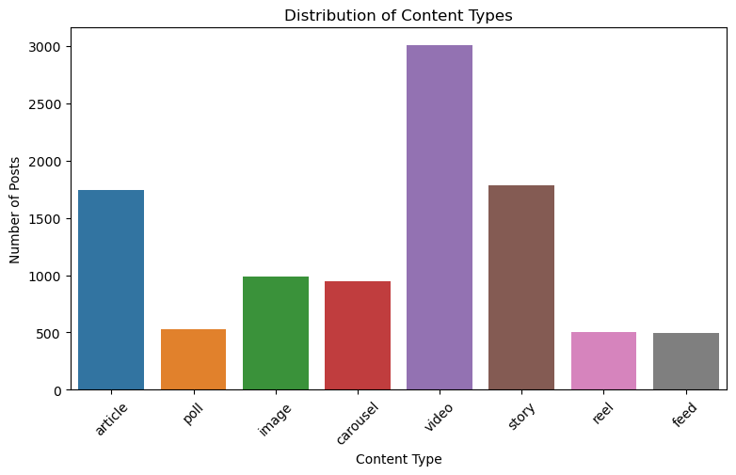
Univariate Analysis: Platform & Content Mix
Each platform contributes exactly 2,500 posts.
Video is the most common content type (3,007 posts).
Social Media Performance Analytics • 5

Slide 6
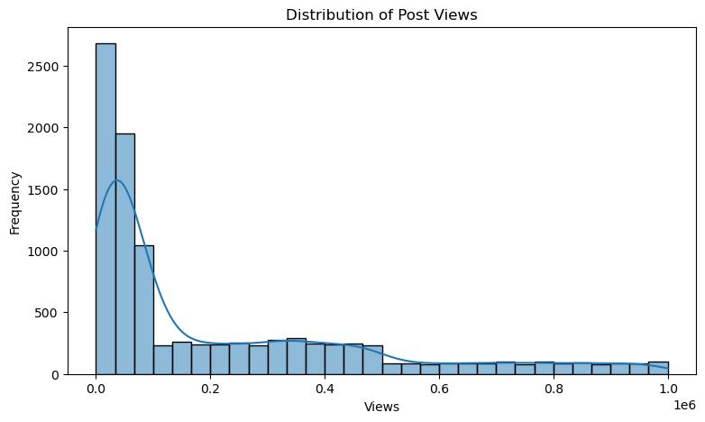
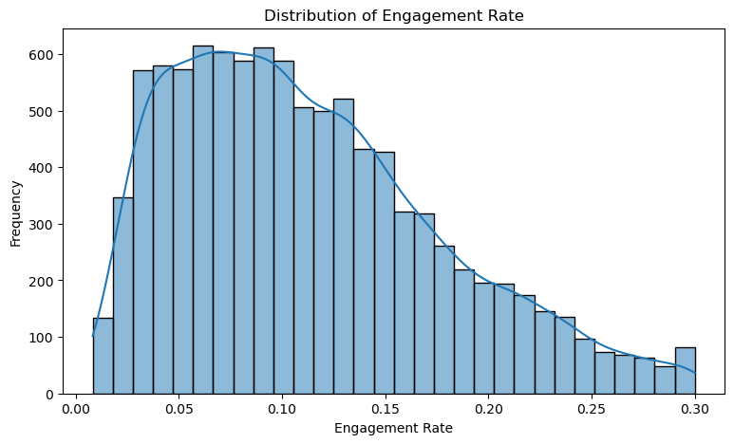
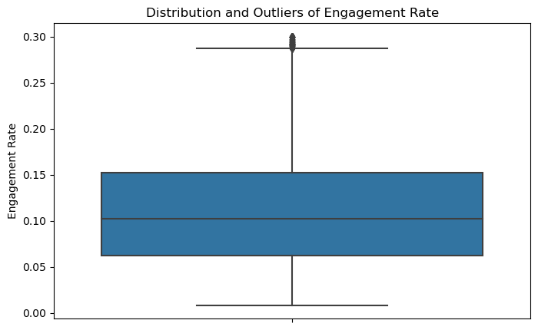
Univariate Analysis: Reach & Engagement
Average engagement rate = 11.27%; distribution is right-skewed.
High-engagement observations create visible upper-tail outliers.
Social Media Performance Analytics • 6

Slide 7
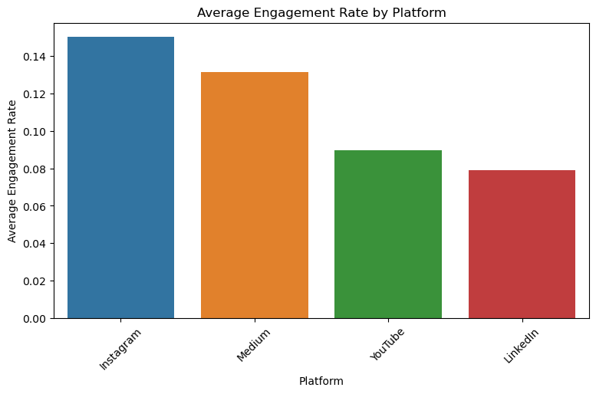
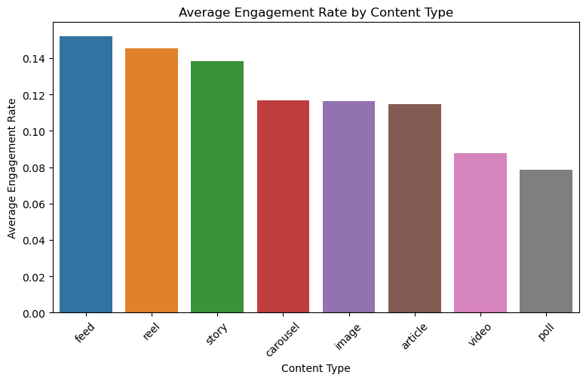
Bivariate Analysis: Platform & Content Performance
• Instagram has the highest average engagement rate: 15.04%.
• Medium follows at 13.16%, while YouTube is 8.98% and LinkedIn is 7.89%.
• Feed content performs best at 15.21%, followed by reels at 14.53%.
Social Media Performance Analytics • 7

Slide 8
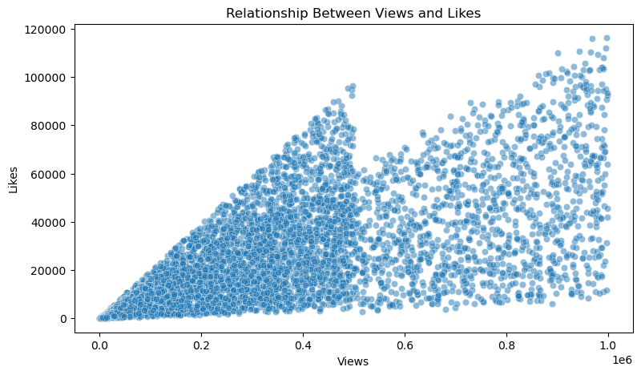

Bivariate Analysis: Views, Likes & Shares
Views and likes show a strong positive relationship (r ≈ 0.78).
Views and shares also rise strongly with reach (r ≈ 0.78).
Social Media Performance Analytics • 8

Slide 9
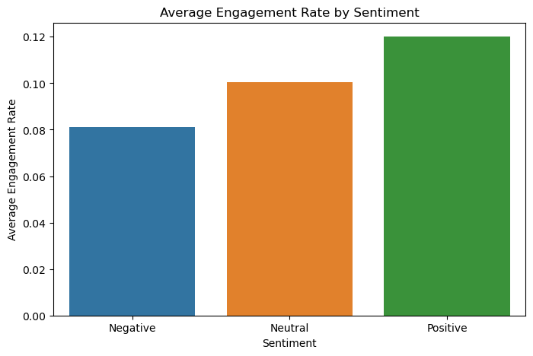
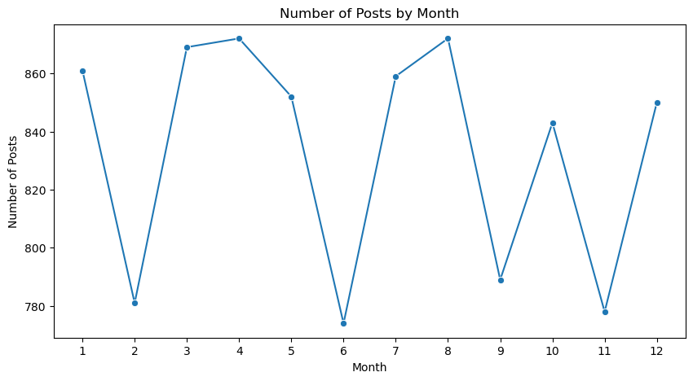
Sentiment & Time-Based Analysis
Positive posts average 12.01% engagement vs 8.10% for negative posts.
Post volume peaks in April and August (872 posts each).
Social Media Performance Analytics • 9

Slide 10
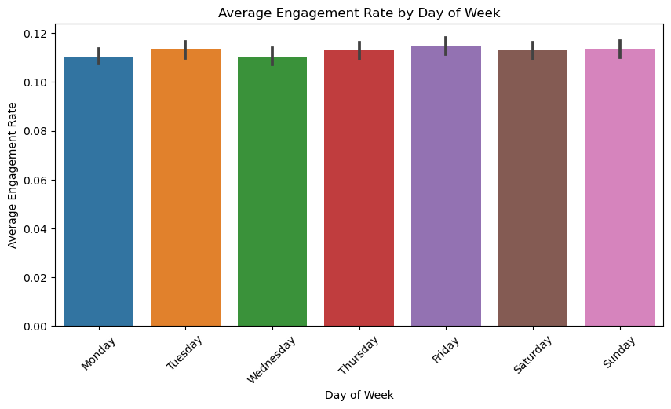
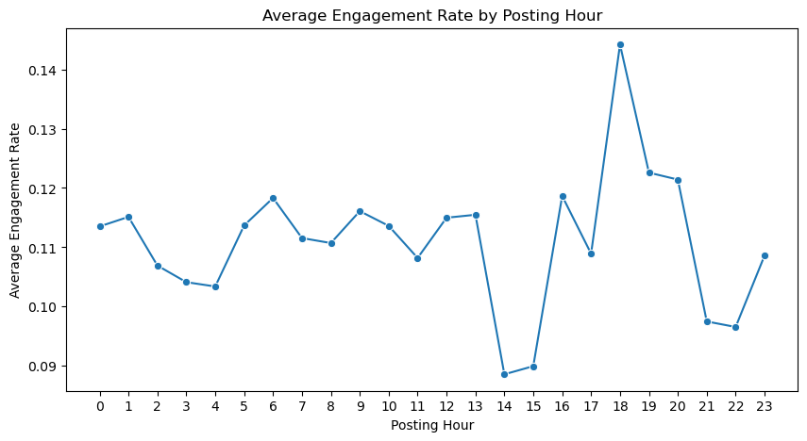
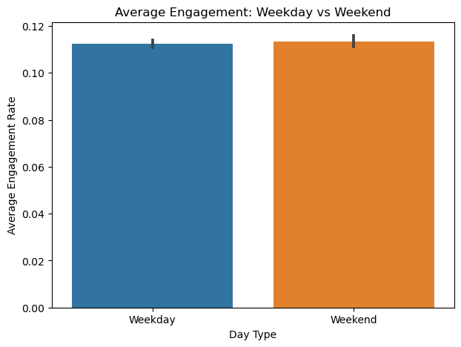
Timing Analysis: Day & Hour
Weekend engagement is only slightly higher than weekday engagement.
Posting hour matters more selectively, with a visible evening peak.
Social Media Performance Analytics • 10

Slide 11
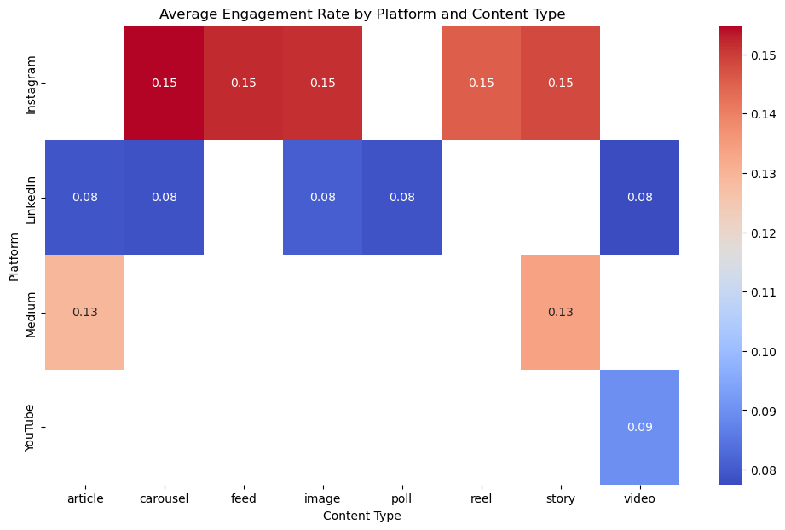
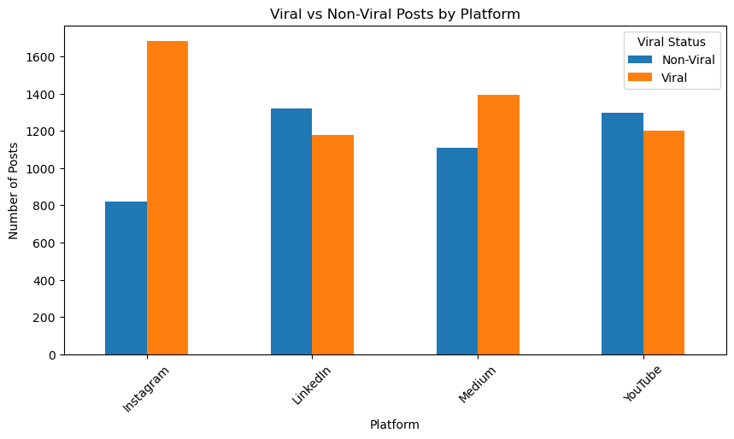
Multivariate Analysis: Platform × Content & Virality
• Instagram combines strong performance across several content formats.
• Viral posts are especially common on Instagram: 1,682 viral vs 818 non-viral.
• Medium also has more viral than non-viral posts (1,392 vs 1,108).
• LinkedIn is the only platform here with more non-viral than viral posts.
Social Media Performance Analytics • 11

Slide 12
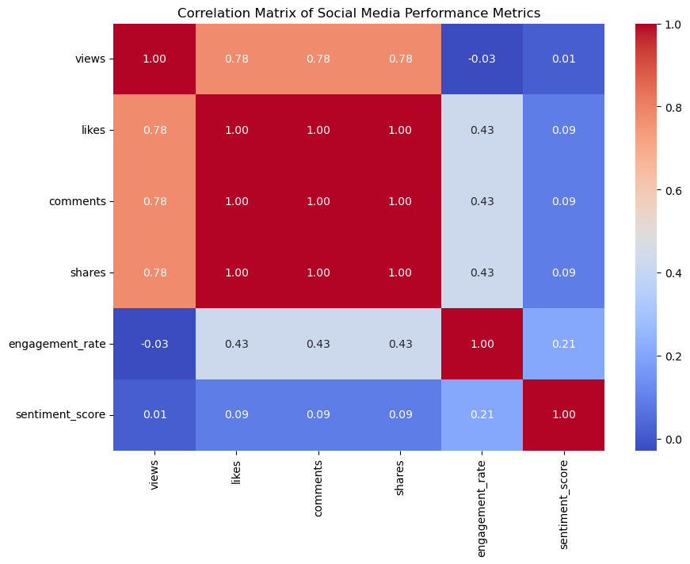
Correlation Analysis
Views ↔ Likes
0.78
strong positive
Engagement ↔ Likes
0.43
moderate positive
Engagement ↔ Sentiment
0.21
weak positive
Reach strongly translates into likes, comments and shares; sentiment has a smaller effect.
Social Media Performance Analytics • 12

Slide 13
Key Findings
Instagram leads engagement
Feed & reel formats are strongest
1
2
15.04% average engagement rate.
15.21% and 14.53% average engagement.
Positive sentiment performs better
Virality is platform-dependent
3
4
12.01% vs 8.10% for negative posts.
Instagram records 1,682 viral posts.
Reach and reactions move together
Posting volume is seasonal
5
6
Views correlate ~0.78 with likes/shares.
April and August each have 872 posts.
Social Media Performance Analytics • 13

Slide 14
Recommendations
• Prioritize Instagram when the objective is higher engagement and virality.
• Test feed and reel formats more aggressively than lower-performing formats.
• Use positive, audience-friendly messaging where it fits the brand.
• Use reach as an early performance signal because it is strongly associated with reactions.
• Plan content calendars around high-volume periods such as April and August.
• Test evening publishing windows and compare performance by platform rather than using one universal posting time.
Next step: turn these findings into a platform-specific content strategy and A/B testing plan.
Social Media Performance Analytics • 14

Slide 15
THANK YOU
Questions & Discussion
Social Media Performance Analytics — Python EDA Project

