Slide 1
Which dealers need management attention?
Sales alone can hide rising stock, late payments and service concerns.
Regional managers need a clear answer: who needs attention, why, and what should happen next.
Our prototype turns 30 simulated dealer histories into a review queue and a suggested follow-up.
DEALER ACTION PLANNER • SIMULATED DATA 1 / 4
Notes:
0–25 sec. A manufacturer sells through dealers, but sales target performance alone can mislead. A dealer may hit target while overdue payments or old stock rise. Managers have limited time, so the question is which dealers to review, why, and what action to take. We used synthetic data for 30 dealers.

Slide 2
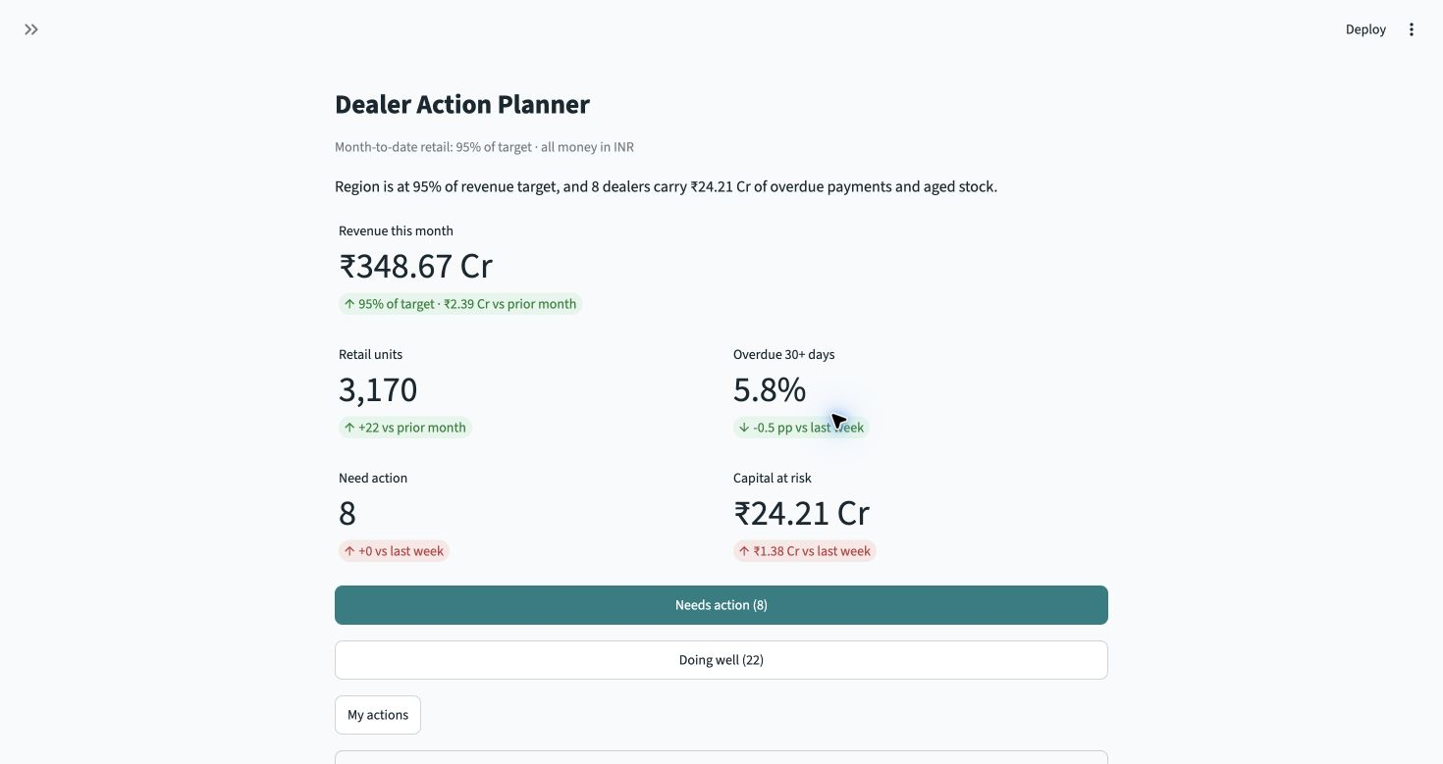
The manager starts with two paths
Week 24 example
8 need action
22 doing well
The home view shows the business picture, then sends the manager to either list.
Actual app: Home → Needs action or Doing well
DEALER ACTION PLANNER • SIMULATED DATA 2 / 4
Notes:
25–50 sec. This is the real app at simulated week 24. Its home view has five business measures, including overdue payments and capital at risk. The manager enters one of two paths: eight dealers in Needs action, or 22 in Doing well. Counts are calculated from the data.

Slide 3
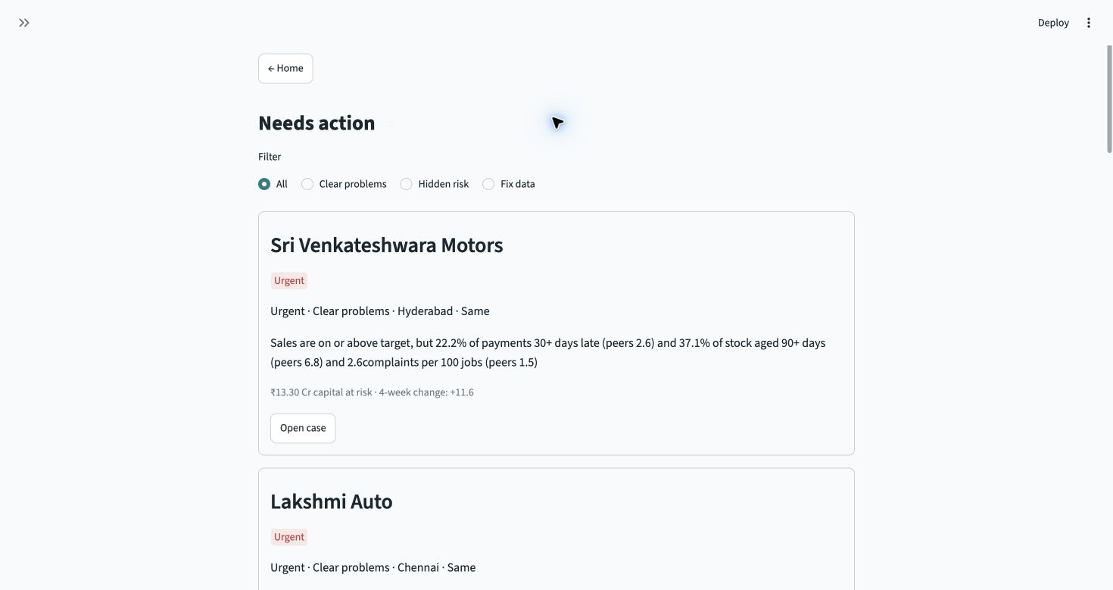
Needs action leads to an evidence-based plan
Clear problems
Hidden risk
Fix data
Example: Sri Venkateshwara Motors sells above target, but 22.2% of payments are 30+ days late.
The case shows peer evidence, an urgent status, an owner and a due date.
Queue → dealer case → accept plan → My actions
DEALER ACTION PLANNER • SIMULATED DATA 3 / 4
Notes:
50–90 sec. Needs action has three filters: Clear problems, Hidden risk, and Fix data. Open Sri Venkateshwara Motors. It reaches sales target, yet late payments and aged stock make it urgent. The case exposes the indicators and peer comparison. The suggested finance and inventory review has an owner and due date. Accepting it records the follow-up in My actions. Pattern flags are only patterns worth checking, not accusations.

Slide 4
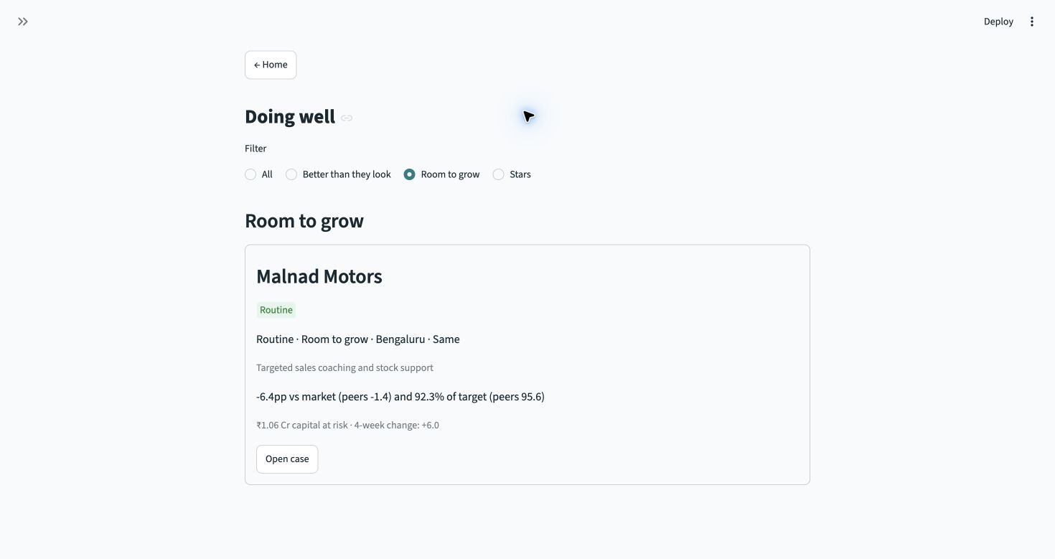
Doing well protects good dealers and finds growth
Better than they look
Room to grow
Stars
A market dip, disputed invoices or a new outlet can explain an apparent shortfall.
Value: managers spend time on the right cases. Limit: all data and thresholds are simulated and need real validation.
Context check → support opportunity → routine monitoring
DEALER ACTION PLANNER • SIMULATED DATA 4 / 4
Notes:
90–120 sec. Doing well has three direct filters. Better than they look prevents a weak target result being mistaken for a weak dealer when context explains it. Room to grow finds a healthy dealer with low share in a growing market; Stars remain under routine monitoring. The value is a transparent priority queue and accountable follow-up. The key limitation is that this is simulated data with assumed thresholds. We would validate them with real dealer records before operational use.

