Slide 1
F20/21DL Data Mining and Machine Learning
Diana Bental
Ekaterina Komendantskaya
(with material from David Corne and slides from http://www.cs.waikato.ac.nz/ml/weka/book.html)

Slide 2
Diana Bental
Office hour in EM1.05 Monday 10.15-11.15am
d.s.bental@hw.ac.uk Extension 3367
Ekaterina Komendantskaya
ek19@hw.ac.uk Extension 8283
Lectures
Thursday 13.15 - 14.15 EM 1.83
Friday 12.15 – 13.15 EM 3.36
Labs – from Week 2
4th Year Thursday 10.15 – 11.15 EM G.45/EMG.46
5th Year / MSc Thursday 15.15– 16.15 EM G.45/EMG.46

Slide 3
Mechanics
We’re using Vision
Course Information, Contacts
Learning Materials – lecture slides, links and websites
Assessment - coursework specifications and submission
We’re using F21DL on Vision. If you don’t have F21DL 2018-2019 (Data Mining and Machine Learning) on your list of courses then email me and I will add you.
d.s.bental@hw.ac.uk
It’s a bit of a work in progress so please let us know if there are issues

Slide 4
Module assessment
50% exam
Electronic exam
Three main items of coursework
CW 1: 15% CW 2: 15% CW 3: 20%
Group coursework
Divide yourselves into groups of 4 and sign up on Vision
CW1 Released next week
Extra bit added to each c/w for MSc students
Weeks 6-10 Weekly Class Exercises on Vision– no marks but you must complete them!

Slide 5
Coursework Software
Using WEKA 3
Available on Linux
http://www.cs.waikato.ac.nz/ml/weka/
Online tutorials and MOOCS

Slide 6
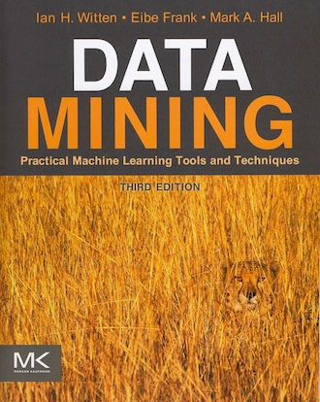
Course Textbook
Data Mining: Practical Machine Learning Tools and Techniques, 3rd Edition Ian H. Witten, Eibe Frank and Mark A Hall, Elsevier 2011
Sections on WEKA 3

Slide 7
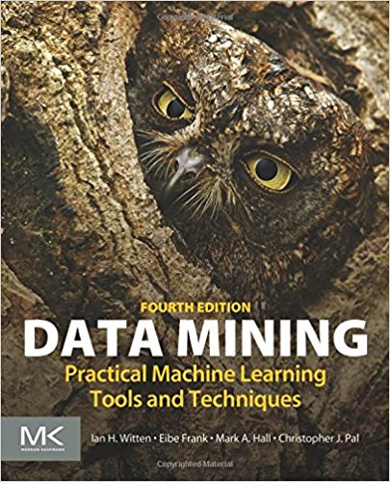
Course Textbook
Data Mining: Practical Machine Learning Tools and Techniques, 3rd Edition Ian H. Witten, Eibe Frank and Mark A Hall, Elsevier 2011
Sections on WEKA 3
New 4th Edition
“Deep learning”

Slide 8
Part 1
Introduction & Terminology
Input Preparation
Output - Knowledge Representations
Algorithms and Basic Statistics
Evaluation
Coursework 1
Part 2
4 learning approaches
Probability: Bayesian Networks
Unsupervised Learning: Clustering
Supervised Linear Learning: Decision Trees
Supervised Non-Linear Learning: Neural Networks
Courseworks 2 & 3
Notes:
We don’t cover all of machine learning. We focus on data mining. Reinforcement learning was covered in AI (last year for undergraduates)

Slide 9
This lecture
What can we do with data?
Where does data come from?
What should we do with data?

Slide 10
Data Mining and Machine Learning– Why are they important?
Data are being generated in enormous quantities
Data are being collected over long periods of time
Data are being kept for long periods of time
Computing power is formidable and cheap
A variety of Data Mining and Machine Learning software is available
All of these data contain `hidden knowledge’ – facts, rules, patterns, that can be usefully exploited ….. if we can find them

Slide 11
What can we do with data?
Answer simple questions like:
How many female clients do we have?
How much paint did we sell in 2007?
Which is the most profitable branch of our supermarket?
Which postcodes suffered the most dropped calls in July?

Slide 12
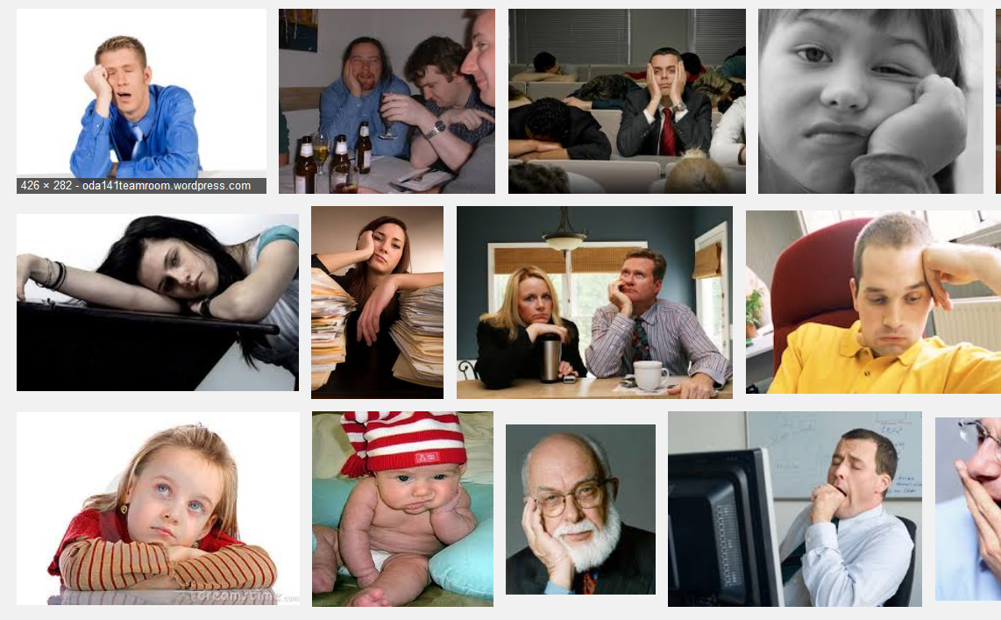
We can, but …

Slide 13
More interesting things that can be done with data
Answer difficult and valuable questions like:
How can we predict ovarian cancer early enough to treat it successfully?
How can I make significant profit on the stock market next month?
Two different authors claim to have written this story – how can we resolve the dispute?
How can we get our customers to spend more money in the store?
Is this loan applicant a good credit risk?
Is this sonar image a mine or a rock?
What other websites will this customer be interested in?

Slide 14
Data Mining - Definition & Goal
Definition
Data Mining is the exploration and analysis of (often) large quantities of data in order to discover meaningful patterns and rules
Goal
To permit some other goal to be achieved or performance to be improved through a better understanding of the data

Slide 15
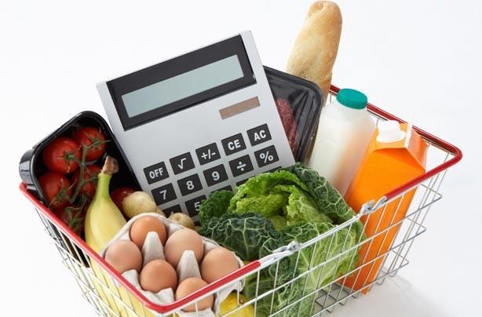
Some examples of large databases
Shopping basket data: much commercial DM is done with this. In one store, 18,000 baskets per month
Tesco has >500 stores. Per year, 100,000,000 baskets ?
The Internet
~ 4.7 billion (searchable) pages
305 billion printed pages
Lots of datasets: UCI Machine Learning repository
How can we begin to understand and exploit such datasets? Especially the big ones?

Slide 16
Like this …

Slide 17
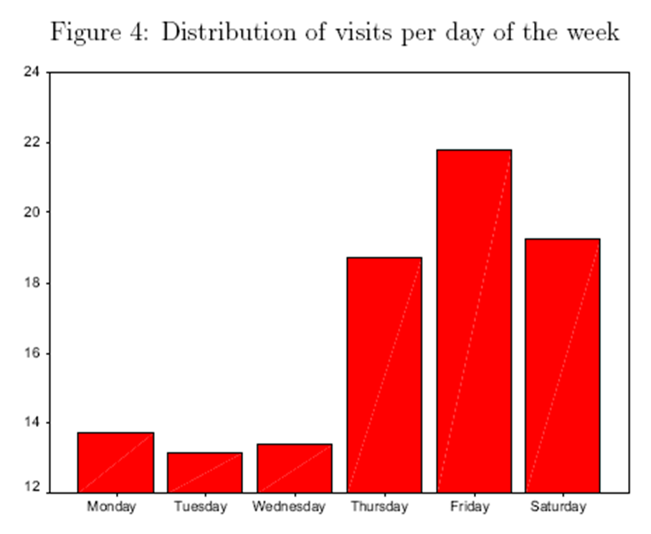
and this…
Notes:
More interesting questions – what do people tend to buy together?

Slide 18
Data Mining & Machine Learning
Data Mining is the process of discovering patterns and inferring associations in raw data
… a collection of techniques intended to analyse small or large amounts of data
… can employ a range of techniques, either individually or in combination with each other
Is Machine Learning the same?

Slide 19
Philosophy – Can machines “learn”?
Dictionary definitions - knowledge
“To get knowledge of by study, experience, or being taught”
“To become aware, by information or from observation”
How would we know if a computer had learnt?
“To commit to memory”
“To be informed of, ascertain; to receive instruction”
Trivial for computers
Operational definition - performance
Things learn when they change their behaviour in a way that makes them perform better in the future.
Do intention and purpose matter? Or reflection?
Notes:
How sophisticated are the things we can learn? Predict what will happen, classify things… what about learning a whole new concept? Or relationship?

Slide 20
Data Mining and Machine Learning
Given some data, we want to extract information that is
Implicit
Previously unknown
Potentially useful (and non-trivial)
We need programs to extract patterns and regularities from the data
Strong patterns lead to good predictions
But
Most patterns are not interesting
Patterns may be inexact (or spurious)
Data may be garbled or missing

Slide 21
Some applications in the field
The result of learning—or the learning method itself—is deployed in practical applications….

Slide 22
1. Processing loan applications (American Express)
Given:
questionnaires with financial and personal information
Question:
should money be lent?
Simple statistical method covers 90% of cases
Borderline cases referred to loan officers
But: 50% of accepted borderline cases defaulted!
Solution: reject all borderline cases?
No! Borderline cases are most active customers
Notes:
Judgment

Slide 23
Enter machine learning….
1000 training examples of borderline cases
20 attributes:
age
years with current employer
years at current address
years with the bank
other credit cards possessed,…
Learned rules: correct on 70% of cases
human experts only 50%
Rules could be used to explain decisions to customers
Notes:
Machine learning doesn’t need to be right all the time. Consider the costs of getting it wrong – giving a loan to someone who defaults, versus not giving enough loans. More on this later.
Explaining decisions – rules gave a structure to the problem, which could be used to explain

Slide 24
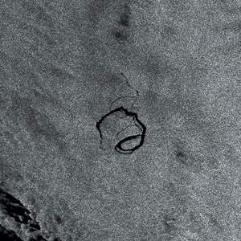
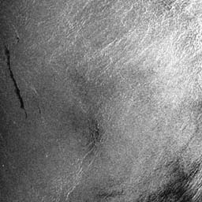
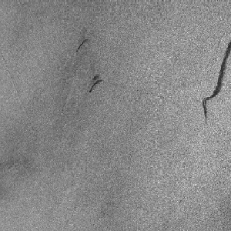
2. Screening images
Given: radar satellite images of coastal waters
Problem: detect oil slicks in those images
Oil slicks appear as dark regions with changing size and shape
Not easy: lookalike dark regions can be caused by weather conditions (e.g. high wind)
Expensive process requiring highly trained personnel
Notes:
Environmental scientists looking for early warnings of oil slicks and eco disasters
Screen the images to identify the most likely ones

Slide 25
Enter machine learning…
Extract the dark regions from normalized images
Attributes:
size of region
shape, area
intensity
sharpness and jaggedness of boundaries
proximity of other regions
info about background
Constraints:
Few training examples—oil slicks are rare!
Unbalanced data: most dark regions aren’t slicks
Requirement: adjustable false-alarm rate
Notes:
Train on examples of spills and non-spills
Inputs are bitmap images from radar satellites
Identify particular attributes
Output is a smaller set of images with coloured borders highlighting possible oil slicks
First normalise the image (image processing) ; then identify suspicious dark regions; identify attributes of the regions; then apply machine learning techniques to decide if they are likely to be oil slicks.
Customize to different uses – especially adjust the false alarm rate, weight up the cost of sending ships out to false alarms against the cost of missing a slick

Slide 26
3. Marketing and sales
Companies precisely record massive amounts of marketing and sales data
Applications:
Customer loyalty: identifying customers who are likely to defect by detecting changes in their behavior (e.g. banks/phone companies)
Special offers: identifying profitable customers (e.g. reliable owners of credit cards who need extra money during the holiday season)

Slide 27
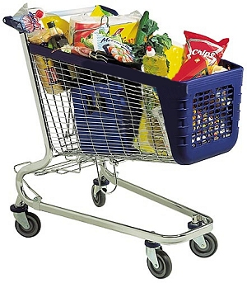
More marketing and sales
Market basket analysis
Association learning techniques
Find groups of items that tend to occur together in a transaction
Analyze checkout data
Historical analysis of purchasing patterns
Identify prospective customers
Focus promotional mailings
targeted campaigns are cheaper than mass-marketed ones
Notes:
Association learning – big problem is that there are many possible groupings… only some are interesting

Slide 28
.... and many more
The result of learning—or the learning method itself—is deployed in practical applications
Electricity supply forecasting
Diagnosis of machine faults
Separating crude oil and natural gas
Reducing banding in rotogravure printing
Finding appropriate technicians for telephone faults
Scientific applications: biology, astronomy, chemistry
Monitoring intensive care patients
Web mining
Recommender systems (Automatic selection of TV programs, online sales, films, music)
Etc.
Usually care about performance (prediction) but structure matters too
Notes:
Structure – what is important? Can we explain and justify the behaviour?
Biology – identify genes; biomedicine; predicting drug activity fromchemical properties and 3-D structure
Monitoring – continuous monitoring; intensive care patients, cybersecurity detecting intrusion parrerns
Web Mining – Search on the web; PageRank algorithm (counting links in and out), can also use ML to decide what a search engine should return – people rank relevance or “likes” or they click though; learn which links are used or liked in response to queries. Document retrieval.

Slide 29
(Some) Ethics of Data Mining
Ethical issues arise in practical applications
Personal Information
anonymizing data is difficult
85% of Americans can be identified from just zip code, birth date and sex
Discrimination
e.g. loan applications: using some information (e.g. sex, religion, race) is unethical
Ethical situation depends on the application
e.g. a medical applications may need the same information
Attributes may contain problematic information
E.g. area code may correlate with race
Notes:
Created a nice anonymous set of data, no names – but can we still pin down an individual? Identify an instance with an individual

Slide 30
Ethics of Data Mining
Important questions:
Who is allowed access to the data?
Social norms – a library will not tell you who has a book
For what purpose was the data collected?
What kind of conclusions can be legitimately drawn from it?
Learning from existing data
Are we just reinforcing old behaviour patterns?
Caveats must be attached to results
Purely statistical arguments are never sufficient!
Are results put to good use?
Make it easier and quicker for shoppers, or more profitable for the shop?
Notes:
Why are you collecting the data?
Issues of taking data collected for one purpose and using at for a different purpose
Reinforcing behaviour patterns - Does the past predict the future? Or does it prejudice the future?
Nb Jobsuche job recommender example (MSc project)
We have seen this in the algorithms used to recommend links on Youtube.
Unexpected effects – YouTube was “learning” interest; measured by what people clicked on and how long they stayed; but in a political context this tended to increase the presentation of more extreme articles.

Slide 31

Garbage in, garbage out….
Historic example:
1980s, “expert system” for a local police force
Recognise the “modus operandi” of burglars
Identify the criminals
Analyse existing criminal records
But:
Important attributes were missing
Broken glass - common
Cut glass - rare
Records only stored
Glass – broken / cut
Class values were inaccurate
“Taken into consideration”
Notes:
Important area – data quality. If the input data is poor quality, the results will be poor too.
What might we mean by poor quality data? Does having lots of data always solve the problem?
Example: Hard to tell who committed a burglary and many repeat offenders
Not a machine learning system (too early) but a researcher trying to identify patterns with persistent individual criminals or groups of criminals to make an expert system by hand.
Most burglars break glass, only a very few would cut it; so if there was cut glass you would immediately have narrowed down to a few suspects. But the records only had one tickbox for “glass – broken or cut” so the useful information was lost.
“Taken into a consideration” – if police arrest one suspect for one crime they were sure of, then the suspect might get treated favourably if they also agreed to have some earlier previously unsolved crimes “taken into consideration” (i.e. added to their record). What if they hadn’t actually committed the earlier crimes but agreed to get favourable treatment?

Slide 32
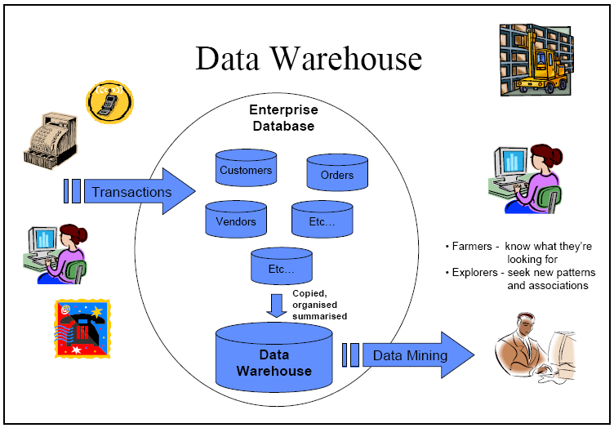
Data Warehouse
For organisational learning to take place data from many sources must be gathered together over time and organised in a consistent and useful way
Data Warehousing allows an organisation to remember its data and what it has learned about its data
Data Mining techniques use the data in a Data Warehouse and subsequently add their results to it

Slide 33
Data Warehousing
Hopefully – a source of “clean” data
“A subject-oriented, integrated, time-variant and nonvolatile collection of data in support of management's decision making process”
W. H. Inmon, "What is a Data Warehouse?" Prism Tech Topic, Vol. 1, No. 1, 1995 -- a very influential definition.
“A copy of transaction data, specifically structured for query and analysis”
Ralph Kimball, from his 2000 book, “The Data Warehouse Toolkit”

Slide 34
Take away
What can we do with data?
Many interesting and useful things
Real data is often not in the form we want it
What should we do with data?
Learn interesting and useful things
Respect privacy and ethics
Look critically at the “truth” of what we have learnt
Use good quality data

Slide 35
Friday
Basics
Examples (you can investigate in Weka)

