Slide 1
F20DL Data Mining and Machine Learning
Diana Bental
(with material from David Corne and slides from http://www.cs.waikato.ac.nz/ml/weka/book.html)

Slide 2
Lecture 2
Machine learning
Some basic Terminology
Structural descriptions and
Numeric predictions
Discussed in Witten Frank and Elbe “Data Mining and Machine Learning”
examples will recur

Slide 3
Data Mining – Basic Terminology
Start (usually) from a flat table of data
Gender | weight | height | Age in mths | 100m time
Male | 52kg | 1.71m | 243 | 13.7s
Male | 89kg | 1.92m | 388 | 22.3s
Female | 48kg | 1.67m | 219 | 14.6s
Male | 86kg | 1.96m | 274 | 9.58s
Male | 80kg | 1.88m | 260 | 10.56s
etc …

Slide 4
This is called a data instance or a record or just a line of data
Gender | weight | height | Age in mths | 100m time
Male | 52kg | 1.71m | 243 | 13.7s
Male | 89kg | 1.92m | 388 | 22.3s
Female | 48kg | 1.67m | 219 | 14.6s
Male | 86kg | 1.96m | 274 | 9.58s
Male | 80kg | 1.88m | 260 | 10.56s
etc …

Slide 5
This is called an attribute or field; the value of the Age field in the 4th record is 274
Start (usually) from a flat table of data
Gender | weight | height | Age in mths | 100m time
Male | 52kg | 1.71m | 243 | 13.7s
Male | 89kg | 1.92m | 388 | 22.3s
Female | 48kg | 1.67m | 219 | 14.6s
Male | 86kg | 1.96m | 274 | 9.58s
Male | 80kg | 1.88m | 260 | 10.56s
etc …

Slide 6
Usually we are interested in predicting the value of a particular attribute, given the values of the other attributes. What we want to predict is called the target class (or class attribute)
Gender | weight | height | Age in mths | 100m time
Male | 52kg | 1.71m | 243 | 13.7s
Male | 89kg | 1.92m | 388 | 22.3s
Female | 48kg | 1.67m | 219 | 14.6s
Male | 86kg | 1.96m | 274 | 9.58s
Male | 80kg | 1.88m | 260 | 10.56s
etc …
Notes:
Sometimes we are interested in predicting other things – e.g. more than one attribute at a time

Slide 7
What’s in an attribute?
Possible attribute types (levels of measurement)
Nominal, ordinal, interval and ratio
Notes:
Attributes - the column headings (usually) that describe the examples

Slide 8
Nominal
Example:
the attribute gender
values: male / female
Values are distinct symbols
Values serve only as labels or names
Nominal comes from the Latin word for name
No relation is implied among nominal values
no ordering or distance measure
Only tests for equality can be performed

Slide 9
Ordinal
Example:
Attribute temperature
Values: hot > mild > cool
The values are in order
But: there is no defined distance between values
So addition and subtraction don’t make sense
cool + mild = ???!
Example rule: if temperature < hot → play = yes
The distinction between nominal and ordinal is not always clear
E.g. colours, ordered by light wavelength

Slide 10
Interval
Interval quantities are ordered and also measured in fixed and equal units
Example 1: attribute temperature expressed in degrees Fahrenheit
Example 2: attribute year
Difference of two values makes sense
2011 AD – 2005 AD = 6 years
Sum or product doesn’t make sense
2011 AD + 2005 AD = ????
Zero point is not defined!

Slide 11
Ratio
Ratio quantities are ones for which the measurement scheme defines a zero point
Example: attribute distance
Distance between an object and itself is zero
Ratio quantities are treated as real numbers
All mathematical operations are allowed
But
is there a really a defined zero point?
answer depends on scientific knowledge (e.g. Fahrenheit knew no lower limit to temperature)
Notes:
Absolute zero, years since the Big Bang, true zeros
Maybe able to convert the difference between two interval quantities as a ratio
Time span is also a ratio quantity – elapsed time between now and now is zero
Money – usually a ratio, but if we let people overdraw then there is no zero so interval

Slide 12
Attribute types used in practice
Different attribute types are suitable for different machine learning techniques
Many schemes use nominal and ordinal data
E.g. Decision trees, rules, association rules
Schemes require at least the class attribute to be nominal
Some schemes use interval or ratio data
E.g. Regression, neural networks
Some schemes can be used for both
E.g. Nearest neighbour
Special case: dichotomy (boolean attribute)
Notes:
Classification models – nominal or ordinal – decision trees, rules
Regression models – numbers
Neural nets - numbers
Nearest neighbour - numeric or nominal
Ways to cin

Slide 13
Machine learning techniques
Algorithms for acquiring structural descriptions from examples
Structural descriptions represent the patterns explicitly
predict outcomes in new situations
understand and explain how prediction is derived - may be even more important
Methods originate from artificial intelligence, statistics, and research on databases

Slide 14

Structural descriptions
Example: Contact lens data
Age
Spectacle prescription
Astigmatism
Tear production rate
Recommended lenses
Young
Myope
No
Reduced
None
Young
Hypermetrope
No
Normal
Soft
Pre-presbyopic
Hypermetrope
No
Reduced
None
Presbyopic
Myope
Yes
Normal
Hard
…
…
…
…
…
Notes:
Trying to prescribe contact lenses – idealised data set
Table: showing 4 data instances, records or lines of data - rows; There are more rows in reality
five attributes with values ; target class is “recommended lenses” or prescription
Age has 3 values; Prescription short-sighted or longsighted; Astigmatism Yes or No ; Adequate Tear production needed for contact lenses

Slide 15
Contact lens data – in full
Age
Spectacle prescription
Astigmatism
Tear production rate
Recommended lenses
Young
Myope
No
Reduced
None
Young
Myope
No
Normal
Soft
Young
Myope
Yes
Reduced
None
Young
Myope
Yes
Normal
Hard
Young
Hypermetrope
No
Reduced
None
Young
Hypermetrope
No
Normal
Soft
Young
Hypermetrope
Yes
Reduced
None
Young
Hypermetrope
Yes
Normal
hard
Pre-presbyopic
Myope
No
Reduced
None
Pre-presbyopic
Myope
No
Normal
Soft
Pre-presbyopic
Myope
Yes
Reduced
None
Pre-presbyopic
Myope
Yes
Normal
Hard
Pre-presbyopic
Hypermetrope
No
Reduced
None
Pre-presbyopic
Hypermetrope
No
Normal
Soft
Pre-presbyopic
Hypermetrope
Yes
Reduced
None
Pre-presbyopic
Hypermetrope
Yes
Normal
None
Presbyopic
Myope
No
Reduced
None
Presbyopic
Myope
No
Normal
None
Presbyopic
Myope
Yes
Reduced
None
Presbyopic
Myope
Yes
Normal
Hard
Presbyopic
Hypermetrope
No
Reduced
None
Presbyopic
Hypermetrope
No
Normal
Soft
Presbyopic
Hypermetrope
Yes
Reduced
None
Presbyopic
Hypermetrope
Yes
Normal
None
Notes:
24 items
24 lines; there are 3 x 2 x 2 x 2 = 24 combinations of attribute values; the table has one line for each combination.
In the full database, there are no missing combinations of values.
All the values are clear-cut – categorical, no numbers
No contradictory examples

Slide 16
Structural description: if-then rules
If tear production rate = reduced then recommendation = none
Otherwise, if age = young and astigmatic = no then recommendation = soft
Age
Spectacle prescription
Astigmatism
Tear production rate
Recommended lenses
Young
Myope
No
Reduced
None
Young
Hypermetrope
No
Normal
Soft
Pre-presbyopic
Hypermetrope
No
Reduced
None
Presbyopic
Myope
Yes
Normal
Hard
…
…
…
…
…
Notes:
Derive rules for giving prescriptions
The rules were derived from the full database
Rules that summarise the data – don’t tell us anything extra – though they do let us know that (as far as we know) the spectacle prescription doesn’t matter
Do we still have complete data? No missing values but there are missing lines; Young/Astigmatism; should we recommend Hard lenses? Data doesn’t say
Could also create decision trees – see these later

Slide 17
The contact lens data – a complete and correct rule set
If tear production rate = reduced then recommendation = none
If age = young and astigmatic = no and tear production rate = normal then recommendation = soft
If age = pre-presbyopic and astigmatic = no and tear production rate = normal then recommendation = soft
If age = presbyopic and spectacle prescription = myope and astigmatic = no then recommendation = none
If spectacle prescription = hypermetrope and astigmatic = no and tear production rate = normal then recommendation = soft
If spectacle prescription = myope and astigmatic = yes and tear production rate = normal then recommendation = hard
If age young and astigmatic = yes and tear production rate = normal then recommendation = hard
If age = pre-presbyopic and spectacle prescription = hypermetrope and astigmatic = yes then recommendation = none
If age = presbyopic and spectacle prescription = hypermetrope and astigmatic = yes then recommendation = none

Slide 18
Complete and correct rules but..
The rules just summarise the data set
Is there a smaller set of rules that performs as well?
Would that be better, and why?
What if some combinations were not in the dataset?
Notes:
Machine learning research started from aim to compress chess end-games into a smaller easily searchable structure – used a decision tree

Slide 19
Example: The “Weather Problem”
Conditions for playing a game
Outlook
Temperature
Humidity
Windy
Play
Sunny
Hot
High
False
No
Sunny
Hot
High
True
No
Overcast
Hot
High
False
Yes
Rainy
Mild
Normal
False
Yes
…
…
…
…
…
Notes:
Demonstration example
Sample from a larger set with 15 lines of data
Five columns or attributes

Slide 20
Example: The “Weather Problem”
Conditions for playing a game
Outlook
Temperature
Humidity
Windy
Play
Sunny
Hot
High
False
No
Sunny
Hot
High
True
No
Overcast
Hot
High
False
Yes
Rainy
Mild
Normal
False
Yes
…
…
…
…
…
If outlook = sunny and humidity = high then play = no
If outlook = rainy and windy = true then play = no
If outlook = overcast then play = yes
If humidity = normal then play = yes
If none of the above then play = yes
Notes:
Simple rules – try them in turn – decision list

Slide 21
Numeric and categorical attributes
Weather data with mixed attributes
Outlook
Temperature
Humidity
Windy
Play
Sunny
85
85
False
No
Sunny
80
90
True
No
Overcast
83
86
False
Yes
Rainy
75
80
False
Yes
…
…
…
…
…
If outlook = sunny and humidity > 83 then play = no
If outlook = rainy and windy = true then play = no
If outlook = overcast then play = yes
If humidity < 85 then play = yes
If none of the above then play = yes
Notes:
Need to create inequalities: humidity > 83 or <= 83 rather than high / normal; Temperature < 80 >= 80 mild/hot
Where are the boundaries? More complex process

Slide 22
Structural Descriptions: Classification Rules
So far:
Classification rules:
predict the value of one given attribute - the class attribute
other attributes may be numeric or categorical
class attribute is categorical
Eg. Weather game data - play yes / no
If outlook = sunny and humidity = high then play = no
Notes:
The rules are correct; they make no false predictions
Rules that only apply to one instance are not much use in reality, often likely to be wrong
On the full set (with 14 data instances or lines) you can get 60 rules that apply to two or more instances
If you allow rules that are not 100 per cent correct you can get many more

Slide 23
Structural Descriptions: Association Rules
Association rules:
predict the value of any attribute,
or a combination of attributes
categorical attributes
If temperature = cool then humidity = normal
If humidity = normal and windy = false then play = yes
If outlook = sunny and play = no then humidity = high
If windy = false and play = no then outlook = sunny and humidity = high
Notes:
The rules are correct; they make no false predictions
Rules that only apply to one instance are not much use in reality, often likely to be wrong
On the full set (with 14 data instances or lines) you can get 60 rules that apply to two or more instances
If you allow rules that are not 100 per cent correct you can get many more
Used in market basket analysis – if customers buy bread and cheese then they are more likely to buy butter as well (than if they buy just bread or cheese)

Slide 24
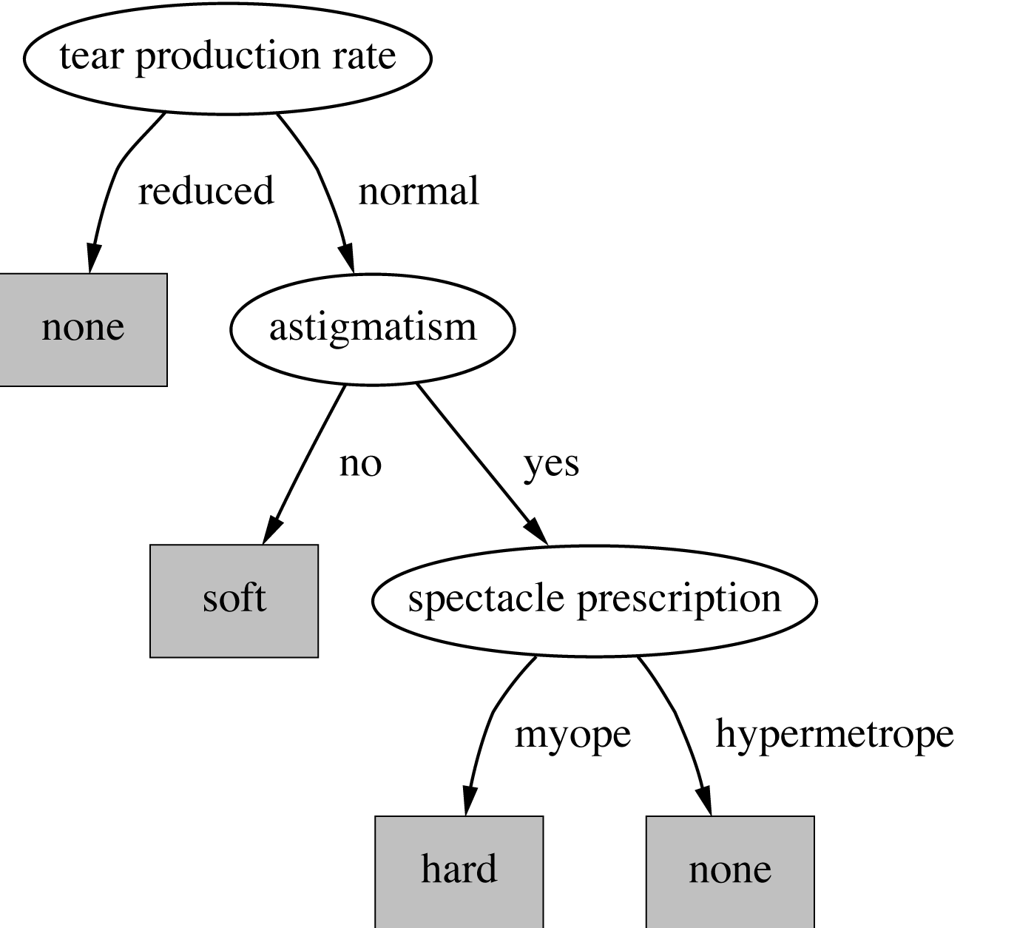
Structural descriptions: Decision Trees e.g. for the Contact Lens Problem
Notes:
More concise and clearer than rules; Easily visualised
First test Tear Production; then Astigmatism; then Spectacle Prescription
Eventually reach a leaf
This time it doesn’t rely on age – might not be perfect
Rules vs trees format – which is best? Later

Slide 25

Numeric data: classifying iris flowers
Sepal length
Sepal width
Petal length
Petal width
Type
1
5.1
3.5
1.4
0.2
Iris setosa
2
4.9
3.0
1.4
0.2
Iris setosa
…
51
7.0
3.2
4.7
1.4
Iris versicolor
52
6.4
3.2
4.5
1.5
Iris versicolor
…
101
6.3
3.3
6.0
2.5
Iris virginica
102
5.8
2.7
5.1
1.9
Iris virginica
…
If petal length < 2.45 then Iris setosa
If sepal width < 2.10 then Iris versicolor
...
Notes:
A classic numeric dataset : 50 examples of each of three types of plants
Iris Setosa; Iris Versicolor; Iris Virginica
Lengths and widths measured in cm
Data is all numeric you can’t say you have complete coverage
Plants naturally vary, so there will be unusual examples in the set
R.A. Fisher in the 1930s
Eventual ruleset was very cumbersome and hard to follow – can create more compact rulesets with the same information

Slide 26
A more realistic example
Canadian labour contract negotiations 1987/8
Attribute
Type
1
2
3
…
40
Duration
(Number of years)
1
2
3
2
Wage increase first year
Percentage
2%
4%
4.3%
4.5
Wage increase second year
Percentage
?
5%
4.4%
4.0
Wage increase third year
Percentage
?
?
?
?
Cost of living adjustment
{none,tcf,tc}
none
tcf
?
none
Working hours per week
(Number of hours)
28
35
38
40
Pension
{none,ret-allw, empl-cntr}
none
?
?
?
Standby pay
Percentage
?
13%
?
?
Shift-work supplement
Percentage
?
5%
4%
4
Education allowance
{yes,no}
yes
?
?
?
Statutory holidays
(Number of days)
11
15
12
12
Vacation
{below-avg,avg,gen}
avg
gen
gen
avg
Long-term disability assistance
{yes,no}
no
?
?
yes
Dental plan contribution
{none,half,full}
none
?
full
full
Bereavement assistance
{yes,no}
no
?
?
yes
Health plan contribution
{none,half,full}
none
?
full
half
Acceptability of contract
{good,bad}
bad
good
good
good
Notes:
Labour negotiations for large organisations (500 plus staff) in the business and personal services sector (teachers, nurses, police_
This table shows the data instances in columns
It describes the attributes (column 1) and the type or range of values they can take (column two) and then 1 column for each data instance 1, 2,3 up to 40
The final column is the class attribute – was the outcome acceptable (good) or not (bad)?
Many values unknown or missing
Very unlikely we can make an exact / perfect classification for a new example

Slide 27
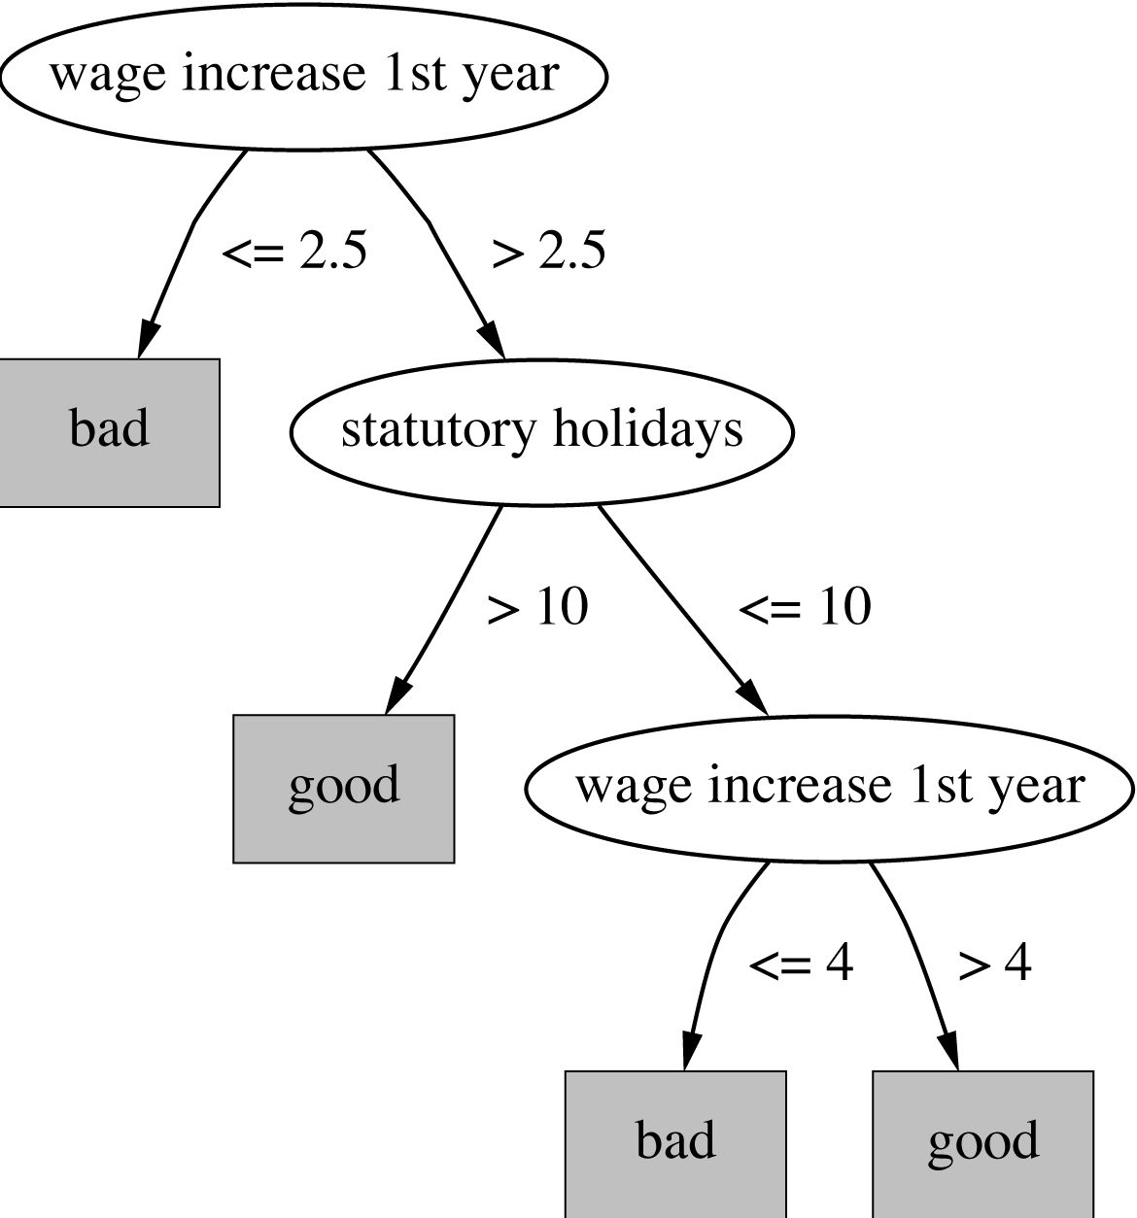
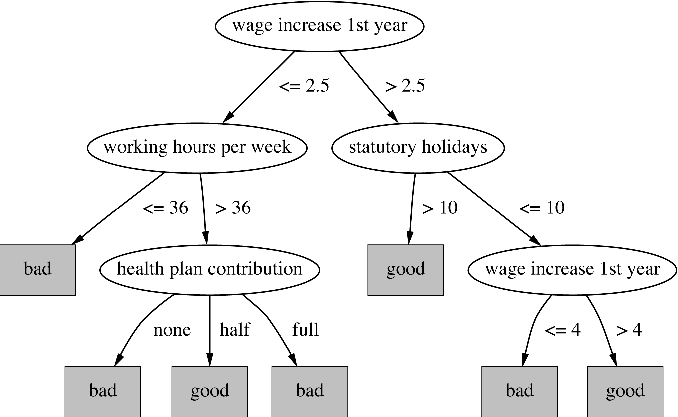
Decision trees for the Canadian labour data

Slide 28
Decision trees for the Canadian labour data
Simple
Approximate
Will predict bad for some outcomes that are really good
But it makes intuitive sense in terms of what is good for the employees

Slide 29
Decision trees for the Canadian labour data
More complex
Not intuitive
If hours exceed 36, why are no health plan or a full health plan bad, but half a health plan good?
Good for thinking in depth about the structure of the data
Notes:
If working hours exceed 36 and no health or full health plan then bad ; but if hours exceed 36 and half health plan then good
Because the outcomes are a compromise between two sides, accepted by both sides
-
Second example actually does represent the data better, but this doesn’t guarantee it will do a better job on a new example
Also it may be overfitted to the data
-
First one was obtained by pruning the secind

Slide 30
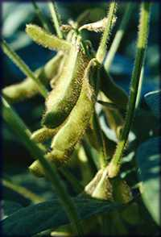
Early example of ML success : Soybean disease classification (1970s)
Attribute
Number of values
Sample value
Environment
Time of occurrence
7
July
Precipitation
3
Above normal
…
Seed
Condition
2
Normal
Mold growth
2
Absent
…
Fruit
Condition of fruit pods
4
Normal
Fruit spots
5
?
Leaf
Condition
2
Abnormal
Leaf spot size
3
?
…
Stem
Condition
2
Abnormal
Stem lodging
2
Yes
…
Root
Condition
3
Normal
Diagnosis
19
Diaporthe stem canker
Notes:
680 examples, each represents a diseased plant
Summarise the data
35 attributes altogether – divided into Environmental, Seed, Fruit, Leaf, Stem and Leaf
Columns give different attributes; number of different values for each attribute , some example values
Diagnosis is the class variable

Slide 31
Early example of ML success : Soybean disease classification (1970s)
Used 300 carefully selected examples as training data
Examples selected to be very different from each other
Automatically derived rules
Also a plant expert created rules
And the computer-generated rules performed better than the expert rules on the rest of the data – 97.5% for the machine vs. 72% for the expert rules
Notes:
How often was the top-ranked diagnosis the right one?
Does this mean that the expert would have done less well than the machine if asked to look at actual plants and diagnose them?
No – the expert would look at information that isn’t available in the dataset, also may not be able express all his knowledge and experience in rules even if using only the same data
But experts aren’t always available
The expert adopted the rules

Slide 32
Two derived rules
If leaf condition is normal and stem condition is abnormal and stem cankers is below soil line and canker lesion color is brown
then diagnosis is rhizoctonia root rot
If leaf malformation is absent and stem condition is abnormal and stem cankers is below soil line and canker lesion color is brown
then diagnosis is rhizoctonia root rot
Notes:
Two very similar rules – second, third and fourth conditions are the same and so is the diagnosis
Abnormal stem condition, and brown stem cankers below the soil line – rhisocotnia root rot?
What about the first line – leaf condition is normal versus leaf malformation is absent?

Slide 33
Two derived rules
If leaf condition is normal and stem condition is abnormal and stem cankers is below soil line and canker lesion color is brown
then diagnosis is rhizoctonia root rot
But
If Leaf condition is normal then Leaf malformation must be absent
So Leaf malformation is a special case of Leaf abnormality
So second rule only applies of there is a different Leaf abnormality
Not obvious!
If leaf malformation is absent and stem condition is abnormal and stem cankers is below soil line and canker lesion color is brown
then diagnosis is rhizoctonia root rot
Notes:
Generalisation is hard to learn

Slide 34
Classifying iris flowers – clustering
Sepal length
Sepal width
Petal length
Petal width
Type
1
5.1
3.5
1.4
0.2
2
4.9
3.0
1.4
0.2
…
51
7.0
3.2
4.7
1.4
52
6.4
3.2
4.5
1.5
…
101
6.3
3.3
6.0
2.5
102
5.8
2.7
5.1
1.9
…
“Unsupervised” learning
Notes:
What if we didn’t know the classification type of the irises and we wanted to find a pattern?
We didn’t even know there were going to be exactly three different kinds of iris, we don’t know what they have in common
Cluster “similar” irises together
Figure out how many groups of similar irises there are, and what feature they all have in common
What might make that especially hard?
-plants vary so data is going to be inaccurate – there may be one or two setosas with very large petals
One of the most exciting kinds of learning!
“Unsupervised” learning
Part 2

Slide 35
So far - these were classifications
Weather problem – play? yes / no
Contact lens – hard / soft / none
Iris type - Setosa; Versicolor / Virginica
Labour negotiation outcomes - good / bad
Soybean diseases – normal / root rot (etc)
All predict categories
Non-class attributes may be numbers
What if we’re trying to predict a number?
Notes:
So far, even if the other attributes were numbers the class attribute was always a nominal/categorical – hence classification

Slide 36
Numeric predictions: predicting CPU performance PRP
209 different computer configurations
Cycle time (ns)
Main memory (Kb)
Cache (Kb)
Channels
Performance
MYCT
MMIN
MMAX
CACH
CHMIN
CHMAX
PRP
1
125
256
6000
256
16
128
198
2
29
8000
32000
32
8
32
269
…
208
480
512
8000
32
0
0
67
209
480
1000
4000
0
0
0
45
Notes:
The class attribute is also numeric
The names of the attributes in the function are in the second line of the table
Regression function to predict (calculate) the class attribute from the others (on next slide)
Complex algorithm to determine what the weights should be for the other variables

Slide 37
Numeric predictions
Structural Description: Linear regression function
Structural Description: Neural networks (later)
PRP = -55.9 + 0.0489 MYCT + 0.0153 MMIN + 0.0056 MMAX + 0.6410 CACH - 0.2700 CHMIN + 1.480 CHMAX
Notes:
Regression function to predict (calculate) the class attribute from the others
Complex algorithm to determine what the weights should be for the other variables
Covered in more detail later

Slide 38
Take away
Different structural descriptions suit different data
Use unsupervised learning if the data has not been pre classified data
Examples are discussed in Witten Frank and Elbe “Data Mining and Machine Learning”
examples will recur

