Slide 1
F20DL Data Mining and Machine Learning
Diana Bental
(with slide material from David Corne and Nick Taylor)

Slide 2
Lecture 6 Statistics

Slide 3
Fundamental Statistics Definitions
A Population is the total collection of all items/individuals/events under consideration
A Sample is that part of a population which has been observed or selected for analysis
E.g. all students is a population.
Students at HWU is a sample; this class is a sample, etc
A Statistic is a measure which can be computed to describe a characteristic of the sample (e.g. the sample mean)
The reason for doing this is almost always to estimate (i.e. make a good guess) things about that characteristic in the population

Slide 4
For example….
This class is a sample from the population of students at HWU
… it can also be considered as a sample of other populations – like what?
One statistic of this sample is your mean weight. Suppose that is 65Kg. i.e. this is the sample mean
Is 65Kg a good estimate for the mean weight of the population?
Another statistic: suppose 10% of you are married.
Is this a good estimate for the proportion that are married in the population?

Slide 5
Some Simple Statistics
The Mean (average) is the sum of the values in a sample divided by the number of values
The Median is the midpoint of the values in a sample (50% above; 50% below) after they have been ordered (e.g. from the smallest to the largest)
The Mode is the value that appears most frequently in a sample
The Range is the difference between the smallest and largest values in a sample
The Variance is a measure of the dispersion of the values in a sample – how closely the observations cluster around the mean of the sample
The Standard Deviation is the square root of the variance of a sample.
Notes:
Median UK salary 22K

Slide 6
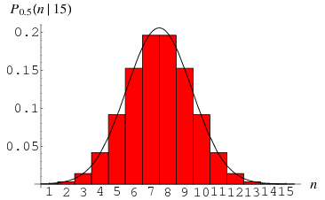
Distributions / Histograms
A Normal (aka Gaussian) distribution (image from Mathworld)

Slide 7
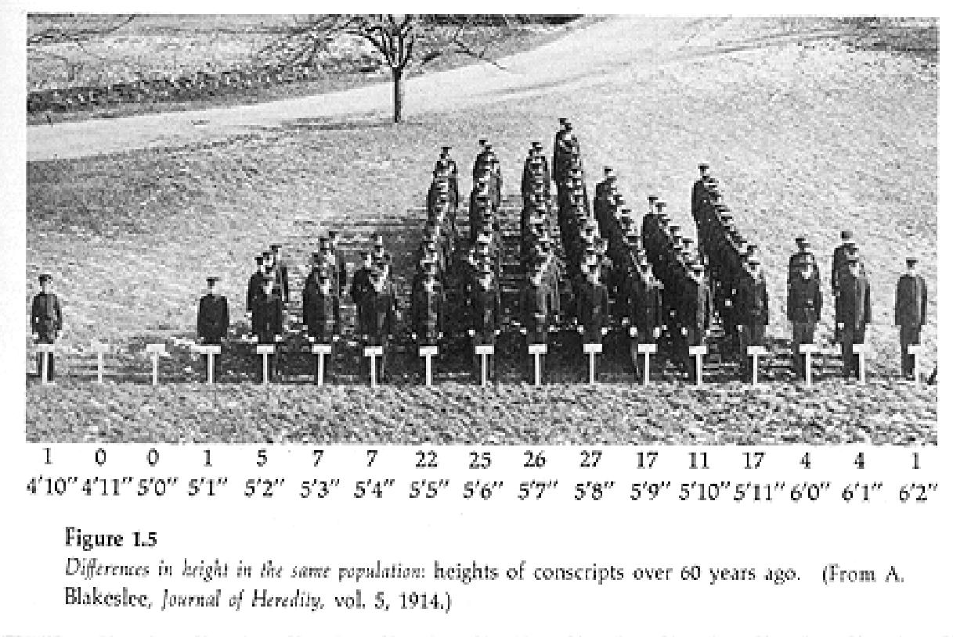
http://www.hccfl.edu/faculty-info/aambrioso/sta-2023h.aspx
http://www.hccfl.edu/faculty-info/aambrioso/sta-2023h.aspx

Slide 8
`Normal’ or Gaussian distributions …
… tend to be everywhere
Given a typical numeric field in a typical dataset, it is common that most values are centred around a particular value (the mean), and the proportion with larger or smaller values tends to tail off.

Slide 9
`Normal’ or Gaussian distributions …
… tend to be everywhere
Given a typical numeric field in a typical dataset, it is common that most values are centred around a particular value (the mean), and the proportion with larger or smaller values tends to tail off.

Slide 10
`Normal’ or Gaussian distributions …
Heights, weights, times (e.g. for 100m sprint, for lengths of software projects), measurements (e.g. length of a petal, waist measurement, coursework marks, level of protein A in a blood sample, …) all tend to be Normally distributed. Why??

Slide 11
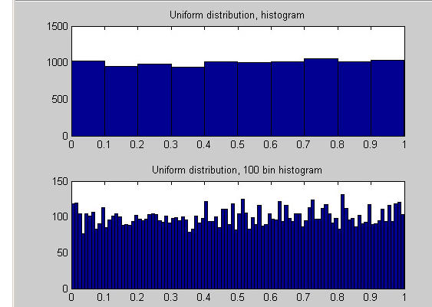
Sometimes distributions are uniform
Uniform distributions. Every possible value tends to be equally likely
Notes:
Roll of a dice – all equally likely – next slide

Slide 12
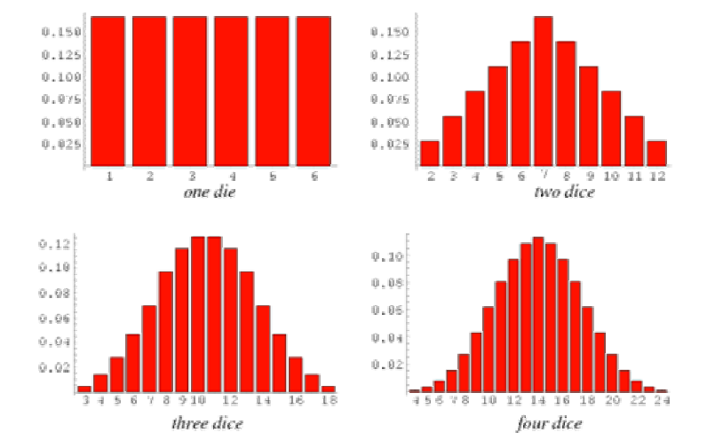
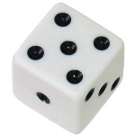

This figure is from: http://mathworld.wolfram.com/Dice.html
One die: uniform distribution of possible totals:
But look what happens as soon as the value is a sum of things;
The more things, the more Gaussian the distribution.
Are measurements (etc.) usually the sum of many factors?
Notes:
2 Dice - 1 in 36 chance of getting a 2 or a 12 (because there is only one combination 1/1 or 6/6)
Higher chance of getting an 8 – 2/6, 1/5
Much higher chance of getting a 6 – 1/5, 2/4, 3/3 – more combinations

Slide 13
Probability Distributions
If a population (e.g. field of a dataset) is expected to match a standard probability distribution then a wealth of statistical knowledge and results can be brought to bear on its analysis
statistics of a sample provide info about a sample but…
if we can assume that our statistic is normally distributed in the population, then our sample statistic provides info about the population

Slide 14
The power of assumptions…
You are a random sample of 30 (ish) HWU/Riccarton students. Suppose:
The mean height of this sample is 1.685cm
There are 5,000 students in the population
With no more information, what can we say about the mean height of the population of 5,000 students?

Slide 15
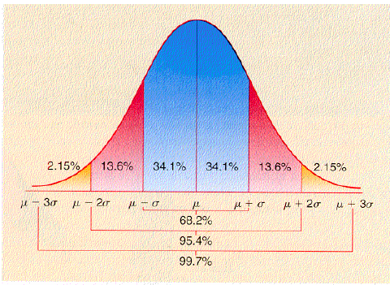
A closer look at the normal distribution
This is the ND with mean mu and std sigma

Slide 16
More than just a pretty bell shape
Suppose the standard deviation of your sample is 0.12
Theory tells us that if a population is Normal, the sample std is a fairly good guess at the population std
So, the sample STD is a good estimate for the population STD
So we can say, for example, that ~95% of the population of 5000
students (4750 students) will be within 0.24m of the population mean

Slide 17
But what is the population mean?
Mean of our sample was 1.685
The Standard Error of the Mean is
pop std / sqrt(sample size)
which we can approximate by:
sample std / sqrt(sample size)
… in our case this 0.12/5.5 = 0.022
This ‘standard error’ (SE) is actually the standard deviation of the
distribution of sample means We can use this it to build a confidence
interval for the actual population mean. Basically, we can be
95% sure that the pop mean is within 2 SEs of the sample mean …

Slide 18
The power of assumptions…
You are a random sample of 30 (ish) HWU/Riccarton students. Suppose:
The mean height of this sample is 1.685cm
There are 5,000 students in the population
With no more information, what can we say about the mean height of the population of 5,000 students?
If we assume the population is normally distributed
…. our sample std (0.12) is a good estimate of the pop std
….. so, means of samples of size 30 will generally have their own
std, of 0.022 (calculated on last slide)
… so, we can be 95% confident that the pop mean is between
1.641 and 1.729 (2 SEs either side of the sample mean)

Slide 19
This is a good time to mention: Z-normalisation (converting measurements to z-scores)
Given any collection of numbers (e.g. the values of a particular field in a dataset) we can work out the mean and the standard deviation.

Slide 20
Z-Normalisation
We looked at min-max normalisation
Scale the values so the lowest value is 0 and the highest is 1
And the remainder fall in between
Z-score normalisation means converting the numbers into units of standard deviation.

Slide 21
Simple z-normalisation example
values
2.8
17.6
4.1
12.7
3.5
11.8
12.2
11.1
15.8
19.6

Slide 22
Simple z-normalisation example
values
2.8
17.6
4.1
12.7
3.5
11.8
12.2
11.1
15.8
19.6
Mean: 11.12
STD: 5.93

Slide 23
Simple z-normalisation example
values
2.8
17.6
4.1
12.7
3.5
11.8
12.2
11.1
15.8
19.6
Mean subtracted
-8.32
6.48
-7.02
1.58
-7.62
0.68
1.08
-0.02
4.68
8.48
Mean: 11.12
STD: 5.93
subtract mean, so
that these are centred around zero

Slide 24
Simple z-normalisation example
values
2.8
17.6
4.1
12.7
3.5
11.8
12.2
11.1
15.8
19.6
Mean subtracted
-8.32
6.48
-7.02
1.58
-7.62
0.68
1.08
-0.02
4.68
8.48
In Z units
-1.403
1.092
-1.18
0.27
-1.28
0.11
0.18
-0.003
0.79
1.43
Mean: 11.12
STD: 5.93
subtract mean, so
that these are centred around zero
Divide each
value by the
std; we now see how usual or unusual each value is
Notes:
Why do Z normalisation instead of Min-Max?
Well mostly because it takes take the spread into account. You are likely to get a few outliers by random chance. If you have a few extreme values that will skew Min-Max a lot. Most of your values will be in a small clump in the middle. Z normalisation is more stable, spreads things out more evenly and less susceptible to outliers.
Weka can do this automatiically – called STANDARDIZATION
Attribute normalization

Slide 25
A bit more basic statistics: Correlation and Regression
Correlation
Understanding whether two fields of the data are related
Can you predict one from the other?
Or is there some underlying cause that affects both?
Basic Regression
Very, very often used
Given that there is a correlation between A and B (e.g. hours of study and performance in exams; height and weight ; radon levels and cancer, etc … this is used to predict B from A.
Linear Regression (predict value of B from value of A)
But be careful…..

Slide 26
Correlation
Phone use (hrs) | Life expectancy
1 | 84
2 | 78
3 | 91
4 | 79
5 | 69
6 | 80
7 | 76
8 | 80
9 | 75
10 | 70
Are these two things
correlated?

Slide 27
Correlation

Slide 28
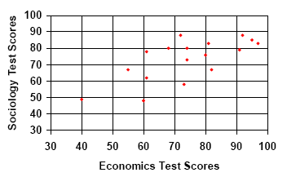
What about these (web credit)

Slide 29
What about these (web credit)

Slide 30
Correlation Measures
It is easy to calculate a number that tells you how well two things are correlated. The most common is “Pearson’s R”
The r measure is:
r = 1 for perfectly positively correlated data
(as A increases, B increases, and the line
exactly fits the points)
r = -1 for perfectly negative correlation
(as A increases, B decreases, and the line
exactly fits the points)

Slide 31
Correlation Measures
r = 0 No correlation – there seems to be
not the slightest hint of any
relationship between A and B
More general and usual values of r:
if r >= 0.9 (r <= -0.9) -- a `strong’ correlation
else if r >= 0.65 (r <= -0.65) -- a moderate correlation
else if r >= 0.2 (r <= -0.2) -- a weak correlation,

Slide 32
Calculating r
You will remember the Sample standard deviation, when you have a sample of n different values whose mean is
Sample std is square root of
Notes:
That’s the variance – (sum of each value minus the mean ) all squared and divided by n-1 the number of items in the sample (minus 1)
Take the square root for the standard deviation
MU is the mean

Slide 33
Calculating r
If we have pairs of (x,y) values, Pearson’s r is:
Interpretation of this should be obvious (?)
Notes:
Correlate two variables, x and y
Take each x and y value pair,
subtract the mean of the x and divide by the STD dev of x – scales each value by how many SDs it is from the mean
Do the same for y
Multiply them
Tells us how far each pair is from the expected value
Add up the values for each pair and divide by the number of values

Slide 34
Correlation (Pearson’s R) and covariance
As we just saw, this is Pearson’s R
Notes:
We want to correlate two attributes, x and y

Slide 35
Correlation (Pearson’s R) and covariance
And this is the covariance between x and y
often called cov(x,y)
Notes:
Correlation is scaled using standard deviation
Whereas covariance isn’t
Uses whatever units X and Y were measured in – so if you scale X or Y (change from inches to metres) then the covariance changes

Slide 36
R = −0.556
cov(x,y) = − 4.35
r = 0.772
cov(x,y) = 6.15
r = 0.772
cov(x,y) = 61.5
R = −0.556
cov(x,y) = − 43.5
Notes:
Two different sets of data – left/green is one set of data, right/red is a different set;
Left side – green – bottom row shows Y axis multiplied by 10,
Right side - red – bottom row shows X axis mutiplied by 10
The same R (correlation) at top and bottom
But different covariances because the scales are different
Green example – multiply Y by 10, covariance multiplies by 10
Red example – multiply X by 10, covariance multiplies by 10
(Why use covariance? Because you’re not scaling by standard deviations, it may be easier to express in familiar units)

Slide 37
So, we calculate r, we think there is a correlation, what next?

Slide 38
We find the ‘best’ line through the data

Slide 39
We can now make predictions! We have just done ‘regression’

Slide 40
So, how do we calculate the best line?

Slide 41
Best line means …
We want the “closest” line, which minimizes the error. I.e. it minimizes the degree to which the actual points stray from the line . For any given point, its distance from the line is called a residual.
We assume that there really is a linear relationship ( e.g. for a top long distance runner, time = miles x 5 minutes), but we expect that there is also random `noise’ which moves points away from the line (e.g. different weather conditions, different physical form, when collecting the different data points). We want this noise (deviations from line) to be as small as possible.
We also want the noise to be unrelated to A (as in predicting B from A) – in other words, we want the correlation between A and the noise to be 0.
Notes:
We are predicting B from A
No correlation between A and noise

Slide 42
Noise/Residuals: the residuals

Slide 43
We want the line, which minimizes the sum of the (squared) residuals.
And we want the residuals themselves to have zero correlation with the variables

Slide 44
When there is only one x, it is called univariate regression, and closely related to the correlation between x and y
In this case the mathematics turns out to be equivalent to simply working out the correlation, plus a bit more
Notes:
Explained on next slides…

Slide 45
Calculating the regression line in univariate regression
First, recall that any line through (x,y) points can be represented by:
where m is the gradient, and c is where it crosses the y-axis at x=0

Slide 46
Calculating the regression line
To get m, we can work out Pearson’s r, and then we calculate:
to get c, we just do this:
Job done
Notes:
Constant = ( mean of y) - Pearson’s r

Slide 47
Now we can:
Try to gain some insight from the slope m
e.g. “since m = −4, this suggests that every extra hour of watching TV leads to a reduction in IQ of 4 points
Or “since m = 0.05, it seems that an extra hour per day of mobile phone use leads to a 5% increase in likelihood to develop brain tumours”.
Notes:
Explained on next slides…

Slide 48
BUT….
Be careful –
It is easy to calculate the regression line, but always remember what the value of r actually is, since this gives an idea of how accurate is the assumption that the relationship is really linear.
So, the regression line might suggest:
“… extra hour per day of mobile phone use leads to a 5% increase in likelihood to develop brain tumours”
but if r ~ 0.3 (say) we can’t say we are very confident about this. Either not enough data, or the relationship is different from linear
Notes:
Explained on next slides…
Low correlation means we can’t be very sure that the relationship is as strong as we think – not enough data to be sure it wasn’t chance, or not the right relationship

Slide 49
And … what about a dataset with more than one non-class field?

Slide 50
The general solution to multiple regression
Suppose you have a numeric dataset, e.g.
3.1 3.2 4.5 4.1 … 2.1 1.8 5.1
4.1 3.9 2.8 2.4 … 2.0 1.5 3.2
…
6.0 7.4 8.0 8.2 … 7.1 6.2 9.5

Slide 51
The general solution to multiple regression
Suppose you have a numeric dataset, e.g.
3.1 3.2 4.5 4.1 … 2.1 1.8 5.1
4.1 3.9 2.8 2.4 … 2.0 1.5 3.2
…
6.0 7.4 8.0 8.2 … 7.1 6.2 9.5
X
y

Slide 52
The general solution to multiple regression
Suppose you have a numeric dataset, e.g.
3.1 3.2 4.5 4.1 … 2.1 1.8 5.1
4.1 3.9 2.8 2.4 … 2.0 1.5 3.2
…
6.0 7.4 8.0 8.2 … 7.1 6.2 9.5
A linear classifier or regressor is:
y_{n} = β₁x_{n1} + β₂x_{n2} + … β_{m}x_{nm} - So, how do you
get the β values?
X
y

Slide 53
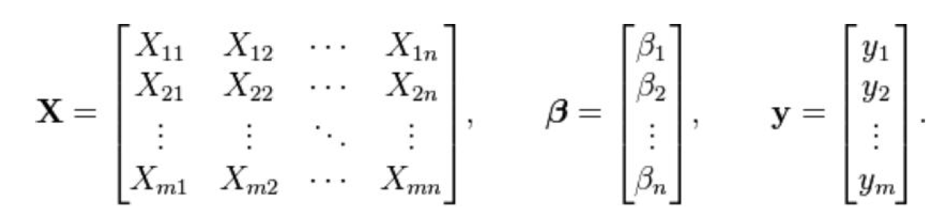
The general solution to multiple regression
By straightforward linear algebra. Treat the data as matrices
and vectors …
Notes:
Multiple variables
Represent as matrices
X matrix of sample values
Beta – vector of weights (for each value)
Y – vector of the outcome attribute, the one we want to predict

Slide 54

The general solution to multiple regression
By straightforward linear algebra. Treat the data as matrices
and vectors …
And the solution is:
Notes:
Our vector is
C transpose x X inverted
Times X transposed
Times Y

Slide 55
And that’s general multivariate linear regression.
If the data are all numbers, you can get a prediction for your ‘target’ field by deriving the beta values with linear algebra.
Note that this is regression, meaning that you predict an actual real number value, such as wind-speed, IQ, weight, etc…, rather than classification, where you predict a class value, such as ‘high’, ‘low’, ‘clever’, …
But … easy to turn this into classification … how?

Slide 56
Pros and Cons
Arguably, there’s no ‘learning’ involved, since the beta values are obtained by direct mathematical calculations on the data
It’s pretty fast to get the beta values too.
HOWEVER
In many, many cases, the ‘linear’ assumption is a poor one – the predictions simply will not be as good as, for example, decision trees, neural networks, k-nearest-neighbour, etc …
The maths/implementation involves getting the inverses of large matrices. This sometimes explodes.
Notes:
However - Big assumption – that the values follow a straight line relationship. In real life they often don’t

Slide 57
Prediction
Commonly, we can of course use the regression line for prediction:
So, predicted life expectancy for 3 hrs per day is: 82 - fine

Slide 58
BUT
If correlation is not strong, the regression line may be meaningless
What would we predict for 8 hrs if we did regression based only on
the first cluster?

Slide 59
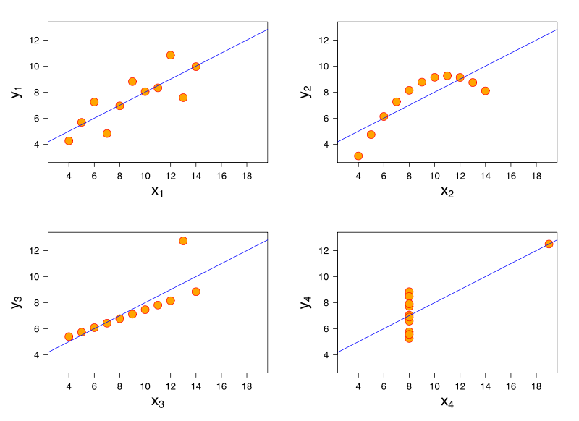
… or, outliers may be distorting the picture,
… or, a straight line is simply not an appropriate model for the data
r is 0.816
y = 3.00 + 0.500x
Anscombe, Francis J. (1973) Graphs in statistical analysis. American Statistician, 27, 17–21.
Notes:
All the same line… y = 3 + x/2
And the same correlation … 0,.86 which is not bad
First is a reasonable example
Second is not a linear relationship
Third is distorted by an outlier
Fourth is just odd… not apparent that there’s any relationship at all. Not taken enough different points on the X axis to tell.

Slide 60
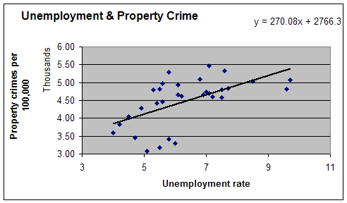
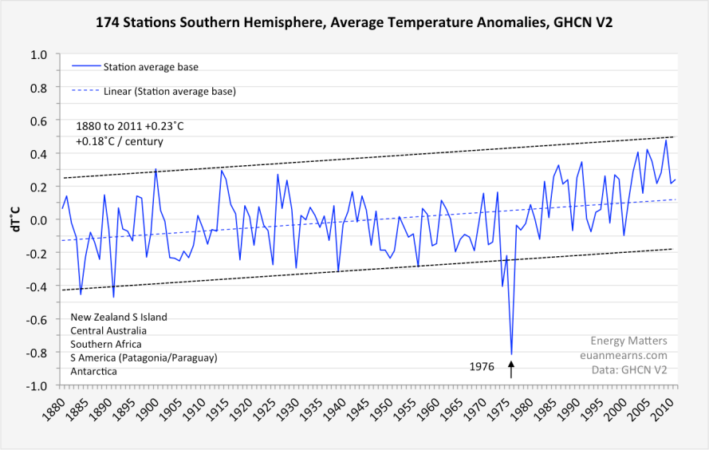
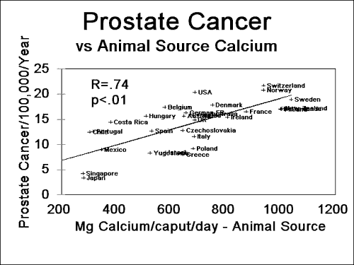
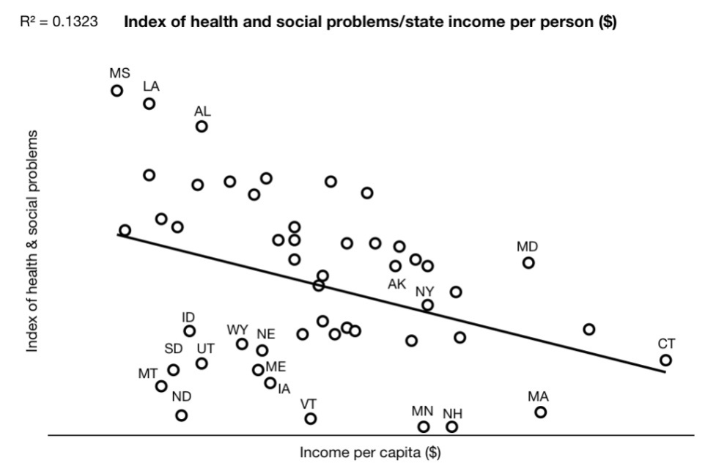
Correlation and regression are used everywhere in science and industry.

Slide 61
Correlation and regression are used everywhere in science and industry.

Slide 62
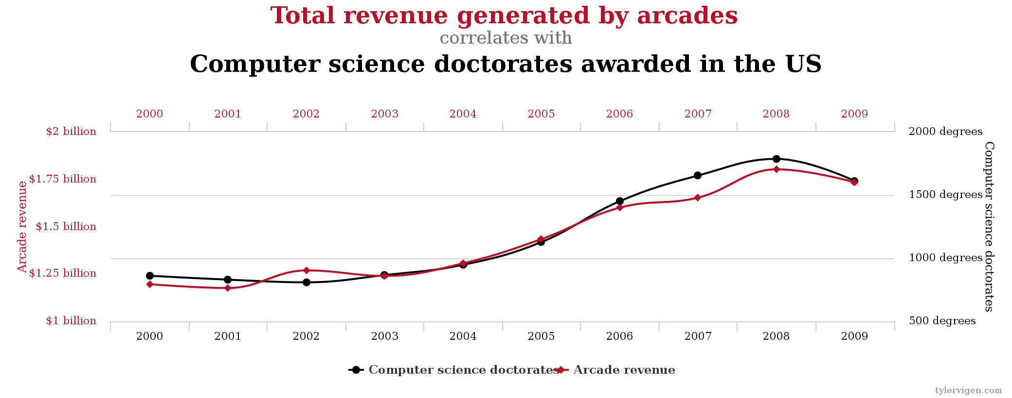

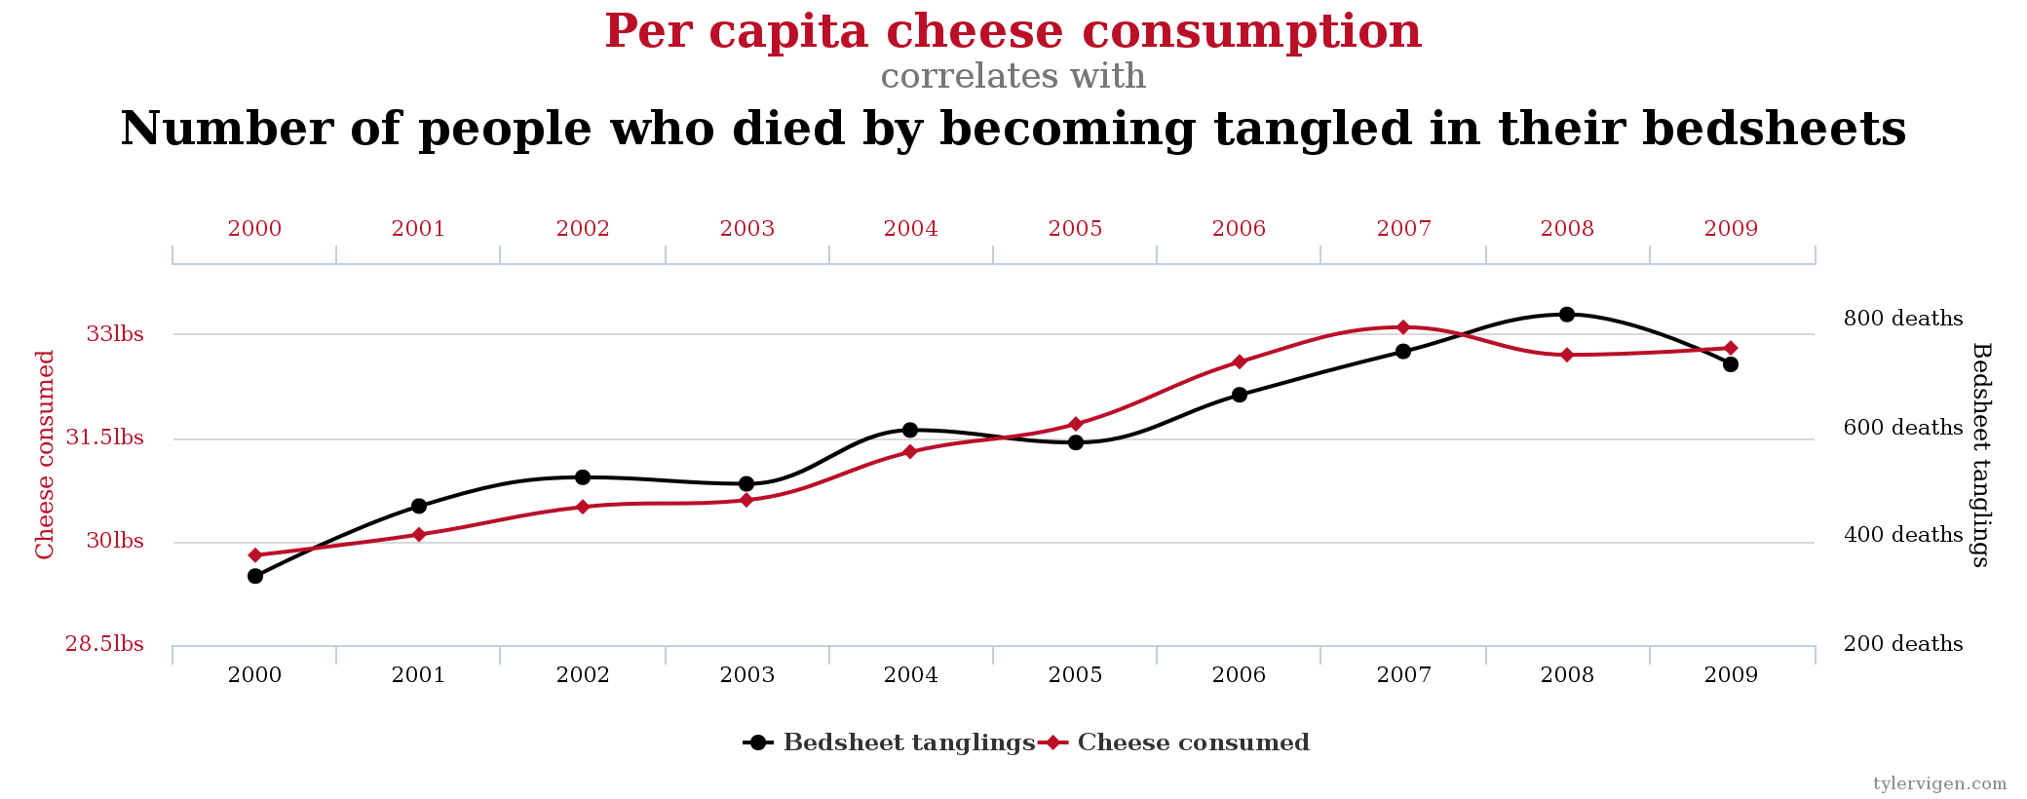
But see here … http://www.tylervigen.com/spurious-correlations

