Slide 1
F20DL Data Mining and Machine Learning
Diana Bental
(with material from David Corne and slides from http://www.cs.waikato.ac.nz/ml/weka/book.html)

Slide 2
We talked about statistics
Basic statistics
Mean, standard deviation …
Comparing samples to populations
Estimating the population mean from a sample mean
Predicting the value of one attribute from another (or several others)
Correlation and regression

Slide 3
Effectiveness and credibility
This lecture: If we use machine learning
How much should we trust the predictions we make?
What measures can we use?
How should we measure?
What data should we measure on? (Next lecture)

Slide 4
Measuring Accuracy: Success rates and Error rates
Natural performance measure for classification problems: error rate
Success: the class of an instance is predicted correctly
Error: the class is predicted incorrectly
Success rate: proportion of correct predictions made over the whole set of instances
Number of correct predictions divided by number of instances
Error rate: proportion of errors made over the whole set of instances
Number of incorrect predictions divided by number of instances
Error rate = 1 – Success rate

Slide 5
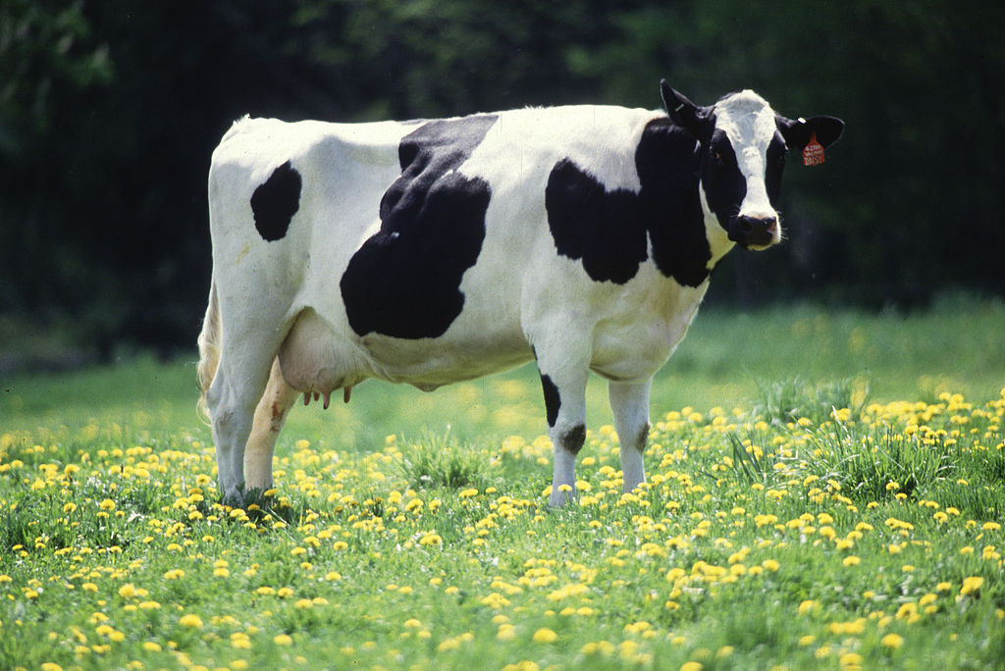
97% is a great success rate… BUT
Farming
Predict: When to send a cow for insemination?
Cows are in oestrus 1 day in 30
If our method predicts that a cow is never in oestrus it will be right 97% of the time
Very high success rate!
But the farmer will never send any cows for insemination
the farm will have no calves
Notes:
Right 29 out of 30
or 97 per cent of the time

Slide 6
So success rate alone is not enough!!
Confusion matrix
With a “yes” or “no” prediction there are four different possibilities
Success rate = (TP + TN) / (TP + TN + FP +FN)
 | Predicted Y | Predicted N
Actually Y | True Positive | False Negative
Actually N | False Positive | True Negative
Notes:
We can define success rate in terms of those four possibilities
One reason for this is looking for rare effects – like cows in oestrus
Could also happen if we have unbalanced data, lots of iris setosas in the world and very few of the others; we would get high accuracy by predicting iris setosas all the time. (So you need to look at instance data and how classes are balanced)
For our cows, we ideally we want ideally want 3 per cent true positives – the cow IS in oestrus and we send her for insemination
And we expect 97 per cent true negatives – the cow is NOT in oestrus and we don’t decide to send the cow for insemination
And we want ZERO False positive and ZERO false negative
But we could probably put up with quite a few false positives – sending a few cows who are not in oestrus – if we could identify most of the cows who are in oestrus
Out of our herd of 100 we might be happy to send 6 cows, 2 come back pregnant
Our overall success rate might be worse than 97 per cent but as farmers we’d be doing better

Slide 7
Two classes is a common and special case

Slide 8
Two classes is a common and special case
Medical applications: cancer, or not?
Computer Vision applications: landmine, or not?
Security applications: criminal, or not?
Biotech applications: gene, or not?
… …

Slide 9
Two classes is a common and special case
Medical applications: cancer, or not?
Computer Vision applications: landmine, or not?
Security applications: terrorist, or not?
Biotech applications: gene, or not?
… …
 | Predicted Y | Predicted N
Actually Y | True Positive | False Negative
Actually N | False Positive | True Negative

Slide 10
Two classes is a common and special case
True Positive: these are ideal. E.g. we correctly detect cancer
 | Predicted Y | Predicted N
Actually Y | True Positive | False Negative
Actually N | False Positive | True Negative

Slide 11
Two classes is a common and special case
True Positive: these are ideal. E.g. we correctly detect cancer
False Positive: to be minimised – cause false alarm – can be
better to be safe than sorry, but can be very costly.
 | Predicted Y | Predicted N
Actually Y | True Positive | False Negative
Actually N | False Positive | True Negative
Notes:
False alarm – search an innocent person; refuse a credit card transaction; even telling someone they need further testing for cancer can be traumatic

Slide 12
Two classes is a common and special case
True Positive: these are ideal. E.g. we correctly detect cancer
False Positive: to be minimised – cause false alarm – can be
better to be safe than sorry, but can be very costly.
False Negative: also to be minimised – miss a landmine / cancer
very bad in many applications
 | Predicted Y | Predicted N
Actually Y | True Positive | False Negative
Actually N | False Positive | True Negative
Notes:
False negative – don’t search someone who is carrying a knife; allow a stolen credit card transaction; miss a case of cancer (very serious!)

Slide 13
Two classes is a common and special case
True Positive: these are ideal. E.g. we correctly detect cancer
False Positive: to be minimised – cause false alarm – can be
better to be safe than sorry, but can be very costly.
False Negative: also to be minimised – miss a landmine / cancer
very bad in many applications
True Negative?:
 | Predicted Y | Predicted N
Actually Y | True Positive | False Negative
Actually N | False Positive | True Negative
Notes:
What’s a true negative – we says it’s not a landmine and it isn’t, we say the patient doesn’t have cancer and they don’t. Also ideal.
Want to maximise our true positive and true negatives and minimise the others.

Slide 14
Two classes is a common and special case
Accuracy measures
Success rate = (TP + TN) / (TP + TN + FP + FN)
Error rate = (FP + FN) / (TP + TN + FP + FN)
 | Predicted Y | Predicted N
Actually Y | True Positive | False Negative
Actually N | False Positive | True Negative
Notes:
Accuracy measures in terms of the confusion matrix

Slide 15
Sensitivity and Specificity: useful measures of accuracy in this kind of 2-class tasks
 | Predicted Y | Predicted N
Actually Y | True Positive | False Negative
Actually N | False Positive | True Negative

Slide 16
Sensitivity and Specificity: common measures of in this kind of 2-class tasks
Sensitivity = TP/(TP+FN) - how many of the real TRUE cases are detected? How sensitive is the classifier to TRUE cases?
A highly sensitive test for cancer: if “NO” then you can be sure it’s “NO”
Specificity = TN/(TN+FP) - how sensitive is the classifier to the negative cases?
A highly specific test for cancer: if “YES” then you can be sure it’s “YES”.
Many classifiers allow you to “move the line”
Notes:
You want high sensitivity for a medical screening test – want to get all the TRUE cases and NOT leave out people who do have cancer. You would be less bothered by getting a lot of positive screens for people who don’t have cancer, because you can send them on for further testing.
So for an inexpensive and non-invasive screening test you might be OK with low specificity. Iif the screen says Yes you then you the try more expensive or more invasive tests (with higher specificity) so as to pick out just the people who REALLY have the disease. This saves you from doing the more expensive or nastier tests on everyone.
For a medical test leading to complex surgery you might want very high specificity: don’t want to do dangerous surgery on a patient who doesn’t have the illness.

Slide 17
YES NO
Notes:
Want to predict yeses and noes – blue is YES , red is no
16 YES, 12 NO
Blue – bad credit card transactions

Slide 18
YES NO
Notes:
NO predicted above the line, YES predicted below
3 TN;
16 TP
0 FN
9 FP
Sensitivity = TP/(TP+FN) = 16 / (16 + 0) = 1
We get all the YES cases
Specificity = TN/(FP+TN) = 3 / ( 9 + 3) = ¼
But We only get ¼ of the N0 cases right

Slide 19
YES NO
Sensitivity: 100%
Specificity: 25%
YES NO
Notes:
Very high sensitivity, low specificity
Detect all the fraudulent credit card transactions but reject most of the valid ones too - not good.

Slide 20

YES NO
Sensitivity: 93.8%
Specificity: 50%
Notes:
Decrease the sensitivity a bit and (in this example) get a great improvement in specificity
Let one fraudulent transaction through, but still failing 50% of the good ones.

Slide 21
YES NO
Sensitivity: 81.3%
Specificity: 83.3%
YES NO
Notes:
Decrease sensitivity more – get reasonable results for both
Pick up most of the fraudulent transactions and let through most of the acceptable ones

Slide 22
YES NO
Sensitivity: 56.3%
Specificity: 100%
YES NO
Notes:
Now 100% specificity but sensitivity is lower. We only ever stop bad credit card transactions, but we let half the bad credit card transactions through.

Slide 23
YES NO
Sensitivity: 100%
Specificity: 25%
YES NO
100% Sensitivity means:
detects all cancer cases (or whatever)
but possibly with many false positives
Notes:
In cancer screening this might be ideal.

Slide 24
YES NO
Sensitivity: 56.3%
Specificity: 100%
YES NO
100% Specificity means:
misses some cancer cases (or whatever)
but no false positives
Notes:
100% specificity but low sensitivity
We change the parameters on our learning algorithm or use a different learning algorithm
Straight line boundary is an example – might have a more wiggly boundary – but still have true and false positives, true and false negatives
We might decide to use a different test (or learn a different set of rules…) or set different parameters
Depends on the consequences of the different kinds of error.

Slide 25
Other measures – e.g. document retrieval, image retrieval, web search…
Get all the relevant documents or get only the relevant documents? Ideally both.
Percentage of relevant documents that are returned: recall =TP/(TP+FN)
Percentage of retrieved documents that are relevant: precision=TP/(TP+FP)
Usually a trade-off – decide which is more important or expensive
All the relevant legal documents to a case, plus a lot of irrelevant ones
Just two excellent suggestions for websites
To compare retrieval methods, combine recall and precision in the F measure:
F-measure =( 2 × recall × precision) / ( recall+precision)
Notes:
Recall is same as sensitivity
Precision is 1-specifity
Recall: how many of the useful documents were returned? Low recall - many useful documents were missed.
Precision: How many of of the returned documents were useful? Low precision – many of he returned documents were not useful.
Usually there is a tradeoff between recall and and precision .
F measure is used to say (in general terms) if one retrieval method is “better” than another as it increases with recall AND precision. However for specific applications a high-recall or high-precision method may be preferable.

Slide 26
Confusion matrix
Four different outcomes for a two-class prediction
 | Predicted Y | Predicted N
Actually Y | True Positive | False Negative
Actually N | False Positive | True Negative

Slide 27
Confusion matrix
Ideal: We want high numbers on the leading diagonal and low numbers (zeroes) everywhere else
 | Predicted Y | Predicted N
Actually Y | Large | 0
Actually N | 0 | Large

Slide 28
Confusion matrix
Cows in Oestrus example – ideal classifier out of 100
 | Predicted Y | Predicted N
Actually Y | 3 | 0
Actually N | 0 | 97

Slide 29
Confusion matrix
“Always in oestrus” classifier
0 on the diagonal – never correctly predict oestrus
Non-0 off the diagonal
 | Predicted Y | Predicted N
Actually Y | 0 | 3
Actually N | 0 | 97
Notes:
Watch for zeroes on the diagonals – true positives and negatives
Watch for non-zeroes off the diagonals – false positives and negatives

Slide 30
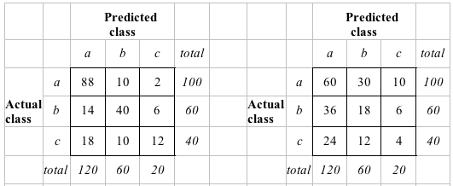
The kappa statistic
Two confusion matrices for a 3-class problem: actual predictor (left) vs. random predictor (right)
Number of successes: sum of entries in diagonal (D)
140/200 predicted correctly ; but we could get 82/200 right just by random picking
Kappa statistic computes the proportion of “extra” successes
Notes:
We’d like a statistic that tells us how well our predictor is doing – a single number
Suppose we know how often we expect something to happen overall (e.g. cows are in oestrus one day per month) or how many people are good credit, poor credit, or can’t lend
But we don’t know which cows will be in oestrus in a particular day or which customers are high or low risk -that’s what we are trying to predict
So is our predictor doing better any than pure chance?
200 customers divided into three classes (good / poor / can’t lend); actual distribution is 100; 60; 40 (last column); our predicted distribution for each class is 120, 60, 20 (total along the bottom) and we got 140 correct – sum along the diagonal.
The second table says, how many would we expect to get right if we randomly predicted 120/200 good, 60/200 poor, 20/100 can’t lend, over the original mix of customers? 60+18+4 = 82 along the diagonal
140 is a better than 82 so our predictor is better than chance, but how much better?
The kappa statistic measures this by comparing the confusion matrix for our learning mechanism with the confusion matrix for pure chance

Slide 31
The kappa statistic
Two confusion matrices for a 3-class problem: actual predictor (left) vs. random predictor (right)
Number of successes: sum of entries in diagonal (D)
Kappa statistic
K = (D_{actual} – D_{random} ) / (D_{ideal} – D_{random} )
K for a random predictor = 0; maximum Kappa is 100%
Notes:
The kappa statistic measures this by comparing the confusion matrix for our learning mechanism with the confusion matrix for pure chance
The ideal matrix would have 120 60 40 along the diagonal and zeroes everywhere else
D actual = 88 + 40 + 12 = 130
D random = 16+18 + 4 = 38
D ideal = 120+60+40 = 200
K = ( 130 – 38) / (200 – 38) = 92 / 162 = 0.57

Slide 32
Counting the cost
Depends on the situation
Terrorist profiling
“not a terrorist” is true nearly all the time
Loan decision
More expensive if someone defaults than if several people are refused loans
Oil-slick detection
Many false alarms, but sending a boat to a false alarm is less expensive than missing a slick
Electric load predication
Cheaper to gear up generators for a storm that doesn’t happen than be caught unprepared
Promotional mailing
Sending promotional mail to one house that doesn’t respond is cheaper than lost busiiness from one house that would respond

Slide 33
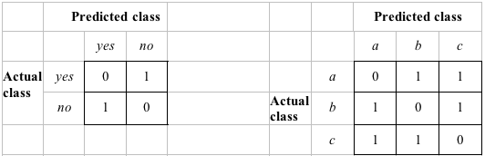
Classification with costs
Two cost matrices:
Replace the success rate by the average cost per prediction
Cost is given by appropriate entry in the cost matrix
Notes:
Simplest case: Cost of being right is zero, wrong is 1

Slide 34
What about different costs?
Can take costs into account when making predictions
Basic idea: only predict a high-cost class when we’re very confident about prediction
Given: predicted class probabilities
Normally we just predict the most likely class
Instead we should make the prediction that minimizes the expected cost
Expected cost: dot product of vector of class probabilities and appropriate column in cost matrix
Choose column (class) that minimizes expected cost
Notes:
But costs and profits usually vary
Replace the “success rate” by the average cost (or profit ) of a decision
If I predict A as the most likely, then if all costs are equal A is “best” choice; but it might be that predicting B when sometimes it’s really A has a lower cost

Slide 35
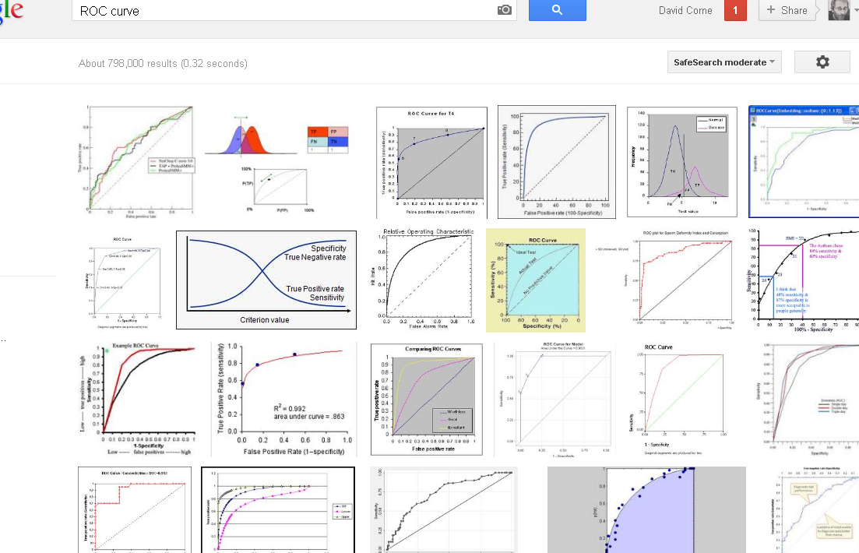
ROC curves

Slide 36
Comparing scenarios
Decisions are often made by comparing possible scenarios
Example: promotional mail out to 1,000,000 households
Mail to everyone: 0.1% respond (1000)
Data mining tool identifies the 10,000 most promising households
0.4% of these respond (400 responses)
If we only spend 1% of the postage and still get 40% of the responses - that may pay off
Data mining tool also identifies the 400,000 most promising households
0.2% of these respond (800 responses)
Have to spend 40% of the postage to get 80% responses – might pay off
We want to identify a subset that gives a high proportion of responses
Notes:
Lift = the increase in response that your data mining tool gives you = factor of 4 in the first case, factor of 2 in the second
You can create a Lift chart – number of respondents you get (y axis) against the number of mails you send out (x axis)
And then use that to decide how many to send, depending on the cost

Slide 37
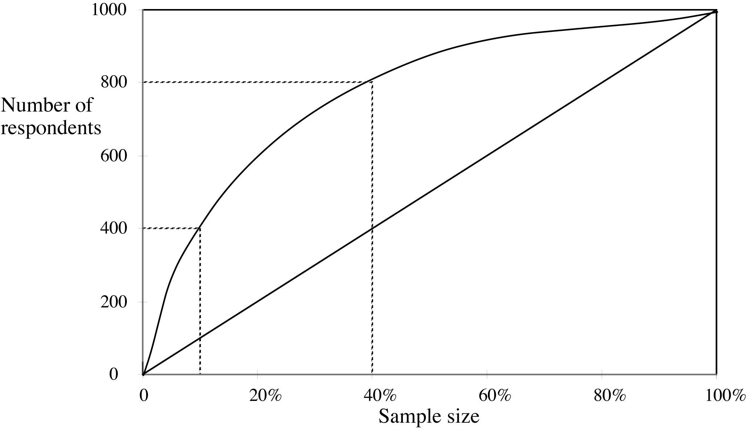
Lift chart

Slide 38
ROC Curves
True positive (Y axis) against False positives (Y axis)
Ideally: want a curve that goes up very steeply – the more square the better
Shows the trade-off between sensitivity and specificity
Pure chance would be a straight line – as many true and false positives
Shows the trade-off between true and false positives for different sample
Notes:
Receiver Operating Characteristic – from signal detection, hit rate versus false alarms on a noisy channel
Sensitivity – getting all the positive cases
Specificity – not picking up a lot of false positives

Slide 39
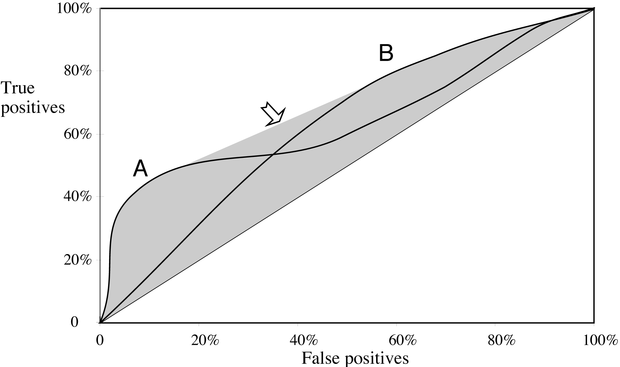
ROC curves for two schemes
For a small, focused sample, use method A
For a larger one, use method B
Notes:
Method A – some rules which work very well at picking out a few of the true positives but don’t identify the others; plus some other rules which aren’t accurate, they pick up the other true positives at the expense of getting lots of others
Method B Not so good at picking out just true positives; but does better when you are wanting to identify a lot of useful items and some less so
Shaded area with arrow – use a combination of A and B (convex hull)

Slide 40
ROC Curves - AUC
Summarised in a single number:
Area Under the ROC Curve (AUC): probability that randomly chosen positive instance is ranked above randomly chosen negative one
Larger AUC is better

Slide 41
Summary of some measures
Domain
Plot
Explanation
Lift chart
Marketing
TP
Subset size
TP
(TP+FP)/(TP+FP+TN+FN)
ROC curve
Communications
TP rate
FP rate
TP/(TP+FN)
FP/(FP+TN)
Recall-precision curve
Information retrieval
Recall
Precision
TP/(TP+FN)
TP/(TP+FP)

Slide 42
We talked about…
some measures of credibility
Accuracy and error rates
Sensitivity and specificity
Precision and recall
and taking costs into account
Confusion matrix and kappa statistic
Lift charts and ROC curves
Next lecture – what data to use?
Notes:
Take away message: can’t rely just on success rates. Need to understand other measures and take tradeoffs into account.
Next lecture – data for training, tuning and testing the model.

