Slide 1
F20DL Data Mining and Machine Learning
Diana Bental
(with material from David Corne and slides from http://www.cs.waikato.ac.nz/ml/weka/book.html)

Slide 2
This lecture…
Main theme: testing the model
Also
What if we don’t have much data?
How to compare very different data mining schemes?

Slide 3
Testing the model
We build a model (decision tree or set of rules etc) from some data – the training data
We want to predict how well the model will perform on new data

Slide 4
Last time…
We talked about some measures we can use
Accuracy and error rates
Sensitivity and specificity
Precision and recall
Confusion matrix and kappa statistic
Taking costs into account
Lift and ROC curves
And noted that accuracy (success rate) is not always the best measure

Slide 5
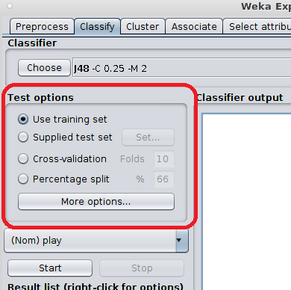
Testing the model
How to test the model?
Notes:
We can see some of the options in Weka
Re-use the training set
Supply some test data
Do a percentage split
Cross-validation
For simplicity: mainly talking about classification models:
And we are going to think about a simple error rate or success rate as our measure of accuracy –(how many right answers, how many wrong) – not the more complex measures like sensitivity/specificity
We would need to extend things to handle numeric prediction
But you couldn’t use a simple error rate for numeric predictions because errors vary in size; needs to be extended to look at other error measures – root mean square errors, mean absolute error etc

Slide 6
1. Use the training set
Calculate the Resubstitution error:
The error rate obtained from running the model on the training data
Resubstitution error is (hopelessly) optimistic!
Error on the training data is not a good indicator of performance on new data
Otherwise 1-NN would be the optimum classifier
Notes:
We did this in lab 1 for the weather/play dataset with ZeroR and OneR
Mention overfitting?

Slide 7
2. Use a Test Set
Test set: independent instances that have played no part in formation of the model
Assumption: both training data and test data are representative samples of the underlying problem
Test and training data may differ in nature
Example: classifiers built using customer data from two different towns, A and B
To estimate performance of a classifier from town A in any completely new town, test it on data from B
Notes:
We haven’t done this much in Weka - we tried it in Lab 1 when we experimented with the J48 decision tree for the weather/play dataset

Slide 8
3. Holdout method (Weka: Percentage split)
Simple solution that can be used if lots of (labeled) data is available:
Split data into a training set and test set
Estimate the error rate of the trained classifier
All examples
Training set
Test set
Notes:
Build the model with the training set
And test it (and get an error rate) with the test set
Need to choose the training set and the test set so they are both representative – don’t want all the iris setosas in the test set and none in the training set!

Slide 9
Use of Hold-Out: Parameter optimization
Some learning schemes operate in two stages:
Stage 1: build a basic structure
Stage 2: optimize parameter settings
The parameter optimization data can’t be used for testing!
Use three sets:
training data
validation data
test data
Validation data is used to optimize parameters
It is important that the test data is not used in any way to create the classifier
Notes:
Hold-out is often used for parameter tuning
We might use a validation set to choose different parameter settings so as to get a satisfactory level of different precision and recall – as we did in yesterday.
The test data mustn’t be used to create or optimize the classifier - So don’t use the validation data for testing.

Slide 10
Holdout method
Dilemma: ideally both training set and test set should be large!
Often use about 2/3 training to 1/3 testing
Sparse dataset: may not have enough data to train while keeping data aside for testing
Notes:
Generally, the larger the training data the better the classifier (but returns diminish)
And the larger the test data the more accurate the error estimate…

Slide 11
Limited amount of (labelled) data
Screening personal loans
only 1000 appropriate examples (people with borderline credit ratings)
Electricity supply data
15 years and 5000 days but only 15 Christmas days and Thanksgivings
Electromechanical fault diagnosis
20 years of data but only 300 usable examples
Detecting oil spills
A lot of human effort to classify images

Slide 12
Making the most of the data
Once evaluation is complete, all the data (including test data) can be used to build the final classifier

Slide 13
Predicting performance
Assume the estimated error rate (from testing) is 25%. How close is this to the true error rate?
Depends on the amount of test data
Prediction is just like tossing a (biased!) coin
“Head” is a correct / successful prediction
“Tail” is an incorrect prediction / error
In statistics, a succession of independent events like this is called a Bernoulli process
Statistical theory provides us with confidence intervals for the true underlying proportion
Notes:
Success rate = correct predications / all predictions
Error rate = (1 – correct predictions / all predicttions)

Slide 14
Use confidence intervals
We can say: p lies within a certain specified interval with a certain specified confidence
Example:
S=750 successes in N=1000 trials
Estimated success rate: 75%
How close is this to true success rate p?
Answer: with 80% confidence p in [73.2,76.7]
Another example: S=75 and N=100 trials
Estimated success rate: 75%
With 80% confidence p in [69.1,80.1]
Note that really N needs to be large, e.g. > 100
Notes:
Same proportion of successes but different size test set
Smaller test set gives us a wider range of possible values for errors
These confidence intervals are based on a normal distribution for the success rate over multiple test instances; only true for >100 test instances

Slide 15
Stratification
Problem: the sample might not be representative
maybe a class is not represented at all in the training or test data
Stratification: Select the test sample so that each class is represented in (roughly) the same proportions in the test and training data
Notes:
If a whole class is missing from the training data the model / classifier will never learn it
If it’s missing from the test data we don’t test any examples

Slide 16
Repeated Holdout method
Holdout is a single experiment – so our error estimate may not be very reliable
Holdout estimate can be made more reliable by repeating the process with different subsamples
In each iteration, a certain proportion is randomly selected for training (possibly with stratification)
The error rates are averaged to yield an overall error rate
This is called the repeated holdout method

Slide 17
Repeated Holdout method
All examples
Test 1
Test 2
Test 3
Notes:
Dark blue – training data
Light blue – test data
Different samples each time, repeated

Slide 18
Repeated Holdout method
Still not optimum: the different test sets overlap
Can we prevent overlapping?

Slide 19
4. Cross-validation
Cross-validation avoids overlapping test sets
K-fold cross-validation
First step: split data into k subsets of equal size (folds)
Second step: use each subset in turn for testing, the remainder for training
The error estimates are averaged to yield an overall error estimate
Perform k tests, using k-1 folds for training and 1 fold for testing each time
Notes:
As provided in Weka!

Slide 20
Example: 3-fold cross-validation
All examples
Test examples
Test 1
Test examples
Test 2
Test examples
Test 3
Notes:
Dark blue – training data
Light blue – test data
3 runs of training then testing

Slide 21
Cross-validation
All the instances in the dataset are used for both training and testing
But not at the same time

Slide 22
Cross-validation
Standard method for evaluation: stratified ten-fold cross-validation
Subsets may be stratified before the cross-validation is performed
Stratification reduces the estimate’s variance
Why ten?
Extensive experiments have shown that this is the best choice to get an accurate estimate
There is also some theoretical evidence for this
Even better: repeated (stratified) cross-validation
ten-fold cross-validation is repeated ten times and the results are averaged (reduces the variance)
Notes:
How many folds?
Many folds – high accuracy in the error estimate
May also get a high variance in the error estimate
Computationally expensive
Few folds
Few experiments so computationally cheaper
Less variance – (because bigger sets)
For large datasets, 3 fold cross-validation may be sufficient
Perform 10 different 10-fold cross-validations! Run the learning mechanism 100 times

Slide 23
So far: Main methods for testing
Use the training set
Supply a new test set
Hold-out methods
Cross-validation

Slide 24
Two methods for small datasets
Leave-one-out cross-validation
The 0.632 bootstrap
Notes:
So those are the main methods for reasonable sized datasets
What about really small datasets

Slide 25
Small datasets: Leave-One-Out cross-validation
Cross-validation
Set the number of folds = number of training instances
Leave one instance out, train on the others, and test on that one instance
So for n training instances, build the classifier n times
Average the results to get an overall error
Makes best use of the data
Largest possible training sets give best possible classifier
Involves no random subsampling
No need to repeat
But: very computationally expensive
Notes:
Uses all the data for training each time – so it improves the learning
Each time, the training data is all the data except 1 example; and the test data is that 1 example
No random sampling, so no need to repeat it
But it’s expensive – run the learning algorithm n times, once for every instance

Slide 26
Disadvantage of Leave-One-Out-CV: no stratification
It guarantees a non-stratified test sample because there is only one instance in the test set!
Extreme (pathological) example: random dataset split equally into two classes
“Perfect” learning method predicts the majority class each time
50% accuracy on fresh data set but
Leave-One-Out-CV estimate is 100% error!
Then the majority class is always the opposite of the test case
Notes:
Stratification – same number of each class in the test and training data
Best learning method will always predict the majority class
Extreme example – gets it wrong every time:
Random dataset split into two equal sized classes – toss a coin and get half heads half tails
50 red examples, 50 blue examples, If I have a fresh set of 10 examples and try to predict their colour, probably get 50 per cent right (ish)
But: if each training run I take out 1 example – e.g. take out a red counter, train with 49 and 50 blue, predict blue; vice versa when I take out a blue counter (predict red)

Slide 27

Small datasets: The bootstrap
Cross validation uses sampling without replacement
The same instance, once selected, can not be selected again for a particular training/test set
The bootstrap uses sampling with replacement to form the training set
Sample a dataset of n instances n times with replacement
Forms a new dataset of n instances
Some are repeated
Use this data as the training set.
Use the leftover instances from the original dataset (that weren’t put into the new training set) for testing

Slide 28
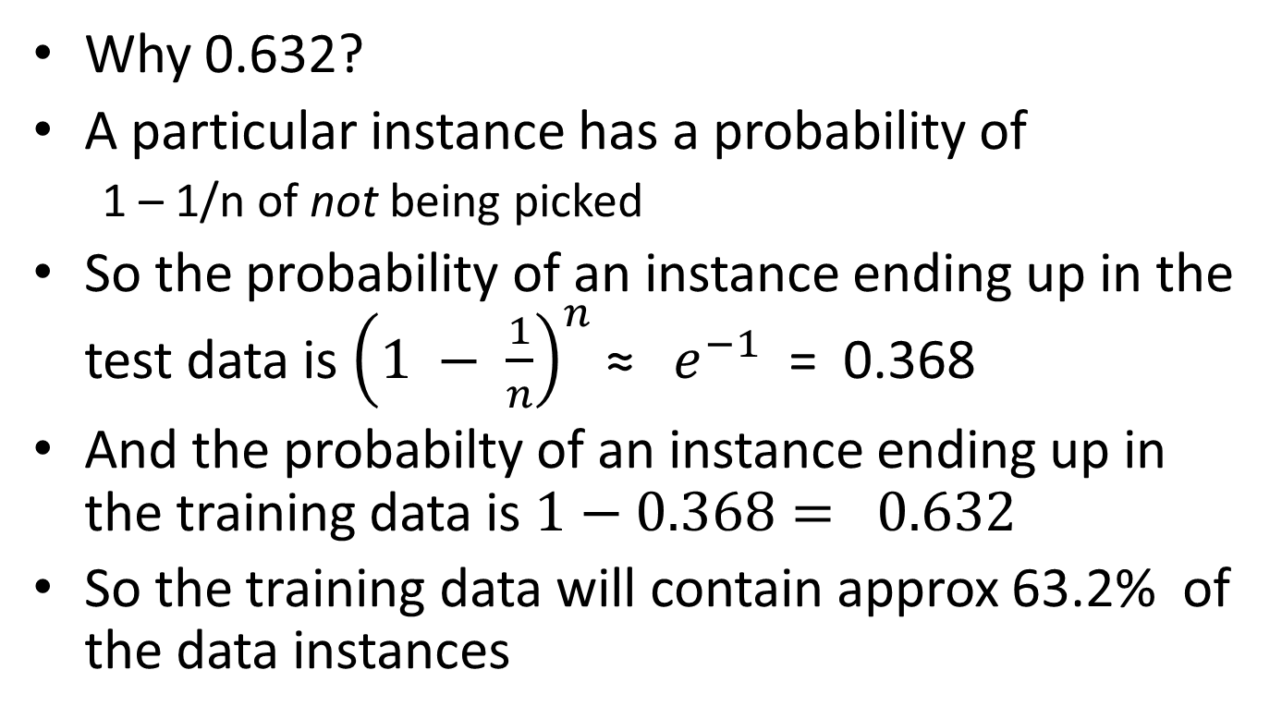
Small datasets: The 0.632 bootstrap
Why 0.632?
A particular instance has a probability of
1 – 1/n of not being picked
So the probability of an instance ending up in the test data is ${\left(1 − \frac{1}{n}\right)}^{n}$ ≈ $e^{−1}$ = 0.368
And the probabilty of an instance ending up in the training data is $1−0.368= 0.632$
So the training data will contain approx 63.2% of the data instances

Slide 29
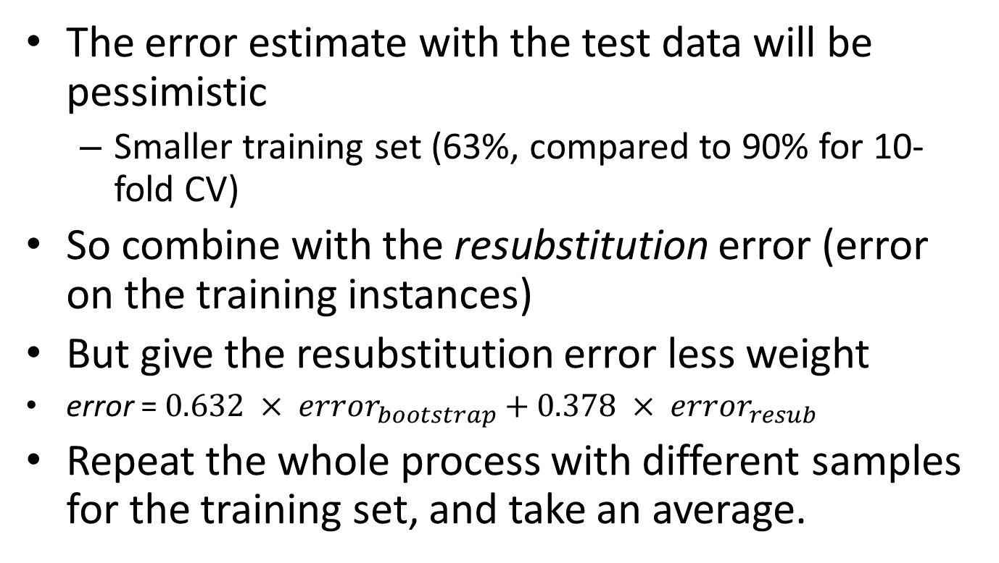
Small datasets: The 0.632 bootstrap
The error estimate with the test data will be pessimistic
Smaller training set (63%, compared to 90% for 10-fold CV)
So combine with the resubstitution error (error on the training instances)
But give the resubstitution error less weight
error = $0.632 × {error}_{bootstrap}$ $+ 0.378 × {error}_{resub}$
Repeat the whole process with different samples for the training set, and take an average.

Slide 30
Small datasets: The 0.632 bootstrap
Best way to test learning mechanisms for very small datasets (usually)
But consider again the (pathological) completely random two-class dataset example
A perfect learning mechanism would give 0% resubstitution error and 50% error on test data
True error ≈ 50%
Bootstrap error ≈ 30%
err = 0.632 x 50 + 0.368 x 0 ≈ 30%
Too optimistic!

Slide 31
Comparing data mining schemes
Which of two learning schemes performs better for some application?
Note: this is domain dependent!
Obvious way: compare 10-fold CV estimates for both schemes
Generally sufficient in applications
What about machine learning research?
Need to show convincingly that a new method works better on many different data sets and applications
Notes:
10-fold CV is usually good enough for applications - we don't lose if the chosen method is not truly better, or not much better

Slide 32
Comparing data mining schemes
In a particular domain
Compare two schemes A and B …
For a given amount of training data
On average, across all possible training sets
If we could have an infinite amount of data from the domain:
Sample infinitely many datasets of specified size
Obtain cross-validation estimate on each dataset for each scheme
Check if mean accuracy for scheme A is better than mean accuracy for scheme B

Slide 33
Comparing schemes: paired t-test
In practice we have limited data and a limited number of estimates for computing the mean
Student’s t-test tells whether the means of two samples are significantly different
In our case the samples are cross-validation estimates for different datasets from the domain
Use a paired t-test because the individual samples are paired
The same cross-validation is applied twice

Slide 34
Comparing schemes: unpaired t-test
If the cross-validation estimates are from different datasets, they are no longer paired (or maybe we have different numbers of c-v estimates for the two schemes)
Then we have to use an un-paired t-test
Notes:
Use an unpaired t-test with appropriate degrees of freedom depending on the number of estimates from each scheme

Slide 35
Summary
Main theme:
Four approaches to testing a model
Also
Two methods for very small datasets
Statistical comparisons for different data mining schemes
Take-away message:
Separate datasets for training , tuning, and testing
Notes:
NB mainly talking about classification models: need to extend things to handle numeric prediction
For numeric oredication - Still need to use independent test set not the training set; can use cross-validation, hold-out etc
But you couldn’t use a simple error rate because errors vary in size; instead use e.g. mean-squared errors (difference between the model’s predicted value and the actual value)

