Slide 1
Lecture 7:
Potential Fields and
Model Predictive Control
CS 344R: Robotics
Benjamin Kuipers

Slide 2
Potential Fields
Oussama Khatib, 1986.
  The manipulator moves in a field of forces.
  The position to be reached is an attractive pole for the end effector and obstacles are repulsive surfaces for the manipulator parts.

Slide 3
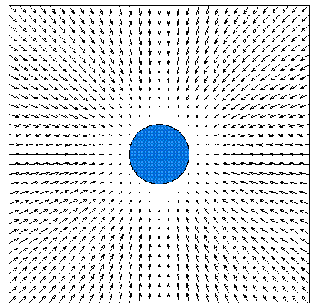
Attractive Potential Field

Slide 4
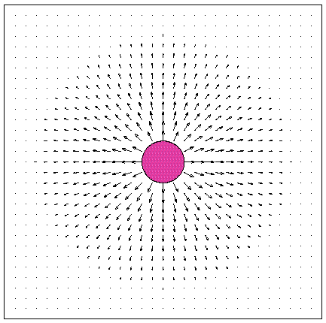
Repulsive Potential Field

Slide 5
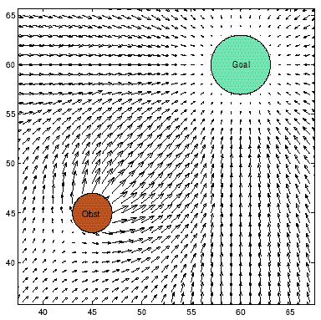
Vector Sum of Two Fields

Slide 6
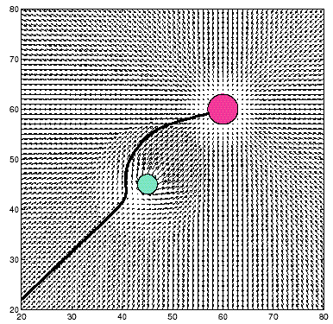
Resulting Robot Trajectory

Slide 7
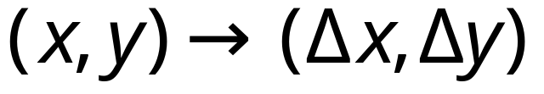
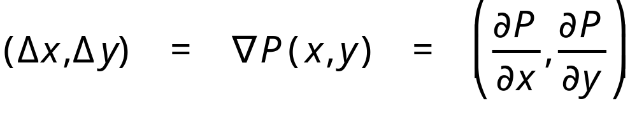
Potential Fields
Control laws meant to be added together are often visualized as vector fields:
In some cases, a vector field is the gradient of a potential function P(x,y):

Slide 8
Potential Fields
The potential field P(x) is defined over the environment.
Sensor information y is used to estimate the potential field gradient ∇P(x)
  No need to compute the entire field.
  Compute individual components separately.
The motor vector u is determined to follow that gradient.

Slide 9
Attraction and Avoidance
Goal: Surround with an attractive field.
Obstacles: Surround with repulsive fields.
Ideal result: move toward goal while avoiding collisions with obstacles.
  Think of rolling down a curved surface.
Dynamic obstacles: rapid update to the potential field avoids moving obstacles.

Slide 10
Potential Problems with
Potential Fields
Local minima
  Attractive and repulsive forces can balance, so robot makes no progress.
  Closely spaced obstacles, or dead end.
Unstable oscillation
  The dynamics of the robot/environment system can become unstable.
  High speeds, narrow corridors, sudden changes.

Slide 11
Local Minimum Problem
Goal
Obstacle
Obstacle

Slide 12
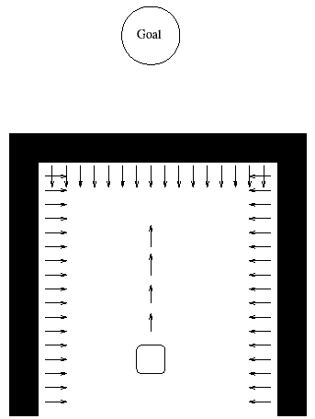
Box Canyon Problem
Local minimum problem, or
AvoidPast potential field.

Slide 13
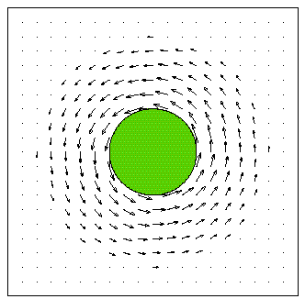
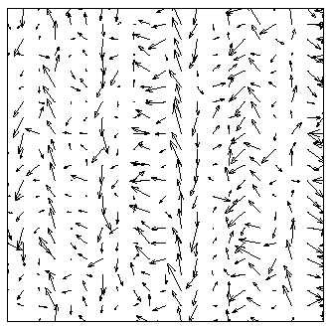
Rotational and Random Fields
Not gradients of potential functions
Adding a rotational field around obstacles
  Breaks symmetry
  Avoids some local minima
  Guides robot around groups of obstacles
A random field gets the robot unstuck.
  Avoids some local minima.

Slide 14
Vector Field Histogram:
Fast Obstacle Avoidance
Build a local occupancy grid map
  Confined to a scrolling active window
  Use only a single point on axis of sonar beam
Build a polar histogram of obstacles
  Define directions for safe travel
Steering control
  Steer midway between obstacles
  Make progress toward the global target

Slide 15
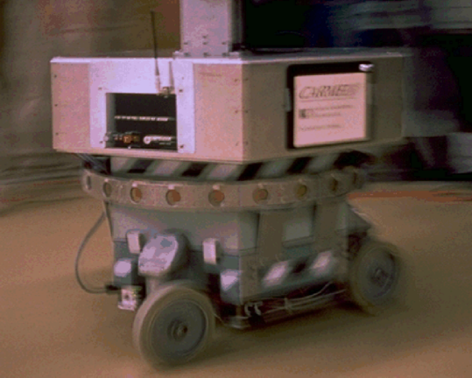
CARMEL: Cybermotion K2A

Slide 16
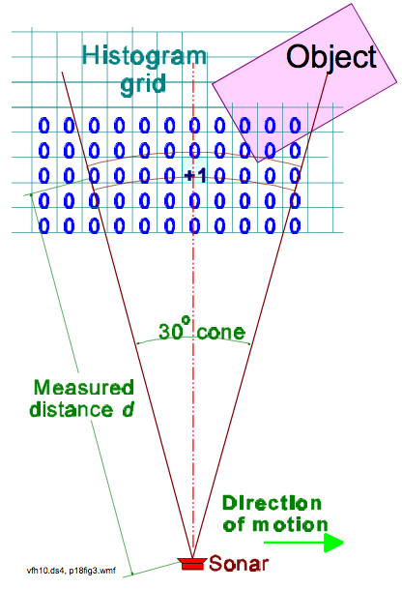
Occupancy Grid
Given sonar distance d
Increment single cell along axis
(Ignores data from rest of sonar cone)

Slide 17
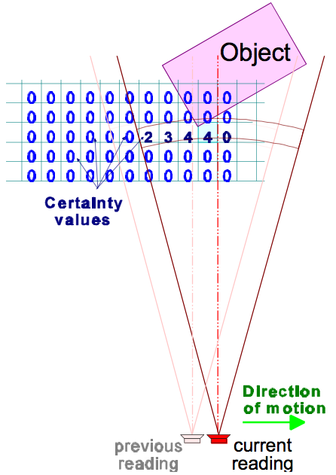
Occupancy Grid
Collect multiple sensor readings
Multiple readings substitutes for unsophisticated sensor model.

Slide 18
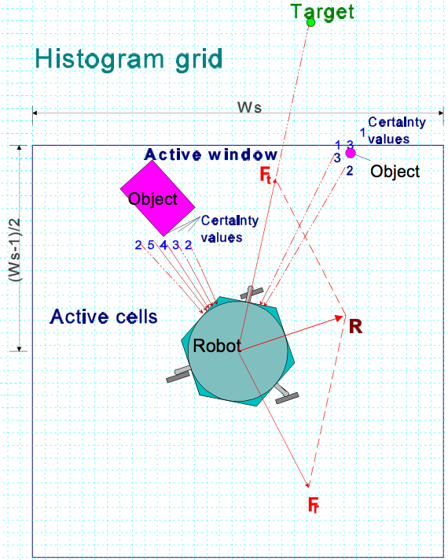
VFF
Active window Ws×Ws around the robot
Grid alone used to define a "virtual force field"

Slide 19
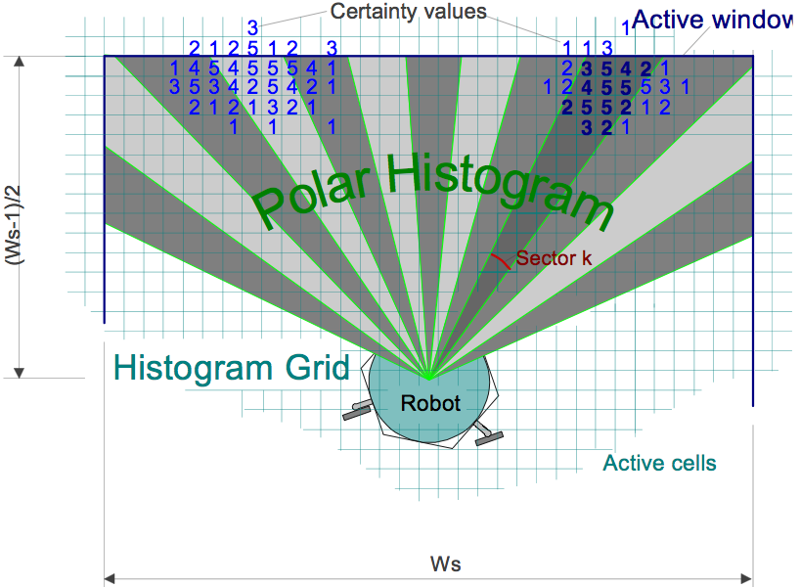
Polar Histogram
Aggregate obstacles from occupancy grid according to direction from robot.

Slide 20
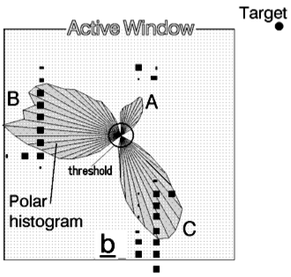
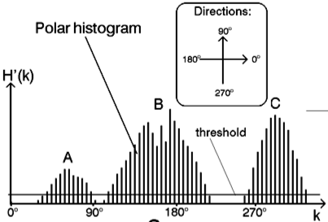
Polar Histogram
Weight by occupancy, and inversely by distance.

Slide 21
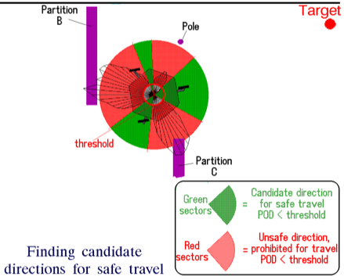
Directions for Safe Travel
Threshold determines safety.
Multiple levels of noise elimination.

Slide 22
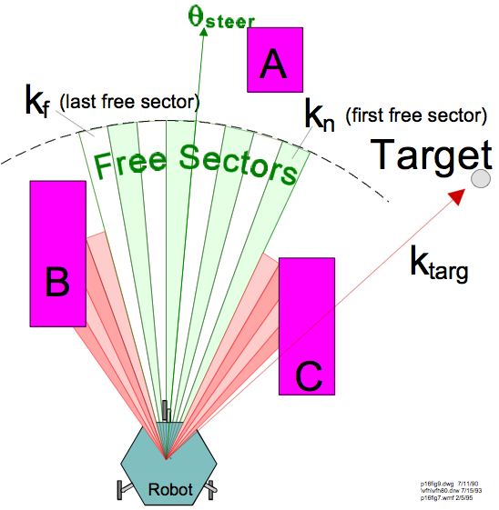
Steer to center of safe sector

Slide 23
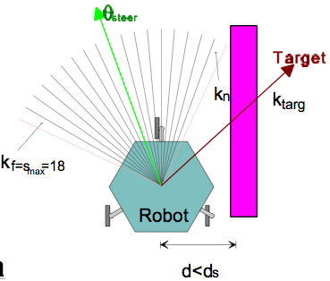
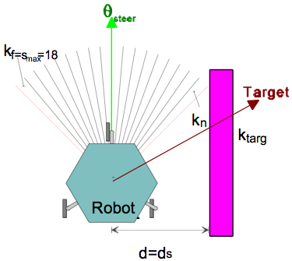
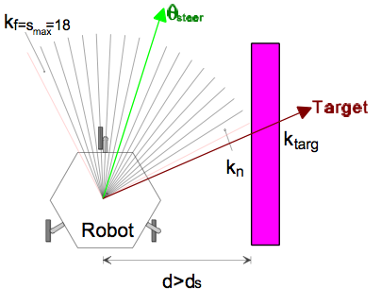
Leads to natural wall-following
Threshold determines offset from wall.

Slide 24
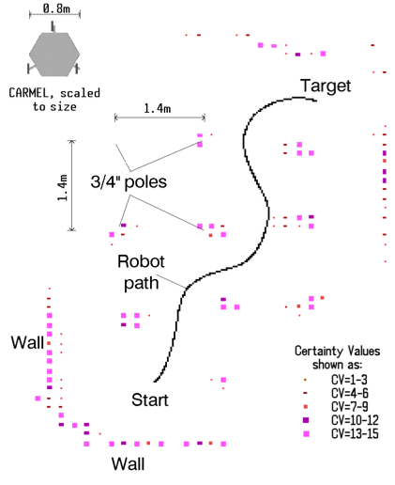
Smooth, Natural Wandering Behavior
Potentially quite fast!
1 m/s or more!

Slide 25
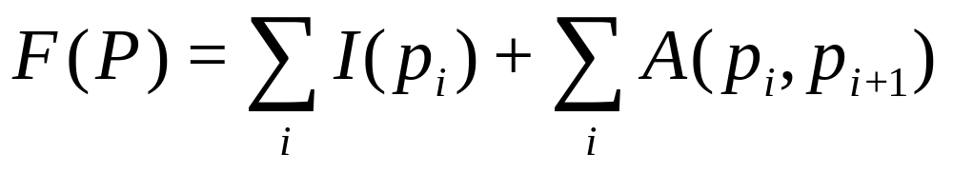
Konolige’s Gradient Method
A path is a sequence of points:
  P = {p₁, p₂, p₃, . . . }
The cost of a path is
Intrinsic cost I(p_{i}) handles obstacles, etc.
Adjacency cost A(p_{i},p_{i+1}) handles path length.

Slide 26
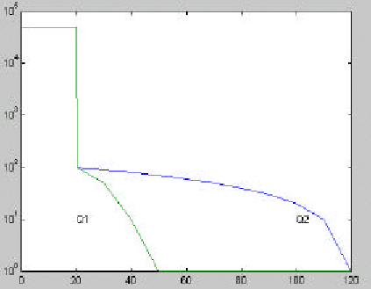
Intrinsic Cost Functions I(p)

Slide 27
Navigation Function N(p)
A potential field leading to a given goal, with no local minima to get stuck in.
For any point p, N(p) is the minimum cost of any path to the goal.
Use a wavefront algorithm, propagating from the goal to the current location.
  An active point updates costs of its 8 neighbors.
  A point becomes active if its cost decreases.
  Continue to the robot’s current position.

Slide 28
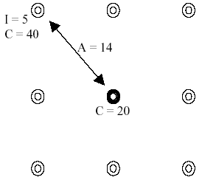
Wavefront Propagation
Notes:
Moving from the center to the upper-left node updates its cost to C=39=20+14+5.

Slide 29
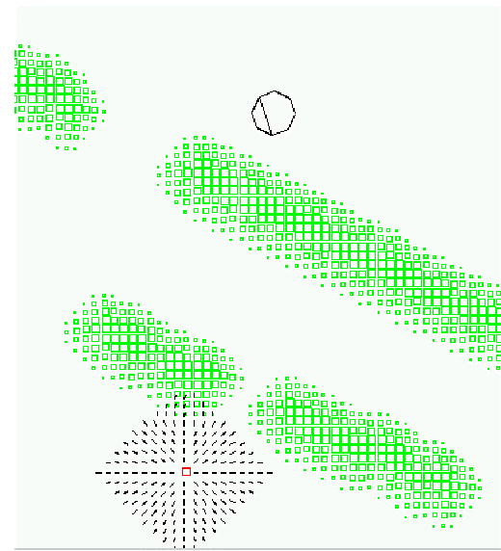

Slide 30
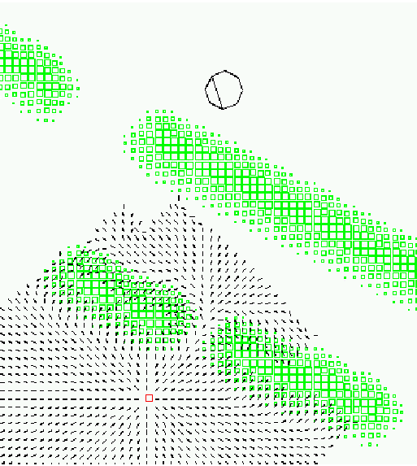

Slide 31
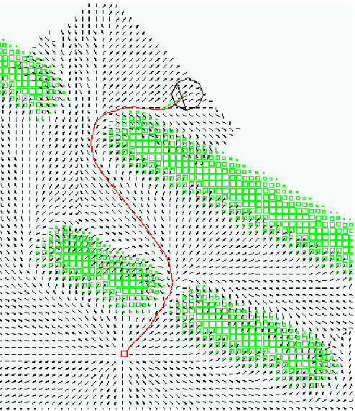

Slide 32
Real-Time Control
Recalculates N(p) at 10 Hz
  (on a 266 MHz PC!)
Handles dynamic obstacles by recalculating.
  Cannot anticipate a collision course.
Much faster and safer than a human operator on a comparison experiment.
Requirements:
  an accurate map, and
  accurate robot localization in the map.

Slide 33
Model-Predictive Control
Replan the route on each cycle (10 Hz).
  Update the map of obstacles.
  Recalculate N(p). Plan a new route.
  Take the first few steps.
  Repeat the cycle.
Obstacles are always treated as static.
  The map is updated at 10 Hz, so the behavior looks like dynamic obstacle avoidance, even without dynamic prediction.

Slide 34
Plan Routes in the
Local Perceptual Map
The LPM is a scrolling map, so the robot is always in the center cell.
  Shift the map only by integer numbers of cells
  Variable heading θ.
Sensor returns specify occupied regions of the local map.
Select a goal near the edge of the LPM.
Propagate the N(p) wavefront from that goal.

Slide 35
Searching for the Best Route
The wavefront algorithm considers all routes to the goal with the same cost N(p).
The A* algorithm considers all routes with the same cost plus predicted completion cost N(p) + h(p).
  A* is provably complete and optimal.

Slide 36


