Slide 1

Haunted by past trauma
Don’t fit into clichéd boxes
Not exactly all that stable
Can’t trust most people
Feel Left Out
But I should be able to live well nonetheless.

Slide 2

Safe Spaces are the answer
Created with trust in mind
Dynamic and Responsive!

Slide 3
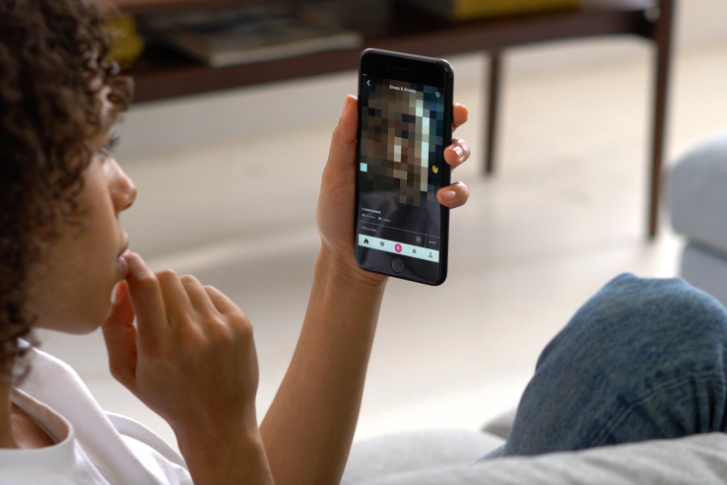
Virtual Spaces are All The Rage
Easy To Build
Not Dynamic or Responsive.
Mostly well moderated
Not generally real-time.
Not Vulnerable to Social-Engineering
Vulnerable to Social-Engineering

Slide 4
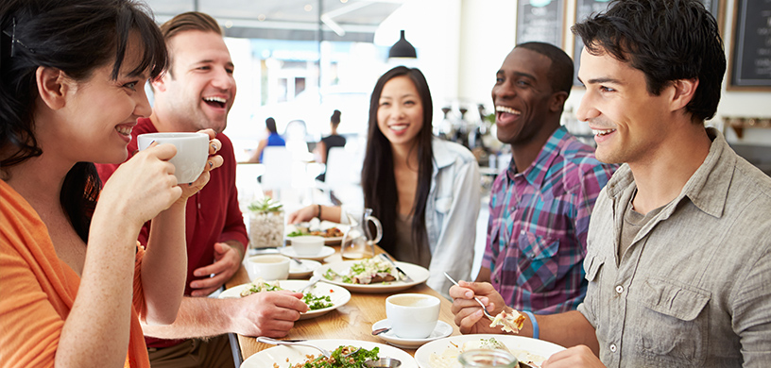
We Propose
A Real-Life, On Demand Safe Space!
Real-Time!
Well Moderated!
Physically Safe Too!
Real People!
Dynamic and Responsive!
Dynamic and Responsive!
Potential to improve millions of lives.

Slide 5
But Nothing’s Really That Simple.
It is super hard to ensure that the safe spaces are safe
There could be ill-intentioned people
Well-meaning people could be incompatible
Very real threat of social engineering
People could be pretending to be someone else

Slide 6
AI is the Answer!
Collect user information from Twitter, Facebook, etc, and from the integrated chatbot
Analyse the patterns using powerful APIs like IBM Watson and find out what people need and what they can provide.
Connect those who can provide to those who need.

Slide 7
AI is the Answer!
Collect user information from Twitter, Facebook, etc, and from the integrated chatbot
Inclusion of Speech, Tone and Face Recognition
Include intelligent planning of routing and meeting places through maps.
Analyse the patterns using powerful APIs like IBM Watson and find out what people need and what they can provide.
Connect those who can provide to those who need.

Slide 8
Blockchain Too?
Use BlockCypher as a blockchain API and use it to store signatures.
Use the signatures to verify the authenticity of the user and the “respectability” of the user, among others.
Guarantee the validity of the data that is presented.

Slide 9
Blockchain Too?
Use BlockCypher as a blockchain API and use it to store signatures.
Use dedicated identity management blockchains
Maybe make a native blockchain?
Use the signatures to verify the authenticity of the user and the “respectability” of the user, among others.
Guarantee the validity of the data that is presented.

Slide 10
DEMO TIME!

