Slide 1
Library for Graph Data Structure
Guide : Prof. Vrinda Parkhi
Name: Vaishnav Sonawane
Roll no: 67
Gr no. 11910585

Slide 2
Project Objective
Aim of Project: To provide the implementation of Graph Data structure and Algorithms related to it.
Project Domain: Data Structures and Algorithms
Problem Definition: To create a library for easy implementation of Graph data structure.
Benefit to Society: User can directly use Graph Data structure, hence will save time in implementing it.

Slide 3
Project objective
The main objective of the project is to reduce the efforts to create Graph Data structure and algorithms associated with it and provide library for Graphs so that users can directly use Graph by importing the header files.

Slide 4
Implementation Details
Graph Data structure using adjacency list method.
Directed and Undirected Graph implementation.
Adding edge of specific weight in graph.
Removing edge in graph
Checking Cycle in graph.
Printing the graph.

Slide 5
Implementation Details
Breadth first search traversal of graph.
Depth first traversal of graph.
Minimum Spanning tree
- Prims Algorithm.
Finding shortest path in Graph.
Dijkstra’s Algorithm.

Slide 6
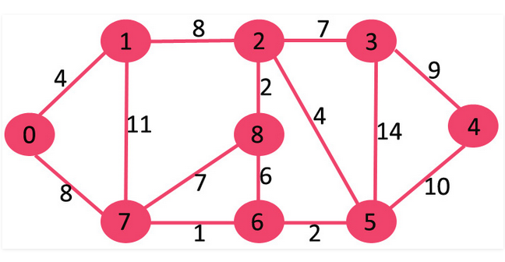
Undirected Graph :
9

Slide 7
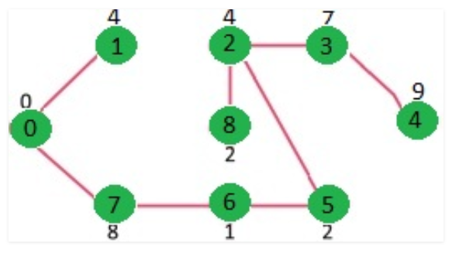
Prim’s algorithm output :
9

Slide 8
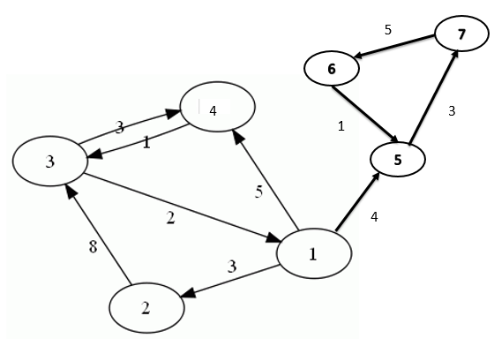

Slide 9
Conclusion
Project implements the Graph data structures and most frequently used algorithms associated with Graph Data structure. User is able to use implemented Graph and all methods by importing necessary header files. By doing this the user is able to save the time to implement Graph and algorithms every time in his/her code.

Slide 10
Future Scope
Printing method of graph can be included using some advance animation libraries in order to give the user animated view of graphs.
Applications of the algorithms can be included so that user can get proper understanding of how the algorithms work for real applications.
Other types of Graphs also can be added including Directed acyclic graphs, Multigraphs, Sparse and dense graphs.

Slide 11
References
[1] K. Mehlhorn, P. Sanders, Algorithms and Data Structures (Springer-Verlag, Berlin Heidelberg, 2008)
[2] J. Genči, Possibilities to Solve Some of the Slovak Higher Education Problems Using Information Technologies, In proceedings of: 10th IEEE International Conference on Emerging eLearning Technologies and Applications, ICETA 2012, Stará Lesná, The High Tatras, Slovakia, November 8-9, 2012
[3] Depth-first search and linear graph algorithms
R Tarjan - SIAM journal on computing, 1972
[4] Data structures and network algorithms
RE Tarjan - 1983
[5] Falley. P “Categories of Data Structures”, Journal of Computing Sciences in Colleges - Papers of the Fourteenth Annual CCSC Midwestern Conference and Papers of the Sixteenth Annual CCSC Rocky Mountain Conference. Volume 23 Issue 1, October 2007. PP. 147-153, 2007-10-01
[6] https://www.geeksforgeeks.org/graph-and-its-representations/
[7] https://www.freecodecamp.org/news/a-gentle-introduction-to-data-structures-how-graphs-work-a223d9ef8837/
[8]https://www.geeksforgeeks.org/the-c-standard-template-library-stl/

Slide 12
Thank You

