Slide 1
Capstone Project
Retail Sales Prediction Vaishno Ku.Tiwari

Slide 2

• Problem Statements • Data Summary • Data Description • Data Pre-processing • Data Cleaning • Data Wrangling • Exploratory Data Analysis • Feature Selection • Linear Regression • LASSO & RIDGE Regression • Decision Tree • Random Forest • Conclusion
Contents

Slide 3
Contents
Rossmann operates over 3,000 drug stores in 7 European countries. Currently, Rossmann store managers are tasked with predicting their daily sales for up to six weeks in advance. Store sales are influenced by many factors, including promotions, competition, school and state holidays, seasonality, and locality. With thousands of individual managers predicting sales based on their unique circumstances, the accuracy of results can be quite varied.
You are provided with historical sales data for 1,115 Rossmann stores. The task is to forecast the "Sales" column for the test set. Note that some stores in the dataset were temporarily closed for refurbishment.

Slide 4
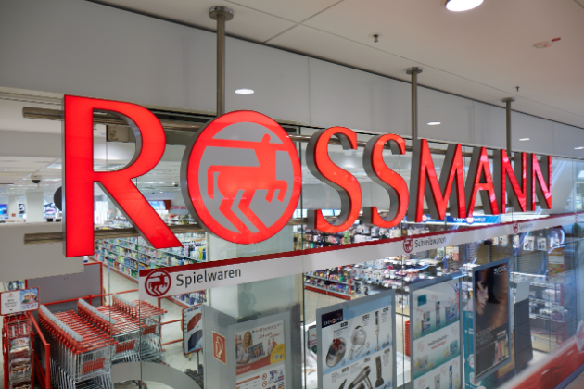
Business Statement
Client interest and demand for product changes with time. Which is important for growing business. Sales prediction is estimating the demand for a service or product for a particular time. This project contains real-world business problem of sales predicting with the help of machine learning models.
Our task is to predict sales and find important factors affecting demand to improve sales.

Slide 5
Data Summary
The data collected had two different data files
1.Rossmann Stores Data:
Historical data including Sales
2. Store:
Supplemental information about the stores
Data Description
Most of the fields are self-explanatory. The following are descriptions for those that aren't.
Id - an Id that represents a (Store, Date) duple within the test set
Store - a unique Id for each store
Sales - the turnover for any given day (this is what you are predicting)
Customers - the number of customers on a given day
Open - an indicator for whether the store was open: 0 = closed, 1 = open

Slide 6
State Holiday - Indicates a state holiday. Normally all stores, with few exceptions, are closed on state holidays. Note that all schools are closed on public holidays and weekends. a = public holiday, b = Easter holiday, c = Christmas, 0 = None
School Holiday - indicates if the (Store, Date) was affected by the closure of public schools.
Store Type - differentiates between 4 different store models: a, b, c, d.
Assortment - describes an assortment level: a = basic, b = extra, c = extended.
Competition Distance - distance in meters to the nearest competitor store.
Competition Open Since [Month/Year] - gives the approximate year and month of the time the nearest competitor was opened.
Promo - indicates whether a store is running a promo on that day.
Promo2 - Promo2 is a continuing and consecutive promotion for some stores: 0 = store is not participating, 1 = store is participating.
Promo2Since[Year/Week] - describes the year and calendar week when the store started participating in Promo2.
Promo Interval - describes the consecutive intervals Promo2 is started, naming the months the promotion is started anew. E.g. "Feb, May, Aug, Nov" means each round starts in February, May, August, November of any given year for that store.

Slide 7
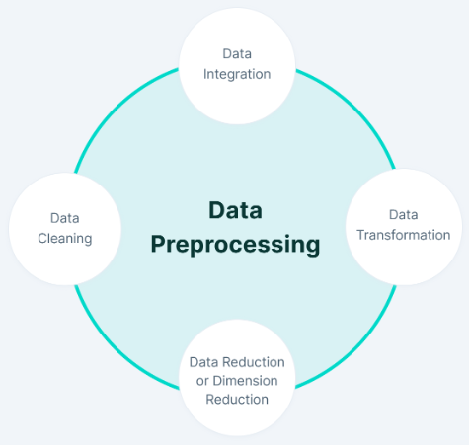
Tasks in Data Preprocessing

Slide 8

Data Pre-Processing and Cleaning
Missing Values
CompetitionDistance : 0.26 %
CompetitionOpenSinceMonth : 31.74 %
CompetitionOpenSinceYear : 31.74 %
Promo2SinceWeek : 48.78 %
Promo2SinceYear : 48.78 %
PromoInterval : 48.78%
Data Wrangling
After the merging two files we have 1017209 rows and 18 columns.
With the help of exploratory data analysis we will find the trends and patterns in the data and make our conclusion.
We will use matplotlib, Seaborn for visualization and pandas to explore data.
We use median for replacing missing values in CompetitionDistance and mode for categorical features.

Slide 9
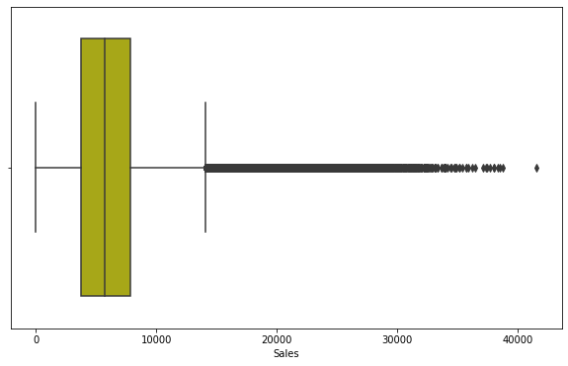
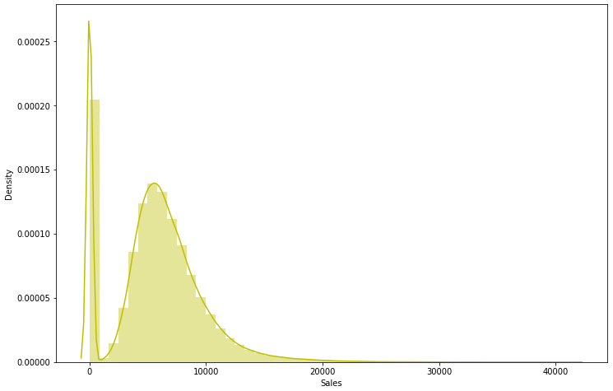
Outliers
Interpretation:
There is skewness in the numerical features so some values can be outliers.
There are some values of sales which were zero which are due to stores where closed which are removed.
There are some values in the sales which are higher due to promotion.

Slide 10
Exploratory Data Analysis
Hypothesis
This is just observing head of dataset:
1. Promotion will leads to increase in sales
2. Weekend the sales would be low as stores will be closed
3. Holidays will leads to decrease in sales
4. The number of customers will positively correlated with sales
5. Sales will be zero when stores are closed

Slide 11
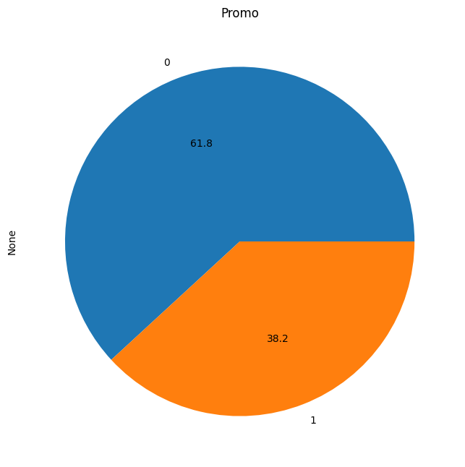
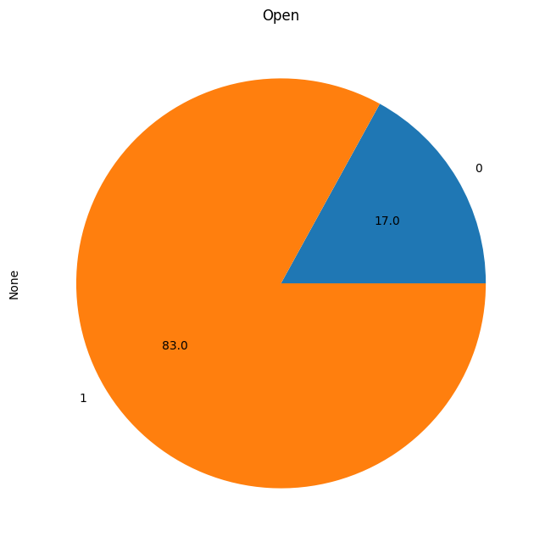
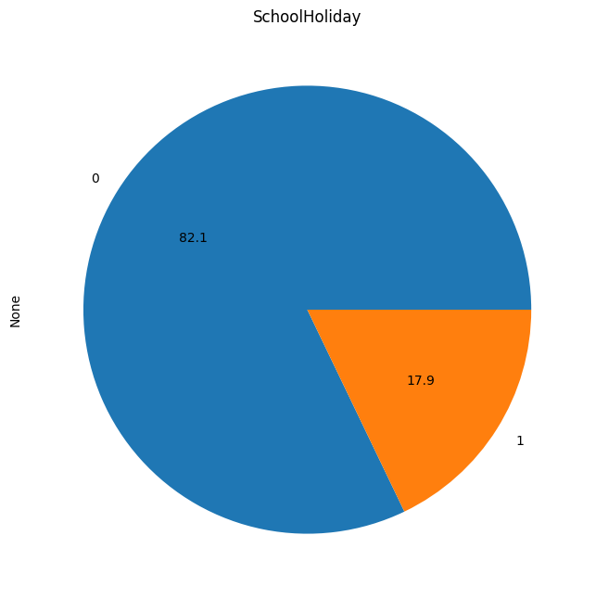
Value Count:
38.2 % data has promotion involved.
54.2% data is of store type "a“.
17% data is of closed stores.
Data contain 2013 values around 40%.

Slide 12
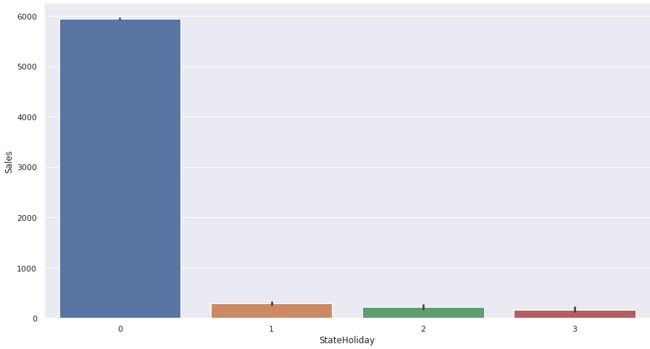
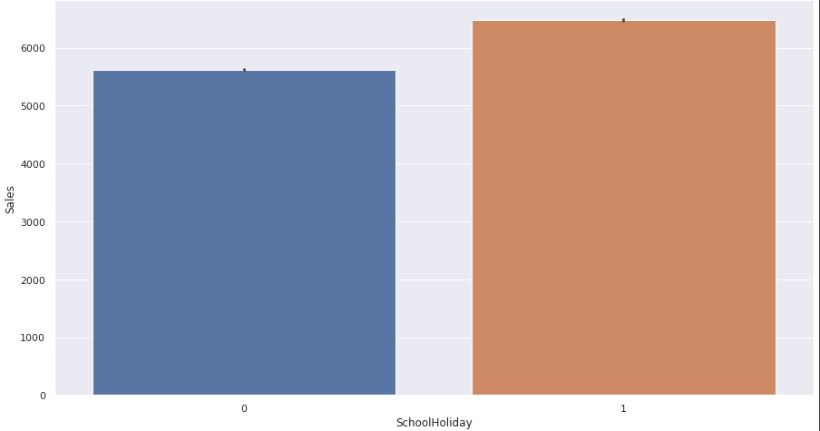
Holidays
Interpretation:
The Sales at state Holiday are low as the stores are closed at state holidays.
The Sales at school Holiday are higher as the stores are open at school holiday.

Slide 13
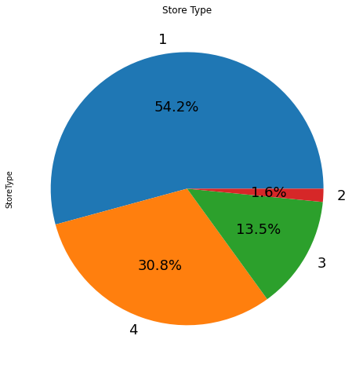
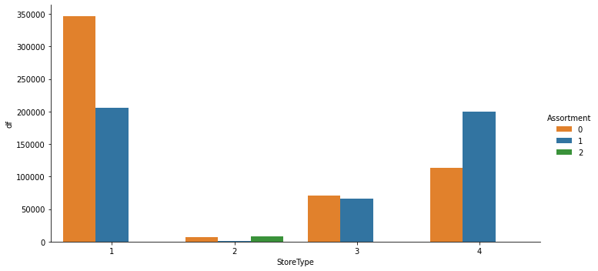
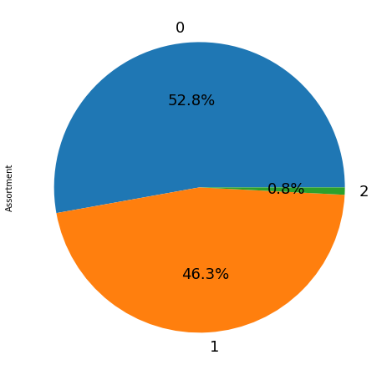
Store Type and Assortment
Interpretation: From this Cat plot we can conclude the Assortment of the three different class.

Slide 14
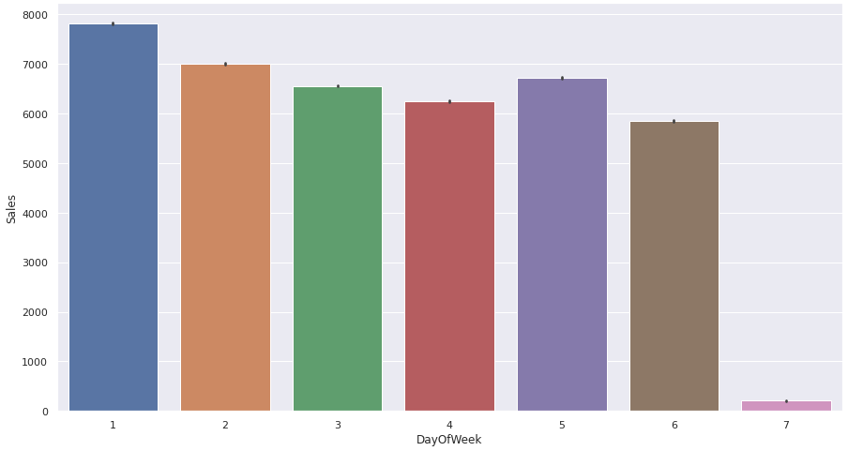
Daily Sales
Interpretation:
This plot shows sales for each day.
Sunday has minimum sales as stores are closed
As the stores are closed at sunday there is slight peak at monday.

Slide 15
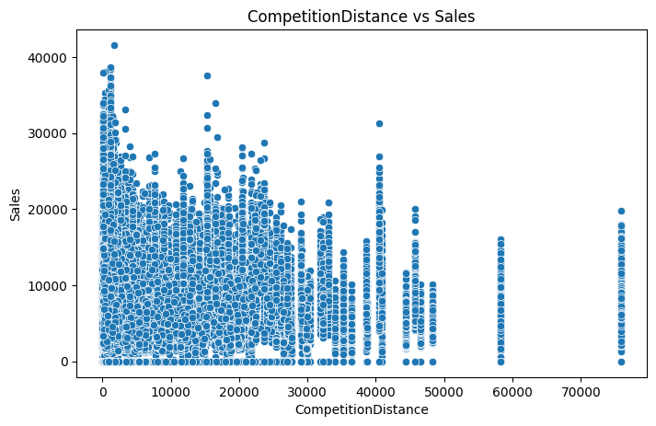
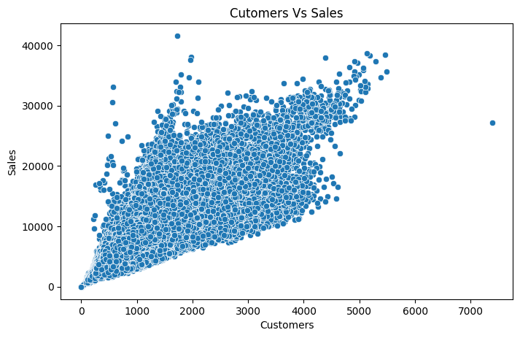
Bivariate Analysis
The competitor stores are closed to each other has more sales.
We can see that `sales` are positively correlated with customer.

Slide 16
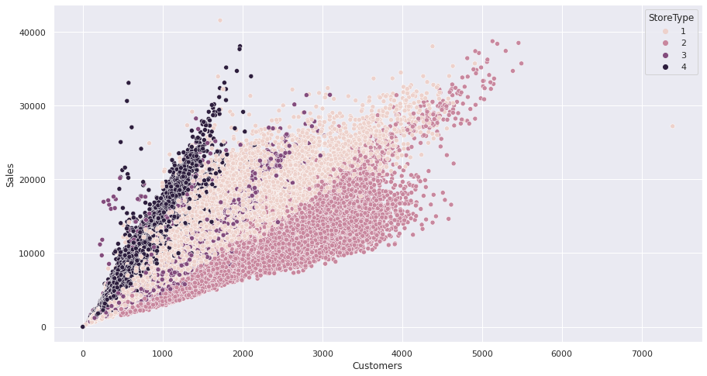
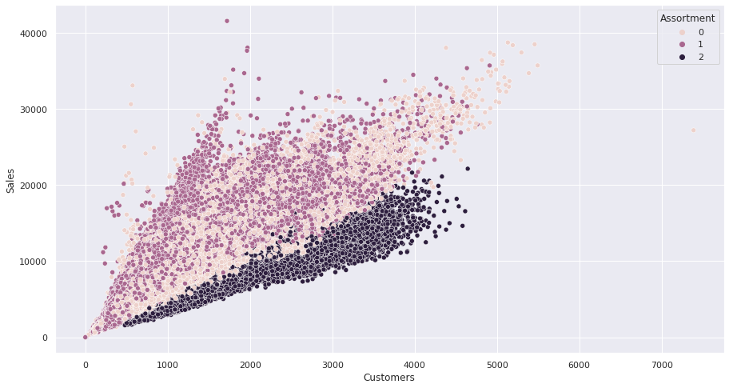
Customers vs Sales
Interpretation:
The scatter plot of customer and sales, where we can see the Stores and their Assortments of stores.

Slide 17
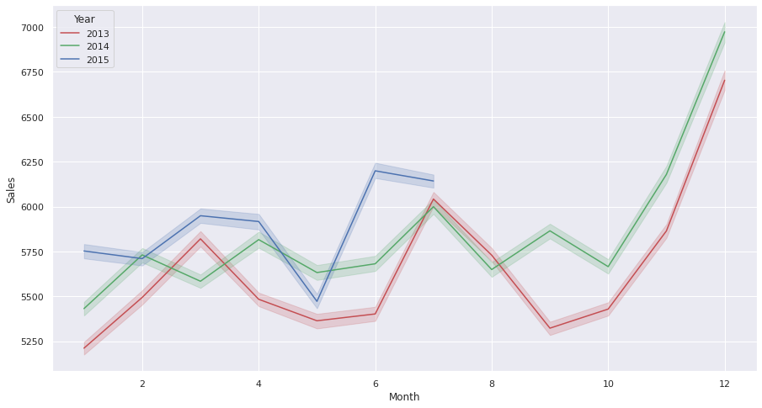
Monthly Sales in Year
From this Line plot we can say the sales at different months corresponding to those years.
The sales in the month of December is the highest sales among others.
Sales where low in 2014 from July to September due to refurbishment.

Slide 18
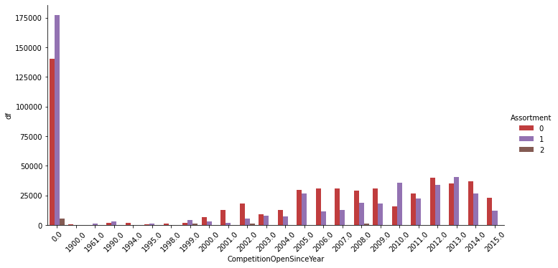
Count plot (Year wise)
Interpretation:
The count plot shows how the Assortment change during the years.

Slide 19
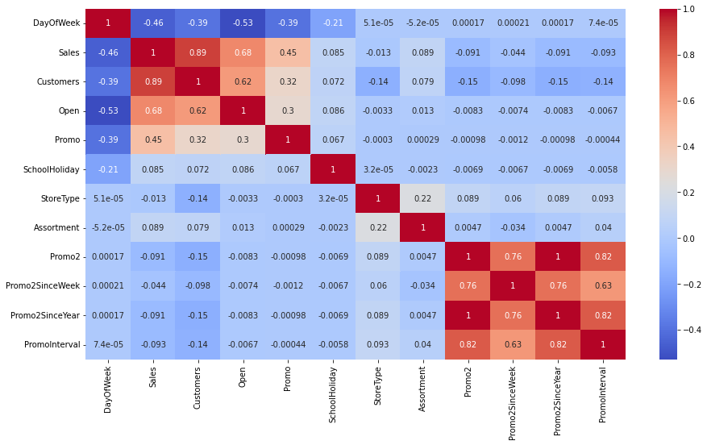
Correlation Heatmap
Interpretation:
`Customers,Sales,Open,Promo` are high and positively correlated with each other.
Where `DayOFWeek` has negative correlation with this features.
`'Promo2', 'Promo2SinceWeek','Promo2SinceYear'` has some correlation with each other.

Slide 20
Insights of Feature Selection
Dependent features: ‘Sales’
Independent features : 'Store', ‘Day Of Week', 'Sales', 'Customers', 'Open', 'Promo', 'State Holiday', 'School Holiday', 'Store Type’, 'Assortment', 'Competition Distance', 'Competition Open Since Month', 'Competition Open Since Year’, 'Promo2', 'Promo2SinceWeek', 'Promo2SinceYear', 'Promo Interval', 'Year', 'Month', 'Day'
Transformation of Data: ‘Min_Max_Scaler’

Slide 21
Why we select Time Base Split over random Split?
1. As we have to predict data of last 6 weeks means we have train on data before the 6 weeks
2. In such case random split will leads to data leakage
3. So we go with time base split for our best model.

Slide 22
Choosing Algorithm
1. There are various factors such as time complexity, categorical features , numerical features , data ,outliers,
noise which decide the best model to be used.
2. As there are many categorical features so the decision tree could work better in such case
3. decision Tree is highly interpretable which will helpful for feature importance
4. Here we go with decision tree along with linear regression models to understand which will work better.

Slide 23
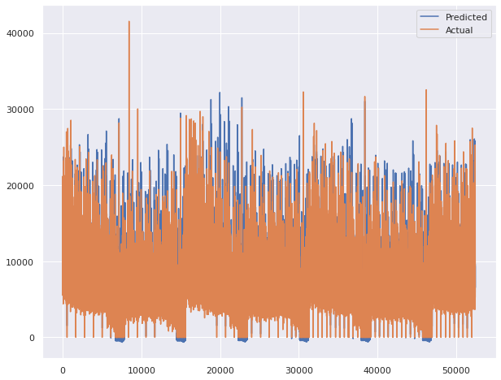
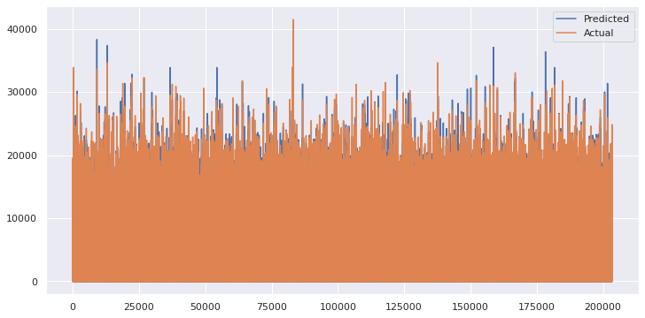
Linear Regression
Decision Tree
Interpretation:
For both models we can see difference between actual and predicted

Slide 24
Comparison of Models
 | Regressions | Train Score | Test Score
1 | Linear Regression | 0.868794 | 0.835077
2 | Lasso Regression | 0.868627 | 0.835137
3 | Ridge Regression | 0.868793 | 0.835092
4 | Decision Tree Regressor | 0.999254 | 0.972405
Interpretation:
Here we use the Regularization methods to find optimum fit of Linear Regression.
But the best model is Decision Tree Regression.

Slide 25
Decision Tree, Decision Tree With Hyper Parameter Tuning,
Random Forest
Algorithm | r2_train_decision | r2_test_decision
Decision Tree | 0.9992554 | 0.972405
Decision Tree With Hyper Parameter Tuning | 0.9869330188179545 | 0.9793247765541335
Random Forest | 0.997199 | 0.983123
Interpretation:
Here we try to get best optimal algorithm by bagging and hyperparameter tuning .
The random forest work best without overfitting it give large value for test data.

Slide 26
Conclusion - EDA
From plot sales and competition Open Since Month shows sales go increasing from November and highest in month December.
From plot Sales and day of week, Sales highest on Monday and start declining from Tuesday to Saturday and on Sunday Sales almost near to Zero.
Plot between Promotion and Sales shows that promotion helps in increasing Sales.
Type of Store plays an important role in opening pattern of stores.
All Type ‘b’ stores never closed except for refurbishment or other reason.
All Type ‘b’ stores have comparatively higher sales and it mostly constant with peaks appears on weekends.
Assortment Level ‘b’ is only offered at Store Type ‘b’.
We can observe that most of the stores remain closed during State Holidays. But it is interesting to note that the number of stores opened during School Holidays were more than that were opened during State Holidays.

Slide 27
Conclusion
In our analysis, we initially did EDA on all the features of our dataset. We first analysed our dependent variable, 'Sales' and also transformed it. Next we analysed categorical variable and replaced null values, we also analysed numerical variable, found out the correlation, distribution and their relationship with the dependent variable using corr() Function. We also removed some numerical features who had mostly 0 values and hot encoded the categorical variables.
Next we implemented five machine learning algorithms Linear Regression, lasso,ridge, decision tree, Random Forest. We did hyperparameter tuning into improve our model performance.

Slide 28
The sales in the month of December is the highest sales among others.
2. The Sales is highest on Monday and start declining from Tuesday to Saturday and on Sunday Sales almost near to Zero.
3. Those Stores who takes participate in Promotion got their Sales increased.
4. Type of Store plays an important role in opening pattern of stores. All Type ‘b’ stores never closed except for refurbishment or other reason.
5. We can observe that most of the stores remain closed during State holidays. But it is interesting to note that the number of stores opened during School Holidays were more than that were opened during State Holidays.

Slide 29
6. The R Squared score of all Linear Regression Algorithm with or without Regularization are quite good which is 0.86.
7. the R Squared score of the Decision Tree Regressor model we got 0.97 on test set which is also good.
8. The Random Forest regressor model performed 0.98 which is very well among the others.
9. We can say that random forest regressor model is our optimal model and can be deploy.

Slide 30

Thank You..!

