Slide 1
FaceForensics++: Learning to Detect Manipulated Facial Images

Slide 2
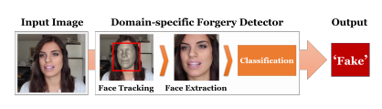
Detection:
Per-frame binary classification problem of the manipulated videos

Slide 3
Approach:
MTCNN to extract faces from the frames of the video.
Used Xceptionnet for training the model.
Used binary classifier for detection of Fake/Real.
Note: To summarize, domain-specific information in combination with a XceptionNet classifier shows the best performance in each test

Slide 4
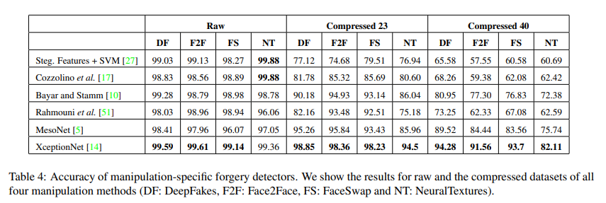
Accuracy comparison of pretrained model

