Slide 1

Playwright Test Architecture
How browser automation, parallel workers, and CI scaling fit together
A personal deep-dive — core engine, test runner internals, and observability

Slide 2

OVERVIEW
What this deck covers
01
Core Object Model
Browser, BrowserContext, and Page — how isolation actually works
02
Protocol Layer
One driver process, three browser engines, one protocol per engine
03
Test Runner Internals
Config resolution, discovery, dispatch, and the worker pool
04
Scaling in CI
Parallel workers, sharding across machines, and merged reporting
05
Observability
Traces, artifacts, and the actionability checks behind auto-waiting

Slide 3
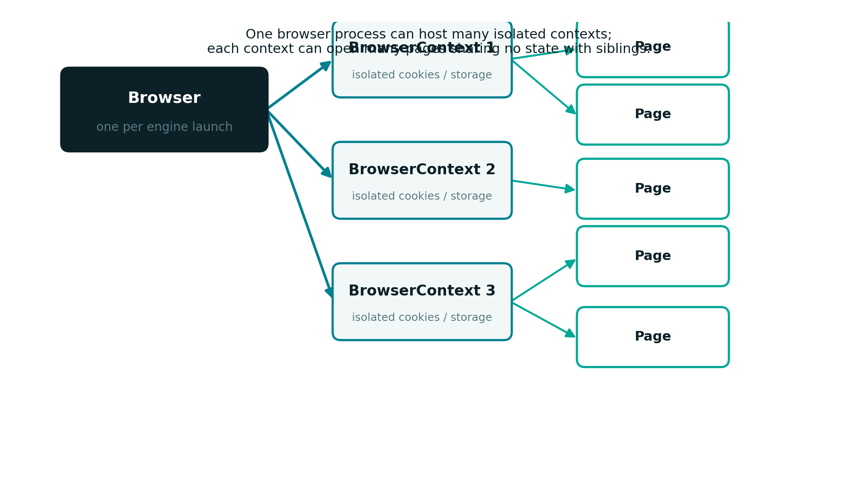
CORE OBJECT MODEL
One driver, many isolated worlds
A single Browser instance can host many BrowserContexts, each fully isolated — no shared cookies, storage, or cache.

Slide 4
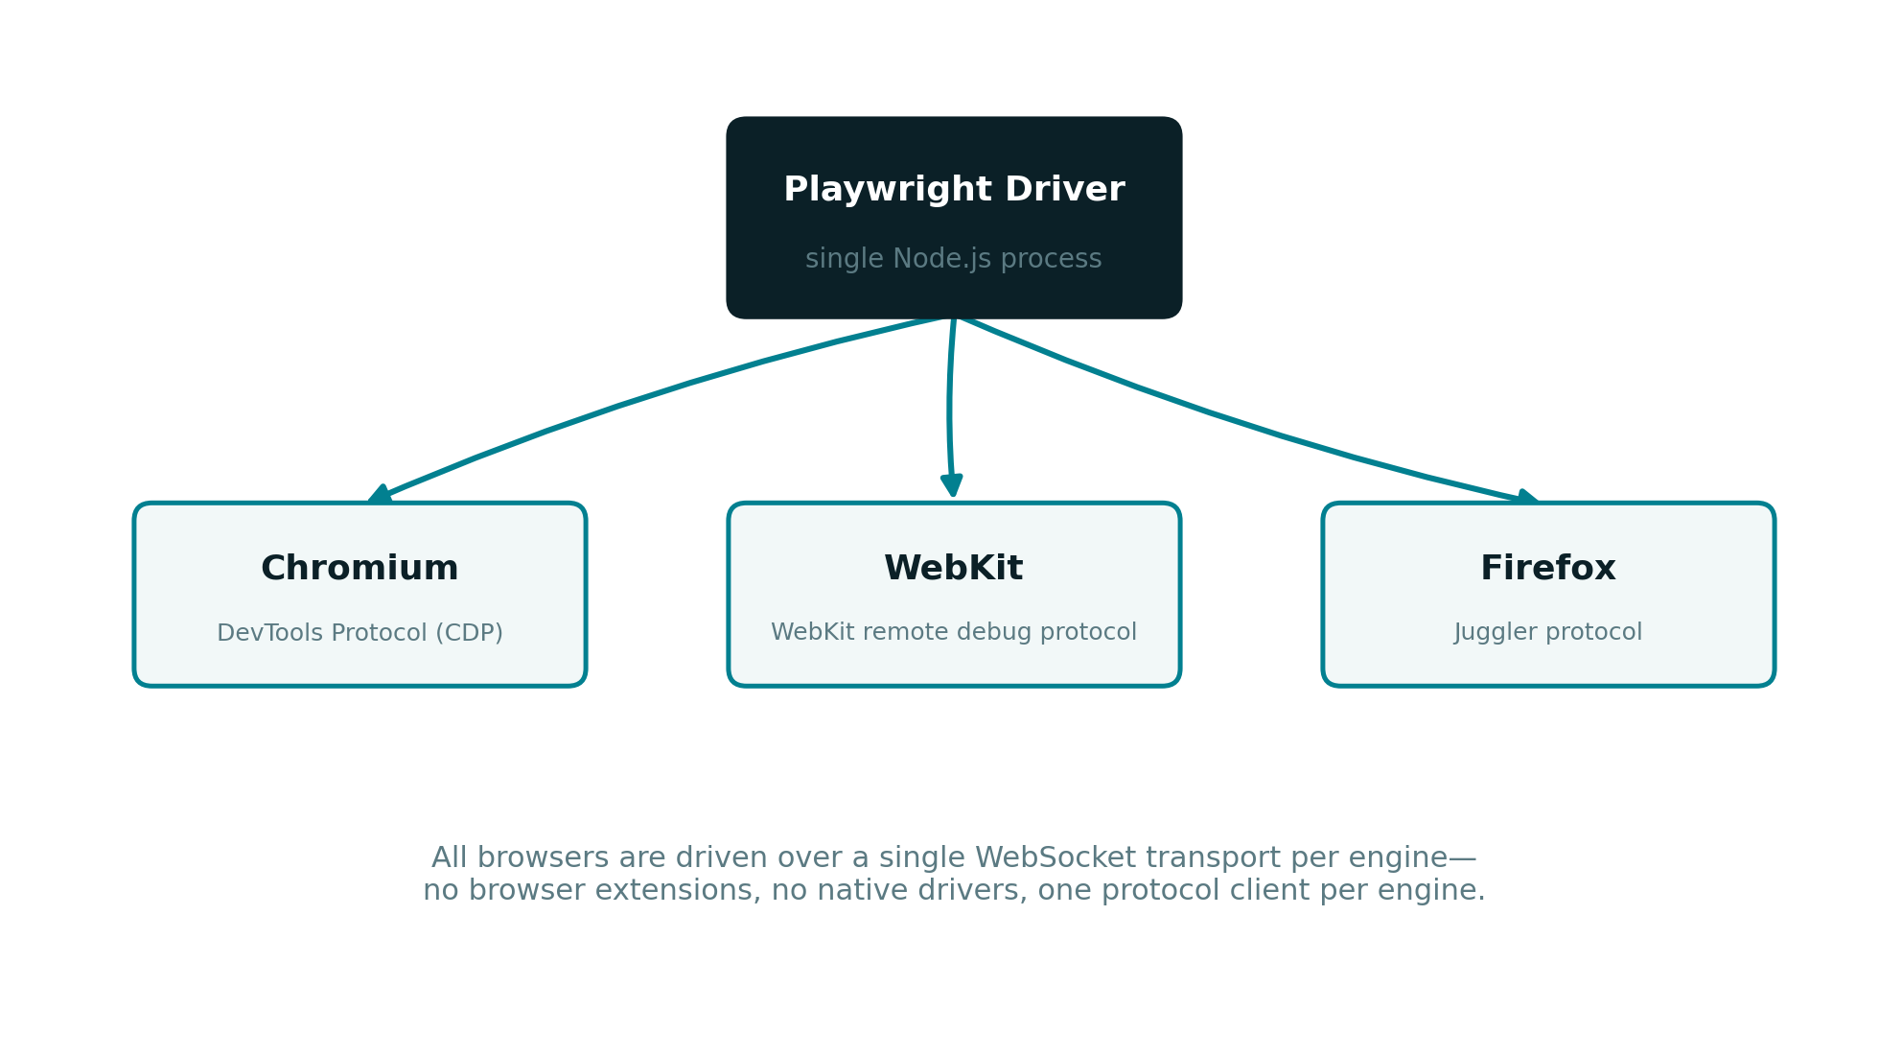
PROTOCOL COMMUNICATION
No extensions, no native drivers — just protocols
Chromium, WebKit, and Firefox are each driven over their own low-level debugging protocol from one Node.js process.

Slide 5

PART TWO
The Test Execution Model
From a single CLI command to a pool of parallel workers

Slide 6
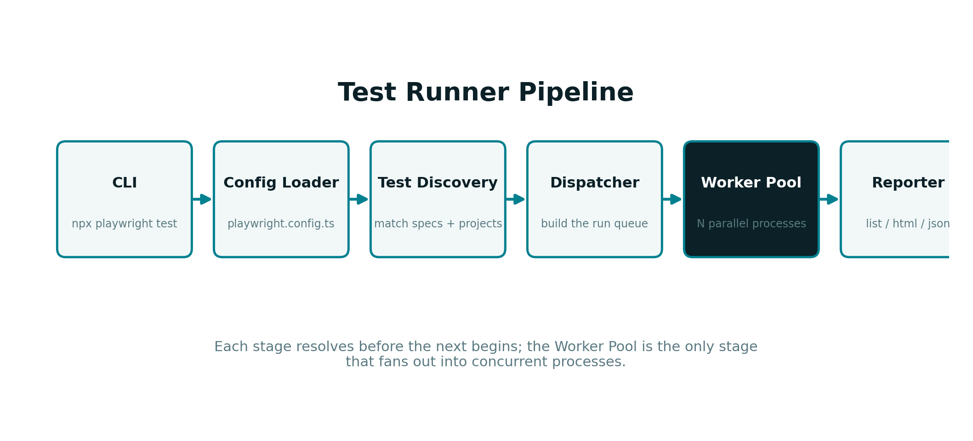
TEST RUNNER INTERNALS
Six stages between the CLI and your report
Only the Worker Pool stage fans out into concurrent processes — everything before it resolves once, sequentially.

Slide 7
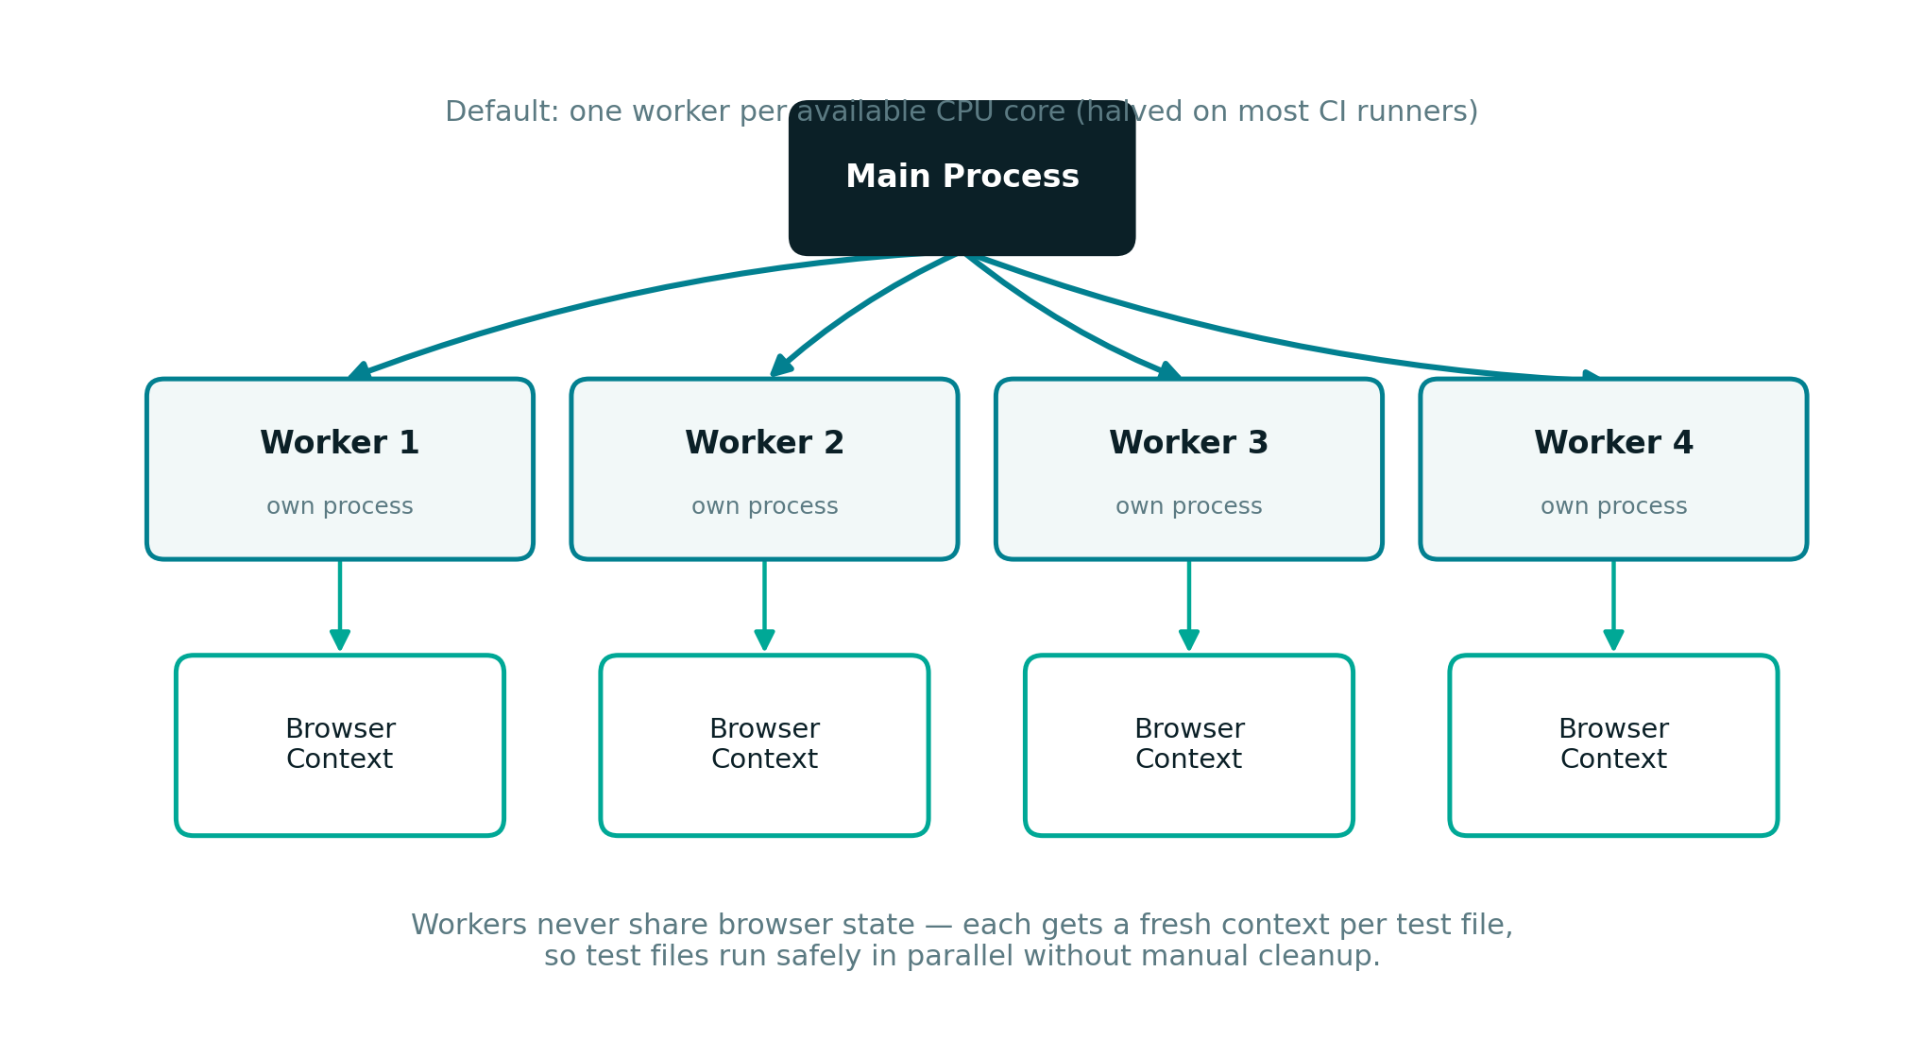
WORKER POOL
Isolation makes parallelism safe
Each worker process gets a fresh browser context per test file — no manual cleanup, no cross-test leakage.

Slide 8

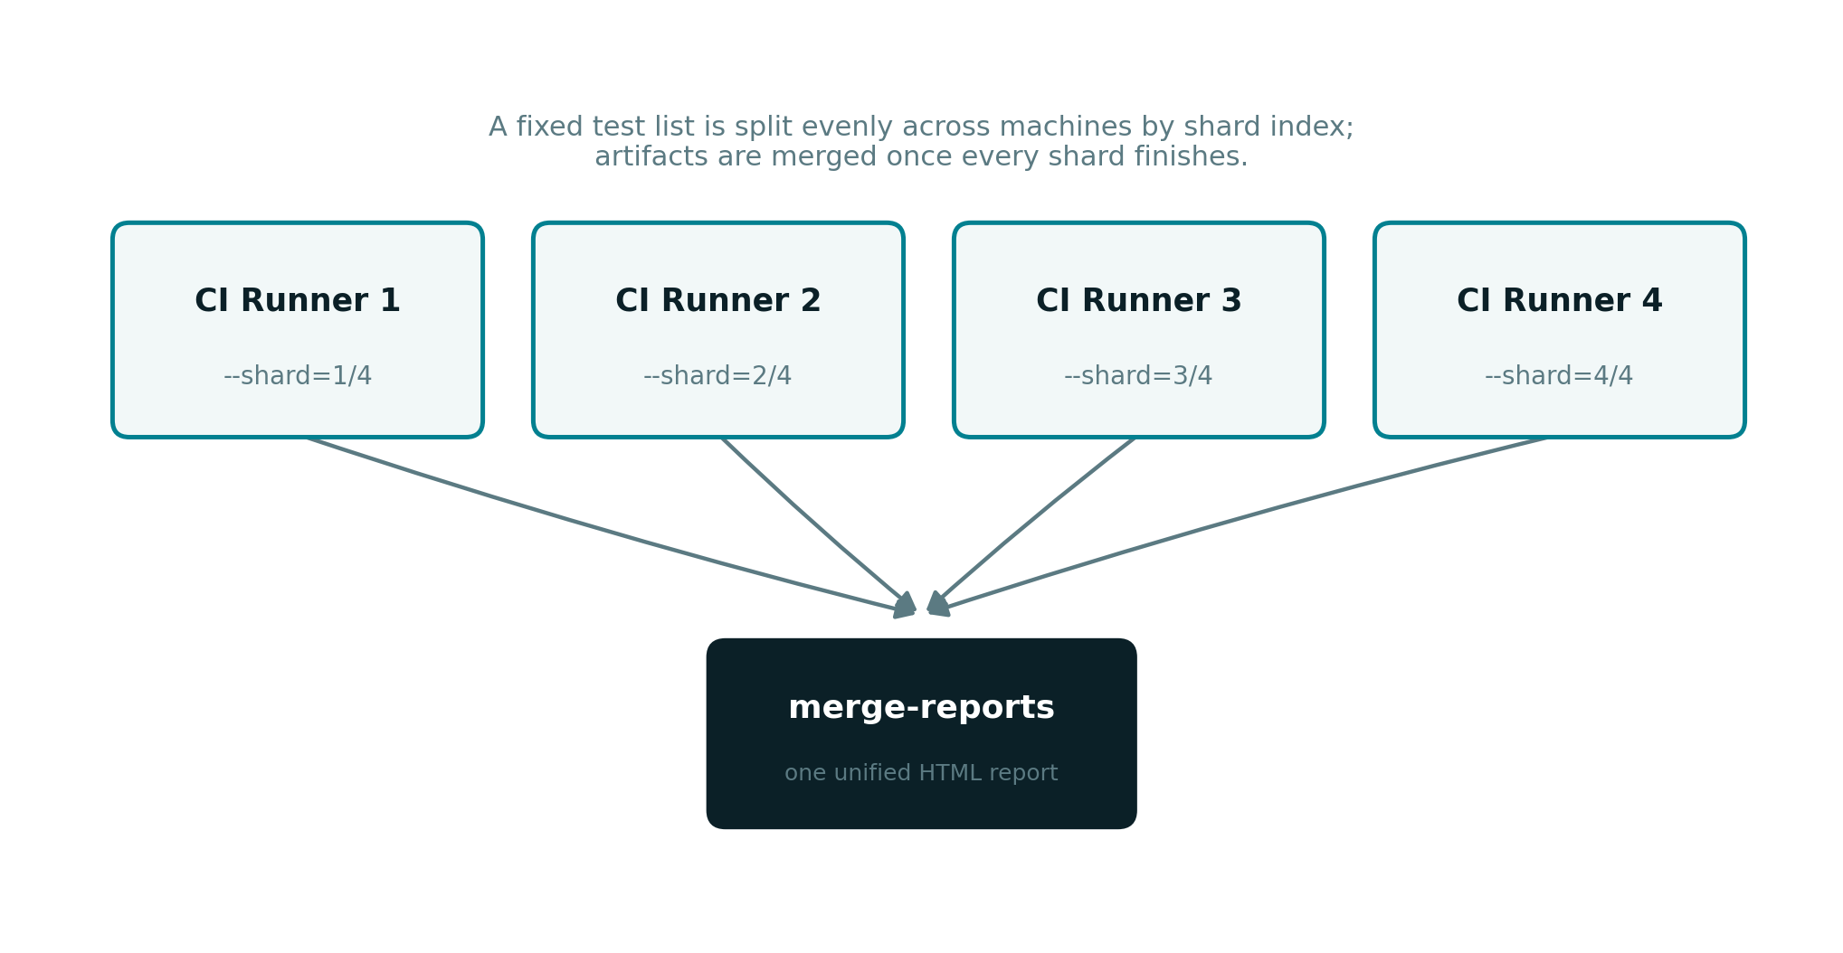
SHARDING
Scaling out across CI machines
A fixed test list is split evenly by shard index; playwright merge-reports reassembles one report from every machine.

Slide 9
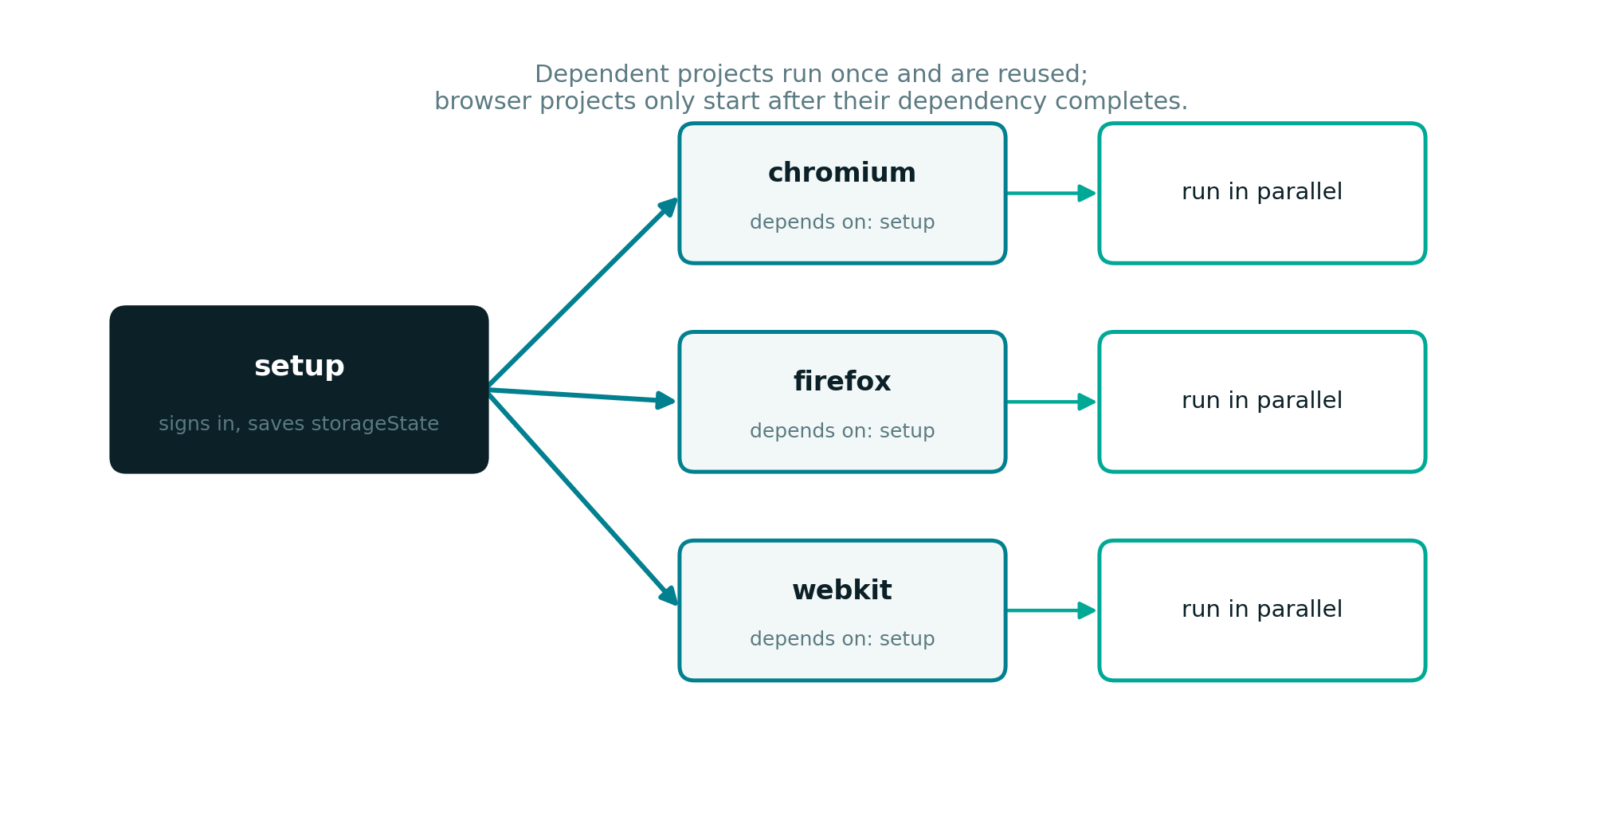
PROJECTS & DEPENDENCIES
Setup once, reuse everywhere
A setup project authenticates once and saves storage state; dependent browser projects reuse it and run in parallel.

Slide 10

PART THREE
Observability & Reliability
What happens after a test fails, and why actions rarely need manual waits

Slide 11
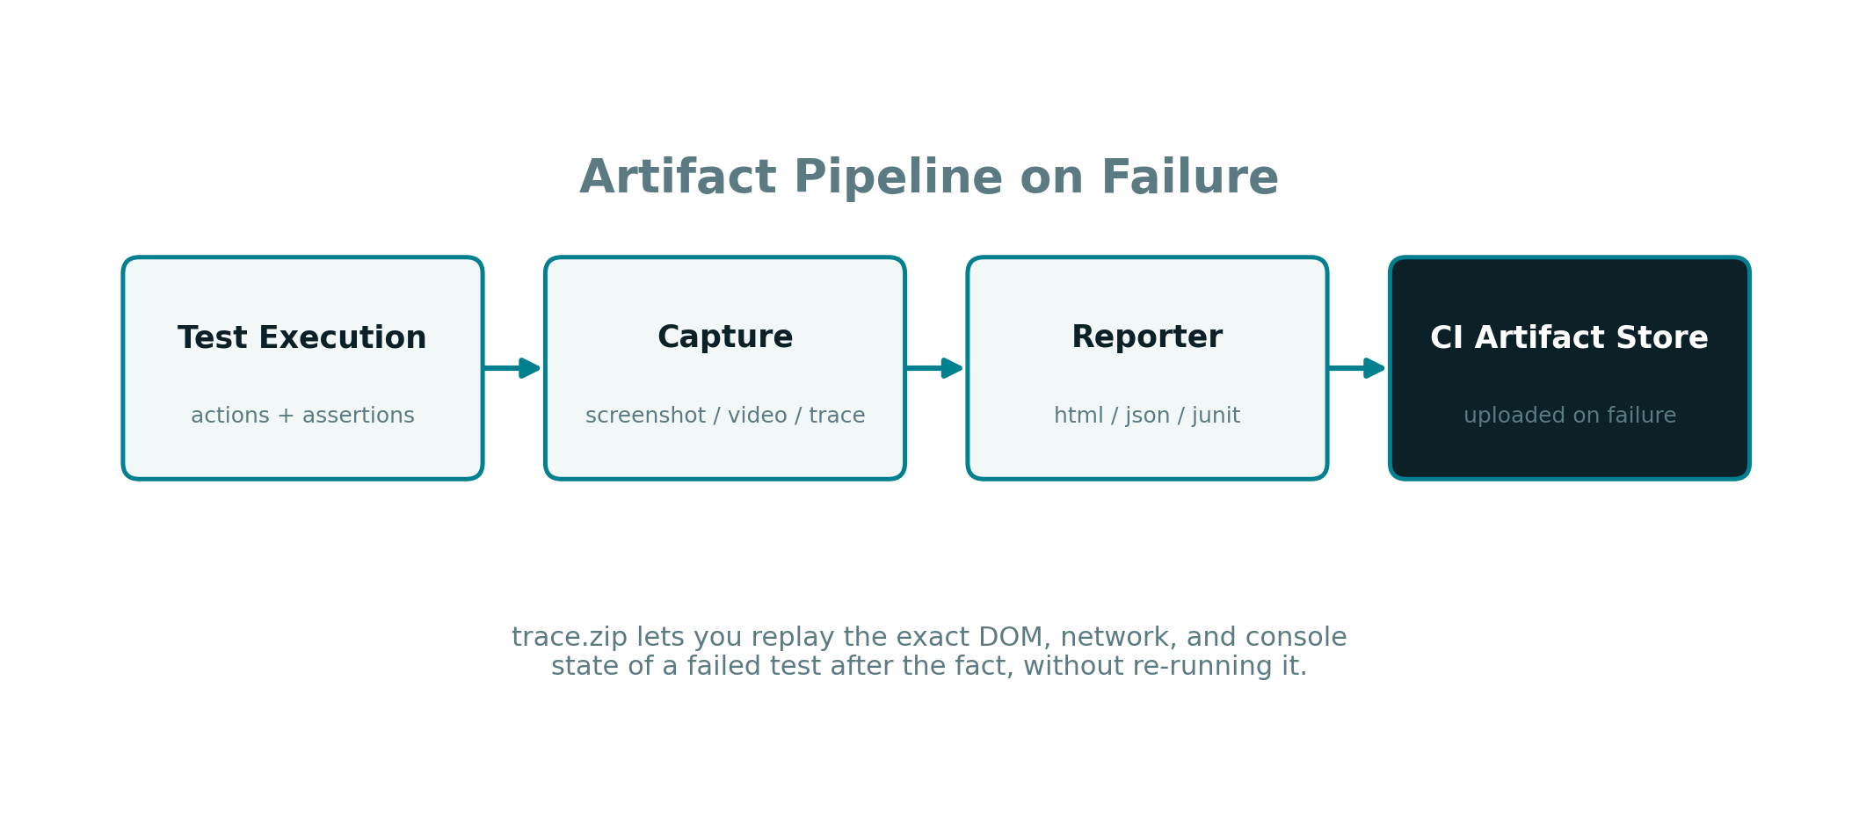
TRACES & ARTIFACTS
Replay a failure without re-running it
trace.zip captures the DOM, network, and console state at the moment of failure for full post-mortem debugging.

Slide 12

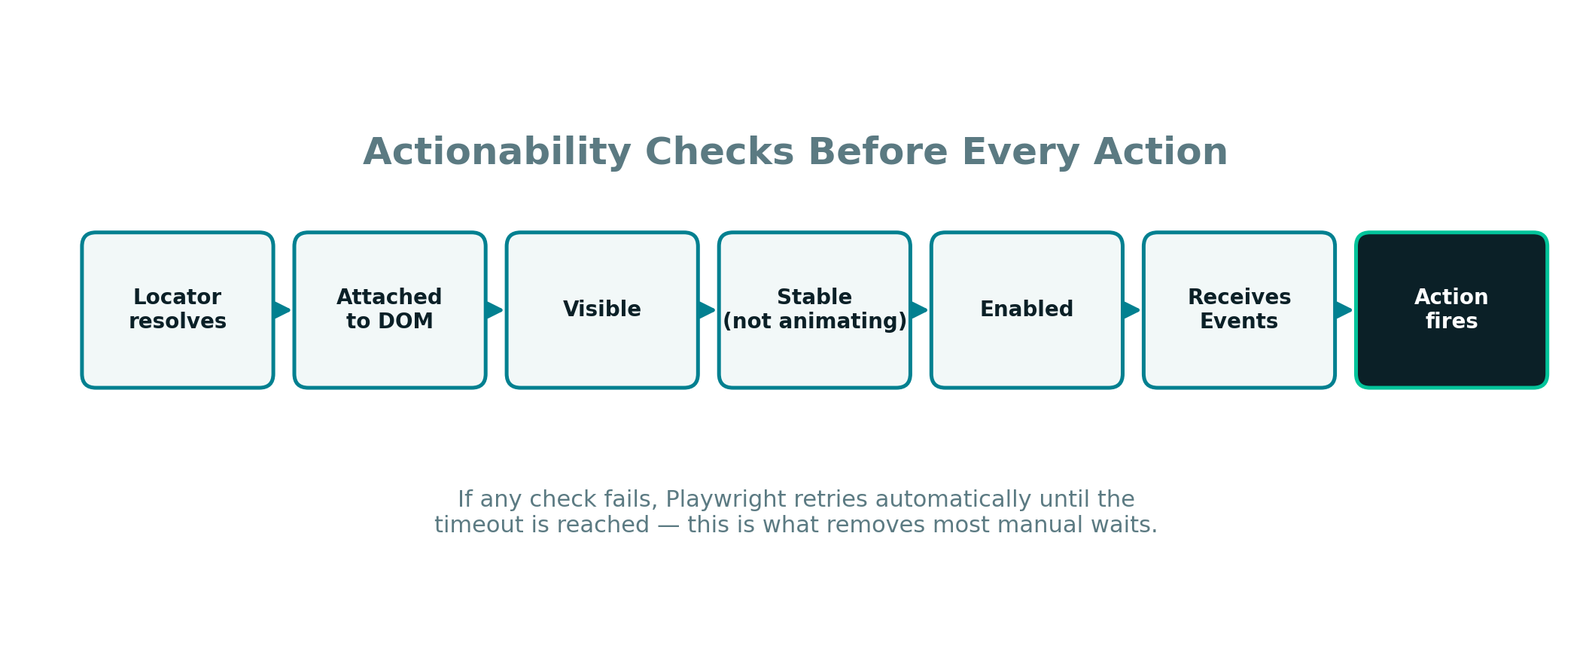
ACTIONABILITY
Six checks before every single action
If any check fails, Playwright retries automatically until timeout — the mechanism behind auto-waiting.

Slide 13

Key Takeaways
Isolation (context → page) is what makes parallel workers and parallel tests safe by default
The test runner pipeline only fans out at one stage — the worker pool
Sharding scales horizontally across machines; workers scale vertically within one
Traces trade a small artifact-storage cost for near-total post-failure visibility
Actionability checks are why most tests need zero manual waits

