Slide 1
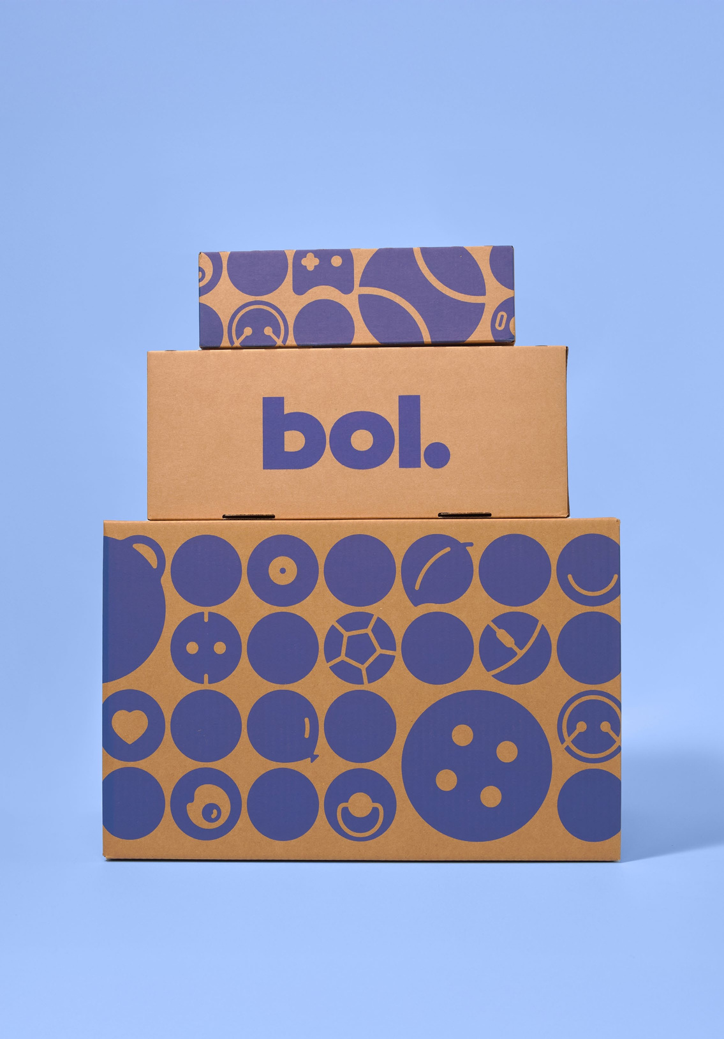
REAL PRODUCT, REAL DATA
Nano Phone Speaker
Cradle to Cradle certified.
Shipped in plastic, from Japan.
168 kg of CO2 to make.
Our verdict: 2 leaves, badge withheld.
HACK4HER × BOL · TRACK 2: THE BRAIN
The Honest Price Tag
We score how sustainable a product really is, show it in one glance, and quietly flag the sellers whose green claims do not hold up.
Team Ctrl+V· bol-com-solution.vercel.app

Slide 2

THE PROBLEM
img
People want to shop greener. The shop makes it hard.
Sustainability information is usually vague, unverifiable jargon, or simply not there.
So a shopper who cares ends up doing the easy thing: the cheapest item with the fastest delivery. The good intention is there but the information to act on it is not.
Bol Sustainability Layer · HACK4HER 2026
2

Slide 3
BOL'S OWN PROMISE
“de winkel van ons allemaal”
the shop that belongs to all of us
Bol says it wants gemak, betaalbaarheid en duurzaamheid, convenience, affordability and sustainability, to go together.
Right now shoppers feel they have to pick. Our layer is built to put all three on the same product.
Bol Sustainability Layer · HACK4HER 2026
3

Slide 4
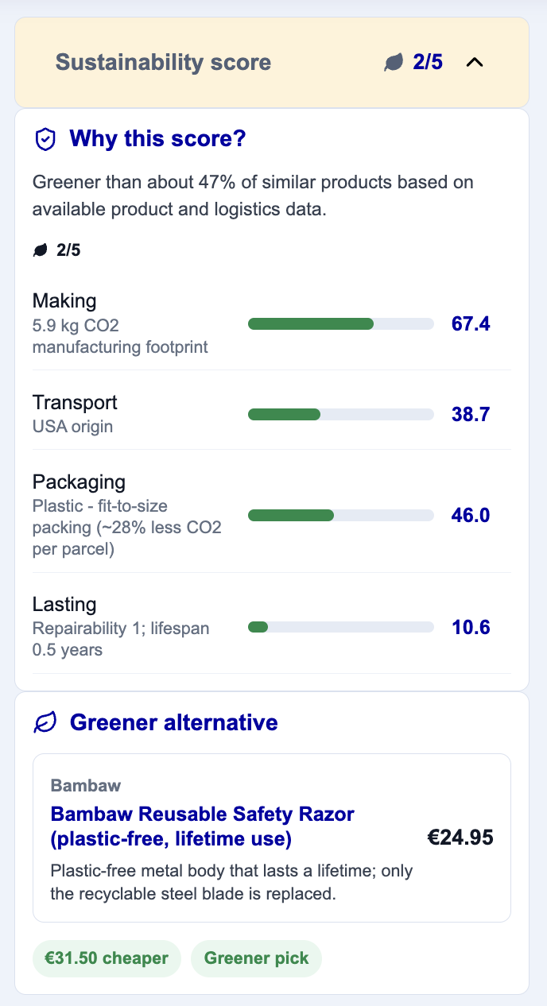
OUR ANSWER
A thin sustainability layer inside the shop
One score, as leaves
Right next to the price.
A reason you can read
Plain language, never a black box.
A greener alternative
In the same category, usually cheaper.
A check on the claim
We notice when a label does not add up.
Bol Sustainability Layer · HACK4HER 2026
4

Slide 5
THE BRAIN
One score, four stages of a product's life
MAKE
MOVE
PACK
LAST
Manufacturing CO2
Origin to NL
Packaging and warehouse
Repairability and lifespan
35% of the score
15% of the score
25% of the score
25% of the score
Each stage is ranked against products in the same category, then blended into one number from 0 to 100.
The weights follow the EU Product Environmental Footprint method, where climate change carries the most weight of any single category.
Bol Sustainability Layer · HACK4HER 2026
5

Slide 6
WHAT WE FOUND IN THE DATA
The footprint is about making, not shipping
Before we trusted the carbon field, we tested it.
Across the whole catalog, CO2 barely moves with how far a product ships (correlation 0.12), and every digital product reads zero. That is the fingerprint of a manufacturing footprint.
So Make and Move measure genuinely different things, and no gram of carbon is counted twice.
0.12
correlation between shipping distance and CO2
Bol Sustainability Layer · HACK4HER 2026
6

Slide 7
HANDLING THE GAPS HONESTLY
Half the sustainability data is missing. We say so.
Rather than hide the gaps, every score carries a confidence level set by how complete its data is.
This score is not on the storefront, so no supplier is penalized directly.
The same number doubles as a readiness check for the EU Digital Product Passport, which will soon require these exact fields.
52%
recyclability blank
49%
lifespan blank
26%
carbon footprint blank
Bol Sustainability Layer · HACK4HER 2026
7

Slide 8
THE CHECK
We compare the claim to the evidence
img
Carbon neutral badge, on an item in the dirtiest quarter of its category for CO2.
A small rule engine looks for contradictions like that one, plus eco labels on plastic, far shipped items, and recyclable claims on barely recyclable material.
When the claim and the data disagree, the badge quietly stays off. We inform the shopper, we do not shame the seller.
SCREENSHOT: a flagged product
Bol Sustainability Layer · HACK4HER 2026
8

Slide 9
THE MYTH WE CAN BUST
Greener almost never costs more
In Bol's catalog, price and sustainability are essentially unrelated.
For 81% of products there is a greener option in the same category that also costs less. That is why our nudge leads with the saving, not with guilt.
Convenience, affordability and sustainability really can sit on the same product.
0.03
price vs sustainability correlation
81%
products with a cheaper greener twin
Bol Sustainability Layer · HACK4HER 2026
9

Slide 10
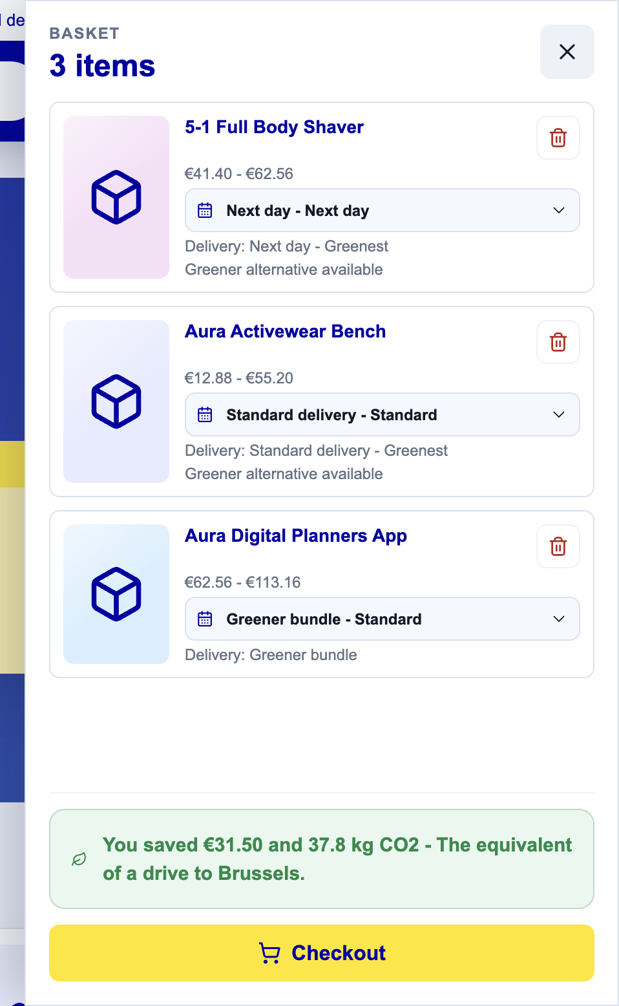
MAKE THE IMPACT REAL
Small swaps barely register. A basket does.
Per product the saving is tiny. Across a basket it adds up.
At checkout we total the money and the CO2 saved, and translate the carbon into something you can picture: a drive to Rotterdam, a drive to Berlin, a short flight to London.
Car at 170 g per km; flights from standard per passenger figures.
Bol Sustainability Layer · HACK4HER 2026
10

Slide 11
img
LIVE DEMO
Let's shop.
Browse the shop, glance the score, open the breakdown, see a greener and cheaper pick, then watch the basket total your impact at checkout.
LIVE: bol-com-solution.vercel.app
Bol Sustainability Layer · HACK4HER 2026
11

Slide 12
COULD BOL REALLY SHIP IT
It fits what Bol already runs
img
Bol already labels a million products Goede Keuze. That label is a yes or no. We make it a ranked, explainable score.
We reuse Bol's own rule for it: a recognised certificate, or at least 50% recycled material.
We lean on Bol's real figures. Fit to size packing saves 28% of packaging CO2 per parcel.
Transport is only 1.5% of Bol's emissions, which is exactly why we put most of the weight on manufacturing.
PHOTO: Goede Keuze / fulfilment
Bol Sustainability Layer · HACK4HER 2026
12

Slide 13
IF WE HAD ANOTHER MONTH
Score the second life, and the scale
img
Bol already refurbishes, repairs and resells. We would feed that back into the score: is a refurbished version on offer, can this be repaired through Bol.
We would also rank products by total impact, units sold times footprint, so Bol can see where a nudge saves tonnes, not grams. Our catalog already adds up to roughly 2.9 million tonnes of embodied CO2.
ICON: refurb, repair, recycle
Bol Sustainability Layer · HACK4HER 2026
13

Slide 14
WHERE WE WANT TO TAKE IT
A winkel van ons allemaal is also a shop that is honest with all of us:
one glance, the real story, and the greener choice that happens to cost less.
Bol Sustainability Layer · HACK4HER 2026
14

Slide 15
Thank you.
Questions?
Team [your names] · bol-com-solution.vercel.app

